Slide 1
NUCLEAR REACTOR MATERIALS
1. INTRODUCTION TO NUCLEAR REACTORS AND MATERIALS
Notes compiled by:
Dr. goh pei sean
Dr. Mohsin mohd sies
Dr. Nor Afifah basri

Slide 3
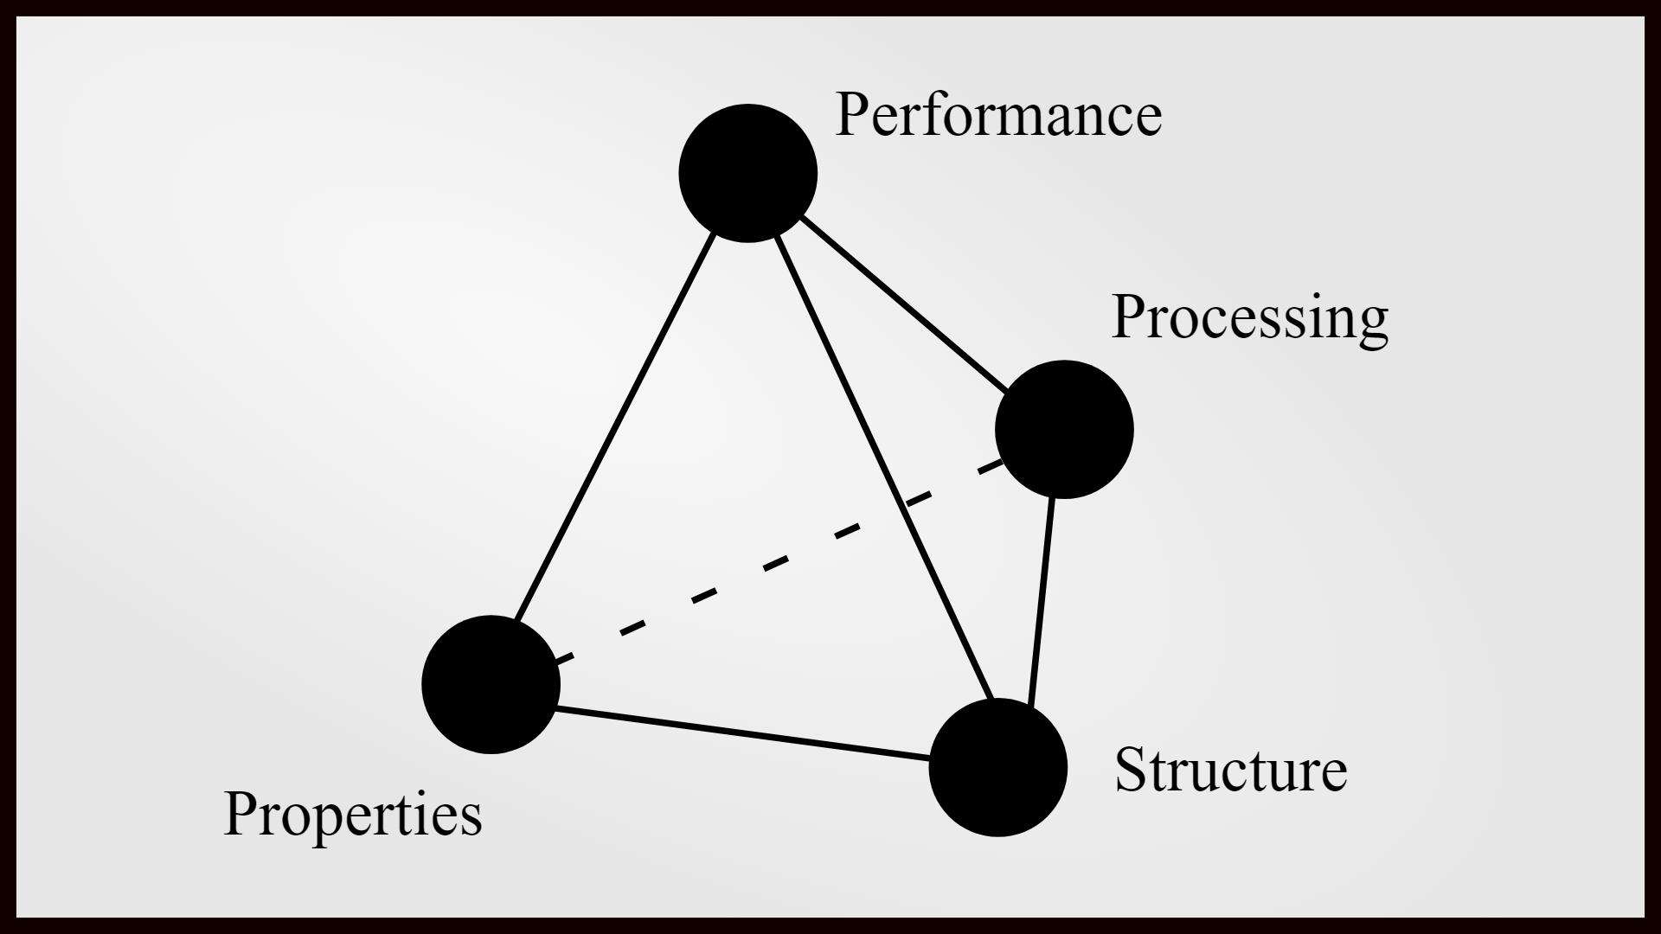
Materials Science and Engineering Tetrahedron

Slide 4
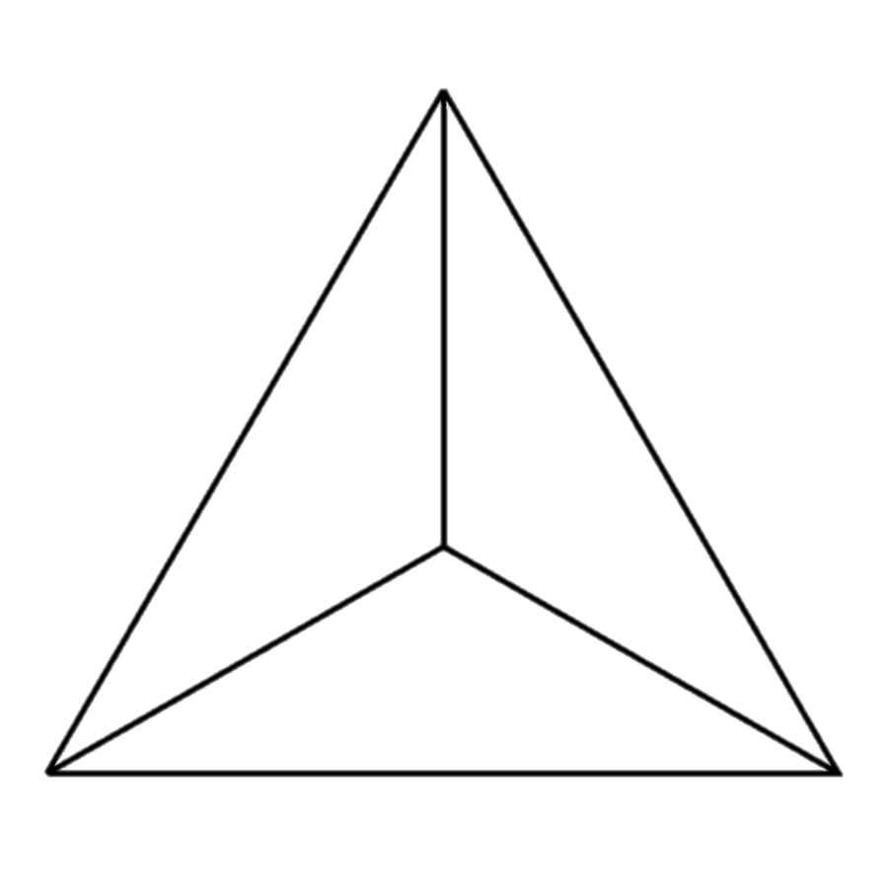
Materials Science and Engineering Tetrahedron
Performance
Properties
Chemical make-up of a material
Composition /
properties
Structure
Description of the arrangement of atoms
Structure
Synthesis / processing
Processing
Synthesis - how materials are made from naturally occurring or man-made chemicals.
Processing - how materials are shaped into useful components to cause changes in the properties of different materials
Performance
Desired material structure / properties

Slide 5

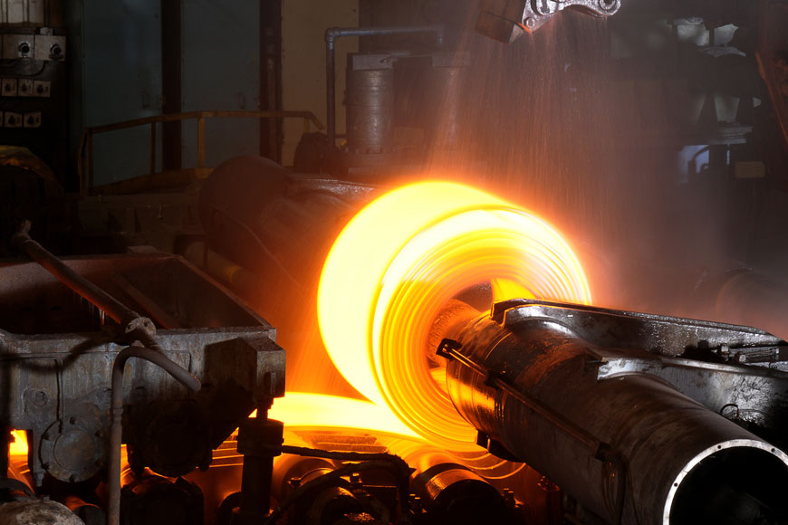
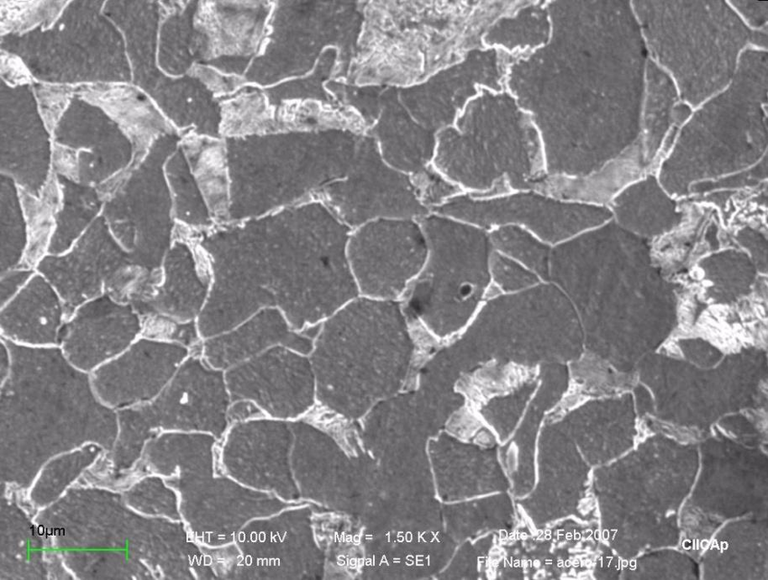
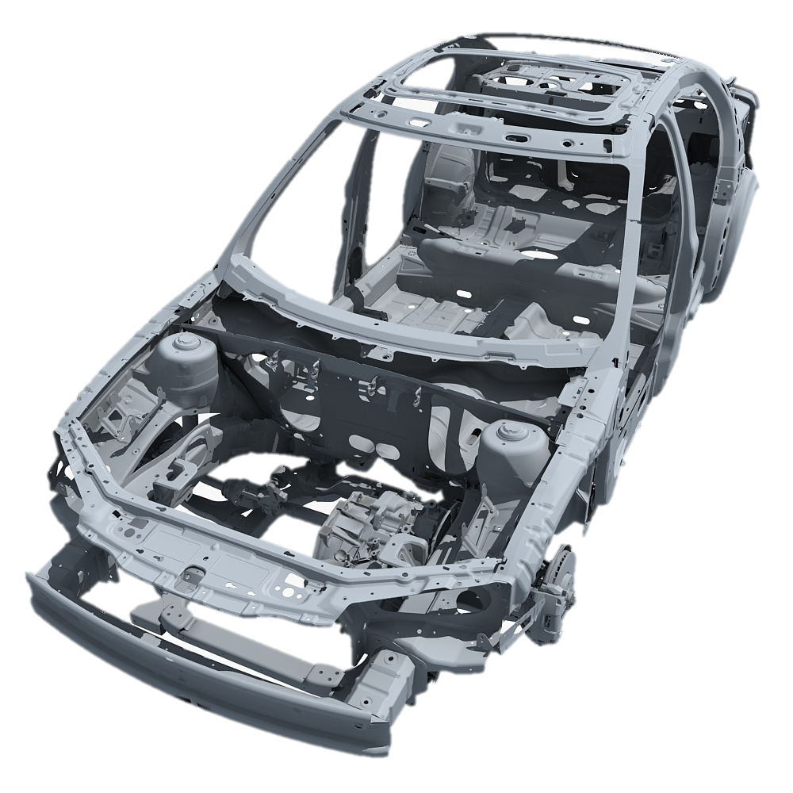
What is the strength-to-density ratio?
What is the formability?
How does this relate to the crashworthiness of the vehicle?
Performance
Iron based?
Aluminium based?
What Alloying elements should be used?
What quantities?
What features of the structure limit the strength and formability?
What control the strength?
Composition / properties
How can steel making be controlled so as to provide high level of toughness and formability?
How can aerodynamic car chassis be formed?
Structure
Synthesis / processing

Slide 6
Atomic Structure
We can examine and describe the structure of materials at 5 different levels:
  Atomic structure
  Short- and long- range atomic arrangements
  Nanostructure
  Microstructure
  Macrostructure
The features of the structure at each of these levels may have distinct and profound influences on material’s properties and behavior.

Slide 7
Atomic Structure
Atomic structure – the nucleus consisting of protons and neutrons and the electrons surrounding the nucleus.
Examination of atomic arrangements allows us to distinguish between materials that are amorphous (those that lack a long range ordering of atoms or ions) or crystalline (those that exhibit periodic geometrical arrangements of atoms and ions).
Amorphous materials have only short-range atomic arrangements. While crystalline material have short- and long- range atomic arrangements.
In short-range atomic arrangements, the atoms or ions show a particular order only over relatively short distances (1 to 10Å).
For crystalline materials, the long-range atomic order is in the form or atoms or ions arranged in a three-dimensional patterns that repeats over much larger distances (from ~10 nm to cm).

Slide 8
Atomic Structure
The nanostructure is the structure of a material at a lengths scale of 1 to 100 nm.
Microstructure is the structure of materials at a length scale of 100 to 100,000 nm or 0.1 to 100 micrometers.
Macrostructure is the structure of a material at a macroscopic level where the length scale is >100 µm.

Slide 9
Atomic Bonding
There are 4 important mechanisms by which atoms are bonded in engineered materials:
  Metallic bonds
  Covalent bonds
  Ionic bonds
  Van der Waals bonds
The first three are relatively strong and are known as primary bonds (relatively strong bonds between adjacent atoms resulting from the transfer of outer orbital electrons).
The van der Waals bonds are secondary bonds and originate from different mechanism and are relatively weaker.

Slide 10
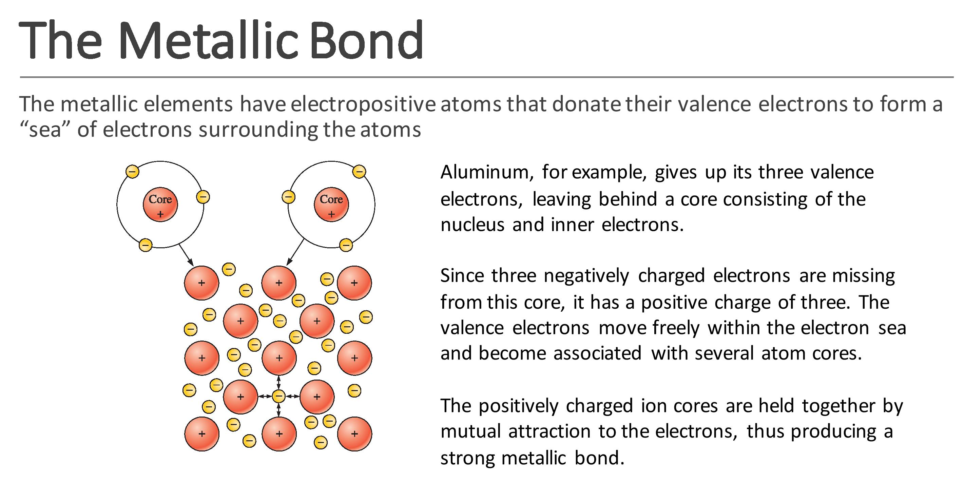

Slide 11
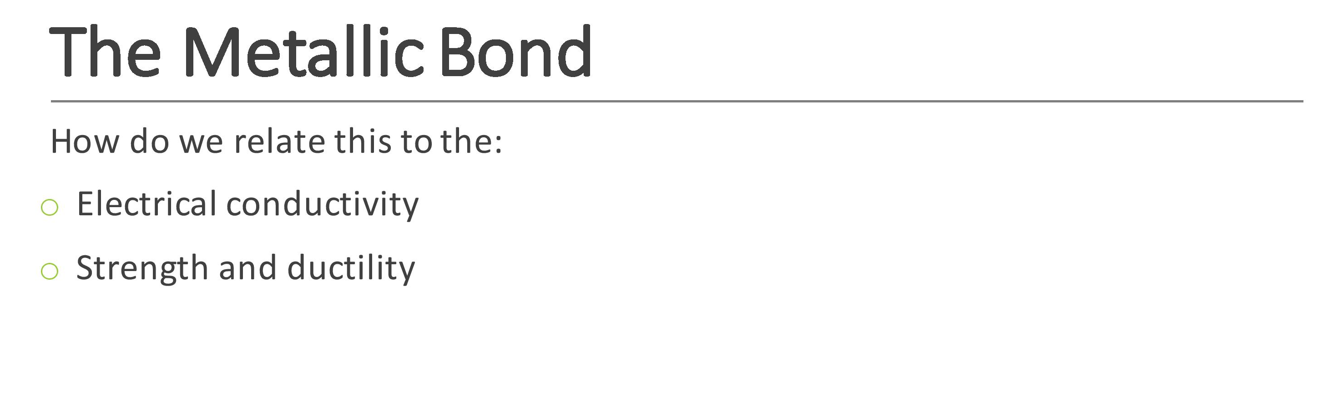

Slide 12
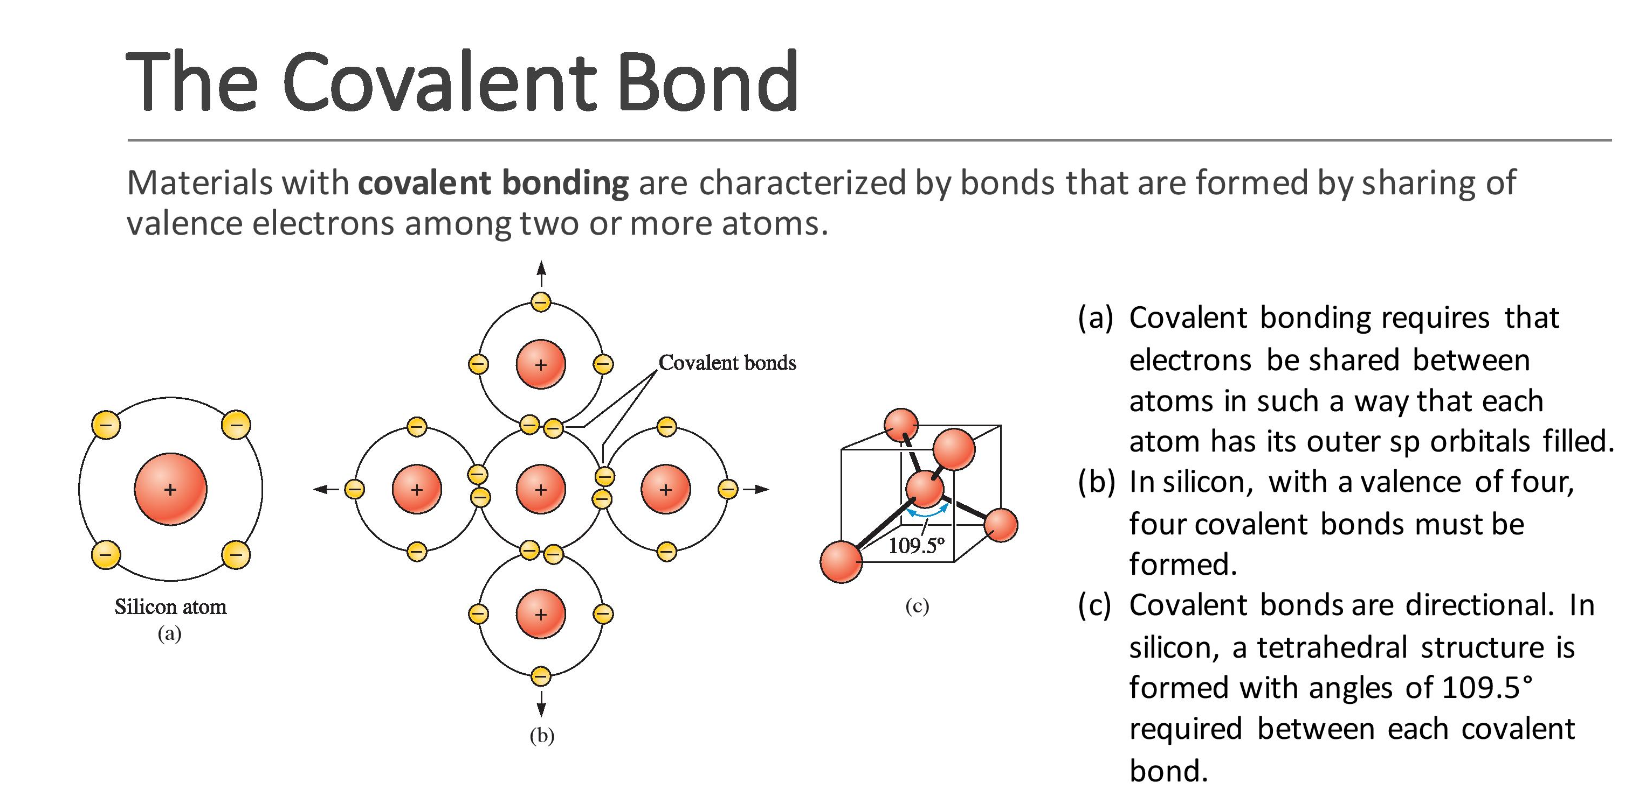

Slide 13
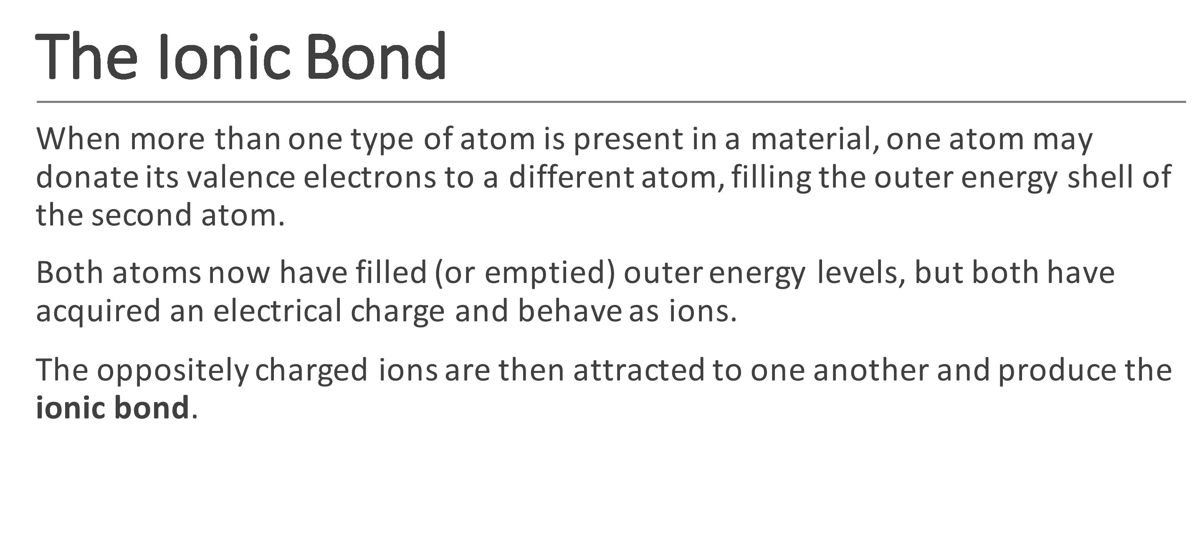

Slide 14
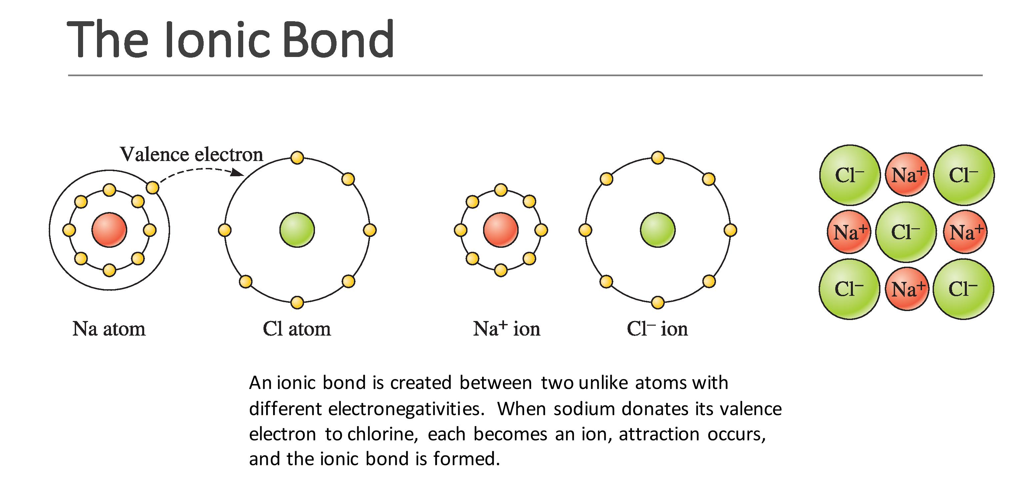

Slide 15
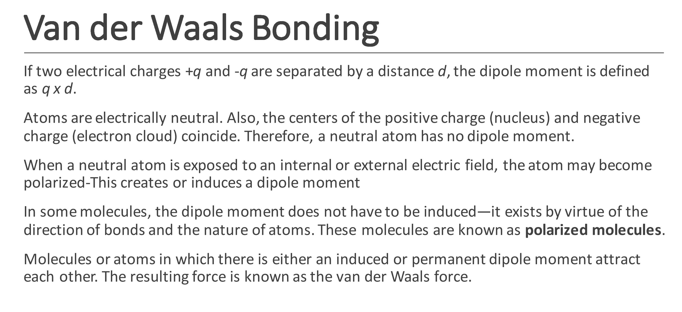

Slide 16
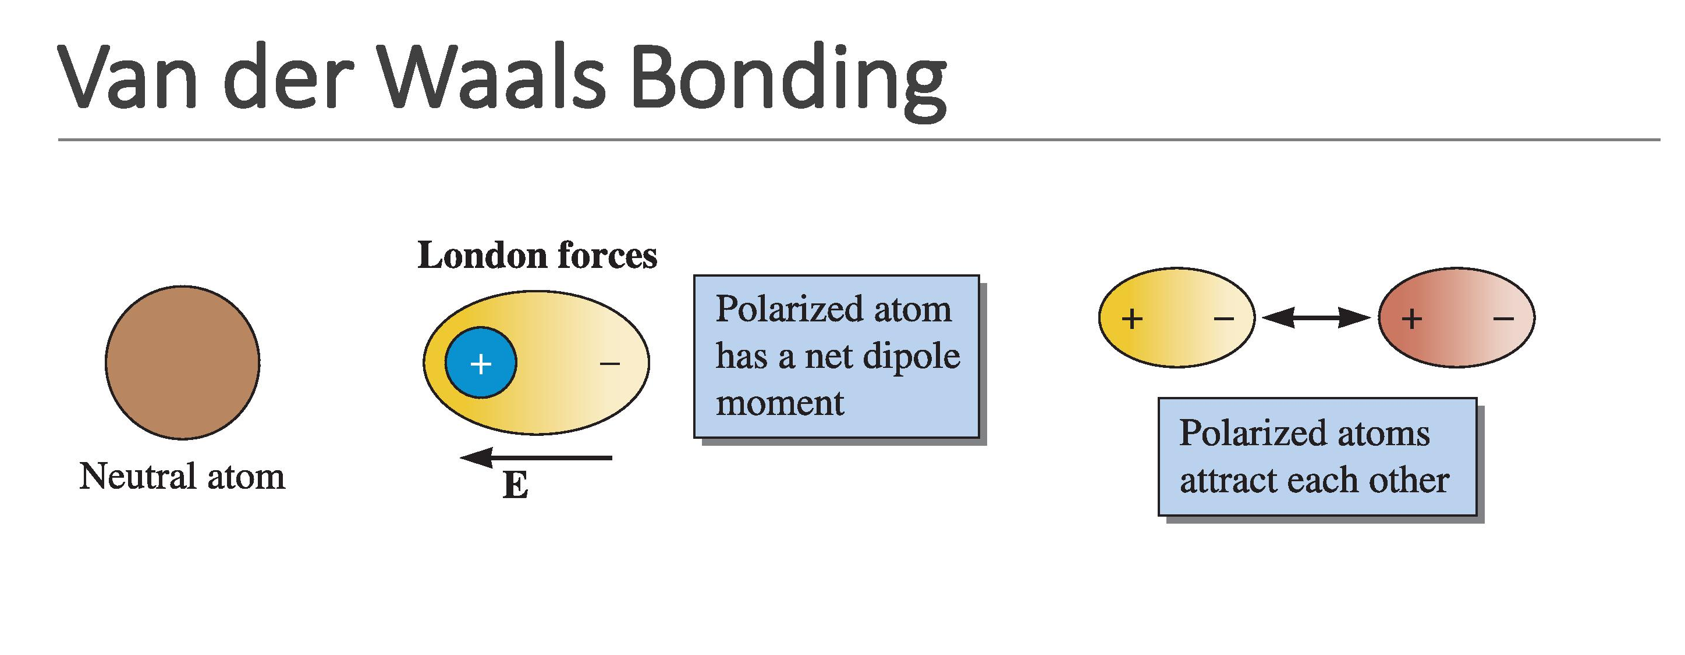

Slide 17
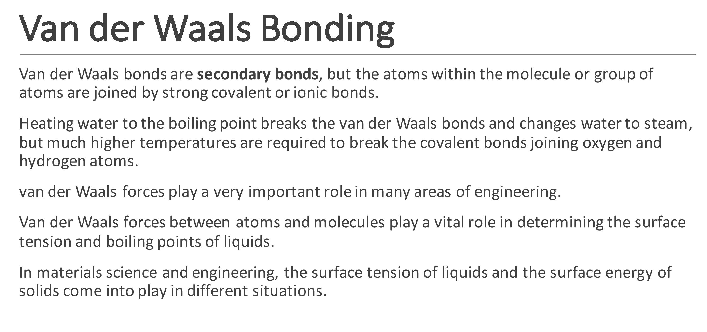

Slide 18
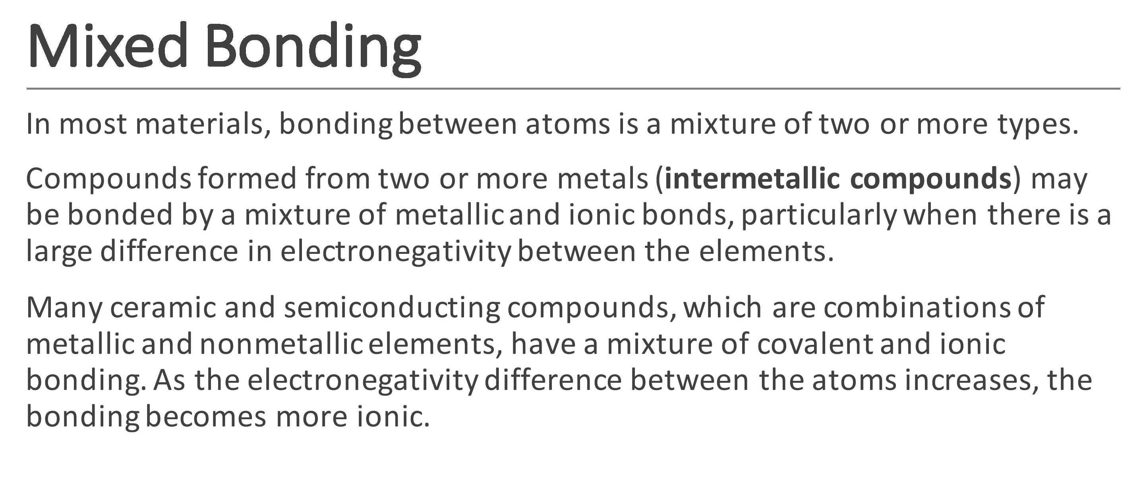

Slide 19
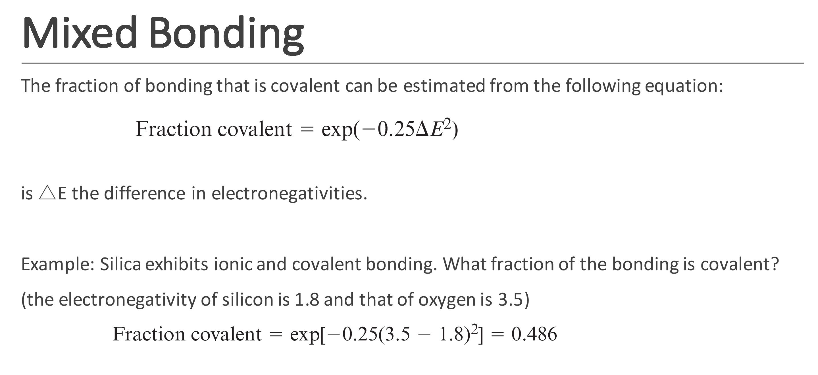

Slide 20
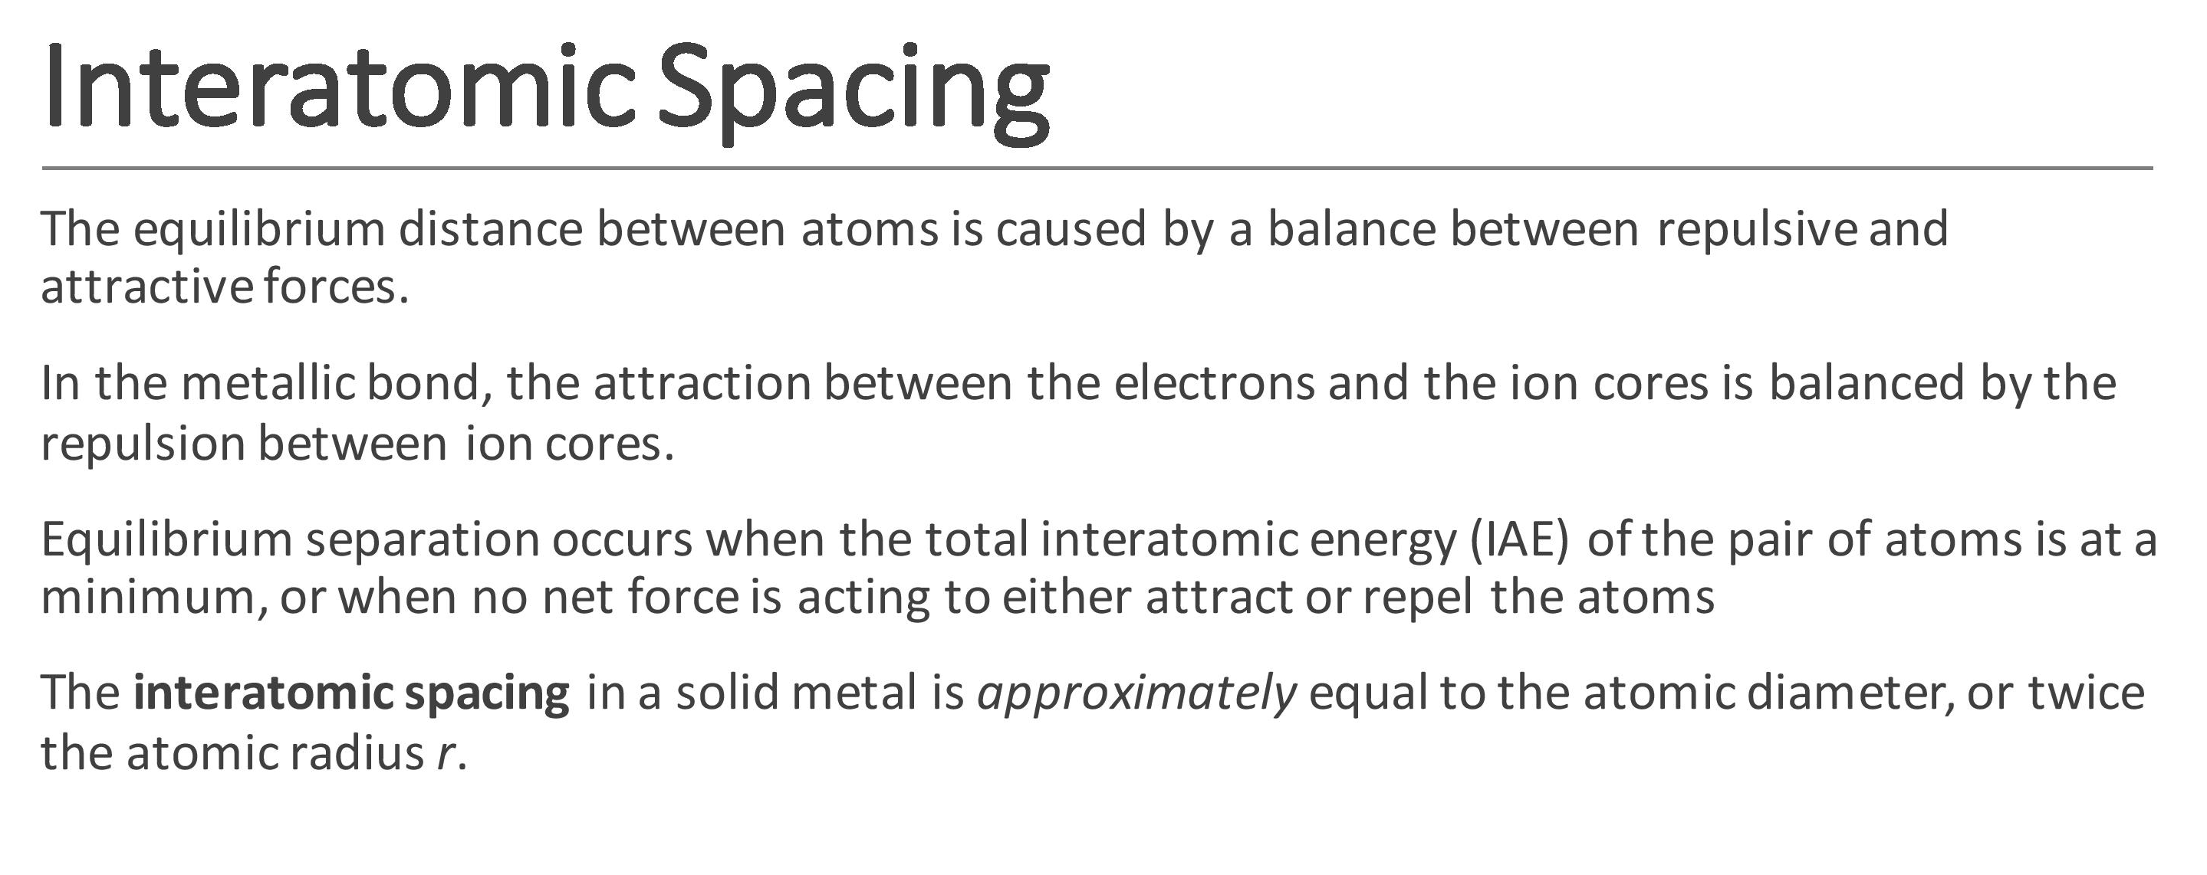

Slide 21
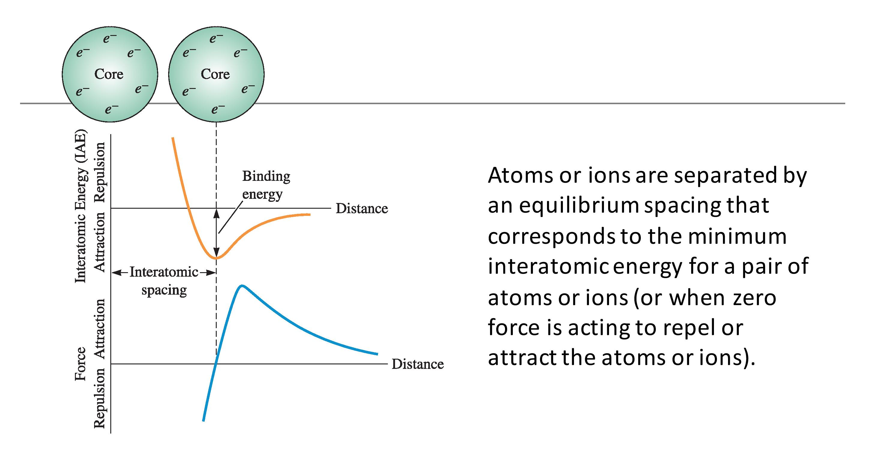

Slide 22
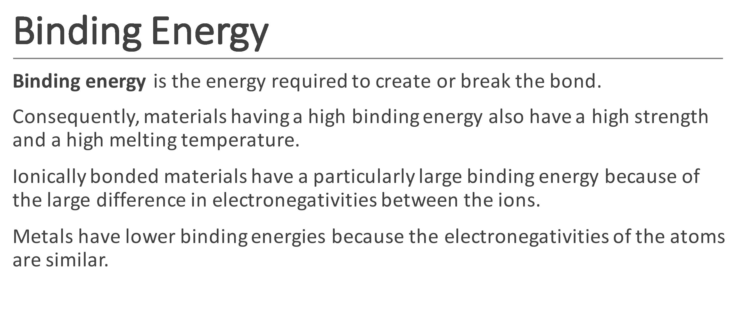

Slide 23
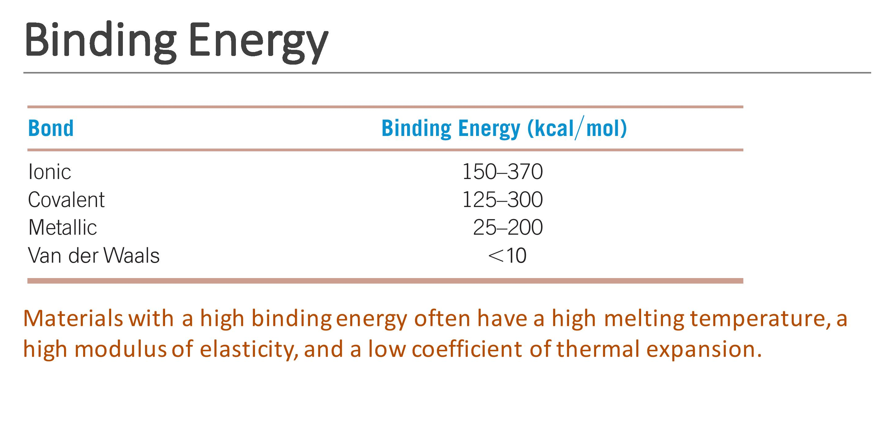

Slide 25
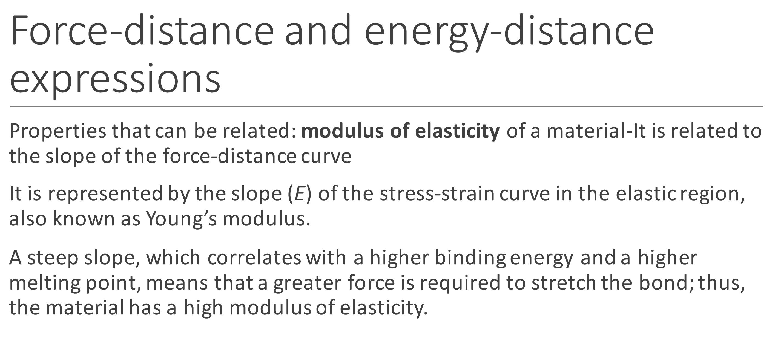

Slide 26
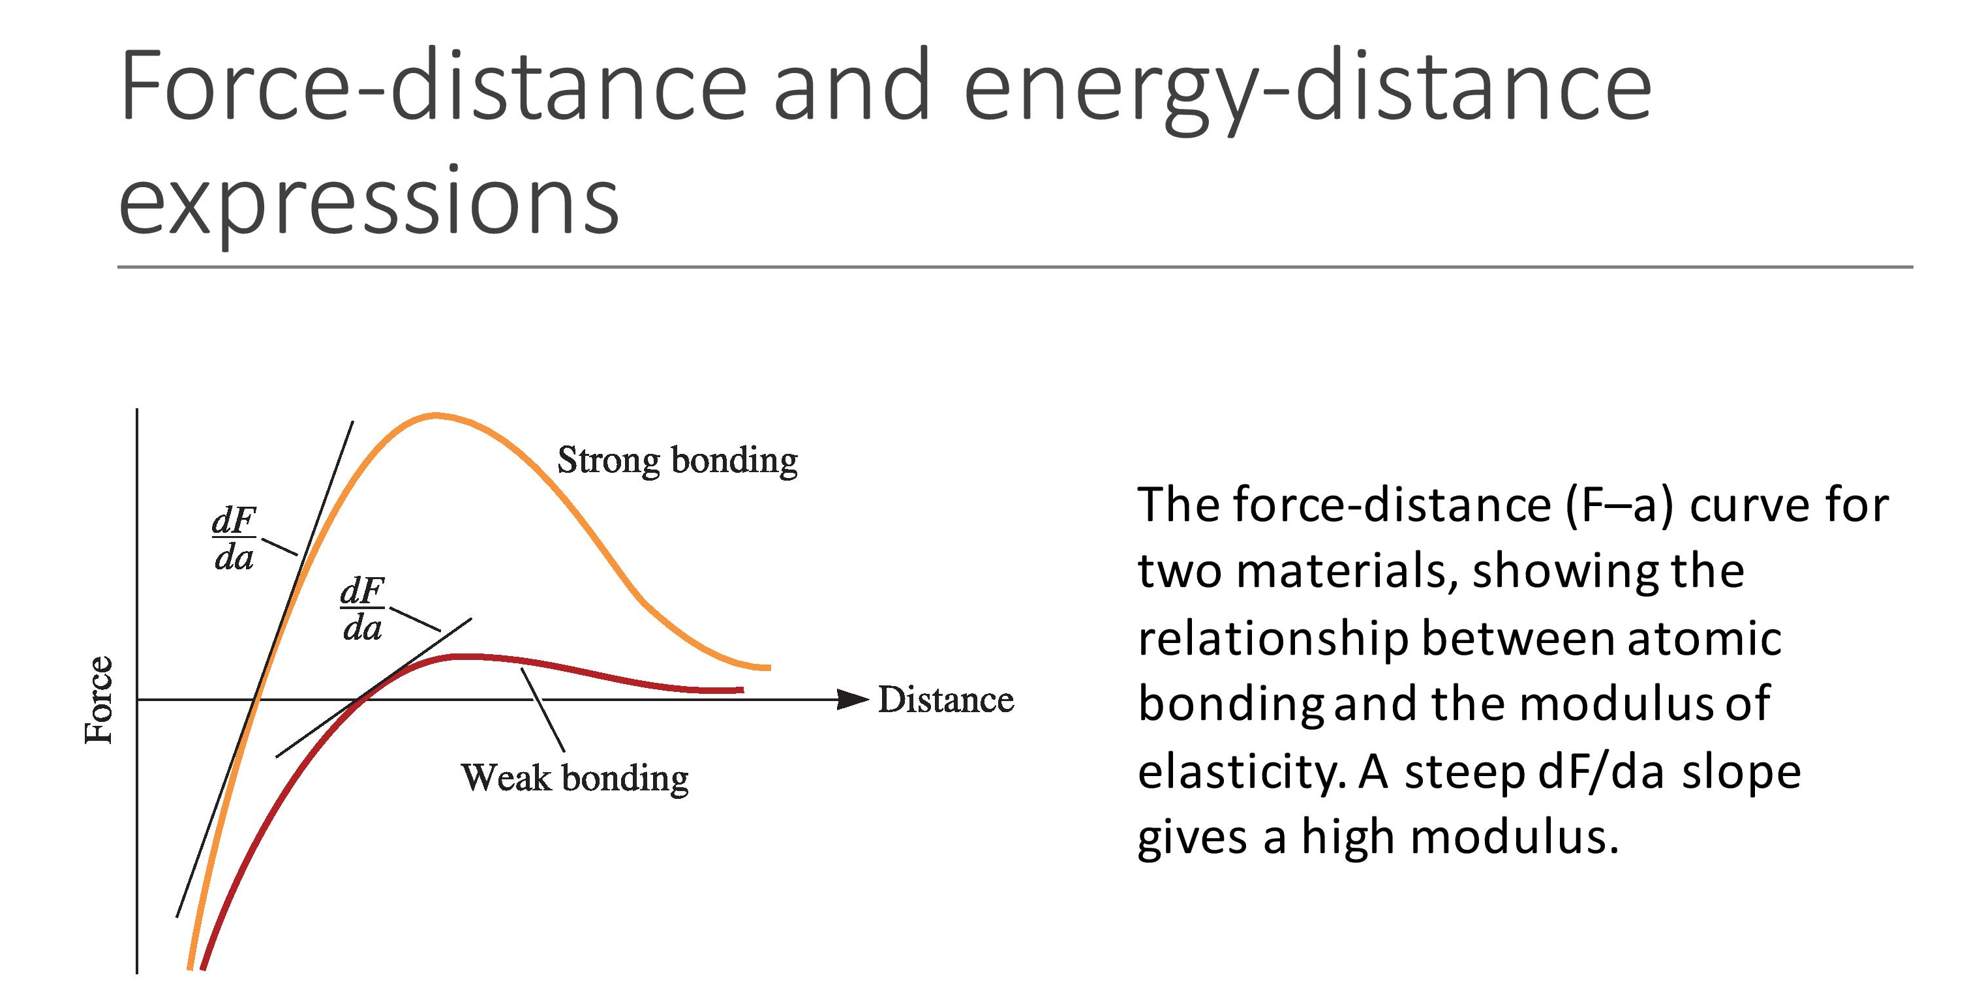

Slide 27
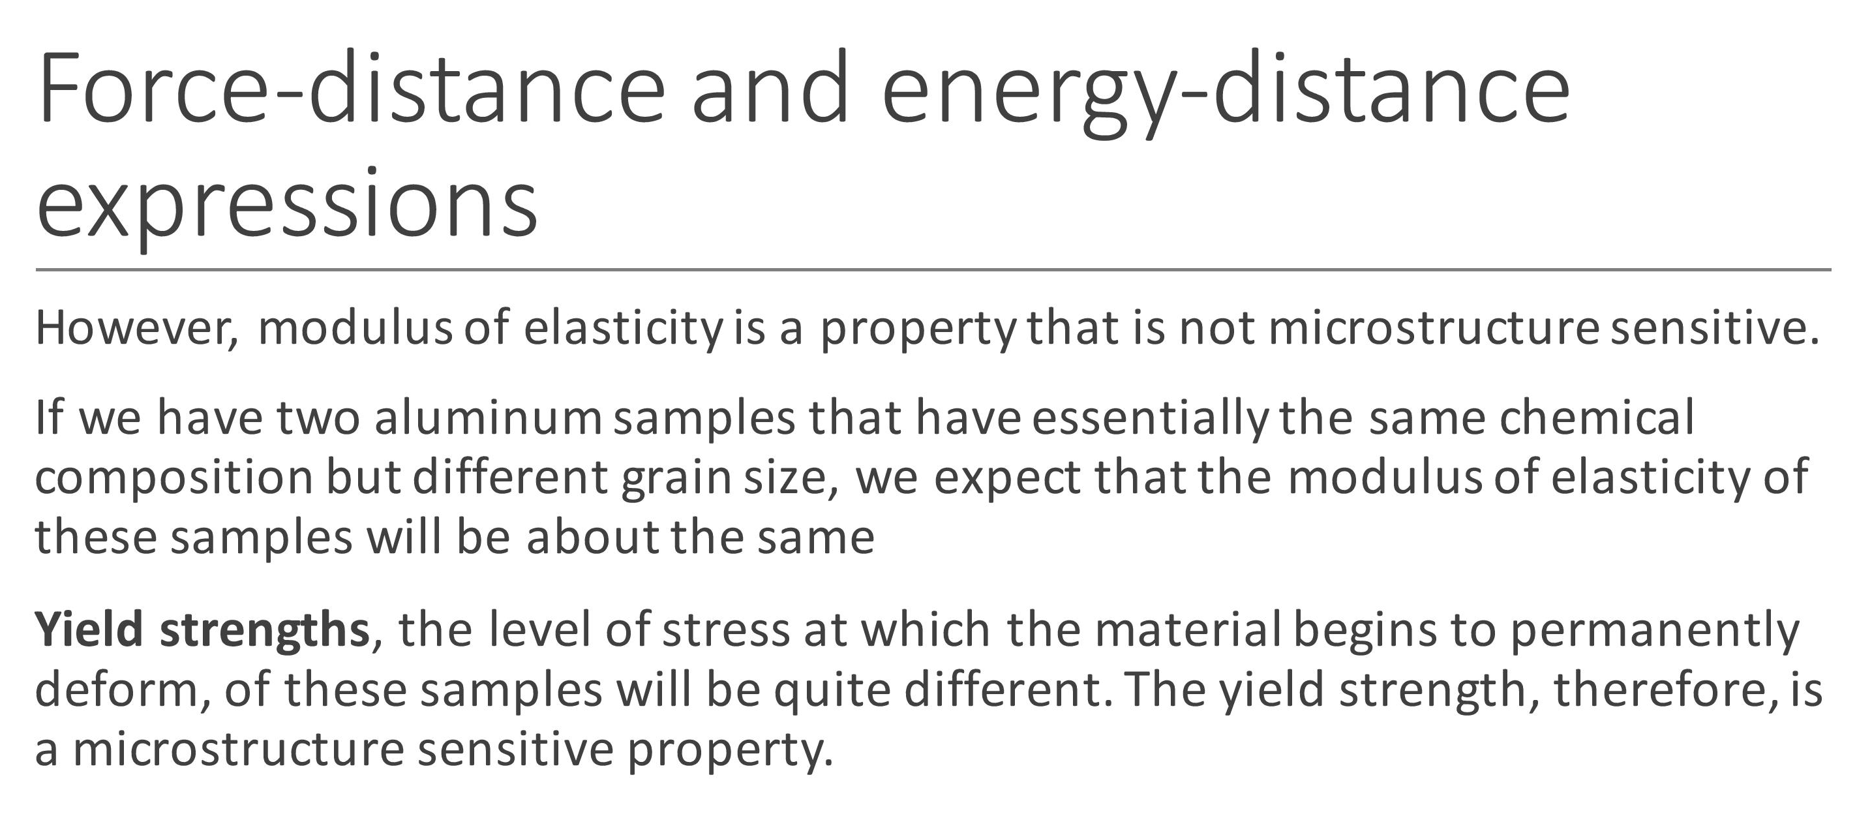

Slide 28
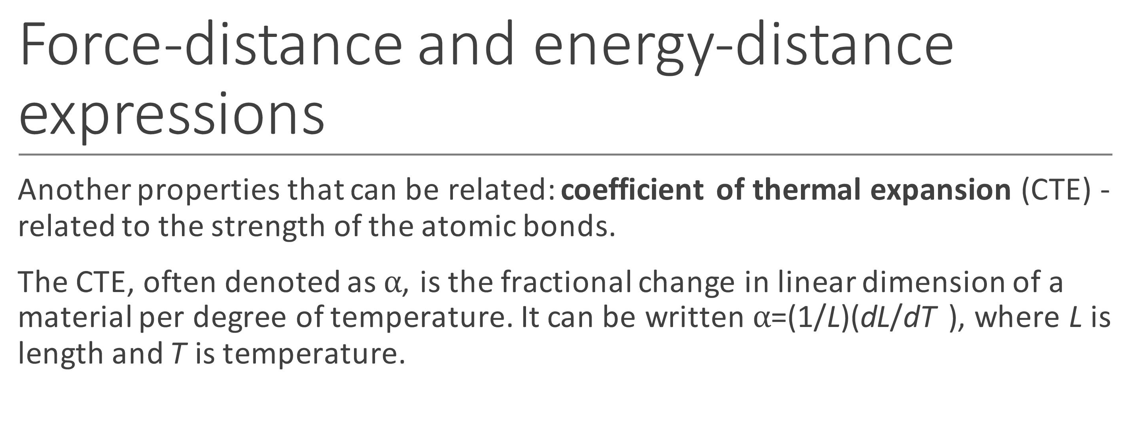

Slide 29
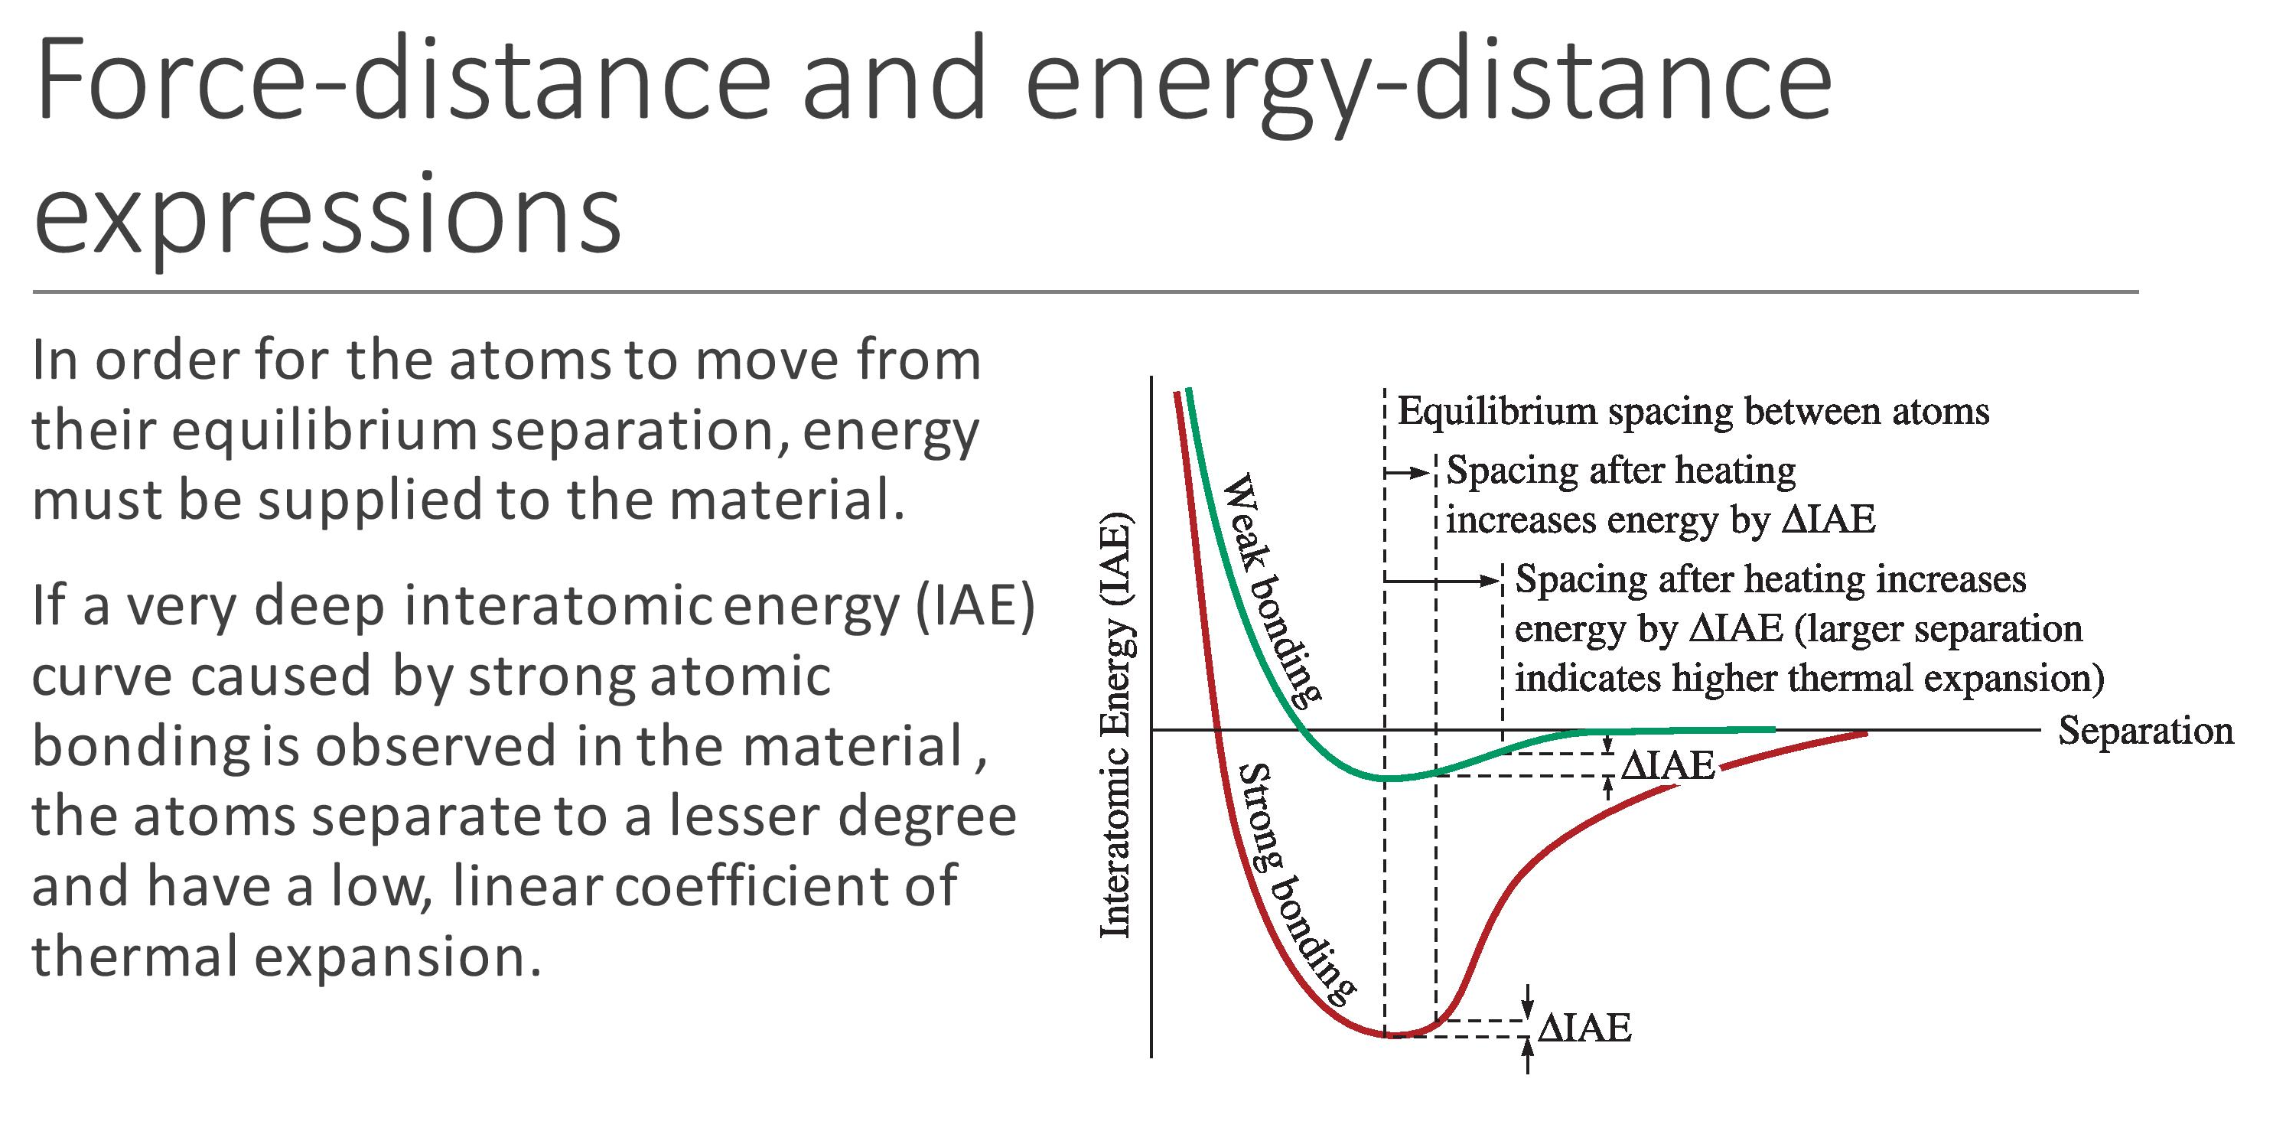

Slide 30
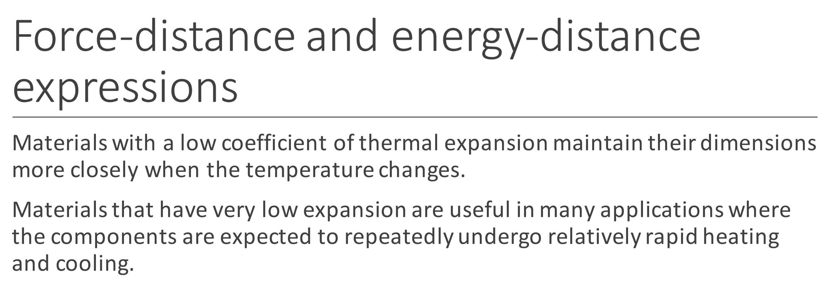

Slide 32
Classifications of Materials
Metals and alloys
Ceramics
Polymers (Plastics)
Composites
Semiconductors
CRYSTALLINE

