Slide 1
NUCLEAR REACTOR MATERIALS
1. INTRODUCTION TO NUCLEAR REACTORS AND MATERIALS
Notes compiled by:
Dr. goh pei sean
Dr. Mohsin mohd sies
Dr. Nor Afifah basri

Slide 2
  Why do nuclear reactors need special materials?
Notes:
The more fundamental aspects of radiation effects can be described on the atomic
scale.

Slide 3
  Temperatures ~300°C
  Neutron radiation damaging atoms
  High pressure (~150 bar)
  Corrosive coolant environment
  Expected lifetime: 40–80 years
Notes:
The more fundamental aspects of radiation effects can be described on the atomic
scale.

Slide 4
  Nuclear reactors are not limited by physics,
  they are limited by materials.
Notes:
The more fundamental aspects of radiation effects can be described on the atomic
scale.

Slide 5
Course Goals
What you will learn in this course
  How nuclear reactors work
  What materials are used in reactors
  How radiation damages materials
  Why materials fail in reactors
  How engineers prevent these failures
Notes:
The more fundamental aspects of radiation effects can be described on the atomic
scale.

Slide 6
Nuclear Reactor
A device in which controlled nuclear fission chain reaction can be maintained.
Main reactor components:
  Source of fissionable material (fuel rods)
  A moderator to slow down neutrons to increase the probability of absorption by a nucleus to split into the two fission fragments and release other neutrons.
  Movable control rods absorb neutrons to maintain the reactor at a critical level to maintain a self-sustaining chain reaction and in the event of an accident can be dropped to be into reactor vessel to shut-down the fission process
  A reflector surrounding the fuel rods and moderator to prevent the loss of neutrons thereby improving the efficiency of the reactor
  A radiation shield surrounding the reactor vessel
  Heat exchanger for the transfer of the energy released by the fission reactions to produce steam
  The steam from the heat exchanger turns a turbine so that electricity is produced in an electric generator.

Slide 7
Nuclear Reactor
A nuclear reactor is basically a machine that does three things:
  Creates heat from nuclear fission
  Controls the chain reaction
  Transfers the heat to produce electricity
Function | Component
Fuel | fuel rods
Slow neutrons | moderator
Control reaction | control rods
Contain radiation | reactor vessel & shield
Produce electricity | steam turbine

Slide 8
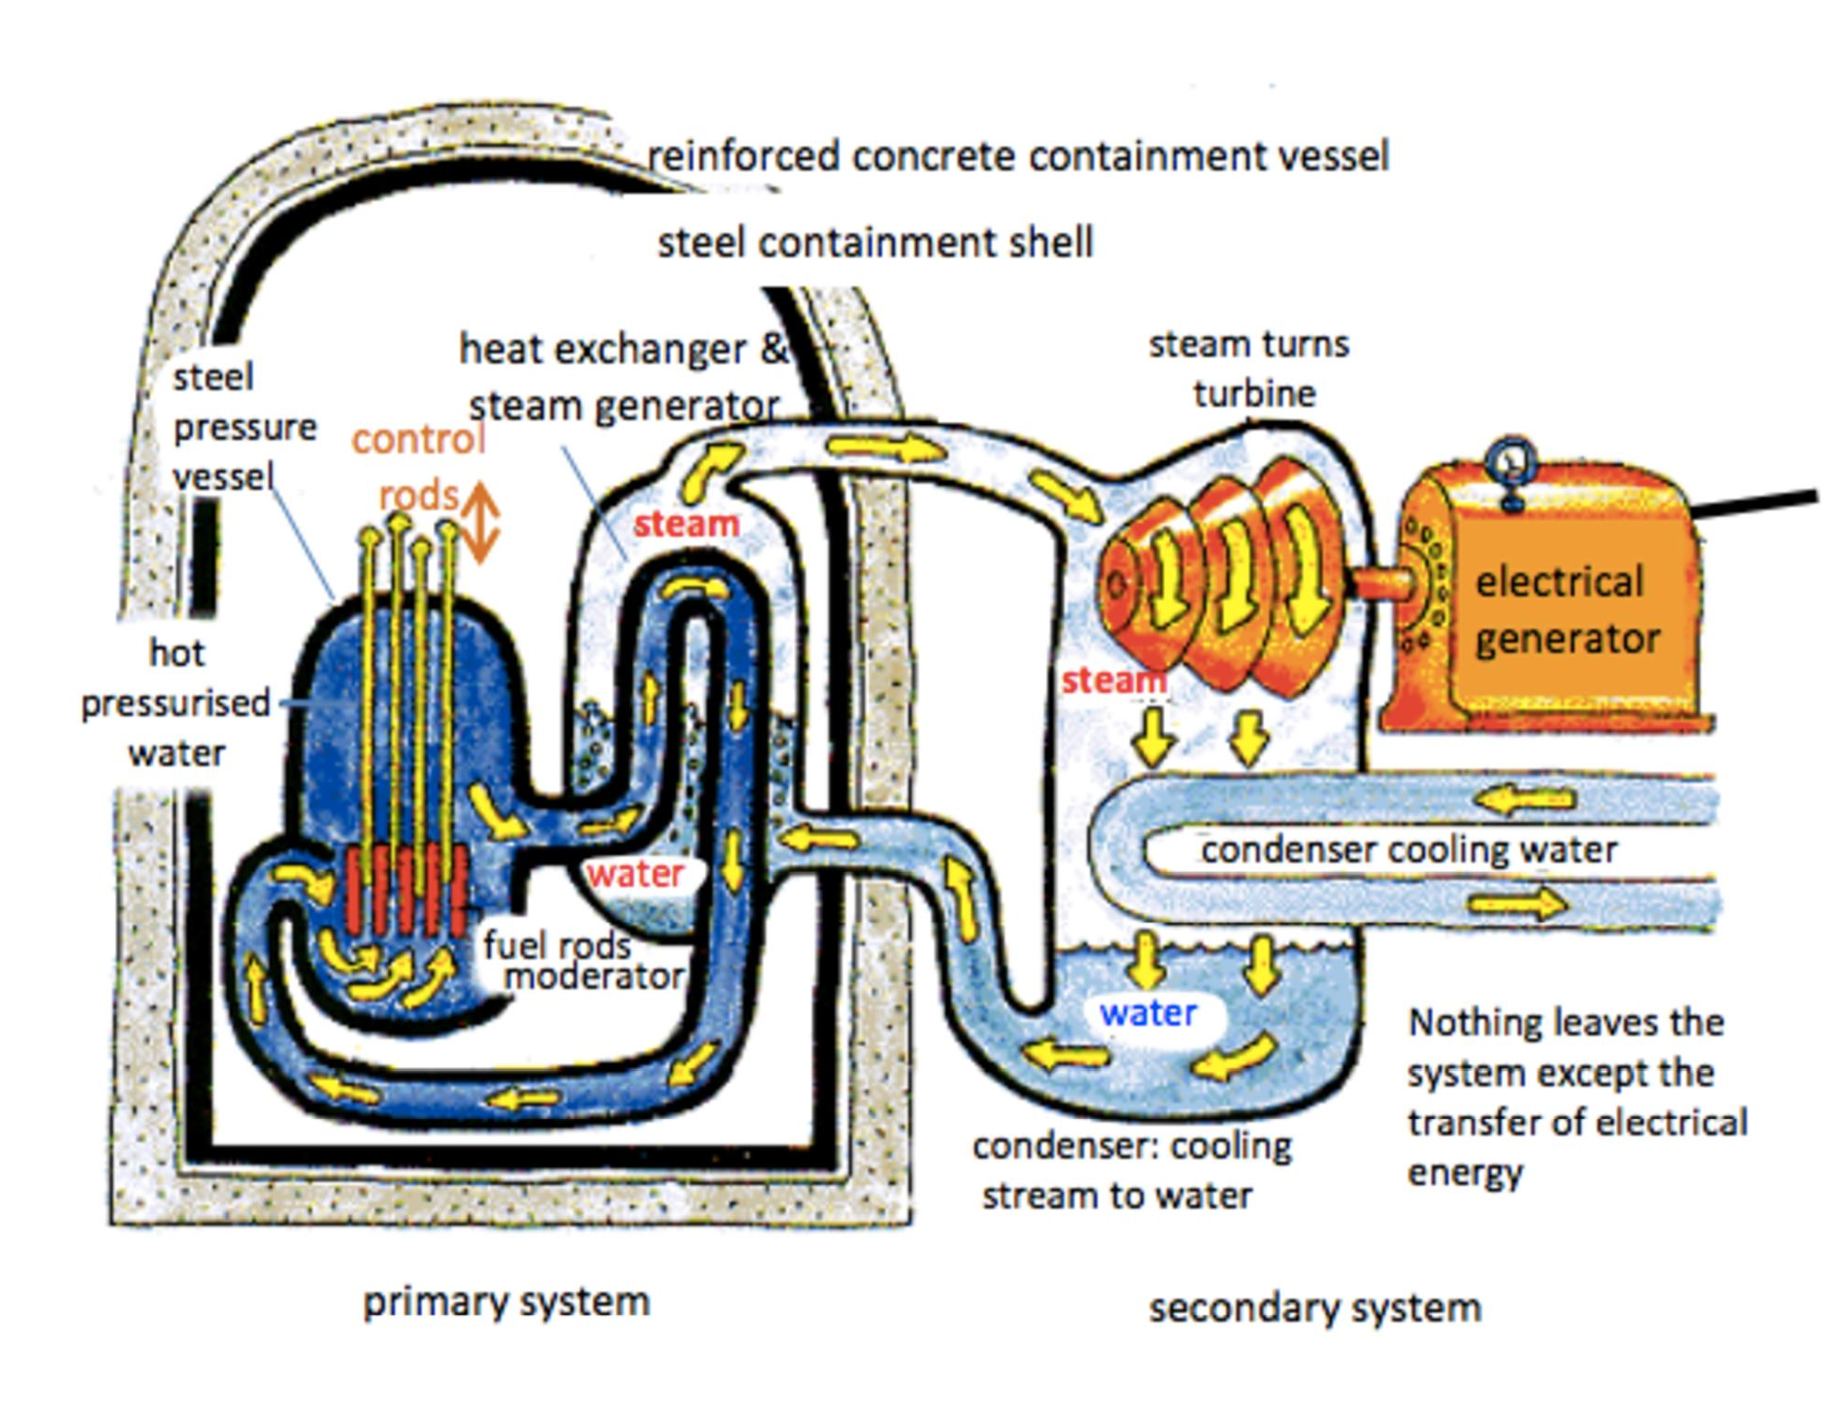

Slide 9
If we place a piece of stainless steel inside a nuclear reactor core for 10 years…
What happens to it?

Slide 10
Nuclear Reactor Integrity
Materials Science and Engineering
Radiation Effects
Remediation and Monitoring
Reactor Components

Slide 11
Light Water Reactor
LWRs rely on the thermal fission of enriched uranium and on normal or ‘light’ water for neutron moderation and heat transfer
LWRs fall into two major categories – research reactors and power reactors
Research reactors are small, on the order of 1MW thermal power, and are optimized to provide intense neutron fluxes for sample irradiation.
Research reactors are fueled with a few kilograms of enriched uranium in fuel rods that are clad with zirconium alloy or with aluminum
Power reactors are generally much larger, on the order of 2 GW of thermal power, and are designed to produce electricity by the adiabatic expansion of steam in a turbine. Two major competing design – BWR and PWR

Slide 12
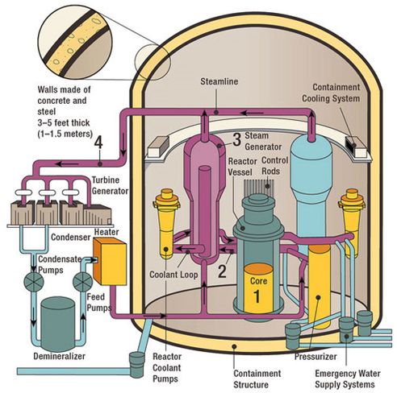
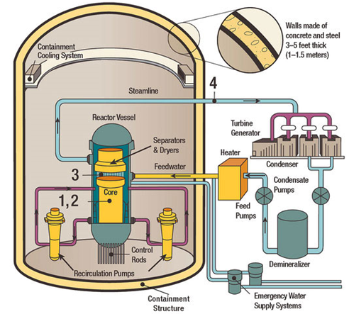
Light Water Reactor
Typical PWR
Typical BWR

Slide 13
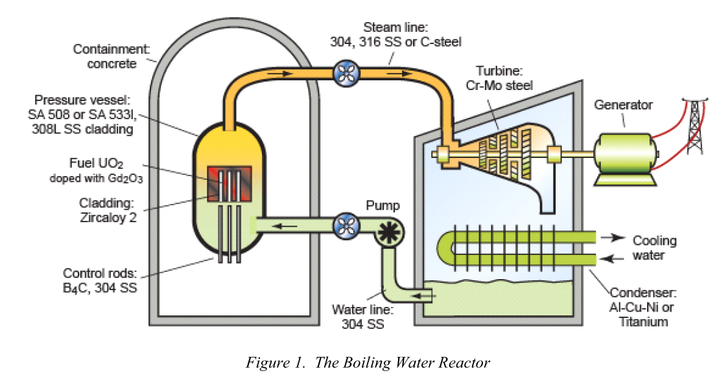
BWR Material Map

Slide 14
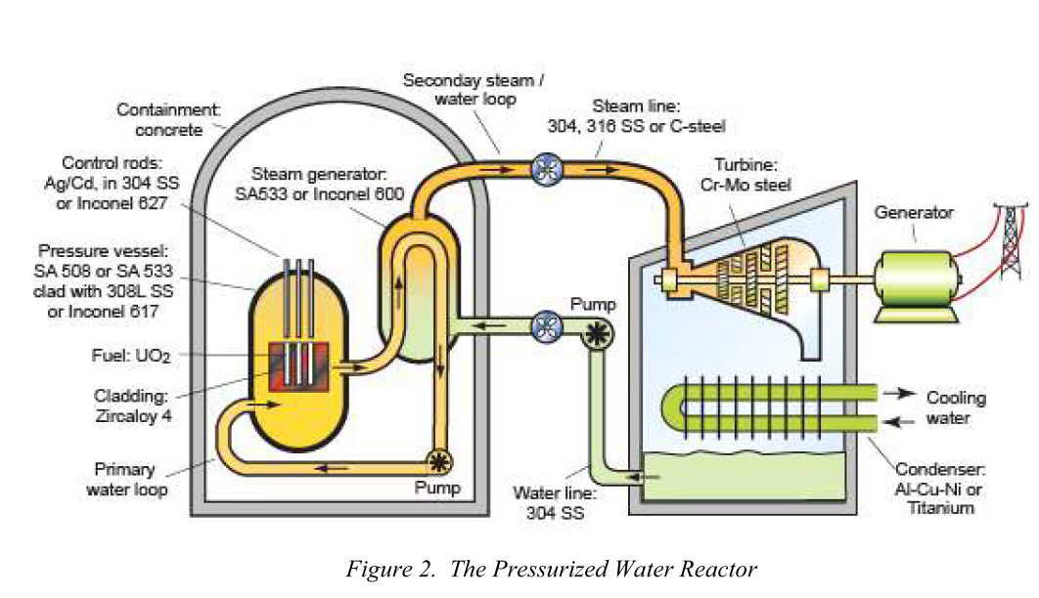
PWR Material Map

Slide 15
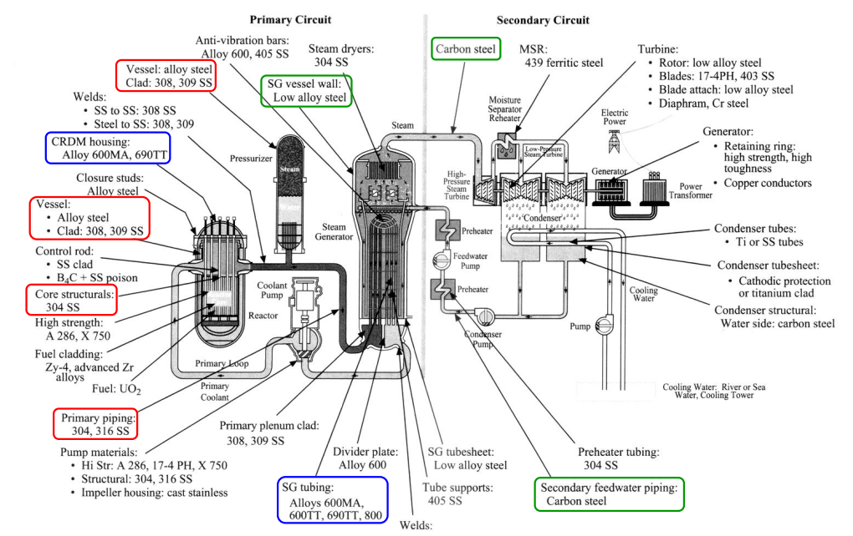
PWR Material Map
Carbon Steels
Stainless Steels
Nickel Alloys

Slide 16
Material Science and Engineering
The discipline of material science involves investigating the relationships that exist between the structures and properties of materials.
In contrast, materials engineering is, on the basis of the structure-property correlations, designing or engineering the structure of a material to produce a predetermined set of properties.

Slide 17
Materials science in nuclear engineering
Materials is an old technology and
has a long history before nuclear.
We know much about …..
strength
electric properties
cost
corrosion resistance
・・etc
For nuclear applications, we should also consider followings.
nuclear properties
radiation damage
reliability
Zircalloy clad tubes for LWR requires Hf-free Zr for the expected low neutron-absorption cross-sections.

Slide 18
Structure and Property
The structure of a material is usually related to the arrangement of its internal components.
Subatomic structure involves electrons within the individual atoms and interaction with their nuclei.
On an atomic level, structure encompasses the organization of atoms or molecules relative to one another.
The next larger structural contains large group of atom that are normally agglomerated together is termed ‘microscopic’ – subject to direct observation using some type of microscope.
Finally, structural elements that may be viewed with the naked eye are termed ‘macroscopic’.

Slide 19
Structure and Property
While in service use, all materials are exposed to external stimuli that evoke some type of response.
For example, a specimen subjected to forces will experience deformation; or a polished material surface will reflect light.
Property is a material trait in terms of the kind and magnitude of response to specific imposed stimulus.

Slide 20
Structure and Property
All important properties of solid materials may be grouped into six different categories
  Mechanical
  Electrical
  Thermal
  Magnetic
  Optical
  Deteriorative

Slide 21
Structure and Property
Mechanical properties relate deformation to an applied load or force. Examples include elastic modulus and strength.
Electrical properties, such as electrical conductivity and dielectric constant, the stimulus is an electric field.
Thermal behavior of solids can be represented in terms if heat capacity and thermal conductivity.
Magnetic properties demonstrate the response of a material to the application of a magnetic field.
Optical properties the stimulus is electromagnetic or light radiation. Example: index of refraction and reflectivity are representative optical properties.
Deteriorative characteristics indicate the chemical reactivity of materials.

Slide 22
Why do we study Materials?
There are several criteria to be concerned / considered during material selection.
Trade-off? – Example: strength and ductility
Deterioration of material properties? – Mechanical strength and environment
Economics?
Safety?

Slide 23
Classifications of Materials
Metals and alloys
Ceramic and glasses
Polymers (Plastics)
Composites
Semiconductors

Slide 24
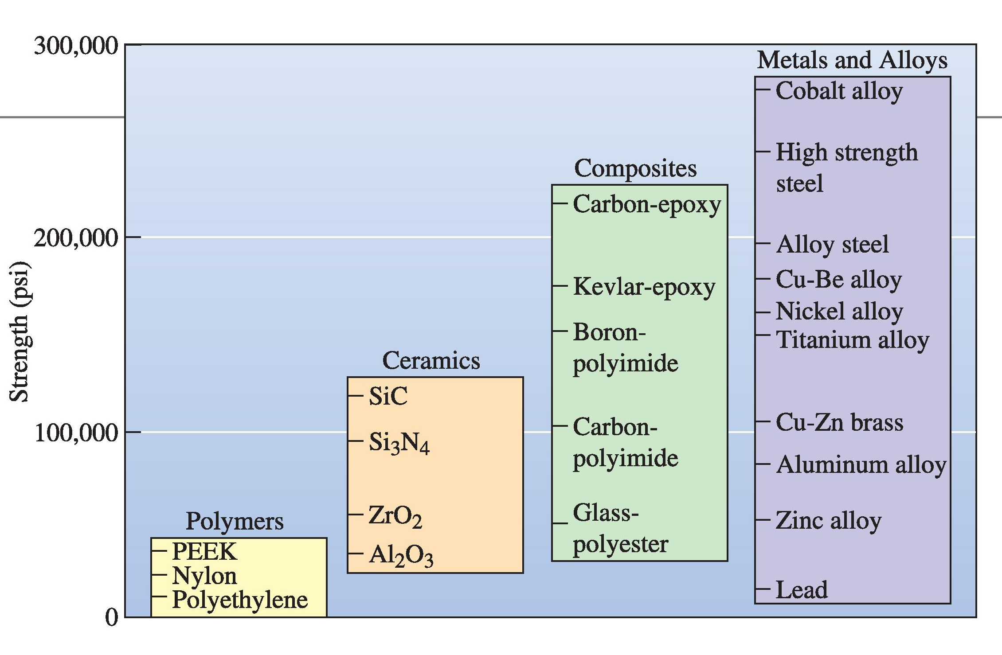

Slide 25
Requirements of Nuclear Material Properties
In selection of nuclear materials required, the material properties and the changes of material properties in an intense radiation environment must be taken into account. The requirements of material properties in nuclear reactors can be divided into two main categories:
  general properties, or basic considerations - similar to the conventional engineering properties of materials, which are required in most engineering designs.
  special properties, or particular considerations - required for nuclear reactor materials arise from nuclear radiation, or irradiation, sources and circumstances of the reactor system. Material properties of a reactor component can have a tremendous change under severe radiation.

Slide 27
Materials used in LWR Plants

