Slide 1
NUCLEAR REACTOR MATERIALS
INTRODUCTION

Slide 2
QUICK CHECK☺
Cladding
Control Rod
Enriched Uranium
MOX fuel
Moderator
Reflector
Blanket

Slide 3
ANSWERS:
Cladding-Protective material surrounding the fuel that acts as a barrier between the fuel and the coolant medium and also prevents escape of the ﬁssion products.
Control Rod-Device containing material with a high neutron absorption cross section that is used to govern the ﬁssion rate of a nuclear reactor by absorbing excess neutrons.
Enriched Uranium-Uranium having a 235 U isotope content greater than that of natural uranium
MOX fuel-is nuclear fuel that contains more than one oxide of fissile material, usually consisting of plutonium blended with natural uranium, reprocessed uranium, or depleted uranium.
Moderator- Material used in a nuclear reactor to decelerate neutrons from the high velocities at which they are released.
Reflector- Layer of material surrounding the core of a nuclear reactor that serves to deﬂect escaping neutron and return many to the core.
Blanket-Fertile or largely fertile material surrounding the cores of certain types of reactors, usually breeder reactors.

Slide 4
Nuclear Reactor
A nuclear reactor is a device in which nuclear reactions are generated, and the chain reaction is controlled to release large amount of steady heat, thereby producing energy.
They are differentiated either by their purpose or by their design features:
  research reactors
  power reactors

Slide 5
To produce energy, a nuclear reactor contains several major components: fuel elements (or rods), control rods, and coolant/moderator
The fuel elements contains the fissile material, typically uranium or plutonium, which is used as the fuel to undergo fission and provide the nuclear energy.
The fissile material is encased in a solid cladding, made of Zircalloy, to contain both the fuel and the resulting fission products and keep them from escaping into the moderator, coolant, or anywhere outside the cladding.
The region inside the nuclear reactor where the fuel elements undergo fission to generate heat is called the nuclear reactor core.
The control rods, usually made of cadmium metal, absorb neutrons in order to control the rate of fission

Slide 6
Research Reactor
Research reactors comprise a wide range of civil and commercial nuclear reactors which are generally not used for power generation.
Many of the world's nuclear reactors are used for research and training, materials testing, or the production of radioisotopes for medicine and industry. They are basically neutron factories.
They are much smaller than power reactors or those propelling ships.
The primary purpose of research reactors is to provide a neutron source for research and other purposes. Their output (neutron beams) can have different characteristics depending on use.
Their power is designated in MW (or kW)- Most range up to 100 MW, compared with 3000 MW (i.e. 1000 MWe) for a typical power reactor.

Slide 7
The IAEA lists several categories of broadly classified research reactors.
They include critical assemblies (usually zero power), test reactors, training facilities, prototypes and even producing electricity.
But most are largely for research, although some may also produce radioisotopes.
As expensive scientific facilities, they tend to be multi-purpose, and many have been operating for more than 30 years.
Notes:
Today, Russia has most research reactors (62), followed by USA (54), Japan (18), France (15), Germany (14) and China (13). Many small and developing countries also have research reactors, including Bangladesh, Algeria, Colombia, Ghana, Jamaica, Libya, Thailand and Vietnam.

Slide 8
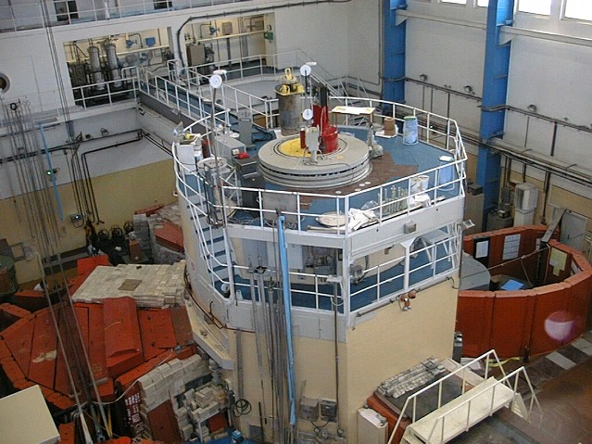
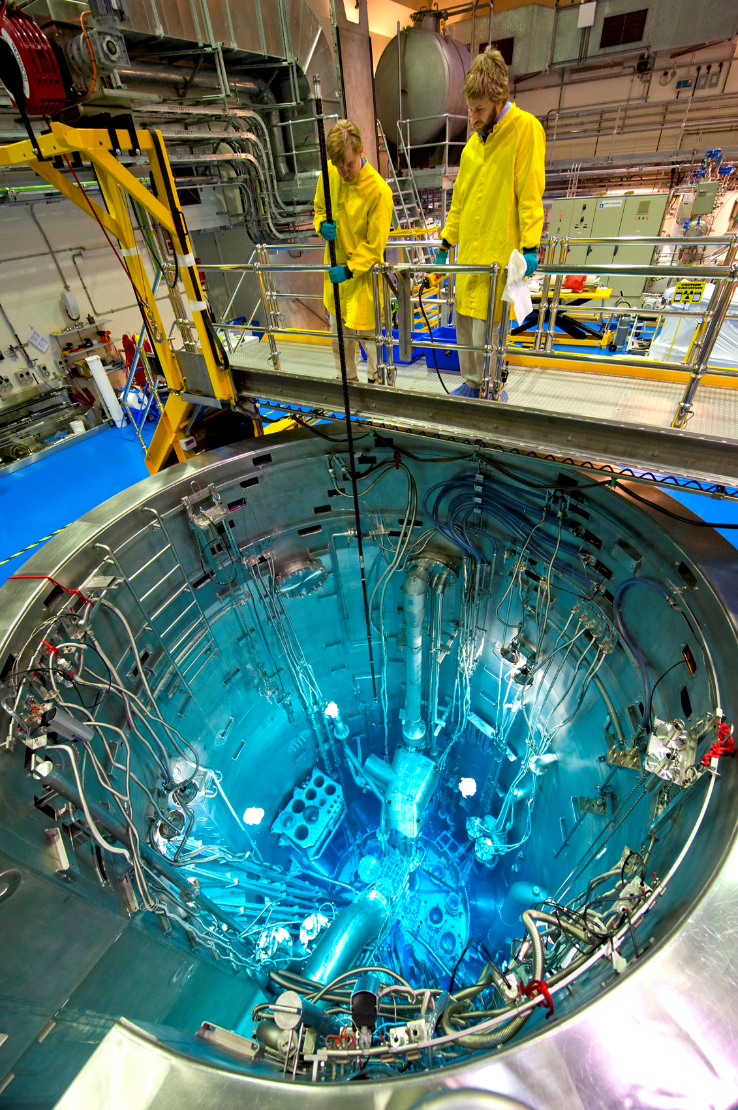
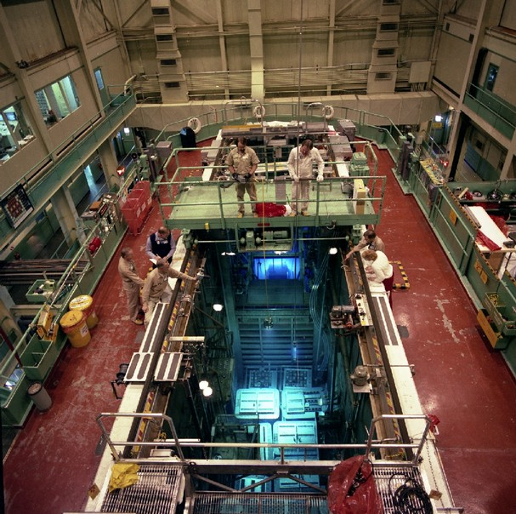
Notes:
Cherenkov radiation is used to detect high-energy charged particles. In pool-type nuclear reactors, beta particles (high-energy electrons) are released as the fission products decay. The glow continues after the chain reaction stops, dimming as the shorter-lived products decay. Similarly, Cherenkov radiation can characterize the remaining radioactivity of spent fuel rods.

Slide 9
General Uses of Research Reactor
Neutron beams are uniquely suited to studying the structure and dynamics of materials at the atomic level.
Neutron scattering is used to answer fundamental questions about the structure and composition of materials used in medicine, mining, transportation, building, engineering, food processing and scientific research.
Neutron activation is also used to produce the radioisotopes, widely used in industry and medicine, by bombarding particular elements with neutrons so that the target nucleus has a neutron added.
  For example, yttrium-90 microspheres to treat liver cancer are produced by bombarding yttrium-89 with neutrons.
Research reactors can also be used for industrial processing.
  Neutron Transmutation Doping (NTD), changes the properties of silicon, making it highly conductive of electricity.
Notes:
Neutrons penetrate most materials to depths of several centimetres. In comparison, X-rays and electrons probe only near the surface.

Slide 10
  In materials testing reactors, materials are also subject to intense neutron irradiation to study changes.
    For instance, some steels become brittle, and alloys which resist embrittlement must be used in nuclear reactors.
  Test reactors -designed to research nuclear power for aircraft, then nuclear-powered rockets and spacecraft

Slide 11
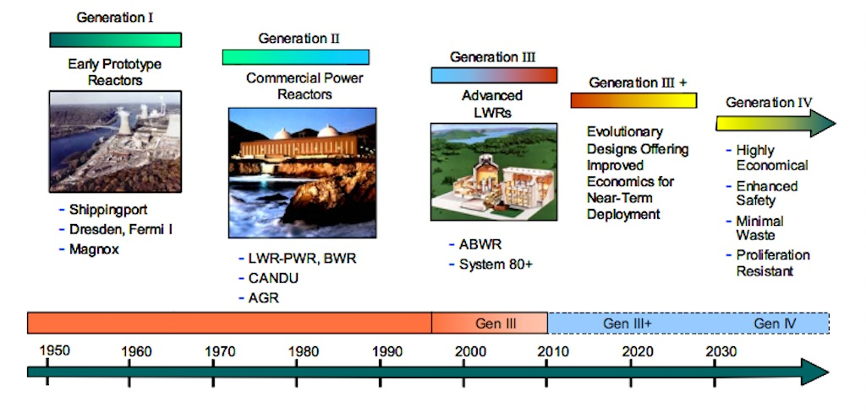
Commercial Reactor: Reactor Types

Slide 12
Reactor Types
Boiling Water Reactor (BWR)
Pressurize Water Reactor (PWR)
Liquid Metal Fast Breeder Reactor (LMFBR)
Advanced gas-cooled reactor (AGR)
Very High Temperature Reactors (VHTR)
Fusion Reactors: the International Thermonuclear Experimental Reactor (ITER)

Slide 13
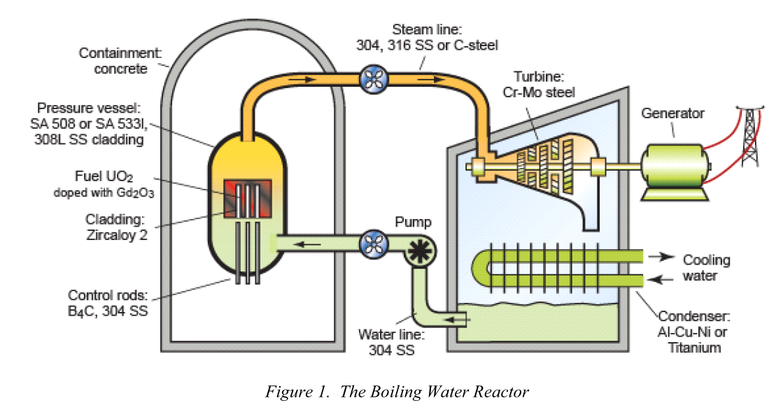
i. Boiling Water Reactor (BWR)

Slide 14
The BWR operates at constant steam pressure (7 MPa), like conventional steam boilers and with a steam temperature of about 560K.
The nuclear core assembly consists of an array of Zircaloy 2 tubes encasing enriched UO2 ceramic fuel pellets.
The power is controlled by control rods inserted from the bottom of the core and by adjusting the rate of flow of water.
Water is circulated through the reactor core where it boils, producing saturated steam.
The water acts as both a coolant and a moderator, slowing down high energy neutrons.
The steam is dried and passed to the turbine-generator through a stainless steel steam line. On exiting the turbine the steam is condensed, demineralized, and returned as water to the reactor.

Slide 15
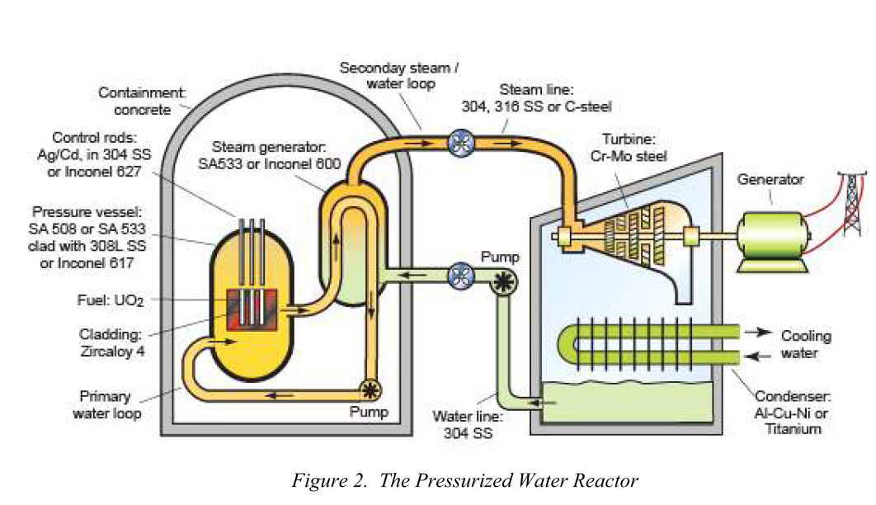
ii. Pressurize Water Reactor (PWR)

Slide 16
PWR has some 200 tube assemblies containing ceramic pellets consisting of either enriched UO2 or a mixture of both uranium and plutonium oxides known as MOX (mixed oxide fuel).
Water is pumped through the core at a pressure sufficient to prevent boiling, acts as both a coolant and a moderator, slowing down high energy neutrons.
The water, at about 600 K, passes to an intermediate heat exchanger. The power is controlled by the insertion of control rods from the top of the core and by dissolving boric acid into the reactor water.
As the reactivity of the fuel decreases, the concentration of dissolved boron ions is reduced by passing the water through an ion-exchanger.

Slide 17
The primary pressurized water loop of a PWR carries heat from the reactor core to a steam generator.
The loop is under a working pressure of about 15 MPa - sufficient to allow the water in it to be heated to near 600 K without boiling.
The heat is transferred to a secondary loop generating steam at 560 K and about 7 MPa, which generates heat that drives the turbine.

Slide 18
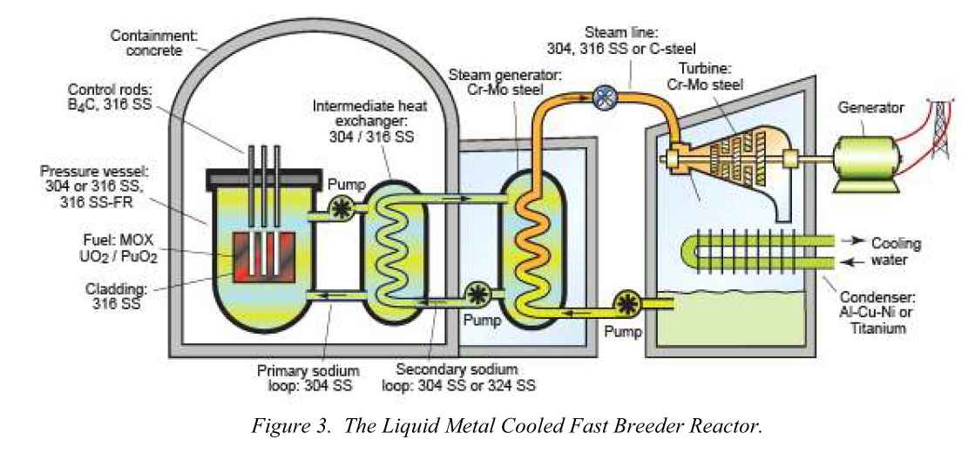
iii. Liquid Metal Fast Breeder Reactor (LMFBR)

Slide 19
A LMFBR is a liquid sodium cooled reactor that makes use of a fast neutron spectrum and a closed fuel cycle.
The liquid sodium coolant transfers heat from the reactor core and is pumped through the primary loop at about 800K.
This sodium in this loop becomes radioactive, requiring an intermediate sodium filled heat-exchange loop to prevent possible leakage of radioactive material outside the containment structure.
The usual choice is a fuel assembly made up of mixed uranium dioxide (UO2) and plutonium dioxide (PuO2 ) fuel rods

Slide 20
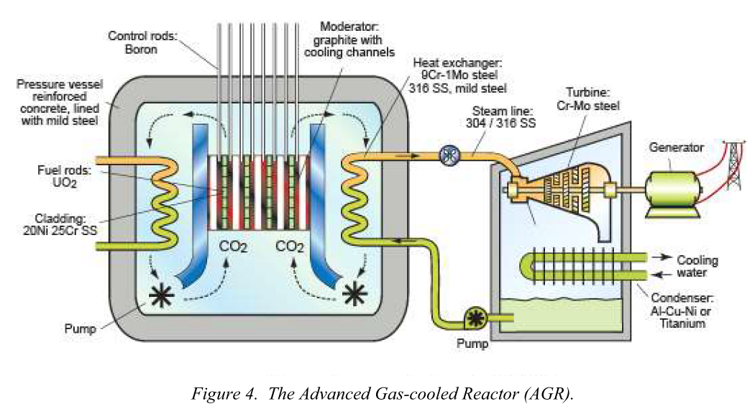
iv. Advanced gas-cooled reactor (AGR)

Slide 21
The advanced gas-cooled reactor (AGR) is graphite moderated and cooled with carbon dioxide (CO 2 ). The core consists of high strength graphite bricks mounted on a steel grid.
Gas circulators blow CO2 up through the core and down into steam generators. Holes in the graphite allow access to the gas.
The outlet temperature of the CO2 is about 943K at a pressure of 4MPa. The graphite in the core is kept at temperatures below 723K to avoid thermal damage.
The reactor core, gas circulators, and steam generators are encased in a pressure vessel made of pre-stressed concrete lined with a mild steel to make it gas tight.
Mild steel is used in areas of the pressure vessel that are exposed to temperatures less than 623K.
Power is primarily controlled through the insertion of control rods made of boron-steel, with back-up by insertion of nitrogen into the cooling gas or by releasing fine boron-rich balls into the gas stream.

Slide 22
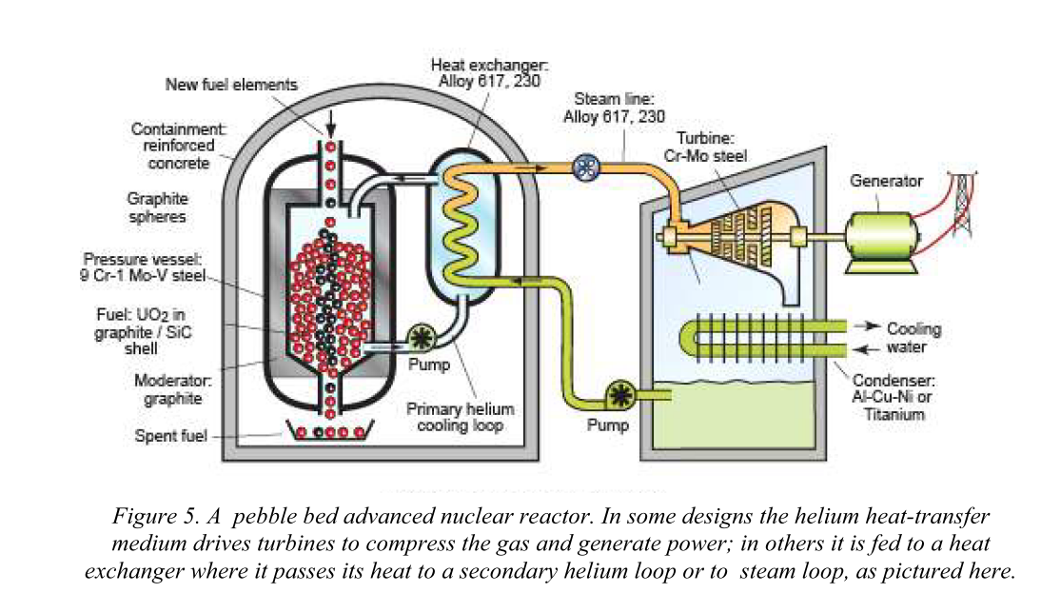
v. Very High Temperature Reactors (VHTR)

Slide 23
VHTR is a proposed IV generation design, moderated with graphite and cooled with helium gas.
The outlet temperature of the coolant is about 1123-1223K at a pressure of 7MPa. Internal reactor temperatures may reach up to 1470K.
The helium coolant is heated in the reactor vessel and flows to the intermediate heat exchanger (IHX). Heat is transferred to a secondary loop with either helium, nitrogen and helium, molten salt, or pressurized water.
The heated fluids can either be used to drive a turbine or to produce hydrogen.

Slide 24
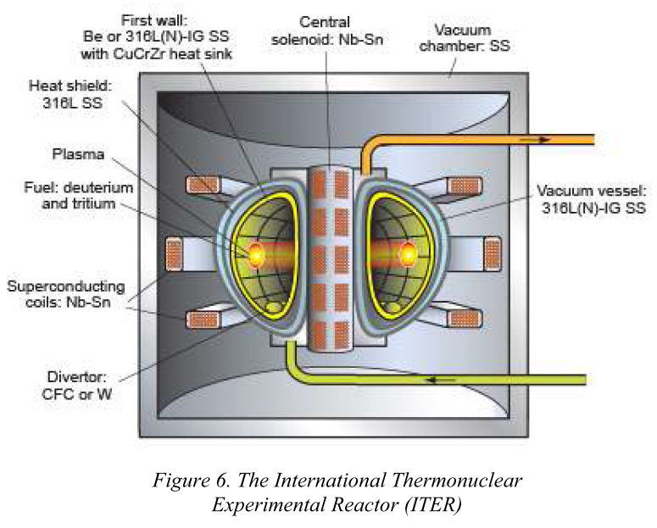
vi. Fusion Reactor

Slide 25
ITER is an experimental fusion reactor designed to produce 500MW of power from an input of 50MW.
Energy is released from the fusion of deuterium and tritium nuclei. This requires a temperature of about 100MK at which the gases forms
ITER uses magnetic confinement to contain the plasma, allowing fusion without contact between the plasma and the containing walls.
The ITER uses a tokamak design. The plasma is contained in a torus shape using strong magnetic fields produced by circumferential superconducting coils and a large central solenoid.

