Slide 1
NUCLEAR REACTOR MATERIALS
4. Monitoring of material degradation

Slide 2
In this Chapter
Approach to develop real-time monitoring
Case studies

Slide 3
Introduction
The loss in capacity factor due to material degradation issues for PWRs and BWRs has generally decreased over the last few decades.
However, it is anticipated that costs associated with management of materials performance will continue to increase as plants age.
One method to improve capacity factors of nuclear power plants and to reduce the costs associated with managing materials performance is through the implementation of successful programs for the real-time monitoring of materials degradation.

Slide 4
Cracking in smaller components characterized early failures . These types of cracking, while still prevalent, represent a smaller fraction of component or material failures at present.
They have been mitigated through managing the operating conditions as well as by replacement of components.
At present, the major issues are with respect to large components which appear to be impacted by late-onset forms of material degradation.
Continued reliability of these components are challenging as they represent high-value components that are safety-critical, and as such, can result in expensive shut-down of operating plants.
Notes:
(such as sensitized stainless steel small-bore piping and bolts in reactor internals) operating condition: (water chemistry, etc.)
(such as the pressure vessel head, pressurizer surge lines, welds in large bore piping, etc.),

Slide 5
In-service inspection practices
Based on requirements in the ASME B&PV Code which were originally developed in the 1960’s.
The code specifies whether volumetric, surface, or visual examinations should be performed depending on the functional requirements of the component and the risks associated with its failure.
While current in-service inspection processes have been successful at detecting cracks in large-scale components, it is almost always after the fact.
Example: corrosion and subsequent cracking in the weld region of the control rod drive mechanism penetrations in the reactor vessel head
Notes:
after the material degradation has reached a stage where replacement of the component is the only option
The environmental degradation incurred during operation resulted in the replacement of the entire reactor vessel head
Boiler and Pressure Vessel Code

Slide 6
Criteria of Detection
1) be non-destructive
2) be able to probe large volumes
3) have submillimeter spatial resolution
4) be capable of real-time/ on-line monitoring
5) be able to operate remotely
6) be able to withstand radiation environments at high temperatures.

Slide 7
Overall Approach for Real Time Monitoring
The framework for real-time monitoring of materials degradation in nuclear power reactors consists of three main interconnected thrust areas:
Microstructural science
Behavior assessment
Monitoring and predictive capabilities

Slide 8
Microstructural science
Development in computational methods at the meso-scale and analytical and nano-scale microscopy to understand the onset and progression of prototypical degradation mechanisms in structural materials
Development of meso-scale quantitative property measurement techniques (physical property or micro-property imaging) to measure magnetic, acoustic, and electrical properties on sub-micron length scales.
Notes:
(under the influence of temperature, neutron irradiation, chemical attack, and other stressors)
Acoustics is the interdisciplinary science that deals with the study of all mechanical waves in gases, liquids, and solids including topics such as vibration, sound, ultrasound and infrasound.

Slide 9
Behavior assessment
Develop multi-scale, multi-physics computational models of material behavior changes caused by degradation mechanisms.
Meso-scale models of degradation evolution and the resulting changes in physical properties of the material (such as acoustic, magnetic, and electrical) will be coupled to macro-scale models of the sensing physics to obtain insights into the sensitivity of measurement methods to early stages of damage

Slide 10
Monitoring and predictive capabilities
Materials science, computational methods, and physical property imaging to develop environmentally hardened sensors to monitor materials behavior under harsh conditions.
The macroscopic measurements from these sensors will be utilized, along with the multi-scale, multi-physics models, to develop inverse analysis methods that attempt to quantify the level of damage at the microstructural level.

Slide 11
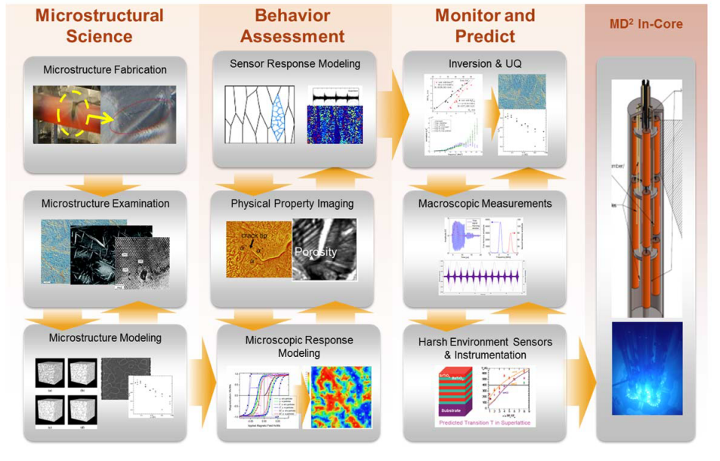
Conceptual illustration of the integrated parts of Material Degradation and Detection
Notes:
Material degradation detection

Slide 12
Material degradation modes in LWR PCS
The majority of the structural components used in the primary system of LWRs are fabricated from the family of Fe-Cr-Ni metals.
  carbon steels (e.g., A553B), stainless steels (e.g., 304 and 308), and nickel-based alloys (e.g., Alloy 600 and X750) and the corresponding weld materials used to join them.
The unique combination of high temperature, corrosive water chemistry, and neutron flux leads to a harsh environment and activates materials degradation processes
The material degradation modes active in LWR primary coolant systems can be grouped into the following categories:
  generalized corrosion
  localized corrosion
  mechanical
Notes:
In general, these materials have exhibited excellent performance in high temperature and pressure water and steam systems.

Slide 13
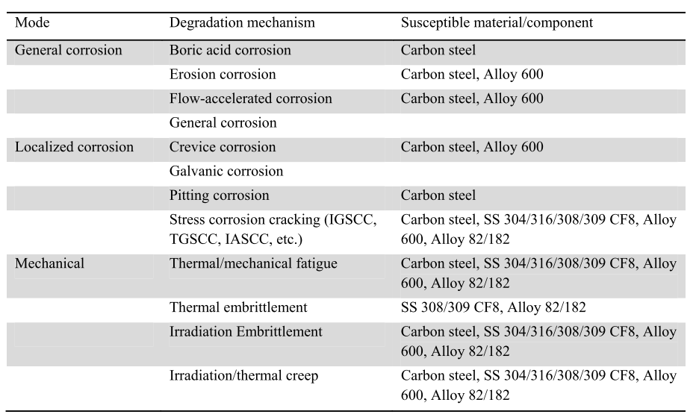
Degradation mechanisms and susceptible materials in LWR primary coolant systems

Slide 14
The research has found that SCC can become active once the conditions of environment, material susceptibility and stress align into a unique combination.
Because of the large number of factors that influence SCC, quantitative predictions of the progression of the degradation process are difficult.
A qualitative understanding of the process which can be separated into 5 distinct stages has been developed by Staehlein 2012
Notes:
The most impactful of the degradation modes shown in Table II is stress corrosion
cracking (SCC), which has several different variants, including intergranular (IGSCC),
transgranular (TGSCC), and irradiation-assisted (IASCC).

Slide 15
Stage 1: Initial condition
This stage represents the as-manufactured state of the material before exposure to the environment.
The as-manufactured state includes surface characteristics such as:
  Finish
  Grain orientation/texture,
  Second phase particles
  Residual stresses.
Notes:
Finish (polishing, etching, oxidation, etc.),

Slide 16
Stage 2: Precursors
The precursor stage characterizes the exposure of the material to the operating environment.
Upon exposure, certain processes may occur that promote the occurrence of SCC, such as surface pitting, depassivation of surface oxides, and buildup of irradiation damage (dislocations, amorphization of second phase particles, etc.).

Slide 17
Stage 3: Incubation
Progression from the precursor to the incubation stage represents the start of the active SCC process.
During this stage the surface and microstructural changes occur that lead to crack initiation at the surface of the material.
These changes include dislocation buildup, entry of oxygen or hydrogen, grain boundary migration of impurities and void formation.

Slide 18
Stage 4: Proto-cracks
The formation of proto-cracks (cracks less than a few microns) results from vacancy coalescence, intergranular corrosion, etc.
Proto-cracks start out as non-interacting with the applied or residual stress field, unlike the propagating cracks in Stage 5

Slide 19
Stage 5: Propagation
This stage represents the process in which the crack interacts both with the local stress field and the local chemical/irradiation conditions.
Crack advance is influenced by the electrochemical potential within the crack environment, the metallurgical chemistry at the crack tip, the stress state, etc.
Stable crack growth rates are observed in experiments designed to simulate the coolant chemistry and strain rates.

Slide 20
Microscopic physical property imaging
The processes that cause material degradation begin to occur in the microstructure at the atomic level respond and interact with the external environment.
Microstructural evolution in the early phases of material degradation requires identifying the impact of lower-length scale changes on key material properties at the sub-micron range.
This allows:
1) identifying the impact of microstructural changes during early stage degradation processes
2) providing validation data to meso-scale modeling methods used to simulate the microstructure evolution during the degradation mechanisms.
Notes:
Atomic level-as the atoms, ions, point defects, dislocations, grain boundaries, external environment-chemical, thermal, mechanical, and irradiation

Slide 21
Scanning Probe Microscopy
Microscopic physical property imaging techniques:
magnetic force microscopy (MFM)
atom force acoustic microscopy (AFAM)
piezoresponse force microscopy (PFM)
These methods are able to resolve the impact of microstructure characteristics on nano-scale magnetization behaviour and the nano-scale elastic material response
By coupling the capabilities of these measurements with classical analytical microscopy methods, possible to construct 3D micro-property, micro-chemistry, and micro-crystallographic information that can be used to identify important relationships between microstructure evolution and material response.
Notes:
for example, transmission electron microscopy (TEM) and integrated, focused ion beam milling,
scanning electron microscopy (SEM), electron backscatter diffraction (EBSD), energy dispersive
spectroscopy (EDS), and atom probe tomography (APT)
…response that can be used to identify important relationships between microstructure evolution and material response

Slide 22
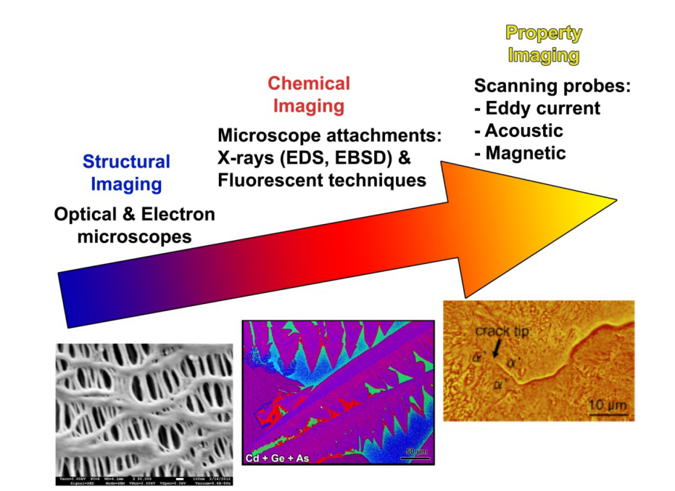
Illustration of the combined power of structural, chemical, and physical property imaging techniques
Notes:
Figure 5 illustrates how the combination of structural imaging (optical and electron
microscopy), chemical imaging (with microscope attachment such as EDS), and property
imaging (magnetic, acoustic, and eddy current/ electrical conductivity) can combine to provide
powerful diagnostic information about material degradation processes.
EBSD-electron back scattering diffraction

Slide 23
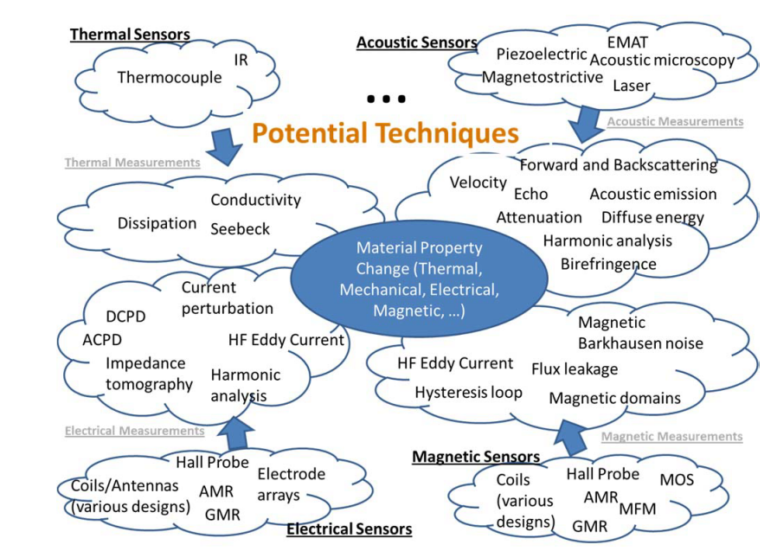
Engineering‐scale degradation measurements -NDE
The main classes (and subclasses) of detection methods of interest are acoustic, magnetic, and electrical. Each detection method can be realized by multiple sensor types
Notes:
The main classes (and subclasses) of detection methods of interest are acoustic (linear and harmonic/nonlinear, with measurements of velocity/attenuation/scattering/nonlinear parameters), magnetic (Barkhausen, DC hysteresis, leakage flux), and electrical (eddy current, AC/DC potential drop, impedance tomography, impedance spectroscopy, etc.).

Slide 24
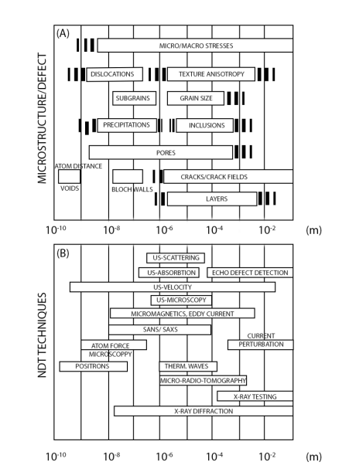
Microstructural defect length scales and applicable NDE techniques

Slide 25
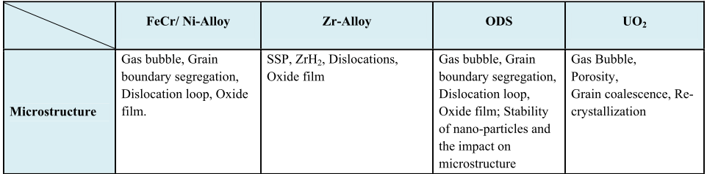
Property changes for NDE monitoring of nuclear materials

Slide 26
In‐pile measurements
Fuel cycle test program should include in-pile instrumentation that allows real-time 3D characterization of fuel during irradiation
Characterization needs include dimensional changes in fuel pellets, microstructural changes and characterization of fission gasses.
On-line continuous monitoring of in-pile materials requires radiation-hardened sensor materials.
Gamma and/or neutron testing has been conducted for the production of radiation-hardened magnetic sensors for space applications, fusion reactors, and other nuclear applications.
Notes:
Improved safety and reliability of nuclear fuels are important for the development of Gen
IV systems and to the competitiveness of existing nuclear plants. The performance of these fuels
must be verified prior to licensing under operating conditions in a fuel cycle test program using
test reactors
microstructural changes (such as porosity and cracking)

Slide 27
Ex‐core measurements
Monitoring of ex-core structural components such as the RPV, on the other hand, allows the introduction of many other types of sensors because the materials used for ex-core components are metallic and therefore allow a wider range of measurement physics.
In addition, the environmental conditions are often less severe than in-core conditions.
Acoustic, ultrasonic and magnetic sensors are of primary interest when dealing with metallic pressure boundary components.

Slide 28
Magnetic sensors measure magnetic field changes near degradation and cracking by means of flux leakage or some effects caused by the discontinuous jump of magnetization due to pinned domain wall movement.
Acoustic and ultrasonic measurements could potentially be implemented using a variety of sensors including those based on piezoelectric, magnetostrictive, and electromagnetic acoustic transduction (EMATs).
Laser excitation of ultrasound may also be a possible means for inspecting components when access to the surface is available.

Slide 29
Detection Technology Gaps
1) measurement signal:
robustness of measurement signal to noise, sensitivity to small-scale changes, and selectivity minimally impacted by other factors
2) sensor technologies:
robustness and long-term stability to harsh temperature, radiation, and chemical environments; high sensitivity over large bandwidths; and integrated sensors in structural materials
3) electronics and instrumentation:
Robustness to harsh environment, low power or power-harvesting capable
4) analytics:
multiscale multiphysics computational modeling to guide interpretation of measured data

