Slide 1
NUCLEAR REACTOR MATERIALS
3. Light water reactor fuel

Slide 2
In this Chapter
Fuel behaviour
Testing and Instrumentation
Notes:
1)fuel behavior during normal operation, Structure and design of fuel, Behavior of fuel pellet and cladding, High-burnup fuel, MOX fuel, Fuel failure
2) Irradiation test, Test reactor, Instrumentation, PIE

Slide 3
Fuel behaviour

Slide 4
Characteristics of nuclear fuel pellet
To produce energy continuously
Atomic density of nuclear fissile material, and nuclear properties of chemical compound must be advantageous for continuity of nuclear reaction.
To transfer the produced energy to coolant
To transfer the energy as thermal energy to coolant effectively, nuclear fuel must have high thermal conductivity.
Work as the first wall for radioactivity
To be stable physically and chemically at high temperature use, defects formation by irradiation must be low.

Slide 5
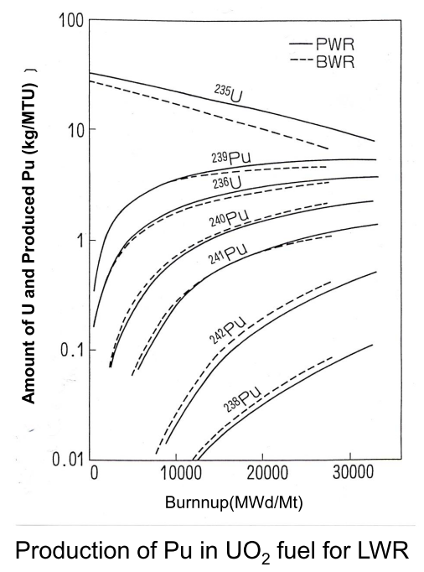
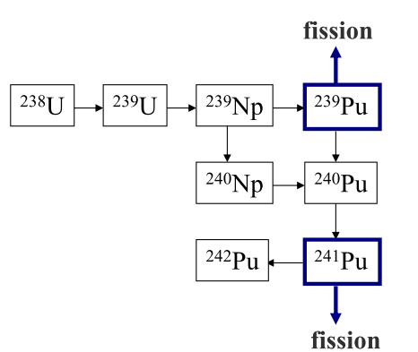
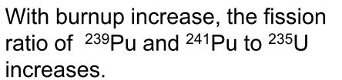
Major nuclear fission reaction in reactor
Notes:
Neptunium

Slide 6
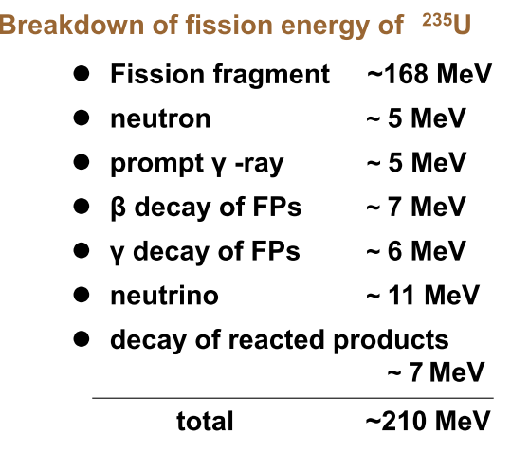
Fission energy and burnup
At one nuclear fission, about 210MeV is produced, and about 195MeV is used as thermal energy.
About 30% of fission energy is converted to electricity at a nuclear power plant.

Slide 7
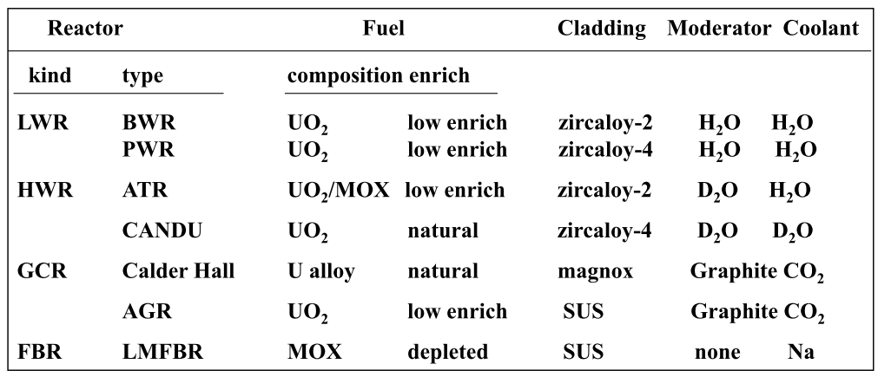
Type of commercial Reactor and fuel form

Slide 8
Composition of natural Uranium
U-235 0.72%
U-238 99.28%
U-234 0.006%
About 3-5% enriched UO2 is used for LWRs

Slide 9
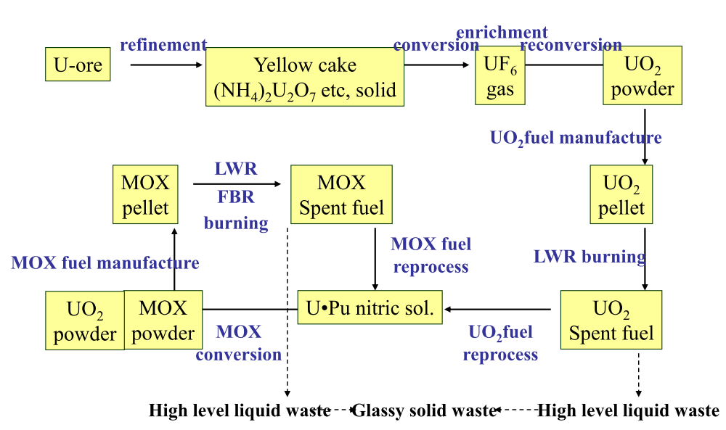
Physical/chemical form of nuclear fuel material

Slide 10
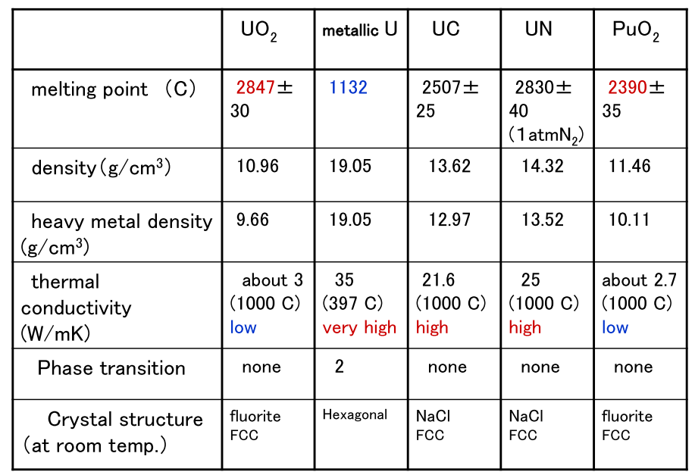
Fundamental property of nuclear fuel material
Notes:
Uranium carbide-As nuclear fuel, uranium carbide can be used either on its own, or mixed with plutonium carbide (PuC and Pu2C3). The mixture is also labeled as uranium-plutonium carbide (PuC U). Uranium carbide is also a popular target material for particle accelerators
Uranium nitride has been considered as a potential fuel for nuclear reactors and also motor vehicles, which would only have to be refueled every 3–5 years. It is said to be safer, stronger, denser, more thermally conductive and having a higher temperature tolerance

Slide 11
Fuel Behaviour
Fuel behavior = comprehensive interaction of many factors
・temperature
・neutron flux
・fission：heat generation, Fission Products accumulation
・micro and macro

Slide 12
Why fuel behaviour is important
To keep the integrity of fuel rod and assembly until the designed burnup(life limit)
Complicated interactions : (experience is important)
・it is sometimes difficult to predict with theoretical/ deterministic model
・cannot be treated as reactor physics by theoretical model
・metallurgical structure sensitivity
・many unknown factors, irradiation experiment is important.

Slide 13
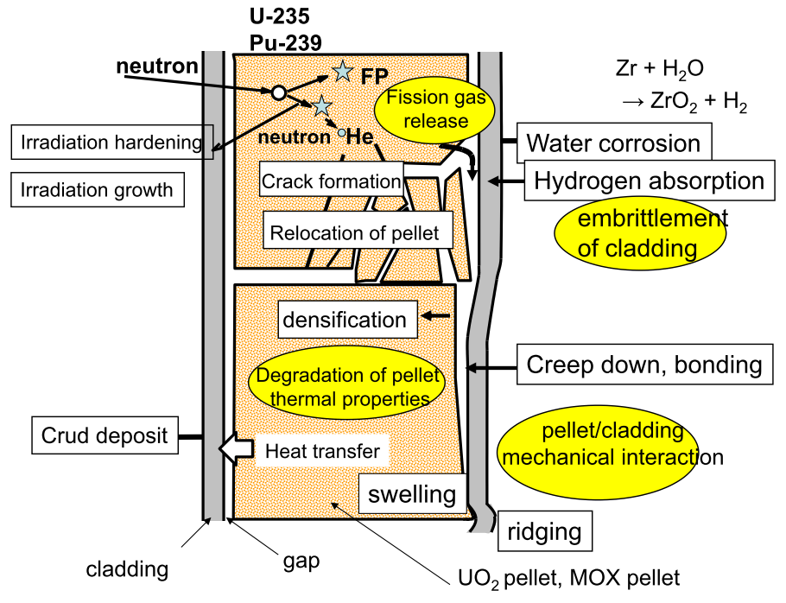
Phenomena occur during rector operation
Notes:
It is normal to fill the gap between the fuel and the cladding with helium gas to permit better thermal contact between the fuel and the cladding. During use the amount of gas inside the fuel pin can increase because of the formation of noble gases (krypton and xenon) by the fission process

Slide 14
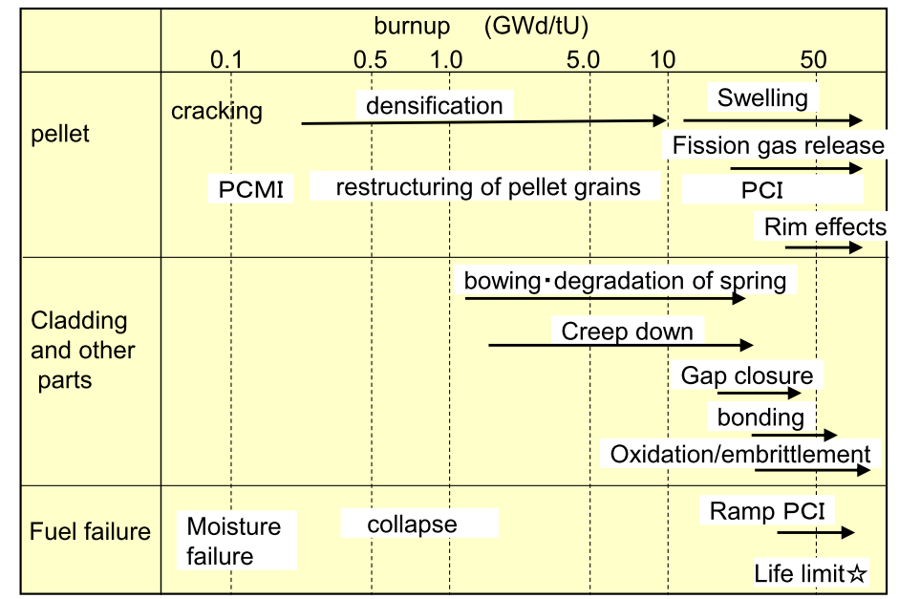
Changes in fuel with burnup increase
Notes:
Pellet-cladding interaction
Swelling- As the void forms, the once-cylindrical pellet degrades into pieces. The swelling of the fuel pellet can cause pellet-cladding interaction when it thermally expands to the inside of the cladding tubing. The swollen fuel pellet imposes mechanical stresses upon the cladding
RIM effect-The effect of high burnup at the pellet surface (“rim”)

Slide 15
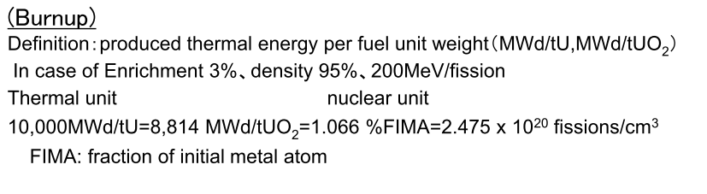
Special unit for nuclear fuel

Slide 16
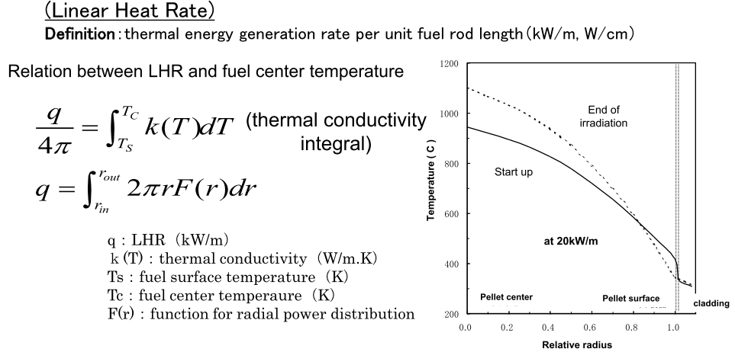

Slide 17
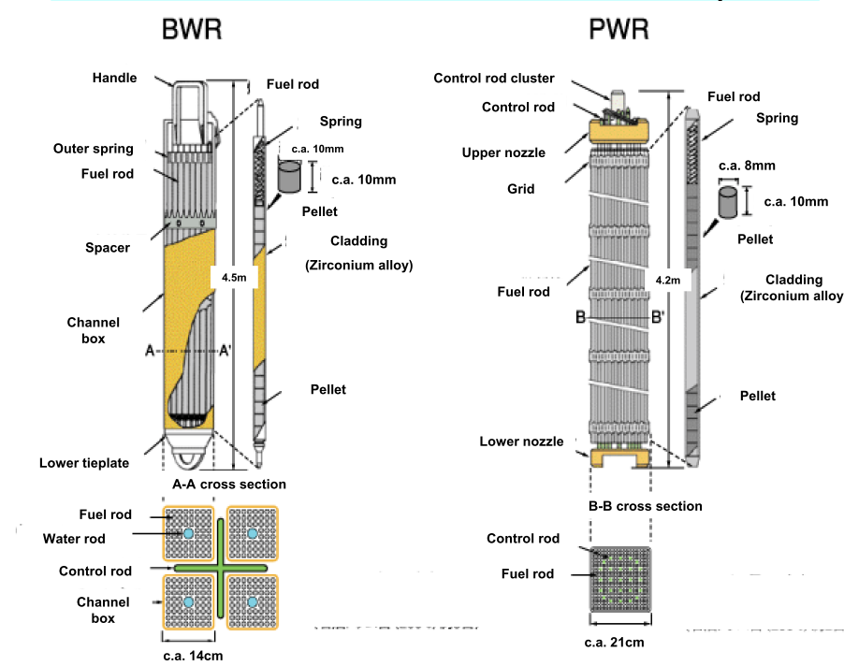
Structure of fuel assembly
Notes:
Pellets meeting QA specifications are loaded into tubes made from an appropriate zirconium alloy, referred to as the ‘cladding’. The filled tube is flushed with helium and pressurized with tens of atmospheres (several MPa) of this gas before the ends are sealed at each end by precision welding. A free space is left between the top of the pellet stack and the welded end-plugs – this is called the ‘plenum’ space and it accommodates thermal expansion of the pellets and some fission product gases. A spring is usually put into the plenum to apply a compressive force on the pellet stack and prevent its movement.

Slide 18
Fuel assembly framework
Nuclear fuel designs dictate that the pellet-filled rods have a precise physical arrangement in terms of their lattice pitch (spacing), and their relation to other features such as water (moderator) channels and control-rod channels.
Characteristics:
Resistant to chemical corrosion, high temperatures, large static loads, constant vibration, fluid and mechanical impacts.
They must also be as neutron-transparent as possible.

Slide 19
Assembly structures comprise a strong framework made from steel and zirconium upon which are fixed numerous grid support pieces that firmly hold rods in their precise lattice positions.
These are made from zirconium alloy and must permit (and even enhance) the flow of coolant water around the fuel rod.
The grid structures grip the fuel rod and so are carefully designed to minimise the risk of vibration-induced abrasion on the cladding tube – called ‘fretting’ wear.

Slide 20
In order to maximize the efficiency of the fission reaction the cladding and indeed all other structural parts of the assembly must be as transparent as possible to neutrons.
Different forms of zirconium alloy, or zircaloy, are therefore the main materials used for cladding.
This zircaloy includes small amounts of tin, niobium, iron, chromium and nickel to provide necessary strength and corrosion resistance.
Hafnium, which typically occurs naturally with zirconium deposits, needs to be removed because of its high neutron absorption cross-section.
Notes:
The exact composition of the alloy used depends on the manufacturer and is an important determiner in the quality of the fuel assembly. Zircaloy oxidizes in air and water, and therefore it has an oxidized layer which does not impair function.

Slide 21
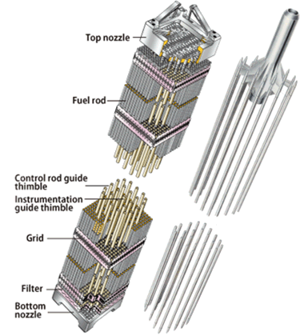
PWR Fuel Assembly
In PWR fuel assembly, thimble tubes and grids are main framework

Slide 22

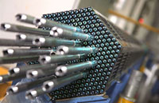
General Assembly
Fuel for western PWRs is built with a square lattice arrangement and assemblies are characterized by the number of rods they contain, typically, 17×17 in current designs
A PWR fuel assembly stands between four and five metres high, is about 20 cm across and weighs about half a tonne.
An 1100 MWe PWR core may contain 193 fuel assemblies composed of over 50,000 fuel rods and some 18 million fuel pellets. Once loaded, fuel stays in the core for several years depending on the design of the operating cycle.

Slide 23
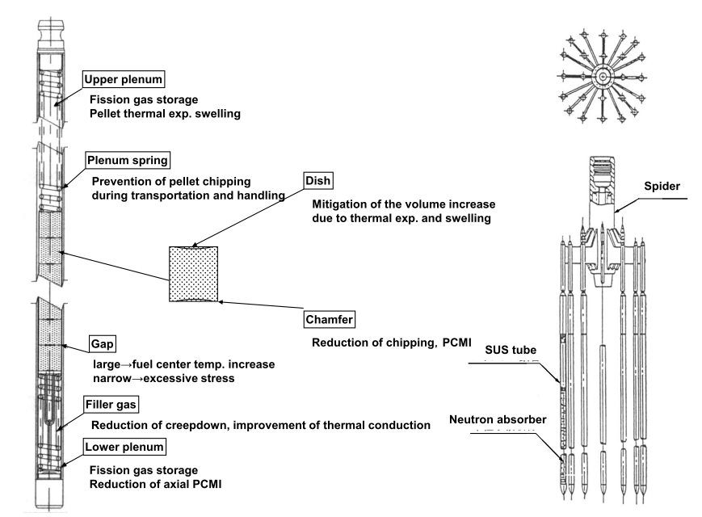
Structure of fuel rod

Slide 24
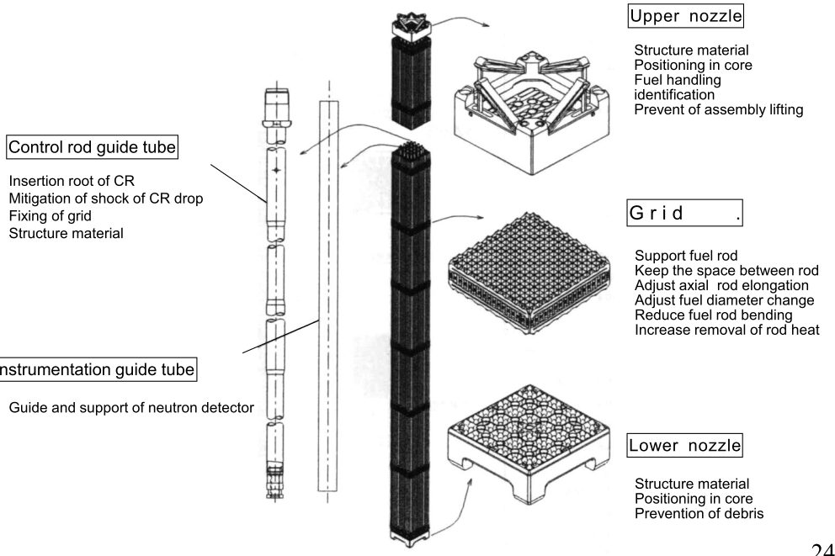
Structure of fuel assembly

Slide 25
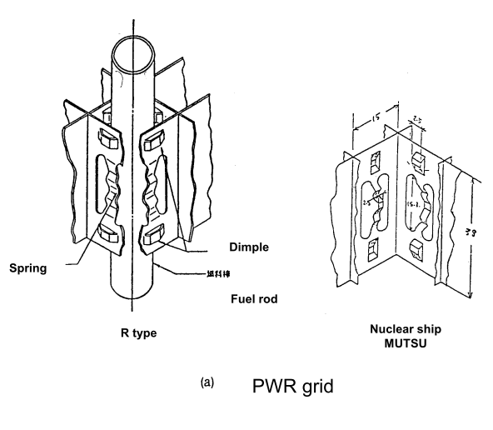
Structure of grid (spacer)
Contact to fuel rod with 3 point support.
The axial elongation/shrinkage of fuel rods are allowed

Slide 26
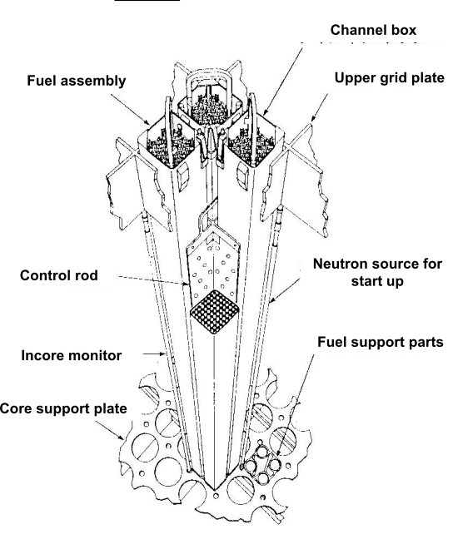
Structure of BWR core
Core consists of units which have one control rod surrounded by 4 fuel assemblies
Fuel assembly sits on core support and the top of the assembly is supported with upper lattice plate

Slide 27
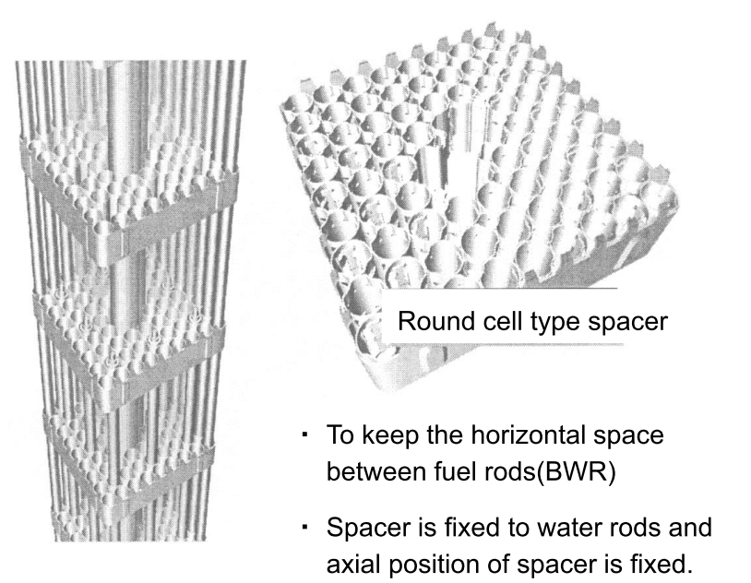
In BWR fuel assembly, water channel, fuel rods and spacer are main framework.

Slide 28
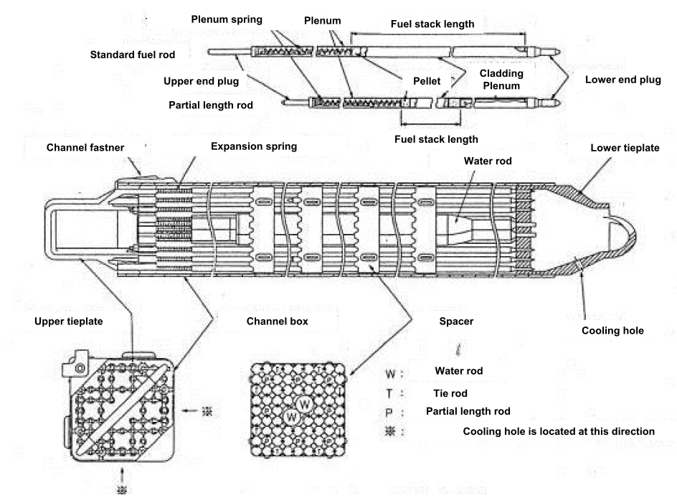
Notes:
BWR fuel assembly 9x9 A-type

Slide 29
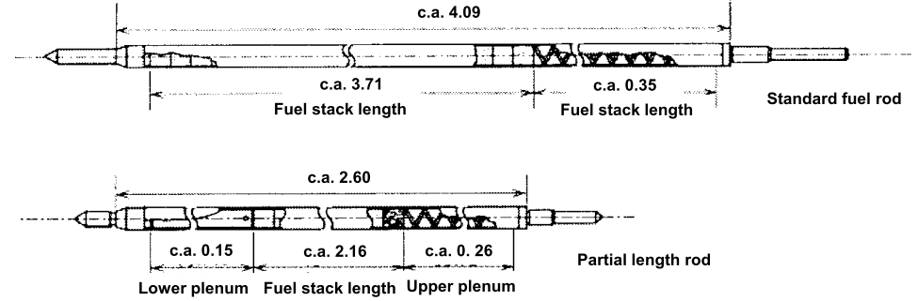
Pellets are installed in Zr liner cladding and welded with both end plugs with 10bar He filler gas.
Important design parameters: pellet density, gap size, plenum volume, cladding thickness, He pressure, etc.
Number in this figure is size for BWR/4, BWR/5 and ABWR (m)

Slide 30
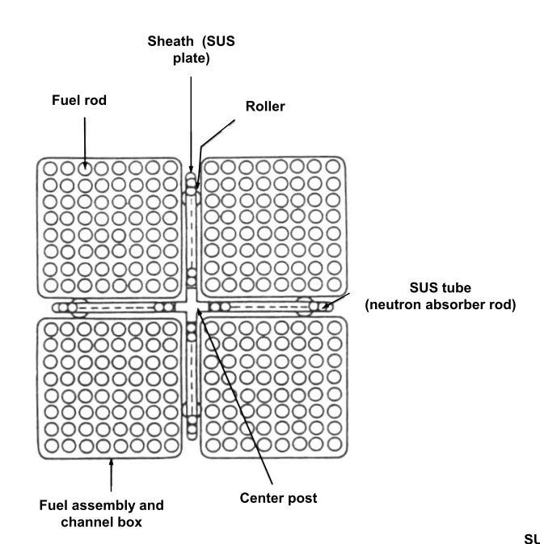
Cross section of Control Rod（BWR）

Slide 31
Characteristics of BWR Fuel Assembly
Four fuel assemblies and a cruciform shaped control blade form a 'fuel module'
each assembly is isolated from its neighbours by a water-filled zone in which the cruciform control rod blades travel (they are inserted from the bottom of the reactor)
each BWR fuel assembly is enclosed in a zircaloy sheath or channel box which directs the flow of coolant water through the assembly and during this passage it reaches boiling point
BWR assemblies contain larger diameter water channels – flexibly designed to provide appropriate neutron moderation in the assembly.
Notes:
Control rods are used when power levels are reduced below 75%, but they are not part of the fuel assembly as in a PWR.

Slide 32
Channel box (BWR)
a side about 14cm，thickness 2-3mm， length about 4m : rectangular tube made of zircaloy-4
Role of channel box
・ keep the coolant flow space for assembly
・ keep the space for CR insertion
・ protection of fuel during handling
・ Use for shipping test in reactor(leak fuel test)

Slide 33
Water rods(Water channel)
The water rods were introduced to enhance the neutron moderation in the central region of assembly and to increase the fission of the fuel.
The non-boiling coolant water flows in the water rods(or water channel) located in the center of the fuel assembly.
The diameter of water rods increased with the enrichment-increase for high burnup use of fuel, to increase the water/ fuel volume ratio within the channel.
Notes:
In BWR, coolant water in a fuel assembly surrounded by channel box is under boiling conditions, and outside of channel box is under non-boiling conditions. Therefore, peripheral rods in the fuel assembly is easier to fission due to
enough thermal neutrons than the rods in the central part far
from non-boiling region.

Slide 34
Guideline for fuel design
Fuel assembly should be designed to keep the integrity regardless the various factors which occur during the in-rector operation.
pressure difference between outside and inside of the rod
irradiation of fuel or other material
changes of pressure/temperature due to change of load
chemical effects
static/dynamic load
deformation of pellet
gas composition change in fuel rod
Fuel assembly should be designed not to deform excessively during transportation or handling.

Slide 35
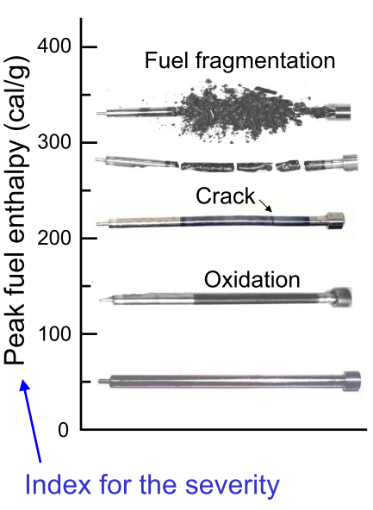
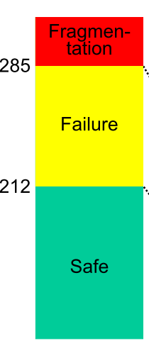

Slide 36
Mechanical design of fuel rod
Requirement
Cladding should not be failed during abnormal transient in operation (cladding should not be failed systematically with penetrated defects by mechanical load)
Conditions to prevent the fuel failure due to over strain, “average circumferential strain of cladding should be below 1%”
In the safety evaluation during the abnormal transient in operation, the evaluated maximum LHR should not exceed the LHR for margin safety.
Notes:
(Linear Heat Rate

Slide 37

Evaluation of BWR fuel rod design
BWR fuel rod is designed under the following standards based on the guideline for safety design judgment.
(1) average circumferential plastic strain of cladding should be less than 1%.
(2) the stress in the cladding should be less than acceptable stress.
(3) Accumulated fatigue coefficient should be less than 1.

Slide 38
Design criteria for PWR fuel
Fuel center temperature should be below the melting point of UO2
Pressure in the rod should not exceed the limit to open the closed gap between cladding/pellet due to the creep deformation of cladding outward, during normal operation.
The stress in the cladding should be less than yield strength of Zirconium alloy(zilcaloy-4)
The circumferential extension strain of cladding during abnormal transient should be less than 1%.
Accumulated fatigue coefficient should be less than designed life limit.
Notes:
2,865°C

Slide 39
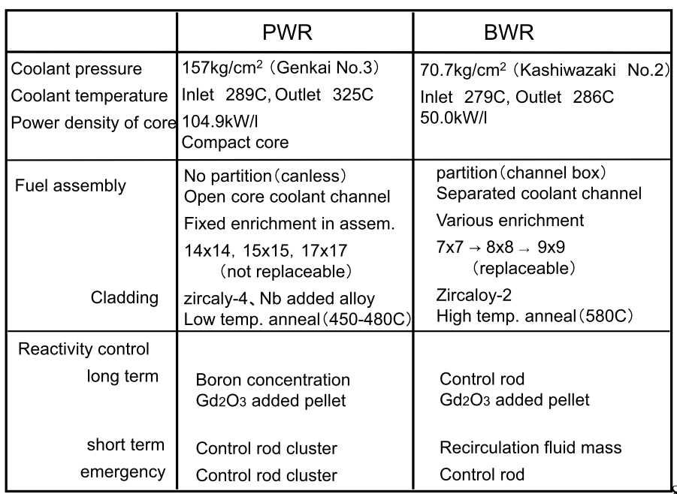
Characteristics of reactor core and fuel in PWR and BWR
Notes:
Gadolinium Burnable absorbers (or burnable 'poisons') such as gadolinium to limit reactivity early in the life increasing the nuclear fuel burnup

Slide 40
MOX Fuel
Mixed uranium oxide + plutonium oxide (MOX) fuel has been used in about 30 light-water power reactors in Europe and about ten in Japan
It consists of depleted uranium (about 0.2% U-235), large amounts of which are left over from the enrichment of uranium, and plutonium oxide that derives from the chemical processing of used nuclear fuel (at a reprocessing plant).
This plutonium is reactor-grade, comprising about one third non-fissile isotopes.
Notes:
(5%) and mostly PWR
MOX fuel is manufactured from plutonium recovered from used reactor fuel
Both plutonium-239 and plutonium-241 are fissile, meaning that they can sustain a nuclear chain reaction
Pu-239 is produced artificially in nuclear reactors when a neutron is absorbed by U-238, forming U-239, which then decays in a rapid two-step process into Pu-239. It can then be separated from the uranium in a nuclear reprocessing plant.

Slide 41
Advantages of MOX
The use of up to 50% of MOX does not change the operating characteristics of a reactor, though the plant must be designed or adapted slightly to take it.
A significant advantage of MOX is that the fissile concentration of the fuel can be increased easily by adding a bit more plutonium
MOX use also becomes more attractive as the need to reduce the volume of spent fuel increases.
Seven UO2 fuel assemblies give rise to one MOX resulting in only about 35% of the volume, mass and cost of disposal.
Notes:
More control rods are needed
whereas enriching uranium to higher levels of U-235 is relatively expensive

Slide 42
Handling of Pu
Plutonium from reprocessed fuel is usually fabricated into MOX as soon as possible to avoid problems with the decay of short-lived plutonium isotopes.
  In particular, Pu-241 (half-life 14 years) decays to Am-241 which is a strong gamma emitter, giving rise to a potential occupational health hazard if separated plutonium over five years old is used in a normal MOX plant.
  The Am-241 level in stored plutonium increases about 0.5% per year, with corresponding decrease in fissile value of the plutonium.
Notes:
Recovered uranium from a reprocessing plant may be re-enriched on its own for use as fresh fuel. Because it contains some neutron-absorbing U-234 and U-236, reprocessed uranium must be enriched significantly (e.g. one-tenth) more than is required for natural uranium. Thus reprocessed uranium from low-burn-up fuel is more likely to be suitable for re-enrichment, while that from high burn-up fuel is best used for blending or MOX fabrication.

Slide 43
Pu-238 (half-life 88 years), a strong alpha emitter and a source of spontaneous neutrons, is increased in high-burnup fuel. Pu-239, Pu-240 and Pu-242 are long-lived and hence little changed with prolonged storage.
Pu-239, a fissile isotope that is the second most used nuclear fuel in nuclear reactors after U-235, and the most used fuel in the fission portion of nuclear weapons, is produced from U-238 by neutron capture followed by two beta decays.
To late 2014, Areva had reprocessed more than 13,000 tonnes of used fuel and recycled 130 tonnes of plutonium into MOX. From this, it has delivered 4000 MOX fuel assemblies for its 24 reactors licensed to use it.
Notes:
Plutonium (Pu) is an artificial element, except for trace quantities of primordial 244Pu, and thus a standard atomic mass cannot be given. Like all artificial elements, it has no stable isotopes.
The most stable are Pu-244, with a half-life of 80.8 million years, Pu-242, with a half-life of 373,300 years, and Pu-239, with a half-life of 24,110 years.

Slide 44
Recycling of MOX
Used MOX fuel reprocessing has been demonstrated since 1992 in France, at the La Hague plant.
In 2004 the first reprocessing of used MOX fuel was undertaken on a larger scale with continuous process.
Ten tonnes of MOX irradiated to about 35,000 MWd/t and with Pu content of about 4% was involved.
Since 2004 an increasing amount of MOX from German and Swiss reactors has been reprocessed, totaling about 70 tonnes, with a wide range of composition.
As MOX is repeatedly recycled it is mixed with substantial proportions (70-80%) of plutonium from UOX fuel.
Notes:
At present the French policy is not to reprocess used MOX fuel, but to store it and await the advent of fuel cycle developments related to Generation IV fast neutron reactor designs. Used MOX fuel is several times more radioactive than used uranium oxide fuel, but this has little practical significance.

Slide 45
Fuel behavior of MOX (use for LWRs)
MOX for LWRs contains several % fissile Pu；
①Thermal conductivity is a little lower than that of UO2.
②Fission gas release is a little larger than that of UO2
③Creep rate is larger than that of UO2
④Melting point decreases.

Slide 46
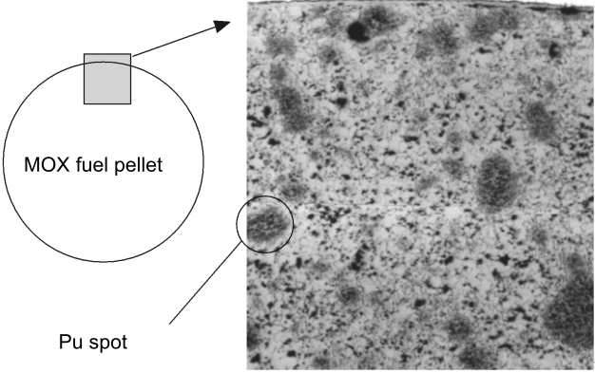

Slide 47
Emerging Fuel-Thorium
Thorium exists in nature in a single isotopic form – Th-232 – which decays very slowly.
The decay chains of natural thorium and uranium give rise to minute traces of Th-228, Th-230 and Th-234, It decays eventually to lead-208.
Compared to UO₂ , Thorium oxide (ThO₂)
relatively inert and does not oxidise further
has higher thermal conductivity and lower thermal expansion
much higher melting point
Much lower fission gas release in nuclear reaction
Notes:
Thorium is weakly radioactive: all its known isotopes are unstable, with the seven naturally occurring ones (thorium-227, 228, 229, 230, 231, 232, and 234) having half-lives between 25.52 hours and 14.05 billion years
(but the presence of these in mass terms is negligible)

Slide 48
Estimated world thorium resources
Country | Tonnes
India | 846,000
Brazil | 632,000
Australia | 595,000
USA | 595,000
Egypt | 380,000
Turkey | 374,000
Venezuela | 300,000
Canada | 172,000
Russia | 155,000
South Africa | 148,000
China | 100,000
Norway | 87,000
Greenland | 86,000
Finland | 60,000
Sweden | 50,000
Kazakhstan | 50,000
Other countries | 1,725,000
World total | 6,355,000
IAEA-NEA publication Uranium 2014: Resources, Production and Demand

Slide 49
Thorium as Nuclear Fuel
Thorium (Th-232) is not itself fissile but it is ‘fertile’ and upon absorbing a neutron will transmute to uranium-233
Th-232 is first irradiated in a reactor to provide the necessary neutron dosing to produce protactinium-233.
The Pa-233 that is produced can either be chemically separated from the parent thorium fuel and the decay product U-233 then recycled into new fuel, or
Thorium fuels therefore need a fissile material as a ‘driver’ so that a chain reaction (and thus supply of surplus neutrons) can be maintained. The only fissile driver options are U-233, U-235 or Pu-239
Notes:
and so is not directly usable in a thermal neutron reactor.
In this regard it is similar to uranium-238 (which transmutes to plutonium-239).

Slide 50
key benefits of Thorium
Thorium cycles exclusively allow thermal breeder reactors.
  More neutrons are released per neutron absorbed in the fuel in a traditional (thermal) type of reactor. This means that if the fuel is reprocessed, reactors could be fueled without mining any additional U-235 for reactivity boosts
The Th-U fuel cycle does not irradiate Uranium-238 and therefore does not produce transuranic (bigger than uranium) atoms
  like Plutonium, Americium, Curium, etc. These transuranics are the major health concern of long-term nuclear waste. Thus, Th-U waste will be less toxic on the 10,000+ year time scale.
Thorium is more abundant in Earth’s crust than Uranium
Notes:
,

Slide 51
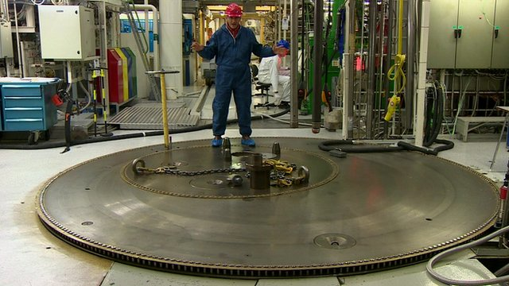
Experiments in a Norwegian underground plant could lead to the radioactive element thorium being developed as a safer alternative in the production of nuclear power.

Slide 52
Temperature effect of Fuel Behaviour
Temperature distribution in fuel rod and changes due to irradiation(burnup)
Temperature depends on gap width and LHR.
Temperature⇔deformation⇔gap pellet deformation (thermal expansion, densification, creep) cladding deformation（ridging, creep down）
Temperature⇔structure change (accumulation of fission products: thermal properties change)

Slide 53
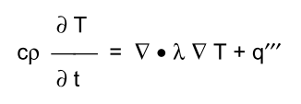
Thermal Analysis
Thermal analysis providing local temperatures and temperature gradients that are of relevance for complex thermal, mechanical, physical and chemical processes
The thermal analysis in a fuel rod is governed by the heat conduction equation:
thermal conductivity =λ, specific heat = c, density =ρ and the local power density=q′′′
Notes:
depending on design and operational parameters, material selection, loading conditions,
burnup etc.
local temperature T depends on local material properties n also time-dependent boundary conditions and heat transfer coefficients (coolant-to-fuel rod and gap conductance). No single parameter dictates the behaviour of a fuel rod for all real or postulated
conditions. Nevertheless, under steady-state normal operation the gap conductance and the thermalconductivity λ dominate.

Slide 54
Thermal conductivity of LWR fuel
Three contributions are identified: i) conduction through lattice vibrations , ii) conduction through free electrons and iii) a small contribution due to radiation.
At lower temperatures the phononic term dominates. At higher temperature the electronic contribution is more significant
Together, both contributions lead to a minimum of the total thermal conductivity λ at temperatures around 2000 K.
Beside the dependence on the temperature, the thermal conductivity of UO2 depends on the porosity P, the oxygen-to-metal ratio O/M (stoichiometry) and the burnup (rim zone)
Notes:
At low temp-thermal resistance due to scattering by residual impurities and to scattering from lattice dislocations and grain boundaries (lattice imperfections)

Slide 55
a. The effect of porosity
Porosity in a ceramic material decreases the thermal conductivity. Geometry (morphology, size, shape, orientation) and physical properties (emissivity of the solid, properties of the gas trapped inside the pores) are of importance.
b. The effect of stoichiometry
Hypo- and hyperstoichiometric fuel has a lower thermal conductivity than stoichiometric fuel since introducing point defects (vacancies or interstitials) increases phonon scattering.
Notes:
Porosity-Simultaneously, depending on irradiation conditions, new classes of porosity evolve,mainly at grain boundaries but also in the interior of the grains. In addition, macroscopic and microscopic cracking of the fuel takes place, which provides further internal volumes.

Slide 56
c. The degradation effect of burnup
the burnup effect consists of two contributions: a general degradation in the thermal conductivity of the fuel and the development of the “rim zone” which may act as a thermal barrier.

Slide 57
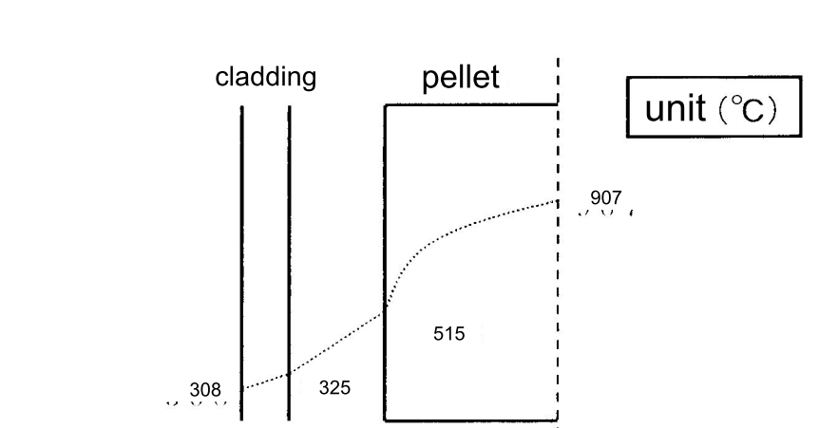
Radial temperature distribution
The fuel center temperature during normal operation is around 1000 C in LWRs.

Slide 58
Heat transfer coefficient
The heat transfer coefficient between fuel and cladding (gap conductance) is one of the important contributors defining the temperature of the fuel.
Gap conductance models depend on temperature, gas composition, gas and contact pressure on surface morphology (roughness, waviness)
Two situations must be taken into considerations:
Low burnup
High burnup

Slide 59
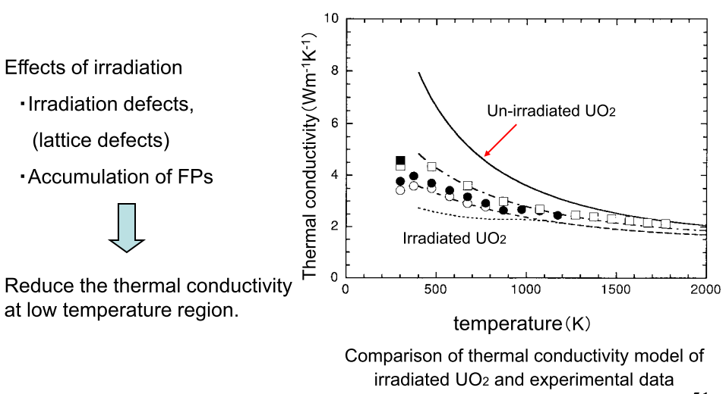
Irradiation effects on thermal conductivity

Slide 60
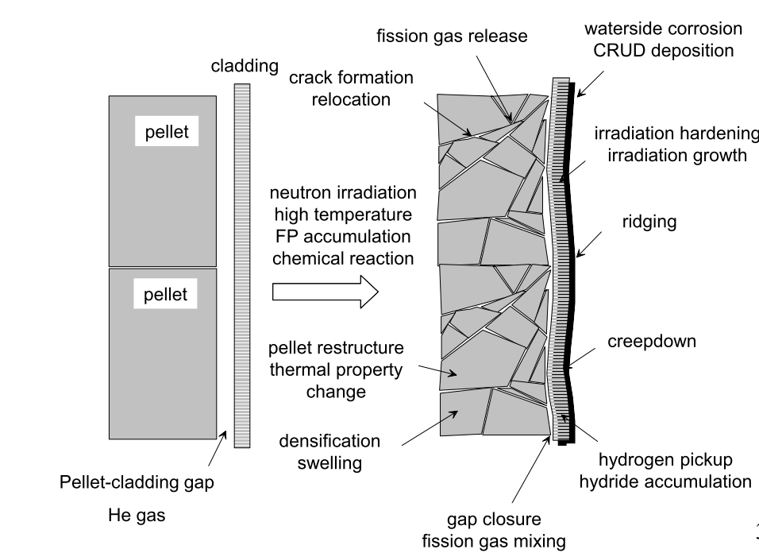
Fuel on power conditions

Slide 61
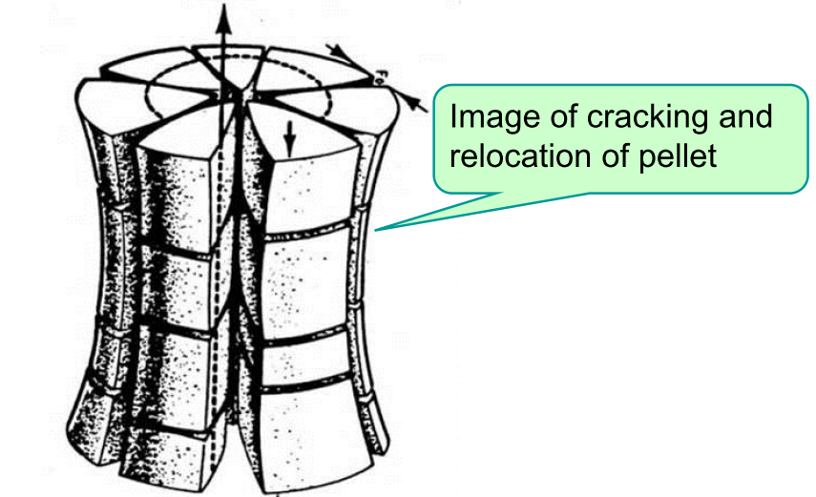
Cracking, thermal expansion and relocation of pellet

Slide 62
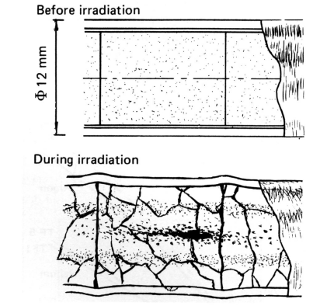
PCMI : Pellet-Clad Mechanical Interaction

Slide 63
Densification/Swelling
Densification
Pores from manufacturing shrink/disappear due to the fission fragments passage, and the density of UO2 pellet increases.
Mainly occurs, at low temperature less than 1000 C and low burnup less than 10GWd/t.

Slide 64
Swelling
Density of UO2 decreases due to FPs(Fission Products) accumulation
Solid FP swelling
・ Precipitation or solution of solid FPs in UO2 matrix
・ Independent of irradiation conditions(temperature)
FP gas bubble swelling
・ Gas bubbles grow in grain or grain boundary
・ Strongly depends on irradiation conditions(temperature,rod power)

Slide 65
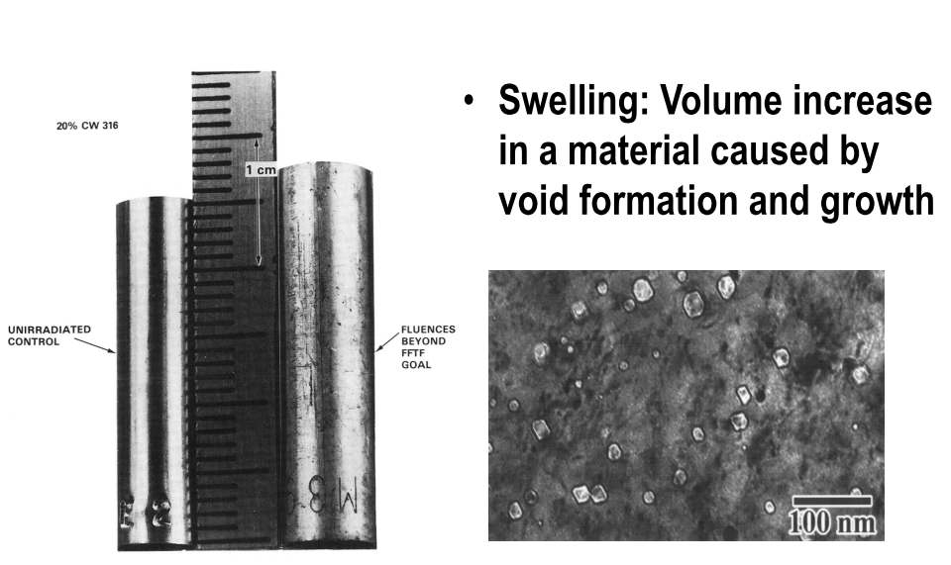

Slide 66
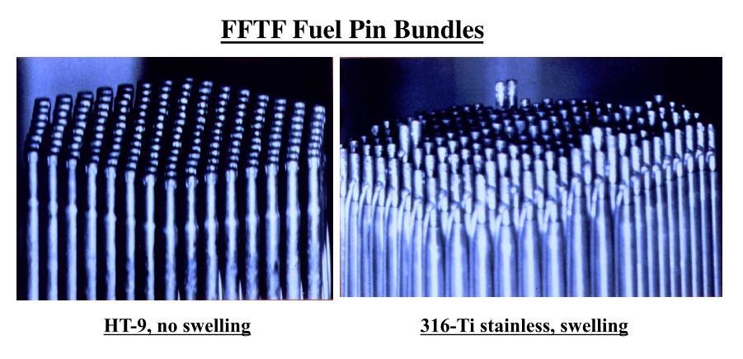
Notes:
The Fast Flux Test Facility is a 400 MW thermal, liquid sodium cooled, nuclear test reactor owned by the U.S. Department of Energy

Slide 67
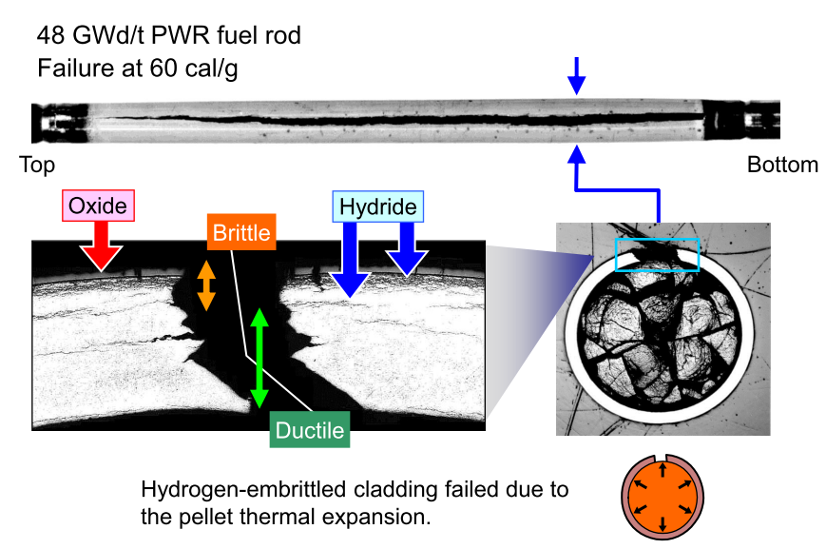

Slide 68
Accumulative effects of fission and structure change of pellet
①change of radial power density distribution in pellet
  accumulation of FPs（solid atoms, gas atoms） and irradiation defect
②formation of fission gas bubbles and fission gas release
③swelling
④degradation of thermal conductivity of pellet
⑤formation of rim structure
⑥change of O/M ratio
  consumption of oxygen due to inner surface oxidation of zircaloy cladding

Slide 69
Restructuring of pellet
Cracking and relocation of pellet
Cracking during power up (from outer to inner)
Cracking during power down(from inner to outer, stop at circumferential cracks)
Phenomenon of gap width reduction due to radial movement of pellet fragments(relocation)

Slide 70
Fission gas release (FGR)
Splitting of the fissile nucleus into two fragments in the doublet distribution of mass numbers occur in the regions 90 - 100 and 140, thus giving high yield to the rare gas species krypton and xenon and the volatile species iodine and caesium.
Consequence:
clad integrity is challenged
Krypton and xenon have lower thermal conductivities than helium, the release of these gases also causes worsening in the pellet-clad gap conductance and increased fuel temperatures.
Notes:
through increased internal pressure and also Stress Corrosion Cracking (SCC)

Slide 71
FGR Mechanisms
Production of gases(Xe,Kr) by fission
Nucleation of gas bubbles in matrix
Growth of gas bubbles by atomic migration of fission gas atoms to existing bubbles.
Re-solution of the gas atom within the bubble.
Migration of the bubbles, either as a randum-walk process in the absence of directed forces acting on the bubble or as biased motion when such forces are present.
Coalescence of bubbles moving either in a random or directional fashion.
Interaction of bubbles with the crystal defects(dislocation and grain boundaries).
Release of fission gases, either to external surface or internal surface such as grain boundaries. When the bubbles on grain boundaries become sufficiently large and numerous, they can link up and release gas to one of the external surface.
Release of fission gas by direct flight of energetic fission fragments out of an external surface.(small and significant only at low temperature.)
Notes:
main mechanism for fission gas release (FGR) is considered as “athermal”. It is indeed weakly
temperature dependent.

Slide 72
FGR at higher Burnup
In the centre of the pellet some diffusion can occur and fission gases diffuse from the bulk of the grains to the grain boundaries. When the temperature is high enough, bubbles will nucleate, grow and interlink for the gas to escape.
At intermediate temperature (700-800 °C), thermal activation is too low to allow bubble nucleation and the limited amount of fission gas, that diffused to grain boundaries, is trapped by the grain boundaries and remains as segregated atoms.
This segregation embrittles the grain boundaries and enhances intergranular fracture induced by any thermal stress.
Notes:
Thus, after a long steady-state operation, the grain boundaries are charged in fission gas, and any change in power leads to cracking of the fuel and release of the segregated fission gas. The higher the burnup, the more efficient the process.

Slide 73
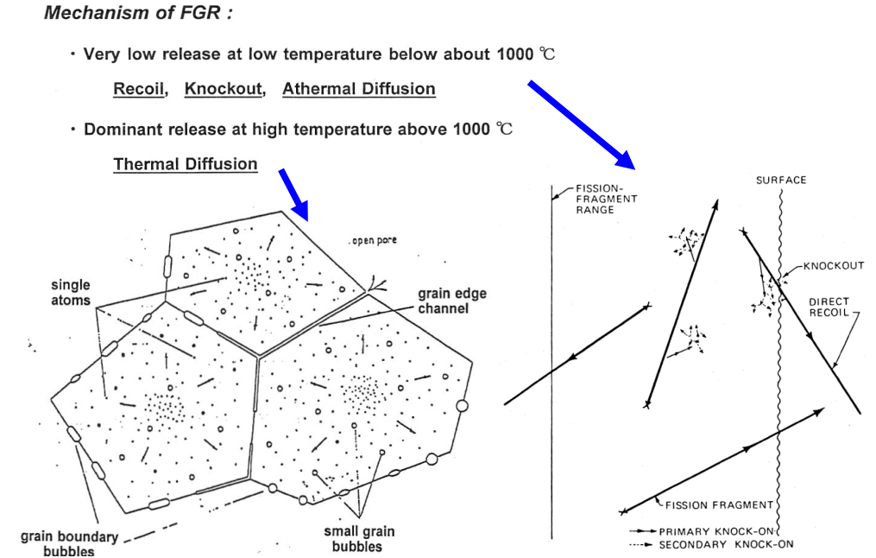

Slide 74
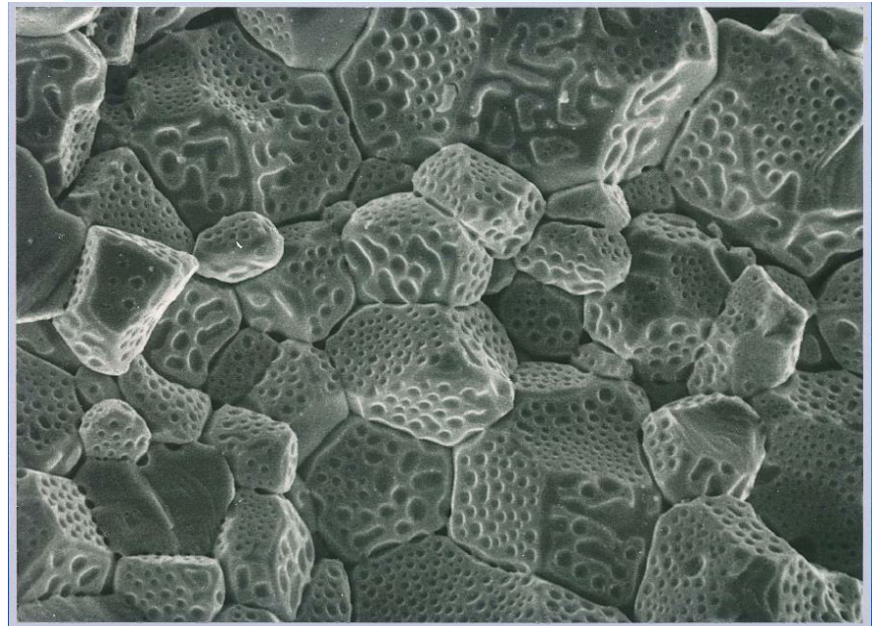
Fission gas bubbles on grain boundary

Slide 75
Fission Product Swelling
At the start of irradiation, there is a contraction in volume as pores remaining from the sintering process continue to shrink.
This is most pronounced in low density fuel, especially if the porosity is small, typically less than one micron diameter.
This process quickly saturates and is followed by a monotonic increase in volume as more and more fission products take the place of the fissionable uranium.
This swelling has several identifiable components: 1. solid fission products, 2. fission gas as individual atoms, 3. fission gas precipitated into intragranular bubbles, 4. fission gas in intergranular bubbles ( situated on grain boundaries).
Notes:
they cause a volume change which is
dependent only on burnup. Swelling caused by the formation of fission gas bubbles (points 3 and 4)
only occurs at temperatures sufficiently high to permit atomic migration.

Slide 76
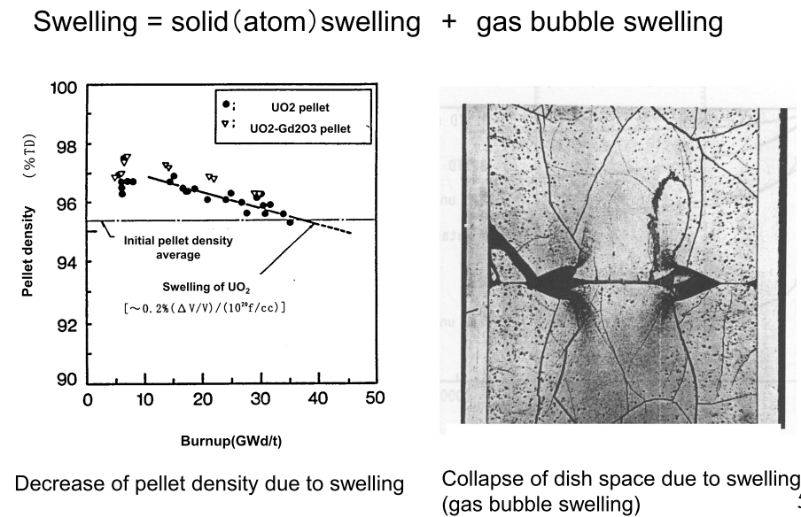

Slide 77
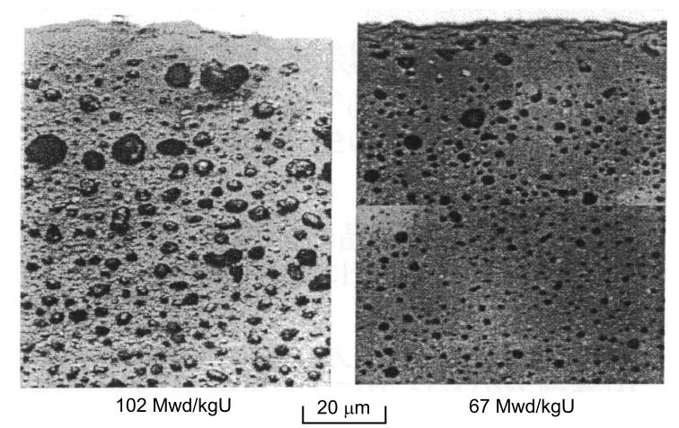
Rim structure
Formed at pellet rim at high burnup. Appears at local burnup above 70GWd/t.
Porous structure in which large gas bubbles of several μm size are surrounded by subdivided small grains(about 0.1μm ).

Slide 78
Rim structure appears at outer periphery(rim) of pellet where local burnup is very high.
  Production of 239 Pu due to resonance neutron absorption of 238 U at rim and burning of 239 Pu
  Formation of rim structure(proposed model)
  Subdivision of grain(polygonization) by irradiation defects, and accumulation of gas bubble
  Subdivision of grain and recrystalization by irradiation defects, sweep of gas bubble and accumulation of gas bubble
  Recrystalization due to high pressure in the gas bubbles.

Slide 79
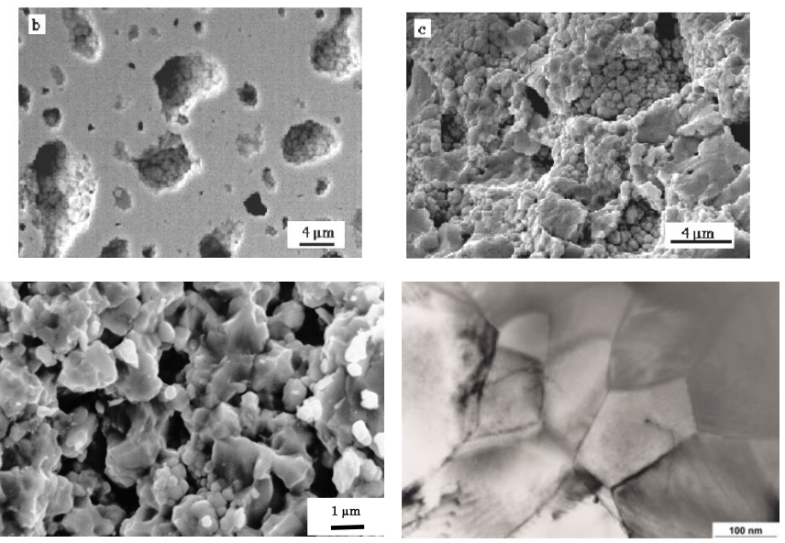

Slide 80
Stress Corrosion Cracking
This type of failure was generic to zirconium alloy clad fuel that was subjected to significant power increases.
It is grouped with other types of pellet-clad-interaction (PCI) failure mechanisms observed to occur in zirconium alloy fuel cladding
it was evident that the concurrence of four factors was necessary for the failure to take place: sufficient stress, sufficient time, a susceptible material and the presence of the right chemical environment.
Notes:
it was regarded as a form of chemical attack by fission products. identified iodine as the most probable active species for stress corrosion cracking (SCC).

Slide 81
a. Sufficient stress
With increasing power, the pellet thermal expansion leads to an increase in the pellet diameter, i.e. a departure from the initial cylindrical shape, and cracking of the pellet periphery.
Also, during normal fuel handling, small UO2 chips can relocate to the space between the pellet surface and the clad.
All these processes, independently or in combination, can increase the stress in the cladding.
In addition, the geometry of the cladding (wall thickness-to-diameter ratio), its creep rate under reactor operating conditions, and the presence of flaws on the internal clad surface all contribute to produce the resultant stress field.
Notes:
creep (sometimes called cold flow) is the tendency of a solid material to move slowly or deform permanently under the influence of mechanical stresses. It can occur as a result of long-term exposure to high levels of stress that are still below the yield strength of the material. Creep is more severe in materials that are subjected to heat for long periods, and generally increases as they near their melting point.
A yield strength or yield point of a material is defined in engineering and materials science as the stress at which a material begins to deform plastically.

Slide 82
b. Sufficient time
The time to failure was divided into two periods: an incubation time and a propagation time.
The incubation time was the period required for the formation of incipient cracks.
The propagation time was the time required for these cracks to grow through the clad wall thickness.
Notes:
The majority of the time to failure is the incubation time, during which
no apparent damage to the cladding is observed to occur.

Slide 83
c. Susceptible material
After a critical irradiation dose, the positive effects of the clad metallurgical properties disappear and all materials become about equally susceptible to cracking.
Two types of protective layers have been extensively studied and implemented in fuel fabrication;
a lubricant and chemical barrier (graphite) that is applied as an internal coating after tubing fabrication
a metallic barrier (zirconium) that is applied in the form of an internal thin layer as part of the tube fabrication process for BWR fuel.
Notes:
For HWR=candu

Slide 84
d. Chemical environment
iodine was first targeted as the chemically-active species due to its high yield, volatility and known properties of the halogens in causing SCC
Cs and/or Cd were both capable of cracking zirconium alloys, with a mixture of these species being more potent than either one by itself.
The presence of other species can act as either inhibitors or promoters.
Graphite can act as a strong inhibitor. The replacement of graphite by siloxane as a chemical coating has proved to be even more effective. Oxygen has also been proved to be an effective inhibitor that may restore the protective oxide layers on most of the regions that are sensitive to the chemical attack.
The presence of iron and organic iodides significantly increase the frequencies of crack initiation and shorten times to failure, thereby classifying them as promoters

Slide 85
Characteristics of fuel cladding
 High corrosion resistance at outer surface
 Adaptability for pellet deformation(swelling, thermal expansion)
 SCC resistance of inner surface
 Small thermal neutron absorption cross section
 Mechanical strength as structural material
 High film coefficient of heat transfer from pellet to coolant
 Integrity and easy machining as parts

Slide 86
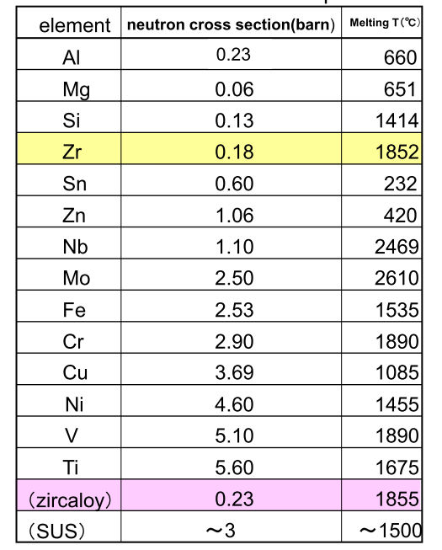
low thermal neutron cross section and high melting point are important
In FBR, mechanical strength at high temperature is important and thermal neutron cross section is not so important.

Slide 87
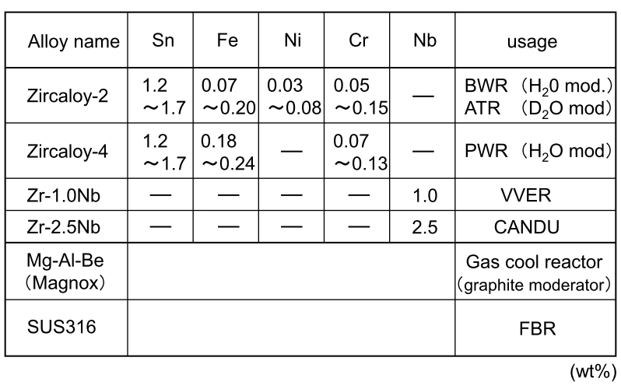
Composition of various zirconium alloy

Slide 88
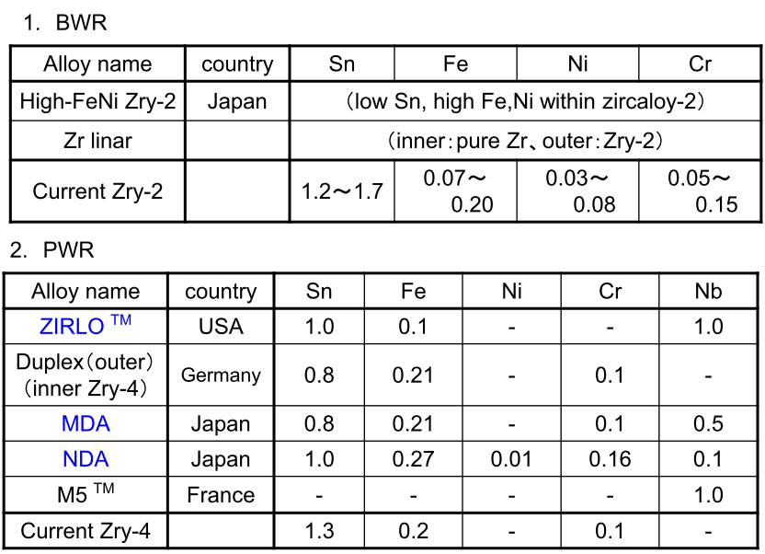
New zirconium alloy
Notes:
for high burnup use

Slide 89
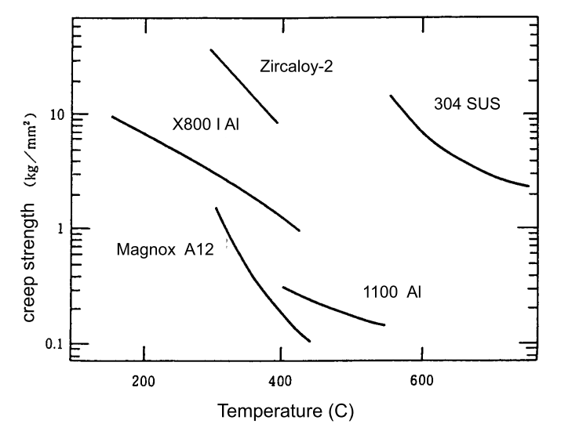
Creep strength of cladding materials
Notes:
creep (sometimes called cold flow) is the tendency of a solid material to move slowly or deform permanently under the influence of mechanical stresses. It can occur as a result of long-term exposure to high levels of stress that are still below the yield strength of the material. Creep is more severe in materials that are subjected to heat for long periods, and generally increases as they near their melting point.

Slide 90
Hydrogen distribution in the cladding
The hydrogen generated in the cooling water diffuses through the zirconium oxide layer into the Zircaloy.
The build-up of a hydrogen concentration at the outer surface causes a hydrogen flow to the inner side of the cladding.
The result is a gradient in the hydride concentration across the clad wall.
The hydride structure depends on the temperature history, especially during cooling down (shutdown of the reactor).

Slide 91
At room temperature hydrogen in Zircaloy cladding is mainly present as radial and/or circumferential zirconium hydrides throughout the cladding thickness.
At operational temperatures between 300°C and 400°C and at hydrogen concentrations higher than the solubility limit, zirconium hydrides will be formed predominantly at the outer interface Zircaloy-ZrO2
The effect of the amount of hydrogen on the mechanical properties of the cladding depends largely on the size and orientation of the zirconium hydrides platelets formed and on the presence of stresses in the cladding

Slide 92
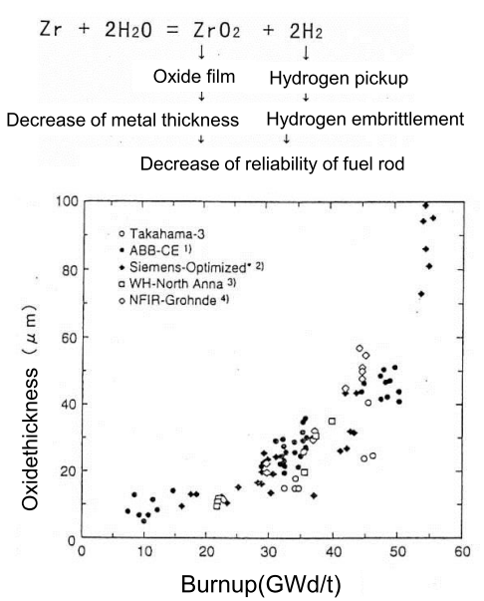
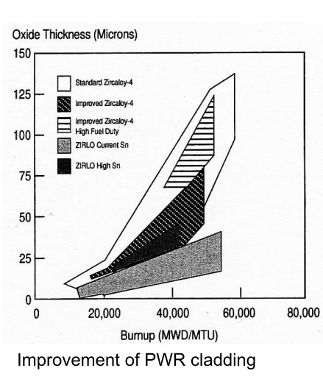
Water side corrosion of cladding and accumulation of hydride

Slide 93
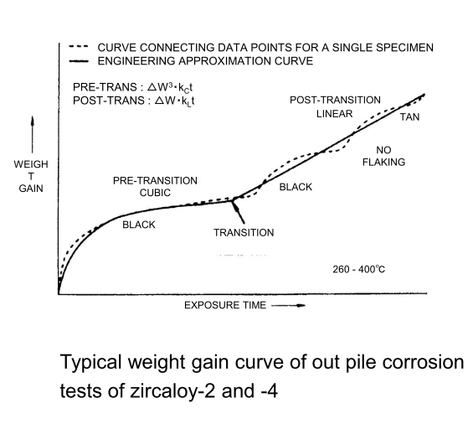
Weight gain curve of cladding oxidation
Fine oxide film formed at interface of oxide and metal, works as protective film.
Repeated formation and destruction of protective film result in linear weight gain.
The destruction of protective oxide film is caused by the compressive stress in the film due to volume increase by oxidation.

Slide 94
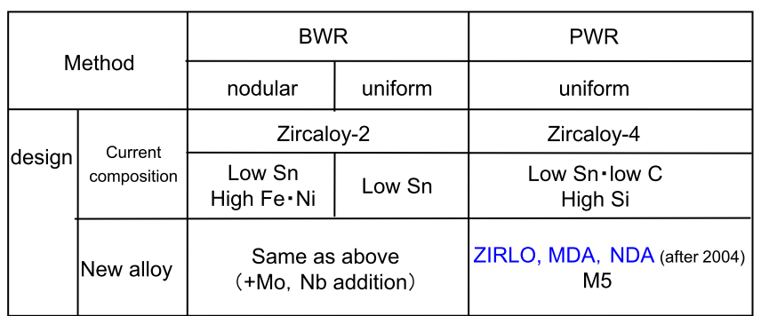
Improvement of water corrosion resistance of zirconium alloy
Notes:
Mitsubishi developed alloy

Slide 95
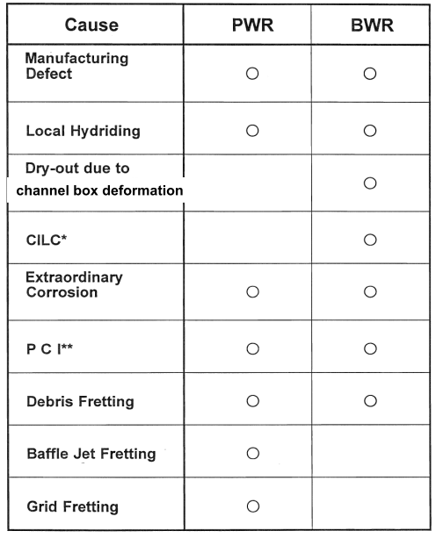
Fuel failure
Notes:
Crud induced localized corrosion

Slide 96


Slide 97

Pellet Cladding Interaction (PCI)

Slide 98

Pellet shape and ridging deformation

Slide 99

Development of high burnup fuel
To Improve of economics- reduction of fuel cycle cost, high burnup use-reduction of spent fuel
Effective use of resources： use of plutonium as MOX fuel in LWR

Slide 100
Testing and Instrumentation

Slide 101
Introduction
Requirements for enhanced reactor safety and efficiency make it necessary to perform precise in- and post-reactor experiments and, consequently, to use more up-to-date measurement equipment and analysis techniques, thus developing hot labs and research reactor facilities.
Non destructive and destructive PIE techniques used for investigation of water reactor fuel.
Recent practices in high burn up fuel investigation revealed the importance of advanced PIE techniques, such as 3-D tomography, secondary ion mass spectrometry and scanning electron microscopy.
Advanced in-pile measurement techniques for better understanding of the mechanisms of fuel behaviour under irradiation.

Slide 102


Hot Cell

Slide 103
Post Irradiation Testing
Nuclear reactor core structural material and nuclear fuels are used in a very hostile environment of high temperature, high pressure and with intense beta, gamma and neutron irradiation.
Materials in a high radiation environment can undergo unique behaviors such as swelling and non-thermal creep.
Post Irradiation Examination (PIE) is the study of used nuclear materials such as nuclear fuel.
information is gained which enables the users of fuel to assure themselves of its quality and it also assists in the development of new fuels.
After major accidents the core (or what is left of it) is normally subject to PIE in order to find out what happened.
Notes:
If there are nuclear reactions within the material (such as what happens in the fuel), the stoichiometry will also change slowly over time. These behaviors can lead to new material properties, cracking, and fission gas release
Post irradiation examination techniques lead to a better understanding of material behaviour.

Slide 104
PIE Technique
Full range of non-destructive and destructive PIE techniques including:
Visual inspection
Puncturing and fission gas analysis
Profilometry measurements
Eddy current testing
Eddy current oxide measurement.
Gamma scanning
Light optic and scanning electron microscopy
Wavelength dispersive element analysis
ICP-MS
Notes:
ICP-MS – chemical analysis of dissolved fuel specimens
Wavelength dispersive element analysis – quantitative and qualitative element analysis for fuel pellet radial burnup profile.

Slide 105
PIE Technique
Full range of non-destructive and destructive PIE techniques including:
Visual inspection – an initial inspection of the rod. Defects and damage are documented.
Puncturing and fission gas analysis – the rod is punctured and the accumulated gas is analyzed using gas mass spectrometry.
Profilometry measurements – the measurements provide a diameter profile for the rod.
Eddy current testing – detects any defects that are not visible.
Eddy current oxide measurement – measurements of the outer oxide thickness.
Gamma scanning – the activity of selected nuclides is measured as a function of the axial position.
Light optic and scanning electron microscopy – metallographic and ceramographic studies of cladding and pellets.
Wavelength dispersive element analysis – quantitative and qualitative element analysis for fuel pellet radial burnup profile.
ICP-MS – chemical analysis of dissolved fuel specimens

Slide 106
Case Study 1: 55GWd/t High Burnup Fuel of PWR in Japan
Japanese PWR utilities are planning to increase the burnup of fuel from 48 GWd/t to 55GWd/t
In order to confirm the integrity of the fuel prior to the practical use of 55 GWd/t fuel, the present PIE was conducted at the fuel hot laboratory using 55 GWd/t fuel rods which had been spent for four cycles at a PWR plant in Japan.
The average burnup of a fuel assembly was 52 GWd/t and 13 fuel rods were removed from the assembly for their transportation to a hot laboratory. The assembly was the 17 x 17 type with advanced fuel materials
Notes:
for the purposes of improving the fuel cycle economy and reducing the amount of
spent fuel.

Slide 107
That is three types of the claddings: 1. Zircaloy-4 claddings, which are currently in use, 2. MDA and 3. ZIRLO as improved corrosion-resistant claddings
three types of fuel pellets : 1. pellets currently in use, 2. large grain-size pellets aimed at reducing the released amount of FP gas and 3. pellets with added Gd2O3 at a loading of 10 wt%

Slide 108

(1) γ Scanning Measurement
The γ scanning measurement was conducted to confirm the burnup along the axial direction of the fuel rods and the migration of FP.
The observed γ ray intensity showed an almost flat pattern except at the grid section and the upper and lower ends, confirming almost even burning along the axial direction.
Measurement results of the γ ray intensity of Cs-137 along the axial direction.

Slide 109

(2) Measurement of Dimensions
Figure shows the measurement results of the fuel rod length.
The rod length changes was smaller with the improved corrosion-resistant claddings (MDA/ZIRLO) than current Zircaloy-4 claddings, presumably because of the different alloy constituents of these claddings.
Meanwhile, the fuel rods containing large grain-size pellets showed a larger rod length changes, presumably because of the influence of PCMI.

Slide 110

(3) Measurement of FP Gas Release Rate
The puncture test was conducted to check the released amount of FP gas.
While the FP gas release rate increased with increased burnup, the measurement results this time were lower than the overseas data due to its low linear heat rate/low temperature irradiation condition.
The difference in the grain-size of pellets did not significantly affect the FP gas release rate.
Comparison of fission gas release among the fuel pellet types

Slide 111


(4) Cladding Oxide Film Thickness and Hydrogen Content
The oxide film thickness on the outer surface of the cladding was measured by the eddy current method to check any positive effect of the improved corrosion-resistant claddings.
Figure shows the measurement results for the peak oxide film thickness and the corresponding data of an earlier study.
The results indicate a better corrosion-resistance performance of the improved corrosion-resistant claddings than current Zircaloy-4 claddings.

Slide 112


(5) Cladding Mechanical Properties
The tensile test by using the dog-bone shape specimen was conducted at 385°C to identify the mechanical properties.
Figures shows 0.2% yield strength and fracture elongation along with corresponding data of an earlier study.
The results indicate that this study claddings have good mechanical properties perfomance in the high burnup region.
The mechanical properties data of the improved corrosion-resistant claddings fall within the existing data range for the claddings currently in use.

Slide 113

Case Study 2-Underwater Fuel Inspection for Irradiated LWR Fuels in KAERI
Table shows the in-pool examination activities conducted in PIEF for underwater inspection of spent nuclear fuels at KAERI.

Slide 114

Visual Inspection
A radiation resistant underwater camera mounted on the XY table is used for the visual inspection of the fuel assembly.
Fuel assembly standing on rotary base plate of the visual and dimensional inspection stand is inspected as the rotary plate rotates the fuel assembly to expose all faces to a camera.
The measuring head equipped with underwater cameras and detecting sensors is raised and lowered along the fuel assembly for inspection.
Visual and Dimensional Inspection Stand in PIEF Pool of KAERI

Slide 115

Hold-down Spring Force Measurement
The spring should have enough strength to suppress the fuel assembly and should not exceed the design strength during irradiation so as not to make any deflection or damage of the fuel assembly structures due to the thermal and irradiation growth of the assembly.
The leaf spring of fuel assembly is pressed down and the load-displacement curve is obtained which reveals the spring characteristics after irradiation.
Notes:
The hold down spring is to suppress the fuel assembly against very strong and high
speed of upstream coolant flows during the reactor operation.

Slide 116

Exponential experiment
The experiment was applied to the sub-criticality estimation for LWR spent fuel and confirmed that the experiment can be used to obtain the neutron effective multiplication factor for the sub-critical system in order to validate criticality calculations.
The exponential experiment system is installed in PIEF pool at KAERI in order to determine the neutron multiplication factor for the PWR spent fuel stored in pool.

Slide 117
In-Pile Measurements
Fuel Temperature | Heat transfer (fuel thermal conductivity, gap conductance)
Rod Internal Pressure Change | Fission gas release, fuel densification & swelling
Fuel Stack Length Change | Fuel densification & swelling
Fuel Cladding Length Change | PCMI, (or when no PCMI, surface heat transfer, growth)
Fuel Rod Outer Diameter Change | PCMI, (or when no PCMI, creep & growth, corrosion)

Slide 118
Summary
Performance of materials in critical components of the nuclear reactor need to be assessed for assurance of safe continued operation of Nuclear Power Plants.
Today’s nuclear power stations have proven the fuel to be very reliable in its performance, with a negligibly small rate of failure.
Reliable predictions of fuel behaviour are important in order to achieve improved design and economics of the nuclear fuel cycle.
Feedback information generated by post irradiation examination is used by designers, fabricators, reactor operators in improving design, safety & economy of the nuclear plant systems.

