Slide 1
NUCLEAR REACTOR MATERIALS
2. Materials in pwr

Slide 2
In this Chapter
Major component and degradation mechanisms
Design and Materials of PWR Components
Corrosion-Related Issues in PWR

Slide 3
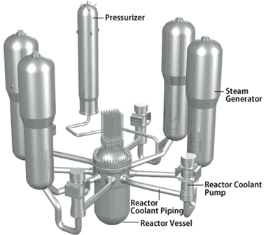
Major Components
Reactor pressure vessel
Reactor coolant piping
Steam generator
Reactor coolant pumps
Pressurizer
Control rod drive mechanism
RPV internals
Feed water piping and nozzles
Notes:
The PWR Reactor Coolant System has three (3) major functions:
•Transfer the heat from the reactor for the steam generator
•Maintain the pressure within acceptable limits
•Maintain the pressure boundary

Slide 4
Possible Material Degradation Processes
Reactor pressure vessel
Radiation embrittlement, Primary water stress corrosion cracking (PWSCC), Boric acid corrosion
Reactor coolant piping and safe ends
Low and high cycle thermal fatigue, Thermal embrittlement, High cycle mechanical fatigue
Steam generator
PWSCC, Intergranular stress corrosion cracking (IGSCC), Intergranular attack, Pipe fretting, Denting, Corrosion fatigue, High cycle fatigue, Wastage
Reactor coolant pumps
Thermal embrittlement, boric acid corrosion, high cycle mechanical and thermal fatigue

Slide 5
Pressurizer
Low cycle thermal fatigue, PWSCC
Control rod drive mechanism
Thermal embrittlement, PWSCC
RPV internals
Irradiation induced stress corrosion cracking (IASCC), High cycle mechanical fatigue, IGSCC, Stress relaxation, IG cracking
Feedwater piping and nozzles
High and low cycle thermal fatigue, Flow accelerated corrosion (FAC), SCC
Notes:
FAC-is a corrosion mechanism in which a normally protective oxide layer on a metal surface dissolves in a fast flowing water. The underlying metal corrodes to re-create the oxide, and thus the metal loss continues.

Slide 6
2. Design and Materials of PWR Components

Slide 7
Stainless Steel
300 Series—austenitic chromium-nickel alloys
  Type 301—highly ductile, for formed products. Also hardens rapidly during mechanical working. Good weldability. Better wear resistance and fatigue strength than 304.
  Type 302—same corrosion resistance as 304, with slightly higher strength due to additional carbon.
  Type 303—free machining version of 304 via addition of sulfur and phosphorus. Also referred to as "A1" in accordance with ISO 3506.
  Type 304—the most common grade; the classic 18/8 (18% chromium, 8% nickel) stainless steel. Outside of the US it is commonly known as "A2 stainless steel", in accordance with ISO 3506 (not to be confused with A2 tool steel).
  Type 304L—same as the 304 grade but lower carbon content to increase weldability. Is slightly weaker than 304.
  Type 304LN—same as 304L, but also nitrogen is added to obtain a much higher yield and tensile strength than 304L.

Slide 8
  Type 308—used as the filler metal when welding 304.
  Type 309—better temperature resistance than 304, also sometimes used as filler metal when welding dissimilar steels, along with inconel.
  Type 310 310S— is a highly alloyed austenitic stainless steel used for high temperature application. The high chromium and nickel content give the steel excellent oxidation resistance as well as high strength at high temperature. This grade is also very ductile, and has good weldability enabling its widespread usage in many applications.
  Type 316—the second most common grade (after 304); for food and surgical stainless steel uses; alloy addition of molybdenum prevents specific forms of corrosion. It is also known as marine grade stainless steel due to its increased resistance to chloride corrosion compared to type 304. 316 is often used for building nuclear reprocessing plants.
  Type 316L—is an extra low carbon grade of 316, generally used in stainless steel watches and marine applications, as well exclusively in the fabrication of reactor pressure vessels for boiling water reactors, due to its high resistance to corrosion. Also referred to as "A4" in accordance with ISO 3506.
  Type 321—similar to 304 but lower risk of weld decay due to addition of titanium. See also 347 with addition of niobium for desensitization during welding.

Slide 9
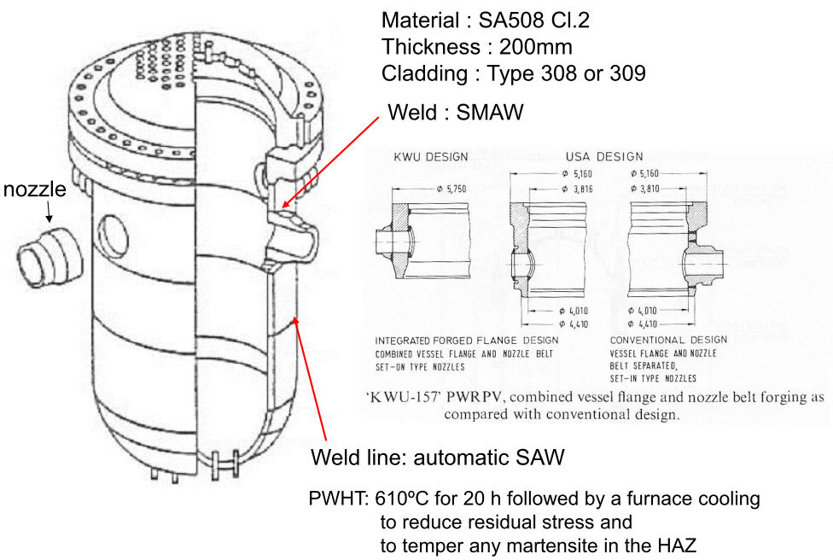
Reactor Pressure Vessel
Notes:
Shielded metal arc welding (SMAW)
Submerged arc welding (SAW)
Martensite-most commonly refers to a very hard form of steel crystalline structure, but it can also refer to any crystal structure that is formed by diffusionless transformation
Tempering is a heat treatment technique applied to ferrous alloys, such as steel or cast iron, to achieve greater toughness by decreasing the hardness of the alloy. The reduction in hardness is usually accompanied by an increase in ductility, thereby decreasing the brittleness of the metal.

Slide 10
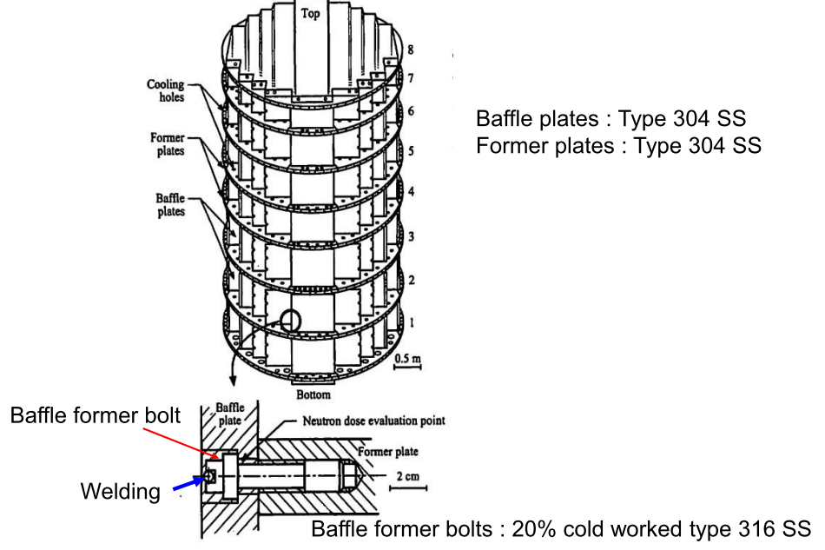
Neutron Reflector

Slide 11
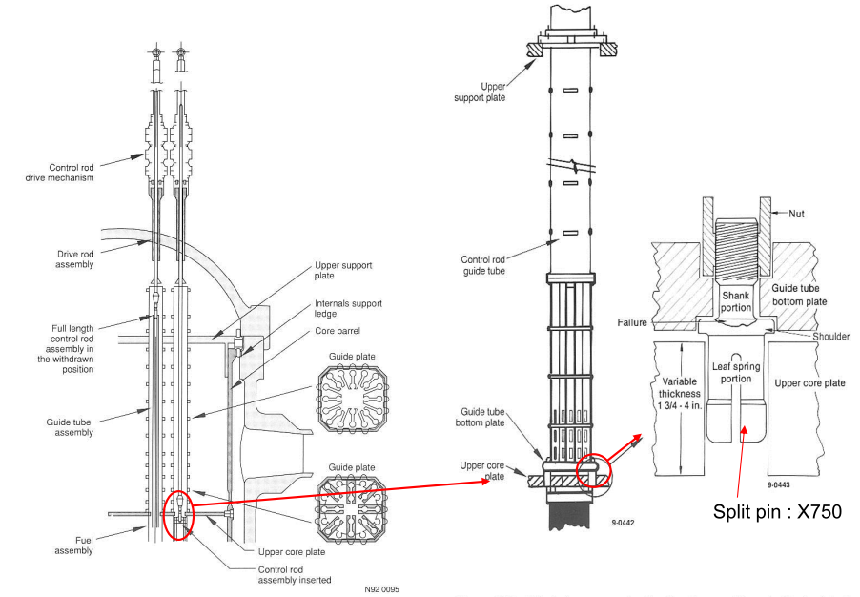
Control Rod and Guide Tube Assemblies
Notes:
X750 Inconel is a nickel chromium alloy made precipitation hardenable by additions of Al and Ti.

Slide 12
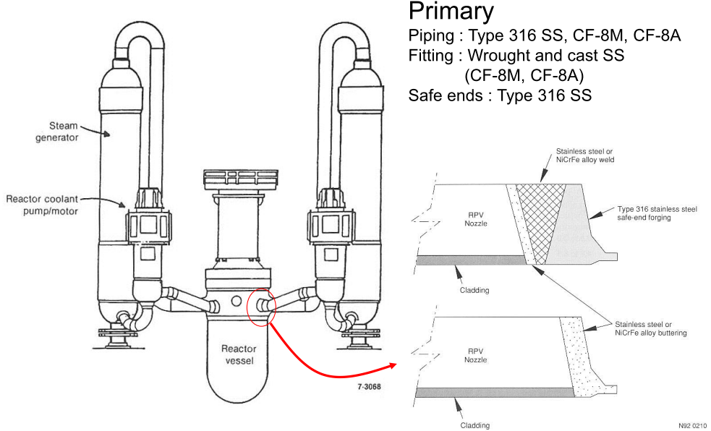
Water Coolant Piping

Slide 13
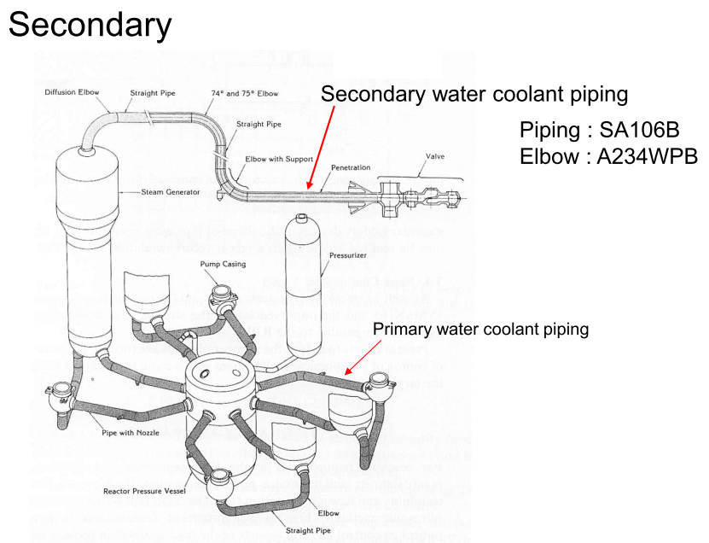

Slide 14
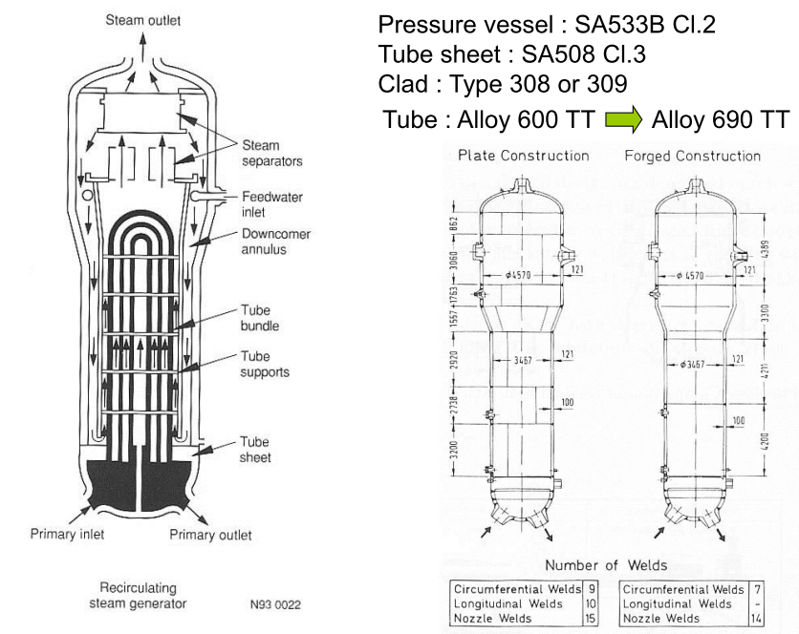
Steam Generator

Slide 15
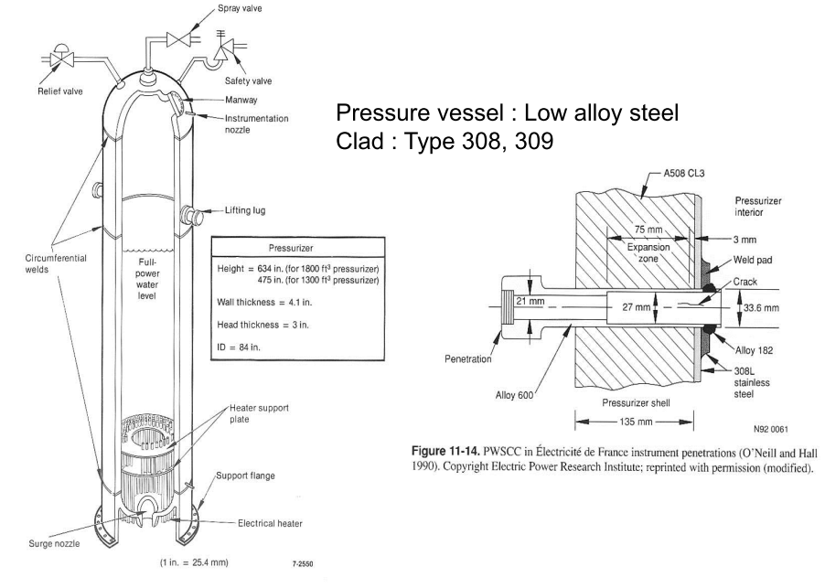
Pressurizer

Slide 16
3.Corrosion-Related Issues in PWR

Slide 17
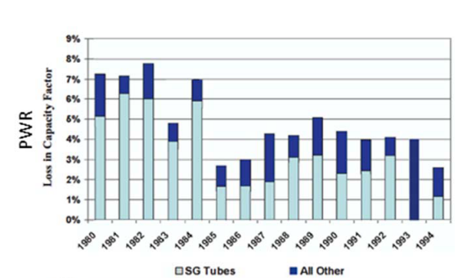
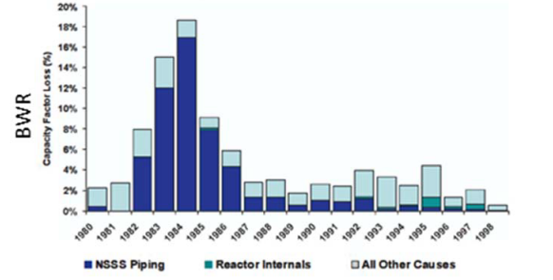
Plant capacity losses from materials degradation
The loss in capacity factor due to material degradation issues for PWRs and BWRs

Slide 18
Water Chemistry
Structural materials of PWR/BWR are exposed to the high-temperature cooling water.
In the corrosive environments, chemical interactions between the materials and water caused various kind of material degradation and consequent problems on the components.
Therefore, a quality of cooling water or water chemistry is one of the most important issue for the operation of NPPs.
Current challenge of the management of water chemistry:
Reactor lifetime
Fuel utilization
Notes:
In recent years, the management of water chemistries has been faced with new challenges that stem from two basic
requirements. The first is the extension of nuclear reactor lifetimes beyond their initial design values. The second requirement consists of efforts to achieve a higher level of fuel utilization, primarily through higher fuel burn-up, extension of fuel cycles and load changes. The third is new changes and design modifications of fuel elements,

Slide 19
Materials Integrity in the Reactor Coolant System
Austenitic stainless steels (e.g., Type 304, 316, and A-286) and nickel-base alloys (e.g., Alloys 600, 690, X-750, and 718) are major construction materials used in the reactor coolant system (RCS).
Typical applications of Alloy 600 in the RCS include steam generator tubes and plugs, pressurizer instrument nozzles, pressurizer heaters and heater sleeves, piping safe ends, and hot leg instrument nozzles.
High strength alloys X-750, 718, and A-286 are extensively used in core internals as bolts, springs, and guide pins.

Slide 20
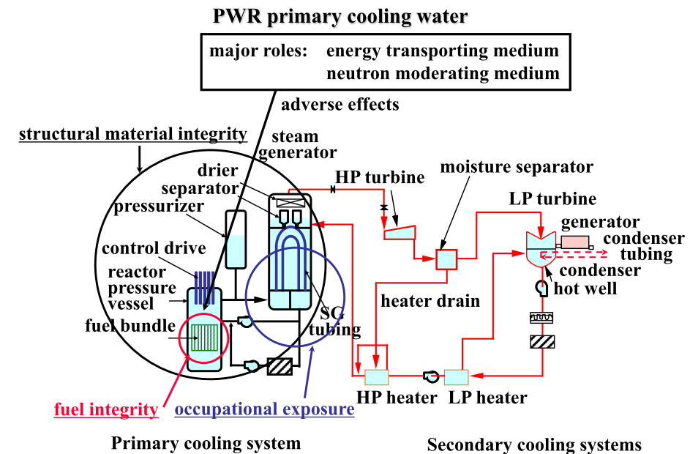
Major roles of cooling water

Slide 21
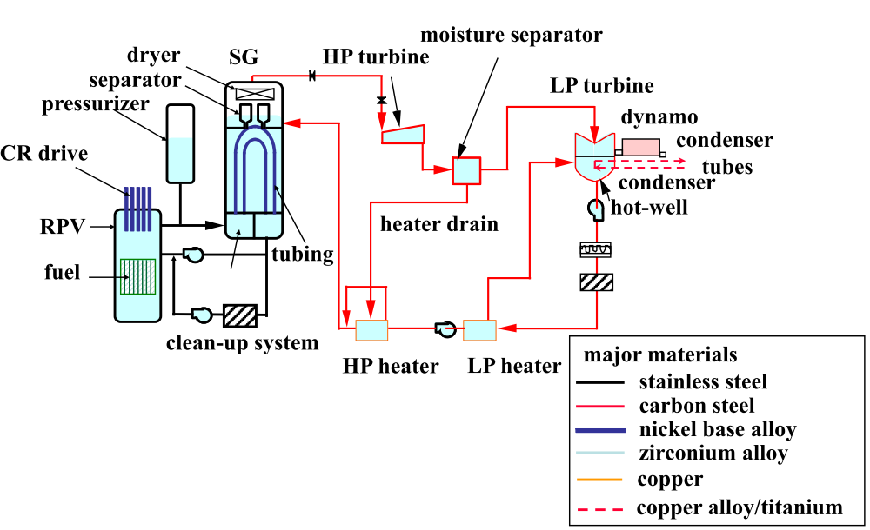
Material atlas of PWR primary and secondary cooling systems

Slide 22
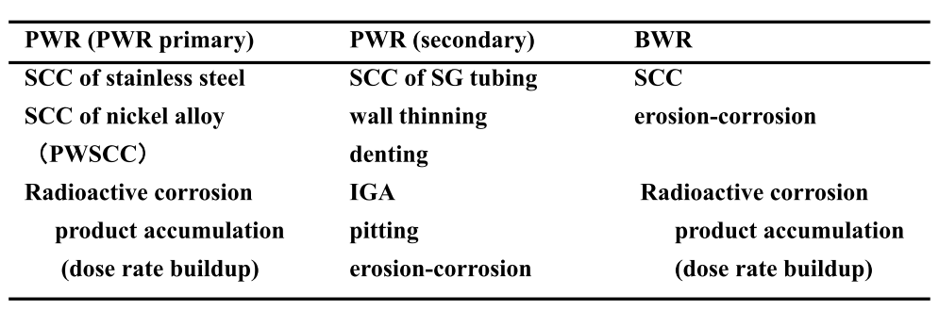
Interactions between cooling water and structural materials

Slide 23
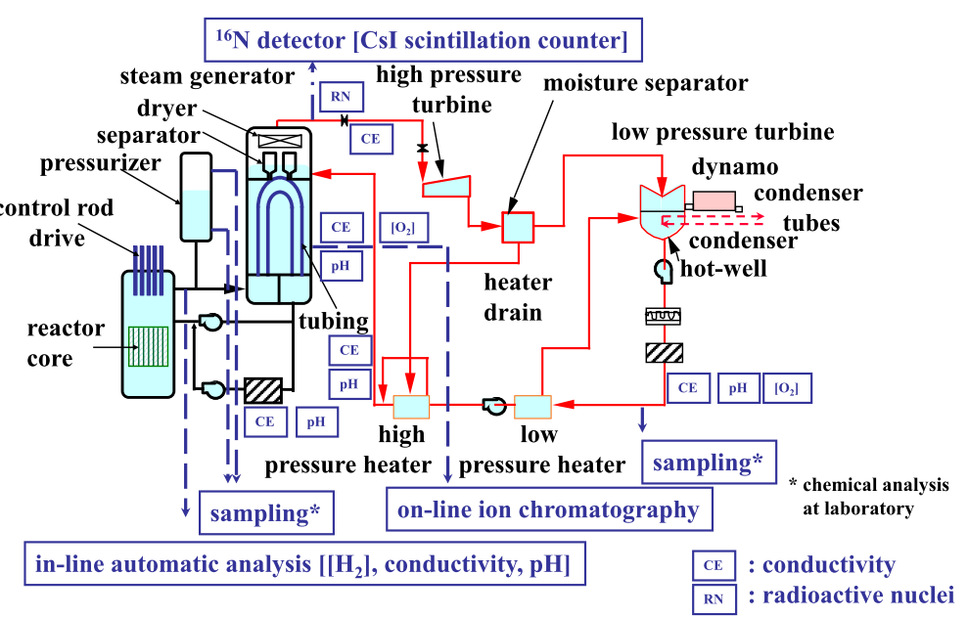
Locations for in-line monitoring and sampling in PWR

Slide 24
Water chemistry impacts both general corrosion and stress corrosion cracking (SCC) of RCS materials.
General corrosion is an oxidation process which occurs relatively uniformly over a material surface.
Some of the corrosion products released from system surfaces will form deposits on the fuel elements. Activation products of species present in such deposits (e.g., Co-58, Co-60) and their release, transport, and deposition on out-of-core surfaces lead to increased plant radiation levels
Notes:
If the environment is properly controlled, the oxide film formed will lead to a reduction in the rate of corrosion until a steady-state condition is reached between oxide film thickness (protective) and the general corrosion rate.

Slide 25
Stress corrosion cracking
SCC is the term given to crack initiation and sub-critical crack growth of susceptible alloys under the influence of tensile stress and a ‘corrosive’ environment.
SCC is a complex phenomenon driven by the synergistic interaction of mechanical, electrochemical and metallurgical factors.
The results show that PWSCC of alloy 600 components occurs when high tensile stress, a primary water environment, and a susceptible microstructure are simultaneously present.
PWSCC of the CRDM can lead to boric acid corrosion of the reactor pressure vessel (RPV) head as a result of primary water leaks and therefore can have a significant impact on the plant safety.

Slide 26
Primary Water Stress Corrosion Cracking (PWSCC)
Minimization of oxygen and halide concentrations in the RCS is necessary to prevent SCC of austenitic stainless steels
There is substantial literature describing the susceptibility of other RCS materials such as alloys 600, X-750, 718 and A-286 to this type of corrosion
Small concentrations of oxygen can significantly increase the ECP and increase alloy susceptibility. The strong influence of oxygen is illustrated by the increased susceptibility of these alloys to SCC In BWR coolant as compared to PWR coolant.
Notes:
This increased susceptibility is attributed mostly to the about 200 ppb oxygen in the BWR coolant, although differences in pH and temperature are also factors.

Slide 27
PWSCC has occurred principally in highly-stressed regions (e.g., U-bends and tubesheet expansion transitions) in steam generators with susceptible Alloy 600 tubing and in Alloy 600 tube plugs and in vessel head and pressurizer penetrations.
Current data suggest that coolant chemistry is a second-order effect in the PWSCC process.
Other factors that more directly contribute to PWSCC are high coolant temperature, high applied and residual stresses, cold work, and a susceptible alloy microstructure.
Notes:
This increased susceptibility is attributed mostly to the about 200 ppb oxygen in the BWR coolant, although differences in pH and temperature are also factors.

Slide 28
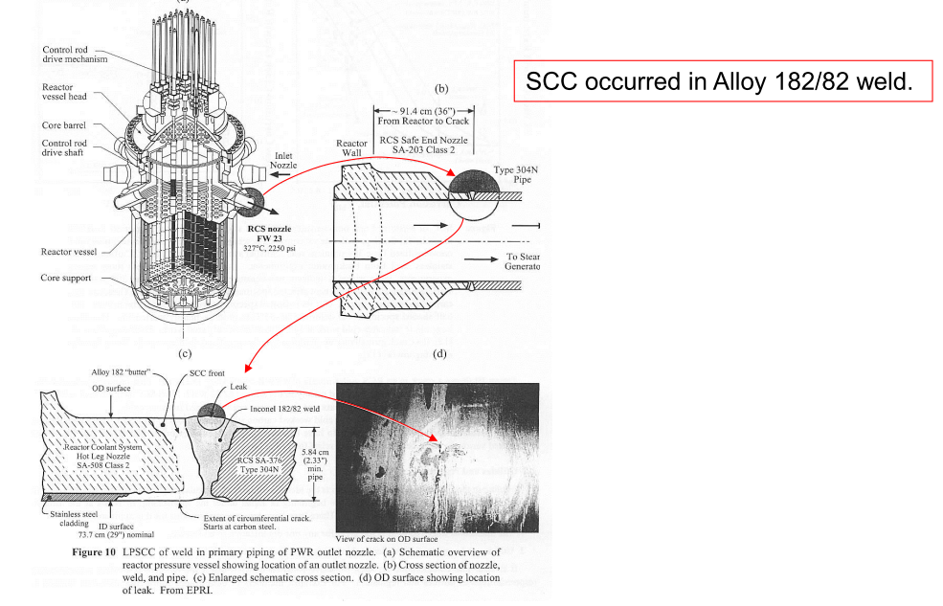

Slide 29
Dissolved Oxygen and Hydrogen
Oxidizing conditions would lead to increased formation and transport of corrosion products, higher radiation fields, crud buildup on fuel, increased corrosion of fuel rods, and increased susceptibility of some structural materials to SCC.
Minimization of coolant oxygen concentrations will lead to minimization of both SCC and general corrosion in the RCS.
Dissolved oxygen concentrations can be controlled during plant heat-up by venting or vacuum filling followed by the use of hydrazine or hydrogen for residual oxygen scavenging.
Production rates of oxidizing species by radiolysis suggest a dissolved hydrogen concentration of significantly less than 15 cc/kg is sufficient to eliminate the oxidizing species under all operating conditions.
Since oxygen can also be added to the coolant from other sources, an excess inventory of hydrogen must be maintained while the reactor is at power.

Slide 30
Lithium
Li-7 hydroxide is used in nuclear power engineering as an additive in PWR primary coolant for maintaining water chemistry.
It counteracting the corrosive effects of boric acid and minimizing corrosion in steam generators of PWRs.
Why Li-7 but not Li-6 is used?
The effect of lithium is small compared to more dominant effects of stress, heat-to-heat variations and temperature.
It only becomes a significant factor if long-term operation at elevated lithium concentrations (e.g., 3.5 ppm lithium) is considered or if relatively small increases in susceptibility to PWSCC
Notes:
lithium-6, which would interact in the reactor core to form undesirable tritium, a radioactive form of hydrogen.
molten salt reactors, which would require thousands of pounds of lithium-7 as primary coolant.

Slide 31
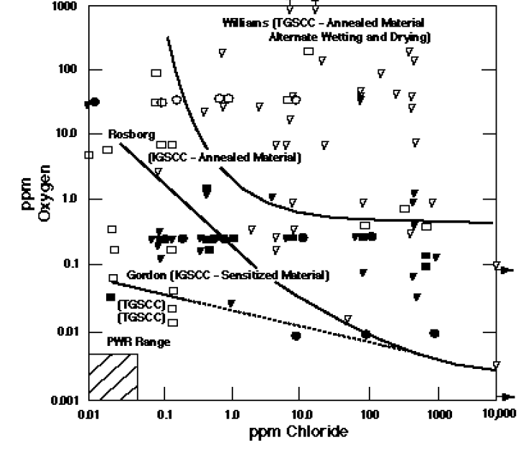
Halide
Chloride induced SCC occurs when austenitic stainless steels are exposed to chloride ions in the presence of oxygen in high-temperature water.

Slide 32
Problems related to water chemistry
• Latest experiences with problems related to water chemistry are as follows.
1) Increasing occupational exposure
Challenge to more dose reduction by water chemistry improvement
2) Flow accelerated corrosion of PWR feed water piping
Water chemistry improvement applying experience with BWR and fossil plants
Notes:
2) Stress corrosion cracking of BWR core
Mitigation of corrosive conditions by water chemistry control

Slide 33
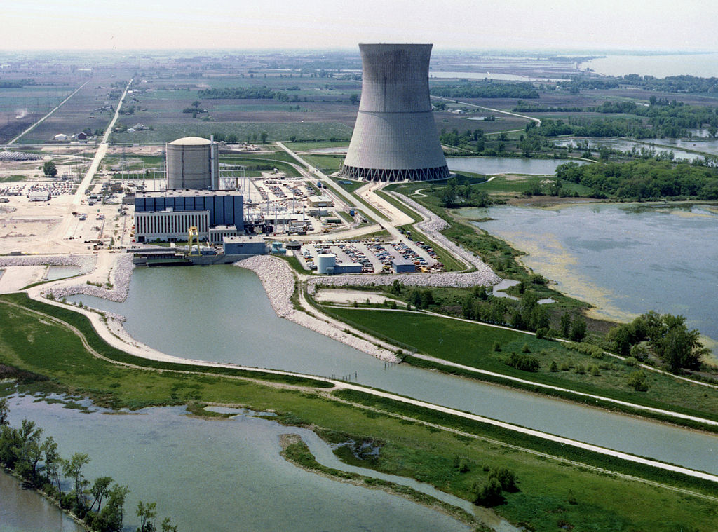
Case Study (PWSCC-BAC)
D-B Nuclear Power Station (PWR), Ohio US
Background: On March 5, 2002, maintenance workers discovered that corrosion had eaten a football-sized hole into the reactor vessel head of the D-B plant. Although the corrosion did not lead to an accident, this was considered to be a serious nuclear safety incident.

Slide 34
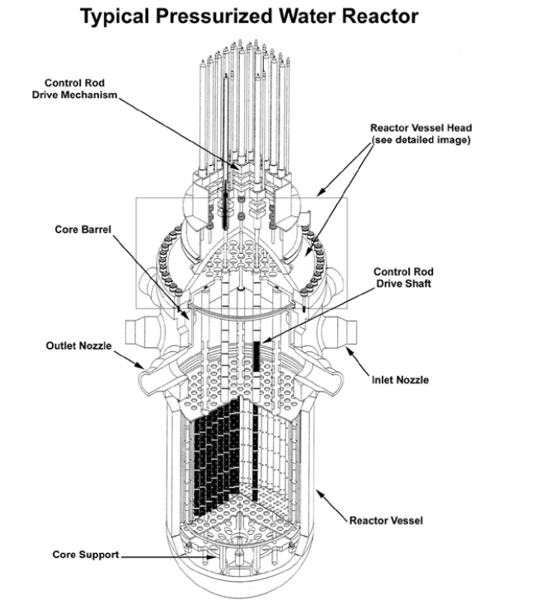
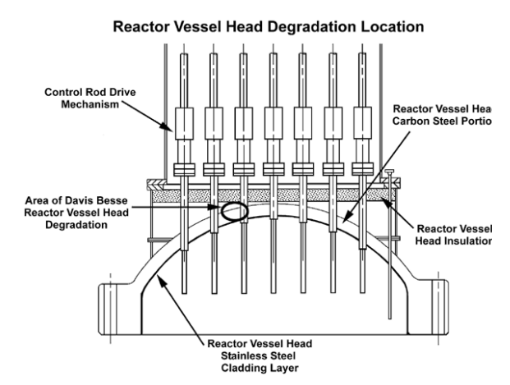

Slide 35
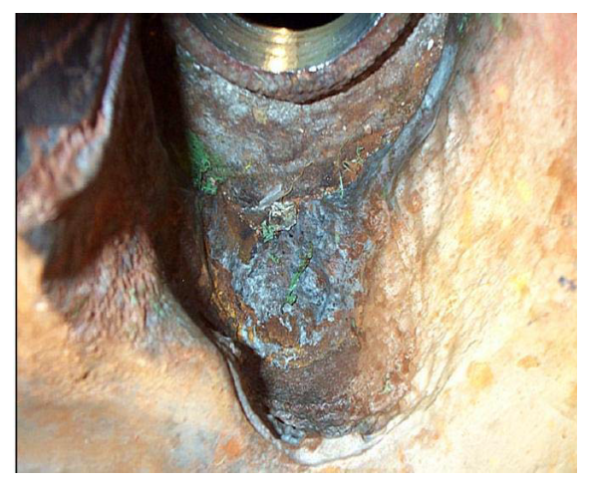
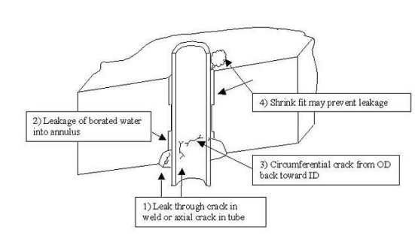
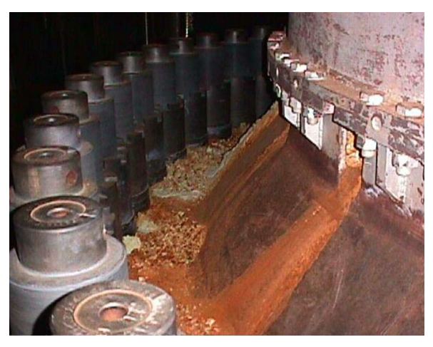

Slide 36
The D-B reactor had Alloy 600 control rod drive mechanism nozzles, the pieces of pipe that went from the reactor vessel head to the control rod drive mechanism.
PWSSC for a given batch of Alloy 600 depends on the residual stresses left from manufacturing, the stress from operating pressure, the time that the material has been exposed to pure water, and the temperature at which the exposure took place.
For D-B NPP, the temperature was a few degrees higher than at other similar pressurized water reactors. This exacerbated the cracking.
The nozzle leaks and flange leaks released boric acid into many including reactor vessel head itself.
The inside surface of the reactor vessel head is a thin layer of stainless steel, which is impervious to boric acid, but the outside of the reactor vessel head is carbon steel, which can be corroded by boric acid.

Slide 37
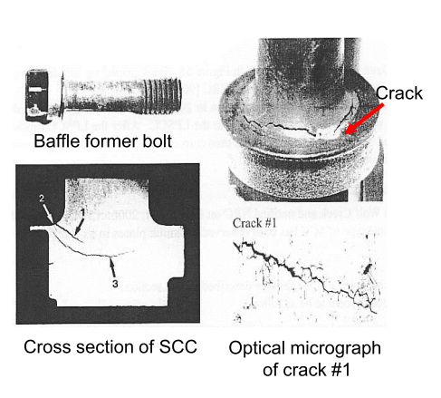
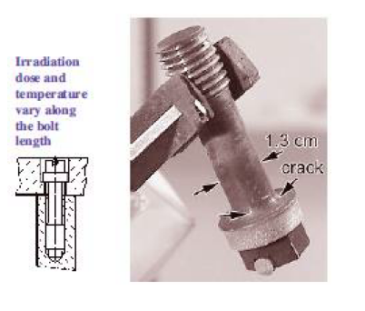
Irradiation Assisted Stress Corrosion Cracking (IASCC)
Notes:
Baffle Former Bolts are vital joint elements of the reactor core internal structure

Slide 38
Flow Accelerated Corrosion (FAC)
FAC is one the most common problems in nuclear and fossil power plants.
It is a corrosion mechanism in which a normally protective oxide layer on a metal surface dissolves in a fast flowing water. The underlying metal corrodes to re-create the oxide, and thus the metal loss continues.
FAC involves dissolution of normally poorly soluble oxide by combined electrochemical, water chemistry and mass-transfer phenomena.
The mitigation of FAC to prevent such tragic accident is one of important subjects for corrosion engineers in nuclear power plants.

Slide 39
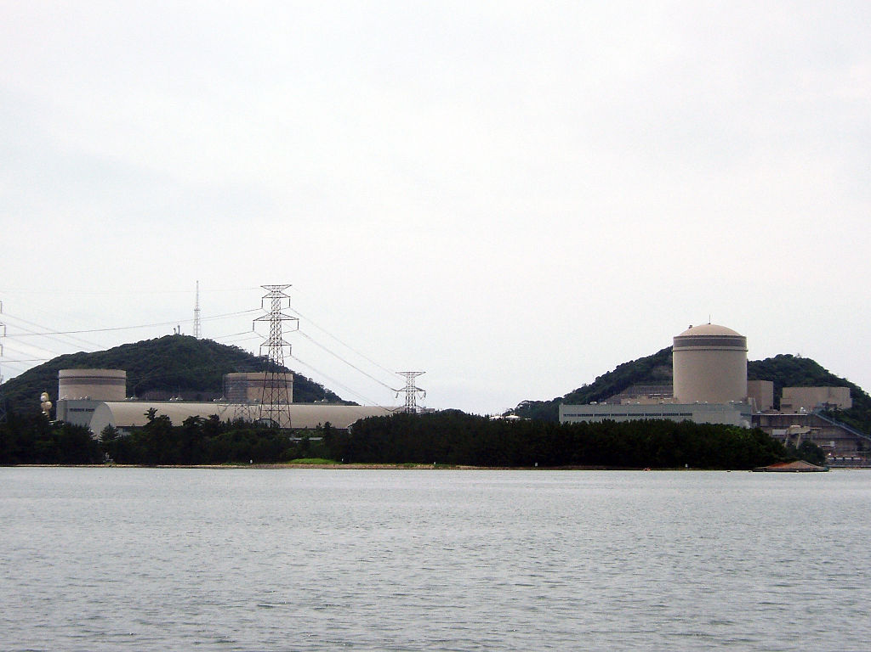
Case Study (FAC)
Mihama-3 NPP
On 9 August 2004, an accident occurred in a building housing turbines for the Mihama 3 reactor.
Hot water and steam leaking from a broken pipe killed five workers and resulted in six others being injured.
The accident had been called Japan's worst nuclear power accident before the crisis at Fukushima I Nuclear Power Plant.

Slide 40
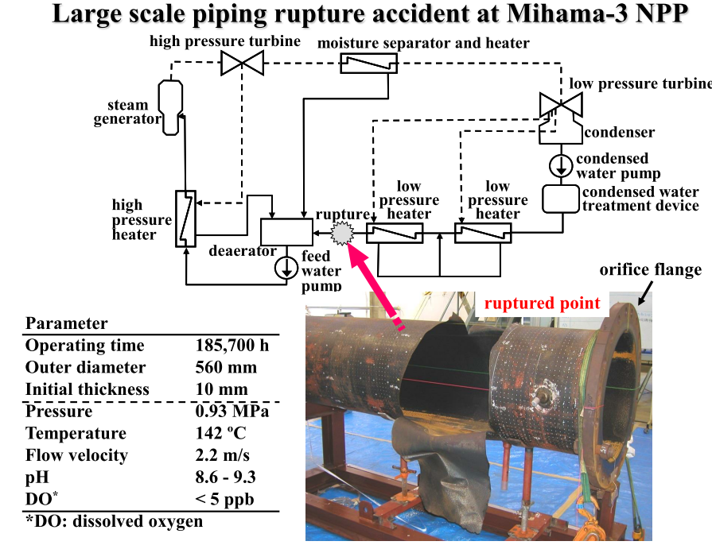

Slide 41
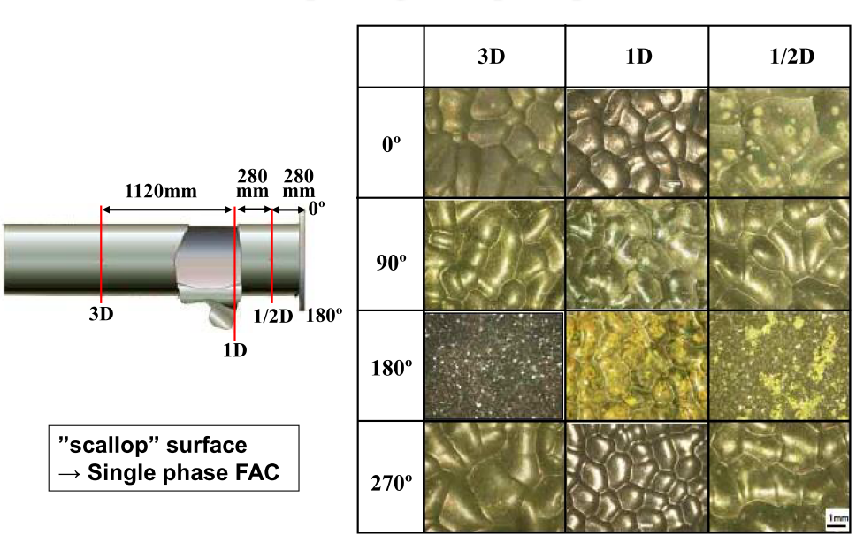
Microscope image of rupture pares

Slide 42
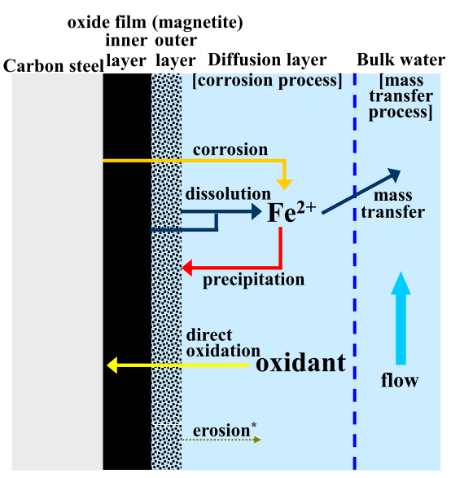
Mechanism of FAC
FAC mechanism: Two processes
1: corrosion process [production of soluble Fe 2+ and their accumulation at the oxide water interface]
2: mass transfer process [flowing water removes the soluble ferrous ions by a convective mass transfer mechanism]

Slide 43
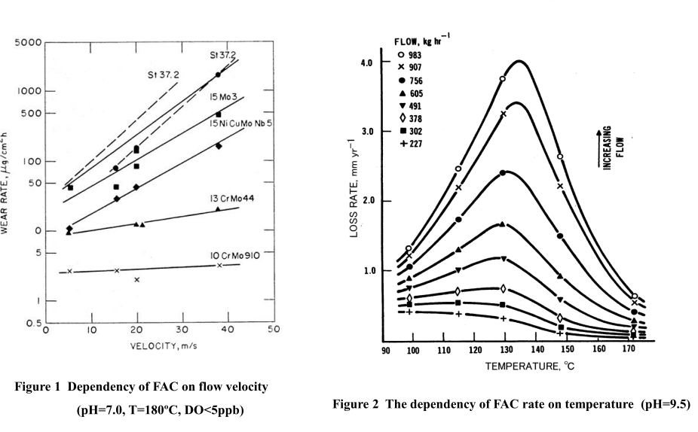

Slide 44
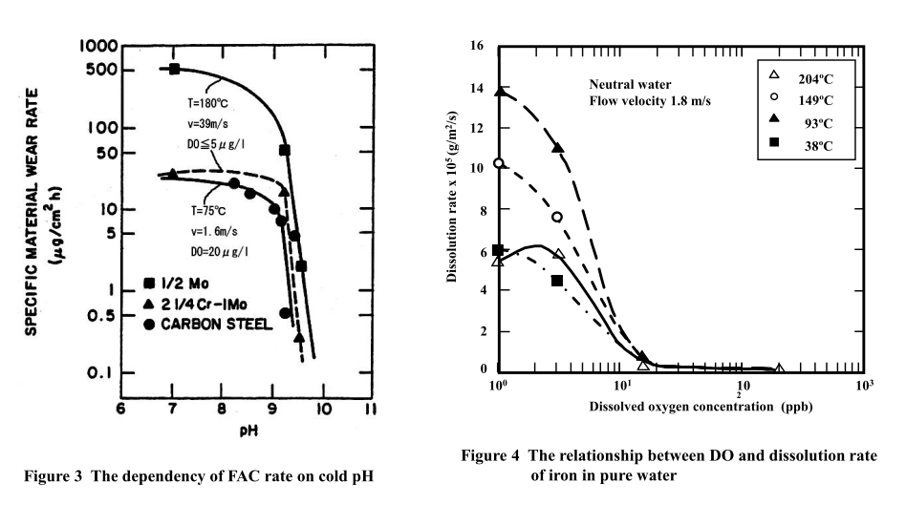

Slide 45
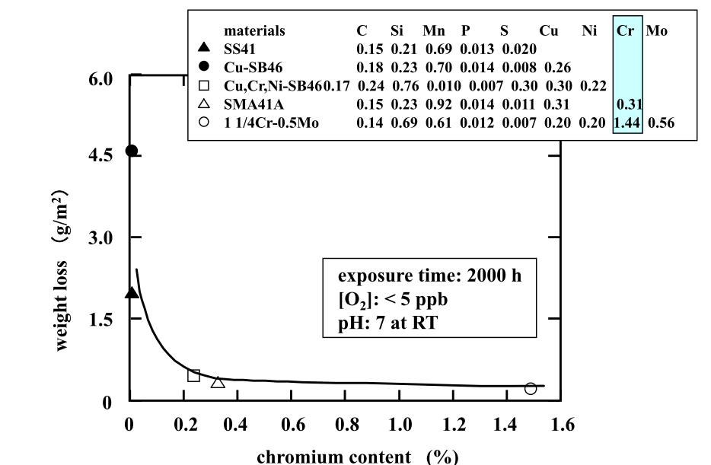

Slide 46
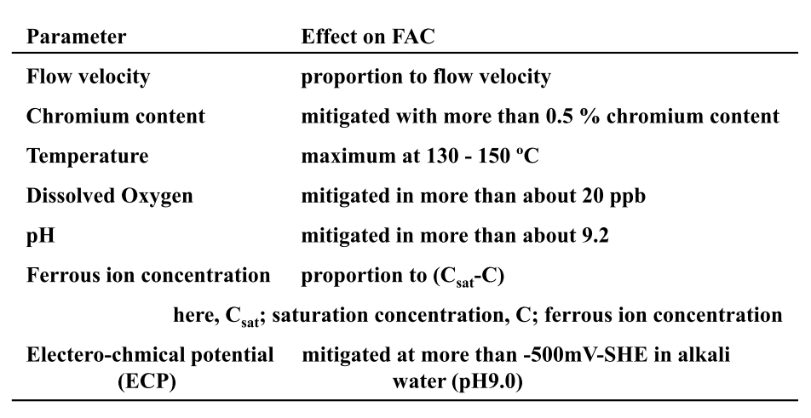
Summary of Parameters

Slide 47
Cladding of fuel rods
A typical composition of nuclear-grade zirconium alloys is more than 95 weight percent zirconium and less than 2% of tin, niobium, iron, chromium, nickel and other metals.
The absorption cross section for thermal neutrons is 0.18 barn for zirconium, which is much lower than that for such common metals as iron (2.4 barn) and nickel (4.5 barn).
Alloy | Sn, % | Nb, % | Vendor (country) | Component | Reactor type
Zircaloy 2 | 1.2–1.7 | – | All vendors | Cladding, structural components | BWR, CANDU
Zircaloy 4 | 1.2–1.7 | – | All vendors | Cladding, structural components | BWR, PWR, CANDU
ZIRLO | 0.7–1 | 1 | Westinghouse | Cladding | PWR
Zr Sponge | – | – | Japan and Russia | Cladding | BWR
ZrSn | 0.25 | – | Westinghouse | Cladding | BWR
Zr2.5Nb | – | 2.4–2.8 | – | Pressure tube | CANDU
E110 | – | 0.9–1.1 | Russia | Cladding | VVER
E125 | – | 2.5 | Russia | Pressure tube | RBMK
E635 | 0.8–1.3 | 0.8–1 | Russia | Structural components | VVER
M5 | – | 0.8–1.2 | Areva | Cladding, structural components | PWR
Notes:
which are added to improve mechanical properties and corrosion resistance

Slide 48
Zircaloys 2 and 4 do behave very similarly.
Oxidation occurs at the same rate in air or in water and proceeds in ambient condition or in high vacuum.
A sub-micrometer thin layer of zirconium dioxide is rapidly formed in the surface and stops the further diffusion of oxygen to the bulk and the subsequent oxidation.
The dependence of oxidation rate R on temperature and pressure can be expressed as
R = 13.9·P^{1/6}·exp(−1.47/k_{B}T)
The oxidation rate R is here expressed in gram/(cm²·second); P is the pressure in atmosphere, that is the factor P^{1/6} = 1 at ambient pressure; the activation energy is 1.47 eV; k_{B} is the Boltzmann constant (8.617×10⁻⁵ eV/K) and T is the absolute temperature in Kelvin

Slide 49

Cladding Corrosion
At normal operating temperatures, the zirconium alloy corrosion reaction can be described by:
The major effect of corrosion on cladding integrity results from two related processes:
1) the formation of a ZrO2 layer causes cladding thinning
2) the absorption of hydrogen (the atomic hydrogen produced by corrosion) by the zirconium alloy embrittles the cladding.
Factors affecting the above reaction include temperature the microstructure of the cladding material, local boiling, and coolant chemistry.
Notes:
The zirconium alloy fuel rod cladding forms a barrier against the release of the radioactive fission products formed during operation. Maintaining cladding integrity, therefore, is a major objective of the plant operator and licensing authorities.
(zirconium alloy oxidation as shown in eq. 2-2 is most significant at elevated temperatures; embrittlement is of most concern at lower temperatures, e.g., during fuel handling),

Slide 50
During the case of a loss-of-coolant accident in a nuclear reactor, this reaction was responsible for hydrogen explosion accident.
Example:
Three Mile Island Nuclear Generating Station, 1, 2 and 3 of the Fukushima Daiichi Nuclear Power Plant
Many water cooled reactor containment buildings have catalyst-based recombinator units installed to rapidly convert hydrogen and oxygen into water at room temperature before the explosive limit is reached.

Slide 51
Formation of hydrides and hydrogen embrittlement
Also, 5–20% of hydrogen diffuses into the zirconium alloy cladding forming zirconium hydrides.
The hydrogen production process also mechanically weakens the rods cladding thus blisters and cracks form upon hydrogen accumulation.
In case of Loss-of-Coolant Accident (LOCA) in a damaged nuclear reactor, hydrogen embrittlement accelerates the degradation of the zirconium alloy cladding of the fuel rods exposed to high temperature steam
Notes:
because the hydrides have lower ductility and density than zirconium or its alloys

Slide 52
The rate of zirconium alloy corrosion is controlled by the temperature of the metal/metal-oxide (Zr/ZrO 2 ) interface.
Since the cladding transfers heat to the coolant, the interface temperature during operation is always higher than that of the coolant.
As the oxide grows thicker, the interface temperature increases, which in turn increases the corrosion rate.
This effect is the major factor leading to accelerated corrosion with burnup

Slide 53
Fuel Crud Deposition
Corrosion product (crud) deposition on fuel surfaces has implications for fuel performance through heat transfer and local chemistry modifications.
Crud is currently one of the key industry issues and has been implicated in several recent cases of crud-related fuel failures and core plugging.
Activated crud is deposited on out-of-core surfaces, mainly steam generators, resulting in high radiation fields and high doses of plant staff.
Due to radiation build-up in primary circuit systems, decontamination of primary systems components and steam generators is used.
Several issues involving decontamination were observed in some cases.
Notes:
In PWRs with high coolant temperatures, these conditions exist for a large fraction of the feed fuel, and it is these
high power fuel assemblies that drive AOA.

Slide 54
Effect of temperature on oxidation rate
R = 13.9·P^{1/6}·exp(−1.47/kBT)
P is the pressure in atmosphere, that is the factor P^{1/6} = 1 at ambient pressure; the activation energy is 1.47 eV; kB is the Boltzmann constant (8.617×10−5 eV/K) and T is the absolute temperature in Kelvin
Temperature (°C) | [O] rate
0 | 10⁻²⁰ g m⁻² s⁻¹
300 | 6×10⁻⁸ g m⁻² s⁻¹
700 | 5.4 mg m⁻² s⁻¹
1000 | 300 mg m⁻² s⁻¹
Notes:
Whereas there is no clear threshold of oxidation, it becomes noticeable at macroscopic scales at temperatures of several hundred °C.

Slide 55
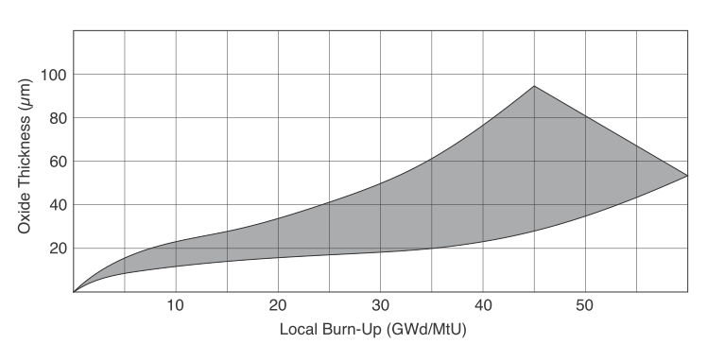
Zircaloy Corrosion versus Core Burn-Up - Industry Experience
Notes:
With thick oxide films and high heat flux, the corrosion rate increases further and the corrosion can cause premature failure.

Slide 56
Effect of Li on Zircaloy Corrosion
At a LiOH concentration corresponding to 70 ppm Li the corrosion rate is increased by a factor of two to six in water at 300-360°C
A smaller, yet measurable effect was reported at a Li concentration of 7 ppm
Improvements in fuel economy and dose reduction initiatives have led to the use of higher lithium levels due to longer cycle lengths.
Notes:
The susceptibility of the Zircaloys to accelerated corrosion in concentrated solutions of
LiOH in the absence of boric acid is well known

Slide 57
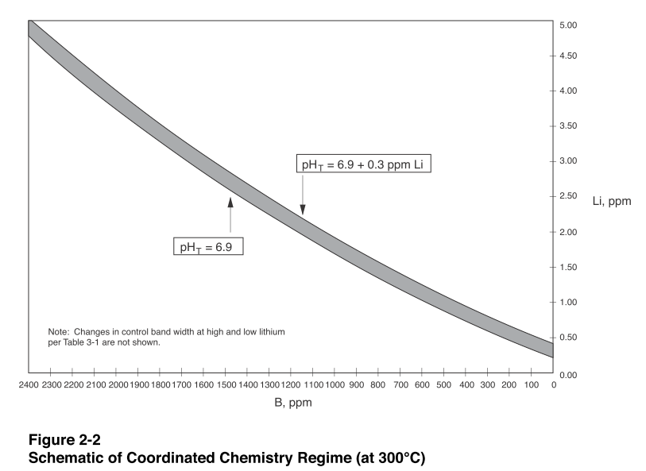
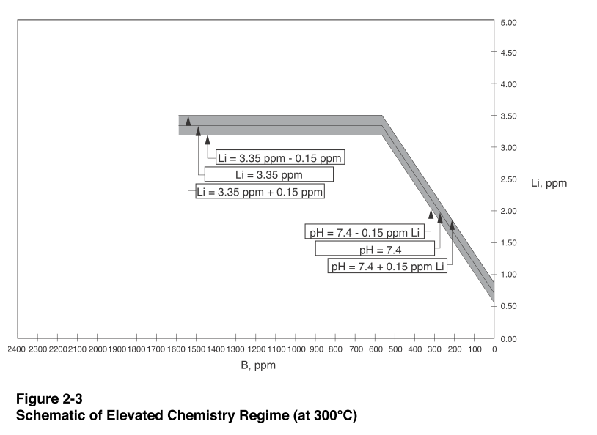
Notes:
As can be seen in Figures 2-2 through 2-4, the integrated exposure of fuel to lithium
throughout one fuel cycle is increased significantly when the chemistry is changed
from Coordinated Li/B at pH T 6.9 to Elevated Lithium.

Slide 58
Case Study
To evaluate the potential effects of the increased lithium exposure on fuel cladding corrosion, fuel surveillance programs were implemented to obtain cladding oxide thickness data when the Elevated Lithium regime was implemented at four plants in the late 1980s- St. Lucie-1, Oconee-2, and Millstone-3
In all three cases, it was concluded that the Elevated Lithium chemistry increased the oxide thickness on the order of 10-15%.

Slide 59
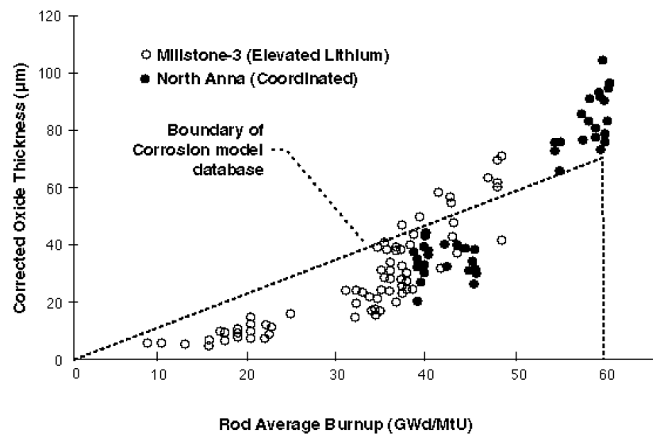
Measured Oxide vs. Rod Average Burnup at Millstone and North Anna

Slide 60
Alternate Cladding Material to Zircaloy-4
At least three of these materials have been approved by licensing authorities and are in use on full-region bases:
ZIRLO in the U.S. (0.7–1 Sn and 1Nb Westinghouse)
ELS Duplex Clad and the M5 alloy in some European countries.
Additionally, all vendors are reporting in-reactor results from various cladding alloy demonstration programs.
As these alloys are screened extensively in autoclave tests, including resistance to concentrated LiOH, they offer the promise of greater flexibility in the allowable ranges of pH and Li than exists for Zircaloy-4.
Notes:
Performance of these new alloys requires close surveillance under a variety of operational duties and coolant chemistries to ensure
their acceptance as robust materials in the future.
zirconium low oxidation
niobium

Slide 61
Fuel Axial Offset
Irreversible deposition of boric acid on rod surfaces occurs, causing a reduction in the reactivity of the upper part of the active zone.
It is believed that boron concentrates to the extent that a boron compound, most likely LiBO2 , precipitates within the crud deposit.
There are three conditions that must be present for AOA to occur:
Soluble boron
A layer of porous crud of sufficient thickness to serve as the medium for concentration of the soluble boron
Sufficient heat flux at the surface.

Slide 62
The occurrence of AOA at burnups of 4000 to about 8000 MWd/MtU indicates that sufficient crud is deposited in the first 4-8 months of the cycle to cause the problem.
It is also noted that AOA has been observed in plants and cycles using both Coordinated and Modified Li/B control strategies.
However, not all high temperature plants/cycles have experienced AOA.
Attempts have been made to relate corrosion product release rates and concentrations in the coolant to AOA
Notes:
megawatt days per metric ton of uranium
indicating that a complete explanation for this phenomenon has not yet been developed.

