Slide 1
NUCLEAR REACTOR MATERIALS
EFFECT OF RADIATION

Slide 2
Radiation Environment
The amount of radiation that a material encountered during their life cycle strongly depends on radiation environment and their operation conditions.
Different environment is characterized by its own spectrum of particles and energy distribution
The common radiation environments are:
Space
High energy physics experiments
Natural environments
Processing induced radiation
Nuclear
Notes:
https://books.google.com.my/books?id=AonqCAAAQBAJ&pg=PA37&lpg=PA37&dq=microscopic+effects+of+radiation&source=bl&ots=alvb0a_OVH&sig=eNsub63OTwGPYYWWytaHBxXXLaE&hl=en&sa=X&ved=0CDAQ6AEwBTgKahUKEwix7Y3hm5bIAhWUUo4KHcyRADk#v=onepage&q=microscopic%20effects%20of%20radiation&f=false

Slide 3
i) Space Environment
- Heavy ion trapped in the magnetosphere
- Cosmic ray protons and heavy ions
- Proton and heavy ions from solar flares
Notes:
Fluence is the number of particles that intersect a unit area. Units: 1/m² Flux is the rate at which something flows through a unit area. The units depend on what you're measuring.
Reference https://www.physicsforums.com/threads/flux-vs-fluence.196240/

Slide 4
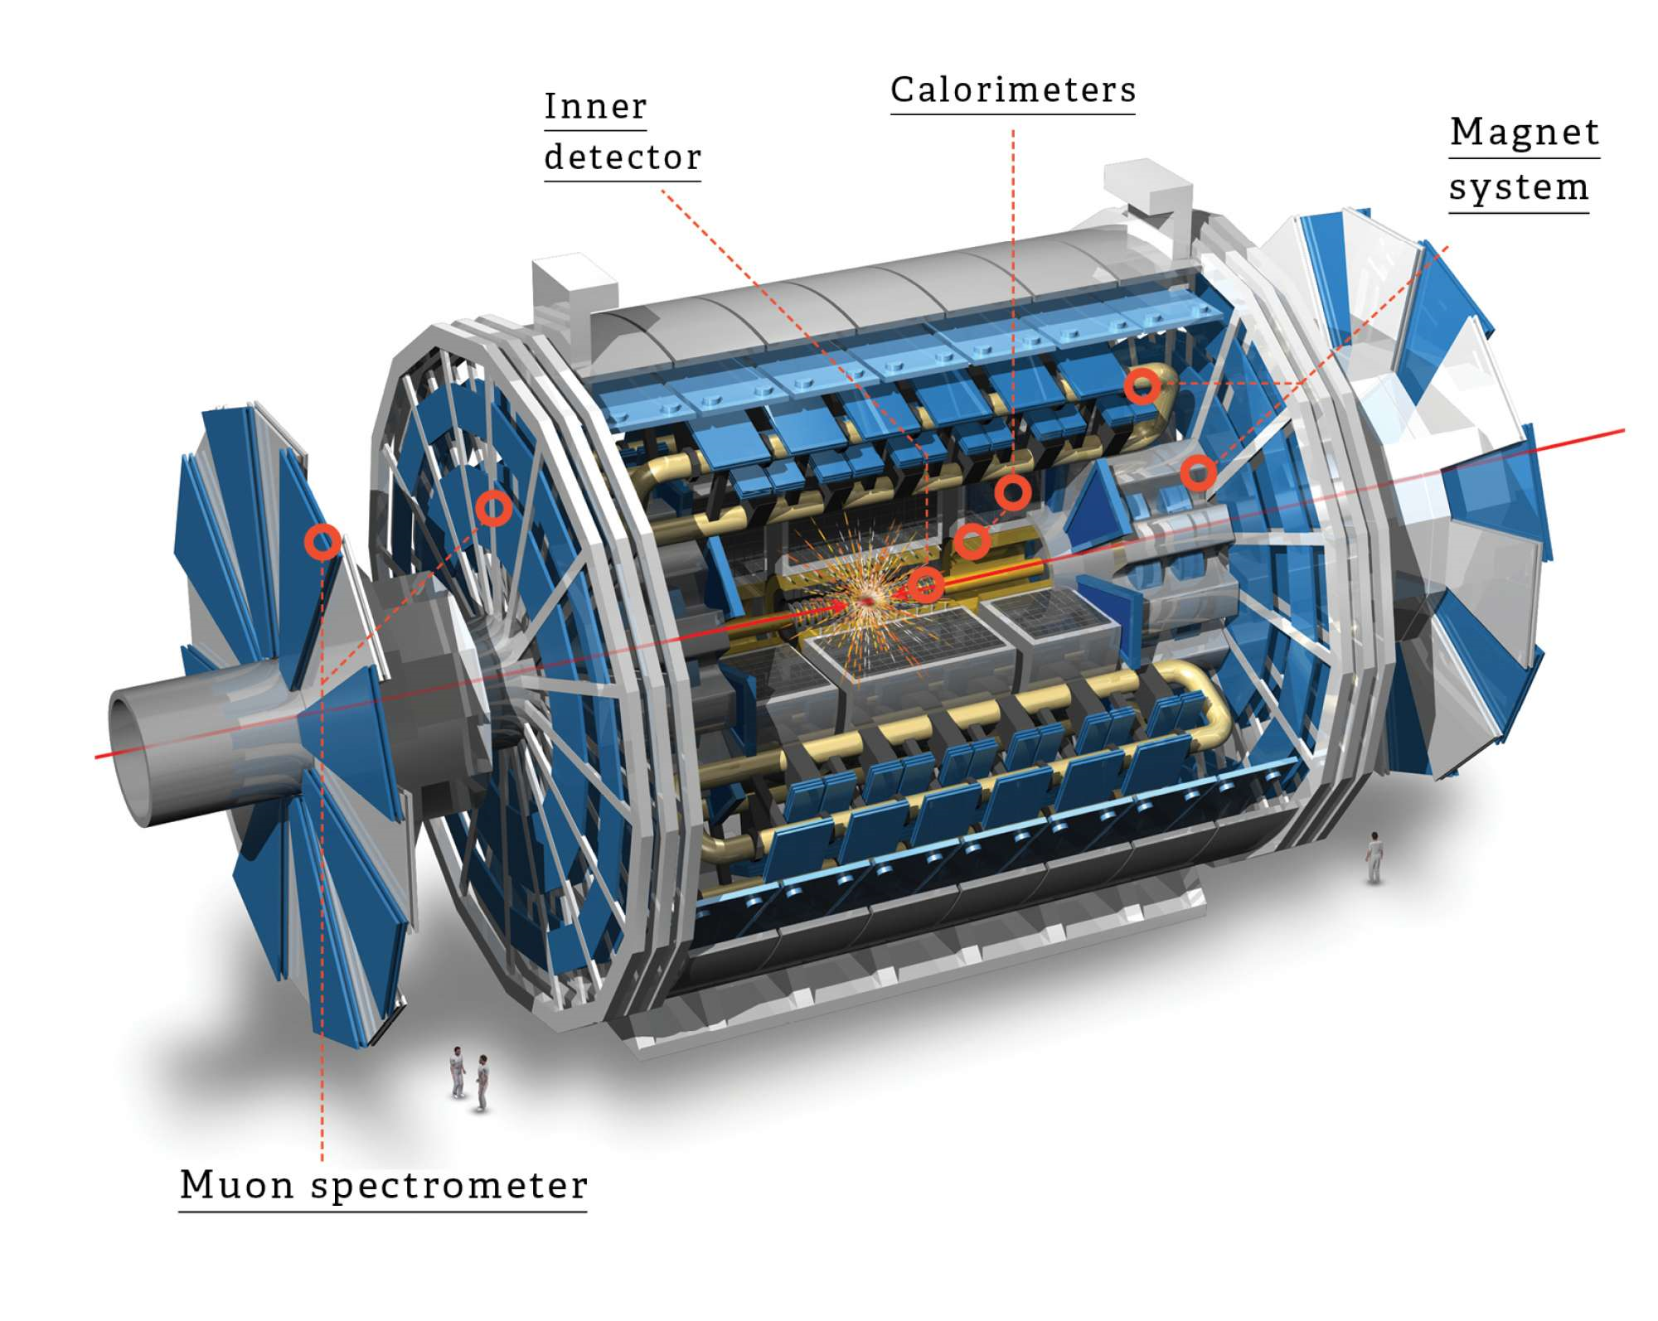
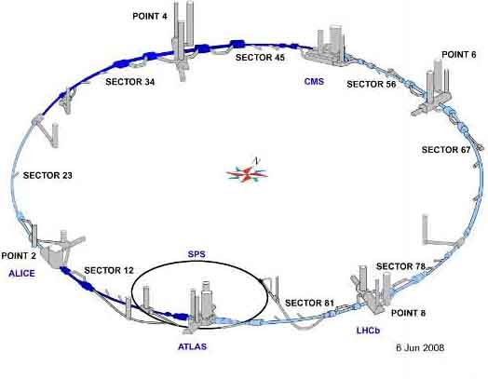
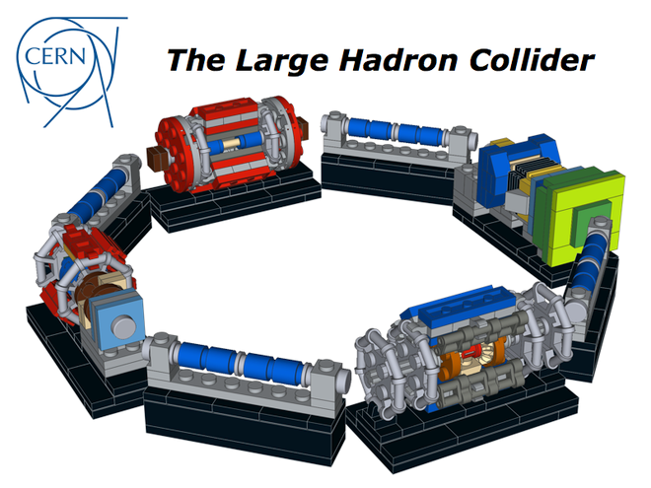
ii) High energy physics experiments
ATLAS, CMS experiments at the Large Hadron Collider (LHC) at CERN
Electron or proton beams with energy as high as 500 GeV are used to study elementary particle with short lifetime- bosons, muons and quarks
Notes:
Compact muon solenoid
European Organization for Nuclear Res
It lies in a tunnel 27 kilometres (17 mi) in circumference, as deep as 175 metres (574 ft) beneath the France–Switzerland border near Geneva, Switzerlandearch (CERN)
ATLAS will be used to look for signs of new physics, including the origins of mass and extra dimensions
like ATLAS, hunt for the Higgs boson and look for clues to the nature of dark matter

Slide 5
iii) Natural Environment
Source of ionising radiation is due to alpha particles coming from the radioactive impurities, such as uranium and thorium or radioactive daughter products in the used materials
Radioactive impurities can also be introduced by the reactants used during the devise processing steps. Example: Boron is used as p-type dopant for junction formation and to influence the stress and flow properties of silica layer-BPSG
Notes:
Heavy ion, in nuclear physics, any particle with one or more units of electric charge and a mass exceeding that of the helium-4 nucleus (alpha particle). Special types of accelerators are capable of producing fairly intense, high-energy beams of heavy ions, which are used in basic research, as in the production of synthetic transuranium elements (e.g., hahnium [atomic number 105]).

Slide 6
iv) Processing-induced radiation
The fabrication of modern semiconductor devices uses a great number of processing step to introduce radiation damage.
Examples: ion implantation, x-ray lithography, plasma enhanced chemical vapour deposition
The degree of introduced damage is much lower than the other radiation environment

Slide 7
Nuclear Environment
Nuclear power reactors are characterized by the existence of high radiation fields.
The radiation fields have a profound effect on the properties of many materials which, by design, must fulfill specific neutronic, structural and transport functions.
The appearance of these primary radiations and particles serve to initiate numerous and complex cascade effects in the materials.
For example:
  atoms can be dislodged from their positions by the fission fragments
  emitted gamma ray may cause ionization and induce the production of x-rays
Notes:
Structural-strength and reliability
Neutronic transport-interaction with matter, affected by various radiations and particles associated with nuclear fission

Slide 8
Effects of radiation
  Microscopic
  Macroscopic
  Annealing
What can we do?
  Detector and characterizations
  Material design and engineering
Notes:
Annealing, in metallurgy and materials science, is a heat treatment that alters the physical and sometimes chemical properties of a material to increase its ductility and reduce its hardness, making it more workable. It involves heating a material to above its recrystallization temperature, maintaining a suitable temperature, and then cooling.
In annealing, atoms migrate in the crystal lattice and the number of dislocations decreases, leading to the change in ductility and hardness.

Slide 9
The development of truly predictive material is through the thorough understanding of the fundamental radiation damage mechanisms
This requires the application of a wide range of instruments, particularly spectrometry and microscopy to understand the radiation-induced electrically active defects.

Slide 10
Spectroscopy in brief…
Spectroscopy is the study of the interaction between matter and radiated energy.
Is used to study the incident spectrums, emitted spectrums and absorbed spectrums of materials.
Spectroscopic data is often represented by a spectrum, a plot of the response of interest as a function of wavelength or frequency

Slide 11
Decay Heat Measurement
Understanding the β-decay properties of fission products is very important for nuclear reactor monitoring & safety.
β-decay of fission products is a source of power during nuclear reactor operation and after, this activity is the main contributor to the decay-heat representing ~7-8% of a reactor nominal power.
In order to perform measurements of fission products β-decay properties-Total Absorption spectrometer (TAS) characterization is carried out.

Slide 12
Interaction of high energy radiation such as α, β and γ rays as well as particles such as electrons, protons, neutrons etc with crystal lattices give rise to defects/imperfections
The microscopic defects produced in materials due to irradiation are referred to as radiation damage.
The crystal defects thus produced modify the macroscopic properties of materials which are referred to as radiation effects.
The damage can be described by the following groupings:
  Vacancies or Knock-ons
  Interstitials
  Ionization
  Thermal Spikes
  Impurity Atoms
Although the above are effects produced on the atomic and nuclear level, a sufficient number of these processes contribute to important macroscopic changes in the material.
Notes:
The more fundamental aspects of radiation effects can be described on the atomic
scale.

Slide 13
Vacancies or Knock-ons
The removal of an atom from its position by the direct interaction of a high energy neutron or a fission fragment.
Interstitials
An interstitial is formed when an atom, which is knocked out from its position, comes to rest at some remote point.
Ionization
Ionization is caused by the removal of electrons from their electronic shells and has the effect of changing the chemical bonds of molecules.

Slide 14
Thermal Spikes
This term identifies localized high temperature domains caused by the deposition of energy from neutrons and fission fragments.
Impurity Atoms
The capture of neutrons and nuclear reactions induced by various radiations has the effect of transmuting an atom into an element which is foreign to the material.

Slide 15
Primary Knock-on Atoms (PKA)
The first atom that an incident particle encounters in the target.
After it is displaced from its initial lattice site, the PKA:
  can induce the subsequent lattice site displacements of other atoms if it possesses sufficient energy, or
  come to rest in the lattice at an interstitial site if it does not.
A neutron with sufficient energy produces a number of these PKAs which in turn produce knock-ons leading to displacement/collision cascades .
The atoms displaced by PKAs are known as secondary knock-on atoms.
Thus a high energy neutron may produce a number of PKAs which lead to many secondary knock-ons resulting in a large number of atomic displacements.

Slide 16
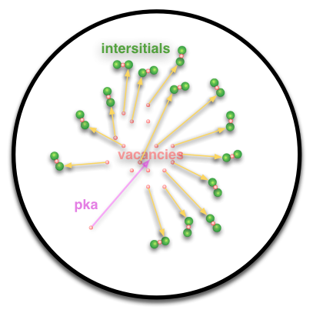
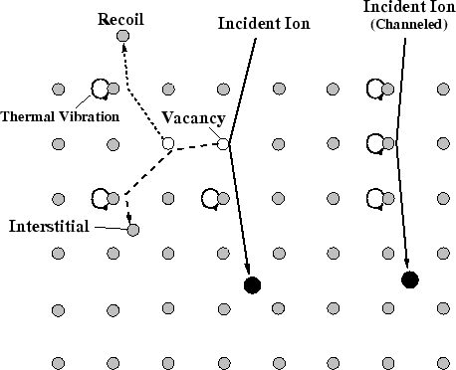

Slide 17
Collision Models
Upon bombardment, atoms can only be displaced if the energy they receive exceeds a threshold energy E_{d}.
When a moving atom collides with a stationary atom, both atoms will have energy greater than E_{d} after the collision only if the original moving atom had an energy exceeding 2E_{d}.
Thus, only PKAs with an energy greater than 2E_{d} can continue to displace more atoms and increase the total number of displaced atoms
The majority of displaced atoms leave their lattice sites with energies no more than two or three times Ed.
Notes:
In particle physics, the threshold energy for production of a particle is the minimum kinetic energy a pair of traveling particles must have when they collide.
(note Ed is very small ≈25 eV)

Slide 18
Such an atom will collide with another atom approximately every mean interatomic distance traveled, losing half of its energy during the average collision.
Assuming that an atom that has slowed down to a kinetic energy of 1 eV becomes trapped in an interstitial site-
  displaced atoms will typically be trapped no more than a few interatomic distances away from the vacancies they leave behind.
There are several possible scenarios for the energy of PKAs, and these lead to different forms of damage.
In the case of electron or gamma ray bombardment, the PKA usually does not have sufficient energy to displace more atoms.

Slide 19
The resulting damage consists of a random distribution of Frenkel defects, usually with a distance no more than four or five interatomic distances between the interstitial and vacancy.
When PKAs receive energy greater than Ed from bombarding electrons, they are able to displace more atoms, and some of the Frenkel defects become groups of interstitial atoms with corresponding vacancies, within a few interatomic distances of each other.
In the case of bombardment by fast-moving atoms or ions, groups of vacancies and interstitial atoms widely separated along the track of the atom or ion are produced.
As the atom slows down, the cross section for producing PKAs increases, resulting in groups of vacancies and interstitials concentrated at the end of the track

Slide 20
Frenkel Pair/Defect
A Frenkel defect, Frenkel pair, or Frenkel disorder is a type of point defect in a crystal lattice
The defect forms when an atom or smaller ion (usually cation) leaves its place in the lattice, creating a vacancy, and becomes an interstitial by lodging in a nearby location.
Their prime mechanism of generation is by particle irradiation
This defect does not have any impact on the density of the solid as it involves only the migration of the ions within the crystal, thus preserving both the volume as well as mass.
In ionic crystals, charge neutrality requires (as we will see) that defects come in pairs with opposite charge, or at least the sum over the net charge of all charged point defects must be zero.
One of the simple ways of maintaining charge neutrality with two different point defects is to always have a vacancy - interstitial pair
Notes:
Point defects are where an atom is missing or is in an irregular place in the lattice structure.
the discussion of this defect in AgCl in 1926 by Frenkel

Slide 21
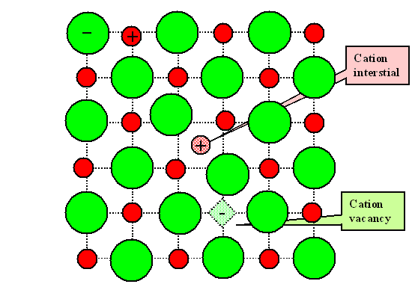

Slide 22
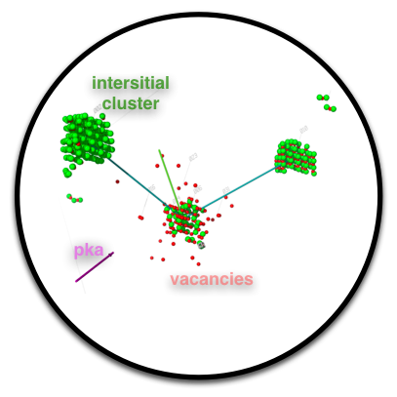
PKA moves through the lattice
  produces vacancy interstitial pairs (Frenkel Pair)
  PKA slows, reduces mean distance between collisions
  clusters formed
Thermal motion ≈98% lattice defects anneal
  defect/impurity reactions
Stable defects influence the material properties
Displacements per atom [dpa] using simple models and thus-evaluated dpa may be related to the changes in the macroscopic properties of the materials.
Notes:
such as mechanical, physical, thermal, electrical, etc.

Slide 23
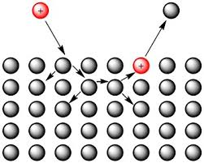
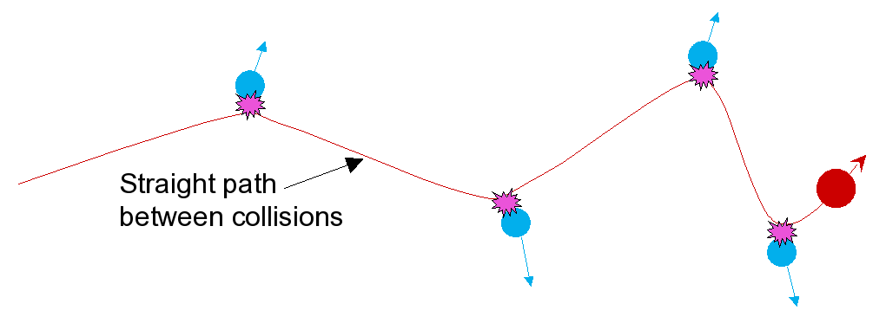
Collision Cascade
Linear collision cascade theory:
The primary ion collides with an atom on the surface of the target, causing other elastic collisions to occur within the target. Eventually, a target atom or molecule is ejected from the surface.

Slide 24
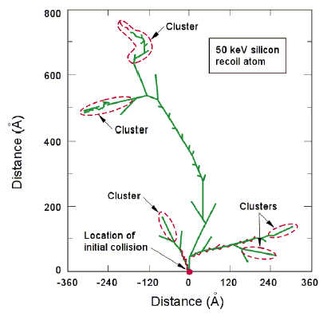
Collision Cascade in Si
A single incident particle can cause a cascade of collisions to occur to a portion of the affected material (e.g., Si) lattice atoms.
These collisions are produced by both incident “heavy” particles (p, n, ions) and secondary particles.
Defects (vacancies, interstitials, Frenkel pairs, dislocations) are produced along the tracks of the secondary particles and in clusters at the end of these tracks as shown in Figure

Slide 25
As the PKA slows to stop, it can collide with all atoms it encounters, impart kinetic energy to other atoms and initiate the ejections of atoms from their localized region
The size of the collision cascade is the primary function of the energy of the PKA.
The energy of PKA produced in a function of the irradiating species.
The nature of residual damage is the function of both PKA energy and the temperature of the material- at high temperature, the frenkel paairs have greater chance of spontaneously recombining to annihilate the damage
For metal like Zirconium, the displacement cascade results in the formation of damage zone/depleted zone- characterized by vacancy-rich core surrounded by the interstitial-rich shell
Notes:
More energetic PKA-greater area of cascade-more atoms are displaced
Both vacancies and interstitials, especially the latter, are mobile at sufficiently high temperature and annealing facilitates their recombination. At the higher
temperature, the vibration of the atoms in the lattice increases, thereby providing a mechanism by which an interstitial atom can migrate to a vacancy; and hence, fix both defects.

Slide 26
Damage Analysis of PKA
The degree to which the lattice is exposed to Frenkel damage is described in term of an accumulated fluence of the irradiating species (neutron).
Parameter for damage analysis : number of displacement event which occurred in the atom of the lattice--DISPLACEMENT PER ATOM (dpa)
Dpa is affected by the particle fluence, type of irradiating species, energy of the irradiating species.
Example:
Neutron fluence of 1x 10^21 n/cm2 in zirconium in a light water reactor is 1.3 dpa
Neutron fluence of 1x 10^21 n/cm2 in zirconium in a heavy water reactor is 1 dpa

Slide 27
A fluence of 10^22 n/cm2 is typical of end-of-life exposure for many zirconium core components
Based on the previous calculation, during the lifetime of the component, every atom is displaced from its laticce site in average ten times.
There must be a process which restore crystallinity to the damaged lattice!
A large fraction of the interstitials and vacancies can recombine with one another to annihilate the vacancy-interstitial pair.
Some vacancies and interstitials diffuse to lattice impefection such as dislocations or grain boundaries where they are absorbed.
All these processes normally occur at very high temperature
Notes:
The displaced atom need not necessary recombine with its corresponding vacancies.

Slide 28
Model for dpa
A simple model for calculating the atomic displacements is due to Kinchin and Pease.
let us consider a collision between a high energy neutron [mass, m] and a lattice atom of mass M. En = energy of the neutron
The atom is scattered with energy T transferred from the neutron. ⇒ But there exists a threshold energy, Ed [displacement threshold energy] such that the atom with trasferred energy T will be displaced and becomes PKA if and only if T>Ed (note Ed is very small ≈25 eV)
The neutron will now have an energy [En-T] if the energy consumed in the scattering process is assumed negligible.
The neutron with energy [En-T] and the PKA with energy T produce other knock-on atoms -higher-order knock-ons ⇔

Slide 29
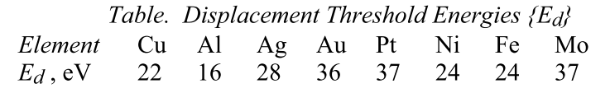

Slide 30
Model for dpa
The Kinchin and Pease model is based on the following assumptions :
• 2-body elastic collisions
• hard sphere model
• atomic displacements occur only when T ≥Ed
• no energy is consumed in displacing a lattice atom
• atomic arrangement in the material is random [no crystallography]
• no annihilation

Slide 31
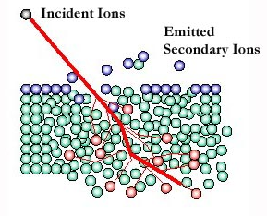
Secondary ion mass spectrometer (SIMS)
SIMS is a surface analysis technique used to characterize the surface and sub-surface region of materials.
It effectively employs the mass spectrometry of ionised particles which are emitted when a solid surface is bombarded by energetic primary particles.
The primary particles may be electrons, ions, neutrals or photons.
Notes:
• Spectroscopy is the science of studying the interaction between matter and radiated energy while spectrometry is the method used to acquire a quantitative measurement of the spectrum.
• Spectroscopy does not generate any results. It is the theoretical approach of science. Spectrometry is the practical application where the results are generated.

