Slide 1
Core Thermal Design
Mohsin Mohd Sies
Universiti Teknologi Malaysia
mohsin@fkm.utm.my
http://www.fkm.utm.my/~mohsin

Slide 2
Motivation
Thermal (not nuclear) considerations limit the amount of reactor power generation
Temperatures anywhere in the core must not exceed material property limitations (fuel, cladding)
Otherwise fuel element damage might result in release of large quantities of radioactive material into coolant, or in-core fuel meltdown.

Slide 3
Core Thermal Design
Core thermal design is an art of compromise
An iterative process (interdependence of heat flux and water density)
Overall plant characteristics is influenced by thermal hydraulic considerations

Slide 4
Core Thermal Design
Once core basic lattice has been determined from nuclear, hydraulic, and heat transfer, the overall size of core becomes a sole function of thermal considerations
Parameters
  Fuel temperature distribution (most important)
  Specific power
  Power density
  Heat flux

Slide 5
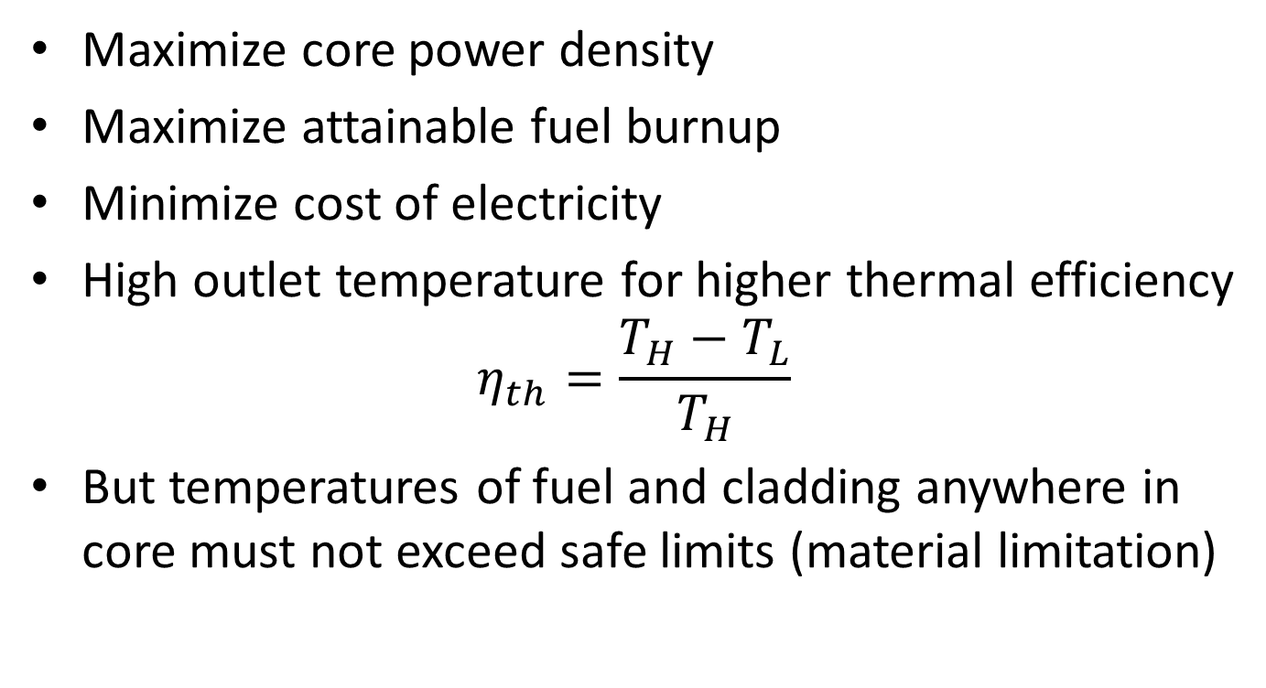
Core Design Objectives
Maximize core power density
Maximize attainable fuel burnup
Minimize cost of electricity
High outlet temperature for higher thermal efficiency
$$η_{th}=\frac{T_{H}−T_{L}}{T_{H}}$$
But temperatures of fuel and cladding anywhere in core must not exceed safe limits (material limitation)

Slide 6
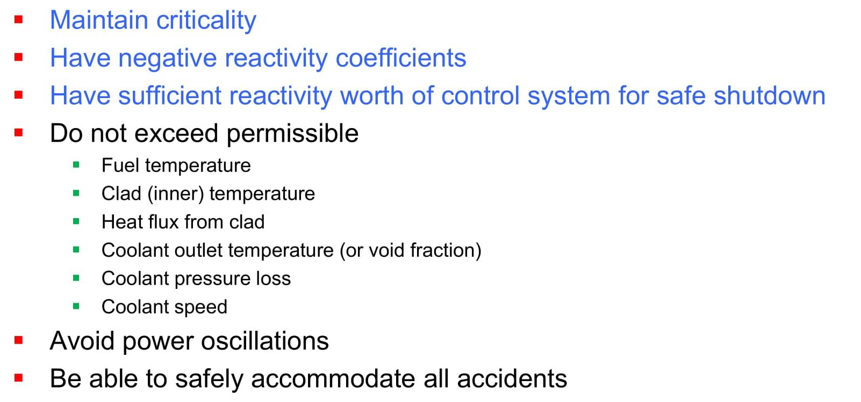
Design Constraints

Slide 7
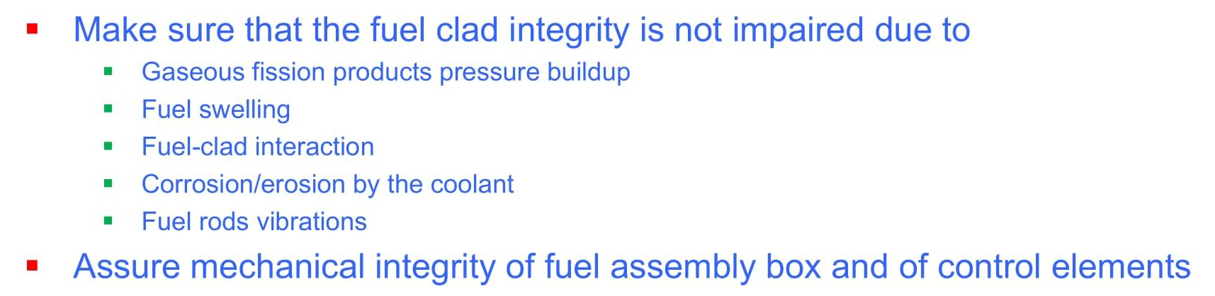
Design Constraints

Slide 8
Thermal Reactor Design
3 categories of design considerations
  Nuclear Design
  Thermal-hydraulics Design
  Mechanical/Material Design

Slide 9
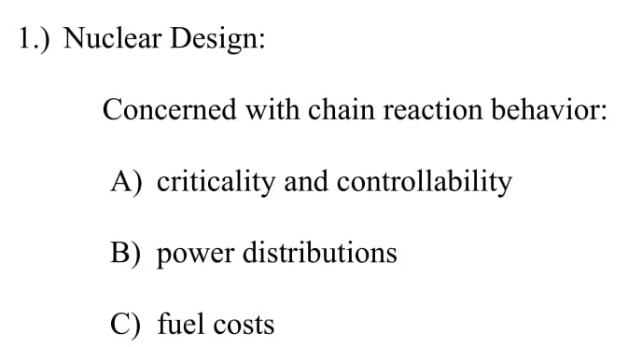
Nuclear Design

Slide 10
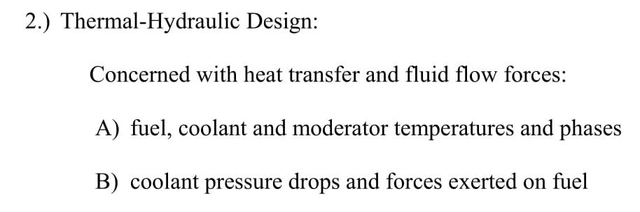
Thermal-hydraulics Design

Slide 11
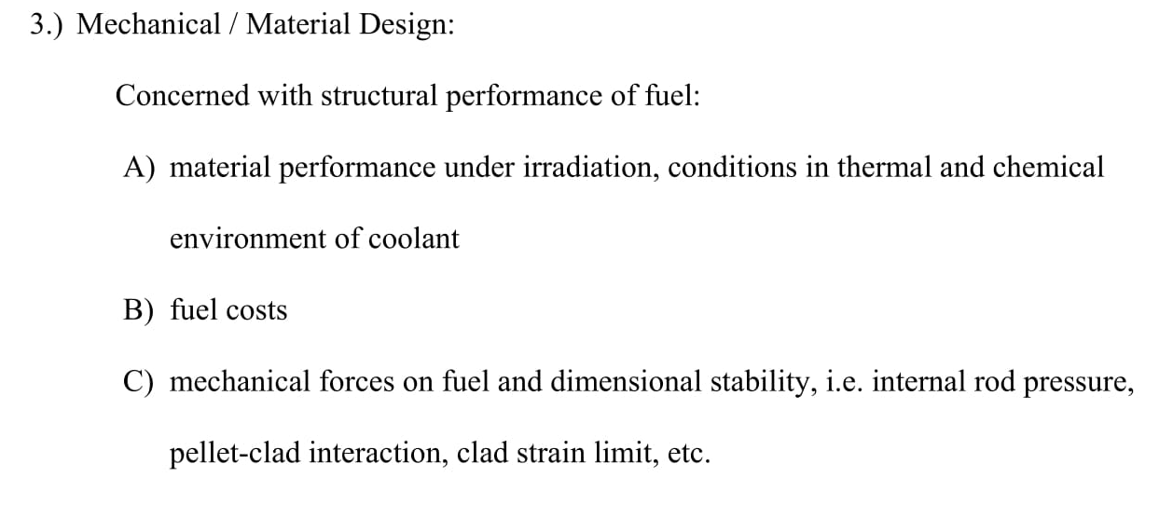
Mechanical/Materials Design

Slide 12
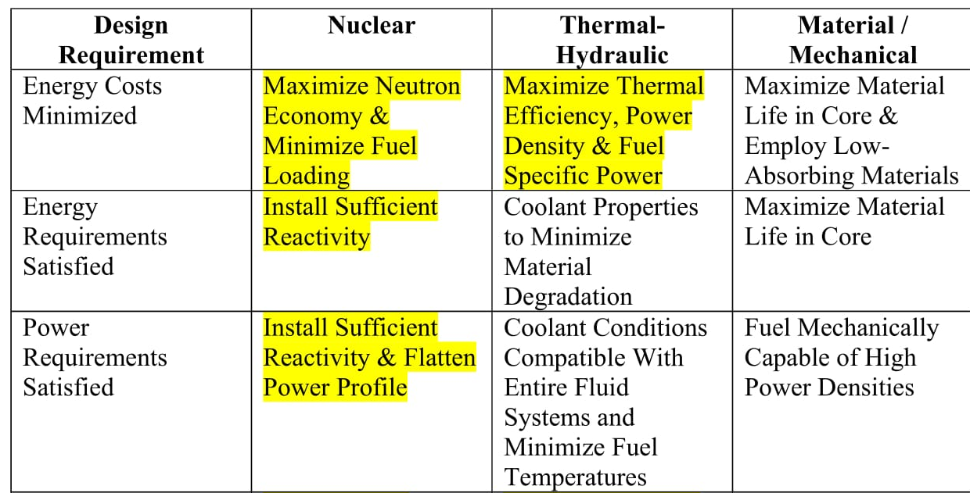
Impact on various design areas

Slide 13
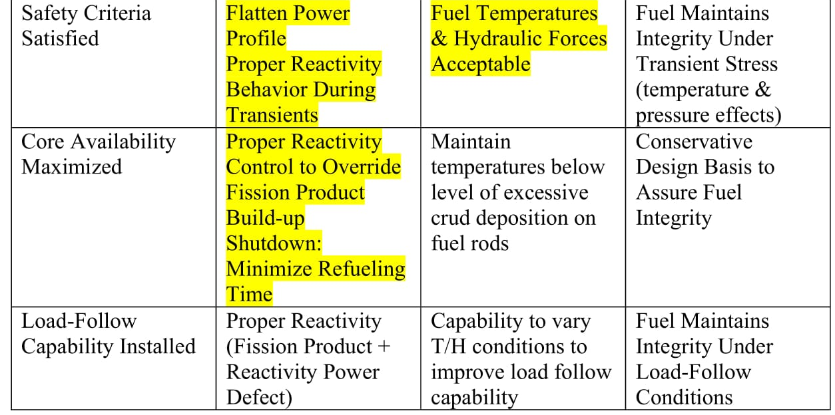
Impact on various design areas

Slide 14
Thermal Design Safety Aspects
DNB Ratio
Hot channel, hot spot factors
Thermal limits
  Fuel centerline temperature
  Cladding inner surface temperature
Values change with fuel burnup!

Slide 15
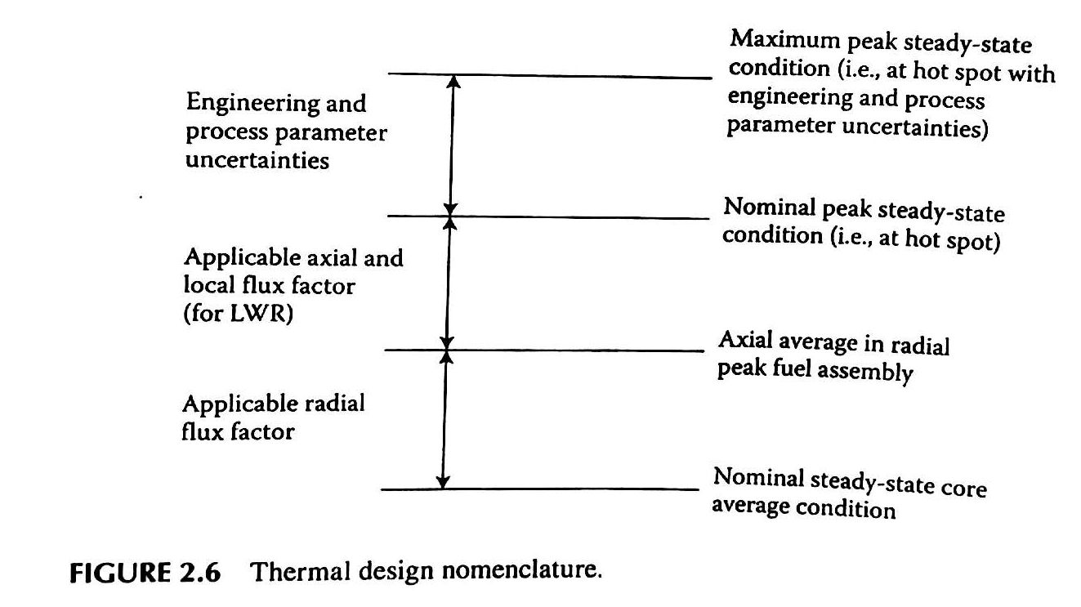
Thermal Design Nomenclature
(Nominal, Average, Peak, Maximum)

Slide 16
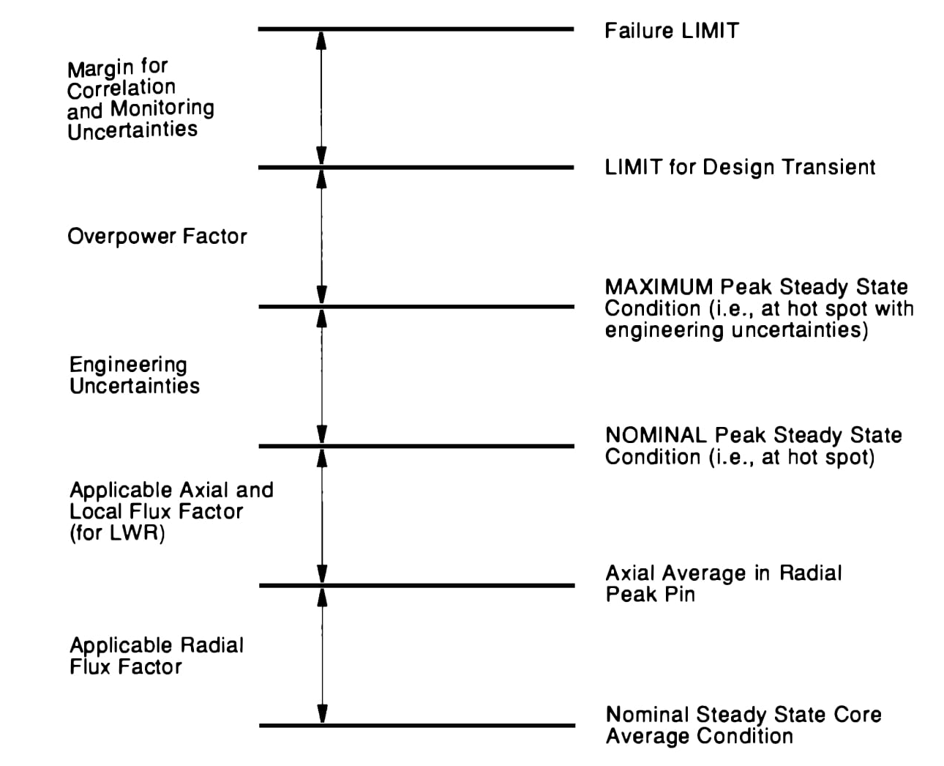
Thermal Design Margin

Slide 17
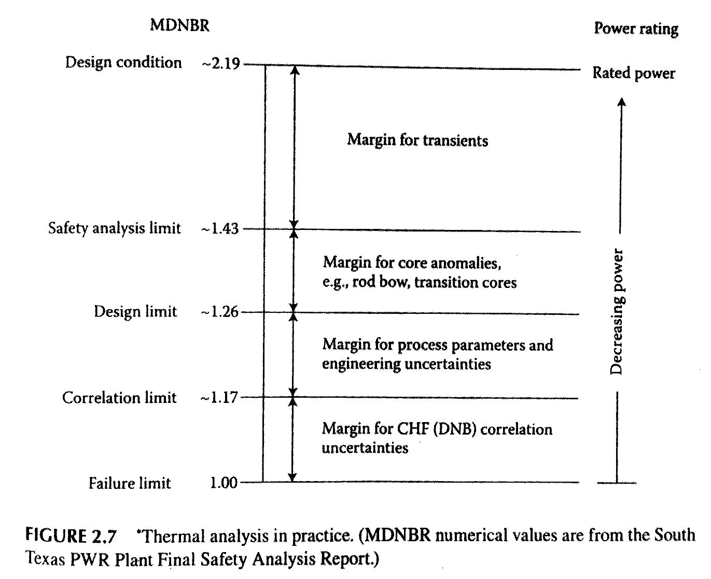
Thermal Design Limits

Slide 18
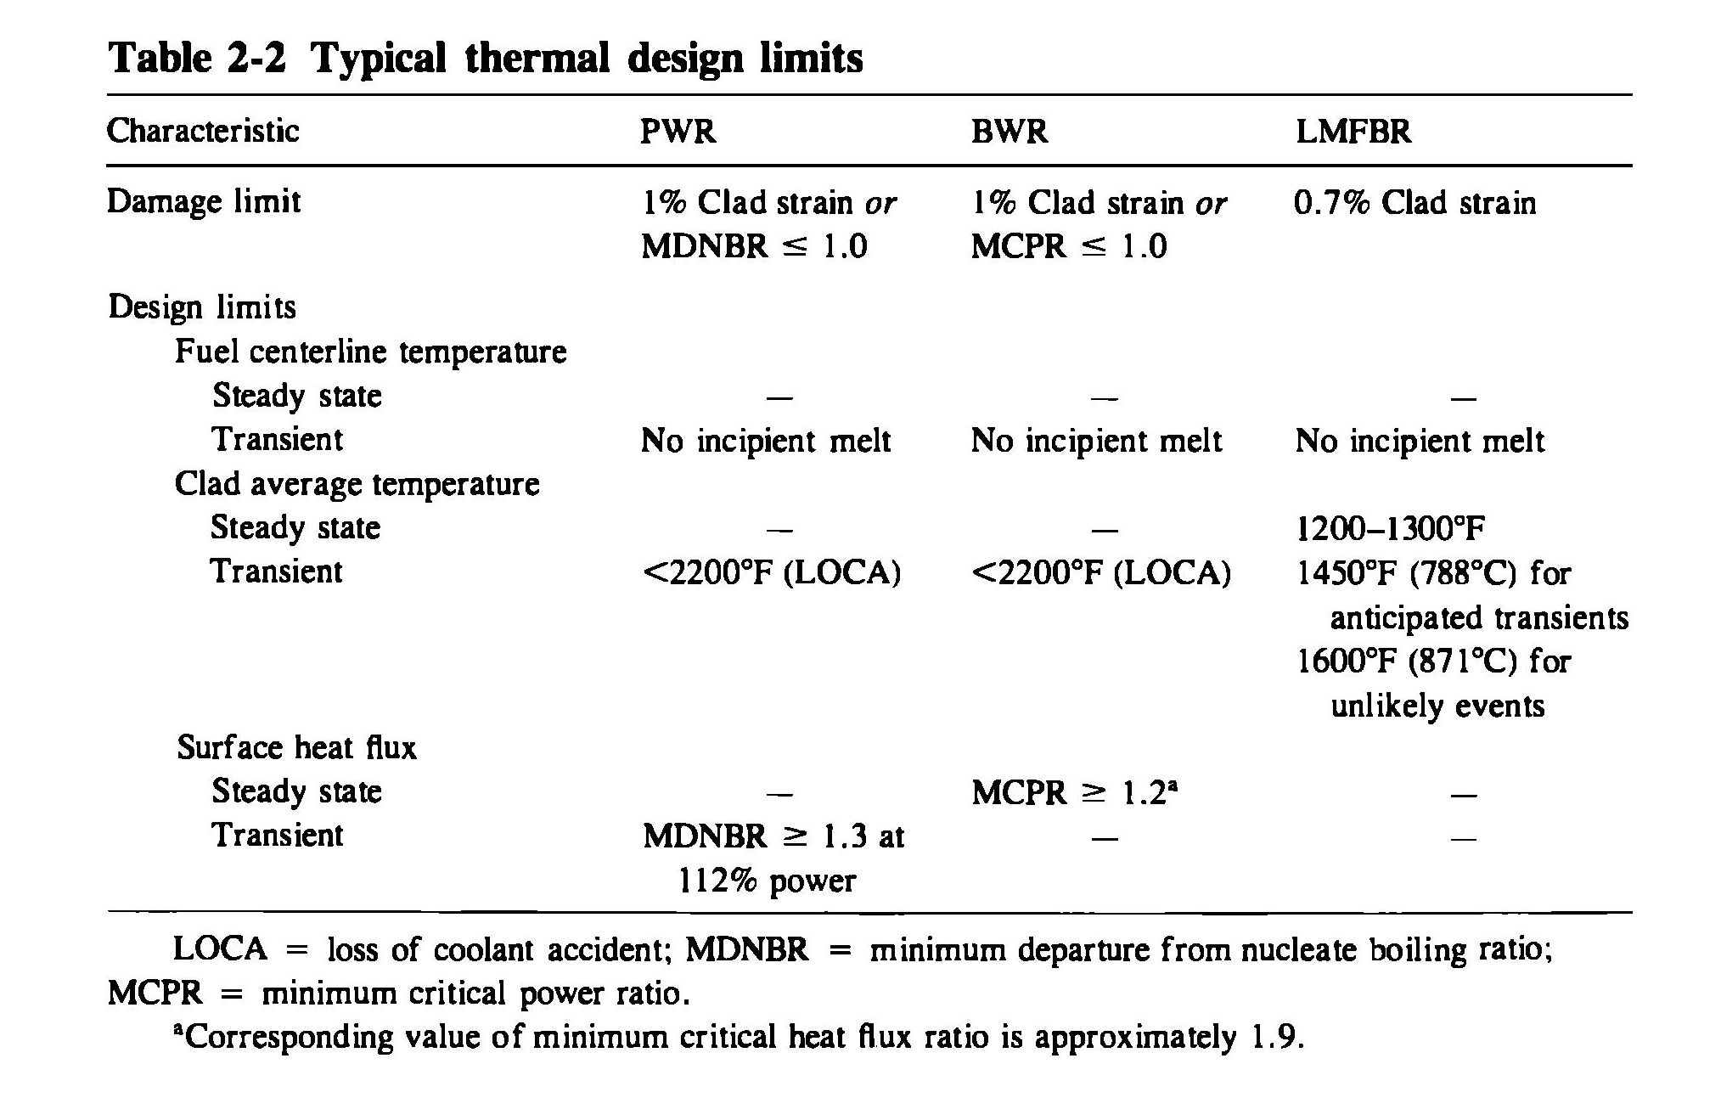
Thermal Design Limits

Slide 19
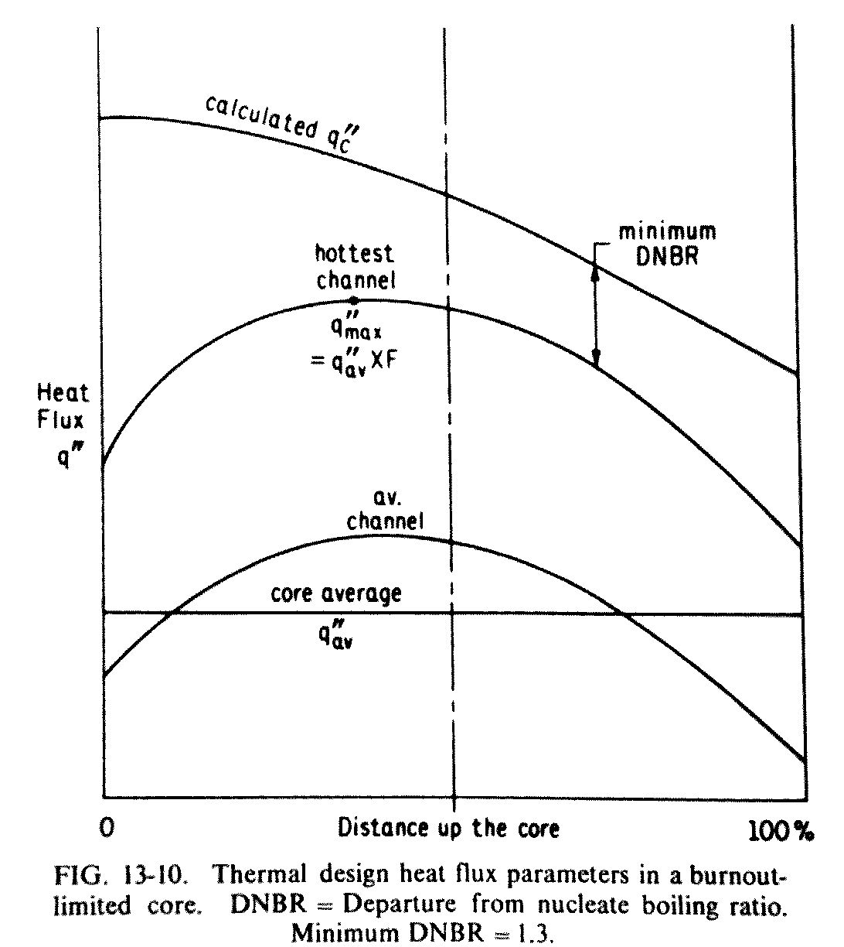
DNB Ratio

Slide 20
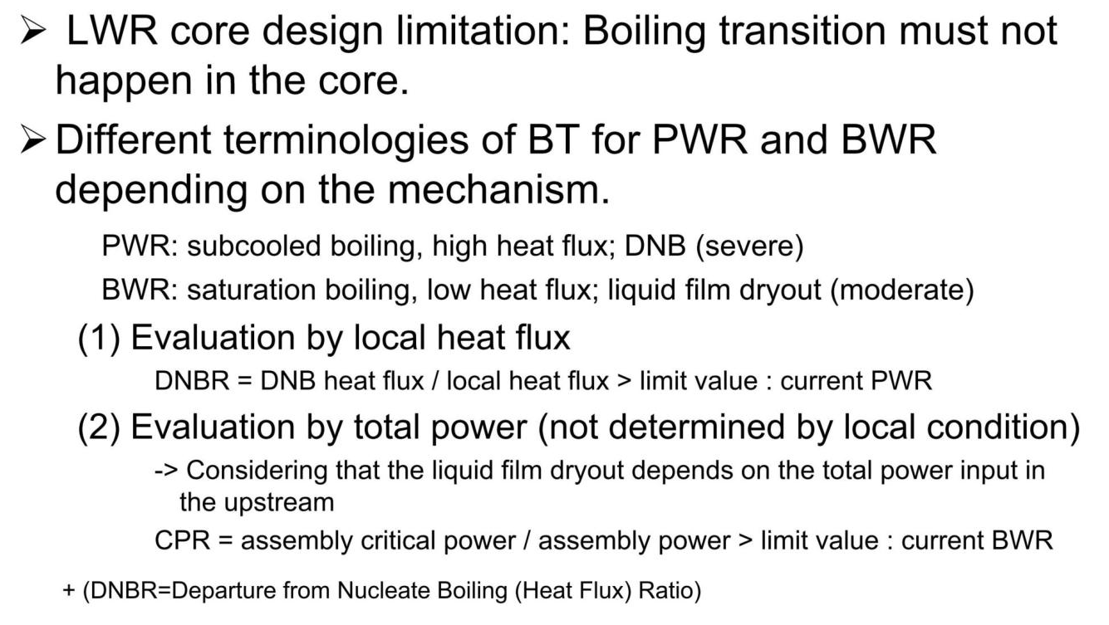
Boiling Crisis for LWR

Slide 21
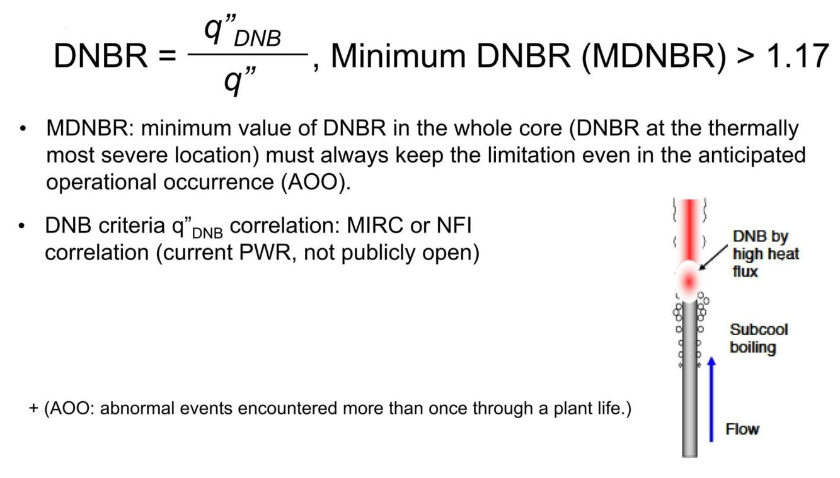
Evaluation by Local Heat Flux (PWR)

Slide 22
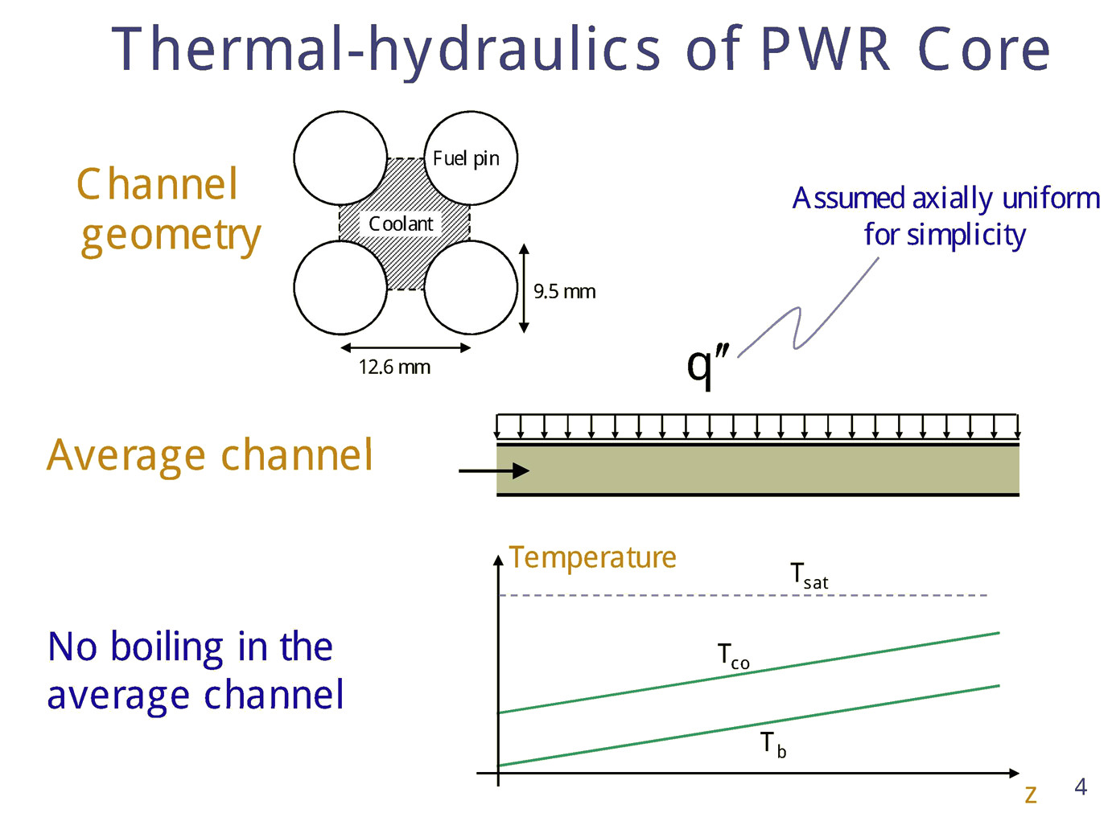

Slide 23
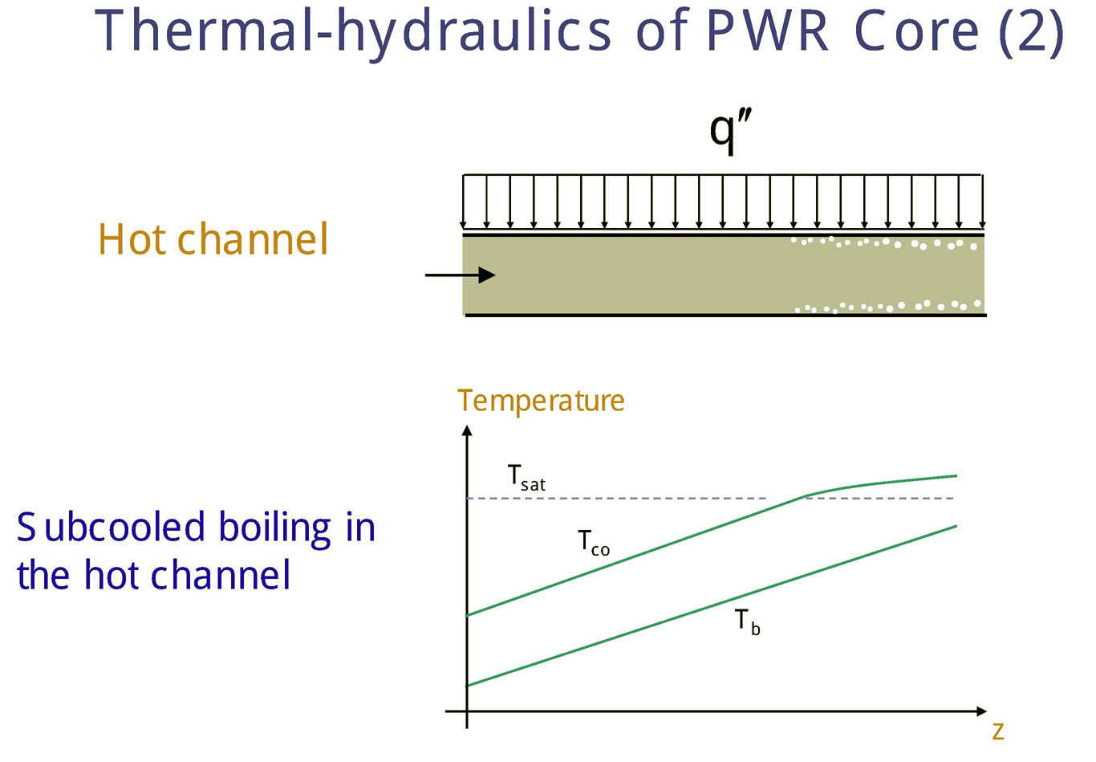

Slide 24
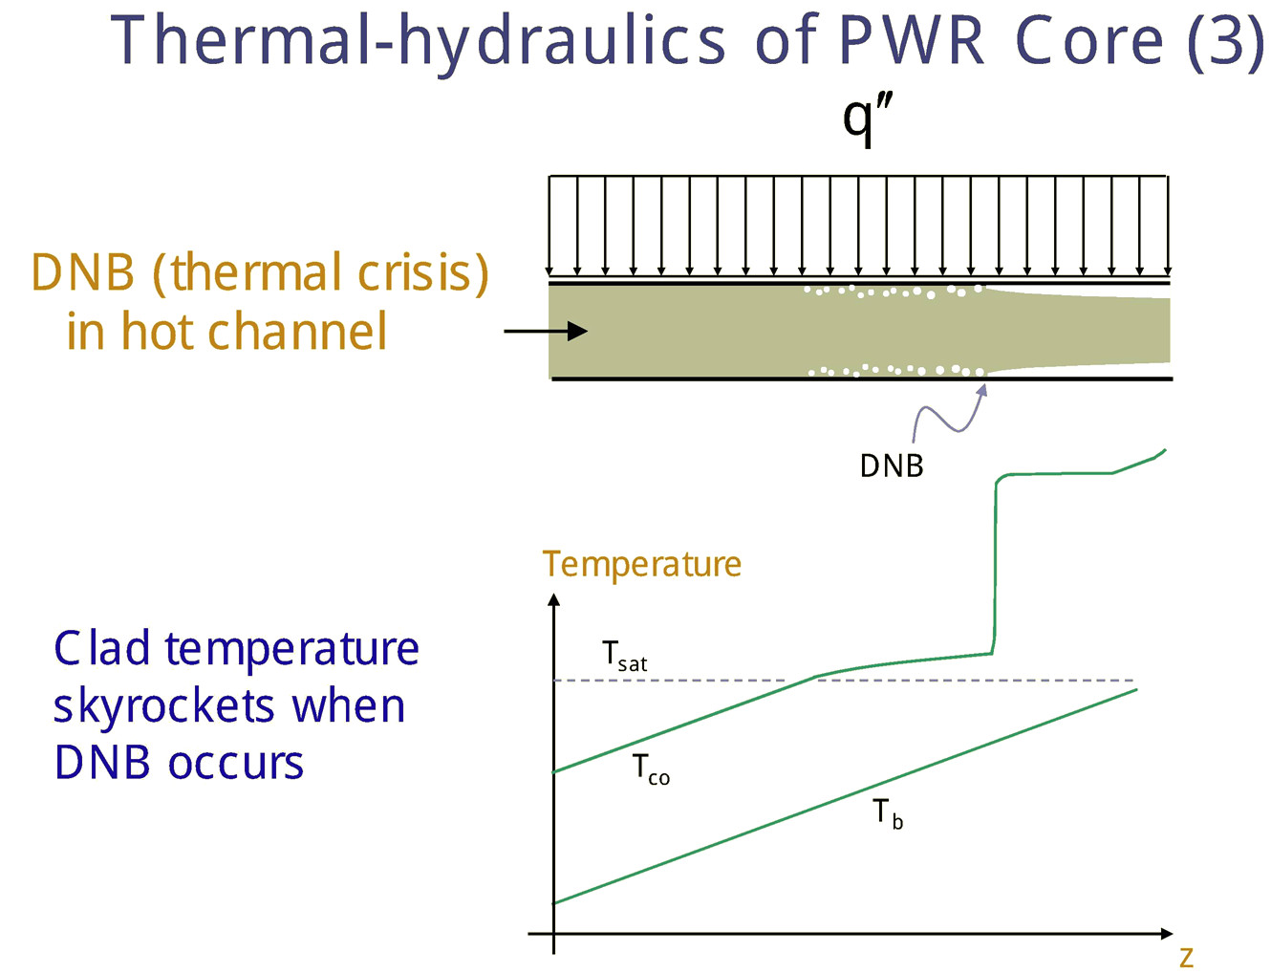

Slide 25
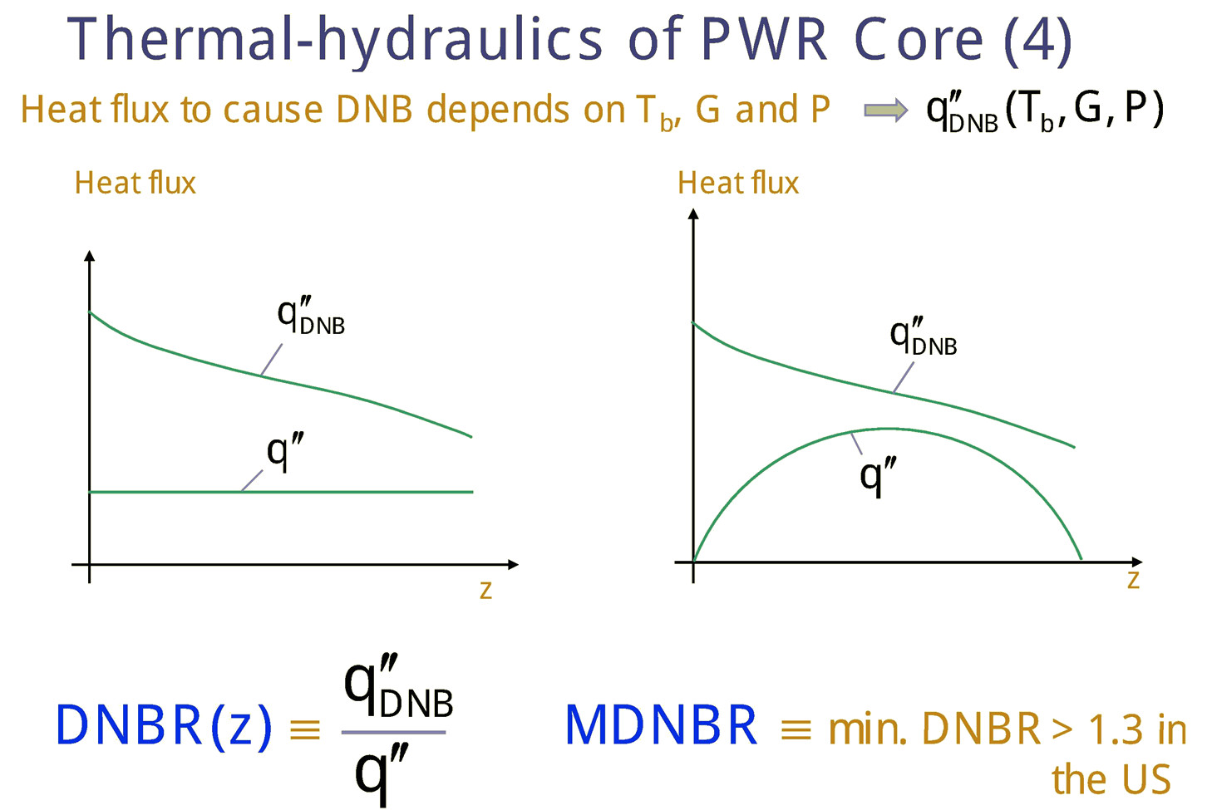

Slide 26
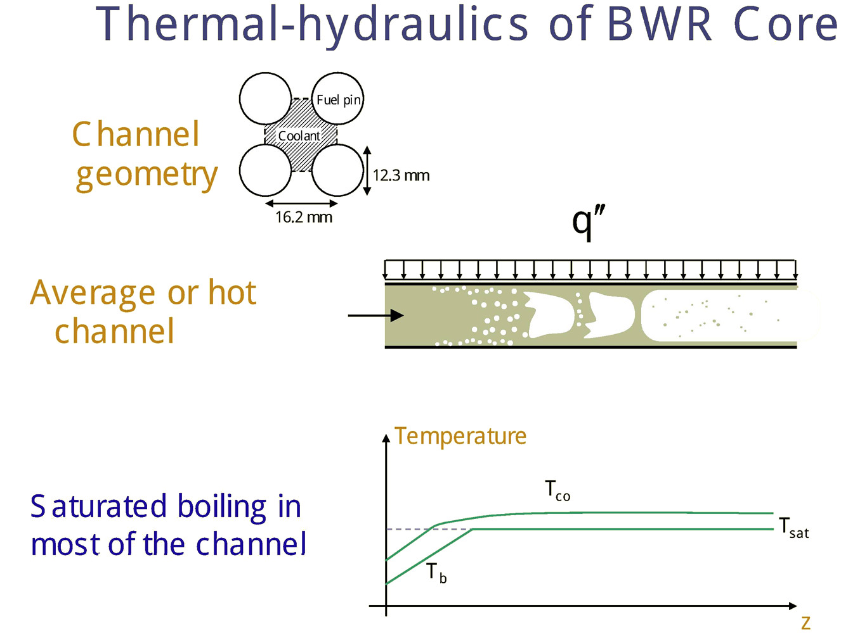

Slide 27
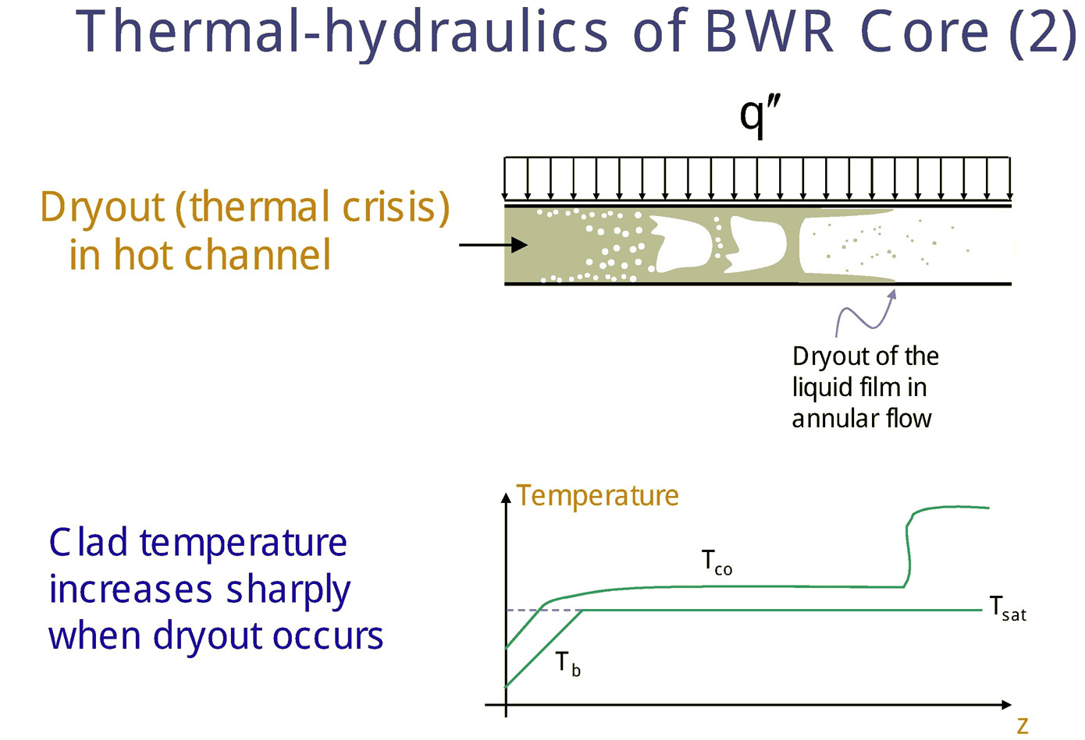

Slide 28
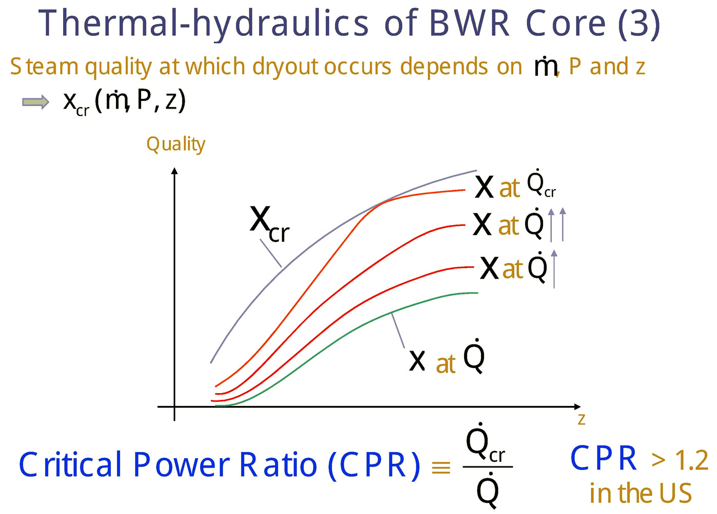

Slide 29
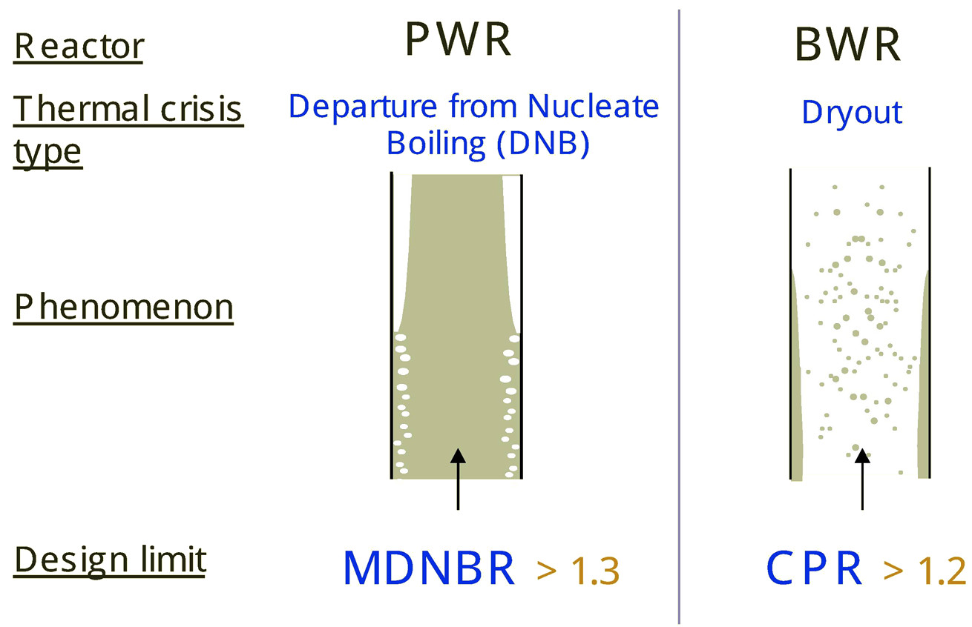
Thermal Crisis Summary
MDNBR > 1.17 (Japan)

Slide 30
Hot-spot Factors
Hot spot factor (hot-channel factor) is safety factor or margin multiplied to calculated nominal temperatures.
Deviation from nominal values contributed by
  Nuclear hot-spot factors
  Engineering hot-spot factors

Slide 31
Nuclear Hot-spot Factors
Deviations due to
  Partially inserted control rods
  Nonhomogeneities
    Moderator (boiling)
    Fuel
    Structural and other materials

Slide 32
Engineering Hot-spot Factors
Deviations due to
  Mechanical subfactors
    Manufacturing tolerances (clad thickness)
    Warping of fuel elements
  Flow distribution subfactors
    Maldistribution of coolant flow
    Heat transfer coefficient, h
    Fuel element dimensions

Slide 33
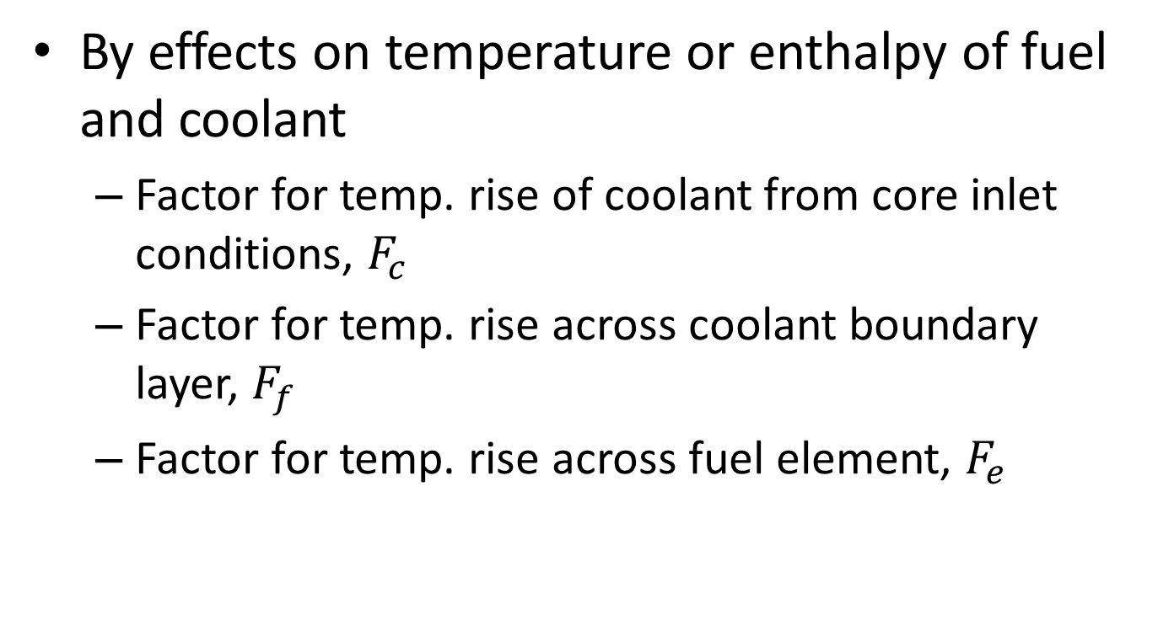
Hot-spot Factors (classified by effects)
By effects on temperature or enthalpy of fuel and coolant
  Factor for temp. rise of coolant from core inlet conditions, $F_{c}$
  Factor for temp. rise across coolant boundary layer, $F_{f}$
  Factor for temp. rise across fuel element, $F_{e}$

Slide 34
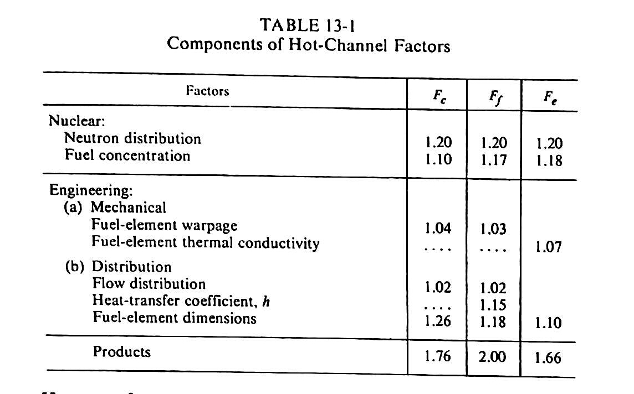

Slide 35
Overall Hot-spot Factor
Combining hot-spot subfactors, f, to get overall hot-spot factor, F.
Methods;
  Multiplicative
    All deviation factors are assumed to take place simultaneously at the same point.
    Overly conservative result
  Statistical
    Many deviation factors are independent of each other
    Small probability of occurring at the same point
    More realistic result

Slide 36
References
Todreas, Kazimi, Nuclear Systems, Thermal Hydraulic Fundamentals, CRC Press
Lamarsh, Introduction to Nuclear Engineering, Prentice-Hall
M M ElWakil, Nuclear Heat Transport, International Textbook Company
Buongiorno, Notes on Two Phase Flow, Boiling Heat Transfer, and Boiling Crises in PWRs and BWRs, MIT
Buongiorno, Boiling Crisis in LWRs, MIT
Reactor Thermal Engineering IIb, ITP @ JAEA, August 2010

