Slide 1
Boiling Heat Transfer Exercise

Slide 2
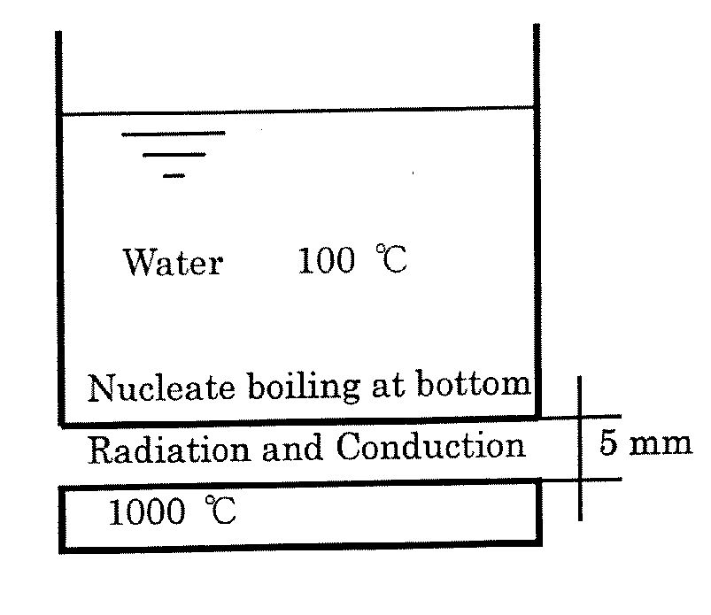
Exercise 4 – Boiling Heat Transfer
Purpose: Finding temperature under boiling heat transfer condition
Method: Using principles of heat transfer and other relevant correlations (Rohsenow). In this case it is necessary to employ an iterative method to solve the final nonlinear equation.
Pressure = 0.1 MPa
Diameter = 20 cm

Slide 3

Exercise 4 – Boiling Heat Transfer
Calculate : The bottom surface temperature of the pan, neglecting resistance of the pan.
Ts = boiling water temperature
Tw = surface temperature of pan
on water side
T2 = bottom surface of pan temperature
$$q=q_{cond}+q_{rad}$$
T1 = hot plate temperature
Between hot plate and pan, both conduction and radiation modes of heat transfer occur in parallel

Slide 4
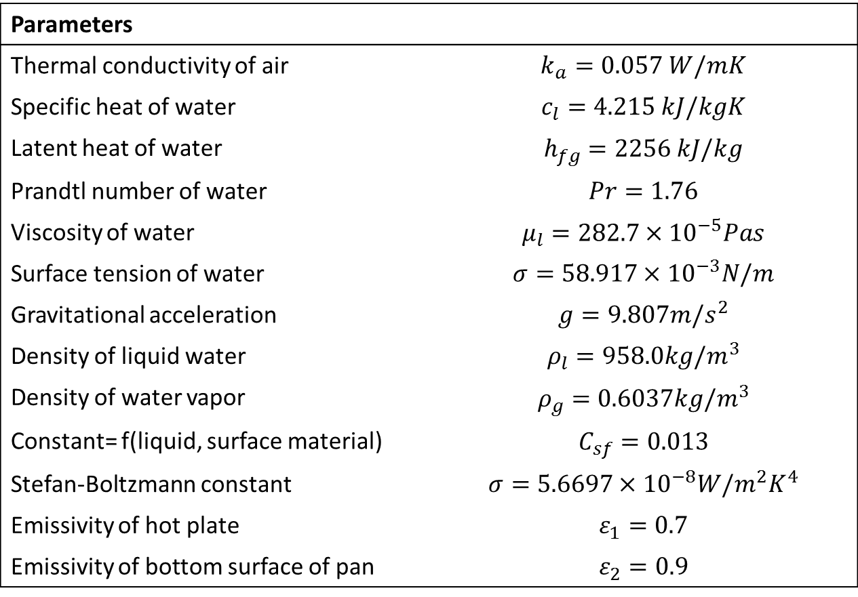
Exercise 4 – Boiling Heat Transfer
Parameters
Thermal conductivity of air | $$k_{a}=0.057 W/mK$$
Specific heat of water | $$c_{l}=4.215 kJ/kgK$$
Latent heat of water | $$h_{fg}=2256 kJ/kg$$
Prandtl number of water | $$Pr=1.76$$
Viscosity of water | $$μ_{l}=282.7×{10}^{−5}Pas$$
Surface tension of water | $$σ=58.917×{10}^{−3}N/m$$
Gravitational acceleration | $$g=9.807m/s^{2}$$
Density of liquid water | $$ρ_{l}=958.0kg/m^{3}$$
Density of water vapor | $$ρ_{g}=0.6037kg/m^{3}$$
Constant= f(liquid, surface material) | $$C_{sf}=0.013$$
Stefan-Boltzmann constant | $$σ=5.6697×{10}^{−8}W/m^{2}K^{4}$$
Emissivity of hot plate | $$ε_{1}=0.7$$
Emissivity of bottom surface of pan | $$ε_{2}=0.9$$

Slide 5

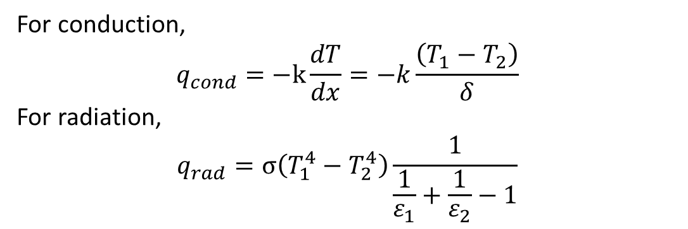
Exercise 4 – Boiling Heat Transfer
T2 = Tw (neglecting resistance of pan), solve for T2
Between hot plate and pan, both conduction and radiation modes of heat transfer occur in parallel
$$q=q_{cond}+q_{rad}$$
For conduction,
$$q_{cond}=−k\frac{dT}{dx}=−k\frac{\left(T_{1}−T_{2}\right)}{δ}$$
For radiation,
$$q_{rad}=σ\left(T_{1}^{4}−T_{2}^{4}\right)\frac{1}{\frac{1}{ε_{1}}+\frac{1}{ε_{2}}−1}$$

Slide 6
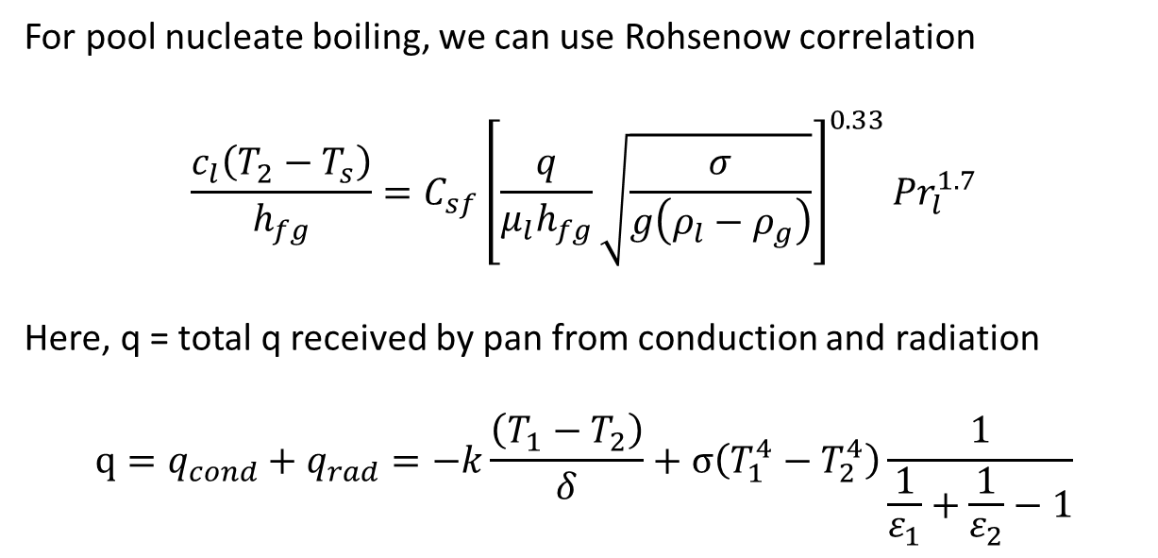
Exercise 4 – Boiling Heat Transfer
For pool nucleate boiling, we can use Rohsenow correlation
$$\frac{c_{l}\left(T_{2}−T_{s}\right)}{h_{fg}}=C_{sf}{\left[\frac{q}{μ_{l}h_{fg}}\sqrt{\frac{σ}{g\left(ρ_{l}−ρ_{g}\right)}}\right]}^{0.33}{Pr}_{l}^{1.7}$$
Here, q = total q received by pan from conduction and radiation
$$q=q_{cond}+q_{rad}=−k\frac{\left(T_{1}−T_{2}\right)}{δ}+σ\left(T_{1}^{4}−T_{2}^{4}\right)\frac{1}{\frac{1}{ε_{1}}+\frac{1}{ε_{2}}−1}$$

Slide 7
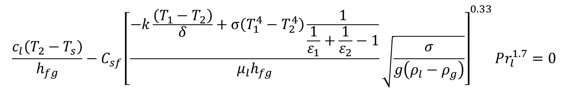
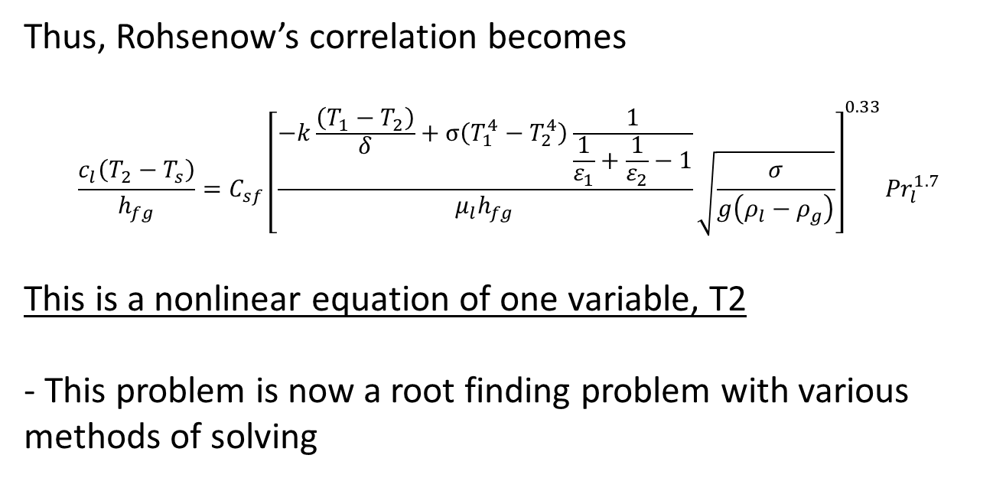
Exercise 4 – Boiling Heat Transfer
Thus, Rohsenow’s correlation becomes
$$\frac{c_{l}\left(T_{2}−T_{s}\right)}{h_{fg}}=C_{sf}{\left[\frac{−k\frac{\left(T_{1}−T_{2}\right)}{δ}+σ\left(T_{1}^{4}−T_{2}^{4}\right)\frac{1}{\frac{1}{ε_{1}}+\frac{1}{ε_{2}}−1}}{μ_{l}h_{fg}}\sqrt{\frac{σ}{g\left(ρ_{l}−ρ_{g}\right)}}\right]}^{0.33}{Pr}_{l}^{1.7}$$
This is a nonlinear equation of one variable, T2
- This problem is now a root finding problem with various methods of solving
$$\frac{c_{l}\left(T_{2}−T_{s}\right)}{h_{fg}}−C_{sf}{\left[\frac{−k\frac{\left(T_{1}−T_{2}\right)}{δ}+σ\left(T_{1}^{4}−T_{2}^{4}\right)\frac{1}{\frac{1}{ε_{1}}+\frac{1}{ε_{2}}−1}}{μ_{l}h_{fg}}\sqrt{\frac{σ}{g\left(ρ_{l}−ρ_{g}\right)}}\right]}^{0.33}{Pr}_{l}^{1.7}=0$$

Slide 8
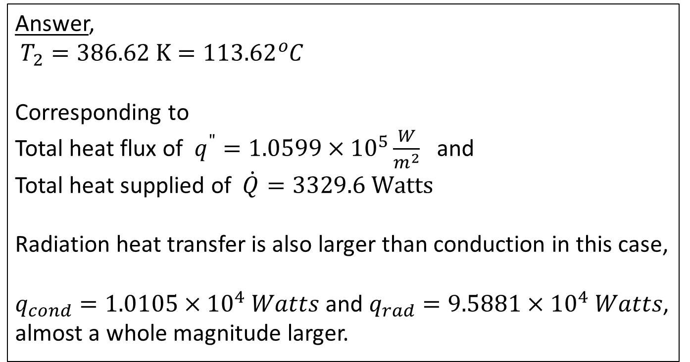
Exercise 4 – Boiling Heat Transfer
Using Octave (a free Matlab clone), the built-in function of fzero employs the Newton-Raphson method to give the root (=T2) of the equation
We also used the Excel spreadsheet to perform manual iteration to find T2.
Answer,
$T_{2}=386.62 K=113.62{}_{}^{o}C$
Corresponding to
Total heat flux of $q^{"}=1.0599×{10}^{5}\frac{W}{m^{2}}$ and
Total heat supplied of $\dot{Q}=3329.6 Watts$
Radiation heat transfer is also larger than conduction in this case,
$q_{cond}=1.0105×{10}^{4} Watts$ and $q_{rad}=9.5881×{10}^{4} Watts$, almost a whole magnitude larger.

Slide 9
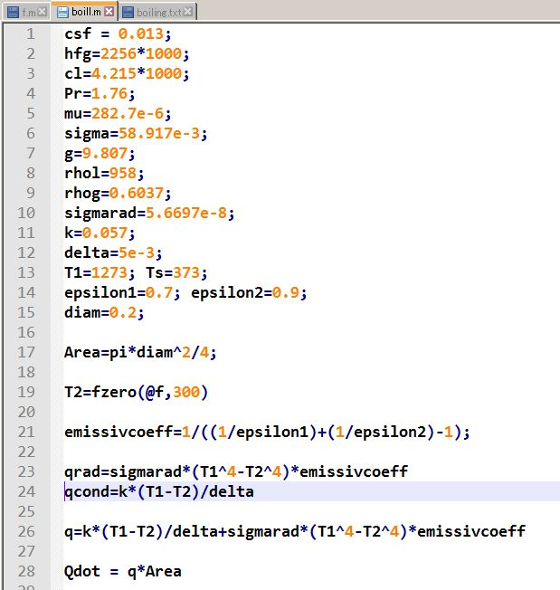
Exercise 4 – Boiling Heat Transfer
Program listing and output
Main Program

Slide 10
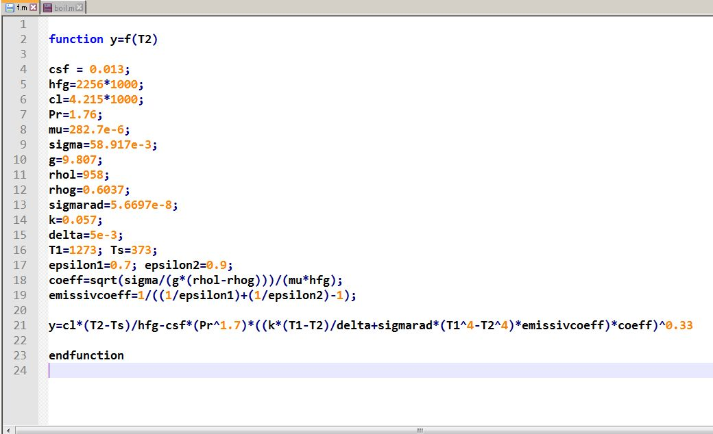
Exercise 4 – Boiling Heat Transfer
Function file to find root for

Slide 11
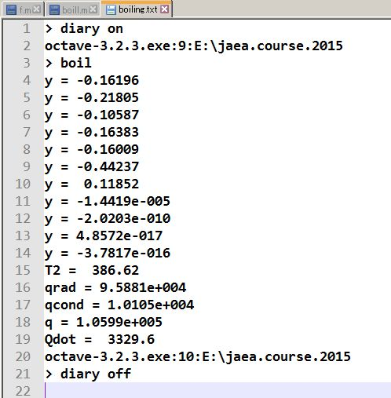
Exercise 4 – Boiling Heat Transfer
Output

Slide 12
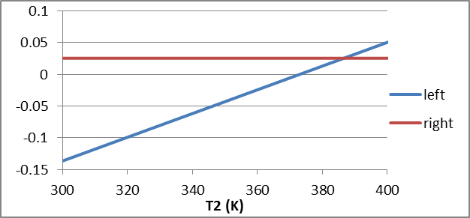
Exercise 4 – Boiling Heat Transfer
Excel output

