Slide 1
Boiling Heat Transfer
Mohsin Mohd Sies
Universiti Teknologi Malaysia
mohsin@fkm.utm.my
http://www.fkm.utm.my/~mohsin

Slide 2
Introduction
In LWRs, boiling is the mechanism of carrying away heat to be converted into mechanical work in the steam turbine.
Good boiling characteristics has to be maintained.
However, boiling crisis must be avoided to prevent catastrophe.
If thermal crisis occurs, the cladding will fail and fission products will be released.

Slide 3
Objectives
To introduce the importance of boiling heat transfer.
To introduce terms used in boiling heat transfer.
To understand the classification and phenomena of boiling.
To understand the boiling curve
To introduce some correlations applicable to boiling.
To understand the importance of boiling crisis in LWR.
To introduce some elements of two phase flow.

Slide 4
Boiling
Occurs at the solid–liquid interface when a liquid is brought into contact with a surface maintained at a temperature sufficiently above the saturation temperature of the liquid.

Slide 5

Newton's Law of Cooling
Boiling heat flux from a solid surface to the fluid
$$q_{boiling}^{′′}=h\left(T_{s}−T_{sat}\right)=h{∆T}_{excess}$$
$${∆T}_{excess}=T_{s}−T_{sat}$$
= Excess temperature
Ts = Temperature of heating surface
Tsat= Saturation temp of liquid
h = convective heat transfer coefficient.

Slide 6
Classification of Boiling
1) Based on Bulk Fluid Motion
a. Pool Boiling
b. Flow Boiling
2) Based on Bulk liquid temperature
a. Sub-cooled Boiling
b. Saturated Boiling

Slide 7
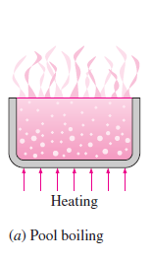
Pool Boiling
Boiling in absence of bulk fluid flow
Fluid body is stationary
Any possible fluid motion will be due to natural convection currents
E.g. boiling of water in a pan on stove

Slide 8
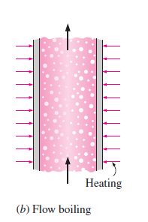
Flow Boiling/Forced Convection Boiling
Boiling in presence of bulk fluid flow
Fluid is forced to flow in a heated pipe or over a surface by pump etc
Convection effects will be present

Slide 9
Sub-cooled Boiling
Boiling is sub-cooled if temperature of main body of fluid is below the saturation temp Tsat (i.e. bulk of liquid is sub-cooled)
It occurs at early stages of boiling
Bubbles formation and disappearance near hot surface
Bubbles disappear as they transfer heat to surrounding sub-cooled liquid
Boiling is confined to locality of hot surface so also called local boiling

Slide 10
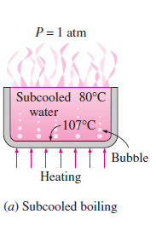
Contd…
Bubbles serve as energy movers and transfer heat to fluid by condensing

Slide 11
Inception of Boiling
Boiling starts with
  Temperature > Tsat
  Nucleation sites
Without nucleation sites, liquid can be superheated beyond Tsat (metastable state)

Slide 12
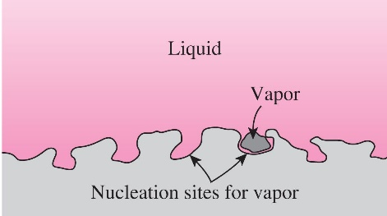
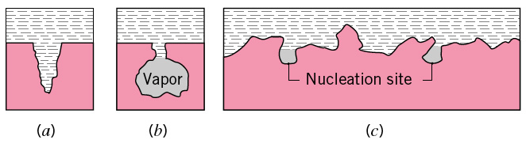
Nucleation Sites

Slide 13
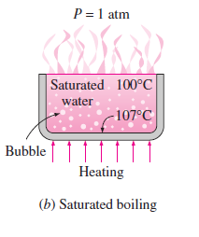
Saturated/Bulk Boiling
Boiling is saturated if temperature of main body of fluid is equal to the saturation temp Tsat (i.e. bulk of liquid is saturated)
It occurs when entire liquid body reaches saturation temperature
Bubbles rise to the top

Slide 14
Boiling Curve for Pool Boiling
Four regimes/phases of pool boiling with change in excess temperature :
Natural Convection Boiling
Nucleate Boiling
Transition Boiling
Film Boiling

Slide 15
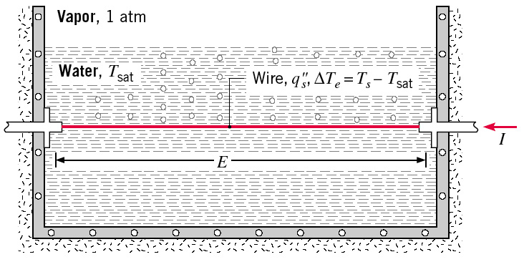
Boiling Curve
Nukiyama’s Experiment (1934)
Used electrically heated nichrome and platinum wires immersed in liquids in his experiments. Nukiyama noticed that boiling takes different forms, depending on the value of the excess temperature ΔTexcess

Slide 16
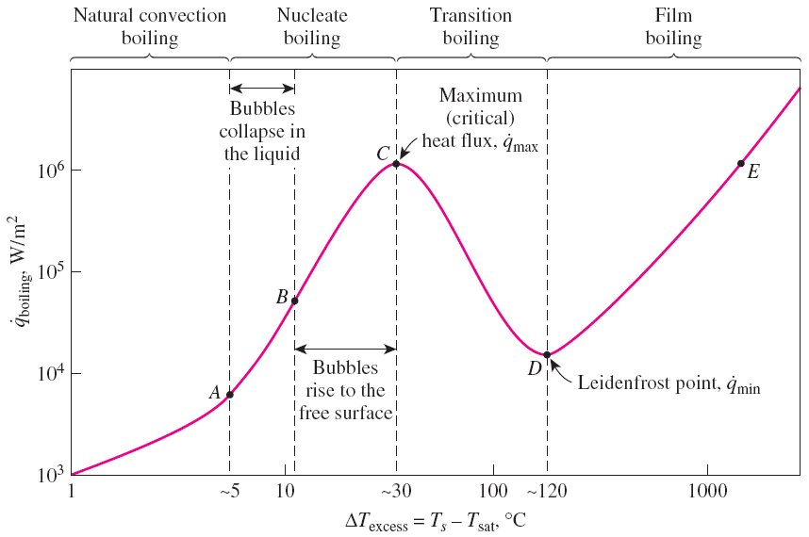
Boiling curve

Slide 17
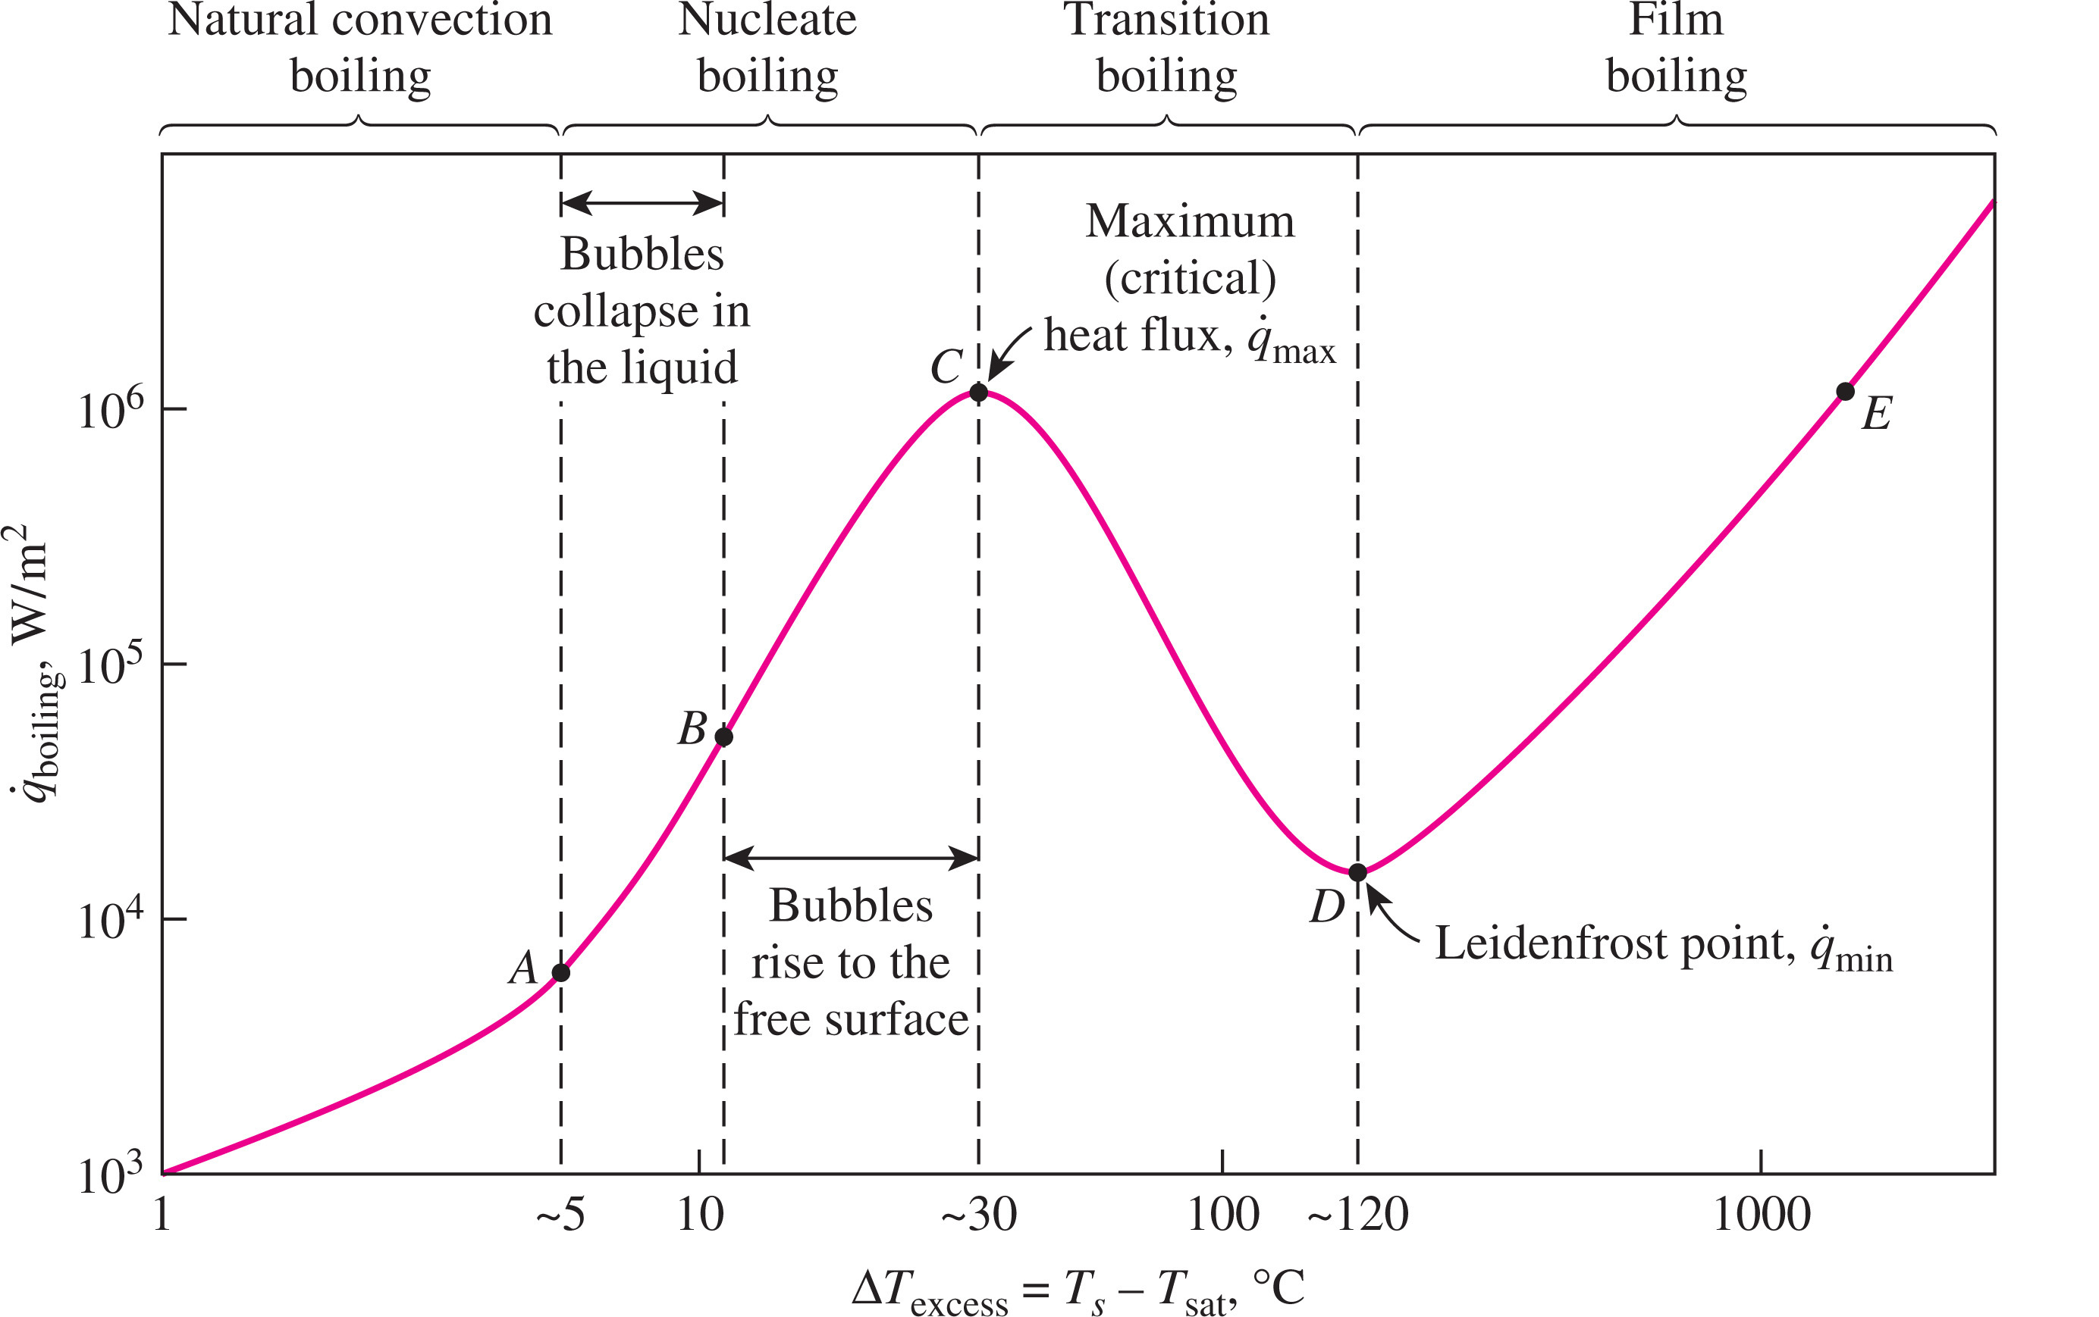
Boiling Curve

Slide 18
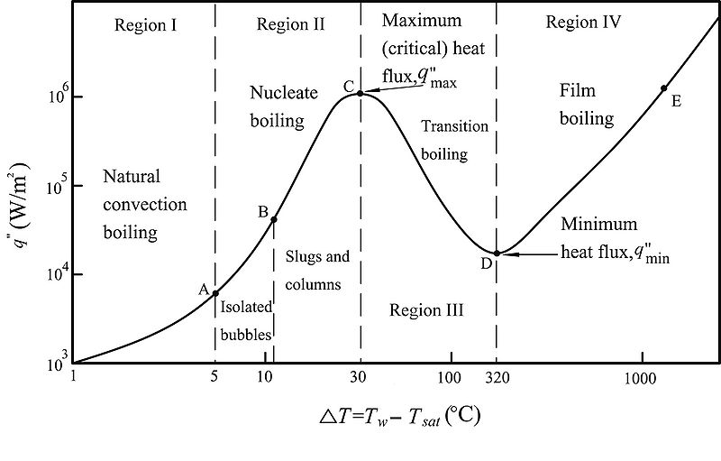
Boiling Curve

Slide 19
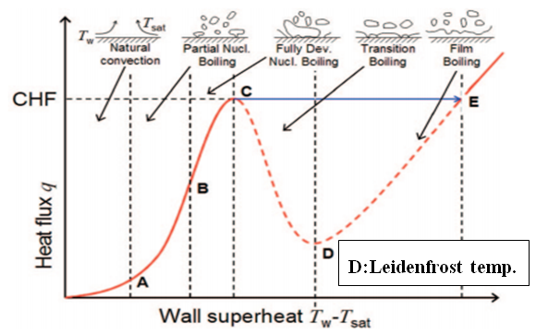
Boiling Curve

Slide 20
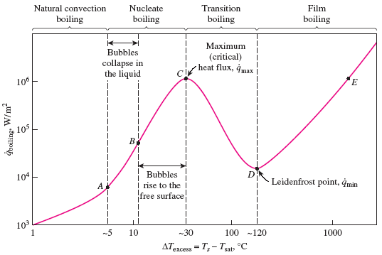
Natural Convection Boiling
(to Point A on the Boiling Curve)
Bubbles do not form on the heating surface until the liquid is heated a few degrees above the saturation temperature (about 2 to 6°C for water)
The liquid is slightly superheated in this case (metastable state).
The fluid motion in this mode of boiling is governed by natural convection currents.
Heat transfer from the heating surface to the fluid is by natural convection.
The natural convection boiling ends at an excess temperature of about 5°C.

Slide 21
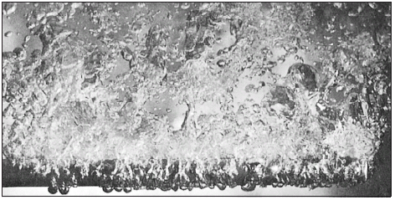
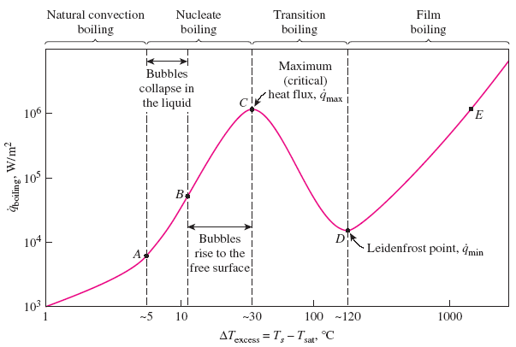
Nucleate Boiling (between Points A and C)
The bubbles form at an increasing rate at an increasing number of nucleation sites as we move along the boiling curve toward point C.
Region A–B ─ isolated bubbles.
Region B–C ─ numerous continuous columns of vapor in the liquid.
Point A is referred to as the onset of nucleate
boiling (ONB).

Slide 22
In region A–B the stirring and agitation caused by the entrainment of the liquid to the heater surface is primarily responsible for the increased heat transfer coefficient.
In region A–B the large heat fluxes obtainable in this region are caused by the combined effect of liquid entrainment and evaporation.
For the entire nucleate boiling range, the heat transfer coefficient ranges from about 2000 to 30,000 W/m²·K.
After point B the heat flux increases at a lower rate with increasing ΔT_{excess}, and reaches a maximum at point C.
The heat flux at this point is called the critical (or maximum) heat flux, and is of prime engineering importance.

Slide 23
Boiling Crisis
A variety of names for Point C
Burnout point
Peak heat flux
Boiling crisis (Russian)
DNB — Departure from Nucleate Boiling
CHF — Critical Heat Flux
Boiling Transition (BT)

Slide 24
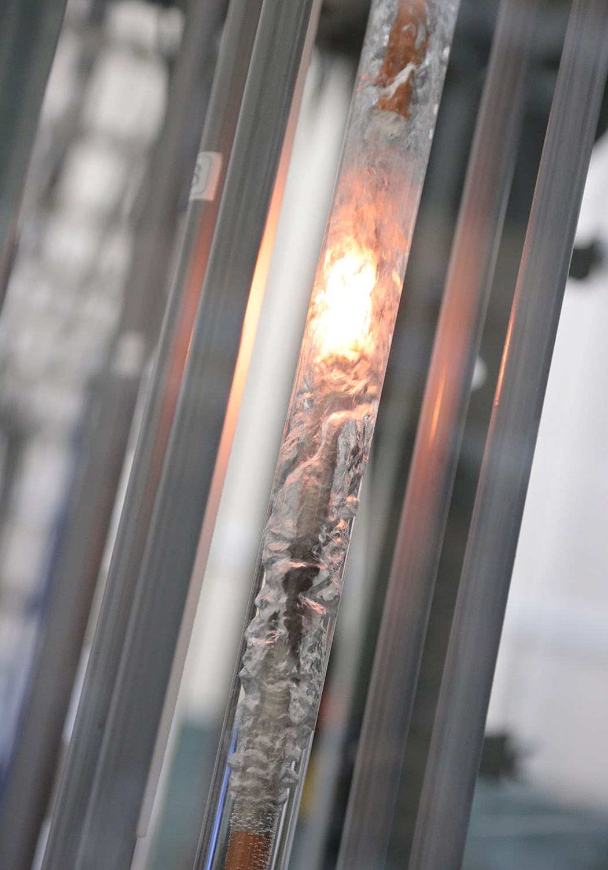
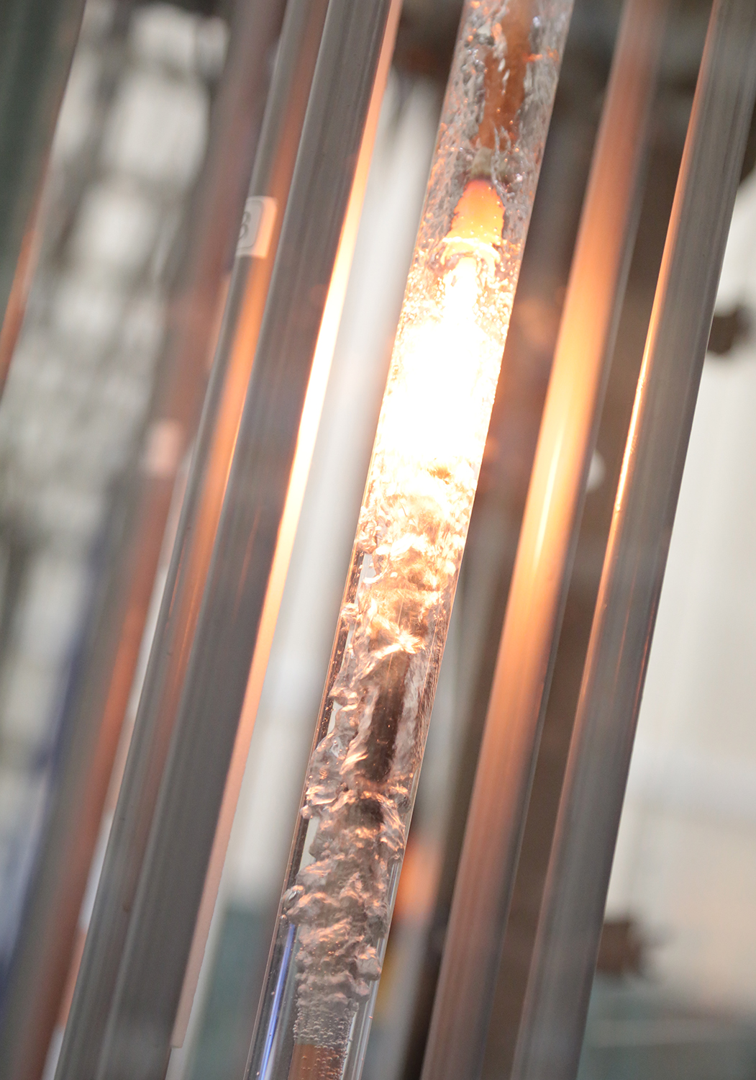
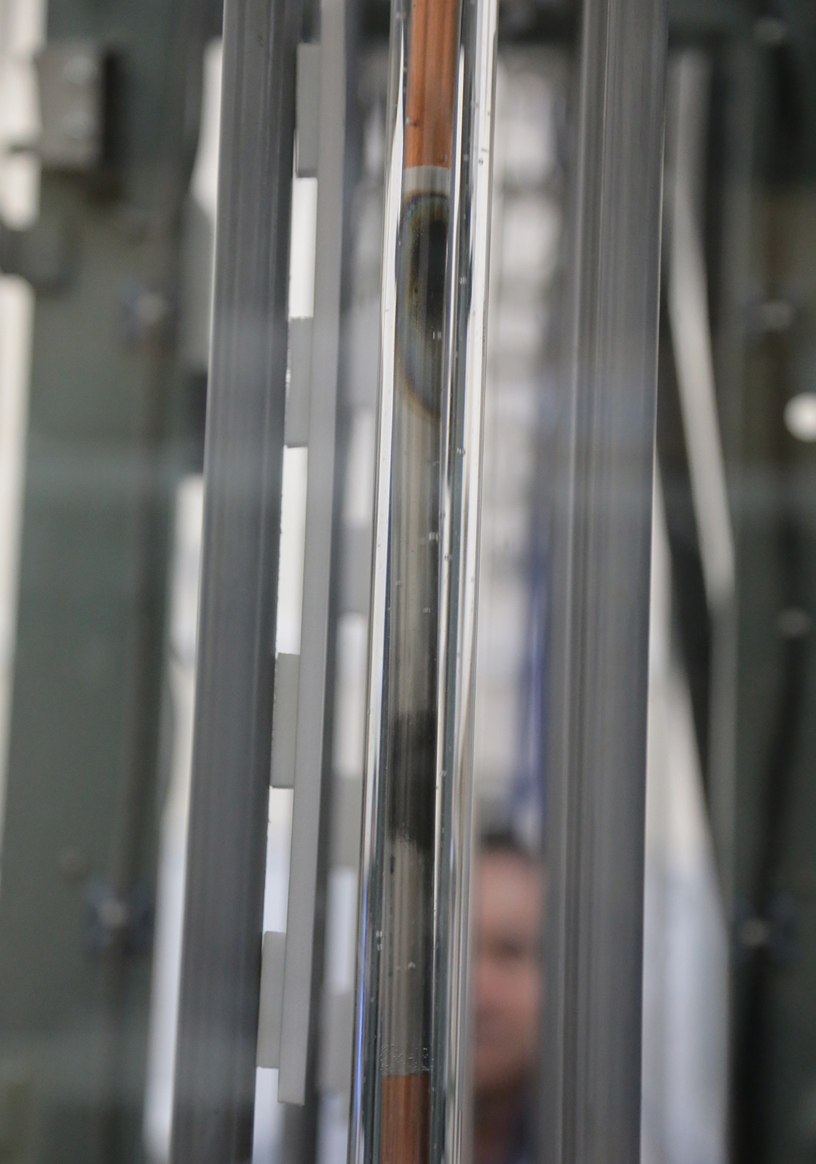
Burnout Phenomenon

Slide 25
Transition Boiling (between Points C and D)
When ΔT_{excess} is increased past point C, the heat flux decreases.
This is because a large fraction of the heater surface is covered by a vapor film, which acts as an insulation.
In the transition boiling regime, both nucleate and film boiling partially occur.
Operation in the transition boiling regime, which is also called the unstable film boiling regime, is avoided in practice.
For water, transition boiling occurs over the excess temperature range from about 30°C to about 120°C.

Slide 26
Film Boiling (beyond Point D)
Beyond point D the heater surface is completely covered by a continuous stable vapor film.
Point D, where the heat flux reaches a minimum is called the Leidenfrost point.
The presence of a vapor film between the heater surface and the liquid is responsible for the low heat transfer rates in the film boiling region.
The heat transfer rate increases with increasing excess temperature due to radiation to the liquid.

Slide 27
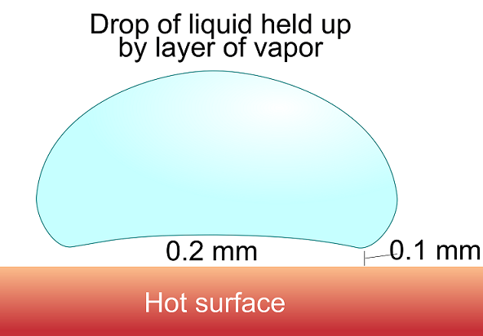
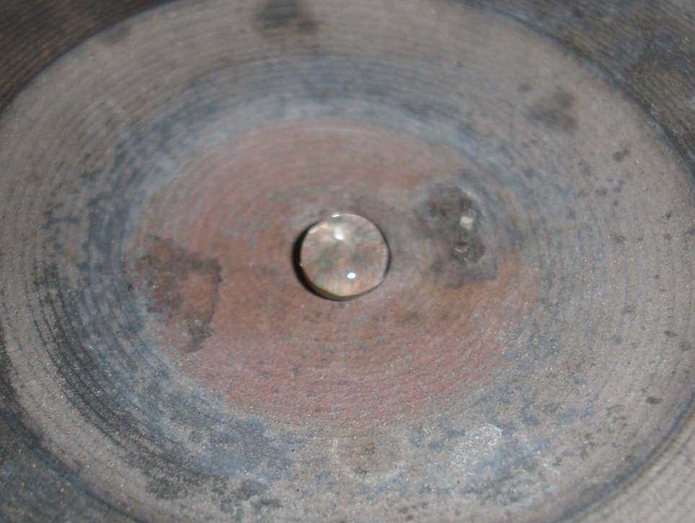
Leidenfrost Effect

Slide 28
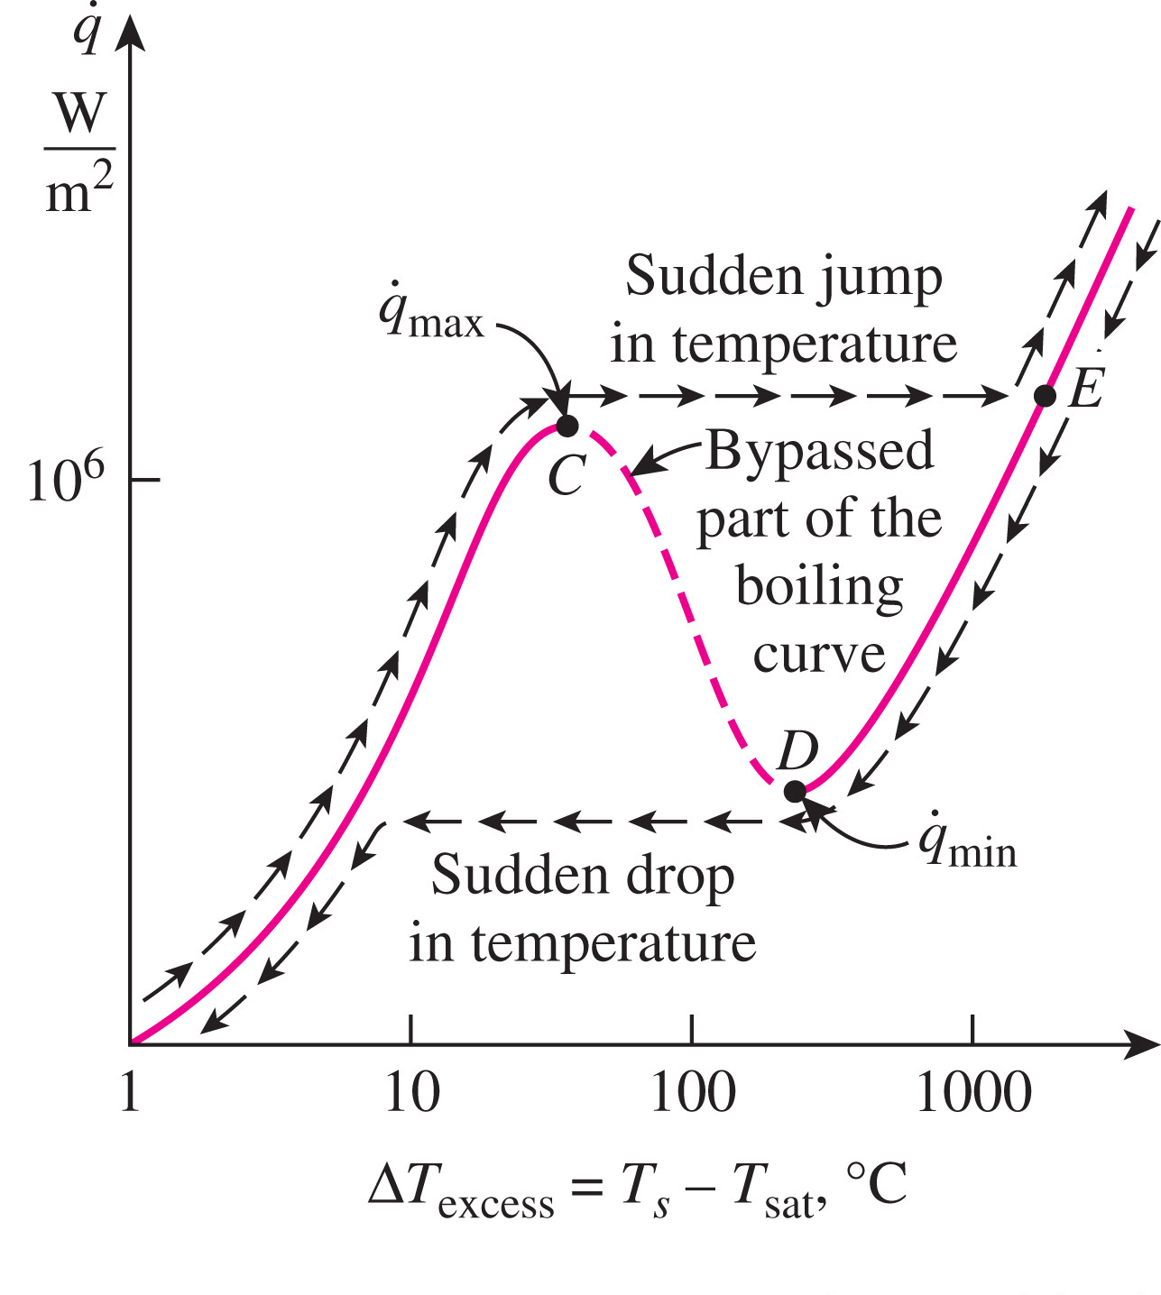
Boiling Curve Hysteresis

Slide 29
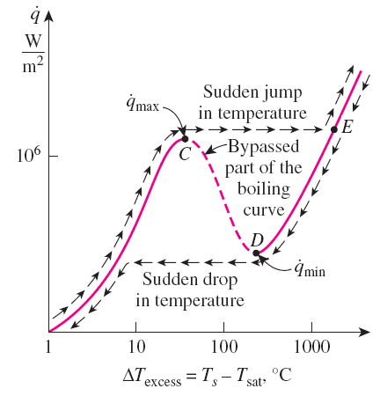
Burnout Phenomenon
A typical boiling process does not follow the boiling curve beyond point C.
When the power applied to the heated surface exceeded the value at point C even slightly, the surface temperature increased suddenly to point E.
When the power is reduced gradually starting from point E the cooling curve follows with a sudden drop in excess temperature when point D is reached.
Hysteresis of boiling curve

Slide 30
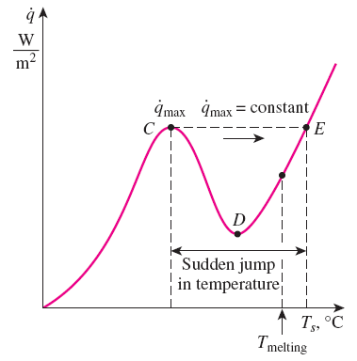
Any attempt to increase the heat flux beyond q_{max} will cause the operation point on the boiling curve to jump suddenly from point C to point E.
However, surface temperature that corresponds to point E is beyond the melting point of most heater materials, and burnout occurs.
Therefore, point C on the boiling curve is also called the burnout point, and the heat flux at this point the burnout heat flux.
Most boiling heat transfer equipment in practice operate slightly below q_{max} to avoid any disastrous burnout.

Slide 31
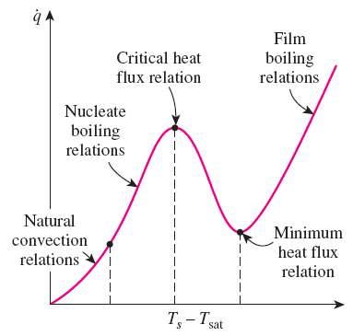
Heat Transfer Correlations in Pool Boiling
Boiling regimes differ considerably in their character.
Different heat transfer relations need to be used for different boiling regimes.
In the natural convection boiling regime heat transfer rates can be accurately determined using natural convection relations (e.g. Dittus-Boelter relation).
Nucleate Boiling
No general theoretical relations for heat transfer in the nucleate boiling regime is available.
Experimental based correlations are used.
The rate of heat transfer strongly depends on the nature of nucleation and the type and the condition of the heated surface.

Slide 32
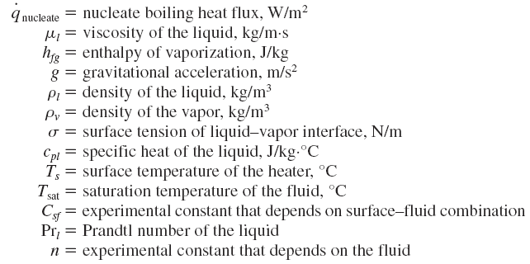
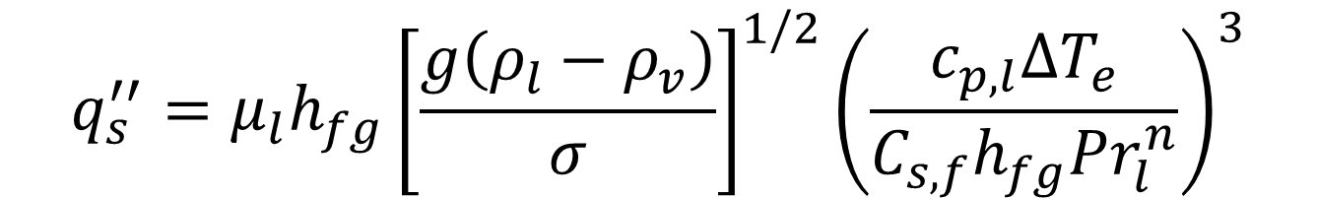

Rohsenow Correlation for Nucleate Boiling
$$q_{s}^{′′}=μ_{l}h_{fg}{\left[\frac{g\left(ρ_{l}−ρ_{v}\right)}{σ}\right]}^{1/2}{\left(\frac{c_{p,l}{∆T}_{e}}{C_{s,f}h_{fg}{Pr}_{l}^{n}}\right)}^{3}$$
$$q_{s}^{′′}$$

Slide 33
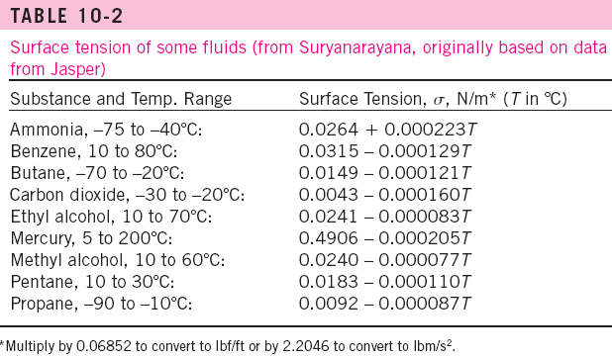
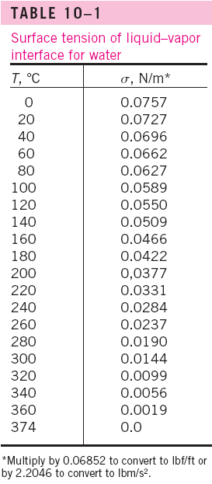
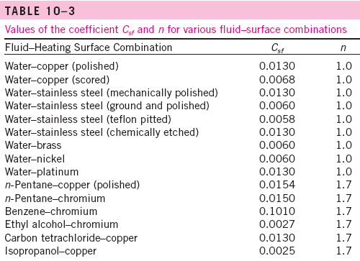
Constants for Rohsenow

Slide 34
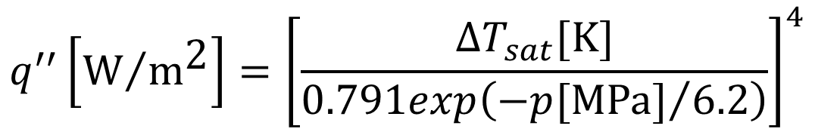
Nucleate Boiling, High Pressures
Jens-Lottes correlation
(commonly used in LWR calculations)
$$q^{′′}\left[{\text{W}}/{{\text{m}}^{\text{2}}}\right]={\left[\frac{{∆T}_{sat}[\text{K}]}{0.791exp\left({−p[\text{MPa}]}/{6.2}\right)}\right]}^{4}$$

Slide 35
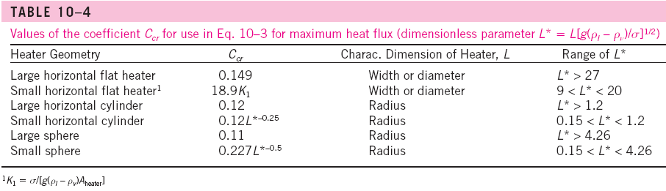
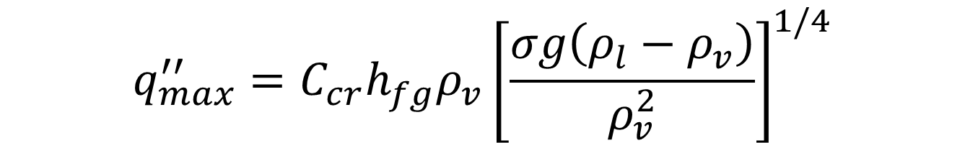
Critical Heat Flux for Nucleate Boiling
Kutateladze, Zuber correlation
$$q_{max}^{′′}=C_{cr}h_{fg}ρ_{v}{\left[\frac{σg\left(ρ_{l}−ρ_{v}\right)}{ρ_{v}^{2}}\right]}^{1/4}$$

Slide 36

Minimum Heat Flux
Zuber correlation
$$q_{min}^{′′}=Ch_{fg}ρ_{v}{\left[\frac{σg\left(ρ_{l}−ρ_{v}\right)}{{\left(ρ_{l}+ρ_{v}\right)}^{2}}\right]}^{1/4}$$

Slide 37
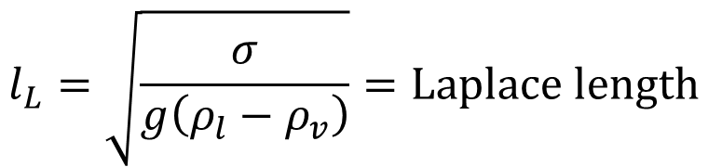
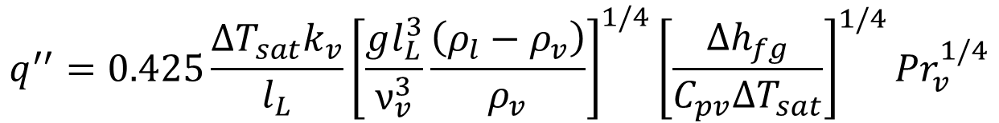
Film Boiling
Berenson Correlation (film boiling on a horizontal surface)
$$q^{′′}=0.425\frac{{∆T}_{sat}k_{v}}{l_{L}}{\left[\frac{gl_{L}^{3}}{ν_{v}^{3}}\frac{\left(ρ_{l}−ρ_{v}\right)}{ρ_{v}}\right]}^{1/4}{\left[\frac{{∆h}_{fg}}{C_{pv}{∆T}_{sat}}\right]}^{1/4}{Pr}_{v}^{1/4}$$
$$l_{L}=\sqrt{\frac{σ}{g\left(ρ_{l}−ρ_{v}\right)}}=\text{Laplace} \text{length}$$

Slide 38
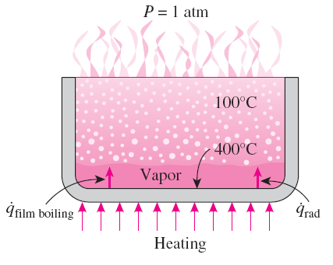



Film Boiling (Radiation Heat Transfer)
At high surface temperatures (typically above 300°C), heat transfer across the vapor film by radiation becomes significant and needs to be considered.

Slide 39
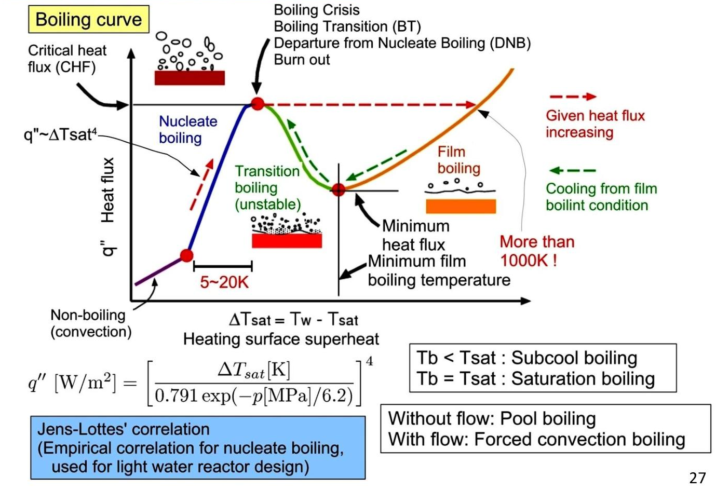

Slide 40
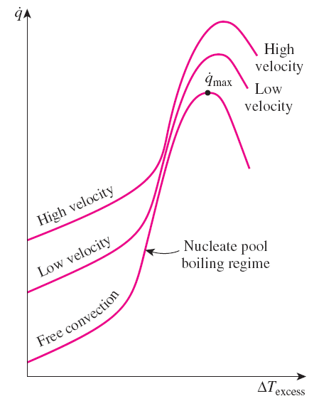
Flow Boiling – of Interest in Nuclear Reactors
In flow boiling, the fluid is forced to move by an external source such as a pump as it undergoes a phase-change process.
It exhibits the combined effects of convection and pool boiling.
External flow boiling over a plate or cylinder is similar to pool boiling, but the added motion increases both the nucleate boiling heat flux and the maximum heat flux considerably.
The higher the velocity, the higher the nucleate boiling heat flux and the critical heat flux.
Internal flow boiling, commonly referred to as two-phase flow, is much more complicated in nature because there is no free surface for the vapor to escape, and thus both the liquid and the vapor are forced to flow together.

Slide 41
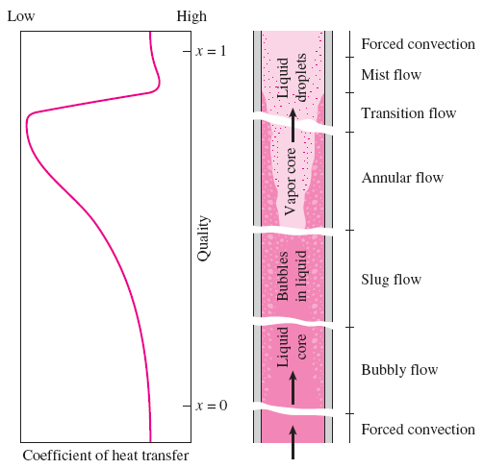
The two-phase flow in a tube exhibits different flow boiling regimes, depending on the relative amounts of the liquid and the vapor phases.
Note that the tube contains a liquid before the bubbly flow regime and a vapor after the mist-flow regime.
Heat transfer in those two cases can be determined using the appropriate relations for single-phase convection heat transfer.

Slide 42
Liquid single-phase flow
  In the inlet region the liquid is subcooled and heat transfer to the liquid is by forced convection (assuming no subcooled boiling).
Bubbly flow
  Individual bubbles
  Low mass qualities
Slug flow
  Bubbles coalesce into slugs of vapor.
  Moderate mass qualities
Annular flow
  Core of the flow consists of vapor only, and liquid adjacent to the walls.
  Very high heat transfer coefficients
Mist flow
  A sharp decrease in the heat transfer coefficient
Vapor single-phase flow
  The liquid phase is completely evaporated and vapor is superheated.

Slide 43
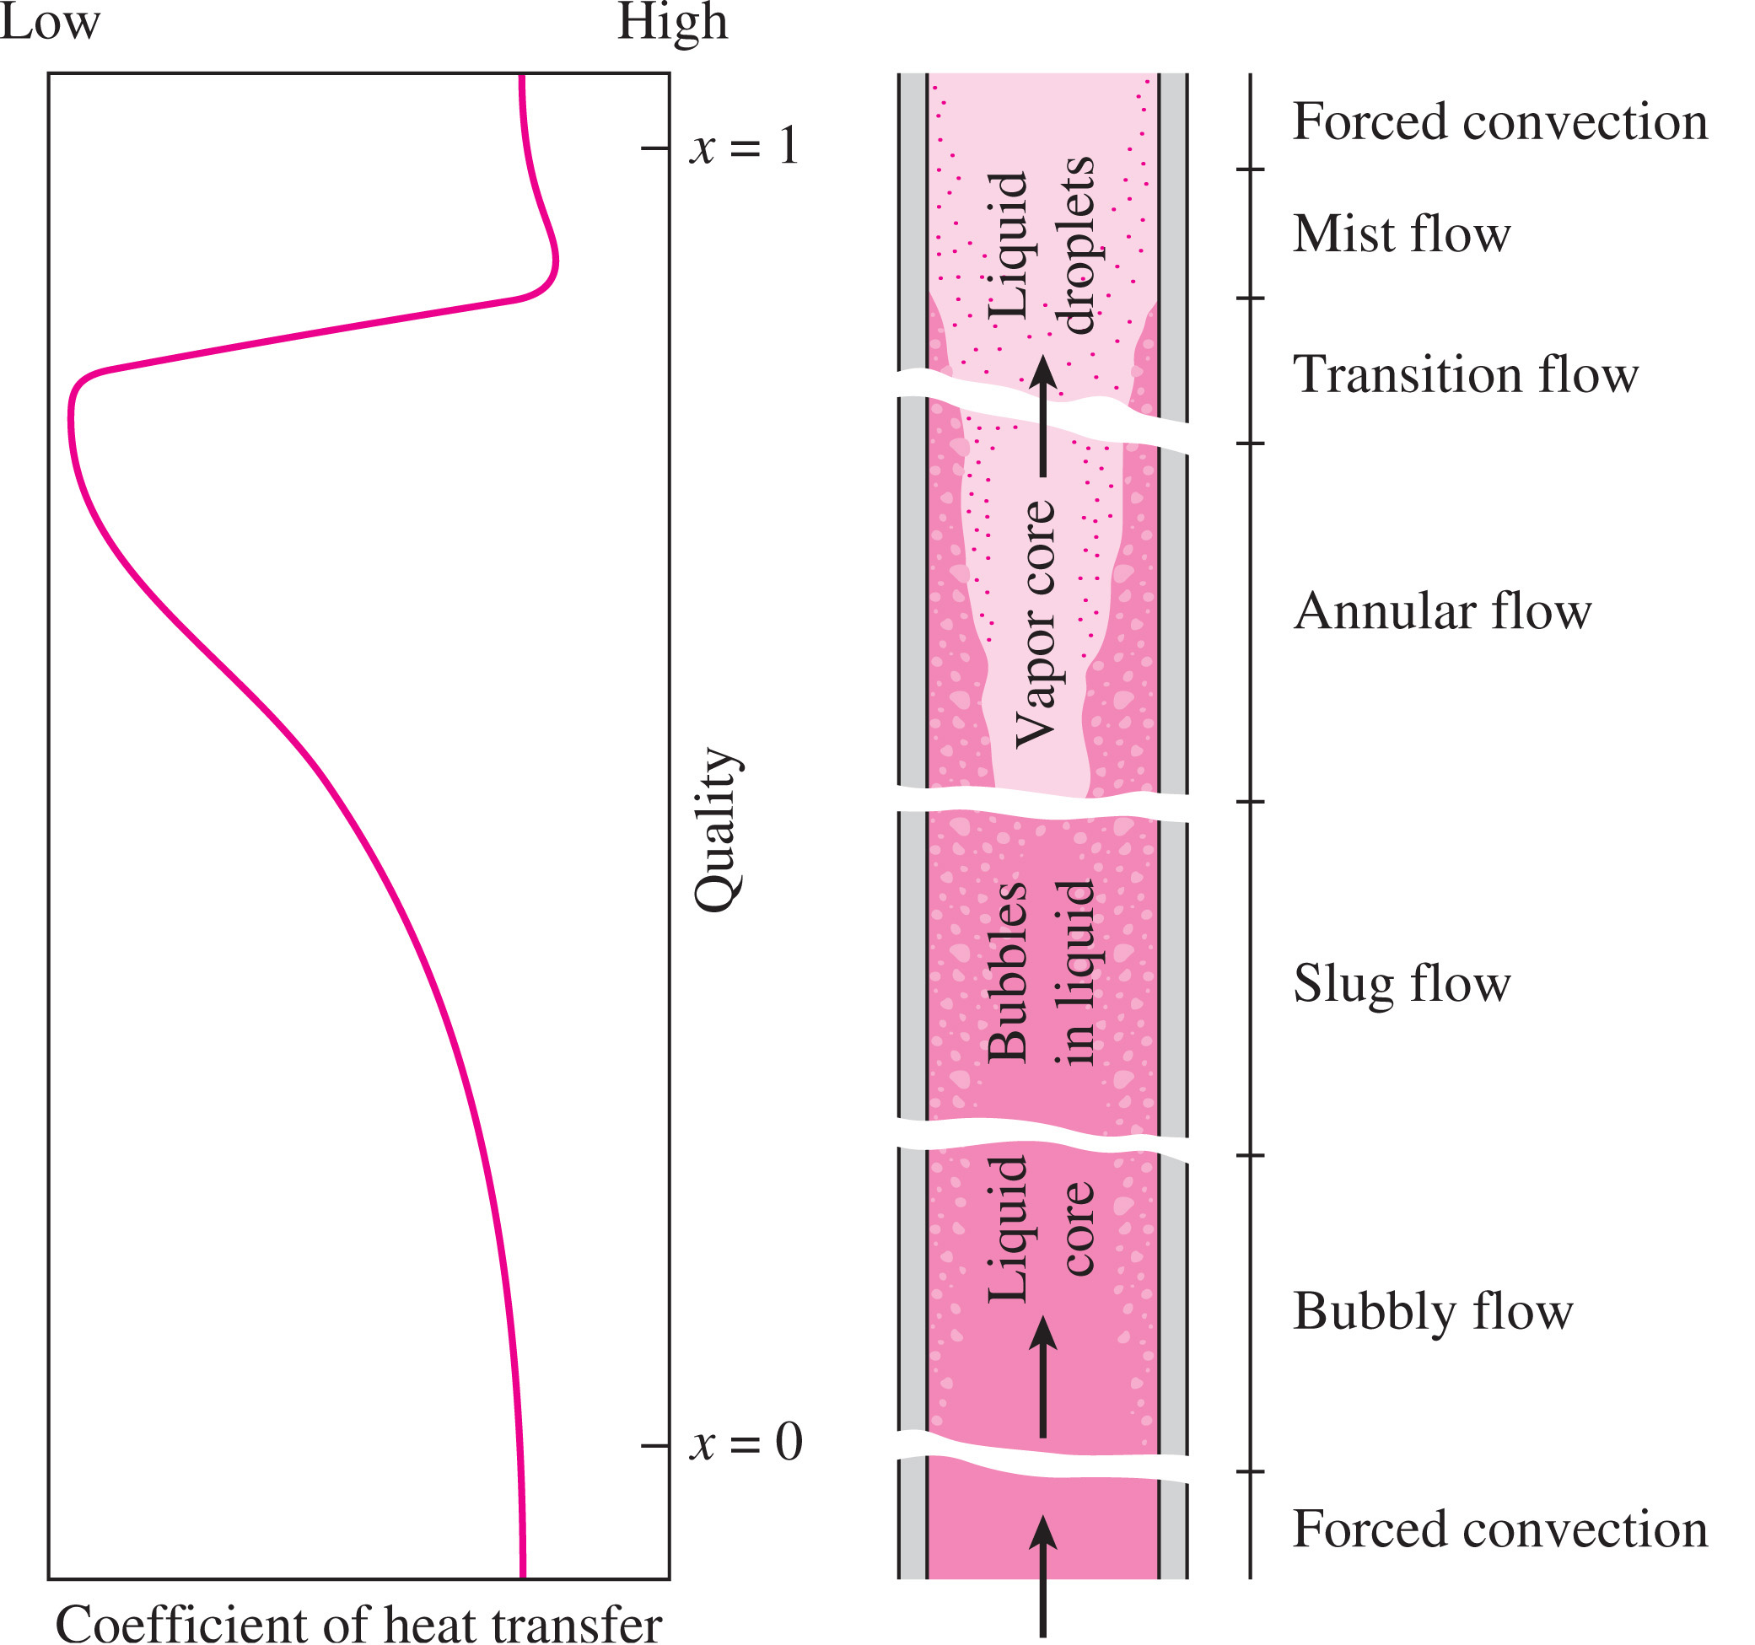
Flow Regime

Slide 44
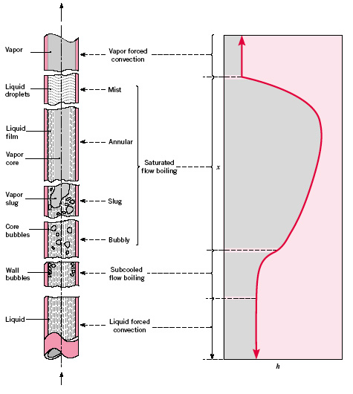
Flow Regime

Slide 45
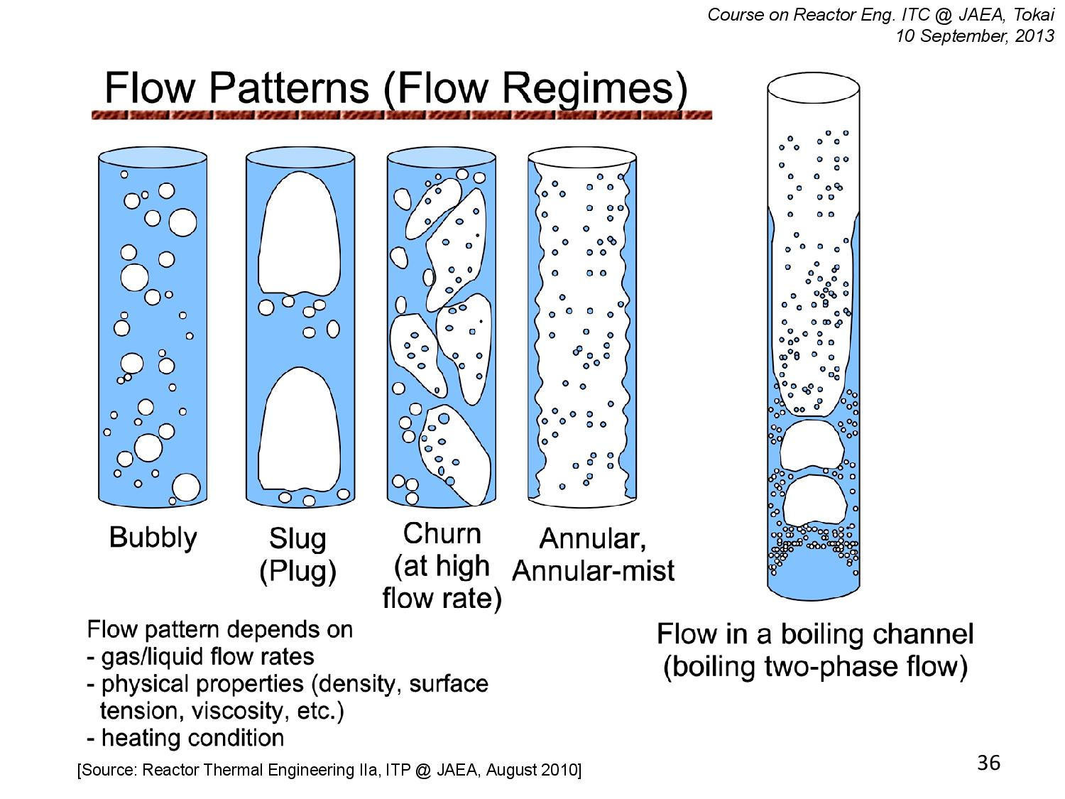

Slide 46
Flow Map
Hewitt and Roberts
1969

Slide 47
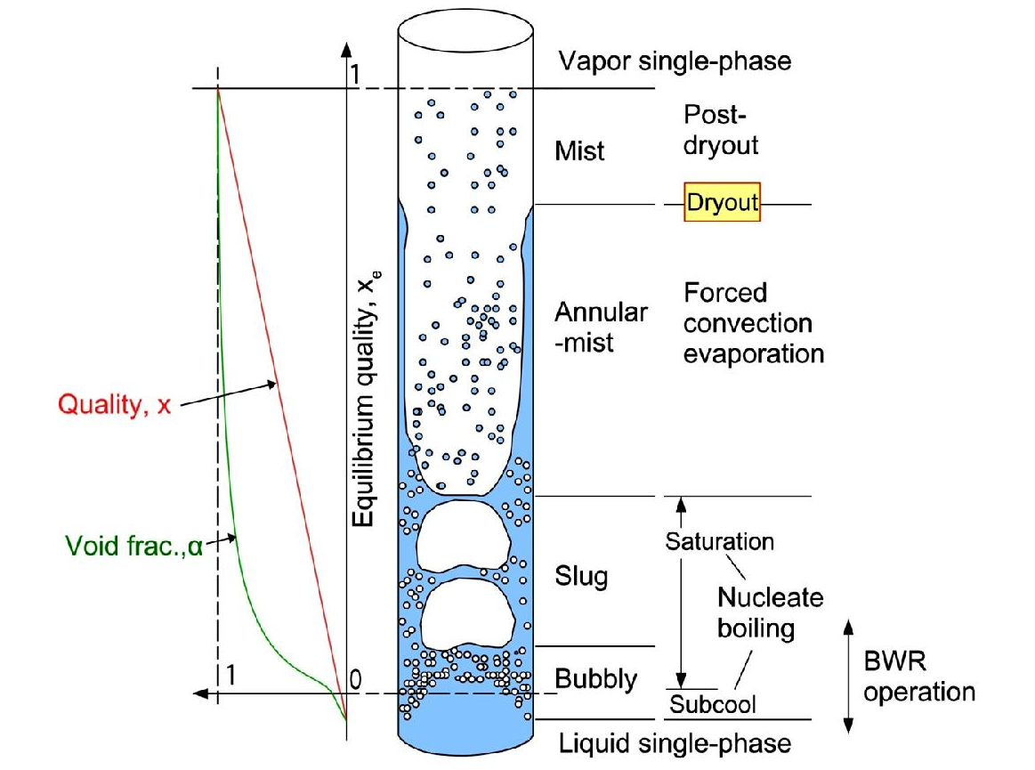
Two Phase Flow Heat Transfer

Slide 48
Heat Transfer Correlation
Single phase liquid region:
  Use a single phase heat transfer correlation appropriate for the geometry, fluid and flow regime (turbulent vs laminar) present in the channel. (e.g. Dittus Boelter correlation)
Two phase region:
  For this region (from the onset of nucleate boiling to the point of dryout), we can use Klimenko’s correlation.
  Klimenko’s correlation distinguishes between two subregions:
    Nucleate boiling dominated subregion (roughly corresponding to bubbly and plug flow)
    Forced evaporation dominated subregion (roughly corresponding to annular flow).

Slide 49
Klimenko Correlation
Along with Newton’s Law of Cooling
Klimenko correlation for Nucleate Boiling Dominated Subregion
Klimenko correlation for Forced Evaporation Subregion

Slide 50
Klimenko Correlation
Where the parameters ${Pe}_{m},{Re}_{m},L_{c}$ are

Slide 51
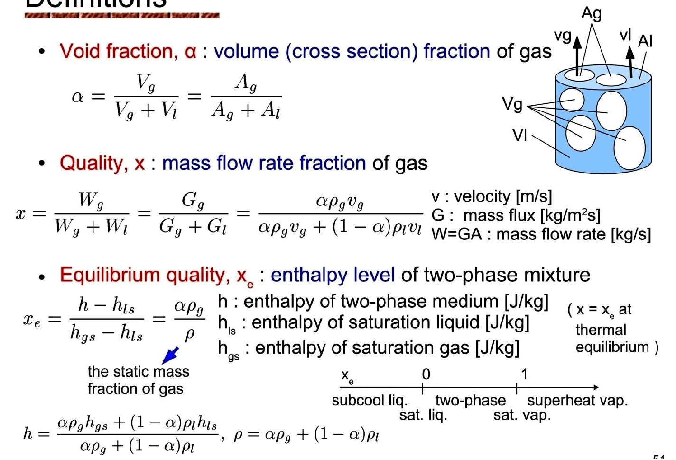
Two Phase Flow
Important Parameters

Slide 52
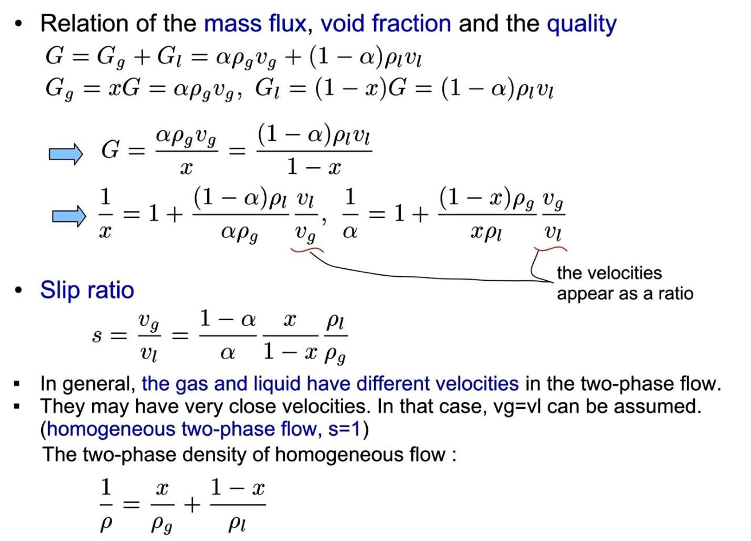
Continued

Slide 53
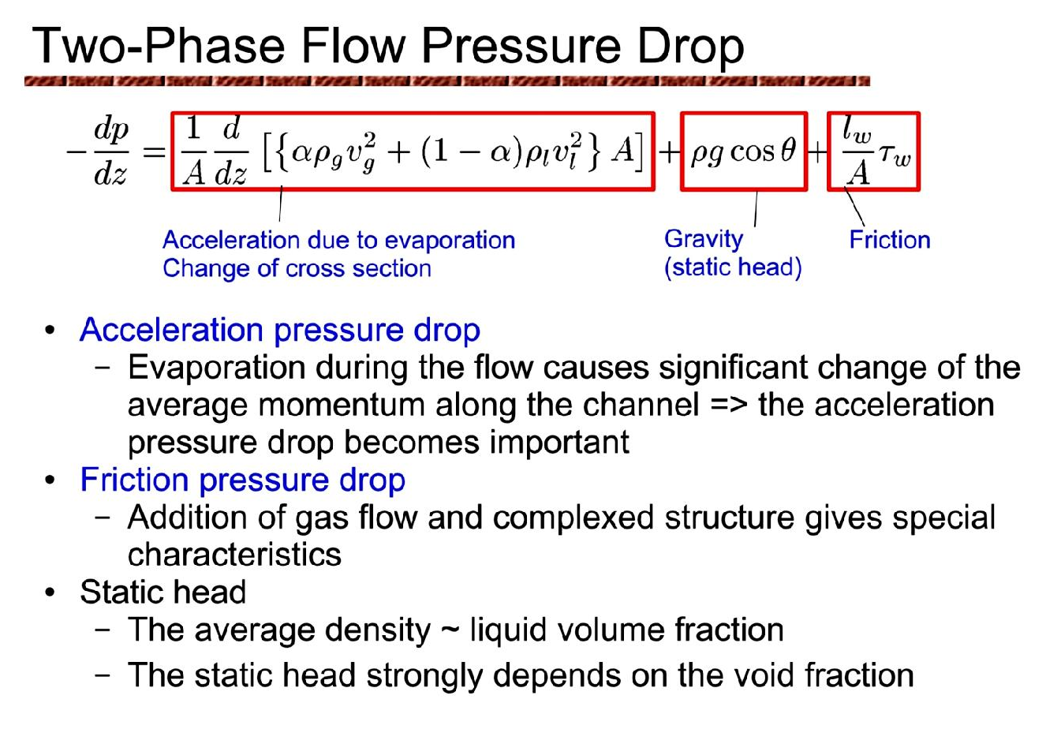

Slide 54
Two Phase Pressure Drop Correlations
Martinelli – Lockhart
Nelson – Martinelli
Chisholm – Laird
Ueda

Slide 55
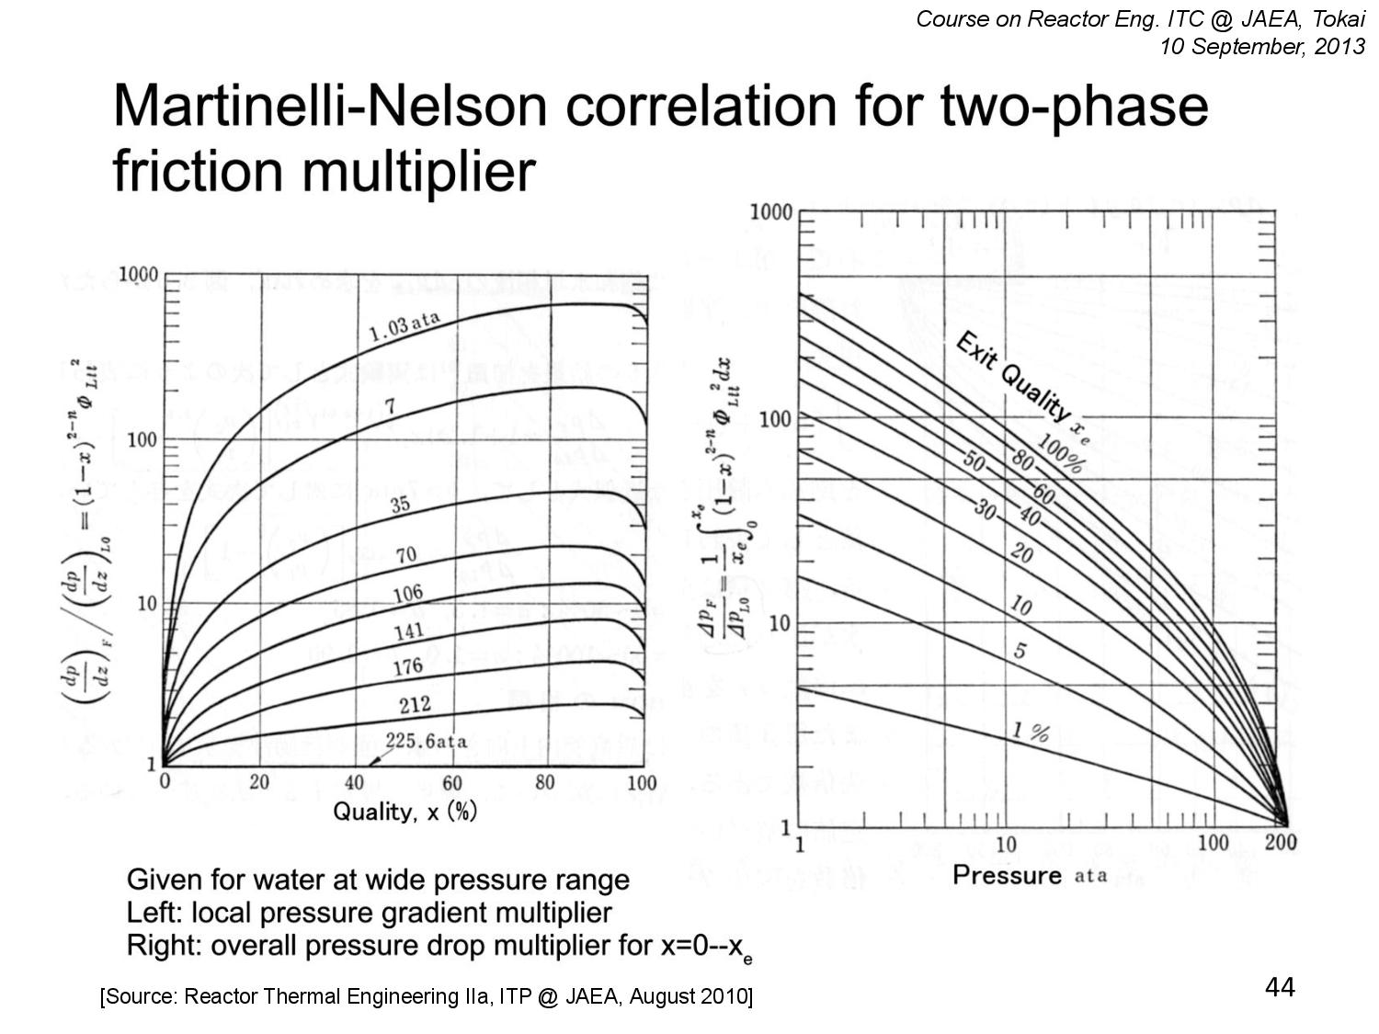

Slide 56
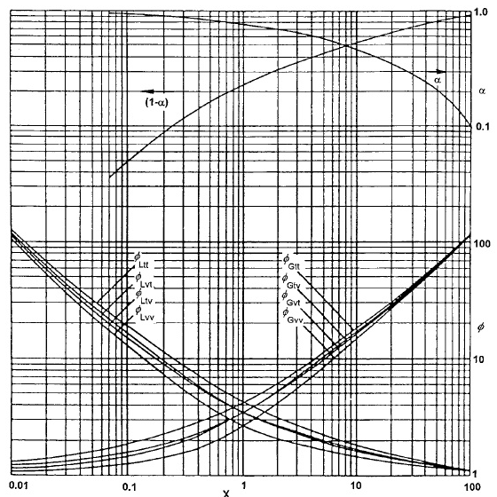
Lockhart-Martinelli Variation Curve

Slide 57
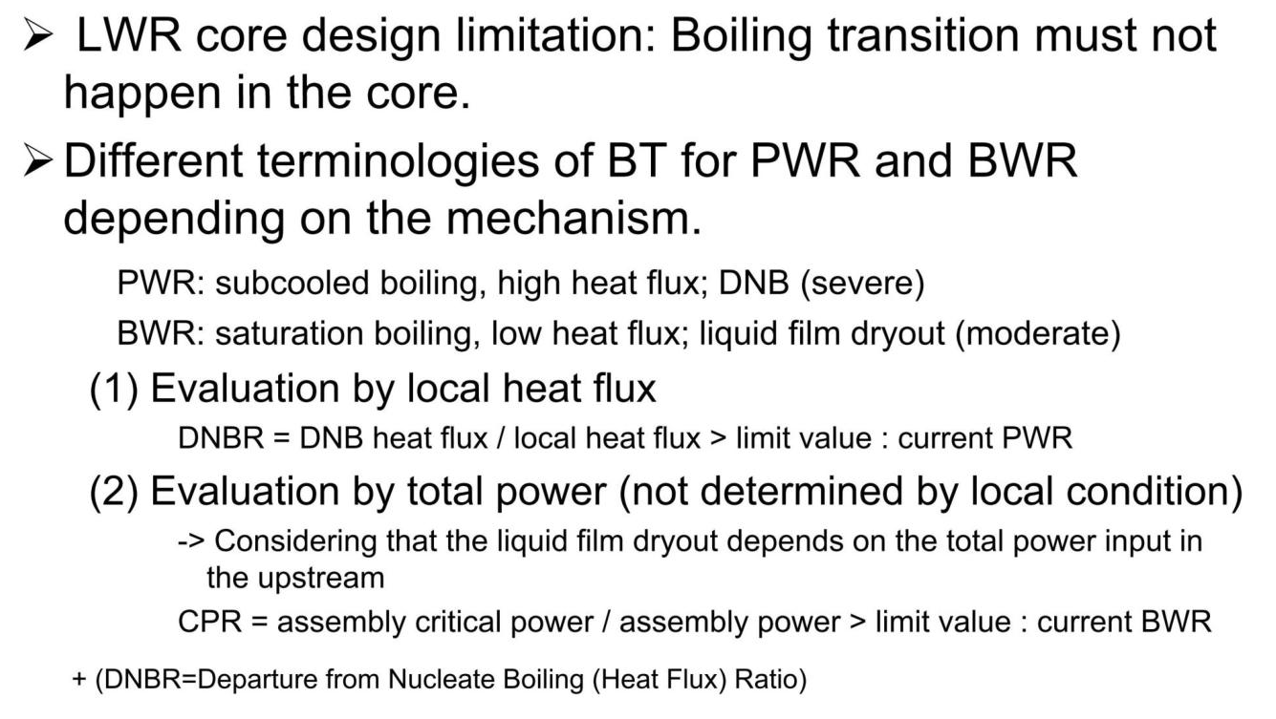
Boiling Crisis for LWR

Slide 58
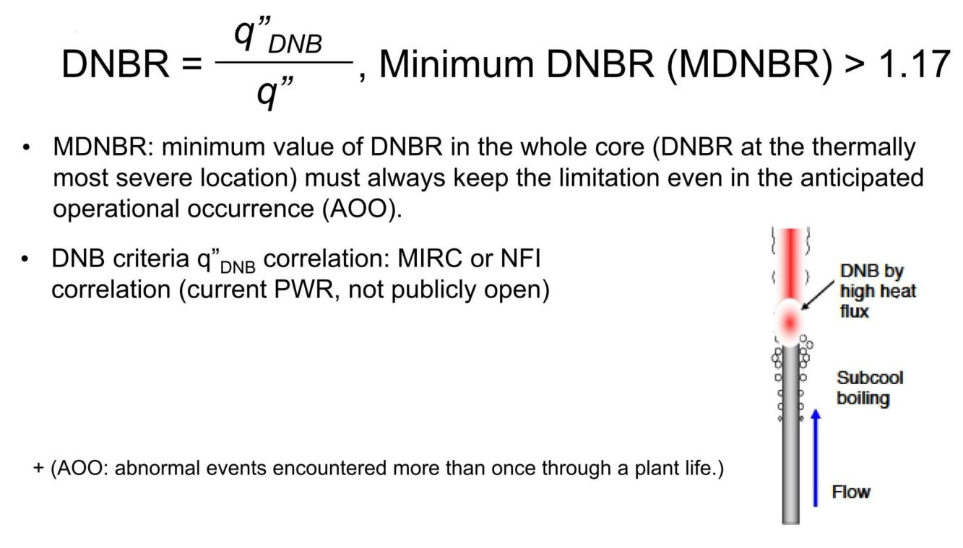
Evaluation by Local Heat Flux (PWR)

Slide 59
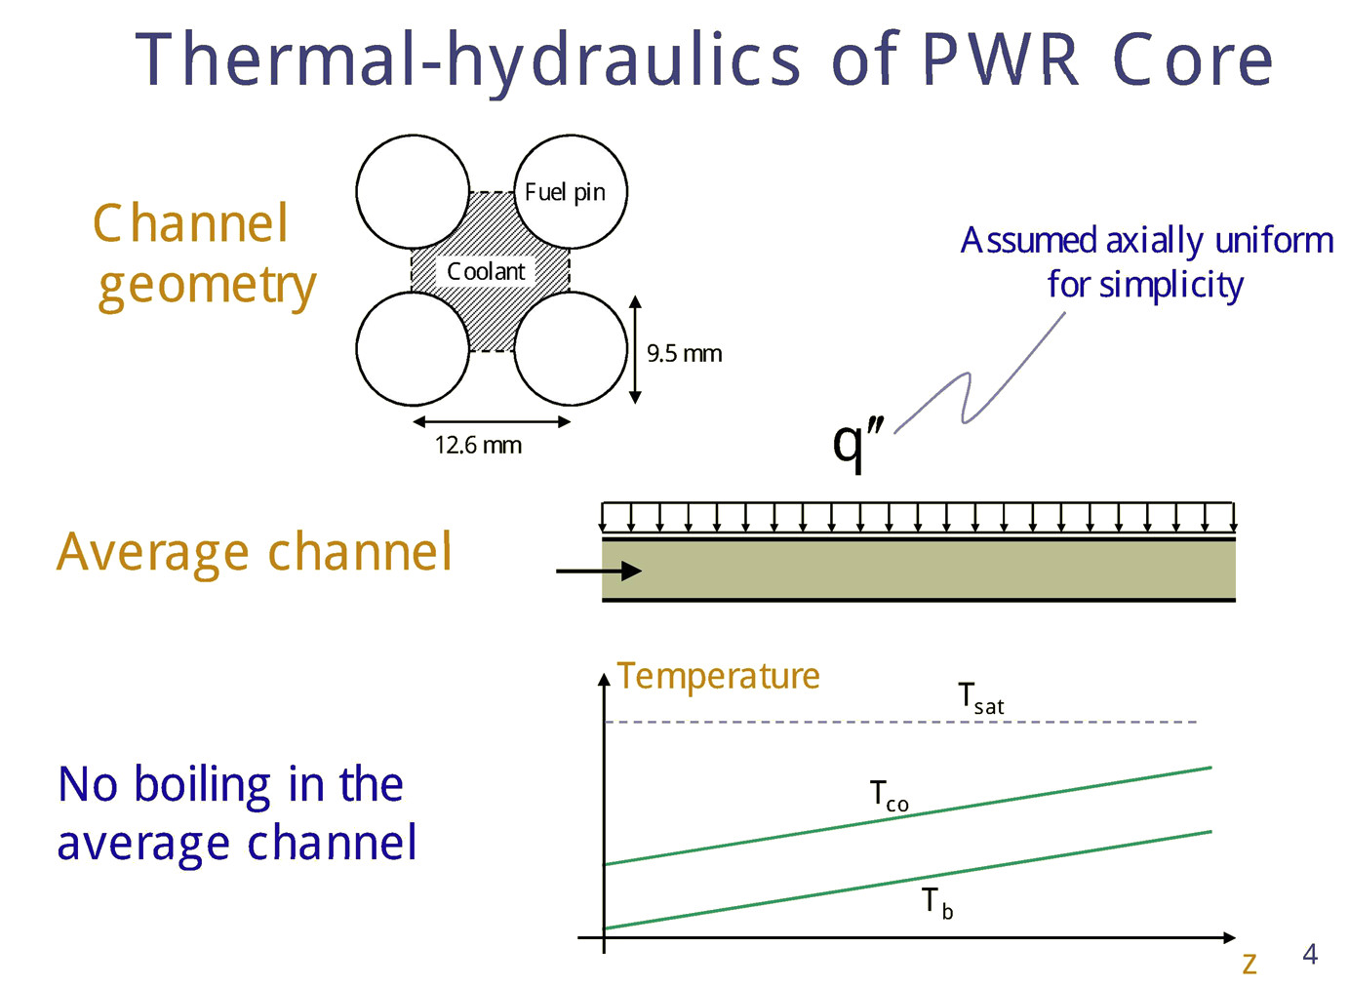

Slide 60
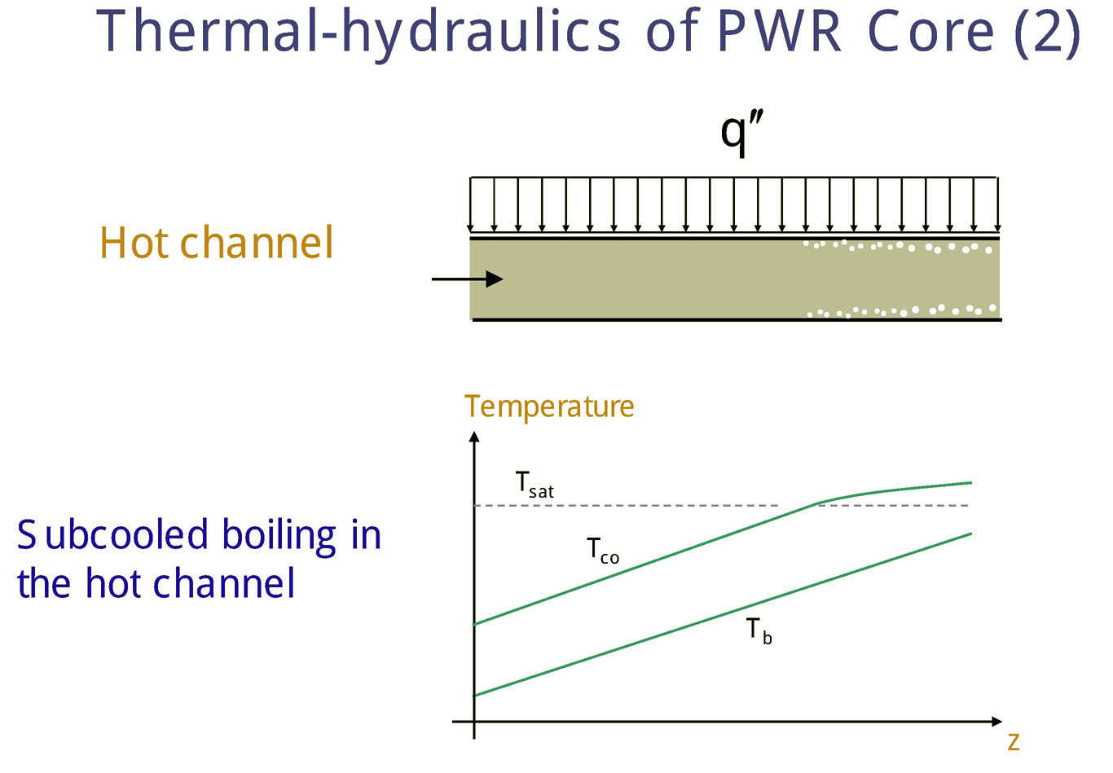

Slide 61


Slide 62


Slide 63


Slide 64


Slide 65


Slide 66

Thermal Crisis Summary
MDNBR > 1.17 (Japan)

Slide 67

Summary
Nucleation Sites
Pool, Flow Boiling
Excess Temperature
Boiling Curve
Boiling Crisis (CHF)
DNB
DNBR, CPR
Two-phase flow
Flow Regime
Heat Flux, Pressure Drop
Correlations

Slide 68
References
Cengel, Heat Transfer, A Practical Approach, McGraw Hill
Incropera, DeWitt, Foundations of Heat Transfer, Wiley
Buongiorno, Notes on Two Phase Flow, Boiling Heat Transfer, and Boiling Crises in PWRs and BWRs, MIT
Buongiorno, Boiling Crisis in LWRs, MIT
Reactor Thermal Engineering IIb, ITP @ JAEA, August 2010

