Slide 1
FORCED CONVECTION
Lecture slides by
Mehmet Kanoğlu, Mohsin Mohd Sies and others
The McGraw-Hill Companies, Inc., John Wiley and Sons

Slide 2
Motivation
Convection is the main mode of heat removal in nuclear reactors
Proper understanding of convection heat transfer is thus necessary for a successful thermal design and operation of nuclear reactors

Slide 3
Objectives
Understand the physical mechanism of convection and its classification
Visualize the development of velocity and thermal boundary layers during flow over surfaces
Gain a working knowledge of the dimensionless Reynolds, Prandtl, and Nusselt numbers
Develop an understanding of the mechanism of heat transfer in turbulent flow.
Evaluate the heat transfer associated with flow over a flat plate for both laminar and turbulent flow, and flow over cylinders and spheres.
Have a visual understanding of different flow regions in internal flow, and calculate hydrodynamic and thermal entry lengths.
Analyze heating and cooling of a fluid flowing in a tube under constant surface temperature and constant surface heat flux conditions, and work with the logarithmic mean temperature difference.
Determine the Nusselt number in fully developed turbulent flow using empirical relations, and calculate the heat transfer rate.

Slide 4
Introduction to Convection
Convection denotes energy transfer between a surface and a fluid moving over the surface.
The dominant contribution due to the bulk (or gross) motion of fluid particles.
In this chapter we will
  Introduce the convection transfer equations
  Discuss the physical mechanisms underlying convection
  Discuss physical origins and introduce relevant dimensionless parameters that can help us to perform convection transfer calculations in subsequent chapters.
Note similarities between heat, mass and momentum transfer.

Slide 5
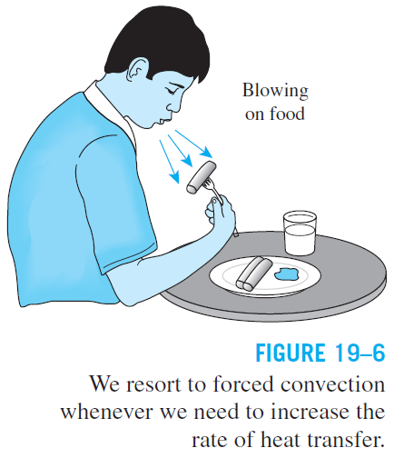
Convection in daily life
We turn on the fan on hot summer days to help our body cool more effectively. The higher the fan speed, the better we feel.
We stir our soup and blow on a hot slice of pizza to make them cool faster.
The air on windy winter days feels much colder than it actually is.
The simplest solution to heating problems in electronics packaging is to use a large enough fan.

Slide 6
Classifications
Forced vs Natural Convection
Turbulent vs Laminar Flows
External vs Internal Flows
Constant Temperature vs Constant Heat Flux

Slide 7
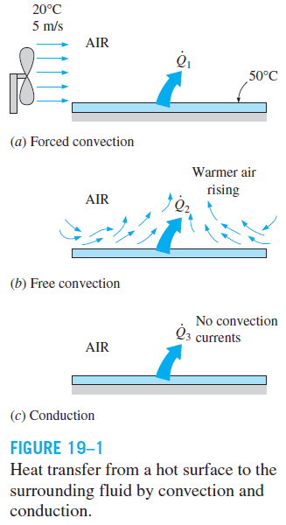
19-1 PHYSICAL MECHANISM OF CONVECTION
Conduction and convection both require the presence of a material medium but convection requires fluid motion.
Convection involves fluid motion as well as heat conduction.
Heat transfer through a solid is always by conduction.
Heat transfer through a fluid is by convection in the presence of bulk fluid motion and by conduction in the absence of it.
Therefore, conduction in a fluid can be viewed as the limiting case of convection, corresponding to the case of quiescent fluid.

Slide 8
The fluid motion enhances heat transfer, since it brings warmer and cooler chunks of fluid into contact, initiating higher rates of conduction at a greater number of sites in a fluid.
The rate of heat transfer through a fluid is much higher by convection than it is by conduction.
In fact, the higher the fluid velocity, the higher the rate of heat transfer.
Heat transfer through a fluid sandwiched between two parallel plates.

Slide 9
Convection heat transfer strongly depends on the fluid properties dynamic viscosity, thermal conductivity, density, and specific heat, as well as the fluid velocity. It also depends on the geometry and the roughness of the solid surface, in addition to the type of fluid flow (such as being streamlined or turbulent).
Newton’s law of cooling
Convection heat transfer coefficient, h: The rate of heat transfer between a solid surface and a fluid per unit surface area per unit temperature difference.

Slide 10
The Central Question for Convection
Convection heat transfer strongly depends on
  Fluid properties - dynamic viscosity, thermal conductivity, density, and specific heat
  Flow conditions - fluid velocity, laminar, turbulence.
  Surface geometry – geometry, surface roughness of the solid surface.
In fact, the question of convection heat transfer comes down to determining the heat transfer coefficient, h.
This MAINLY depends on the velocity and thermal boundary layers.

Slide 11
Approach
Two approaches:
  Experimental or empirical: Experimental heat transfer measurements are correlated in terms of dimensionless parameters
  Theoretical approach: Solution of boundary layer equations.

Slide 12
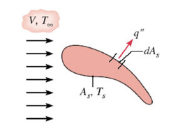
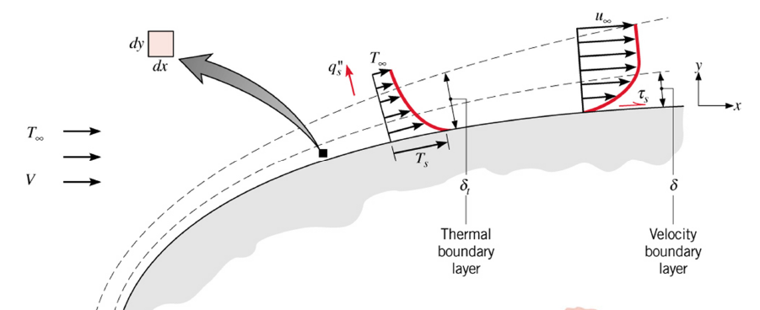
Flow & Thermal Considerations
What is Velocity & Thermal Boundary Layers ?

Slide 13
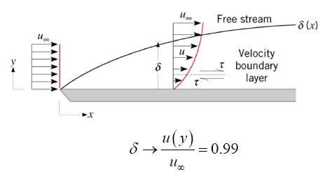
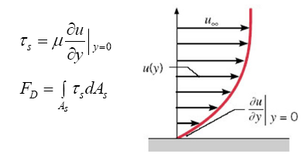
Flow & Thermal Considerations
Velocity Boundary Layers – Physical meaning/features
A consequence of viscous effects associated with relative motion between a fluid and a surface
A region of the flow characterised by shear stresses and velocity gradients.
A region between the surface and the free stream whose thickness, δ increases in the flow direction.
why does δ increase in the flow direction ?
- the viscous effects penetrate further into the free stream along the plate and δ increases
Manifested by a surface shear stress, τ_{s} that provides a drag force, F_{D}

Slide 14
No-slip condition: A fluid in direct contact with a solid “sticks” to the surface due to viscous effects, and there is no slip.
Boundary layer: The flow region adjacent to the wall in which the viscous effects (and thus the velocity gradients) are significant.
The fluid property responsible for the no-slip condition and the development of the boundary layer is viscosity.
A fluid flowing over a stationary surface comes to a complete stop at the surface because of the no-slip condition.
The development of a velocity profile due to the no-slip condition as a fluid flows over a blunt nose.

Slide 15
An implication of the no-slip condition is that heat transfer from the solid
surface to the fluid layer adjacent to the surface is by pure conduction, since the fluid layer is motionless, and can be expressed as
The determination of the convection heat transfer coefficient when the temperature distribution within the fluid is known
The convection heat transfer coefficient, in general, varies along the flow (or x-) direction. The average or mean convection heat transfer coefficient for a surface in such cases is determined by properly averaging the local convection heat transfer coefficients over the entire surface area A_{s} or length L as

Slide 16

Nusselt Number
In convection studies, it is common practice to nondimensionalize the governing equations and combine the variables, which group together into dimensionless numbers in order to reduce the number of total variables.
Nusselt number: Dimensionless convection heat transfer coefficient
L_{c} characteristic length
The Nusselt number represents the enhancement of heat transfer through a fluid layer as a result of convection relative to conduction across the same fluid layer.
The larger the Nusselt number, the more effective the convection.
A Nusselt number of Nu = 1 for a fluid layer represents heat transfer across the layer by pure conduction.
Heat transfer through a fluid layer of thickness L and temperature difference ΔT.

Slide 17
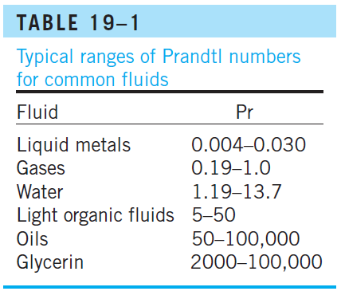
Prandtl Number
The relative thickness of the velocity and the thermal boundary layers is best described by the dimensionless parameter Prandtl number
The Prandtl numbers of gases are about 1, which indicates that both momentum and heat dissipate through the fluid at about the same rate.
Heat diffuses very quickly in liquid metals (Pr << 1) and very slowly in oils (Pr >> 1) relative to momentum.
Consequently the thermal boundary layer is much thicker for liquid metals and much thinner for oils relative to the velocity boundary layer.
17

Slide 18

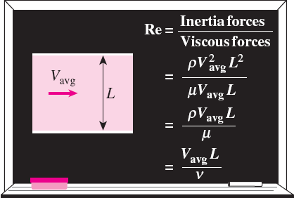

Reynolds Number
At large Reynolds numbers, the inertial forces, which are proportional to the fluid density and the square of the fluid velocity, are large relative to the viscous forces, and thus the viscous forces cannot prevent the random and rapid fluctuations of the fluid (turbulent).
At small or moderate Reynolds numbers, the viscous forces are large enough to suppress these fluctuations and to keep the fluid “in line” (laminar).
The transition from laminar to turbulent flow depends on the geometry, surface roughness, flow velocity, surface temperature, and type of fluid.
The flow regime depends mainly on the ratio of inertial forces to viscous forces (Reynolds number).
Critical Reynolds number, Re_{x,c}: The Reynolds number at which the flow becomes turbulent.
The value of the critical Reynolds number is different for different geometries and flow conditions.
i.e for flow over a flat plate:
18

Slide 19
19-2 THERMAL BOUNDARY LAYER
A thermal boundary layer develops when a fluid at a specified temperature flows over a surface that is at a different temperature.
Thermal boundary layer: The flow region over the surface in which the temperature variation in the direction normal to the surface is significant.
The thickness of the thermal boundary layer δ_{t} at any location along the surface is defined as the distance from the surface at which the temperature difference T − T_{s} equals 0.99(T∞− T_{s}).
The thickness of the thermal boundary layer increases in the flow direction, since the effects of heat transfer are felt at greater distances from the surface further down stream.
The shape of the temperature profile in the thermal boundary layer dictates the convection heat transfer between a solid surface and the fluid flowing over it.
Thermal boundary layer on a flat plate (the fluid is hotter than the plate surface).
19

Slide 20
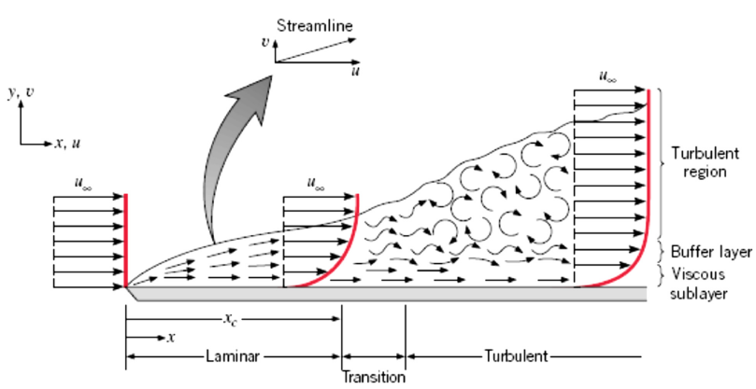
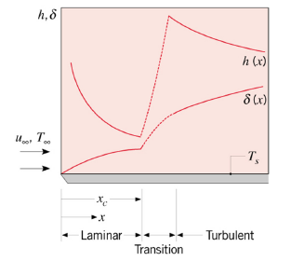
Flow & Thermal Considerations
Boundary Layer Transition
- Effect of transition on boundary layer thickness and local convection coefficient

Slide 21
Boundary Layer Approximations
Need to determine the heat transfer coefficient, h
In general, h=f (k, c_{p}, ρ, μ, V, L)
We can apply the Buckingham pi theorem, or obtain exact solutions by applying the continuity, momentum and energy equations for the boundary layer.
In terms of dimensionless groups:
(x*=x/L)
Local and average Nusselt numbers (based on local and average heat transfer coefficients)
where:
Prandtl number
Reynolds number
(defined at distance x)
20

Slide 22
Boundary Layers - Summary
Velocity boundary layer (thickness δ(x)) characterized by the presence of velocity gradients and shear stresses - Surface friction, C_{f}
Thermal boundary layer (thickness δ_{t}(x)) characterized by temperature gradients – Convection heat transfer coefficient, h
Concentration boundary layer (thickness δ_{c}(x)) is characterized by concentration gradients and species transfer – Convection mass transfer coefficient, h_{m}
18

Slide 23
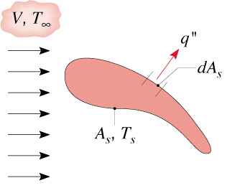
Heat Transfer Coefficient
Recall Newton’s law of cooling for heat transfer between a surface of arbitrary shape, area A_{s} and temperature T_{s} and a fluid:
Generally flow conditions will vary along the surface, so q” is a local heat flux and h a local convection coefficient.
The total heat transfer rate is
where
is the average heat transfer coefficient
14

Slide 24
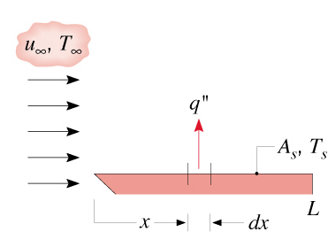
Heat Transfer Coefficient
For flow over a flat plate:
How can we estimate heat transfer coefficient?
15

Slide 25
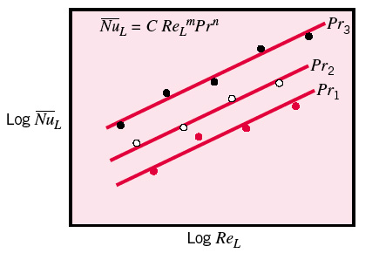
Approaches to determine convection coefficients, h
Experimental
Heat transfer experiment (Section 7.1)
Correlating the data in term of dimensionless number
Establish equation
2. Analytical
Solving using boundary layer equation (Section 6.4)
Example analysis by similarity method (refer Section 7.2.1)
Step includes:
i) Obtain temperature profile T∗ for a particular geometry
ii) Evaluate local Nusselt number (Eq.6.31)
iii) Evaluate local convection coefficient
iv) Determine the average convection coefficient (Eq. 6.9)

Slide 26



Heat Transfer Convection
_
Local and average Nusselt numbers:
Average Nusselt number:
Film temperature:
Average friction coefficient:
Average heat transfer coefficient:
Heat transfer rate:
_
*The overbar indicates an average from x∗=0 (the boundary layer begins to develop) to the location interest.
_
_
_
26

Slide 27
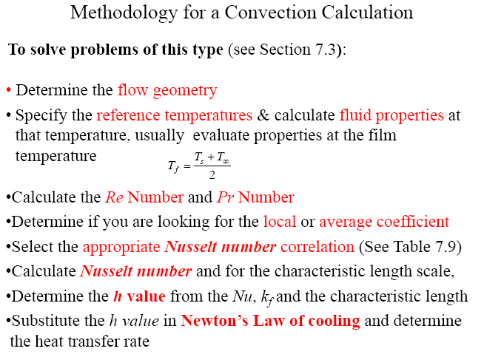
Convection – External Flow

Slide 28
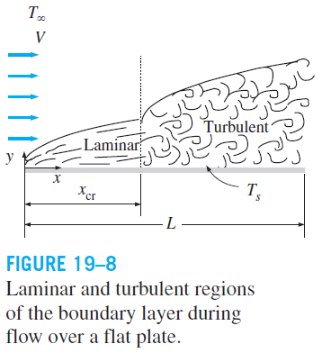
19-3 PARALLEL FLOW OVER FLAT PLATES
The transition from laminar to turbulent flow depends on the surface geometry, surface roughness, upstream velocity, surface temperature, and the type of fluid, among other things, and is best characterized by the Reynolds number.
The Reynolds number at a distance x from the leading edge of a flat plate is expressed as
A generally accepted value for the Critical Reynold number
The actual value of the engineering critical Reynolds number for a flat plate may vary somewhat from 10⁵ to 3 × 10⁶, depending on the surface roughness, the turbulence level, and the variation of pressure along the surface.

Slide 29

The local Nusselt number at a location x for laminar flow over a flat plate may be obtained by solving the differential energy equation to be
These relations are for isothermal and smooth surfaces
The local friction and heat transfer coefficients are higher in turbulent flow than they are in laminar flow.
Also, h_{x} reaches its highest values when the flow becomes fully turbulent, and then decreases by a factor of x^{−0.2} in the flow direction.
The variation of the local friction and heat transfer coefficients for flow over a flat plate.

Slide 30
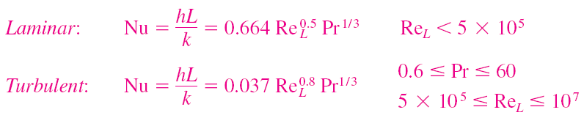


Nusselt numbers for average heat transfer coefficients
Laminar + turbulent
Graphical representation of the average heat transfer coefficient for a flat plate with combined laminar and turbulent flow.

Slide 31
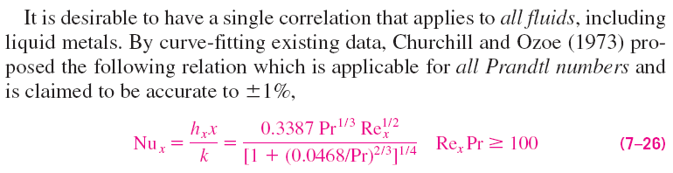
For liquid metals
For all liquids, all Prandtl numbers
Churchill and Ozoe correlation

Slide 32
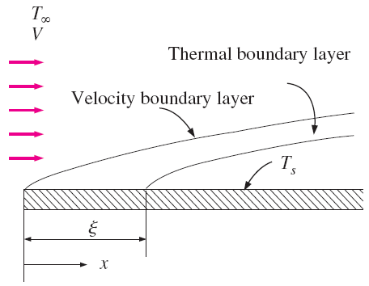
Flat Plate with Unheated Starting Length
Local Nusselt numbers
Average heat transfer coefficients
Flow over a flat plate with an unheated starting length.

Slide 33


Uniform Heat Flux
For a flat plate subjected to uniform heat flux
These relations give values that are 36 percent higher for laminar flow and 4 percent higher for turbulent flow relative to the isothermal plate case.
When heat flux is prescribed, the rate of heat transfer to or from the plate and the surface temperature at a distance x are determined from

Slide 34
Convection – External Flow
Example: 7.1
Air at a pressure of 6 kN/m² and a temperature of 300°C flows with a velocity of 10 m/s over a flat plate 0.5 m long. Estimate the cooling rate per unit width of the plate needed to maintain it at a surface temperature of 27°C.

Slide 35
19-4 FLOW OVER CYLINDERS AND SPHERES
Flows across cylinders and spheres, in general, involve flow separation, which is difficult to handle analytically.
Flow across cylinders and spheres has been studied experimentally by numerous investigators, and several empirical correlations have been developed for the heat transfer coefficient.
Variation of the local heat transfer coefficient along the circumference of a circular cylinder in cross flow of air.

Slide 36

For flow over a cylinder (Zukauskas)
The fluid properties are evaluated at the film temperature
For flow over a sphere
The fluid properties are evaluated at the free-stream temperature T∞, except for μ_{s}, which is evaluated at the surface temperature T_{s}.
Constants C and m are given in the table.
The relations for cylinders above are for single cylinders or cylinders oriented such that the flow over them is not affected by the presence of others. They are applicable to smooth surfaces.

Slide 39
Example
A mercury-in-glass thermometer at 40ºC (OD = 1 cm) is inserted through a duct wall into a 3 m/s airstream at 66ºC. Estimate the heat transfer coefficient between the air and the thermometer, refer to Fig Q2.1
glass thermometer, diameter 1 cm
wall of a duct
air flows at 3 m/s
at 66ºC
Fig.Q 2.1

Slide 40
19-5 GENERAL CONSIDERATIONS FOR PIPE FLOW
Liquid or gas flow through pipes or ducts is commonly used in heating and cooling applications and fluid distribution networks.
The fluid in such applications is usually forced to flow by a fan or pump through a flow section.
Although the theory of fluid flow is reasonably well understood, theoretical solutions are obtained only for a few simple cases such as fully developed laminar flow in a circular pipe.
Therefore, we must rely on experimental results and empirical relations for most fluid flow problems rather than closed-form analytical solutions.
For a fixed surface area, the circular tube gives the most heat transfer for the least
pressure drop.
Circular pipes can withstand large pressure differences between the inside and the outside without undergoing any significant distortion, but noncircular pipes cannot.
40

Slide 41

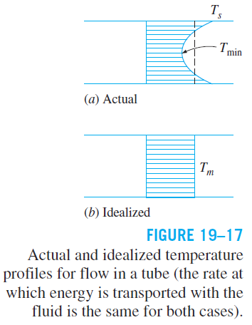

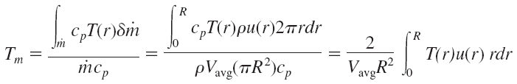

Re < 2300 laminar, Re > 10,000 turbulent, and transitional in between.
When designing piping networks and determining pumping power, a conservative approach is taken and flows with Re > 4000 are assumed to be turbulent.
In fluid flow, it is convenient to work with an average or mean temperature T_{m}, which remains constant at a cross section. The mean temperature T_{m} changes in the flow direction whenever the fluid is heated or cooled.
Bulk mean fluid temperature
41

Slide 42
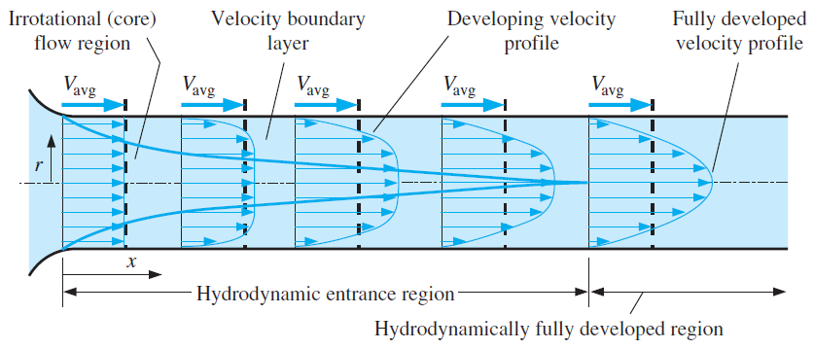
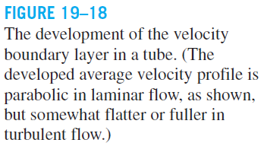
Thermal Entrance Region

Slide 43
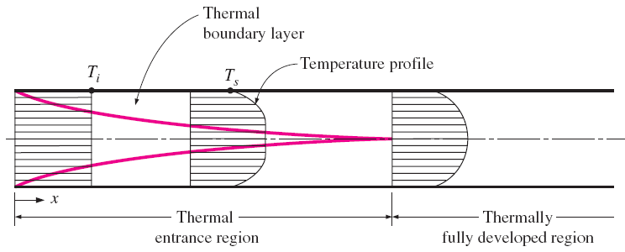
The fluid properties in internal flow are usually evaluated at the bulk mean fluid temperature, which is the arithmetic average of the mean temperatures at the inlet and the exit: T_{b} = (T_{m, i} + T_{m, e})/2
Thermal entrance region: The region of flow over which the thermal boundary layer develops and reaches the tube center.
Thermal entry length: The length of this region.
Thermally developing flow: Flow in the thermal entrance region. This is the region where the temperature profile develops.
Thermally fully developed region: The region beyond the thermal entrance region in which the dimensionless temperature profile remains unchanged.
Fully developed flow: The region in which the flow is both hydrodynamically and thermally developed.
The development of the thermal boundary layer in a tube.

Slide 44
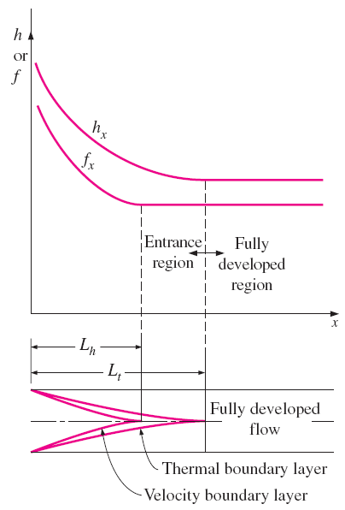
Hydrodynamically fully developed:
Variation of the friction factor and the convection heat transfer coefficient in the flow direction for flow in a tube (Pr>1).
Thermally fully developed:
Surface heat flux
In the thermally fully developed region of a tube, the local convection coefficient is constant (does not vary with x).
Therefore, both the friction (which is related to wall shear stress) and convection coefficients remain constant in the fully developed region of a tube.
The pressure drop and heat flux are higher in the entrance regions of a tube, and the effect of the entrance region is always to increase the average friction factor and heat transfer coefficient for the entire tube.

Slide 45
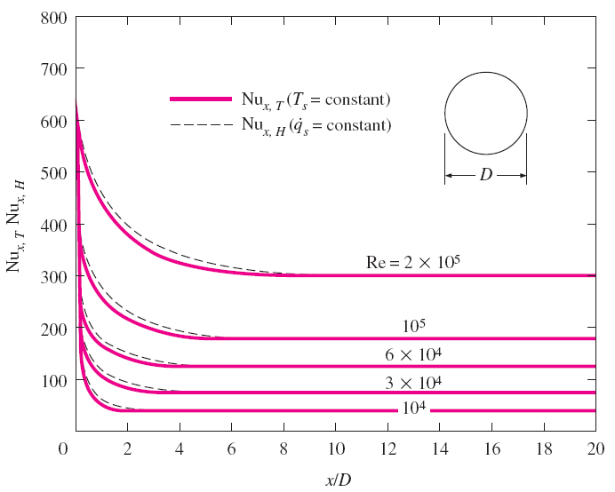
Entry Lengths
The Nusselt numbers and thus h values are much higher in the entrance region.
The Nusselt number reaches a constant value at a distance of less than 10 diameters, and thus the flow can be assumed to be fully developed for x > 10D.
The Nusselt numbers for the uniform surface temperature and uniform surface heat flux conditions are identical in the fully developed regions, and nearly identical in the entrance regions.
Variation of local Nusselt number along a tube in turbulent flow for both uniform surface temperature and uniform surface heat flux.

Slide 46

19-6 GENERAL THERMAL ANALYSIS
Rate of heat transfer
The thermal conditions at the surface can be approximated to be
constant surface temperature (T_{s}= const)
constant surface heat flux (q_{s} = const)
The constant surface temperature condition is realized when a phase change process such as boiling or condensation occurs at the outer surface of a tube.
The constant surface heat flux condition is realized when the tube is subjected to radiation or electric resistance heating uniformly from all directions.
We may have either T_{s} = constant or q_{s} = constant at the surface of a tube, but not both.
Surface heat flux
h_{x} the local heat transfer coefficient
The heat transfer to a fluid flowing in a tube is equal to the increase in the energy of the fluid.

Slide 47

Constant Surface Heat Flux (q_{s} = constant)
Rate of heat transfer:
Mean fluid temperature at the tube exit:
Surface temperature:
Variation of the tube surface and the mean fluid temperatures along the tube for the case of constant surface heat flux.

Slide 48

Energy interactions for a differential control volume in a tube.
Circular tube:
The shape of the temperature profile remains unchanged in the fully developed region of a tube subjected to constant surface heat flux.

Slide 49
Constant Surface Temperature (T_{s} = constant)
Rate of heat transfer to or from a fluid flowing in a tube
Two suitable ways of expressing ΔT_{avg}
arithmetic mean temperature difference
logarithmic mean temperature difference
Arithmetic mean temperature difference
Bulk mean fluid temperature: T_{b} = (T_{i} + T_{e})/2
By using arithmetic mean temperature difference, we assume that the mean fluid temperature varies linearly along the tube, which is hardly ever the case when T_{s} = constant.
This simple approximation often gives acceptable results, but not always.
Therefore, we need a better way to evaluate ΔT_{avg}.

Slide 50

Integrating from x = 0 (tube inlet, T_{m} = T_{i}) to x = L (tube exit, T_{m} = T_{e})
The variation of the mean fluid temperature along the tube for the case of constant temperature.
Energy interactions for a differential control volume in a tube.

Slide 51


log mean temperature difference
NTU: Number of transfer units. A measure of the effectiveness of the heat transfer systems.
For NTU = 5, T_{e} = T_{s}, and the limit for heat transfer is reached.
A small value of NTU indicates more opportunities for heat transfer.
ΔT_{ln} is an exact representation of the average temperature difference between the fluid and the surface.
When ΔT_{e} differs from ΔT_{i} by no more than 40 percent, the error in using the arithmetic mean temperature difference is less than 1 percent.
An NTU greater than 5 indicates that the fluid flowing in a tube will reach the surface temperature at the exit regardless of the inlet temperature.

Slide 52
Example
Air at atmospheric pressure and 27ºC enters a 12 m long, 1.5 cm ID tube with a mass flow rate of 0.1 kg/s. The tube surface is maintained at a uniform temperature of 80ºC. Determine,
  The average heat transfer coefficient,
  The rate of heat transfer to the air.

Slide 53
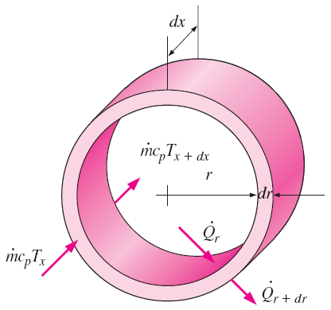

19-7 LAMINAR FLOW IN TUBES
The rate of net energy transfer to the control volume by mass flow is equal to the net rate of heat conduction in the radial direction.
The differential volume element used in the derivation of energy balance relation.

Slide 54


Constant Surface Heat Flux
Applying the boundary conditions ∂T/∂x = 0 at r = 0 (because of symmetry) and T = T_{s} at r = R
Therefore, for fully developed laminar flow in a circular tube subjected to constant surface heat flux, the Nusselt number is a constant.
There is no dependence on the Reynolds or the Prandtl numbers.

Slide 55
Constant Surface Temperature
The thermal conductivity k for use in the Nu relations should be evaluated at the bulk mean fluid temperature.
For laminar flow, the effect of surface roughness on the friction factor and the heat transfer coefficient is negligible.
Laminar Flow in Noncircular Tubes
Nusselt number relations are given in Table 8-1 for fully developed laminar flow in tubes of various cross sections.
The Reynolds and Nusselt numbers for flow in these tubes are based on the hydraulic diameter D_{h} = 4A_{c}/p,
Once the Nusselt number is available, the convection heat transfer coefficient is determined from h = kNu/D_{h}.
In laminar flow in a tube with constant surface temperature, both the friction factor and the heat transfer coefficient remain constant in the fully developed region.

Slide 56
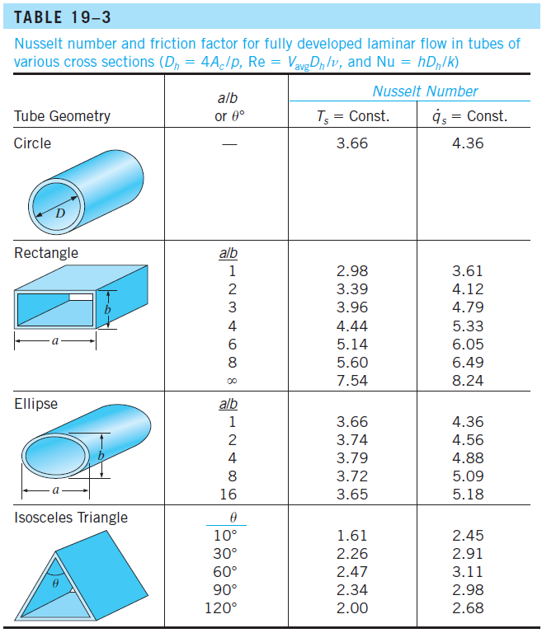

Slide 57


Developing Laminar Flow in the Entrance Region
For a circular tube of length L subjected to constant surface temperature, the average Nusselt number for the thermal entrance region:
The average Nusselt number is larger at the entrance region, and it approaches asymptotically to the fully developed value of 3.66 as L → ∞.
When the difference between the surface and the fluid temperatures is large, it may be necessary to account for the variation of viscosity with temperature:
All properties are evaluated at the bulk mean fluid temperature, except for μ_{s}, which is evaluated at the surface temperature.
The average Nusselt number for the thermal entrance region of flow between isothermal parallel plates of length L is

Slide 58
19-8 TURBULENT FLOW IN TUBES
Correlations
First Petukhov equation
Chilton–Colburn analogy
Dittus–Boelter equation
Colburn equation
Second Petukhov equation
Gnielinski relation

Slide 59

19-8 TURBULENT FLOW IN TUBES
Chilton–Colburn analogy
First Petukhov equation
Colburn equation
Dittus–Boelter equation
When the variation in properties is large due to a large temperature difference
All properties are evaluated at T_{b} except μ_{s}, which is evaluated at T_{s}.

Slide 60
Second Petukhov equation
Gnielinski relation
The relations above are not very sensitive to the thermal conditions at the tube surfaces and can be used for both T_{s} = constant and q_{s} = constant.

Slide 61
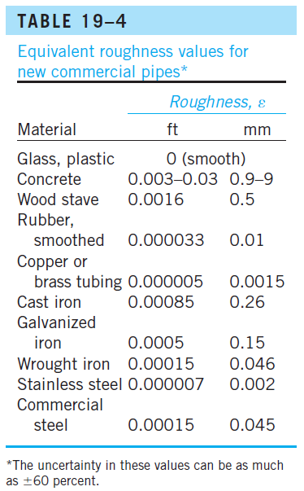
In turbulent flow, wall roughness increases the heat transfer coefficient h by a factor of 2 or more.
The convection heat transfer coefficient for rough tubes can be calculated approximately from Gnielinski relation or Chilton–Colburn analogy by using the friction factor determined from the Moody chart or the Colebrook equation.

Slide 62
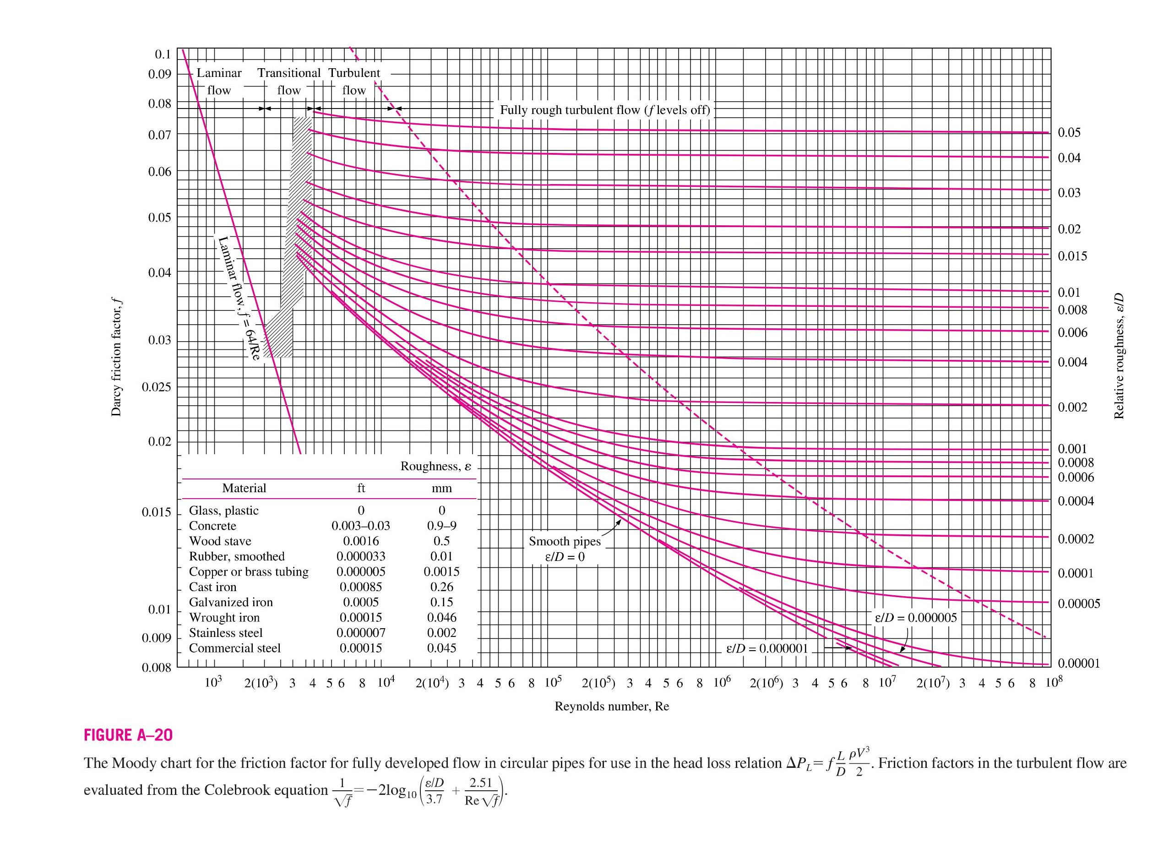

Slide 63
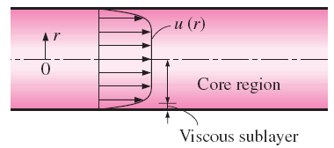
Developing Turbulent Flow in the Entrance Region
The entry lengths for turbulent flow are typically short, often just 10 tube diameters long, and thus the Nusselt number determined for fully developed turbulent flow can be used approximately for the entire tube.
This simple approach gives reasonable results for pressure drop and heat transfer for long tubes and conservative results for short ones.
Correlations for the friction and heat transfer coefficients for the entrance regions are available in the literature for better accuracy.
Turbulent Flow in Noncircular Tubes
Pressure drop and heat transfer characteristics of turbulent flow in tubes are dominated by the very thin viscous sublayer next to the wall surface, and the shape of the core region is not of much significance.
The turbulent flow relations given above for circular tubes can also be used for noncircular tubes with reasonable accuracy by replacing the diameter D in the evaluation of the Reynolds number by the hydraulic diameter D_{h} = 4A_{c}/p.
In turbulent flow, the velocity profile is nearly a straight line in the core region, and any significant velocity gradients occur in the viscous sublayer.

Slide 64
Example
Air at an average temperature of 150ºC flow a short square duct 10 x 10 x 2.25 cm at a rate of 15 kg/hr. The duct wall temperature is 430ºC. Determine the heat transfer coefficient .

Slide 65

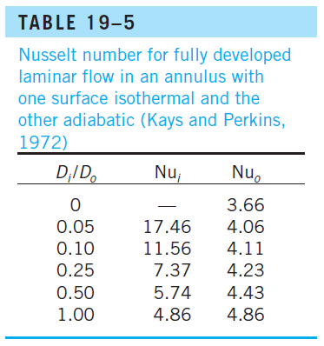
Flow through Tube Annulus
The hydraulic diameter of annulus
For laminar flow, the convection coefficients for the inner and the outer surfaces are determined from
Tube surfaces are often roughened, corrugated, or finned in order to enhance convection heat transfer.
For fully developed turbulent flow, h_{i} and h_{o} are approximately equal to each other, and the tube annulus can be treated as a noncircular duct with a hydraulic diameter of D_{h} = D_{o} − D_{i}.
The Nusselt number can be determined from a suitable turbulent flow relation such as the Gnielinski equation. To improve the accuracy, Nusselt number can be multiplied by the following correction factors when one of the tube walls is adiabatic and heat transfer is through the other wall:

Slide 66
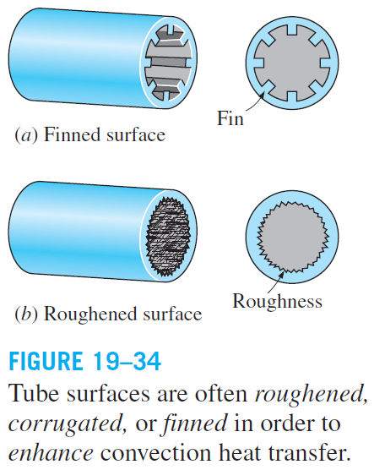
Heat Transfer Enhancement
Tubes with rough surfaces have much higher heat transfer coefficients than tubes with smooth surfaces.
Heat transfer in turbulent flow in a tube has been increased by as much as 400 percent by roughening the surface. Roughening the surface, of course, also increases the friction factor and thus the power requirement for the pump or the fan.
The convection heat transfer coefficient can also be increased by inducing pulsating flow by pulse generators, by inducing swirl by inserting a twisted tape into the tube, or by inducing secondary flows by coiling the tube.

Slide 67
Example
A highly conducting thin plate L = 2 m long separates the hot and cold airstreams flowing on both sides parallel to the plate surface. The hot stream is at the atmospheric pressure abd has a temperature of T_{h} = 250ºC and a velocity u_{h} = 50 m/s. The cold stream also atmospheric pressure and has temperature of T_{c} = 50ºC and velocity u_{c} = 15 m/s.
Determine,
  The average heat transfer coefficient for the hot air stream,
  The average heat transfer coefficient for the cold air stream, and
  Total heat transfer rate between the stream per meter width of the separating plate,
Fluid properties can be taken at T_{m} = [T_{h} + T_{c}}/2.

Slide 68
Summary
Physical Mechanism of Convection
Thermal Boundary Layer
Parallel Flow Over Flat Plates
Flow Across Cylinders and Spheres
General Considerations for Pipe Flow
  Thermal Entrance Region
General Thermal Analysis
  Constant Surface Heat Flux
  Constant Surface Temperature
Laminar Flow in Tubes
Turbulent Flow in Tubes
68
Notes:
68

