Slide 1
SKPN 3133 Transport Processes
(Nuclear Heat Transport)
Heat Transfer
Mohsin Mohd Sies
Nuclear Engineering, Universiti Teknologi Malaysia

Slide 2
Outline
Introduction to Heat Transfer
Heat Transfer and Fluid Flow (Nonmetallic coolants)
  Convective Heat Transfer
Boiling Heat Transfer
  Boiling Regimes
  Boiling Crisis
  Two Phase Flow
Thermal Design of Reactor

Slide 3
Cooling of Reactors
The most suitable coolant depends on the reactor type
  Fast reactors cannot use coolants that are good moderators (containing hydrogen, carbon – light/heavy water, organic fluids)
  CANDU reactors (natural uranium) cannot use light water (high neutron absorption cross section)
Compromise between conflicting requirements

Slide 4
Coolant selection
Economic
  Low initial cost
  Availability (He, heavy water, liquid metals are less available than light water and other gases)
  Low pumping losses (highest for gases)
  High heat transfer coefficient

Slide 5
Coolant selection
Physical
  Low melting points (so it stays fluidized during shutdown)
  Low vapor pressures (high boiling point – to avoid high pressurization)
  Compatibility – with fuel, cladding, heat exchangers, pumps, structural materials (to avoid expensive materials like titanium & molybdenum)
  Good thermal stability (organic liquids decompose at high temperatures)

Slide 6
Coolant selection
Neutronics
  Low neutron absorption cross section
  Moderating power to suit reactor type
  Low induced radioactivity
  Good radiation stability (organic liquids suffer from nuclear radiation damage)

Slide 7
INTRODUCTION TO HEAT TRANSFER
Heat: The form of energy that can be transferred from one system to another as a result of temperature difference.
Thermodynamics is concerned with the amount of heat transfer as a system undergoes a process from one equilibrium state to another.
Heat Transfer deals with the determination of the rates of such energy transfers as well as variation of temperature.
The transfer of energy as heat is always from the higher-temperature medium to the lower-temperature one.
Heat transfer stops when the two mediums reach the same temperature.
Heat can be transferred in three different modes:
conduction, convection, radiation
All modes of heat transfer require the existence of a temperature difference.

Slide 8
What is Heat Transfer?
“Energy in transit due to temperature difference.”
Thermodynamics tells us:
How much heat is transferred (δQ)
How much work is done (δW)
Final state of the system
Heat transfer tells us:
How (with what modes) δQ is transferred
At what rate δQ is transferred
Temperature distribution inside the body
Heat transfer
complementary
Thermodynamics

Slide 10
APPLICATIONS OF HEAT TRANSFER
Energy production and conversion
- steam power plant, solar energy conversion etc.
Refrigeration and air-conditioning
Domestic applications
- ovens, stoves, toaster
Cooling of electronic equipment
Manufacturing / materials processing
- welding,casting, soldering, laser machining
Automobiles / aircraft design
Nature (weather, climate etc)

Slide 11
Application Areas of Heat Transfer
11

Slide 12
Historical Background
Kinetic theory: Treats molecules as tiny balls that are in motion and thus possess kinetic energy.
Heat: The energy associated with the random motion of atoms and molecules.
Caloric theory: Heat is a fluidlike
substance called the caloric that is a massless, colorless, odorless, and
tasteless substance that can be poured from one body into another
It was only in the middle of the nineteenth century that we had a true physical understanding of the nature of heat.
Careful experiments of the Englishman James P. Joule published in 1843 convinced the skeptics that heat was not a substance after all, and thus put the caloric theory to rest.

Slide 14
ENGINEERING HEAT TRANSFER
Heat transfer equipment such as heat exchangers, boilers, condensers, radiators, heaters, furnaces, refrigerators, and solar collectors are designed primarily on the basis of heat transfer analysis.
The heat transfer problems encountered in practice can be considered in two groups: (1) rating and (2) sizing problems.
The rating problems deal with the determination of the heat transfer rate for an existing system at a specified temperature difference.
The sizing problems deal with the determination of the size of a system in order to transfer heat at a specified rate for a specified temperature difference.
An engineering device or process can be studied either experimentally (testing and taking measurements) or analytically (by analysis or calculations).
The experimental approach has the advantage that we deal with the actual physical system, and the desired quantity is determined by measurement, within the limits of experimental error. However, this approach is expensive, timeconsuming, and often impractical.
The analytical approach (including the numerical approach) has the advantage that it is fast and inexpensive, but the results obtained are subject to the accuracy of the assumptions, approximations, and idealizations made in the analysis.

Slide 15
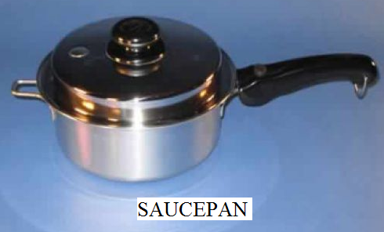
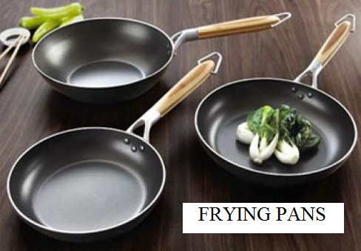
APPLICATIONS OF HEAT TRANSFER
a) Applications of conduction
Uses of good conductors of heat:
1. Cooking utensils e.g. saucepans, frying pans, boilers, base of electric irons.

Slide 16
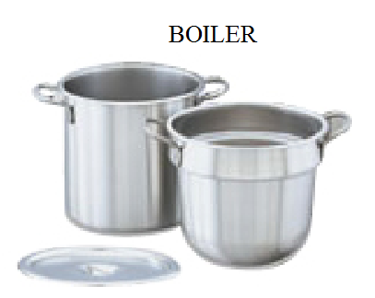
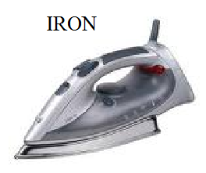
USES OF GOOD CONDUCTORS OF HEAT

Slide 17
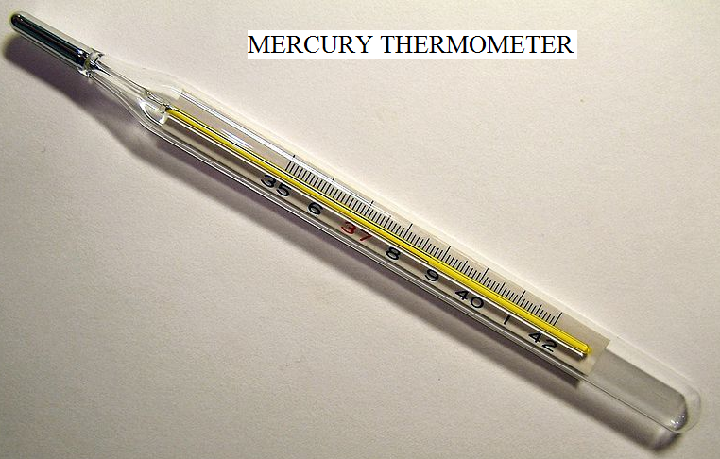
USES OF GOOD CONDUCTORS OF HEAT
2. Mercury is used in thermometers as it is a good conductor.

Slide 18
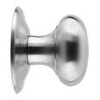



USES OF GOOD CONDUCTORS OF HEAT
3. A metal door knob feels cold to touch as the heat is conducted away from the hand.

Slide 19
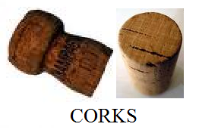
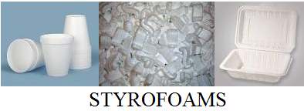
USES OF BAD CONDUCTORS OF HEAT
1. Materials such as cork, fibreglass and styrofoam are bad conductor of heat.
- This is due to a lot of air trapped in them.
- Air is a good insulator of heat.

Slide 20
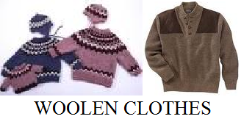



USES OF BAD CONDUCTORS OF HEAT
2. Woolen clothes are used to keep people warm in winter.
Animals have thick fur/feathers to reduce heat loss of heat to the cold surrounding.

Slide 21


USES OF BAD CONDUCTORS OF HEAT
3. Handles of cooking utensils are made of wood or plastic.

Slide 22
b) Applications of convection
1. The heating coil of an electric kettle is placed at the bottom so that convection current can occur.

Slide 23
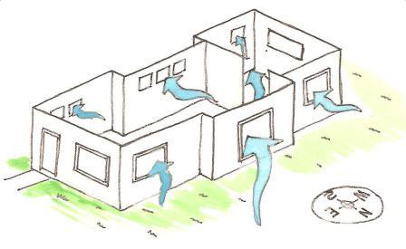
APPLICATIONS OF CONVECTION
2. Ventilation in homes which is used to keep rooms cool.
Windows, doors or other vents can be opened or closed as needed to reduce the temperature and improve the quality of the air you're breathing.

Slide 24
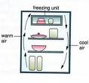
APPLICATIONS OF CONVECTION
3. Convection currents in a fridge.

Slide 25
APPLICATIONS OF CONVECTION
4. Domestic hot water supply.

Slide 26

APPLICATIONS OF CONVECTION
5. Cloud formation as warm moist air rises before condensing.

Slide 27
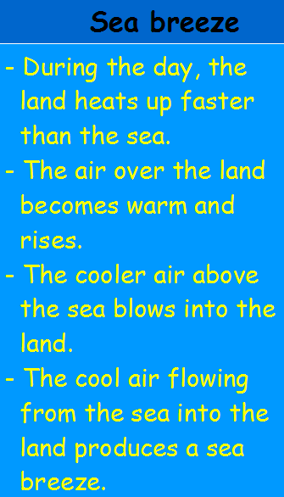
APPLICATIONS OF CONVECTION
6. i) Natural convection currents in sea breeze.

Slide 28
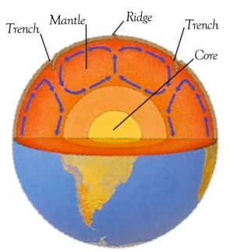
APPLICATIONS OF CONVECTION
Convection inside the earth

Slide 29
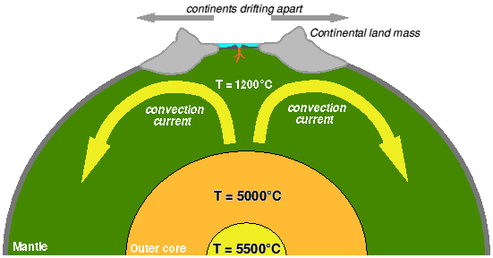
APPLICATIONS OF CONVECTION
Convection inside the earth

Slide 30
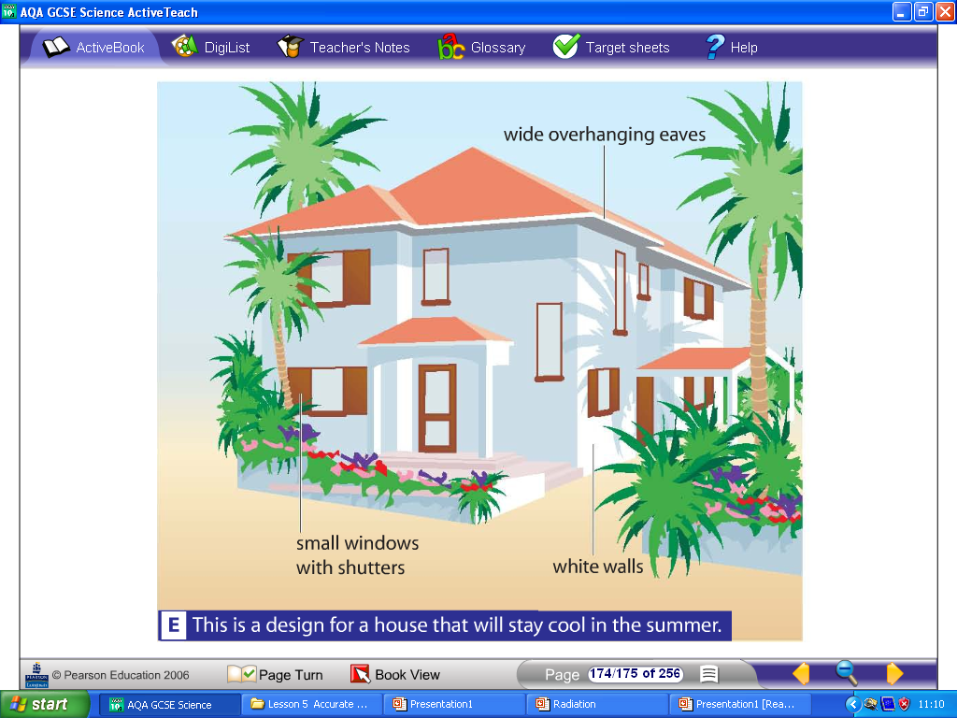
C) APPLICATIONS OF RADIATION
1. Why are houses painted white in hot countries?
- White reflects heat radiation and so keeps the house cooler.

Slide 31


APPLICATIONS OF RADIATION
2. White clothing/light coloured clothes reduces absorption of heat in hot climates
help students stay cool in summer
keep students warm in winter

Slide 32
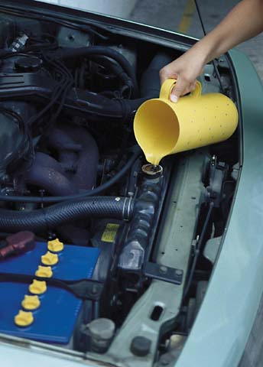
APPLICATIONS OF RADIATION
Radiators in cars are painted black.
It loses energy easily!

Slide 33
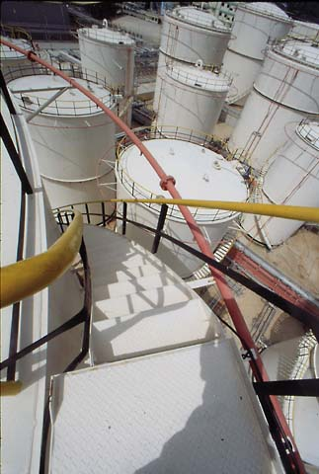
APPLICATIONS OF RADIATION
Fuel storage tanks are painted silvery
- reflect away energy from the Sun
- will not overheat

Slide 34
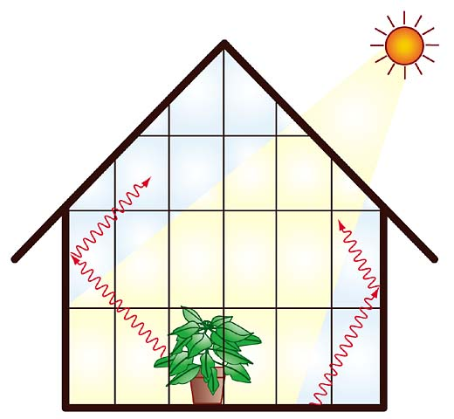
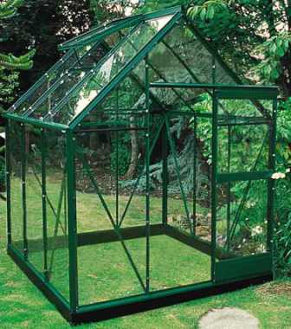
APPLICATIONS OF RADIATION
Warmed air & floor emit infra-red radiation
But this infra-red radiation can't escape easily through the glass.
⇒ infra-red radiation is trapped inside the greehouse
⇒ keeps greenhouse warm
⇒ plants can grow even in cold weather

Slide 35
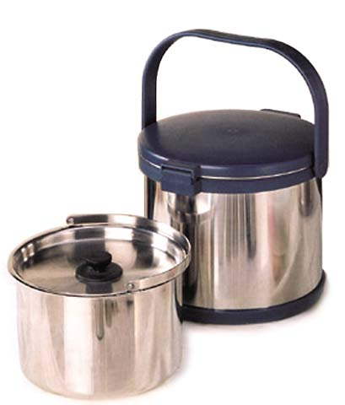
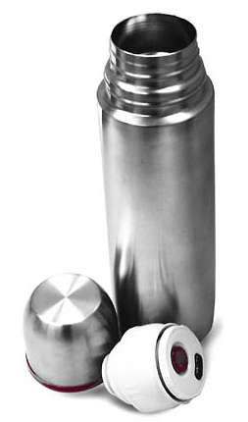
Examples of heat transfer by radiation
The thermos or vacuum flask
It keeps food hot or cold by
↓ heat exchange between food & environment
through conduction, convection & radiation.

Slide 36
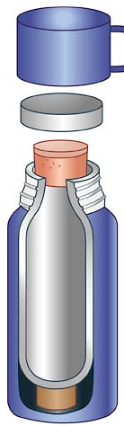
The thermos or vacuum flask
cap
plastic / cork stopper
↓ heat loss by conduction & convection
insulated support
↓ heat loss by conduction

Slide 37
The thermos or vacuum flask
Silvery glass wall
↓ heat loss by radiation
vacuum flask
vacuum between the double glass walls ↓ heat loss by conduction & convection
outer case

Slide 38
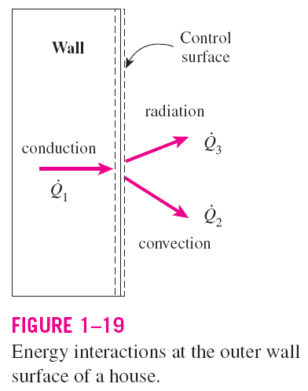


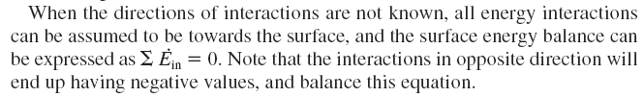
Surface Energy Balance
A surface contains no volume or mass, and thus no energy. Thereore, a surface
can be viewed as a fictitious system whose energy content remains constant during a process.
This relation is valid for both steady and transient conditions, and the surface energy balance does not involve heat generation since a surface does not have a volume.

Slide 39
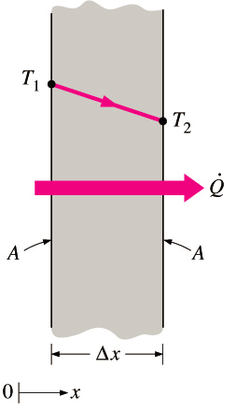


16-2 CONDUCTION
Conduction: The transfer of energy from the more energetic particles of a substance to the adjacent less energetic ones as a result of interactions between the particles.
In gases and liquids, conduction is due to the collisions and diffusion of the molecules during their random motion.
In solids, it is due to the combination of vibrations of the molecules in a lattice and the energy transport by free electrons.
The rate of heat conduction through a plane layer is proportional to the temperature difference across the layer and the heat transfer area, but is inversely proportional to the thickness of the layer.
Heat conduction through a large plane wall of thickness Δx and area A.

Slide 40
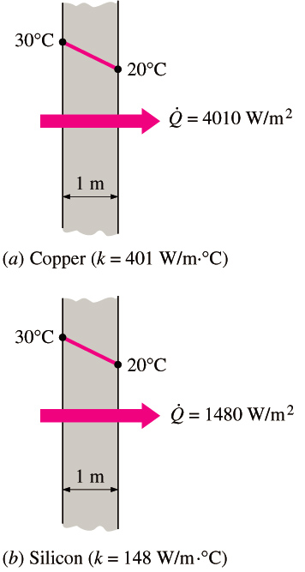
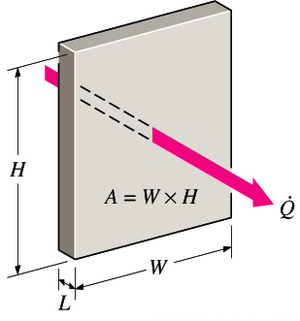
When x → 0
Fourier’s law of heat conduction
Thermal conductivity, k: A measure of the ability of a material to conduct heat.
Temperature gradient dT/dx: The slope of the temperature curve on a T-x diagram.
Heat is conducted in the direction of decreasing temperature, and the temperature gradient becomes negative when temperature decreases with increasing x. The negative sign in the equation ensures that heat transfer in the positive x direction is a positive quantity.
In heat conduction analysis, A represents the area normal to the direction of heat transfer.
The rate of heat conduction through a solid is directly proportional to its thermal conductivity.

Slide 41
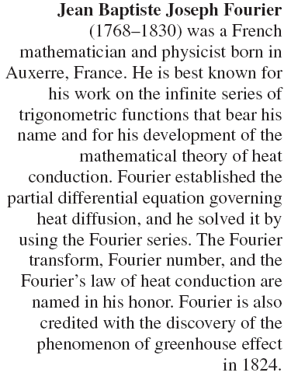
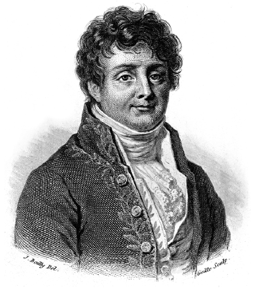

Slide 42
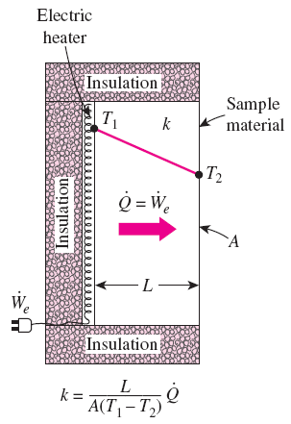
Thermal Conductivity
Thermal conductivity: The rate of heat transfer through a unit thickness of the material per unit area per unit temperature difference.
The thermal conductivity of a material is a measure of the ability of the material to conduct heat.
A high value for thermal conductivity indicates that the material is a good heat conductor, and a low value indicates that the material is a poor heat conductor or insulator.
A simple experimental setup to determine the thermal conductivity of a material.

Slide 43
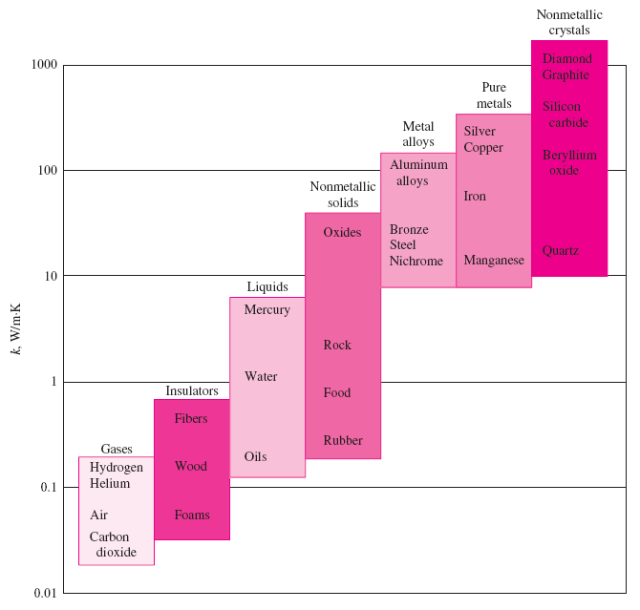
The range of thermal conductivity of various materials at room temperature.

Slide 44
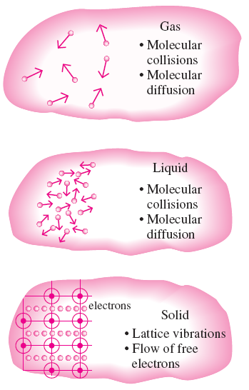
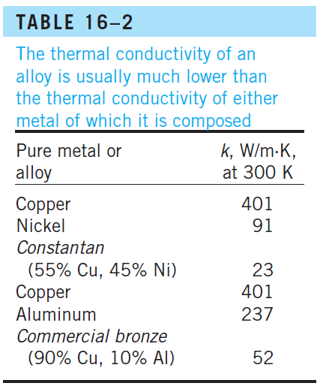
The thermal conductivities of gases such as air vary by a factor of 10⁴ from those of pure metals such as copper.
Pure crystals and metals have the highest thermal conductivities, and gases and insulating materials the lowest.
The mechanisms of heat conduction in different phases of a substance.

Slide 45
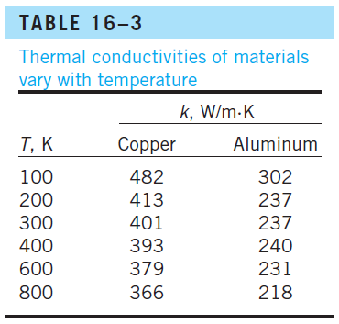
The variation of the thermal conductivity of various solids, liquids, and gases with temperature.

Slide 46

Thermal Diffusivity
c_{p} Specific heat, J/kg · °C: Heat capacity per unit mass
ρc_{p} Heat capacity, J/m³·°C: Heat capacity per unit volume
α Thermal diffusivity, m²/s: Represents how fast heat diffuses through a material
A material that has a high thermal conductivity or a low heat capacity will obviously have a large thermal diffusivity.
The larger the thermal diffusivity, the faster the propagation of heat into the medium.
A small value of thermal diffusivity means that heat is mostly absorbed by the material and a small amount of heat is conducted further.

Slide 47
Example:
The wall of an industrial furnace is constructed from 0.2 m thick fireclay brick having a thermal conductivity of 2.0 W/mK. Measurements made during steady state operation reveal temperatures of 1500 and 1250 K at the inner and outer surfaces, respectively. What is the rate of heat loss through a wall which is 0.5 m by 4 m on a side ?

Slide 48
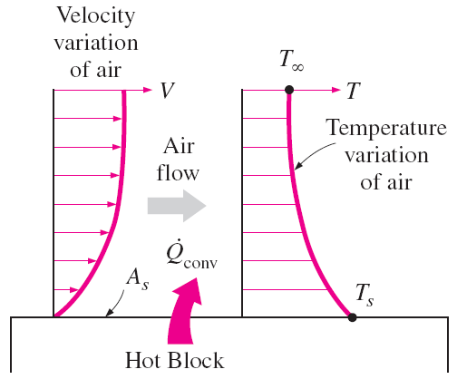
16-3 CONVECTION
Convection: The mode of energy transfer between a solid surface and the adjacent liquid or gas that is in motion, and it involves the combined effects of conduction and fluid motion.
The faster the fluid motion, the greater the convection heat transfer.
In the absence of any bulk fluid motion, heat transfer between a solid surface and the adjacent fluid is by pure conduction.
Heat transfer from a hot surface to air by convection.

Slide 49
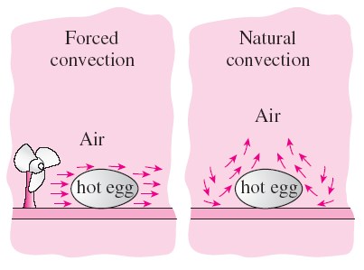
Forced convection: If the fluid is forced to flow over the surface by external means such as a fan, pump, or the wind.
Natural (or free) convection: If the fluid motion is caused by buoyancy forces that are induced by density differences due to the variation of temperature in the fluid.
The cooling of a boiled egg by forced and natural convection.
Heat transfer processes that involve change of phase of a fluid are also considered to be convection because of the fluid motion induced during the process, such as the rise of the vapor bubbles during boiling or the fall of the liquid droplets during condensation.

Slide 51

Newton’s law of cooling
h convection heat transfer coefficient, W/m² · °C
A_{s} the surface area through which convection heat transfer takes place
T_{s} the surface temperature
T∞ the temperature of the fluid sufficiently far from the surface.
The convection heat transfer coefficient h is not a property of the fluid.
It is an experimentally determined parameter whose value depends on all the variables influencing convection such as
the surface geometry
the nature of fluid motion
the properties of the fluid
the bulk fluid velocity

Slide 52
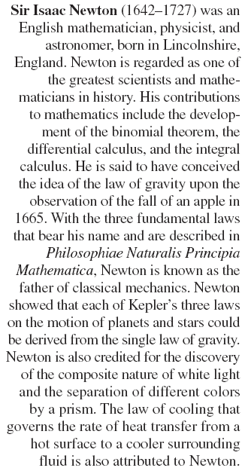
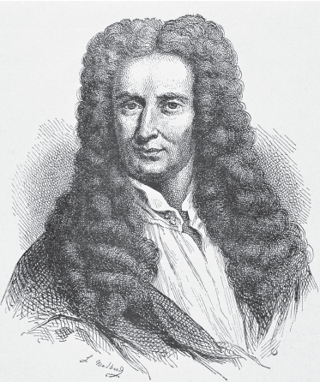

Slide 53
16-4 RADIATION
Radiation: The energy emitted by matter in the form of electromagnetic waves (or photons) as a result of the changes in the electronic configurations of the atoms or molecules.
Unlike conduction and convection, the transfer of heat by radiation does not require the presence of an intervening medium.
In fact, heat transfer by radiation is fastest (at the speed of light) and it suffers no attenuation in a vacuum. This is how the energy of the sun reaches the earth.
In heat transfer studies we are interested in thermal radiation, which is the form of radiation emitted by bodies because of their temperature.
All bodies at a temperature above absolute zero emit thermal radiation.
Radiation is a volumetric phenomenon, and all solids, liquids, and gases emit, absorb, or transmit radiation to varying degrees.
However, radiation is usually considered to be a surface phenomenon for solids.

Slide 54


Stefan–Boltzmann law
σ = 5.670 × 10⁻⁸ W/m² · K⁴ Stefan–Boltzmann constant
Blackbody: The idealized surface that emits radiation at the maximum rate.
Radiation emitted by real surfaces
Emissivity ε : A measure of how closely a surface approximates a blackbody for which ε = 1 of the surface. 0≤ ε ≤ 1.
Blackbody radiation represents the maximum amount of radiation that can be emitted from a surface at a specified temperature.

Slide 55

Absorptivity α: The fraction of the radiation energy incident on a surface that is absorbed by the surface. 0≤ α ≤ 1
A blackbody absorbs the entire radiation incident on it (α = 1).
Kirchhoff’s law: The emissivity and the absorptivity of a surface at a given temperature and wavelength are equal.
The absorption of radiation incident on an opaque surface of absorptivity .

Slide 56

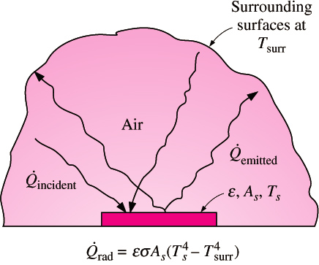
Net radiation heat transfer: The difference between the rates of radiation emitted by the surface and the radiation absorbed.
The determination of the net rate of heat transfer by radiation between two surfaces is a complicated matter since it depends on
the properties of the surfaces
their orientation relative to each other
the interaction of the medium between the surfaces with radiation
When a surface is completely enclosed by a much larger (or black) surface at temperature T_{surr} separated by a gas (such as air) that does not intervene with radiation, the net rate of radiation heat transfer between these
two surfaces is given by
Radiation is usually significant relative to conduction or natural convection, but negligible relative to forced convection.
Radiation heat transfer between a surface and the surfaces surrounding it.

Slide 57
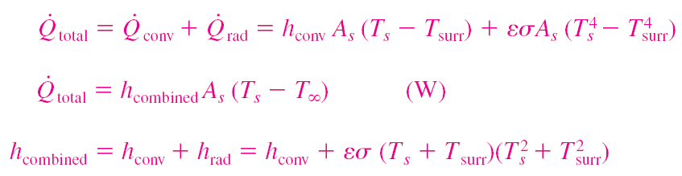
When radiation and convection occur simultaneously between a surface and a gas:
Combined heat transfer coefficient h_{combined}
Includes the effects of both convection and radiation

Slide 58
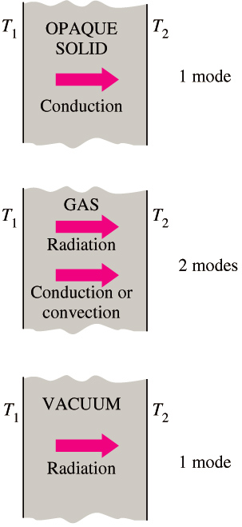
16-5 SIMULTANEOUS HEAT TRANSFER MECHANISMS
Heat transfer is only by conduction in opaque solids, but by conduction and radiation in semitransparent solids.
A solid may involve conduction and radiation but not convection. A solid may involve convection and/or radiation on its surfaces exposed to a fluid or other surfaces.
Heat transfer is by conduction and possibly by radiation in a still fluid (no bulk fluid motion) and by convection and radiation in a flowing fluid.
In the absence of radiation, heat transfer through a fluid is either by conduction or convection, depending on the presence of any bulk fluid motion.
Convection = Conduction + Fluid motion
Heat transfer through a vacuum is by radiation.
Most gases between two solid surfaces do not interfere with radiation.
Liquids are usually strong absorbers of radiation.
Although there are three mechanisms of heat transfer, a medium may involve only two of them simultaneously.

Slide 59
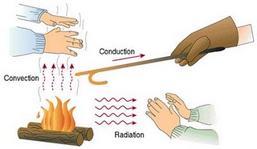

Slide 60
Example:
An uninsulated steam pipe passes through a room in which the air and walls are at 25°C. The outside diameter of pipe is 80 mm, and its surface temperature and emissivity are 180°C and 0.85, respectively. If the free convection coefficient from the surface to the air is 6 W/m²K, what is the rate of heat loss from the surface per unit length of pipe ?

Slide 61
C1: Introduction
Problem 1.63:
A rectangular forced air heating duct is suspended from the ceiling of a basement whose air and walls are at a temperature of T∞ = T_{sur} = 5°C. The duct is 15m long and its cross section is 350 mm x 200 mm.
For an uninsulated duct whose average surface temperature is 50°C, estimate the rate of heat loss from the duct. The surface emissivity and convection coefficient are approximately 0.5 and 4 W/m²K, respectively.
If heated air enters the duct at 58°C and a velocity of 4 m/s and the heat loss corresponds to the result part (i), what is the outlet temperature ? Density and specific heat of the air may be assumed to be 1.10 kg/m³ and 1008 J/kgK, respectively.

Slide 62
C1: Introduction
Problem 1.65:
During its manufacture, plate glass at 600°C is cooled by passing air over its surface such that the convection heat transfer coefficient is 5 W/m²K. To prevent cracking, it is known that the temperature gradient must not exceed 15°C/mm at any point in the glass during the cooling process. If the thermal conductivity of the glass is 1.4 W/mK and its surface emissivity is 0.8, what is the lowest temperature of the air that can initially be used for the cooling ? Assume that the temperature of the air equals that of the surroundings.

Slide 63
Thermal Resistance
The conduction heat transfer rate can be calculated:
.
(3.2a)
Similarly for heat convection, Newton’s law of cooling applies:
.
(3.2b)
And for radiation heat transfer:
.
(3.2c)
Recall electric circuit theory - Ohm’s law for electrical resistance:

Slide 64
Thermal Resistance
We can use this electrical analogy to represent heat transfer problems using the concept of a thermal circuit (equivalent to an electrical circuit).
.
Compare with equations 3.2a-3.2c
The temperature difference is the “potential” or driving force for the heat flow and the combinations of thermal conductivity, convection coefficient, thickness and area of material act as a resistance to this flow:

Slide 65

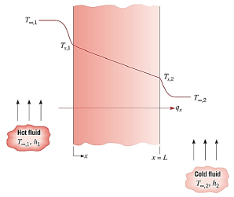

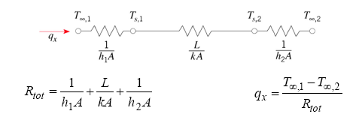
Chapter 3 : One-dimensional, Steady state conduction (without thermal generation)
3.2.1 Thermal resistances & Thermal circuits
Interestingly, there exists an analogy between the diffusion of heat and electrical charge. For example if an electrical resistance is associated with the conduction of electricity, a thermal resistance may be associated with the conduction of heat.
Defining thermal resistance for conduction in a plane wall:
For convection :
For previous simplest case, thermal circuit for plane wall with adjoining fluids:

Slide 66


Chapter 3 : One-dimensional, Steady state conduction (without thermal generation)
3.2.1 Thermal resistances & Thermal circuits
In case of radiation :
(3.13)
where,
(1.9)
Surface temperature
Surrounding temperature

Slide 67
Chapter 3 : One-dimensional, Steady state conduction (without thermal generation)
Example: (Problem 3.2a)
The rear window of an automobile is defogged by passing warm air over its inner surface. If the warm air is at T_{∞,i} = 40°C and the corresponding convection coefficient is h_{i} = 30 W/m²K, what are the inner and outer surface temperatures of 4-mm thick window glass, if the outside ambient air temperature is T_{∞,o} = -10°C and the associated convection coefficient is h_{o} = 65 W/m²K.

Slide 68
Chapter 3 : One-dimensional, Steady state conduction (without thermal generation)
Example (problem 3.5):
The walls of a refrigerator are typically constructed by sandwiching a layer of insulation between sheet metal panels. Consider a wall made from fibreglass insulation of thermal conductivity, k_{i} = 0.046 W/mK and thickness L_{i} = 50 mm and steel panels, each of thermal conductivity k_{p} = 60 W/mK and thickness L_{p} = 3 mm. If the wall separates refrigerated air at T_{∞,o} = 25°C, what is the heat gain per unit surface area ?
Coefficients associated with natural convection at the inner and outer surfaces can be approximated as h_{i} = h_{o} = 5 W/m²K

Slide 69
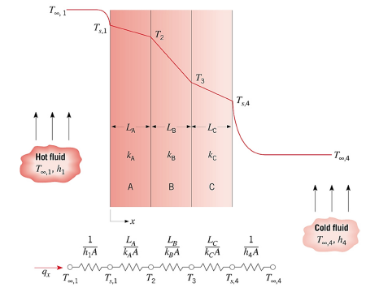
Chapter 3 : One-dimensional, Steady state conduction (without thermal generation)
3.2.2 The composite wall (with negligible contact resistance)

Slide 70



Chapter 3 : One-dimensional, Steady state conduction (without thermal generation)
The composite wall (series type)
Composite wall with negligible contact resistance:
where,
Overall heat transfer coefficient:
* A modified form of Newton’s Law of cooling to encompass multiple resistances to heat transfer

Slide 71
Composite Walls
What is the heat transfer rate for this system?
.
Alternatively
where U is the overall heat transfer coefficient and ΔT the overall temperature difference.

Slide 73
PROBLEM-SOLVING TECHNIQUE
Step 1: Problem Statement
Step 2: Schematic
Step 3: Assumptions and Approximations
Step 4: Physical Laws
Step 5: Properties
Step 6: Calculations
Step 7: Reasoning, Verification, and Discussion

Slide 74
Review
Describe the three kinds of heat transfer.
  Conduction – transfer of heat energy from one particle to another by direct contact. (Primarily in solids)
  Convection – transfer of heat energy in fluids-gases and liquids) through the bulk movement of matter from one place to another. (Produces currents)
  Radiation – transfer of energy through electromagnetic waves. (Matter is not required!) (Radiant & infrared radiation from the sun)

Slide 75
Conduction
Radiation
Convection
Direct contact of particles
Solids/liquids/gases
The handle of a cooking utensil
Transfer of energy by waves
Only radiant energy that is absorbed becomes thermal energy
Lightbulb
Fireplace
Transfer of energy by bulk movement of matter (fluids)
Currents (wind,water)
Hot air balloon

Slide 76
Summary
Conduction
  Fourier’s law of heat conduction
  Thermal Conductivity
  Thermal Diffusivity
Convection
  Newton’s law of cooling
Radiation
  Stefan–Boltzmann law
Simultaneous Heat Transfer Mechanisms

