Slide 1
Chapter 20
NATURAL CONVECTION
Fundamentals of Thermal-Fluid Sciences
4th Edition in SI Units
Yunus A. Çengel, John M. Cimbala, Robert H. Turner
McGraw-Hill, 2012
Lecture slides by
Mehmet Kanoğlu
Copyright © 2012 The McGraw-Hill Companies, Inc. Permission required for reproduction or display.

Slide 2
Objectives
Understand the physical mechanism of natural convection
Derive the governing equations of natural convection, and obtain the dimensionless Grashof number by nondimensionalizing them
Evaluate the Nusselt number for natural convection associated with vertical, horizontal, and inclined plates as well as cylinders and spheres
Analyze natural convection inside enclosures such as double-pane windows

Slide 3
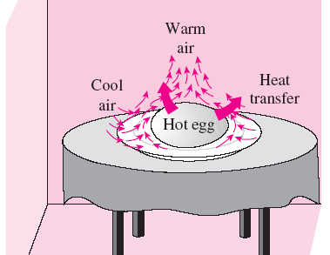
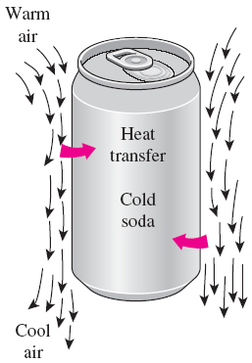
20-1 PHYSICAL MECHANISM OF NATURAL CONVECTION
Many familiar heat transfer applications involve natural convection as the primary mechanism of heat transfer. Examples?
Natural convection in gases is usually accompanied by radiation of comparable magnitude except for low-emissivity surfaces.
The motion that results from the continual replacement of the heated air in the vicinity of the egg by the cooler air nearby is called a natural convection current, and the heat transfer that is enhanced as a result of this current is called natural convection heat transfer.
The warming up of a cold drink in a warmer environment by natural convection.
The cooling of a boiled egg in a cooler environment by natural convection.

Slide 4
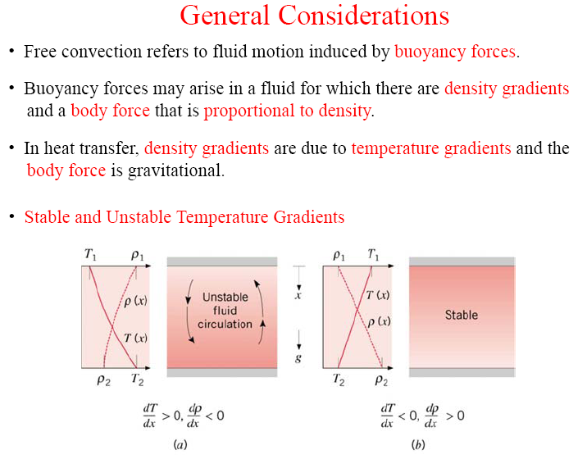
What is buoyancy force ?
The upward force exerted by a fluid on a body completely or partially immersed in it in a gravitational field.
The magnitude of the buoyancy force is equal to the weight of the fluid displaced by the body.

Slide 5
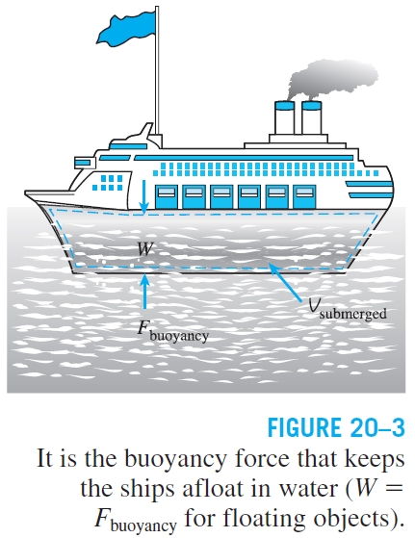
Buoyancy force: The upward force exerted by a fluid on a body completely or partially immersed in it in a gravitational field. The magnitude of the buoyancy force is equal to the weight of the fluid displaced by the body.
The net vertical force acting on a body
Archimedes’ principle: A body immersed in a fluid will experience a “weight loss” in an amount equal to the weight of the fluid it displaces.
The “chimney effect” that induces the upward flow of hot combustion gases through a chimney is due to the buoyancy effect.

Slide 6
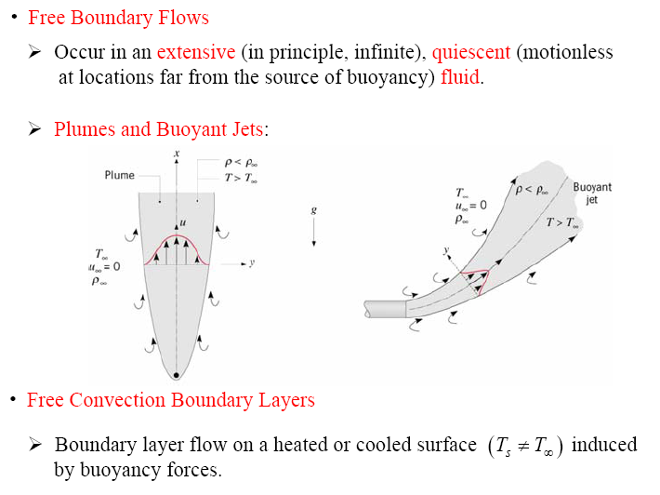
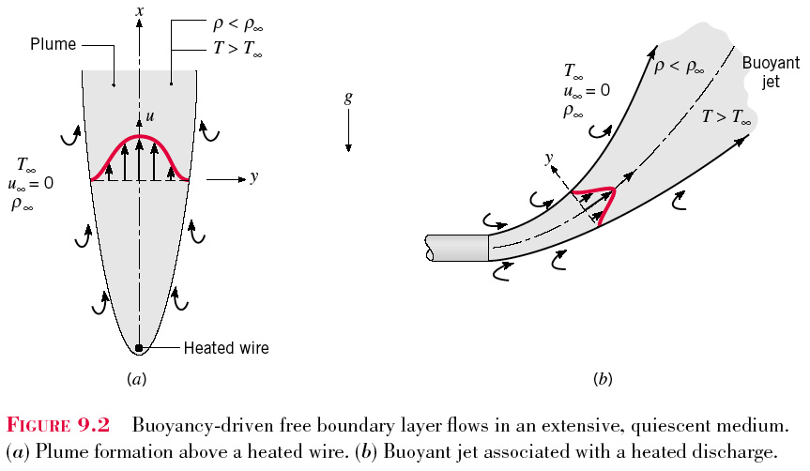

Slide 7
Volume expansion coefficient: Variation of the density of a fluid with temperature at constant pressure.
ideal gas
The larger the temperature difference between the fluid adjacent to a hot (or cold) surface and the fluid away from it, the larger the buoyancy force and the stronger the natural convection currents, and thus the higher the heat transfer rate.
The coefficient of volume expansion is a measure of the change in volume of a substance with temperature at constant pressure.

Slide 8
In natural convection, no blowers are used, and therefore the flow rate cannot be controlled externally.
The flow rate in this case is established by the dynamic balance of buoyancy and friction.
An interferometer produces a map of interference fringes, which can be interpreted as lines of constant temperature.
The smooth and parallel lines in (a) indicate that the flow is laminar, whereas the eddies and irregularities in (b) indicate that the flow is turbulent.
The lines are closest near the surface, indicating a higher temperature gradient.
Isotherms in natural convection over a hot plate in air.

Slide 9
20-2 EQUATION OF MOTION AND THE GRASHOF NUMBER
The thickness of the boundary layer increases in the flow direction.
Unlike forced convection, the fluid velocity is zero at the outer edge of the velocity boundary layer as well as at the surface of the plate.
At the surface, the fluid temperature is equal to the plate temperature, and gradually decreases to the temperature of the surrounding fluid at a distance sufficiently far from the surface.
In the case of cold surfaces, the shape of the velocity and temperature profiles remains the same but their direction is reversed.
Typical velocity and temperature profiles for natural convection flow over a hot vertical plate at temperature T_{s} inserted in a fluid at temperature T∞.

Slide 10
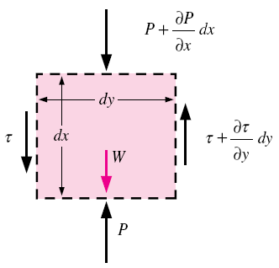
Derivation of the equation of motion that governs the natural convection flow in laminar boundary layer
This is the equation that governs the fluid motion in the boundary layer due to the effect of buoyancy. The momentum equation involves the temperature, and thus the momentum and energy equations must be solved simultaneously.
Forces acting on a differential volume element in the natural convection boundary layer over a vertical flat plate.

Slide 11
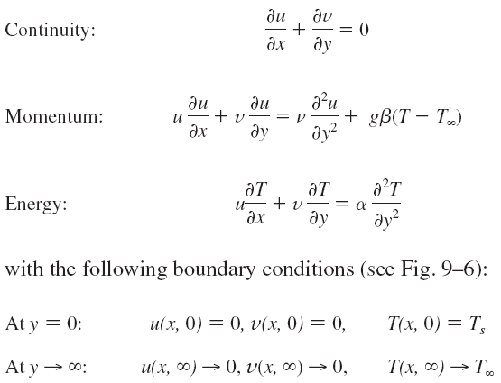
The complete set of conservation equations, continuity (Eq. 6–39), momentum (Eq. 9–13), and energy (Eq. 6–41) that govern natural convection flow over vertical isothermal plates are:
The above set of three partial differential equations can be reduced to a set of two ordinary nonlinear differential equations by the introduction of a similarity variable. But the resulting equations must still be solved along with their transformed boundary conditions numerically.

Slide 12
The Grashof Number
The governing equations of natural convection and the boundary conditions
can be nondimensionalized by dividing all dependent and independent variables
by suitable constant quantities:
Substituting them into the momentum equation and simplifying give
Grashof number: Represents the natural convection effects in momentum equation

Slide 13
The Grashof number provides the main criterion in determining whether the fluid flow is laminar or turbulent in natural convection.
For vertical plates, the critical Grashof number is observed to be about 10⁹.
When a surface is subjected to external flow, the problem involves both natural and forced convection.
The relative importance of each mode of heat transfer is determined by the value of the coefficient Gr/Re²:
Natural convection effects are negligible if Gr/Re² << 1.
Free convection dominates and the forced convection effects are negligible if Gr/Re² >> 1.
Both effects are significant and must be considered if Gr/Re² ≈ 1 (mixed convection).
The Grashof number Gr is a measure of the relative magnitudes of the buoyancy force and the opposing viscous force acting on the fluid.

Slide 14
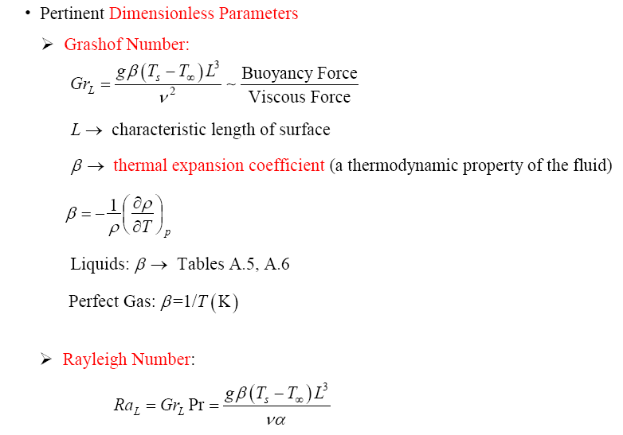
- Ratio of buoyancy forces and thermal and momentum diffusivities.

Slide 15
Rayleigh Number, Ra=Gr.Pr
In fluid mechanics, the Rayleigh number for a fluid is a dimensionless number associated with buoyancy driven flow (also known as free convection or natural convection).
When the Rayleigh number is below the critical value for that fluid, heat transfer is primarily in the form of conduction; when it exceeds the critical value, heat transfer is primarily in the form of convection.
The Rayleigh number is defined as the product of the Grashof number, which describes the relationship between buoyancy and viscosity within a fluid, and the Prandtl number, which describes the relationship between momentum diffusivity and thermal diffusivity.
Hence the Rayleigh number itself may also be viewed as the ratio of buoyancy and viscosity forces times the ratio of momentum and thermal diffusivities.

Slide 16

Forced vs Natural Convection
When analyzing potentially mixed convection, a parameter called the Archimedes number(Ar) parametrizes the relative strength of free and forced convection.
The Archimedes number is the ratio of Grashof number and the square of Reynolds number, which represents the ratio of buoyancy force and inertia force, and which stands in for the contribution of natural convection.
When Ar >> 1, natural convection dominates and when Ar << 1, forced convection dominates.

Slide 17
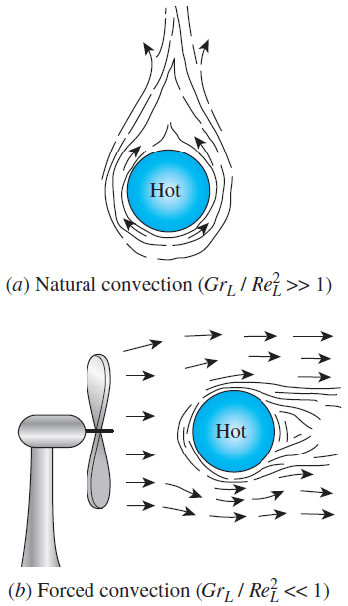
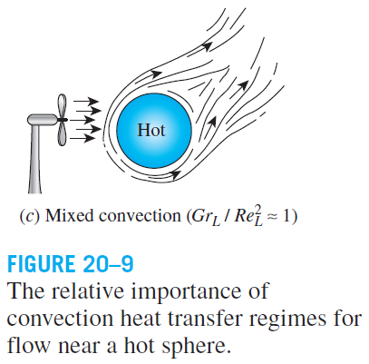

Slide 18

Natural convection over surfaces
1)
2)
3)
*C & n is depend on the geometry of the surface and flow regime.
n=1/4 → laminar flow
n-=1/3 → turbulent flow
1. What is the difference between Re_{L} and Ra_{L} ?
2. What is the transition range in a free convection boundary ?
${10}^{4}≤Ra≤{10}^{9}$ (Laminar)
${10}^{9}≤Ra≤{10}^{13}$ (Turbulent)
*All the properties are evaluated at the film temperature, T_{f}=(T_{s}+T∞)/2

Slide 19
20-3 NATURAL CONVECTION OVER SURFACES
Natural convection heat transfer on a surface depends on the geometry of the surface as well as its orientation, the variation of temperature on the surface and the thermophysical properties of the fluid involved.
With the exception of some simple cases, heat transfer relations in natural convection are based on experimental studies.
Rayleigh number
The constants C and n depend on the geometry of the surface and the flow regime, which is characterized by the range of the Rayleigh number.
The value of n is usually 1/4 for laminar flow and 1/3 for turbulent flow.
All fluid properties are to be evaluated at the film temperature T_{f} = (T_{s} + T∞)/2.
Natural convection heat transfer correlations are usually expressed in terms of the Rayleigh number raised to a constant n multiplied by another constant C, both of which are determined experimentally.

Slide 20

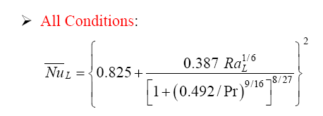
General correlations for vertical plate
where,
→ Eq. (9.24)
Laminar | 10⁴ ≤ Ra_{L} ≤10⁹ | C = 0.59 | n = 1/4
Turbulent | 10⁹ ≤ Ra_{L} ≤10¹³ | C = 0.10 | n = 1/3
For wide range and more accurate solution, use correlation Churchill and Chu
→ Eq. (20.21)

Slide 21
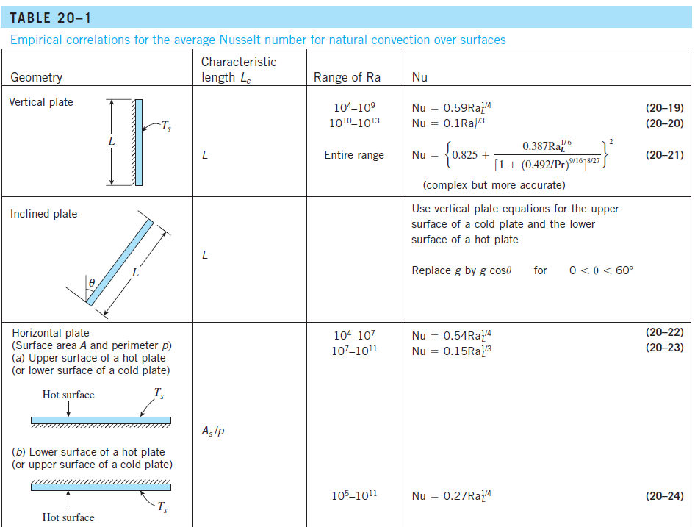

Slide 22
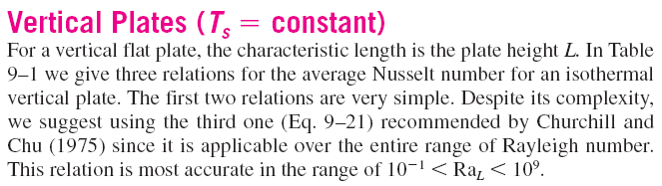

Slide 23

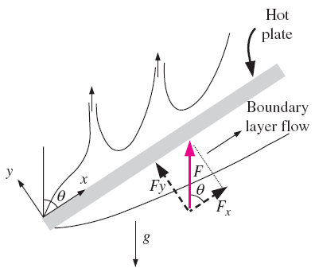
Vertical Plates (q_{s} = constant)
The relations for isothermal plates in the table can also be used for plates subjected to uniform heat flux, provided that the plate midpoint temperature T_{L / 2} is used for T_{s} in the evaluation of the film temperature, Rayleigh number, and the Nusselt number.
Inclined Plates
In a hot plate in a cooler environment for the lower surface of a hot plate, the convection currents are weaker, and the rate of heat transfer is lower relative to the vertical plate case.
On the upper surface of a hot plate, the thickness of the boundary layer and thus the resistance to heat transfer decreases, and the rate of heat transfer increases relative to the vertical orientation.
In the case of a cold plate in a warmer environment, the opposite occurs.
Natural convection flows on the upper and lower surfaces of an inclined hot plate.

Slide 24
Natural Convection
Example:
Consider a 0.6m x 0.6m thin square plate in a room at 30°C. One side of the plate is maintained at a temperature of 90°C, while the other side is insulated. Determine the rate of heat transfer from the plate by natural convection if the plate is vertical.

Slide 25

Horizontal Plates
For a hot surface in a cooler environment, the net force acts upward, forcing the heated fluid to rise.
If the hot surface is facing upward, the heated fluid rises freely, inducing strong natural convection currents and thus effective heat transfer.
But if the hot surface is facing downward, the plate blocks the heated fluid that tends to rise, impeding heat transfer.
The opposite is true for a cold plate in a warmer environment since the net force (weight minus buoyancy force) in this case acts downward, and the cooled fluid near the plate tends to descend.
Natural convection flows on the upper and lower surfaces of a horizontal hot plate.
Characteristic length
L_{c} = a/4 for a horizontal square surface of length a
L_{c} = D/4 for a horizontal circular surface of diameter D

Slide 26
Horizontal Cylinders and Spheres
The boundary layer over a hot horizontal cylinder starts to develop at the bottom, increasing in thickness along the circumference, and forming a rising plume at the top.
Therefore, the local Nusselt number is highest at the bottom, and lowest at the top of the cylinder when the boundary layer flow remains laminar.
The opposite is true in the case of a cold horizontal cylinder in a warmer medium, and the boundary layer in this case starts to develop at the top of the cylinder and ending with a descending plume at the bottom.
Natural convection flow over a horizontal hot cylinder.

Slide 27

20-4 NATURAL CONVECTION INSIDE ENCLOSURES
Enclosures are frequently encountered in practice, and heat transfer through them is of practical interest. In a vertical enclosure, the fluid adjacent to the hotter surface rises and the fluid adjacent to the cooler one falls, setting off a rotationary motion within the enclosure that enhances heat transfer through the enclosure.
L_{c} charecteristic length: the distance between the hot and cold surfaces
T₁ and T₂: the temperatures of the hot and cold surfaces
Ra > 1708, natural convection currents
Ra > 3×10⁵, turbulent fluid motion
Nu = 1
Fluid properties at
Convective currents in a horizontal enclosure with (a) hot plate at the top and (b) hot plate at the bottom.
Convective currents in a vertical rectangular enclosure.

Slide 28
Effective Thermal Conductivity
effective thermal conductivity
The fluid in an enclosure behaves like a fluid whose thermal conductivity is
kNu as a result of convection currents.
Nu = 1, the effective thermal conductivity of the enclosure is equal to the conductivity of the fluid. This case corresponds to pure conduction.
Numerous correlations for the Nusselt number exist. Simple power-law type relations in the form of Nu = CRa^{n}, where C and n are constants, are sufficiently accurate, but they are usually applicable to a narrow range of Prandtl and Rayleigh numbers and aspect ratios.
A Nusselt number of 3 for an enclosure indicates that heat transfer through the enclosure by natural convection is three times that by pure conduction.

Slide 29
Horizontal Rectangular Enclosures
For horizontal enclosures that contain air, These relations can also be used for other gases with 0.5 < Pr < 2.
For water, silicone oil, and mercury
[ ]⁺ only positive values to be used
Based on experiments with air. It may be used for liquids with moderate Prandtl numbers for Ra_{L} < 10⁵.
When the hotter plate is at the top, Nu = 1.
A horizontal rectangular enclosure with isothermal surfaces.

Slide 30
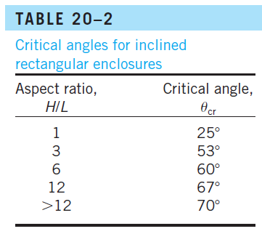
Inclined Rectangular Enclosures
An inclined rectangular enclosure with isothermal surfaces.

Slide 31

Vertical Rectangular Enclosures
A vertical rectangular enclosure with isothermal surfaces.
Again, all fluid properties are to be evaluated at the average temperature (T₁+T₂)/2.

Slide 32

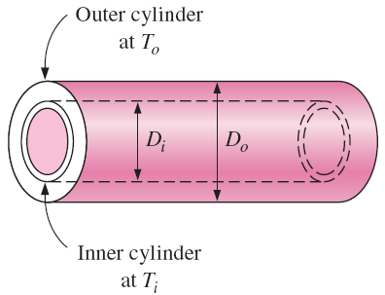
Concentric Cylinders
The rate of heat transfer through the annular space between the cylinders by natural convection per unit length
Characteristic length
the geometric factor for concentric cylinders
For F_{cyl}Ra_{L} < 100, natural convection currents are negligible and thus k_{eff} = k.
Note that k_{eff} cannot be less than k, and thus we should set k_{eff} = k if k_{eff}/k < 1.
The fluid properties are evaluated at the average temperature of (T_{i} + T_{o})/2.
Two concentric horizontal isothermal cylinders.

Slide 33

Concentric Spheres
Characteristic length
Two concentric isothermal spheres.
If k_{eff} /k < 1, we should set k_{eff} = k.

Slide 34


Combined Natural Convection and Radiation
Gases are nearly transparent to radiation, and thus heat transfer through a
gas layer is by simultaneous convection (or conduction) and radiation.
Radiation is usually disregarded in forced convection problems, but it must be considered in natural convection problems that involve a gas. This is especially the case for surfaces with high emissivities.
Radiation heat transfer from a surface at temperature T_{s} surrounded by surfaces at a temperature T_{surr} is
σ = 5.67 × 10⁸ W/m²⋅K⁴ Stefan–Boltzmann constant
Radiation heat transfer between two large parallel plates is
When T∞ < T_{s} and T_{surr} > T_{s}, convection and radiation heat transfers are in opposite directions and subtracted from each other.

Slide 35
Summary
Physical Mechanism of Natural Convection
Equation of Motion and the Grashof Number
Natural Convection Over Surfaces
  Vertical Plates (T_{s} = constant), (q_{s} = constant)
  Vertical Cylinders
  Inclined Plates
  Horizontal Plates
  Horizontal Cylinders and Spheres
Natural Convection Inside Enclosures
  Effective Thermal Conductivity
  Horizontal Rectangular Enclosures
  Inclined Rectangular Enclosures
  Vertical Rectangular Enclosures
  Concentric Cylinders and Spheres
  Combined Natural Convection and Radiation

