Slide 1
Thermodynamics II
Chapter 1
VAPOR POWER CYCLES
Mohsin Mohd Sies
Fakulti Kejuruteraan Mekanikal, Universiti Teknologi Malaysia

Slide 2
Coverage
Analyze vapor power cycles in which the working fluid is alternately vaporized and condensed.
Analyze power generation coupled with process heating called cogeneration.
Investigate ways to modify the basic Rankine vapor power cycle to increase the cycle thermal efficiency.
Analyze the reheat and regenerative vapor power cycles.
Review power cycles that consist of two separate cycles, known as combined cycles.

Slide 3
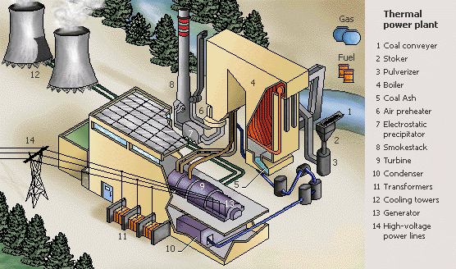
Thermal Power Plant

Slide 4
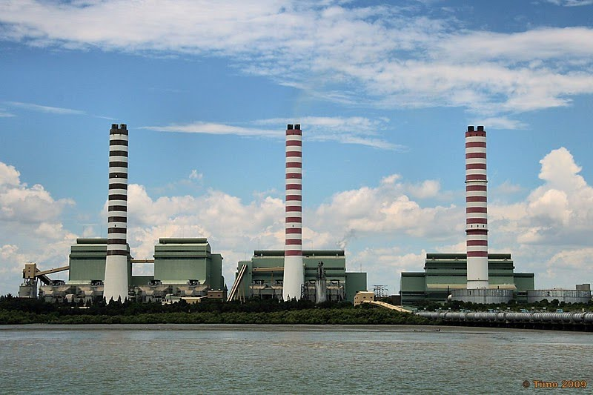
Kapar Power Station

Slide 5
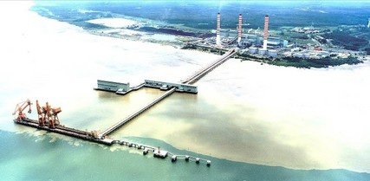
Kapar Power Station

Slide 6
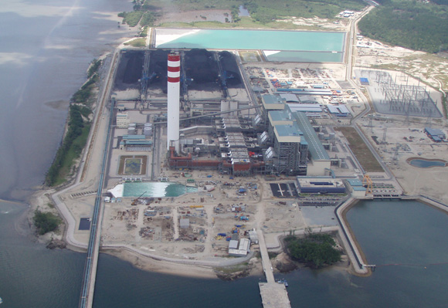
Tanjung Bin Power Station

Slide 7
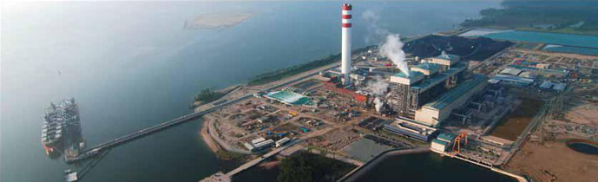
Tanjung Bin Power Station

Slide 8
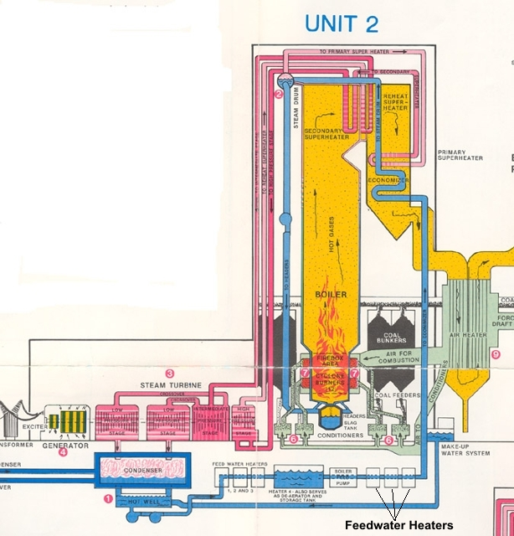
Schematic Diagram

Slide 9
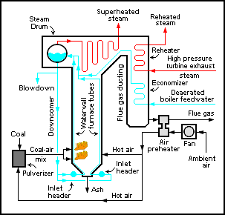

Slide 10
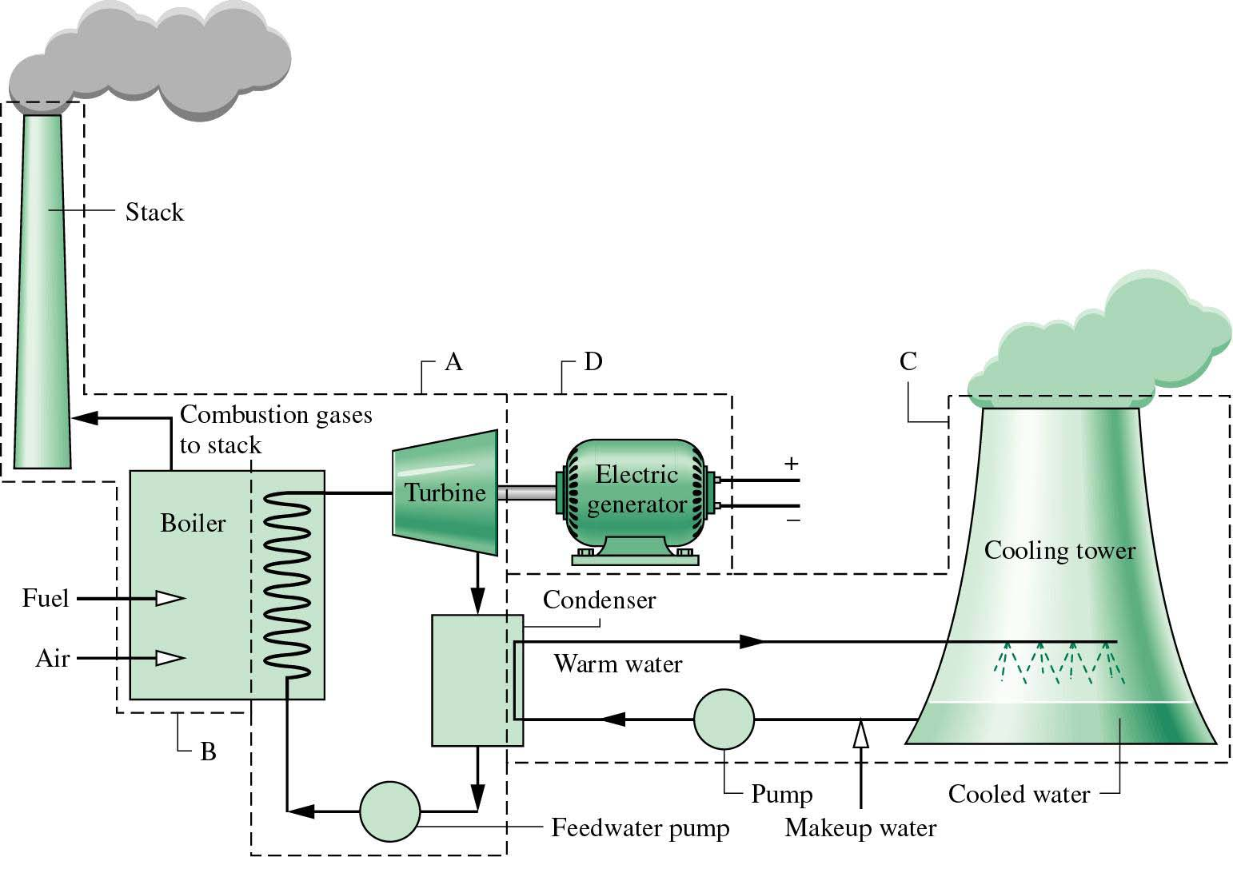
Sub-Systems in a Vapor Power Plant
Our focus will be on sub-system A.

Slide 11
Introduction
Steam (Water Vapor)
Steam is the most common working fluid used in vapor power cycles because of its many desirable characteristics, such as: (a) low cost, (b) availability, and (c) high enthalpy of vaporization#.
Steam power plants are commonly referred to as: (a) coal plants, (b) nuclear plants, or (c) natural gas plants, depending on the type of fuel used to supply heat to the steam.
The steam goes through the same basic cycle in all of them. Therefore, all can be analyzed in the same manner.
# The amount of energy needed to vaporize a unit mass of saturated liquid at a given temperature or pressure, h_{fg}.

Slide 12
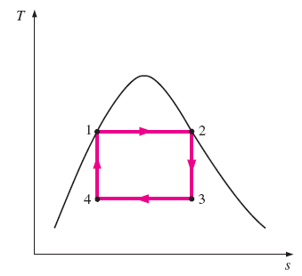

Carnot Vapor Cycle
Carnot cycle is the most efficient power cycle operating between two specified temperature limits (Fig. 10-1).
We can adopt the Carnot cycle first as a prospective ideal cycle for vapor power plants.
Sequence of Processes:
1-2 Reversible and isothermal heating (in a boiler);
2-3 Isentropic expansion (in a turbine);
3-4 Reversible and isothermal condensation (in a condenser); and
4-2 Isentropic compression (in a compressor).

Slide 13
Is Carnot Cycle Practical?
The Carnot cycle is NOT a suitable model for actual power cycles because of several impracticalities associated with it:
Process 1-2
Limiting the heat transfer processes to two-phase systems severely limits the maximum temperature that can be used in the cycle (374°C for water).
Process 2-3
The turbine cannot handle steam with a high moisture content because of the impingement of liquid droplets on the turbine blades causing erosion and wear.
Process 4-1
It is not practical to design a compressor that handles two phases.

Slide 14
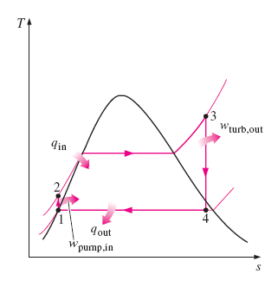

The Rankine Cycle
Many of the impracticalities associated with the Carnot cycle can be eliminated by: (a) superheating the steam in the boiler, and (b) condensing the steam completely in the condenser.
The modified Carnot cycle is called the Rankine cycle, where the isothermal processes are replaced with constant pressure processes to facilitate doing (a) and (b) above. This is the ideal and practical cycle for vapor power plants (Figure 10-2).
This ideal cycle does not involve any internal irreversibilities.

Slide 15
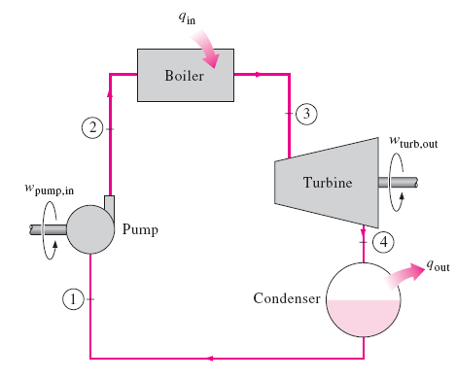
Sequence of Processes
The ideal Rankine cycle consists of four processes:
1-2 Isentropic compression in a water pump;
2-3 Constant pressure heat addition in a boiler;
3-4 Isentropic expansion in a turbine;
4-1 Constant pressure heat rejection
in a condenser.

Slide 16
Energy Analysis of Ideal Rankine Cycle
The pump, boiler, turbine, and condenser are steady-flow devices. Thus all four processes that make up the ideal Rankine cycle can be analyzed as steady-flow processes.
The kinetic and potential energy changes of the steam are usually small. Thus the Steady-flow Energy Equation per unit mass of steam reduces to:
Energy Interactions
The boiler and condenser do not involve any work but both involve with heat interactions.
The pump and the turbine are assumed to be isentropic and both involve work interactions.

Slide 17





Energy Interactions in Each Device
Pump: The work needed to operate the water pump,
where,
Boiler: The amount of heat supplied
in the steam boiler,
Turbine: The amount of work produced
by the turbine,
Condenser: The amount of heat
rejected to cooling medium in the condenser,

Slide 18


Performance of Ideal Rankine Cycle
Thermal Efficiency
The thermal efficiency of the Rankine cycle is determined from,
where the net work output,
Note: +ve quantities only!
Thermal efficiency of Rankine cycle can also be interpreted as the ratio of the area enclosed by the cycle on a T-s diagram to the area under the heat-addition process.

Slide 19
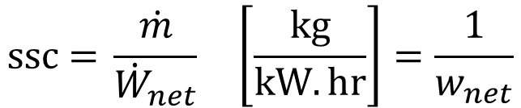
Performance of Ideal Rankine Cycle
Specific Steam Consumption (SSC)
How efficient/economical a steam plant is using the steam to produce a net amount of work output
$$\text{ssc}\text{ =} \frac{\dot{m}}{{\dot{W}}_{net}} \left[\frac{\text{kg}}{\text{kW}.\text{hr}}\right]=\frac{1}{w_{net}}$$
* Be careful about the units

Slide 20
Problem
The Simple Rankine Cycle
10–16
Consider a 210-MW steam power plant that operates on a simple ideal Rankine cycle. Steam enters the turbine at 10 MPa and 500°C and is cooled in the condenser at a pressure of 10 kPa. Show the cycle on a T-s diagram with respect to saturation lines, and determine:
the quality of the steam at the turbine exit,
the thermal efficiency of the cycle, and
the mass flow rate of the steam.
Answers: (a) 0.793, (b) 40.2 percent, (c) 165 kg/s

Slide 21
Problem
The Simple Rankine Cycle
10-16
Solve Prob. 10-16.
Answers: (a) 0.793, (b) 40.2 percent, (c) 165 kg/s
10–17
Repeat Prob. 10–16 assuming an isentropic efficiency of 85 percent for both the turbine and the pump.
Answers: (a) 0.874, (b) 34.1 percent, (c) 194 kg/s

Slide 22
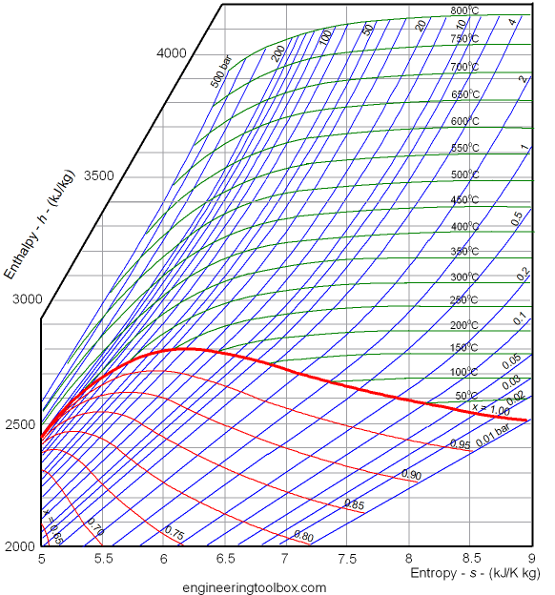
Mollier Diagram (h-s diagram)

Slide 23
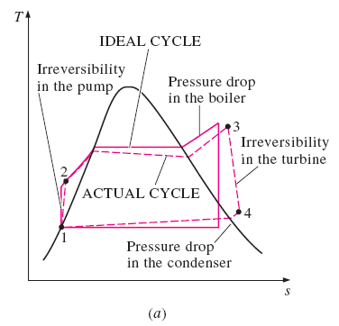
Actual Vapor Power Cycles
The actual vapor power cycle differs from the ideal Rankine cycle as a result of irreversibilities in various components. Two common sources of irreversibilities are: (a) fluid friction, and (b) heat loss to the surroundings.
Fluid friction causes pressure drops in the boiler, condenser, and the piping between various components. Water must be pumped to a higher pressure - requires a larger pump and larger work input.
More heat needs to be transferred to the steam in the boiler to compensate for the undesired heat losses from the steam to the surroundings.
As a result, the cycle thermal efficiency decreases.

Slide 24
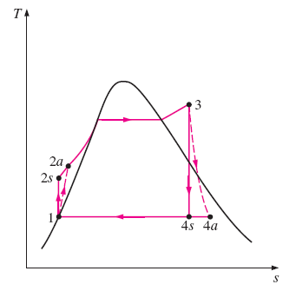
Isentropic Efficiencies
A pump requires a greater work input, and a turbine produces a smaller work output as a result of irreversibilities.
The deviation of actual pumps and turbines from the isentropic ones can be accounted for by utilizing isentropic efficiencies, defined as,
Pump:
Turbine:
In actual condensers, the liquid is usually sub-cooled to prevent the onset of cavitation, which may damage the water pump. Additional losses occur at the bearings between the moving parts as a result of friction. Two other factors are the steam that leaks out during the cycle and air that leaks into the condenser.

Slide 25
Problem
The Simple Rankine Cycle
Homework Exercise
10–22
Consider a steam power plant that operates on a simple ideal Rankine cycle and has a net power output of 45 MW. Steam enters the turbine at 7 MPa and 500°C and is cooled in the condenser at a pressure of 10 kPa by running cooling water from a lake through the tubes of the condenser at a rate of 2000 kg/s. Show the cycle on a T-s diagram with respect to saturation lines, and determine:
the thermal efficiency of the cycle,
the mass flow rate of the steam, and
the temperature rise of the cooling water.
Answers: (a) 38.9 percent, (b) 36 kg/s, (c) 8.4°C

Slide 26
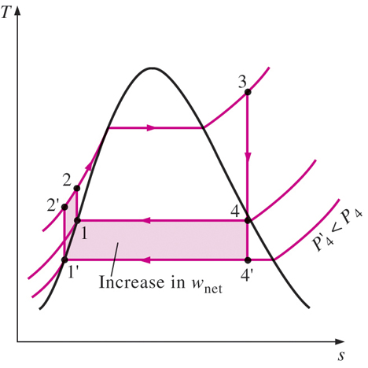

Increasing Efficiency of Rankine Cycle
Thermal efficiency of the ideal Rankine cycle can be increased by: (a) Increasing the average temperature at which heat is transferred to the working fluid in the boiler, or (b) decreasing the average temperature at which heat is rejected from the working fluid in the condenser.
Lowering the Condenser Pressure
The condensers of steam power plants usually operate well below the atmospheric pressure. There is a lower limit to this pressure depending on the temperature of the cooling medium.
Side effect: Lowering the condenser pressure increases the moisture content of the steam at the final stages of the turbine – can cause blade damage, decreasing isentropic efficiency.

Slide 27
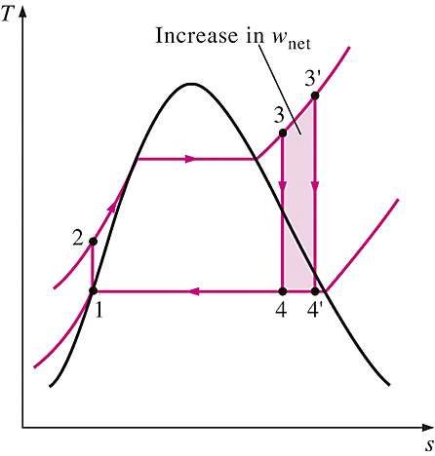
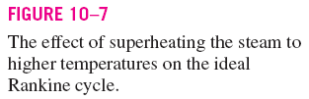
Superheating the Steam to High Temperatures
Superheating the steam increases both the net work output and heat input to the cycle. The overall effect is an increase in thermal efficiency of the cycle.
Superheating to higher temperatures will decrease the moisture content of the steam at the turbine exit, which is desirable – avoid erosion of turbine blades.
The superheating temperature is limited by metallurgical considerations. Presently the highest steam temperature allowed at the turbine inlet is about 620°C.

Slide 28
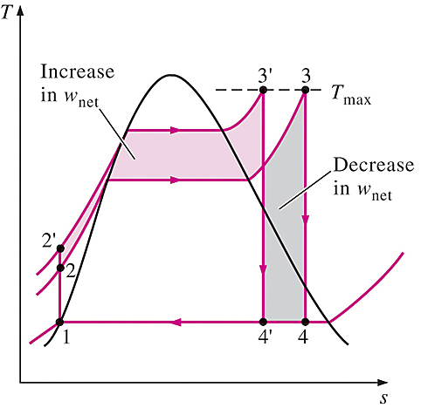

Increasing the Boiler Pressure
Increasing the boiler pressure raises the average temperature at which heat is transferred to the steam. This, in turns increases the thermal efficiency of the cycle.
Note:
For a fixed turbine inlet temperature, the cycle shifts to the left and the moisture content of steam at the turbine exit increases.
This side effect can be corrected by reheating the steam.

Slide 29
Problem
The Reheat Rankine Cycle
10–34
Consider a steam power plant that operates on a reheat Rankine cycle and has a net power output of 80 MW. Steam enters the high-pressure turbine at 10 MPa and 500°C and the low-pressure turbine at 1 MPa and 500°C. Steam leaves the condenser as a saturated liquid at a pressure of 10 kPa. The isentropic efficiency of the turbine is 80 percent, and that of the pump is 95 percent. Show the cycle on a T-s diagram with respect to saturation lines, and determine:
the quality of the steam at the turbine exit,
the thermal efficiency of the cycle, and
the mass flow rate of the steam.
Answers: (a) 88.1°C, (b) 34.1 percent, (c) 62.7 kg/s

Slide 30
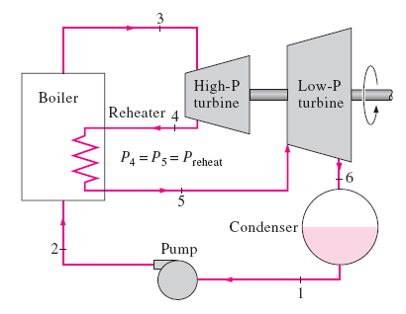
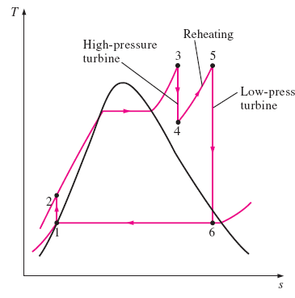

The Ideal Reheat Rankine Cycle
Reheating is a practical solution to the excessive moisture problem in turbines, and it is commonly used in modern steam power plants. This is done by expanding the steam in two-stage turbine, and reheat the steam in between the stages.
Note: Incorporation of the single reheat in a modern power plant improves the cycle efficiency by 4 ~ 5 percent.

Slide 31

With a single reheating process, the total heat input and the total turbine work output for the ideal cycle become,

Slide 32
Problem
The Reheat Rankine Cycle
10–38
A steam power plant operates on the reheat Rankine cycle. Steam enters the high-pressure turbine at 12.5 MPa and 550°C at a rate of 7.7 kg/s and leaves at 2 MPa. Steam is then reheated at constant pressure to 450°C before it expands in the low-pressure turbine. The isentropic efficiencies of the turbine and the pump are 85 percent and 90 percent, respectively. Steam leaves the condenser as a saturated liquid. If the moisture content of the steam at the exit of the turbine is not to exceed 5 percent, determine:
the condenser pressure,
the net power output, and
the thermal efficiency.
Answers: (a) 9.73 kPa, (b) 10.2 MW, (c) 36.9 percent.

Slide 33
Problem
The Regenerative Rankine Cycle
10–44
A steam power plant operates on an ideal regenerative Rankine cycle. Steam enters the turbine at 6 MPa and 450°C and is condensed in the condenser at 20 kPa. Steam is extracted from the turbine at 0.4 MPa to heat the feedwater in an open feedwater heater. Water leaves the feedwater heater as a saturated liquid. Show the cycle on a T-s diagram, and determine:
(a) the net work output per kg of steam flowing through the boiler, and
(b) the thermal efficiency of the cycle.
Answers: (a) 1017 kJ/kg, (b) 37.8 percent

Slide 34
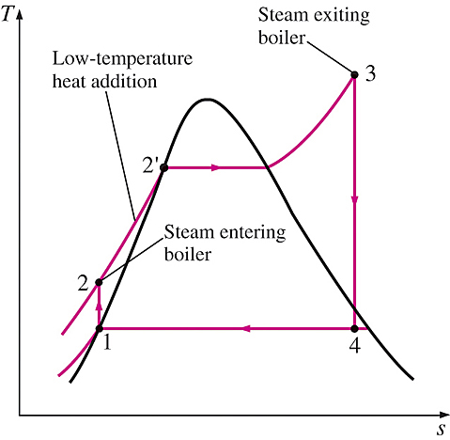
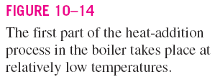
The Ideal Regenerative Rankine Cycle
Heat is transferred to the working fluid during process 2-2’ at a relatively low temperature (Fig. 10-14). This lowers the average heat-addition temperature and thus the cycle efficiency.
Regeneration Process
Steam is extracted from the turbine at various points, and is used to heat the feedwater, before it enters the boiler. The device where the feedwater is heated using the steam is called a regenerator, or a feedwater heater (FWH).
A feedwater heater is a heat exchanger where heat is transferred from the extracted steam to the feedwater either by: (a) mixing the two fluid streams (open FWH) or (b) without mixing them (closed FWH) – heat transfer from steam to feedwater.

Slide 35
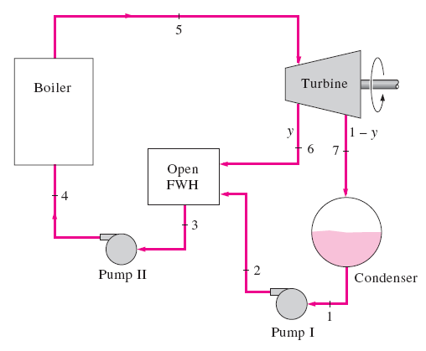
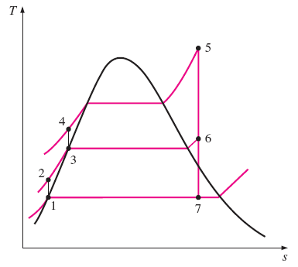

Open Feedwater Heaters
An open FWH is a mixing chamber, where the steam extracted from the turbine (state 6) mixes with the feedwater exiting the pump (state 2). Ideally, the mixture leaves the heater as a saturated liquid (state 3) at the FWH’s pressure.

Slide 36



Energy Analyses
The heat and work interactions in a regenerative Rankine cycle with one feedwater heater can be expressed (per unit mass of steam flowing through the boiler), as follows:
Mass of Steam Extracted
For each 1 kg of steam leaving the boiler, y kg expands partially in the turbine and is extracted at state 6.
The remaining (1-y) kg of the steam expands to the condenser pressure.
Therefore, the mass flow rates of the steam will be different in different components.
Mass fraction of steam extracted from the turbine,
Pump work input,
Note: The cycle efficiency increases further as the number of feedwater heaters is increased.

Slide 37
Problem
The Regenerative Rankine Cycle
10–45
Repeat Prob. 10–44 by replacing the open feedwater heater with a closed feedwater heater. Assume that the feedwater leaves the heater at the condensation temperature of the extracted steam and that the extracted steam leaves the heater as a saturated liquid and is pumped to the line carrying the feedwater.

Slide 38
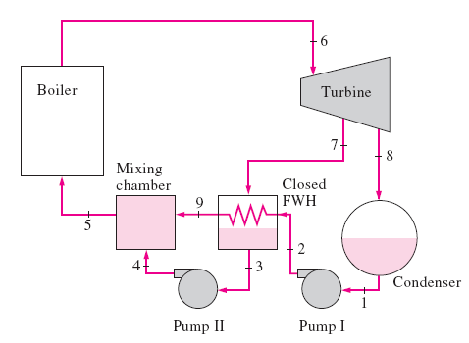
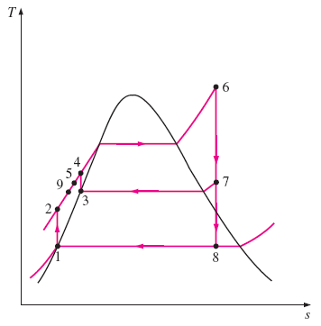

Closed Feedwater Heater
In a closed feedwater heater, heat is transferred from the extracted steam (state 7) to the feedwater leaving the pump (state 2) without mixing. The two streams can be at different pressures (P₇ ≠ P₂). The condensate (state 3) is pumped into a mixing chamber to mixed with the heated feedwater (state 9).
Ideally, T₉ ≈ T₃

Slide 39
Open vs. Closed Feedwater Heater
Open FWHs
Open feedwater heaters are simple and inexpensive. They have good heat transfer characteristics.
For each feedwater heater used, additional feedwater pump is required.
Closed FWHs
The closed feedwater heaters are more complex because of the internal tubing network. Thus they are more expensive.
Heat transfer in closed feedwater heaters is less effective since the two streams are not allowed to be in direct contact.
The closed feedwater heaters do not require a separate pump for each FWH since the extracted steam and the feedwater can be at different pressures.

Slide 40
Problem
The Reheat Regenerative Rankine Cycle
10–49
A steam power plant operates on an ideal reheat-regenerative Rankine cycle and has a net power output of 80 MW. Steam enters the high-pressure turbine at 10 MPa and 550°C and leaves at 0.8 MPa. Some steam is extracted at this pressure to heat the feedwater in an open feedwater heater. The rest of the steam is reheated to 500°C and is expanded in the low-pressure turbine to the condenser pressure of 10 kPa.
Show the cycle on a T-s diagram and determine:
(a) the mass flow rate of steam through the boiler, and
(b) thermal efficiency of the cycle.
Answers: (a) 54.5 kg/s, (b) 44.4 percent

Slide 41
Problem
The Reheat Regenerative Rankine Cycle
10–50
Repeat Prob. 10–49, but replace the open feedwater heater with a closed feedwater heater. Assume that the feedwater water leaves the heater at the condensation temperature of the extracted steam and that the extracted steam leaves the heater as a saturated liquid and is pumped to the line carrying the feedwater.

Slide 42
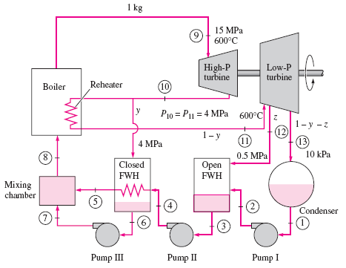

Open & Closed FWH Combined
Most steam power plants use a combination of open and closed feedwater heaters.

Slide 43
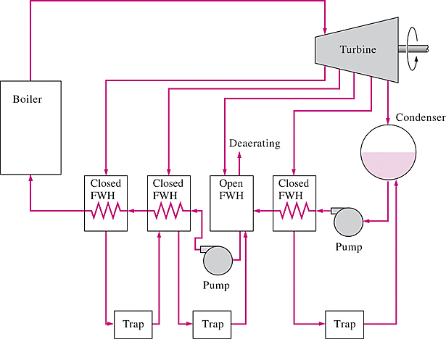

Another combination of open and closed feedwater heaters.

