Slide 1

CHAPTER 7 – TRANSFORMATION OF STREE
23 JUNE 2022 l SCHOOL OF CHEMICAL & ENERGY ENGINEERING l FACULTY OF ENGINEERING
DR. ZULHAIRUN ABDUL KARIM
www.utm.my
Innovative · Entrepreneurial · Global

Slide 2
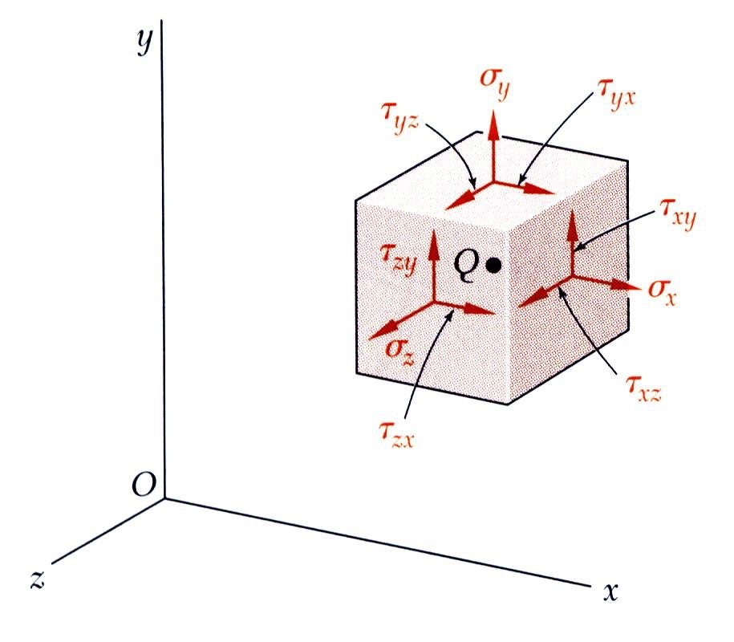
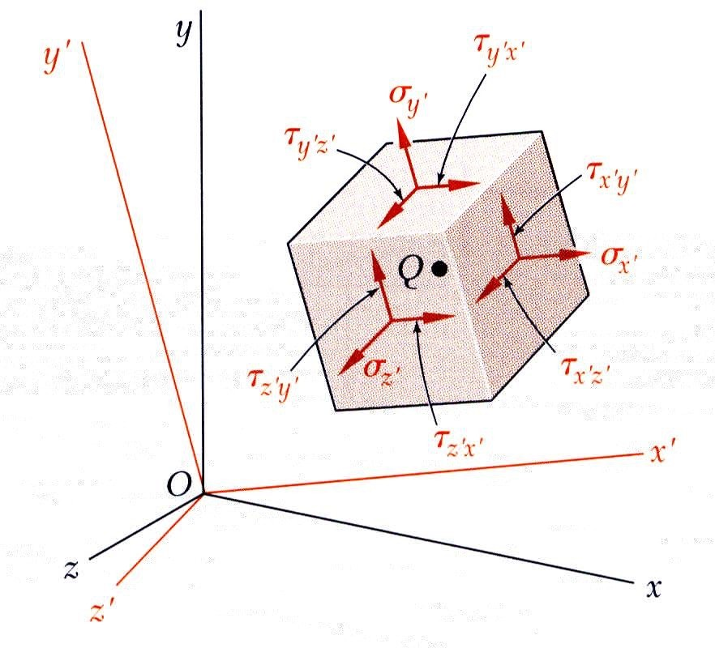

MECHANICS OF MATERIALS
Edition
Third
Beer • Johnston • DeWolf
Introduction
The most general state of stress at a point may be represented by 6 components,
σ _{x} ,σ _{y} ,σ _{z}
^{τ} xy ^{, τ} yz ^{, τ} zx
normal stresses shearing stresses
(Note : τ _{xy} = τ _{yx} , τ _{yz} = τ _{zy} , τ _{zx} = τ _{xz} )
Same state of stress is represented by a different set of components if axes are rotated.
The first part of the chapter is concerned with how the components of stress are transformed under a rotation of the coordinate axes. The second part of the chapter is devoted to a similar analysis of the transformation of the components of strain.

Slide 3
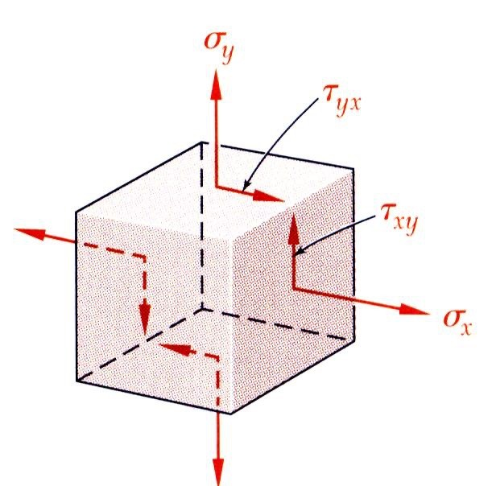
MECHANICS OF MATERIALS
Edition
Third
Beer • Johnston • DeWolf
Introduction
Plane Stress - state of stress in which two faces of the cubic element are free of stress. For the illustrated example, the state of stress is defined by
σ _{x} , σ _{y} , τ _{xy}
and σ _{z} = τ _{zx} = τ _{zy} = 0.
State of plane stress occurs in a thin plate subjected to forces acting in the midplane of the plate.
State of plane stress also occurs on the free surface of a structural element or machine component, i.e., at any point of the surface not subjected to an external force.

Slide 4
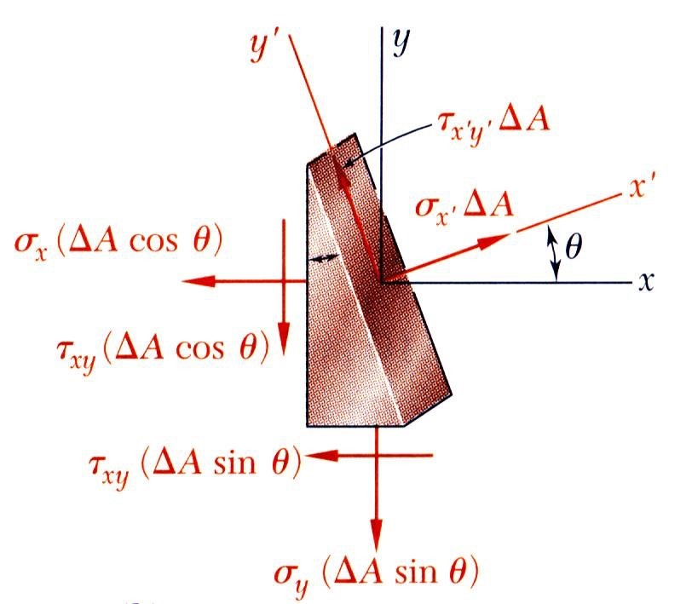
MECHANICS OF MATERIALS
Edition
Third
Beer • Johnston • DeWolf
Transformation of Plane Stress
Consider the conditions for equilibrium of a prismatic element with faces perpendicular to the x, y, and x’ axes.
∑ F_{x′} = 0 = σ _{x′}ΔA − σ _{x} (ΔAcosθ )cosθ −τ _{xy} (ΔAcosθ )sinθ
− σ _{y} (ΔAsinθ )sinθ −τ _{xy} (ΔAsinθ )cosθ
∑ F_{y′} = 0 = τ _{x′y′}ΔA + σ _{x} (ΔAcosθ )sinθ −τ _{xy} (ΔAcosθ )cosθ
− σ _{y} (ΔAsinθ )cosθ +τ _{xy} (ΔAsinθ )sinθ

Slide 5
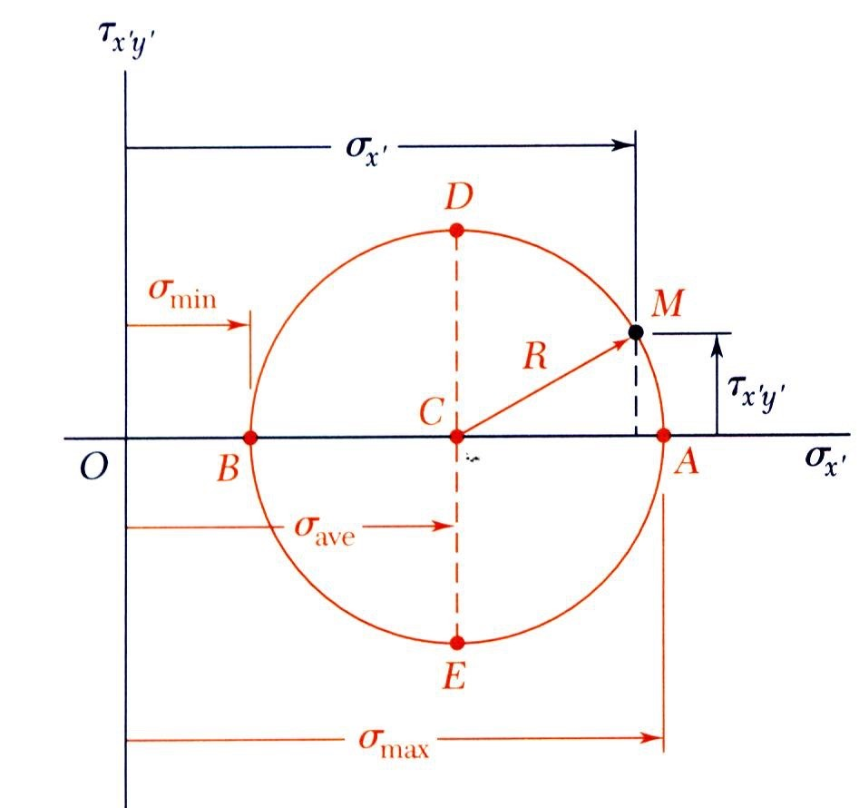
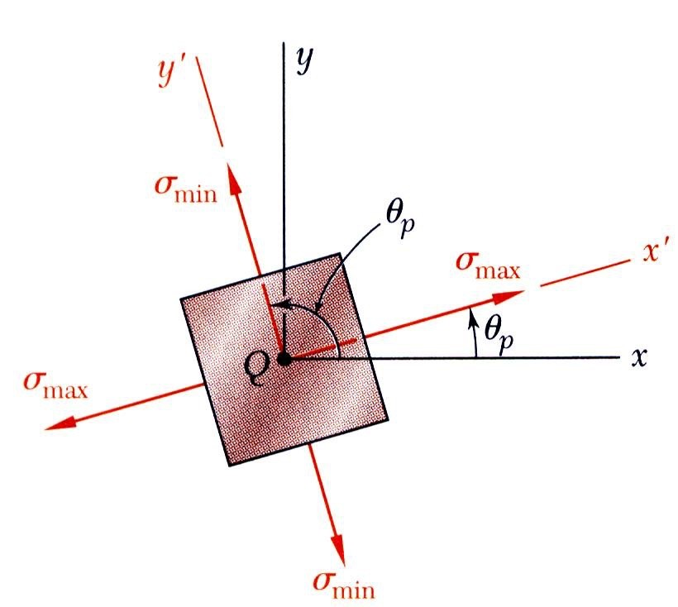
MECHANICS OF MATERIALS
Edition
Third
Beer • Johnston • DeWolf
Principal Stresses
The previous equations are combined to yield parametric equations for a circle,
(σ _{x′} − σ _{ave} )² +τ ² = R²
x′y′
where
σ _{x} + σ _{y}
⎛ σ _{x} − σ _{y} ⎞²
2
^{σ} ave ⁼
R =
⎜
⎝
⎟
⎠
+τ _{xy}
2
2
Principal stresses occur on the principal planes of stress with zero shearing stresses.
σ _{x} + σ _{y} ⎛ σ _{x} − σ _{y} ⎞²
2
^{σ} max,min ⁼
2
2τ _{xy}
±
⎜
⎝
⎟
⎠
+τ _{xy}
2
tan 2θ =
p
σ _{x} − σ _{y}
Note : defines two angles separated by 90º

Slide 6
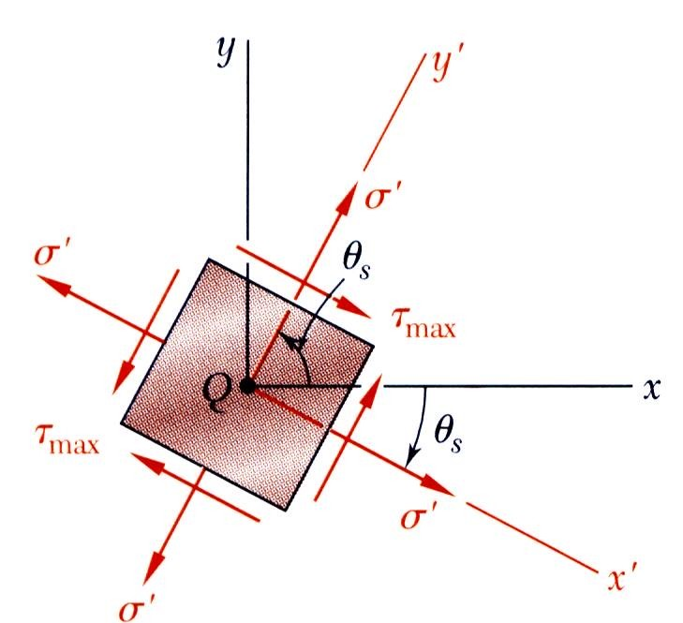
MECHANICS OF MATERIALS
Edition
Third
Beer • Johnston • DeWolf
Maximum Shearing Stress
Maximum shearing stress occurs for
^{σ} x′ ^{= σ} ave
⎛ σ _{x} − σ _{y} ⎞²
2
τ _{max} = R =
⎜
⎝
⎟
⎠
+τ _{xy}
2
₌ ₋ σ _{x} − σ _{y}
tan 2θ
s
2τ _{xy}
Note : defines two angles separated by 90º and offset from θ _{p} by 45º
₌ σ _{x} + σ _{y}
σ ′ = σ
ave
2

Slide 7
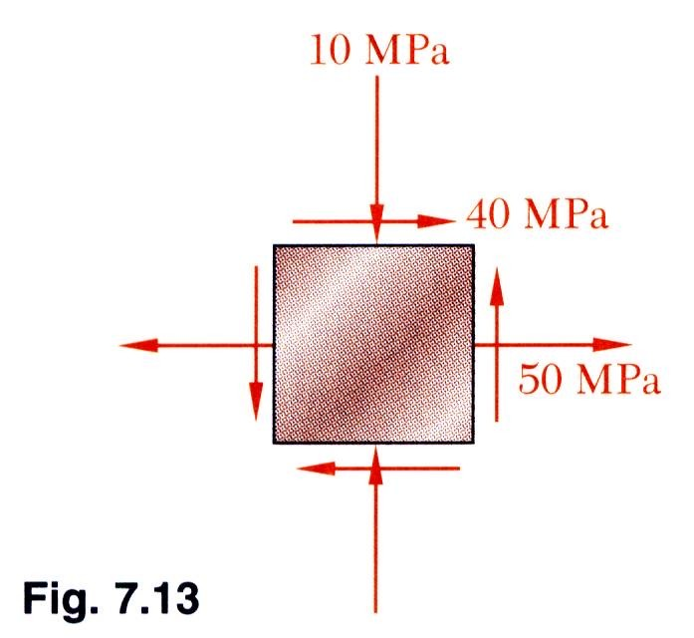
MECHANICS OF MATERIALS
Edition
Third
Beer • Johnston • DeWolf
Example 7.01
SOLUTION:
Find the element orientation for the principal stresses from
2τ _{xy}
tan 2θ =
p
σ _{x} − σ _{y}
Determine the principal stresses from
σ _{x} + σ _{y} ⎛ σ _{x} − σ _{y} ⎞²
2
^{σ} max,min ⁼
±
⎜
⎝
⎟
⎠
+ τ _{xy}
For the state of plane stress shown, determine (a) the principal panes,
(b) the principal stresses, (c) the maximum shearing stress and the corresponding normal stress.
2
2
Calculate the maximum shearing stress with
⎛ σ − σ
⎞2
⎜ x y ⎟
+ τ ²
^{τ} max ⁼
2
xy
⎝
⎠
_{σ ′ =} σ _{x} + σ _{y}
2

Slide 8
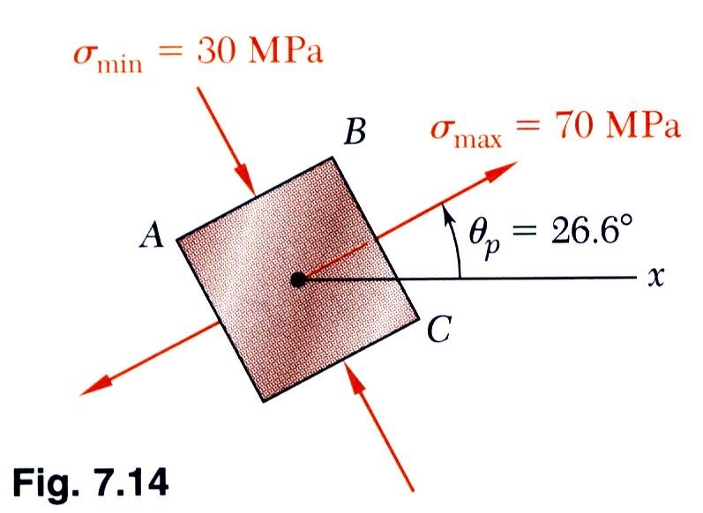
MECHANICS OF MATERIALS
Edition
Third
Beer • Johnston • DeWolf
Example 7.01
SOLUTION:
Find the element orientation for the principal stresses from
2τ _{xy}
= ²⁽⁺ ⁴⁰⁾ = 1.333
tan 2θ =
p
σ _{x} − σ _{y} 50 − (− 10)
2θ _{p} = 53.1°, 233.1°
σ _{x} = +50 MPa
σ _{x} = −10 MPa
θ _{p} = 26.6°, 116.6°
τ _{xy} = +40 MPa
Determine the principal stresses from
σ _{x} + σ _{y} ⎛ σ _{x} − σ _{y} ⎞²
2
^{σ} max,min ⁼
±
⎜
⎝
⎟
⎠
+ τ _{xy}
2
2
= 20 ± (30)² + (40)²
σ _{max} = 70 MPa
σ _{min} = −30 MPa

Slide 9
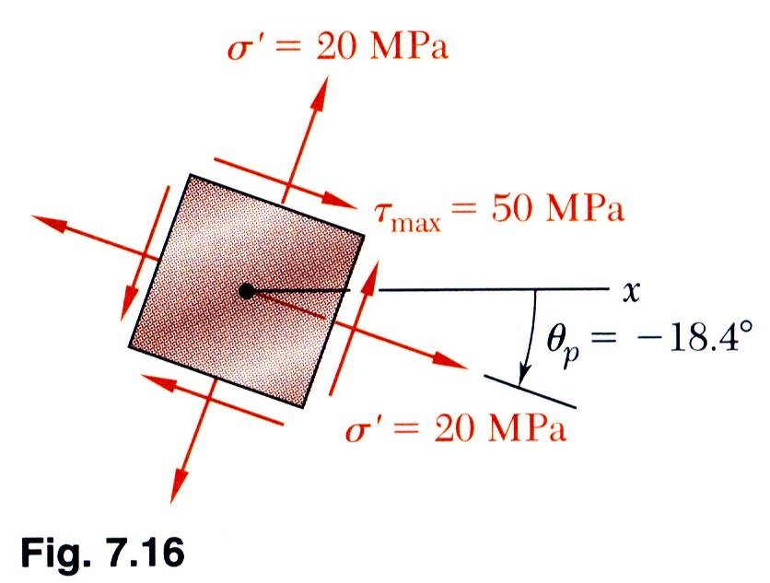
MECHANICS OF MATERIALS
Edition
Third
Beer • Johnston • DeWolf
Example 7.01
Calculate the maximum shearing stress with
⎛ σ _{x} − σ _{y} ⎞²
2
^{τ} max ⁼
⎜
⎝
⎟
⎠
+ τ _{xy}
2
= (30)² + (40)²
τ _{max} = 50 MPa
σ _{x} = +50 MPa
σ _{x} = −10 MPa
τ _{xy} = +40 MPa
θ_{s} = θ _{p} − 45
θ_{s} = −18.4°, 71.6°
The corresponding normal stress is
₌ σ x + σ y ₌ 50 − 10 2 2
σ ′ = σ
ave
σ ′ = 20 MPa

Slide 10
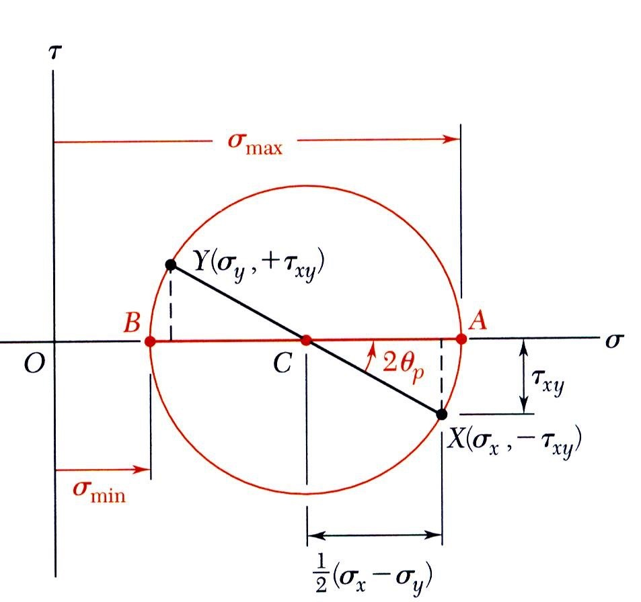
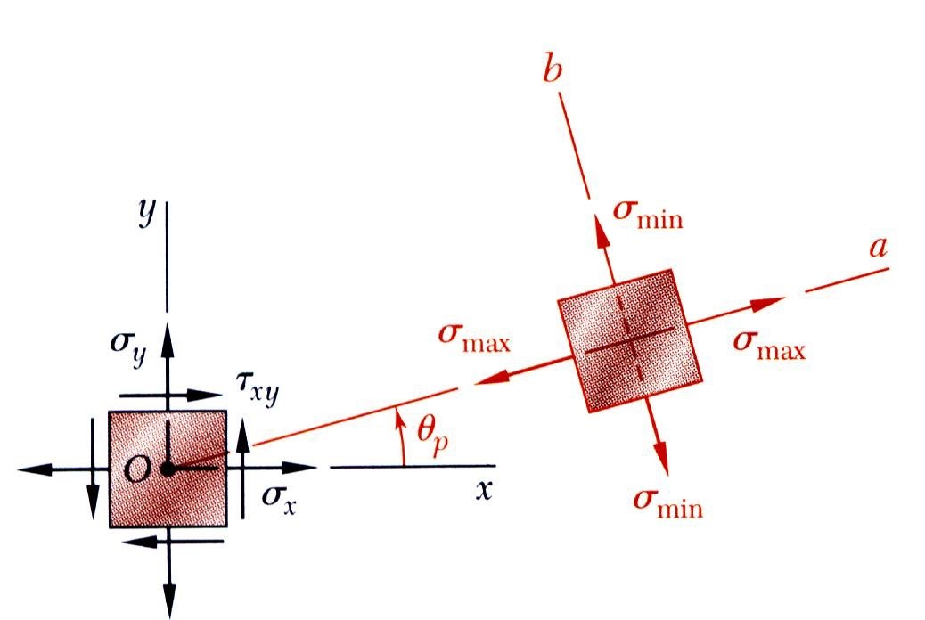
MECHANICS OF MATERIALS
Edition
Third
Beer • Johnston • DeWolf
Mohr’s Circle for Plane Stress
With the physical significance of Mohr’s circle for plane stress established, it may be applied with simple geometric considerations. Critical values are estimated graphically or calculated.
For a known state of plane stress σ x ,σ y ,τ xy plot the points X and Y and construct the circle centered at C.
σ _{x} + σ _{y} ⎛ σ _{x} − σ _{y} ⎞²
2
^{σ} ave ⁼
R =
⎜
⎝
⎟
⎠
+τ _{xy}
2
2
The principal stresses are obtained at A and B.
^{σ} max,min ^{= σ} ave ^{± R}
2τ _{xy}
σ _{x} − σ _{y}
tan 2θ =
p
The direction of rotation of Ox to Oa is the same as CX to CA.

Slide 11
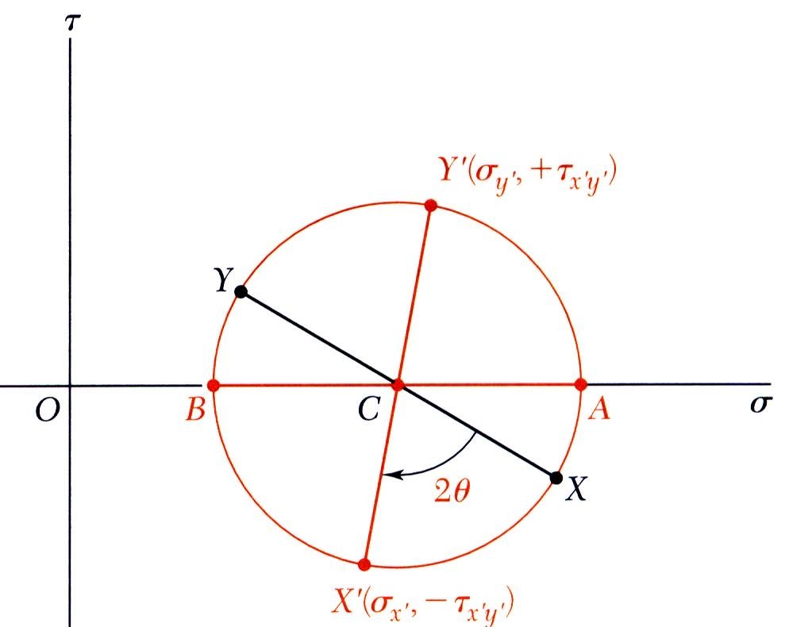
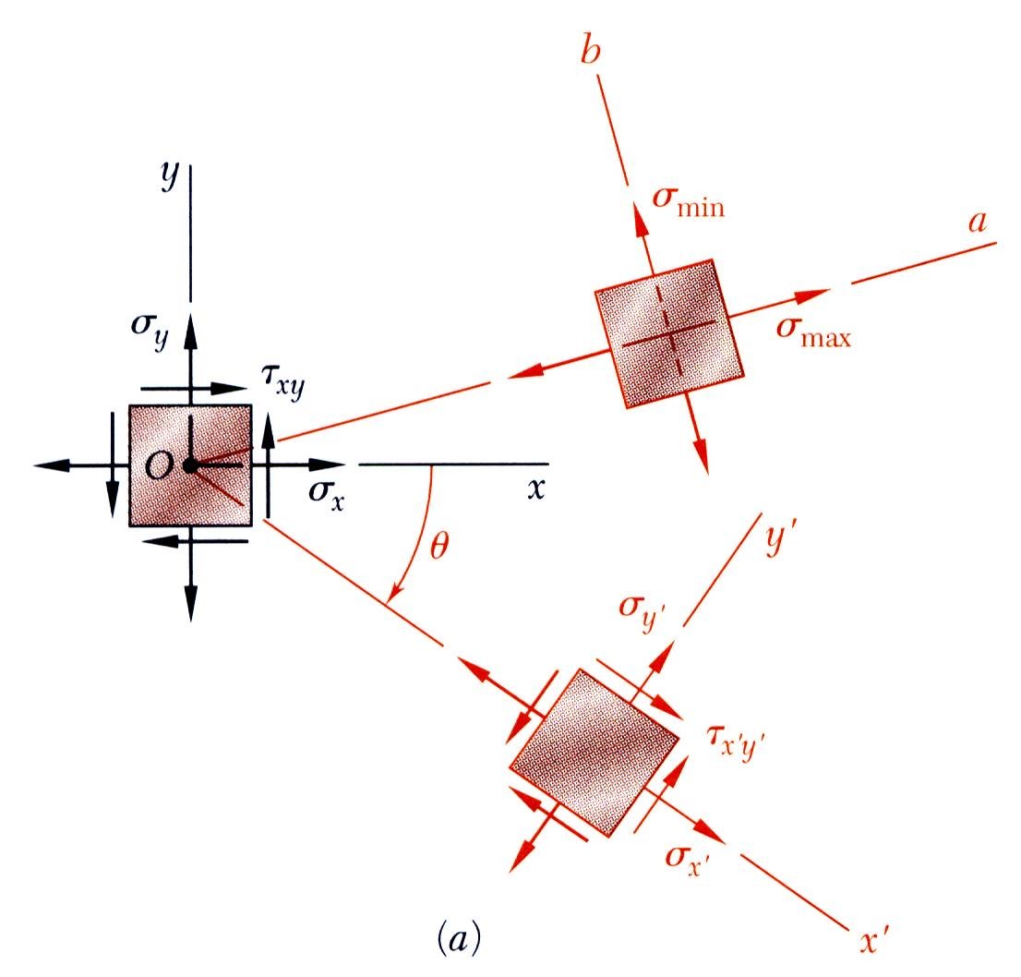
MECHANICS OF MATERIALS
Edition
Third
Beer • Johnston • DeWolf
Mohr’s Circle for Plane Stress
With Mohr’s circle uniquely defined, the state of stress at other axes orientations may be depicted.
For the state of stress at an angle θ with respect to the xy axes, construct a new diameter X’Y’ at an angle 2θ with respect to XY.
Normal and shear stresses are obtained from the coordinates X’Y’.

Slide 12
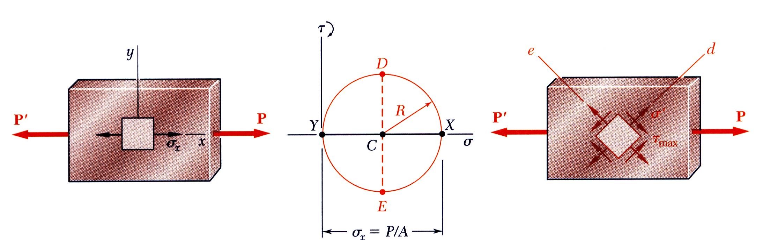
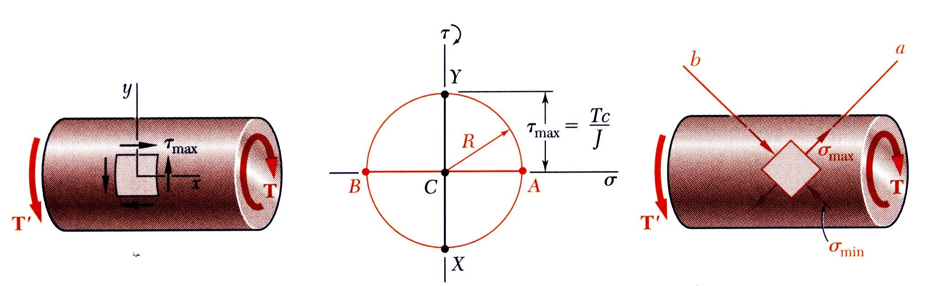
MECHANICS OF MATERIALS
Edition
Third
Beer • Johnston • DeWolf
Mohr’s Circle for Plane Stress
Mohr’s circle for centric axial loading:
σ _{x} = ^{P} ,
σ _{y} = τ _{xy} = 0
σ _{x} = σ _{y} = τ _{xy} = ^{P}
A
2 A
Mohr’s circle for torsional loading:
σ _{x} = σ _{y} = 0
_{τ xy =} Tc
σ _{x} = σ _{y} = ^{Tc}
τ _{xy} = 0
J
J

Slide 13
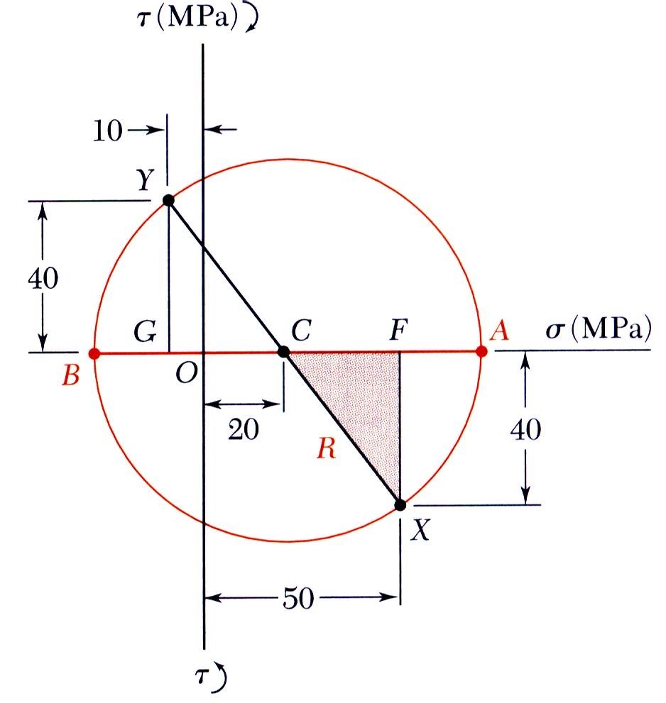
MECHANICS OF MATERIALS
Edition
Third
Beer • Johnston • DeWolf
Example 7.02
For the state of plane stress shown,
construct Mohr’s circle, determine
the principal planes, (c) the principal stresses, (d) the maximum shearing stress and the corresponding normal stress.
SOLUTION:
Construction of Mohr’s circle
σ _{x} + σ _{y}
(50) + (− 10)
2
^{σ} ave ⁼
=
= 20 MPa
2
CF = 50 − 20 = 30 MPa FX = 40 MPa
R = CX = (30)² + (40)² = 50 MPa

Slide 14
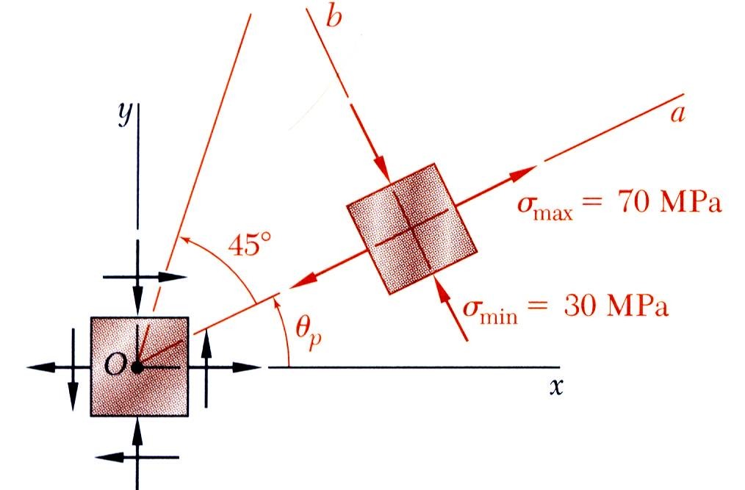
MECHANICS OF MATERIALS
Edition
Third
Beer • Johnston • DeWolf
Example 7.02
Principal planes and stresses
σ _{max} = OA = OC + CA = 20 + 50
σ _{max} = 70 MPa
σ _{max} = OB = OC − BC = 20 − 50
σ _{max} = −30 MPa
tan 2θ _{p} = ^{FX} = ⁴⁰
CP 30
2θ _{p} = 53.1°
θ _{p} = 26.6°

Slide 15
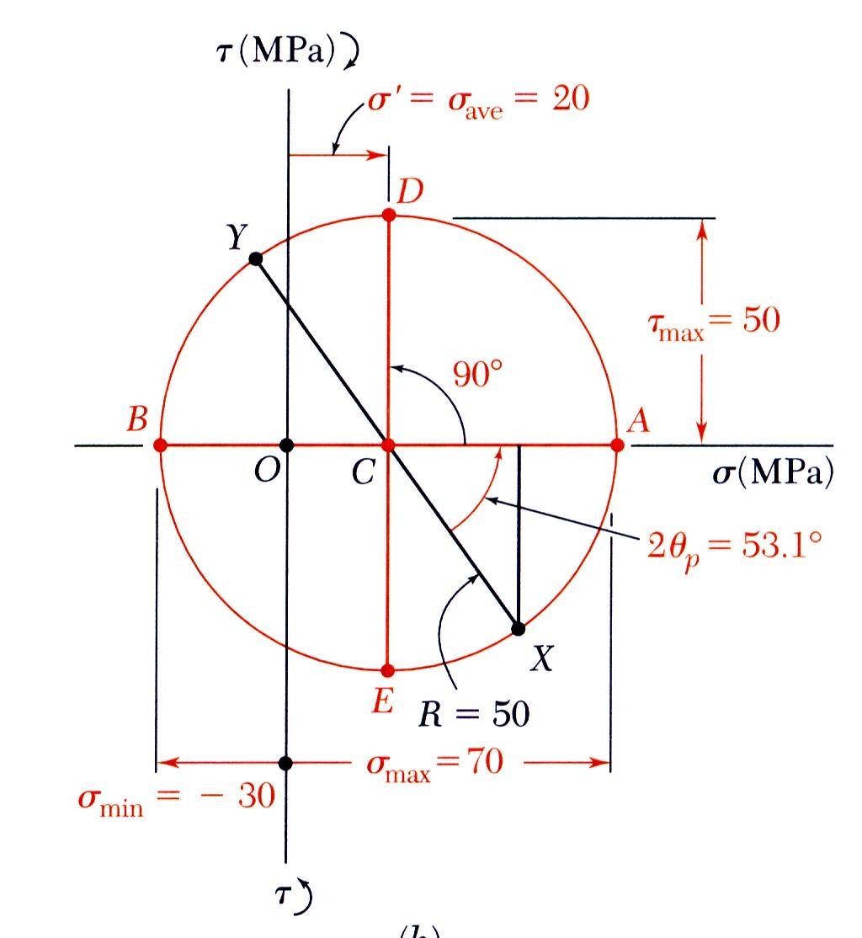
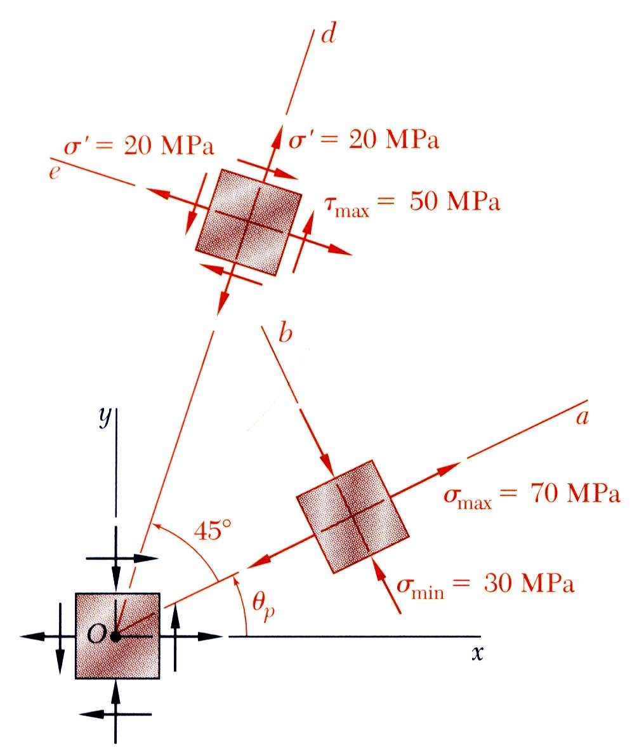
MECHANICS OF MATERIALS
Edition
Third
Beer • Johnston • DeWolf
Example 7.02
Maximum shear stress
θ_{s} = θ _{p} + 45°
τ _{max} = R
σ ′ = σ _{ave}
θ_{s} = 71.6°
τ _{max} = 50 MPa
σ ′ = 20 MPa

Slide 16
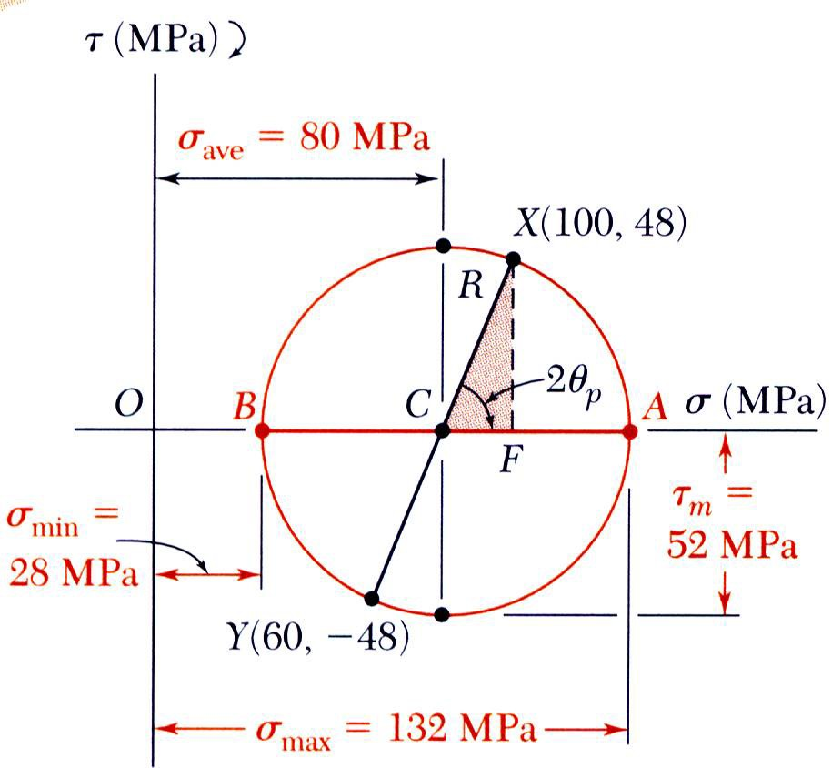
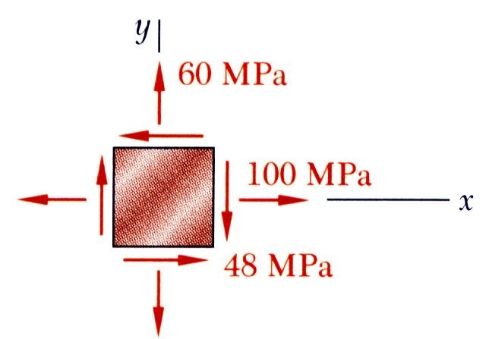
MECHANICS OF MATERIALS
Edition
Third
Beer • Johnston • DeWolf
Sample Problem 7.2
For the state of stress shown, determine (a) the principal planes and the principal stresses, (b) the stress components exerted on the element obtained by rotating the given element counterclockwise through 30 degrees.
SOLUTION:
Construct Mohr’s circle
σ = ^{σ x + σ y} = ¹⁰⁰ ⁺ ⁶⁰ = 80 MPa
ave
2 2
R = (CF )² + (FX )² = (20)² + (48)² = 52 MPa

Slide 17
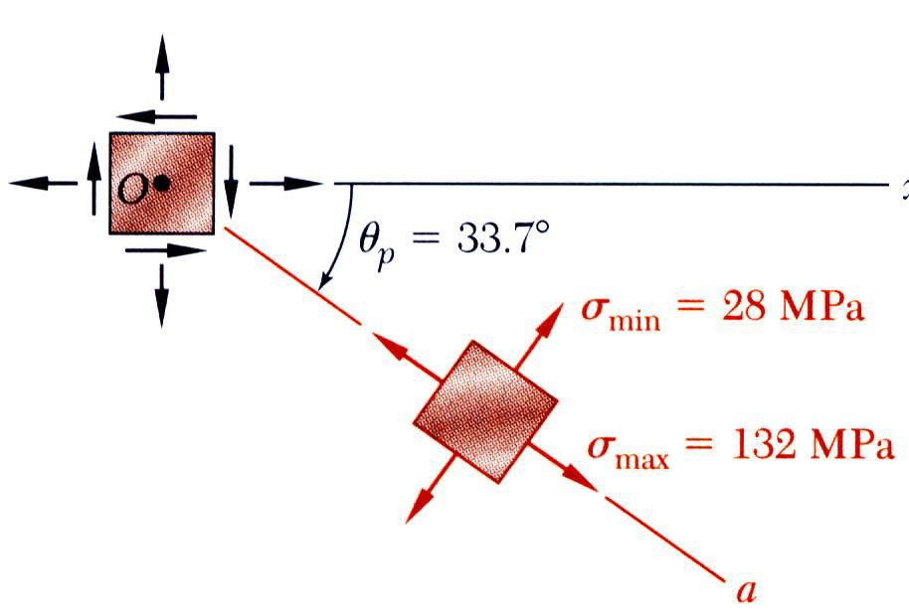
MECHANICS OF MATERIALS
Edition
Third
Beer • Johnston • DeWolf
Sample Problem 7.2
Principal planes and stresses
σ _{max} = OA = OC + CA
= 80 + 52
σ _{max} = OA = OC − BC
= 80 − 52
tan 2θ _{p} = ^{XF} = ⁴⁸ = 2.4
CF 20
2θ _{p} = 67.4°
σ _{max} = +132 MPa
σ _{min} = +28MPa
θ _{p} = 33.7° clockwise

Slide 18
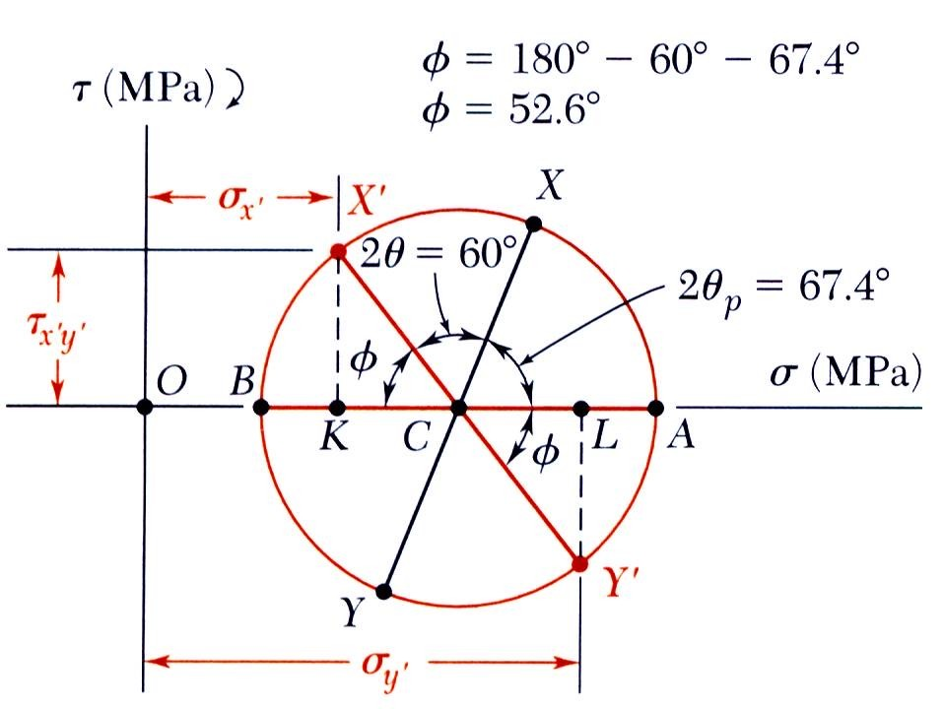
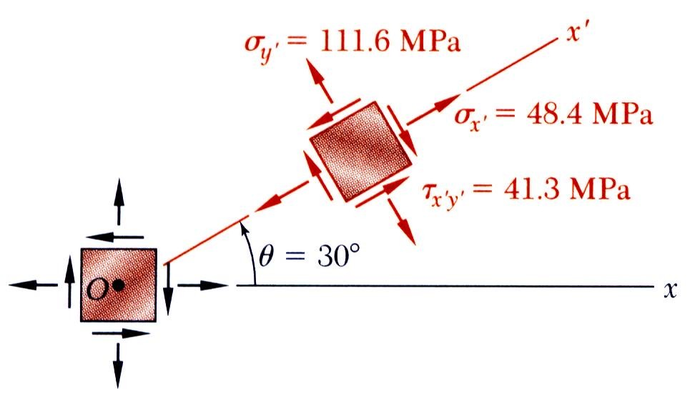
MECHANICS OF MATERIALS
Edition
Third
Beer • Johnston • DeWolf
Sample Problem 7.2
Stress components after rotation by 30º
Points X’ and Y’ on Mohr’s circle that correspond to stress components on the rotated element are obtained by rotating XY counterclockwise through 2θ = 60°
φ = 180° − 60° − 67.4° = 52.6°
σ _{x′} = OK = OC − KC = 80 − 52cos52.6°
σ _{y′} = OL = OC + CL = 80 + 52cos52.6°
τ _{x′y′} = KX ′ = 52sin 52.6°
σ _{x′} = +48.4 MPa
σ _{y′} = +111.6 MPa
τ _{x′y′} = 41.3MPa

