Slide 1
SETG 2363
Strength of Materials
Stress Transformation
Mohsin Mohd Sies
Nuclear Engineering,
Faculty of Chemical and Energy Engineering,
Universiti Teknologi Malaysia

Slide 2
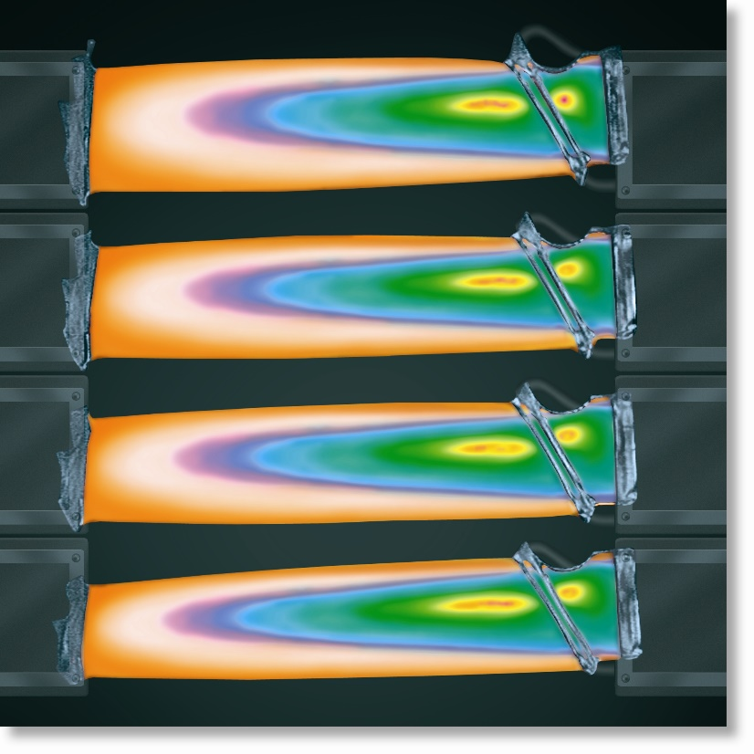
CHAPTER OBJECTIVES
Derive equations for
transforming stress
components between
coordinate systems of
different orientation
Use derived equations to
obtain the maximum normal
and maximum shear stress
at a point
Determine the orientation of elements upon which the maximum normal and maximum shear stress acts

Slide 3
CHAPTER OBJECTIVES
Discuss a method for
determining the absolute
maximum shear stress at a
point when material is
subjected to plane and
3-dimensional states of stress

Slide 4
CHAPTER OUTLINE
Plane-Stress Transformation
General Equations of Plane Stress Transformation
Principal Stresses and Maximum In-Plane Shear Stress
Mohr’s Circle – Plane Stress
Stress in Shafts Due to Axial Load and Torsion
Stress Variations Throughout a Prismatic Beam
Absolute Maximum Shear Stress

Slide 5
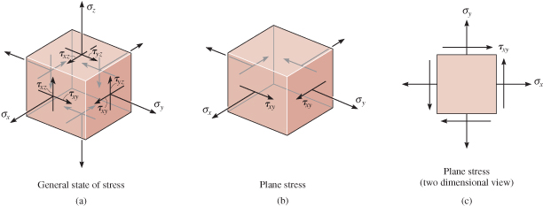
9.1 PLANE-STRESS TRANSFORMATION
General state of stress at a pt is characterized by six independent normal and shear stress components.
In practice, approximations and simplifications are done to reduce the stress components to a single plane.

Slide 6
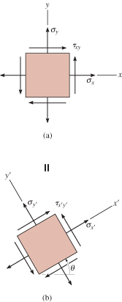
9.1 PLANE-STRESS TRANSFORMATION
The material is then said to be
subjected to plane stress.
For general state of plane stress at a
pt, we represent it via normal-stress
components, σ_{x}, σ_{y} and shear-stress
component τ_{xy}.
Thus, state of plane stress at the pt is
uniquely represented by three
components acting on an element
that has a specific orientation at
that pt.

Slide 7
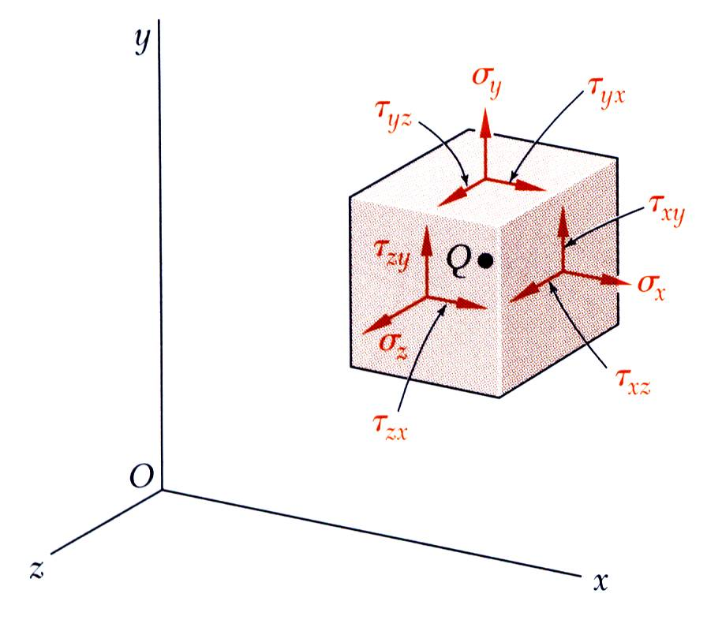
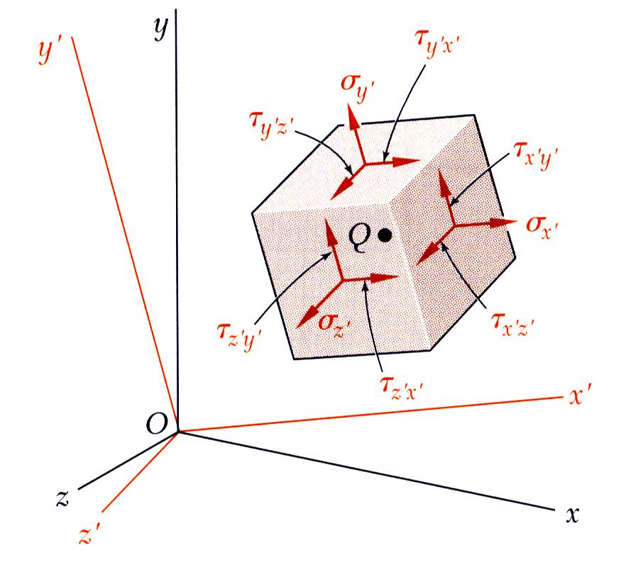
9.1 PLANE-STRESS TRANSFORMATION
The most general state of stress at a point may be represented by 6 components,
Same state of stress is represented by a different set of components if axes are rotated.

Slide 8
9.1 PLANE-STRESS TRANSFORMATION
Transforming stress components from one orientation to the other is similar in concept to how we transform force components from one system of axes to the other.
Note that for stress-component transformation, we need to account for
  the magnitude and direction of each stress component, and
  the orientation of the area upon which each component acts.

Slide 9
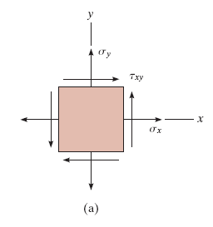
9.1 PLANE-STRESS TRANSFORMATION
Procedure for Analysis
If state of stress at a pt is known for a given orientation of an element of material, then state of stress for another orientation can be determined
=

Slide 10
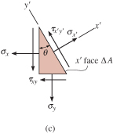
9.1 PLANE-STRESS TRANSFORMATION
Procedure for Analysis
Section element as shown.
Assume that the sectioned area is ∆A, then adjacent areas of the segment will be ∆A sinθ and ∆A cosθ.
Draw free-body diagram of segment,
showing the forces that act on the
element. (Tip: Multiply stress
components on each face by the
area upon which they act)

Slide 11
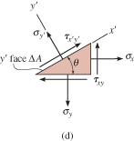
9.1 PLANE-STRESS TRANSFORMATION
Procedure for Analysis
Apply equations of force equilibrium in the x’ and y’ directions to obtain the two unknown stress components σ_{x’}, and τ_{x’y’}.
To determine σ_{y’} (that acts on the +y’ face of the element), consider a segment of element shown below.
Follow the same procedure as
described previously.
Shear stress τ_{x’y’} need not be
determined as it is complementary.

Slide 12
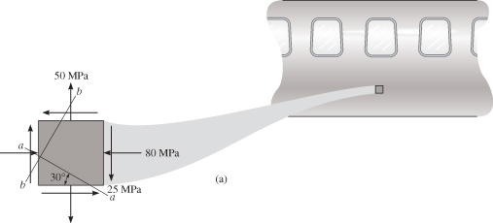
EXAMPLE 9.1
State of plane stress at a pt on surface of airplane fuselage is represented on the element oriented as shown. Represent the state of stress at the pt that is oriented 30° clockwise from the position shown.

Slide 13

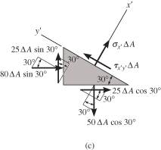
EXAMPLE 9.1 (SOLN)
CASE A (a-a section)
Section element by line a-a and
remove bottom segment.
Assume sectioned (inclined)
plane has an area of ∆A,
horizontal and vertical planes
have area as shown.
Free-body diagram of
segment is also shown.

Slide 14
EXAMPLE 9.1 (SOLN)
Apply equations of force equilibrium
in the x’ and y’ directions (to avoid
simultaneous solution for the two
unknowns)
+ ΣF_{x’} = 0;

Slide 15
EXAMPLE 9.1 (SOLN)
+ ΣF_{y’} = 0;
Since σ_{x’} is negative, it acts
in the opposite direction
we initially assumed.

Slide 16

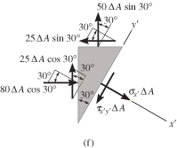
EXAMPLE 9.1 (SOLN)
CASE B (b-b section)
Repeat the procedure to obtain
the stress on the perpendicular
plane b-b.
Section element as shown
on the upper right.
Orientate the +x’ axis
outward, perpendicular to
the sectioned face, with
the free-body diagram
as shown.

Slide 17
EXAMPLE 9.1 (SOLN)
+ ΣF_{x’} = 0;

Slide 18
EXAMPLE 9.1 (SOLN)
+ ΣF_{y’} = 0;
Since σ_{x’} is negative, it acts opposite to its direction shown.

Slide 19
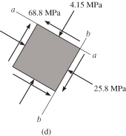
EXAMPLE 9.1 (SOLN)
The transformed stress
components are as shown.
From this analysis, we conclude
that the state of stress at the pt can
be represented by choosing an
element oriented as shown in the
Case A or by choosing a different
orientation in the Case B.
Stated simply, states of stress are equivalent.

Slide 20
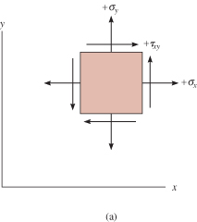
9.2 GENERAL EQNS OF PLANE-STRESS TRANSFORMATION
Sign Convention
We will adopt the same sign convention as discussed in chapter 1.3.
Positive normal stresses, σ_{x} and σ_{y}, acts outward from all faces
Positive shear stress τ_{xy} acts
upward on the right-hand
face of the element.

Slide 21
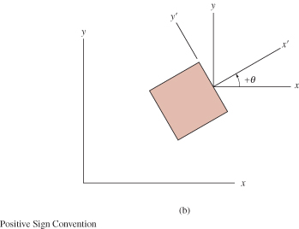
9.2 GENERAL EQNS OF PLANE-STRESS TRANSFORMATION
Sign Convention
The orientation of the inclined plane is determined using the angle θ.
Establish a positive x’ and y’ axes using the right-hand rule.
Angle θ is positive if it
moves counterclockwise
from the +x axis to
the +x’ axis.

Slide 22
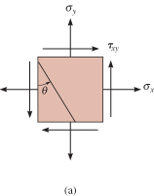
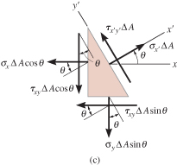
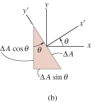
9.2 GENERAL EQNS OF PLANE-STRESS TRANSFORMATION
Normal and shear stress components
Section element as shown.
Assume sectioned area is ∆A.
Free-body diagram of element
is shown.

Slide 23
9.2 GENERAL EQNS OF PLANE-STRESS TRANSFORMATION
Normal and shear stress components
Apply equations of force
equilibrium to determine
unknown stress components:
+ ΣF_{x’} = 0;

Slide 24
9.2 GENERAL EQNS OF PLANE-STRESS TRANSFORMATION
Normal and shear stress components
+ ΣF_{y’} = 0;
Simplify the above two equations using trigonometric identities sin2θ = 2 sinθ cosθ,
sin²θ = (1 − cos2θ)/2, and cos²θ =(1+cos2θ)/2.

Slide 25
9.2 GENERAL EQNS OF PLANE-STRESS TRANSFORMATION
Normal and shear stress components
If σ_{y’} is needed, substitute (θ = θ + 90°) for θ into Eqn 9-1.

Slide 26
9.2 GENERAL EQNS OF PLANE-STRESS TRANSFORMATION
Procedure for Analysis
To apply equations 9-1 and 9-2, just substitute the known data for σ_{x}, σ_{y}, τ_{xy}, and θ according to established sign convention.
If σ_{x}’ and τx’y’ are calculated as positive quantities, then these stresses act in the positive direction of the x’ and y’ axes.
Tip: For your convenience, equations 9-1 to 9-3 can be programmed on your pocket calculator.

Slide 27
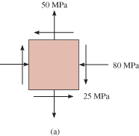
EXAMPLE 9.2
State of stress at a point is represented by the element shown. Determine the state of stress at the point on another element orientated 30° clockwise from the position shown.

Slide 28
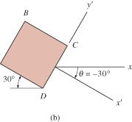
EXAMPLE 9.2 (SOLN)
This problem was solved in Example 9.1 using basic principles. Here we apply Eqns. 9-1 and 9-2.
From established sign convention,
Plane CD
+x’ axis is directed outward,
perpendicular to CD,
and +y’ axis directed along CD.
Angle measured
is θ = −30° (clockwise).

Slide 29
EXAMPLE 9.2 (SOLN)
Plane CD
Apply Eqns 9-1 and 9-2:
The negative signs indicate that σ_{x’} and τ_{x’y’} act in the negative x’ and y’ directions.

Slide 30
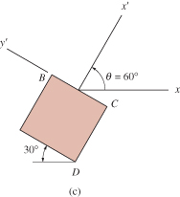
EXAMPLE 9.2 (SOLN)
Plane BC
Similarly, stress components
acting on face BC are
obtained using θ = 60°.

Slide 31
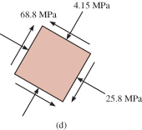
EXAMPLE 9.2 (SOLN)
As shown, shear stress τ_{x’y’} was computed twice to provide a check.
Negative sign for σ_{x’} indicates that stress acts in the negative x’ direction.
The results are shown below.

Slide 32
9.2 PRINCIPAL STRESSES AND MAXIMUM IN-PLANE SHEAR STRESS
In-plane principal stresses
Differentiate Eqn. 9-1 w.r.t. θ and equate to zero:
Solving the equation and let θ = θ_{P}, we get
Solution has two roots, θ _{p1}, and θ _{p2}.
θ _{p1}, and θ _{p2} are 90 degrees apart.

Slide 33
9.2 PRINCIPAL STRESSES AND MAXIMUM IN-PLANE SHEAR STRESS
In-plane principal stresses
For θ _{p1},
For θ _{p2},

Slide 34
9.2 PRINCIPAL STRESSES AND MAXIMUM IN-PLANE SHEAR STRESS
In-plane principal stresses
Substituting either of the two sets of trigonometric relations into Eqn 9-1, we get
The Eqn gives the maximum/minimum in-plane normal stress acting at a pt, where σ₁ ≥ σ₂ .
The values obtained are the principal in-plane principal stresses, and the related planes are the principal planes of stress.

Slide 35
9.2 PRINCIPAL STRESSES AND MAXIMUM IN-PLANE SHEAR STRESS
In-plane principal stresses
If the trigonometric relations for θ_{p1} and θ_{p2} are substituted into Eqn 9-2, it can be seen that
τ_{x’y’} = 0.
No shear stress acts on the principal planes.
Maximum in-plane shear stress
Differentiate Eqn. 9-2 w.r.t. θ and equate to zero:

Slide 36
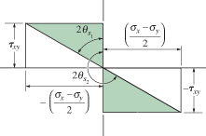
9.2 PRINCIPAL STRESSES AND MAXIMUM IN-PLANE SHEAR STRESS
Maximum in-plane shear stress
The two roots of this equation, θ_{s1} and θ_{s2} can be determined using the shaded triangles as shown.
The planes for maximum
shear stress can be
determined by orienting
an element 45° from the
position of an element
that defines the plane
of principal stress.

Slide 37
9.2 PRINCIPAL STRESSES AND MAXIMUM IN-PLANE SHEAR STRESS
Maximum in-plane shear stress
Using either one of the roots
θ_{s1} and θ_{s2}, and taking trigo
values of sin 2θ_{s} and cos 2θ_{s}
and substitute into Eqn 9-2:
Value calculated in Eqn 9-7 is referred to as the maximum in-plane shear stress.

Slide 38
9.2 PRINCIPAL STRESSES AND MAXIMUM IN-PLANE SHEAR STRESS
Maximum in-plane shear stress
Substitute values for sin 2θ_{s} and cos 2θ_{s} into
Eqn 9-1, we get a normal stress acting on the planes of maximum in-plane shear stress:
You can also program the above equations on your pocket calculator.

Slide 39
9.2 PRINCIPAL STRESSES AND MAXIMUM IN-PLANE SHEAR STRESS
IMPORTANT
Principal stresses represent the maximum and minimum normal stresses at the pt.
When state of stress is represented by principal stresses, no shear stress will act on element.
State of stress at the pt can also be represented in terms of the maximum in-plane shear stress. An average normal stress will also act on the element.
Element representing the maximum in-plane shear stress with associated average normal stresses is oriented 45° from element represented principal stresses.

Slide 40
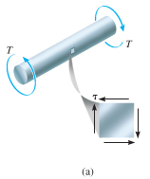
EXAMPLE 9.3
When torsional loading T is applied to bar, it produces a state of pure shear stress in the material. Determine (a) the maximum in-plane shear stress and associated average normal stress, and (b) the principal stress.

Slide 41
EXAMPLE 9.3 (SOLN)
From established sign convention:
Maximum in-plane shear stress
Apply Eqns 9-7 and 9-8,

Slide 42
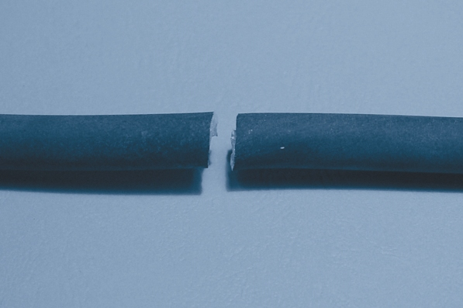
EXAMPLE 9.3 (SOLN)
Maximum in-plane shear stress
As expected, maximum in-plane shear stress represented by element shown initially.
Experimental results show that materials that are ductile will fail due to shear stress. Thus, with a torque applied to a bar
made from mild steel,
the maximum in-plane
shear stress will cause
failure as shown.

Slide 43
EXAMPLE 9.3 (SOLN)
Principal stress
Apply Eqns 9-4 and 9-5,

Slide 44
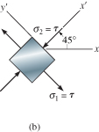
EXAMPLE 9.3 (SOLN)
Principal stress
Apply Eqn 9-1 with θ_{p2} = 45°
Thus, if σ₂ = −τ acts at θ_{p2} = 45°
as shown, and σ₁ = τ acts on
the other face, θ_{p1} = 135°.

Slide 45
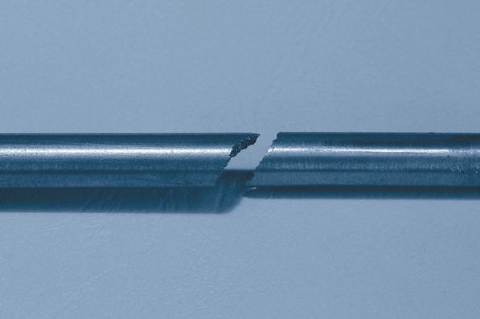
EXAMPLE 9.3 (SOLN)
Principal stress
Materials that are brittle fail due to normal stress. An example is cast iron when subjected to torsion, fails in tension at 45° inclination as shown below.

Slide 46
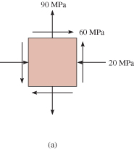
EXAMPLE 9.6
State of plane stress at a pt on a body is represented on the element shown. Represent this stress state in terms of the maximum in-plane shear stress and associated average normal stress.

Slide 47
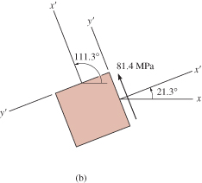
EXAMPLE 9.6 (SOLN)
Orientation of element
Since σ_{x} = −20 MPa, σy = 90 MPa, and
τ_{xy} = 60 MPa and applying Eqn 9-6,
Note that the angles are 45°
away from principal planes
of stress.

Slide 48
EXAMPLE 9.6 (SOLN)
Maximum in-plane shear stress
Applying Eqn 9-7,
Thus acts in the +y’ direction on this
face (θ = 21.3°).

Slide 49
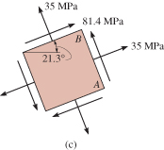
EXAMPLE 9.6 (SOLN)
Average normal stress
Besides the maximum shear stress, the element is also subjected to an average normal stress determined from Eqn. 9-8:
This is a tensile stress.

Slide 50
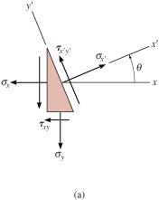
9.4 MOHR’S CIRCLE: PLANE STRESS
Equations for plane stress transformation have a graphical solution that is easy to remember and use.
This approach will help
you to “visualize” how the
normal and shear stress
components vary as the
plane acted on is oriented
in different directions.

Slide 51
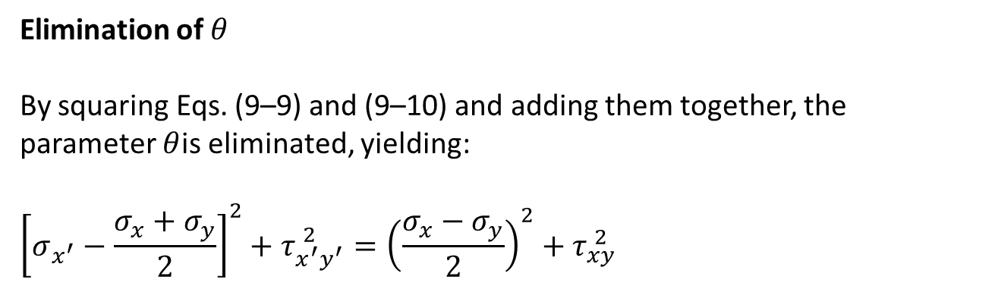
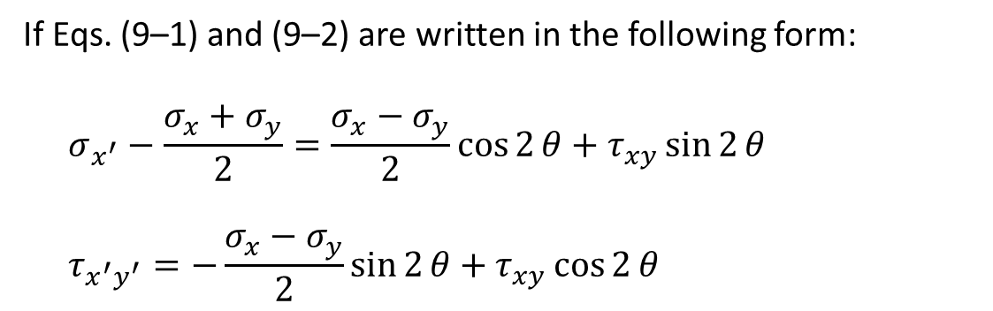
9.4 MOHR’S CIRCLE: PLANE STRESS
Stress Transformation Equations
If Eqs. (9–1) and (9–2) are written in the following form:
$$\begin{matrix} & σ_{x^{′}}−\frac{σ_{x}+σ_{y}}{2}=\frac{σ_{x}−σ_{y}}{2}\cos{2}θ+τ_{xy}\sin{2}θ & & \end{matrix}$$
$$\begin{matrix} & τ_{x^{′}y^{′}}=−\frac{σ_{x}−σ_{y}}{2}\sin{2}θ+τ_{xy}\cos{2}θ & & \end{matrix}$$
Elimination of $θ$
By squaring Eqs. (9–9) and (9–10) and adding them together, the parameter $θ$is eliminated, yielding:
$${\left[σ_{x^{′}}−\frac{σ_{x}+σ_{y}}{2}\right]}^{2}+τ_{x^{′}y^{′}}^{ 2}={\left(\frac{σ_{x}−σ_{y}}{2}\right)}^{2}+τ_{xy}^{ 2}$$

Slide 52
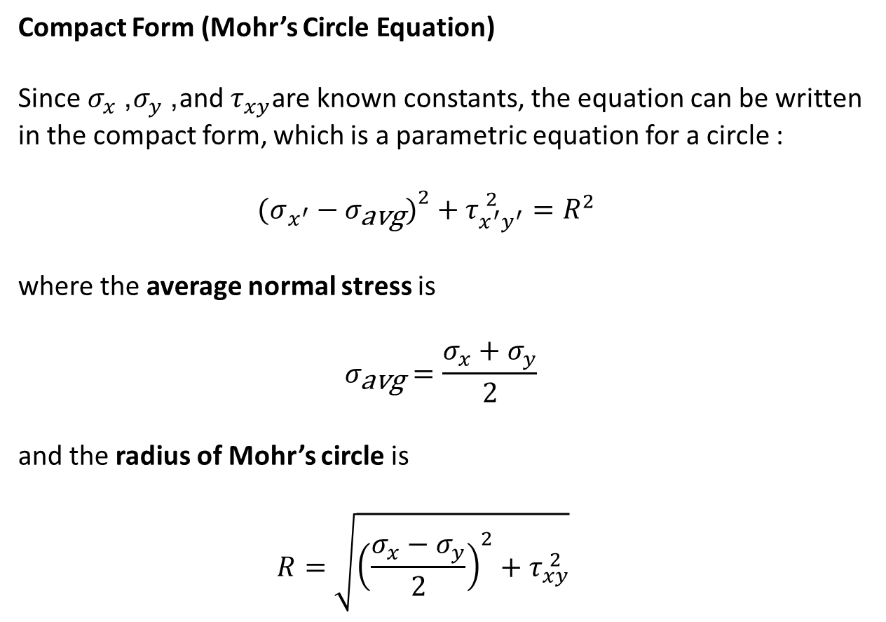
9.4 MOHR’S CIRCLE: PLANE STRESS
Compact Form (Mohr’s Circle Equation)
Since $σ_{x}$, $σ_{y}$, and $τ_{xy}$are known constants, the equation can be written in the compact form, which is a parametric equation for a circle :
$$\begin{matrix} & (σ_{x^{′}}−σ_{\text{avg}}{\left.)\right.}^{2}+τ_{x^{′}y^{′}}^{ 2}=R^{2} & & \end{matrix}$$
where the average normal stress is
$$σ_{\text{avg}}=\frac{σ_{x}+σ_{y}}{2}$$
and the radius of Mohr’s circle is
$$\begin{matrix} & R=\sqrt{{\left(\frac{σ_{x}−σ_{y}}{2}\right)}^{2}+τ_{xy}^{ 2}} & & \end{matrix}$$

Slide 53
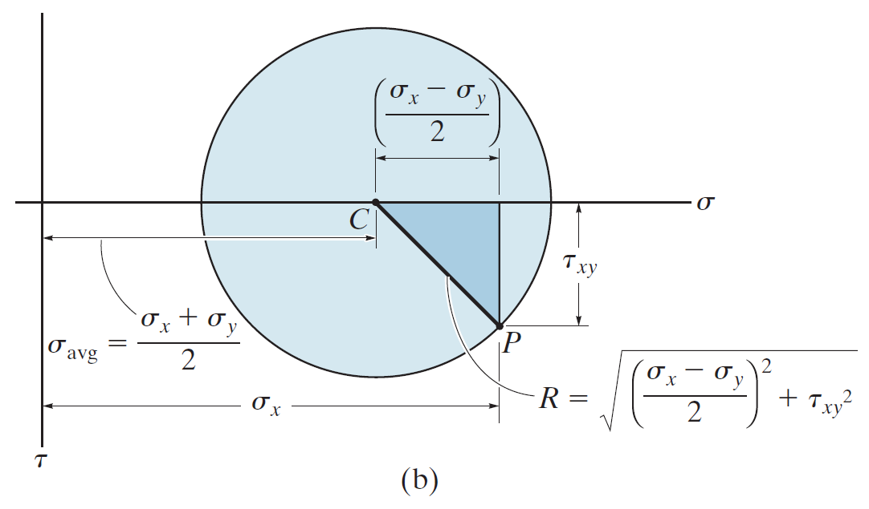
9.4 MOHR’S CIRCLE: PLANE STRESS
Establish coordinate axes; σ positive to the right and τ positive downward, Eqn 9-11 represents a circle having radius R and center on the σ axis at pt C (σ_{avg}, 0). This is called the Mohr’s Circle.

Slide 54
9.4 MOHR’S CIRCLE: PLANE STRESS
To draw the Mohr’s circle, we must establish
the σ and τ axes.
Center of circle C (σ_{avg}, 0) is plotted from the known stress components (σ_{x}, σ_{y}, τ_{xy}).
We need to know at least one pt on the circle to get the radius of circle.

Slide 55
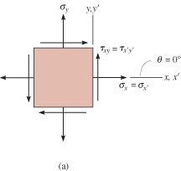
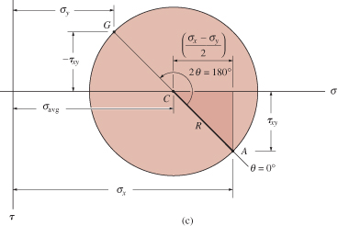
9.4 MOHR’S CIRCLE: PLANE STRESS
Case 1 (x’ axis coincident with x axis)
  θ = 0°
  σ_{x’} = σ_{x}
  τ_{x’y’} = τ_{xy}.
Consider this as reference pt A, and
plot its coordinates A (σ_{x}, τ_{xy}).
Apply Pythagoras theorem to shaded triangle to determine radius R.
Using pts C and A,
the circle can now
be drawn.

Slide 56
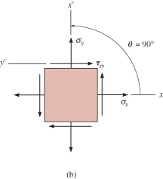
9.4 MOHR’S CIRCLE: PLANE STRESS
Case 2 (x’ axis rotated 90° counterclockwise)
  θ = 90°
  σ_{x’} = σ_{y}
  τ_{x’y’} = −τ_{xy}.
Its coordinates are G (σ_{y}, −τ_{xy}).
Hence radial line CG
is 180°
counterclockwise
from “reference
line” CA.

Slide 57
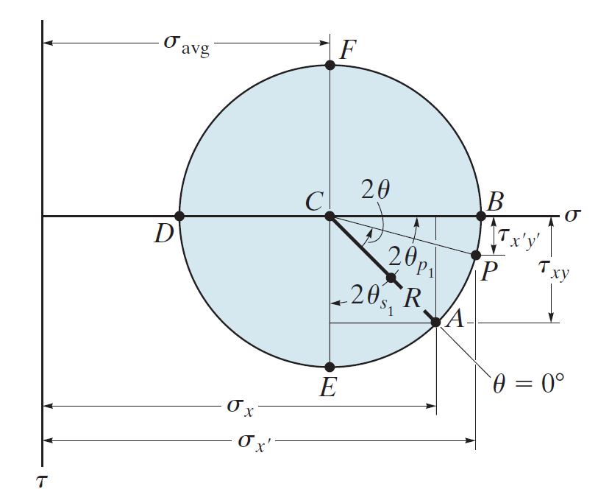

Slide 58
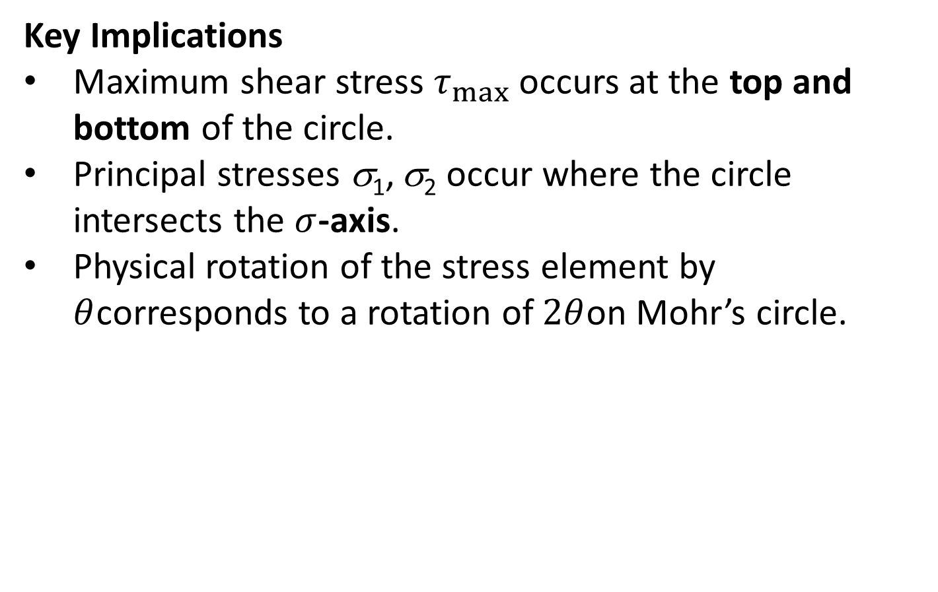
9.4 MOHR’S CIRCLE: PLANE STRESS
Key Implications
Maximum shear stress $τ_{max}$ occurs at the top and bottom of the circle.
Principal stresses σ₁, σ₂ occur where the circle intersects the $σ$-axis.
Physical rotation of the stress element by $θ$corresponds to a rotation of $2θ$on Mohr’s circle.

Slide 59
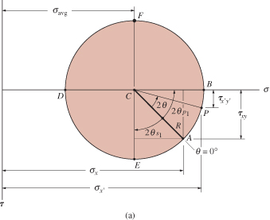
9.4 MOHR’S CIRCLE: PLANE STRESS
Procedure for Analysis
Construction of the circle
Establish coordinate
system where abscissa
represents the normal
stress σ, (+ve to the
right), and the ordinate
represents shear
stress τ, (+ve downward).
Use positive sign convention for σ_{x}, σ_{y}, τ_{xy}, plot the center of the circle C, located on the σ axis at a distance σ_{avg} = (σ_{x} + σ_{y})/2 from the origin.

Slide 60
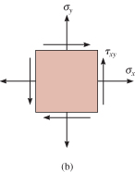
9.4 MOHR’S CIRCLE: PLANE STRESS
Procedure for Analysis
Construction of the circle
Plot reference pt A (σ_{x}, τ_{xy}). This pt represents the normal and shear stress components on the element’s right-hand vertical face. Since x’ axis coincides with x axis, θ = 0.

Slide 61
9.4 MOHR’S CIRCLE: PLANE STRESS
Procedure for Analysis
Construction of the circle
Connect pt A with center C of the circle and determine CA by trigonometry. The distance represents the radius R of the circle.
Once R has been
determined, sketch
the circle.

Slide 62
9.4 MOHR’S CIRCLE: PLANE STRESS
Procedure for Analysis
Principal stress
Principal stresses σ₁ and σ₂ (σ₁ ≥ σ₂) are represented by two pts B and D where the circle intersects the σ-axis.

Slide 63
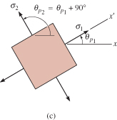
9.4 MOHR’S CIRCLE: PLANE STRESS
Procedure for Analysis
Principal stress
These stresses act on planes
defined by angles θ_{p1} and θ_{p2}.
They are represented on the
circle by angles 2θ_{p1} and 2θ_{p2}
and measured from radial
reference line CA to lines CB and CD respectively.

Slide 64
9.4 MOHR’S CIRCLE: PLANE STRESS
Procedure for Analysis
Principal stress
Using trigonometry, only one of
these angles needs to be
calculated from the circle,
since θ_{p1} and θ_{p2} are 90° apart.
Remember that direction of
rotation 2θ_{p} on the circle represents the same direction of rotation θ_{p} from reference axis (+x) to principal plane (+x’).

Slide 65
9.4 MOHR’S CIRCLE: PLANE STRESS
Procedure for Analysis
Maximum in-plane shear stress
The average normal stress
and maximum in-plane shear
stress components are
determined from the circle as
the coordinates of either pt E
or F.

Slide 66
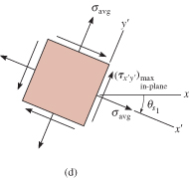
9.4 MOHR’S CIRCLE: PLANE STRESS
Procedure for Analysis
Maximum in-plane shear stress
The angles θ_{s1} and θ_{s2} give
the orientation of the planes
that contain these
components. The angle 2θ_{s}
can be determined using
trigonometry. Here rotation is
clockwise, and so θ_{s1} must be
clockwise on the element.

Slide 67
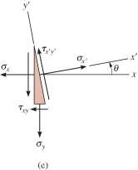
9.4 MOHR’S CIRCLE: PLANE STRESS
Procedure for Analysis
Stresses on arbitrary plane
Normal and shear stress
components σ_{x’} and τ_{x’y’}
acting on a specified plane
defined by the angle θ, can
be obtained from the circle
by using trigonometry to
determine the coordinates
of pt P.

Slide 68
9.4 MOHR’S CIRCLE: PLANE STRESS
Procedure for Analysis
Stresses on arbitrary plane
To locate pt P, known angle θ
for the plane (in this case
counterclockwise) must be
measured on the circle in
the same direction 2θ
(counterclockwise), from the
radial reference line CA to the
radial line CP.

Slide 69
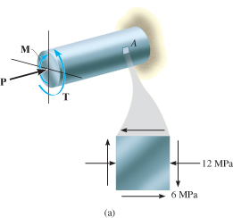
EXAMPLE 9.9
Due to applied loading, element at pt A on solid cylinder as shown is subjected to the state of stress. Determine the principal stresses acting at this pt.

Slide 70
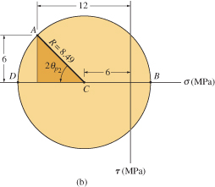
EXAMPLE 9.9 (SOLN)
Construction of the circle
Center of the circle is at
Initial pt A (−2, −6) and the
center C (−6, 0) are plotted
as shown. The circle having
a radius of

Slide 71
EXAMPLE 9.9 (SOLN)
Principal stresses
Principal stresses indicated at
pts B and D. For σ₁ > σ₂,
Obtain orientation of element by
calculating counterclockwise angle 2θ_{p2}, which defines the direction of θ_{p2} and σ₂ and its associated principal plane.

Slide 72
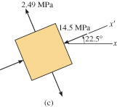
EXAMPLE 9.9 (SOLN)
Principal stresses
The element is orientated such that x’ axis or σ₂ is directed 22.5° counterclockwise from the horizontal x-axis.

Slide 73
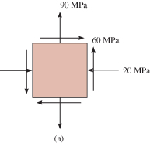
EXAMPLE 9.10
State of plane stress at a pt is shown on the element. Determine the maximum in-plane shear stresses and the orientation of the element upon which they act.

Slide 74
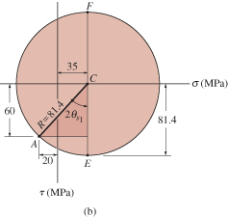
EXAMPLE 9.10 (SOLN)
Construction of circle
Establish the σ, τ axes as shown below. Center of circle C located on the σ-axis, at the pt:

Slide 75
EXAMPLE 9.10 (SOLN)
Construction of circle
Pt C and reference pt A (−20, 60) are plotted. Apply Pythagoras theorem to shaded triangle to get circle’s radius CA,

Slide 76
EXAMPLE 9.10 (SOLN)
Maximum in-plane shear stress
Maximum in-plane shear stress and average normal stress are identified by pt E or F on the circle. In particular, coordinates of pt E (35, 81.4) gives

Slide 77
EXAMPLE 9.10 (SOLN)
Maximum in-plane shear stress
Counterclockwise angle θ_{s1} can be found from the circle, identified as 2θ_{s1}.

Slide 78
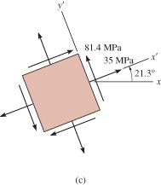
EXAMPLE 9.10 (SOLN)
Maximum in-plane shear stress
This counterclockwise angle defines the direction of the x’ axis. Since pt E has positive coordinates, then the average normal stress and maximum in-plane shear stress both act in the positive x’ and y’ directions as shown.

Slide 79

EXAMPLE 9.11
State of plane stress at a pt is shown on the element. Represent this state of stress on an element oriented 30° counterclockwise from position shown.

Slide 80

EXAMPLE 9.11 (SOLN)
Construction of circle
Establish the σ, τ axes
as shown.
Center of circle C
located on the
σ-axis, at the pt:

Slide 81
EXAMPLE 9.11 (SOLN)
Construction of circle
Initial pt for θ = 0° has coordinates A (−8, −6) are plotted. Apply
Pythagoras theorem
to shaded triangle
to get circle’s
radius CA,

Slide 82
EXAMPLE 9.11 (SOLN)
Stresses on 30° element
Since element is rotated 30° counterclockwise, we must construct a radial line CP, 2(30°) = 60° counterclockwise, measured
from CA (θ = 0°).
Coordinates of pt P (σ_{x’}, τ_{x’y’})
must be obtained. From
geometry of circle,

Slide 83

EXAMPLE 9.11 (SOLN)
Stresses on 30° element
The two stress components act on
face BD of element shown, since
the x’ axis for this face if oriented 30°
counterclockwise from the x-axis.
Stress components acting on adjacent face DE of element, which is 60° clockwise from +x-axis, are represented by the coordinates of pt Q on the circle.
This pt lies on the radial line CQ, which is 180° from CP.

Slide 84
EXAMPLE 9.11 (SOLN)
Stresses on 30° element
The coordinates of pt Q are
Note that here τ_{x’y’} acts in
the −y’ direction.

Slide 85
9.5 STRESS IN SHAFTS DUE TO AXIAL LOAD AND TORSION
Occasionally, circular shafts are subjected to combined effects of both an axial load and torsion.
Provided materials remain linear elastic, and subjected to small deformations, we use principle of superposition to obtain resultant stress in shaft due to both loadings.
Principal stress can be determined using either stress transformation equations or Mohr’s circle.

Slide 86

EXAMPLE 9.12
Axial force of 900 N and torque of 2.50 N⋅m are applied to shaft. If shaft has a diameter of 40 mm, determine the principal stresses at a pt P on its surface.

Slide 87
EXAMPLE 9.12 (SOLN)
Internal loadings
Consist of torque of 2.50 N⋅m and
axial load of 900 N.
Stress components
Stresses produced at pt P are
therefore

Slide 88


EXAMPLE 9.12 (SOLN)
Principal stresses
Using Mohr’s circle, center of circle C
at the pt is
Plotting C (358.1, 0) and
reference pt A (0, 198.9),
the radius found was
R = 409.7 kPA. Principal
stresses represented by
pts B and D.

Slide 89

EXAMPLE 9.12 (SOLN)
Principal stresses
Clockwise angle 2θ_{p2} can be
determined from the circle.
It is 2θ_{p2} = 29.1°. The element
is oriented such that the x’ axis
or σ₂ is directed clockwise
θ_{p1} = 14.5° with the x axis
as shown.

Slide 90
Question 5 Final Exam 2006
A rod in Figure 9 has a circular cross section with a diameter of 5 mm. It is subjected to a torque of 15 N. mm and a bending moment of 10 N. mm;
Determine the maximum normal stress and maximum shear stress. (4 marks)
Determine the principal stresses at the point of maximum flexural stress. (3 marks)
Sketch Mohr’s circle for this case with all the necessary points. (8 marks)
T = 15 N.mm
M = 10 N.mm

