Slide 1
SETG 2363
Strength of Materials
Bending of Beam and
Beam Design
Mohsin Mohd Sies
Nuclear Engineering,
Faculty of Chemical and Energy Engineering,
Universiti Teknologi Malaysia

Slide 2
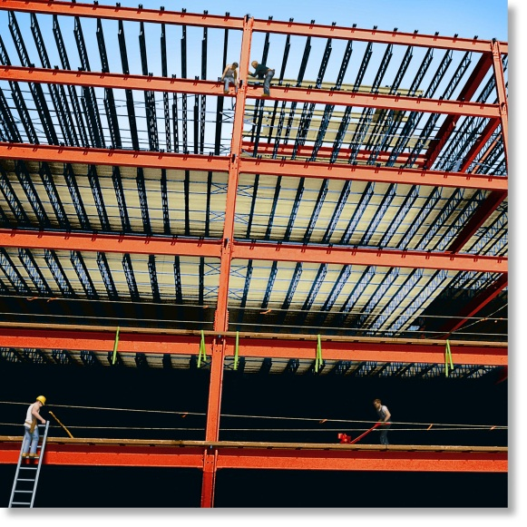
CHAPTER OBJECTIVES
Determine stress in members caused by bending
Discuss how to establish shear and moment diagrams for a beam or shaft
Determine largest shear and moment in a member, and specify where they occur
Consider members that are straight, symmetric x-section and homogeneous linear-elastic material
Consider special cases of unsymmetrical bending.

Slide 3
CHAPTER OUTLINE
Shear and Moment Diagrams
Graphical Method for Constructing Shear and Moment Diagrams
Bending Deformation of a Straight Member
The Flexure Formula
Unsymmetrical Bending
Stress Concentrations

Slide 4
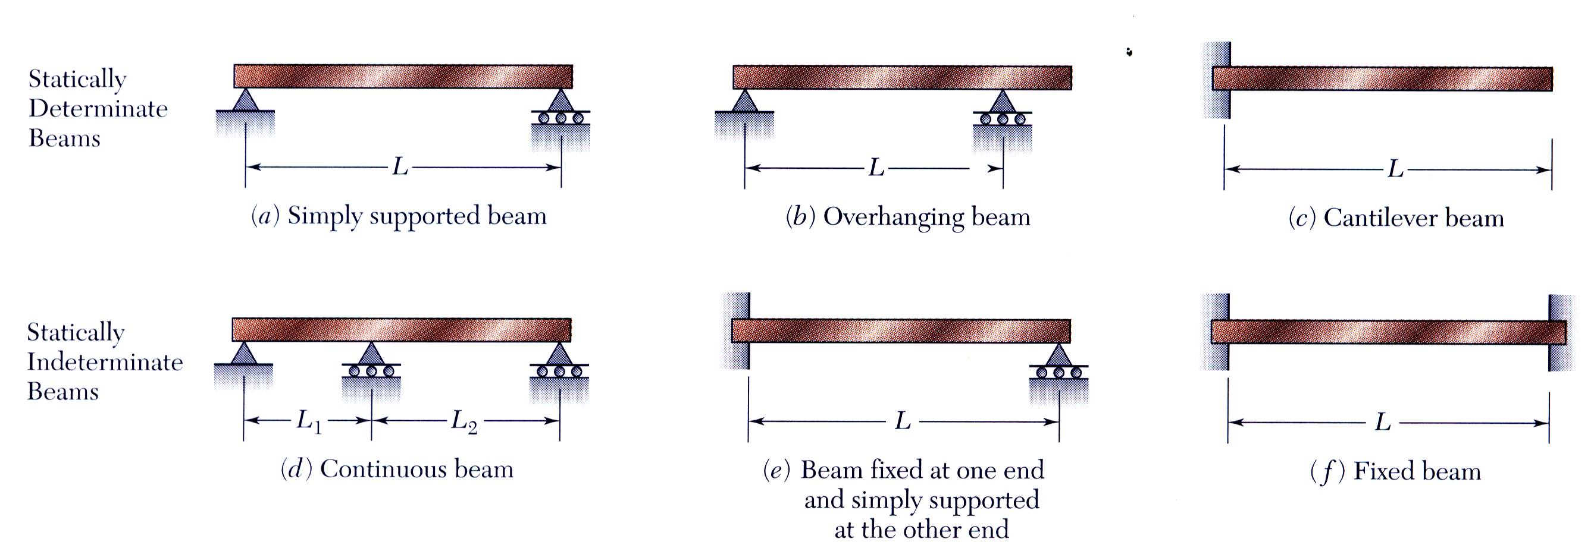
BEAMS
Members that are slender and support loadings applied perpendicular to their longitudinal axis (transverse loadings) are called beams

Slide 5
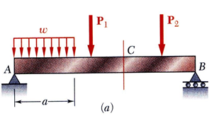
BEAMS
Beams - structural members supporting loads at various points along the member
Transverse loadings of beams are classified as concentrated loads or distributed loads
Applied loads result in internal forces consisting of a shear force (from the shear stress distribution) and a bending couple (from the normal stress distribution)

Slide 6
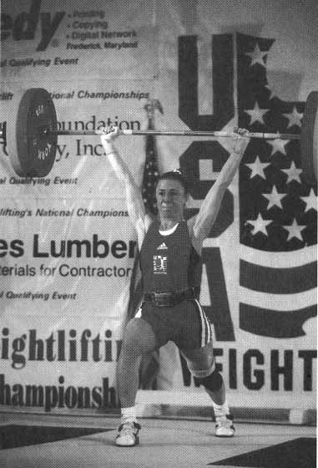
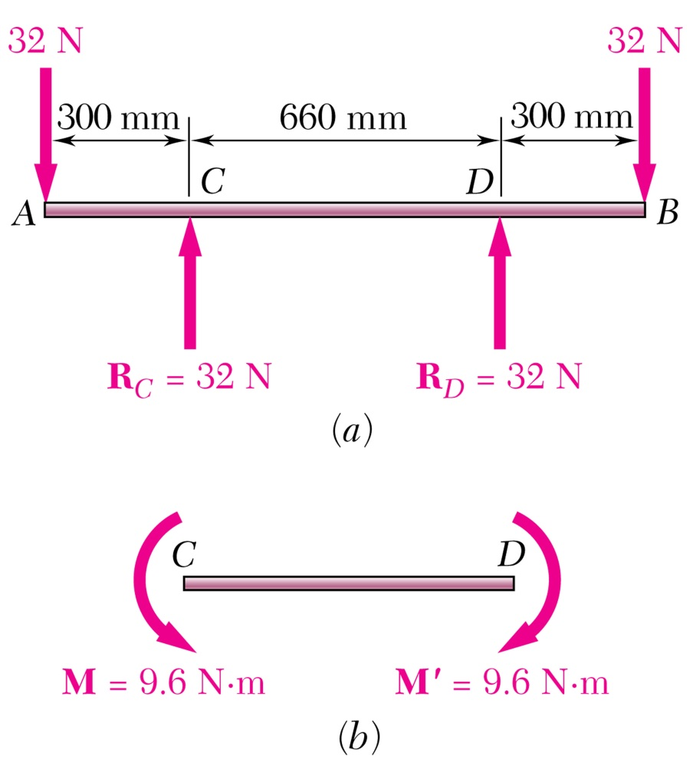
Pure Bending
Pure Bending: Prismatic members subjected to equal and opposite couples acting in the same longitudinal plane.

Slide 7
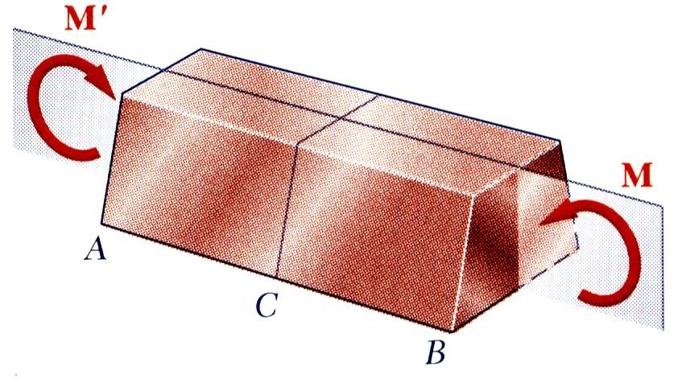
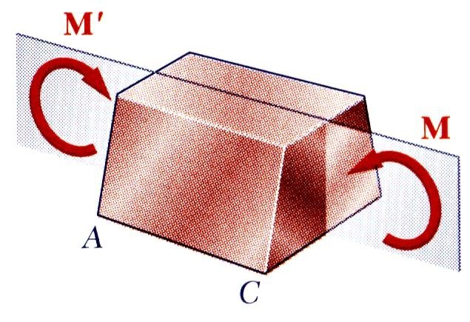
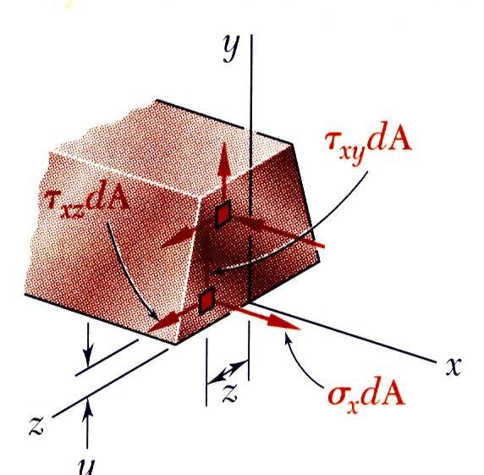
Symmetric Member in Pure Bending
Internal forces in any cross section are equivalent to a couple. The moment of the couple is the section bending moment.
From statics, a couple M consists of two equal and opposite forces.
The sum of the components of the forces in any direction is zero.
The moment is the same about any axis perpendicular to the plane of the couple and zero about any axis contained in the plane.
These requirements may be applied to the sums of the components and moments of the statically indeterminate elementary internal forces.
F_{x} = ∫σ _{x} dA = 0
M _{y} = ∫ zσ _{x} dA = 0
M _{z} = ∫ − yσ _{x} dA = M

Slide 8
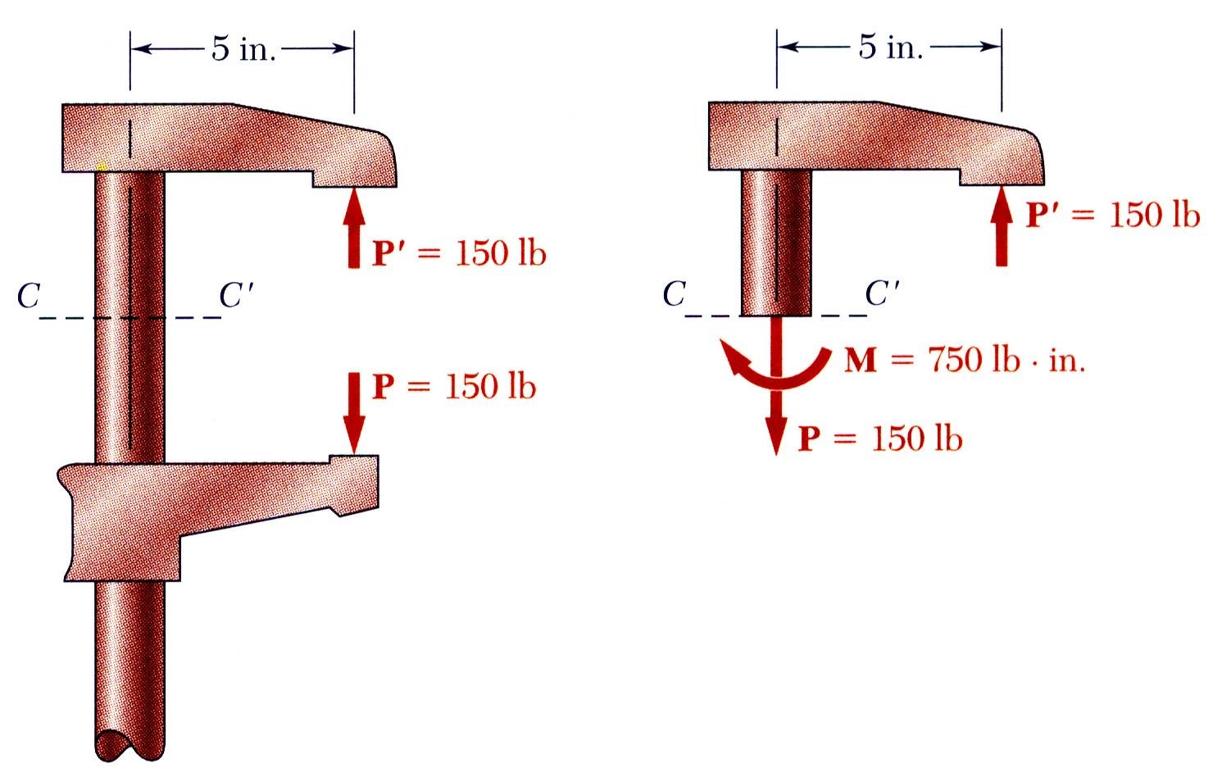
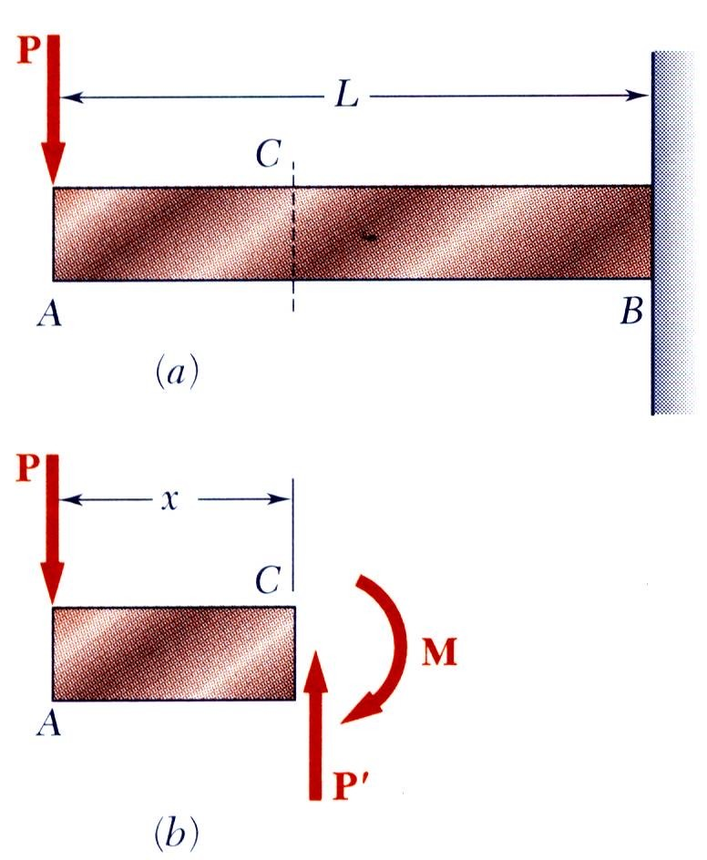
Other Loading Types
Eccentric Loading: Axial loading which does not pass through section centroid produces internal forces equivalent to an axial force and a couple
Transverse Loading: Concentrated or distributed transverse load produces internal forces equivalent to a shear force and a couple
Principle of Superposition: The normal stress due to pure bending may be combined with the normal stress due to axial loading and shear stress due to shear loading to find the complete state of stress.

Slide 9
6.1 SHEAR AND MOMENT DIAGRAMS
In order to design a beam, it is necessary to determine the maximum shear and moment in the beam
Express V and M as functions of arbitrary position x along axis.
These functions can be represented by graphs called shear and moment diagrams
Engineers need to know the variation of shear and moment along the beam to know where to reinforce it

Slide 10
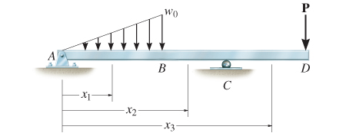
6.1 SHEAR AND MOMENT DIAGRAMS
Shear and bending-moment functions must be determined for each region of the beam between any two discontinuities of loading

Slide 11
6.1 SHEAR AND MOMENT DIAGRAMS
Beam sign convention
Although choice of sign convention is arbitrary, in this course, we adopt the one often used by engineers:

Slide 12
6.1 SHEAR AND MOMENT DIAGRAMS
IMPORTANT
Beams are long straight members that carry loads perpendicular to their longitudinal axis. They are classified according to how they are supported
To design a beam, we need to know the variation of the shear and moment along its axis in order to find the points where they are maximum
Establishing a sign convention for positive shear and moment will allow us to draw the shear and moment diagrams

Slide 13
6.1 SHEAR AND MOMENT DIAGRAMS
Procedure for analysis
Support reactions
Determine all reactive forces and couple moments acting on beam
Resolve all forces into components acting perpendicular and parallel to beam’s axis
Shear and moment functions
Specify separate coordinates x having an origin at beam’s left end, and extending to regions of beam between concentrated forces and/or couple moments, or where there is no discontinuity of distributed loading

Slide 14
6.1 SHEAR AND MOMENT DIAGRAMS
Procedure for analysis
Shear and moment functions
Section beam perpendicular to its axis at each distance x
Draw free-body diagram of one segment
Make sure V and M are shown acting in positive sense, according to sign convention
Sum forces perpendicular to beam’s axis to get shear
Sum moments about the sectioned end of segment to get moment (sum moments around the cut location)

Slide 15
6.1 SHEAR AND MOMENT DIAGRAMS
Procedure for analysis
Shear and moment diagrams
Plot shear diagram (V vs. x) and moment diagram (M vs. x)
If numerical values are positive, values are plotted above axis, otherwise, negative values are plotted below axis
It is convenient to show the shear and moment diagrams directly below the free-body diagram

Slide 16
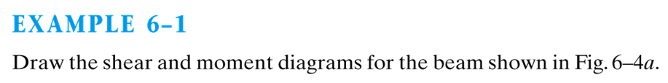
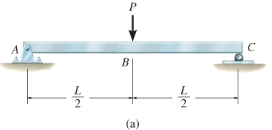

Slide 17
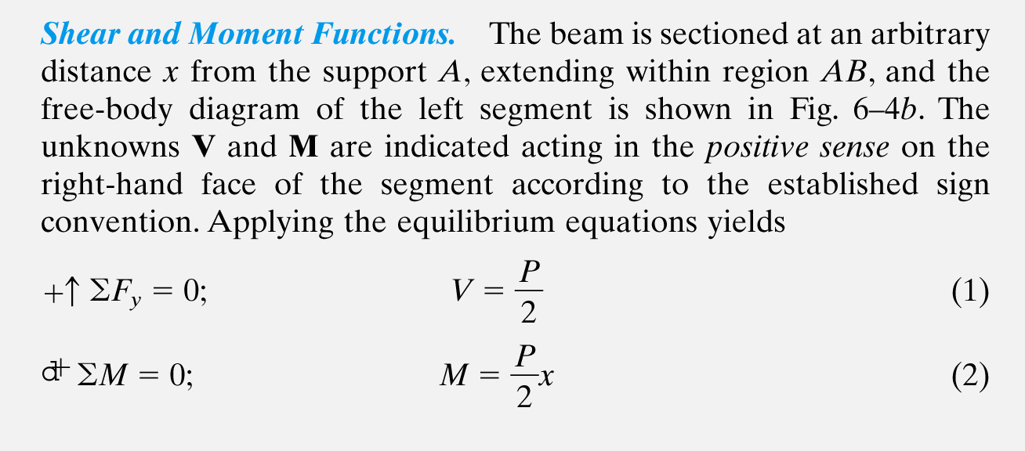
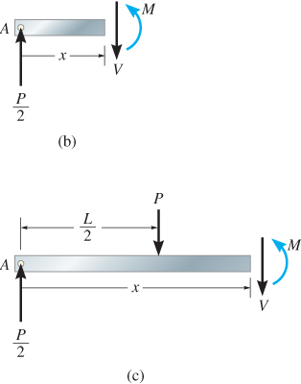

Slide 18
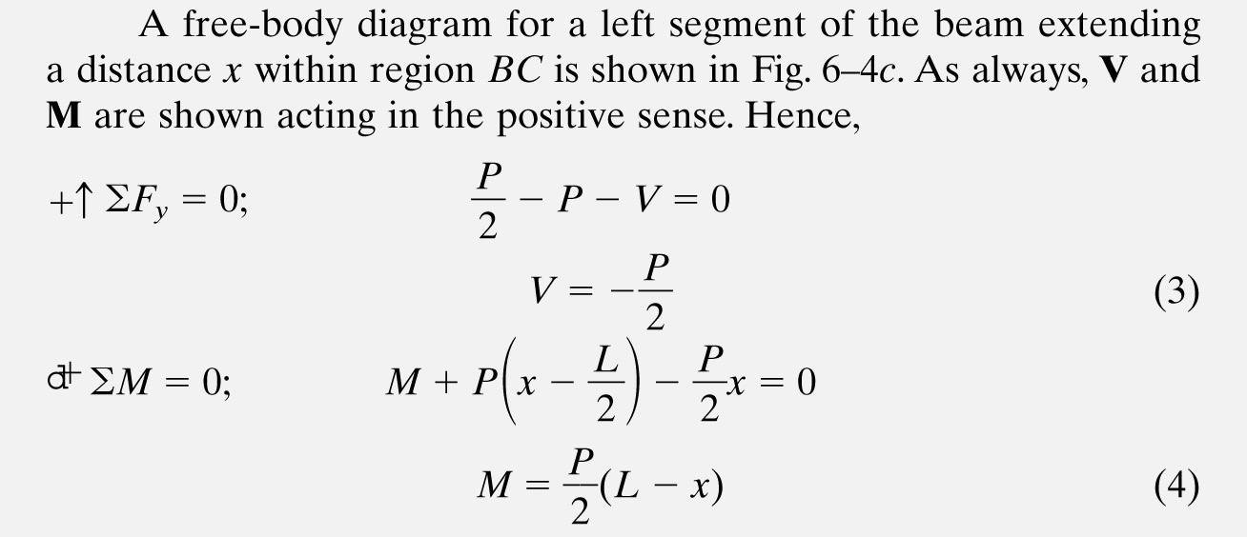

Slide 19
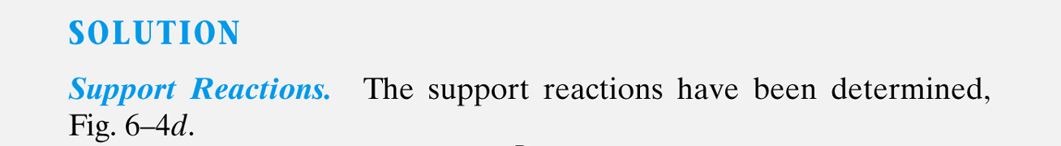
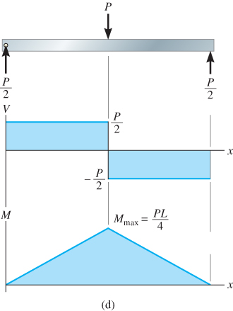

Slide 20
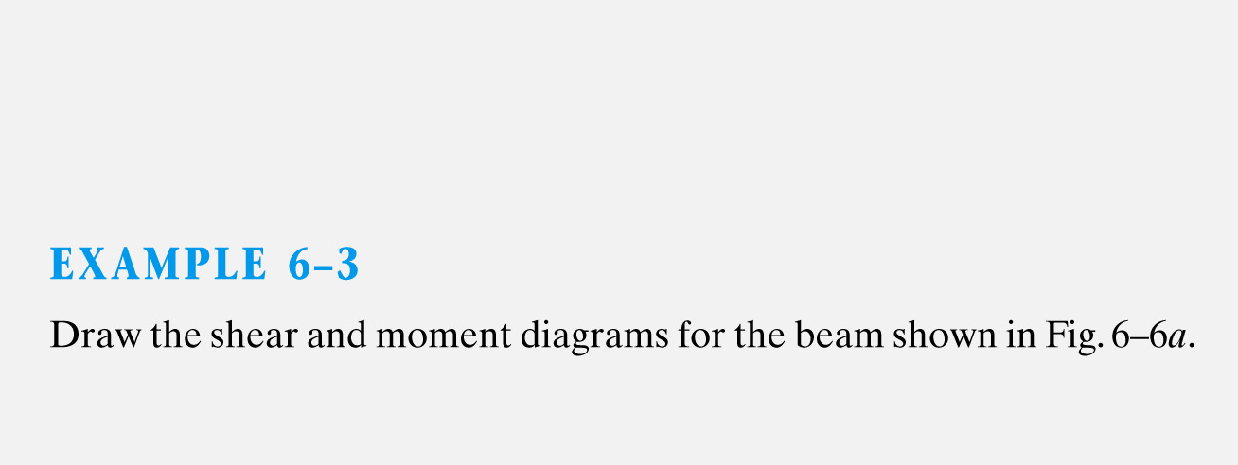
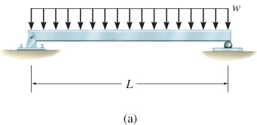

Slide 21
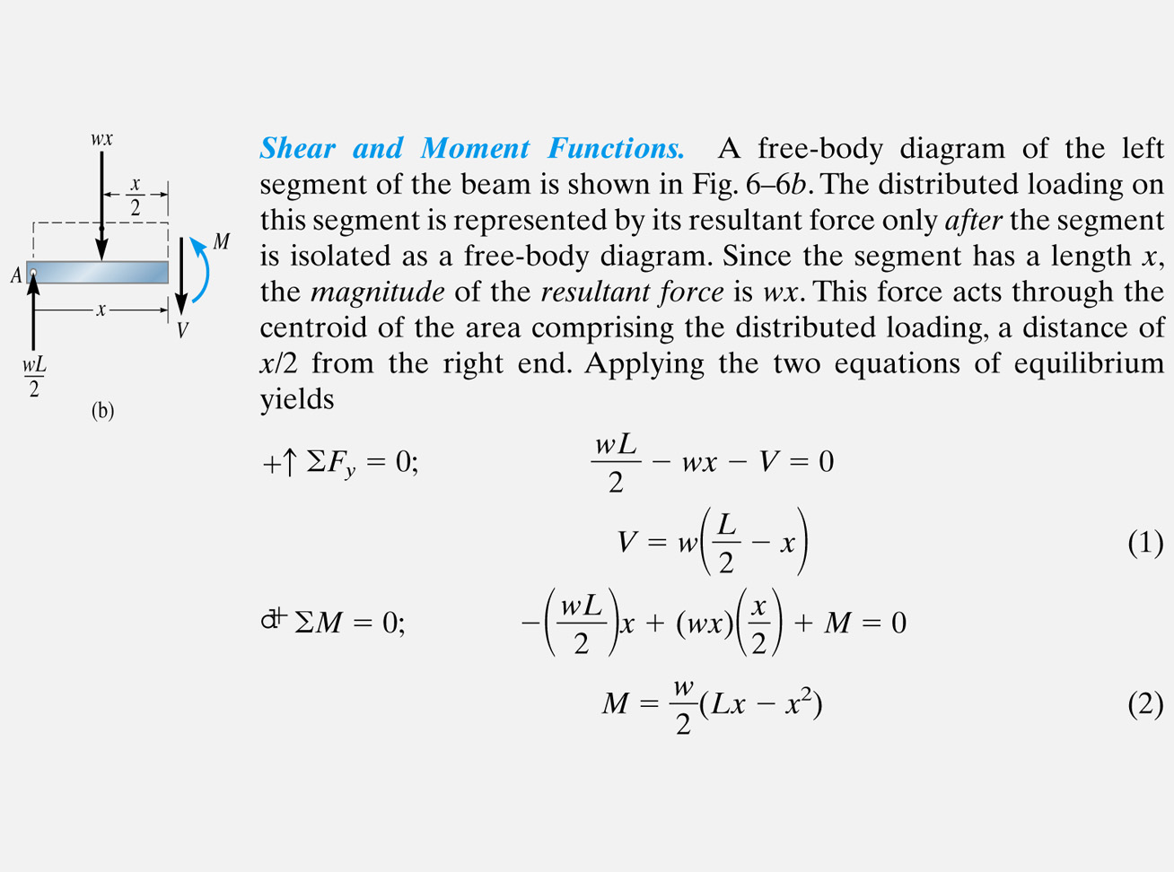
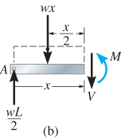

Slide 22
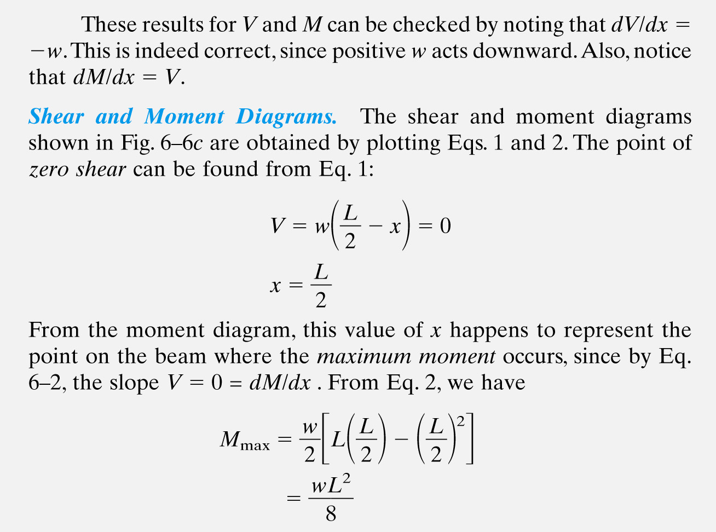

Slide 23
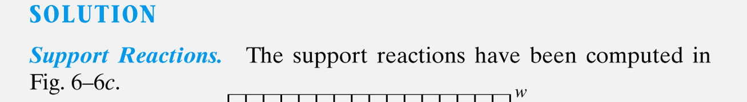
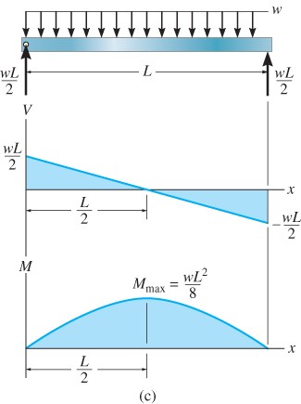

Slide 24
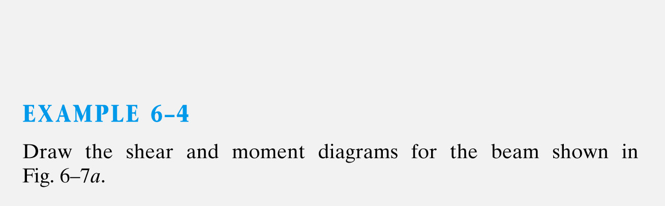
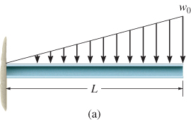

Slide 25
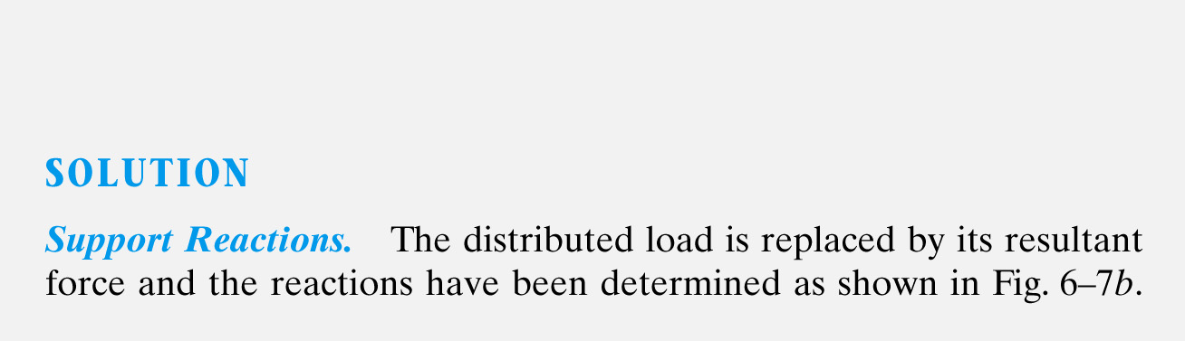
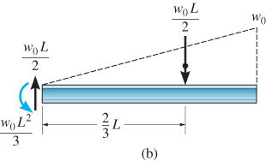

Slide 26
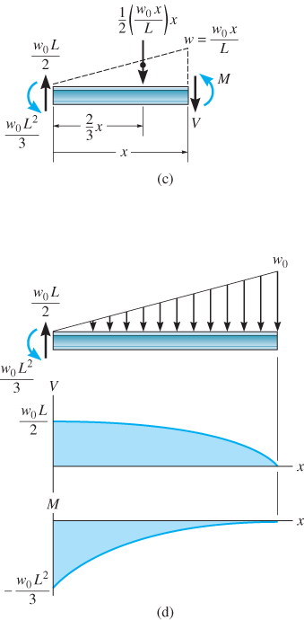
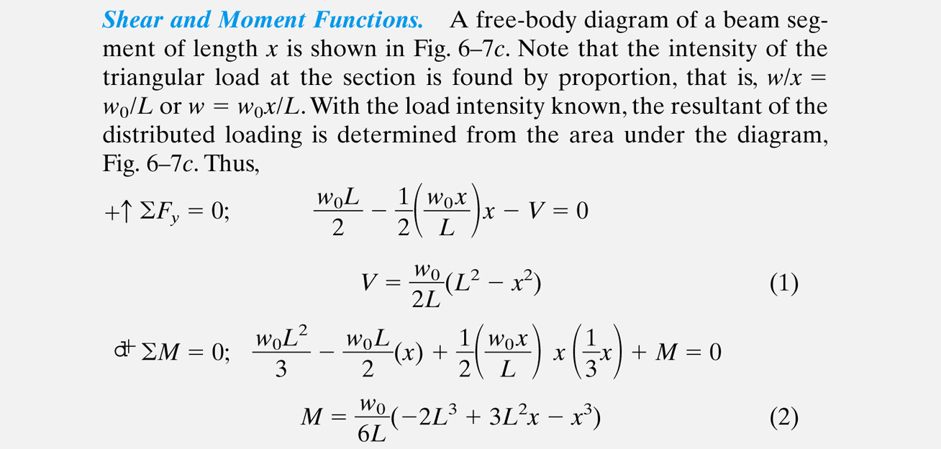

Slide 27
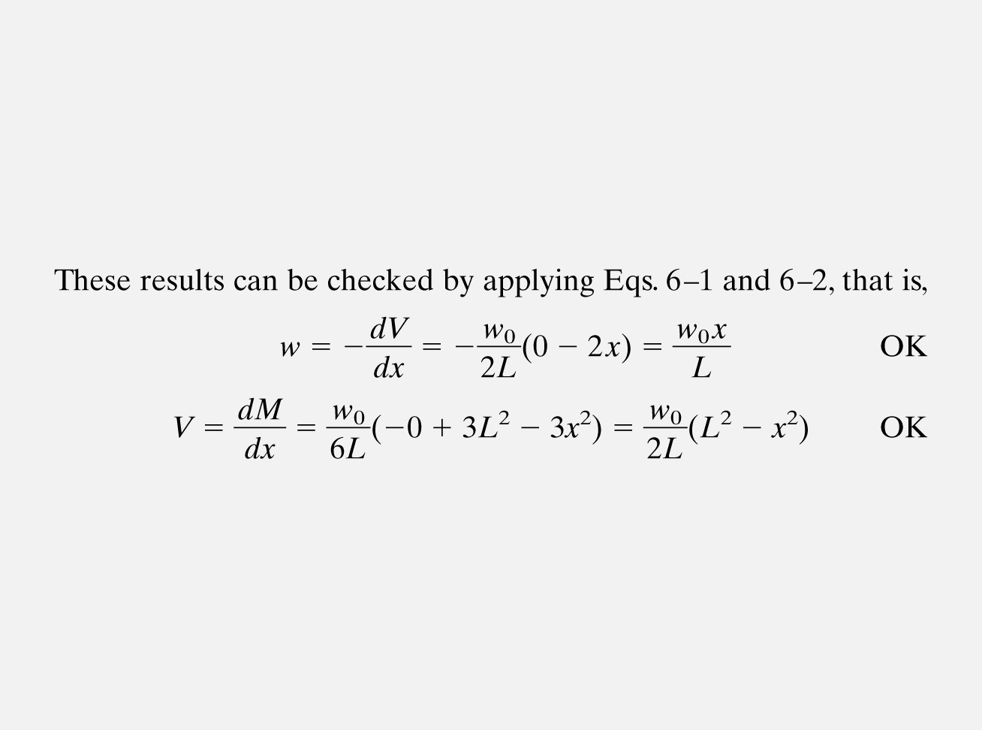

Slide 28
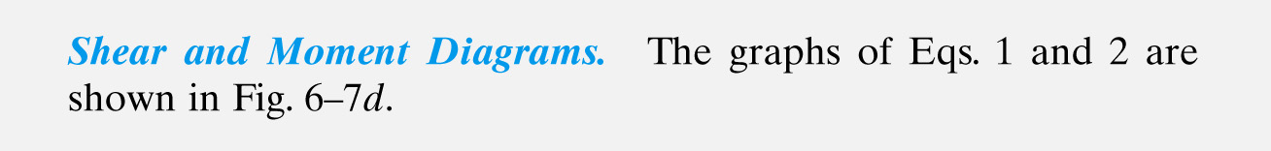

Slide 29
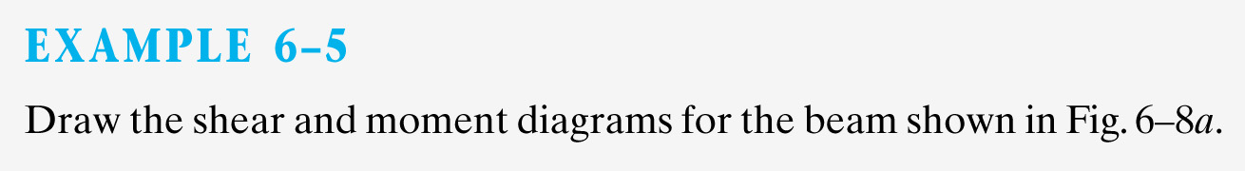
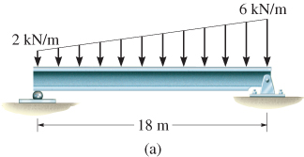

Slide 30
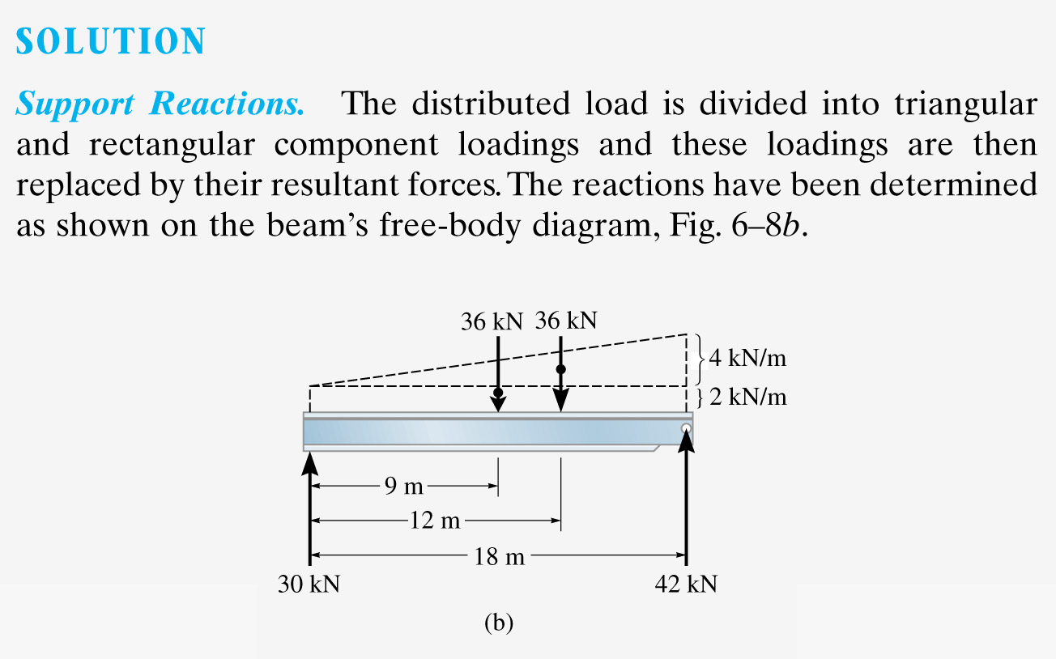

Slide 31
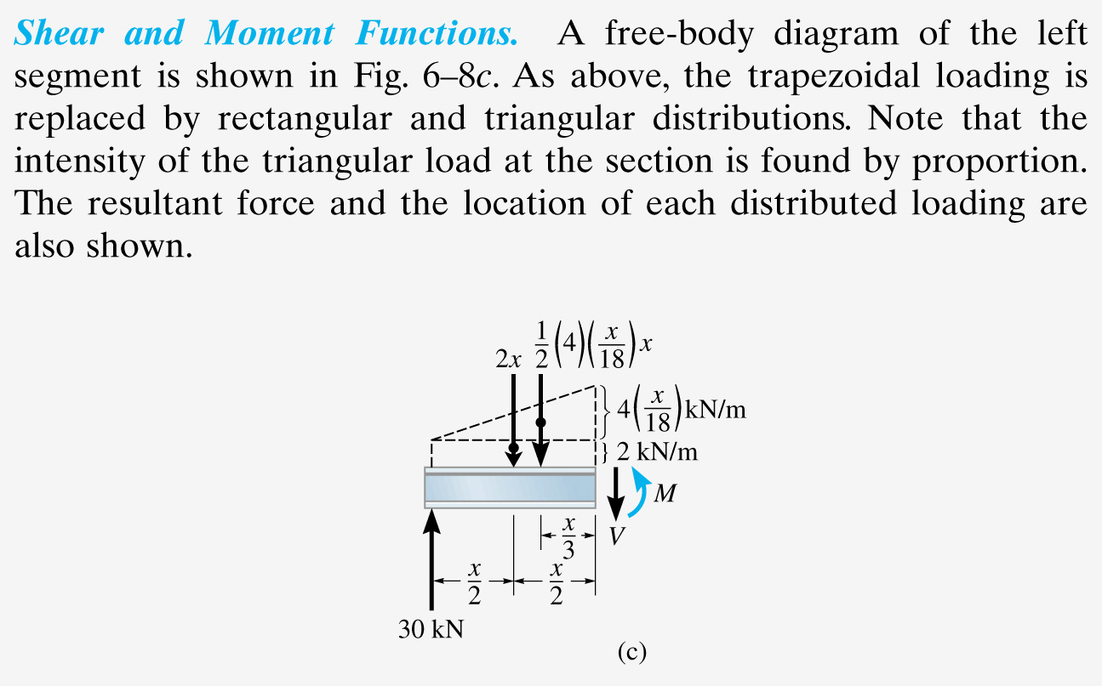

Slide 32
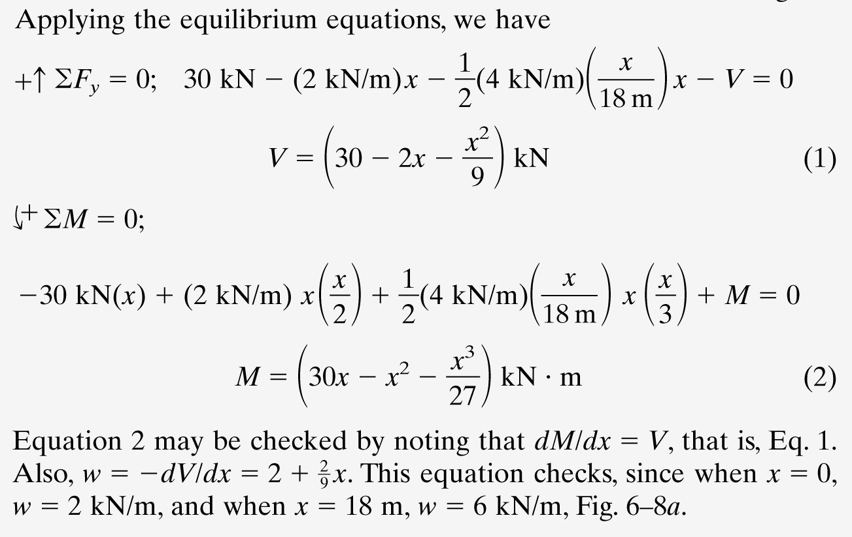

Slide 33
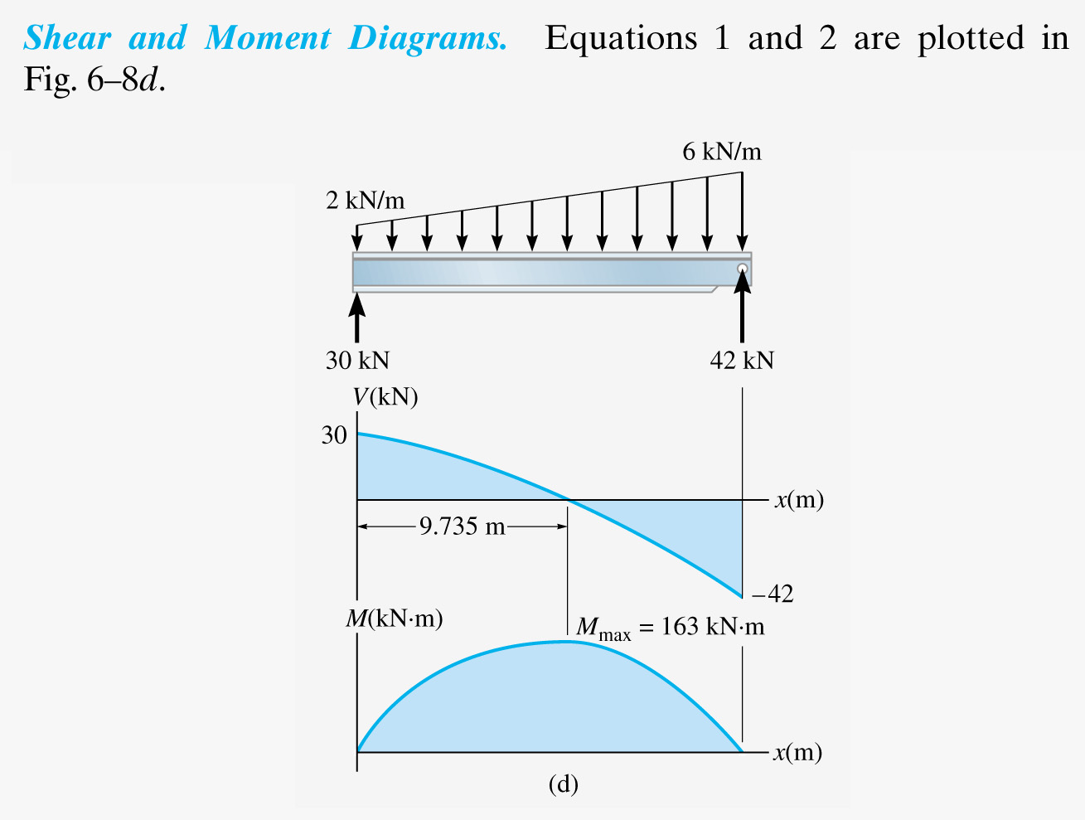

Slide 34
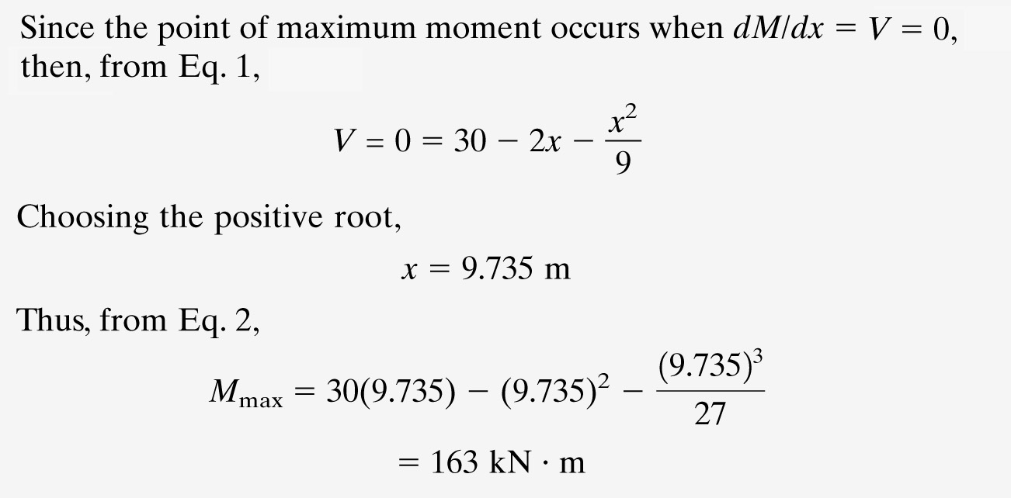

Slide 35
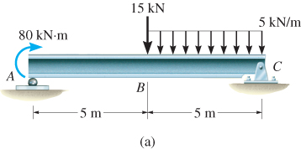
EXAMPLE 6.6
Draw the shear and moment diagrams for beam shown below.

Slide 36
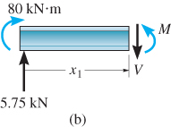
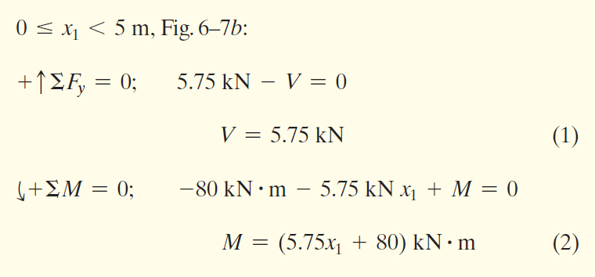
EXAMPLE 6.6 (SOLN)
Support reactions: Shown in free-body diagram.
Shear and moment functions
Since there is a discontinuity of distributed load and a concentrated load at beam’s center, two regions of x must be considered.

Slide 37
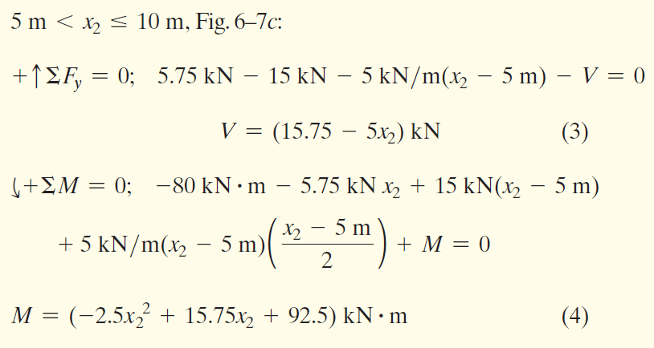
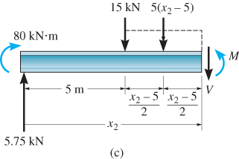

Slide 38
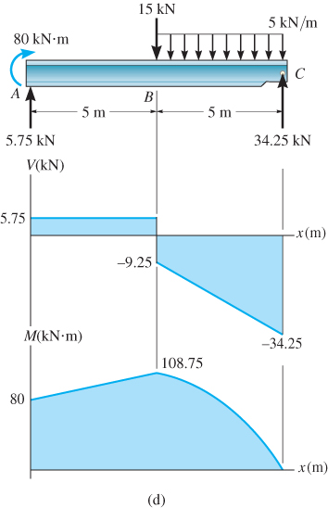
EXAMPLE 6.6 (SOLN)
Shear and moment diagrams

Slide 39
GRAPHICAL METHOD FOR CONSTRUCTING SHEAR AND MOMENT DIAGRAMS
Why?
  Fast and intuitive
  Minimal equations, maximum understanding
We will
  Understand load–shear–moment relationship
  Construct shear force diagrams graphically
  Construct bending moment diagrams using area method

Slide 40
GRAPHICAL METHOD FOR CONSTRUCTING SHEAR AND MOMENT DIAGRAMS
The Big Picture
LOAD → SHEAR → MOMENT
Loads change shear force
Shear force creates bending moment
Area and slope link all diagrams

Slide 41
GRAPHICAL METHOD FOR CONSTRUCTING SHEAR AND MOMENT DIAGRAMS
Shear and moment diagram can also be constructed based on two differential equations that exist among distributed load, shear and moment

Slide 42
GRAPHICAL METHOD FOR CONSTRUCTING SHEAR AND MOMENT DIAGRAMS
Regions of distributed load
dV
dx
dM
dx
= −w(x)
= V
Slope of shear diagram at each point
= −distributed load intensity at each point
Slope of moment diagram at each point
= shear at each point

Slide 43
GRAPHICAL METHOD FOR CONSTRUCTING SHEAR AND MOMENT DIAGRAMS
Regions of distributed load
ΔV = −∫ w(x) dx
ΔM = ∫ V(x) dx
Change in shear
= −area under distributed loading
Change in moment
= area under shear diagram
The entire method is based on two simple relationships:
The Slope Rule: The value of the load gives the slope of the shear diagram. The value of the shear gives the slope of the moment diagram.
The Area Rule: The change in value between two points is equal to the area under the previous diagram.

Slide 44
Before Drawing Any Diagram
Draw the beam and supports clearly
Show all applied loads
Calculate support reactions
Only then draw SFD and BMD

Slide 45
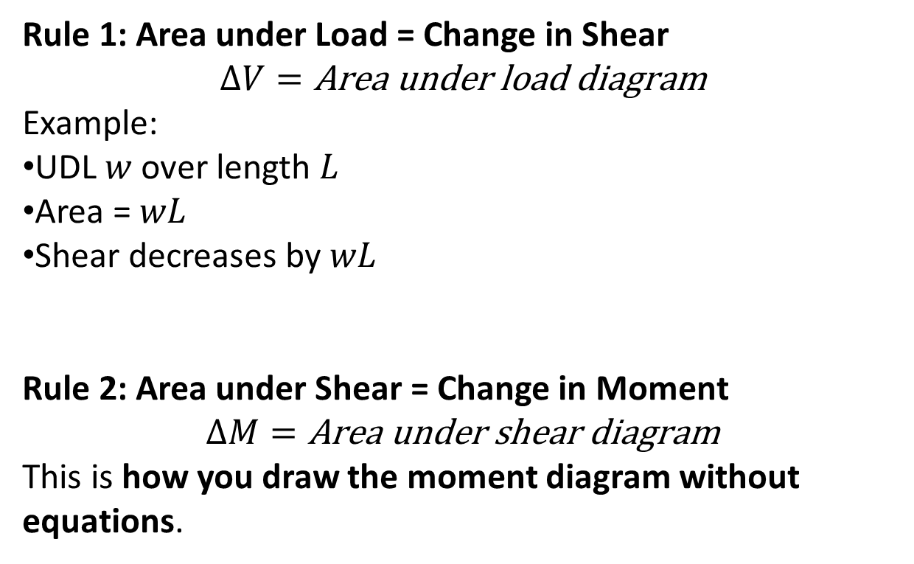
The Area Rule (This Is the “Graphical” Part)
Rule 1: Area under Load = Change in Shear
$$ΔV=\text{Area} \text{under} \text{load} \text{diagram}$$
Example:
UDL $w$ over length $L$
Area = $wL$
Shear decreases by $wL$
Rule 2: Area under Shear = Change in Moment
$$ΔM=\text{Area} \text{under} \text{shear} \text{diagram}$$
This is how you draw the moment diagram without equations.

Slide 46
Load to Shear – Graphical Rules
No load → shear is constant
Point load → sudden jump in shear
UDL → linearly sloping shear
Triangular load → curved shear (parabolic)

Slide 47
Shear to Moment – Graphical Rules
Zero shear → constant moment
Constant shear → straight-line moment
Linear shear → parabolic moment
Curved shear → moment cubic-like curve
Point moment (couple) → moment diagram jumps (vertical step)
Slope of moment diagram equals shear force

Slide 48
Load Type on Beam | Shear Diagram (V) Shape | Moment Diagram (M) Shape
None | Horizontal Line | Diagonal Line
Point Load | Sudden Vertical Jump | Change in Slope (Kink)
Uniform Load (w) | Diagonal Line | Parabolic Curve (x²)
Varying Load | Parabolic Curve (x²) | Cubic Curve (x³)

Slide 49
Area Method (Key Principle)
Change in shear = area under load diagram
Change in moment = area under shear diagram
Moment diagram is the ‘area picture’ of shear
Maximum Bending Moment
Occurs where shear force equals zero
Location where SFD crosses the axis

Slide 50
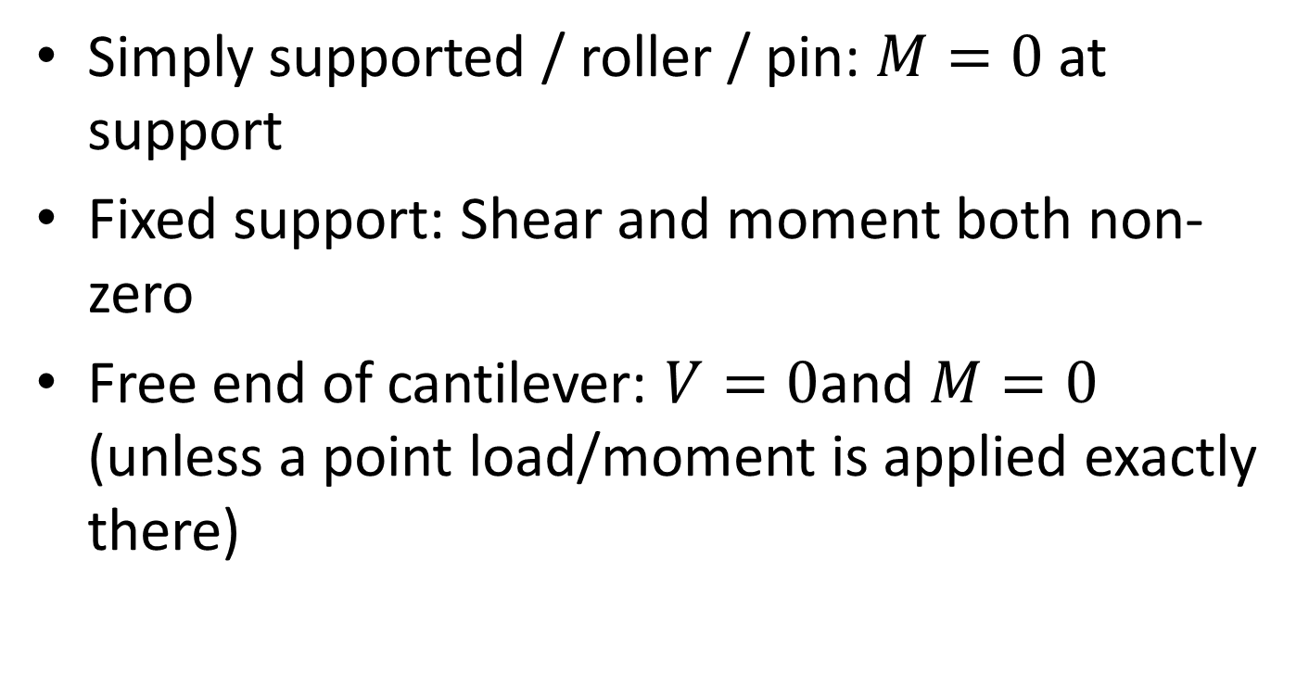
Boundary Conditions
Simply supported / roller / pin: $M=0$ at support
Fixed support: Shear and moment both non-zero
Free end of cantilever: $V=0$and $M=0$ (unless a point load/moment is applied exactly there)

Slide 51
Example 1: Simply Supported Beam + Point Load
• Step-shaped shear force diagram
• Triangular bending moment diagram
• Maximum bending moment at mid-span
• Zero moment at supports

Slide 52
Example 1: Simply Supported Beam + Point Load
• Step-shaped shear force diagram
• Triangular bending moment diagram
• Maximum bending moment at mid-span
• Zero moment at supports

Slide 53
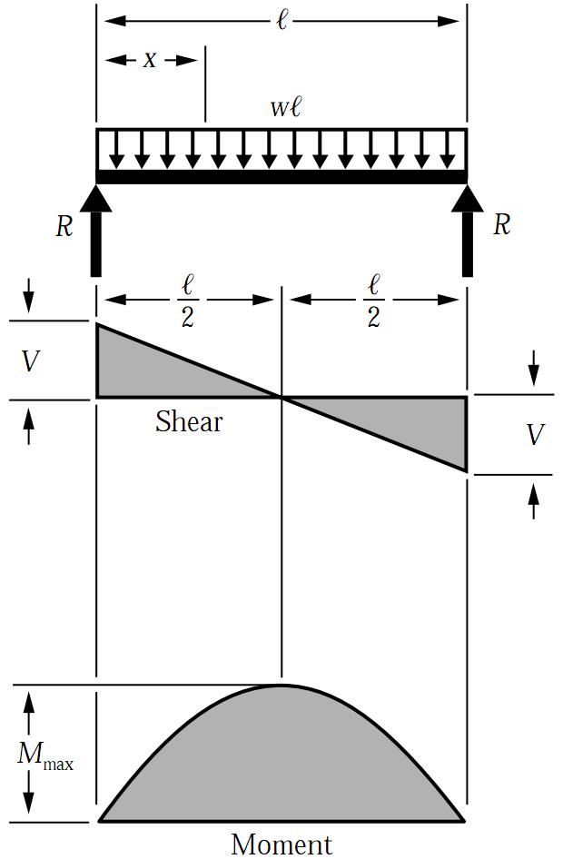
Example 2: Simply Supported Beam + UDL
• Straight-line shear force diagram
• Parabolic bending moment diagram
• Maximum bending moment at mid-span

Slide 54
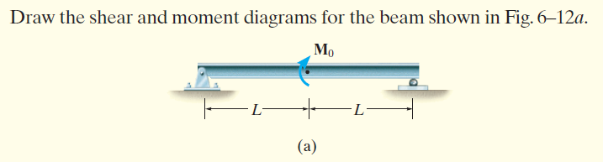
Example 2: Beam + Moment

Slide 55


Example 2: Beam + Moment
SOLUTION
Support Reactions. The support reactions are indicated on the free-body diagram shown in Fig. 6–12b.
Shear Diagram. The shear values at the beam ends are plotted first, as shown in Fig. 6–12c. Because the beam carries no distributed load, the shear diagram has zero slope and is therefore a horizontal line.
Moment Diagram. The bending moment is zero at both ends of the beam, as shown in Fig. 6–12d. The moment diagram has a constant negative slope of $−M_{0}/2L$ , since this value corresponds to the shear force at every section of the beam. The applied couple moment $M_{0}$ , however, produces a discontinuity (jump) in the moment diagram at the midpoint of the beam.

Slide 56

Example 3: Cantilever Beam + Point Load
• Constant shear force diagram
• Linear bending moment diagram
• Maximum bending moment at fixed support

Slide 57

Example 3: Cantilever Beam + Point Load

Slide 58

Example 4: Cantilever Beam + UDL
Linear shear force diagram
Parabolic bending moment diagram
Maximum bending moment at fixed support

Slide 59

Example 4: Cantilever Beam + UDL

Slide 60

Example 4: Cantilever Beam + UDL

Slide 61

Example 5: Cantilever Beam + UDL

Slide 62


Example 5: Cantilever Beam + UDL

Slide 63
Old Exam Question
Referring to the Figure 7;
Draw the shear and bending moment diagram. (8 marks)
Determine the maximum absolute value of shear and bending moment. (2 marks)

Slide 64

Bending Deformations
Beam with a plane of symmetry in pure bending:
member remains symmetric
bends uniformly to form a circular arc
cross-sectional plane passes through arc center and remains planar
length of top decreases and length of bottom increases
a neutral surface must exist that is parallel to the upper and lower surfaces and for which the length does not change
stresses and strains are negative (compressive) above the neutral plane and positive (tension) below it

Slide 65


Strain Due to Bending
Consider a beam segment of length L.
After deformation, the length of the neutral surface remains L. At other sections,
L′ = (ρ − y)θ
δ = L − L′ = (ρ − y)θ − ρθ = − yθ
_{εx =} δ ₌ ₋ yθ ₌ ₋ y
(strain varies linearly)
L ρθ ρ
_{εm =} c
_{ρ =} c
or
ρ
ε_{m}
ε_{x} = − ^{y} ε_{m}
c

Slide 66


6.3 BENDING DEFORMATION OF A STRAIGHT MEMBER
When a bending moment is applied to a straight prismatic beam, the longitudinal lines become curved and vertical transverse lines remain straight and yet undergo a rotation

Slide 67

6.3 BENDING DEFORMATION OF A STRAIGHT MEMBER
A neutral surface is where longitudinal fibers of the material will not undergo a change in length.

Slide 68
6.3 BENDING DEFORMATION OF A STRAIGHT MEMBER
Thus, we make the following assumptions:
  Longitudinal axis x (within neutral surface) does not experience any change in length
  All cross sections of the beam remain plane and perpendicular to longitudinal axis during the deformation
  Any deformation of the cross-section within its own plane will be neglected
In particular, the z axis, in plane of x-section and about which the x-section rotates, is called the neutral axis

Slide 69

6.3 BENDING DEFORMATION OF A STRAIGHT MEMBER
For any specific x-section, the longitudinal normal strain will vary linearly with y from the neutral axis
A contraction will occur (−ε) in fibers located above the neutral axis (+y)
An elongation will occur (+ε)
in fibers located below
the axis (−y)
Equation 6-8
ε = −(y/c)ε_{max}

Slide 70

6.4 THE FLEXURE FORMULA
Assume that material behaves in a linear-elastic manner so that Hooke’s law applies.
A linear variation of normal strain
must then be the consequence of
a linear variation in normal stress
Applying Hooke’s law to Eqn 6-8,
Equation 6-9
σ = −(y/c)σ_{max}

Slide 71

6.4 THE FLEXURE FORMULA (locating the neutral axis)
By mathematical expression, equilibrium equations of moment and forces, we get
Equation 6-10
∫_{A} y dA = 0
σ_{max}
c
Equation 6-11
M = ∫_{A} y² dA
The integral represents the moment of inertia of x-sectional area, computed about the neutral axis. We symbolize its value as I.

Slide 72
6.4 THE FLEXURE FORMULA
Hence, Eqn 6-11 can be solved and written as
Mc
I
Equation 6-12
σ_{max} =
σ_{max} = maximum normal stress in member, at a pt on x-sectional area farthest away from neutral axis
M = resultant internal moment, computed about neutral axis of x-section
I = moment of inertia of x-sectional area computed about neutral axis
c = perpendicular distance from neutral axis to a pt farthest away from neutral axis, where σ_{max} acts

Slide 73

6.4 THE FLEXURE FORMULA
The ratio $\frac{I}{c}$ is also defined as the
elastic section modulus, S
$$S=\frac{I}{c}$$
Thus, Eqn 6-12 can be written as
$$σ_{max}=\frac{M}{S}$$

Slide 74
6.4 THE FLEXURE FORMULA
Normal stress at intermediate distance y can be determined from
My
I
Equation 6-13
σ = −
σ is -ve as it acts in the -ve direction (compression)
Equations 6-12 and 6-13 are often referred to as the flexure formula.
Mc
I
My
I
σ_{max} =
σ = −

Slide 75
6.4 THE FLEXURE FORMULA
IMPORTANT
X-section of straight beam remains plane when beam deforms due to bending.
The neutral axis is subjected to zero stress
Due to deformation, longitudinal strain varies linearly from zero at neutral axis to maximum at outer fibers of beam
Provided material is homogeneous and Hooke’s law applies, stress also varies linearly over the x-section

Slide 76
6.4 THE FLEXURE FORMULA
IMPORTANT
For linear-elastic material, neutral axis passes through centroid of x-sectional area. This is based on the fact that resultant normal force acting on x-section must be zero
Flexure formula is based on requirement that resultant moment on the x-section is equal to moment produced by linear normal stress distribution about neutral axis

Slide 77
6.4 THE FLEXURE FORMULA
Procedure for analysis
Internal moment
Section member at pt where bending or normal stress is to be determined and obtain internal moment M at the section
Centroidal or neutral axis for x-section must be known since M is computed about this axis
If absolute maximum bending stress is to be determined, then draw moment diagram in order to determine the maximum moment in the diagram

Slide 78
6.4 THE FLEXURE FORMULA
Procedure for analysis
Section property
Determine moment of inertia I, of x-sectional area about the neutral axis
Methods used are discussed in Textbook Appendix A
Refer to the course book’s inside front cover for the values of I for several common shapes

Slide 79
6.4 THE FLEXURE FORMULA
Procedure for analysis
Normal stress
Specify distance y, measured perpendicular to neutral axis to pt where normal stress is to be determined
Apply equation σ = My/I, or if maximum bending stress is needed, use σ_{max} = Mc/I
Ensure units are consistent when substituting values into the equations

Slide 80



Radius of Curvature
In the elastic range $ε_{m}=\frac{σ_{m}}{E}$, with the flexure formula, gives the Radius of curvature, $ρ$
$$\frac{1}{ρ}=\frac{M}{EI}$$

Slide 81



Slide 82


Slide 83



Slide 84



Slide 85


Slide 86


Slide 87


Slide 88

Sample Problem 5.1
SOLUTION:
Treating the entire beam as a rigid body, determine the reaction forces.
Section the beam at points near supports and load application points. Apply equilibrium analyses on resulting free bodies to determine internal shear forces and bending couples.
For the timber beam and loading shown, draw the shear and bend-moment diagrams and determine the maximum normal stress due to bending.
Identify the maximum shear and bending moment from plots of their distributions.
Apply the elastic flexure formulas to determine the corresponding maximum normal stress.

Slide 89

Sample Problem 5.1
SOLUTION:
Treating the entire beam as a rigid body, determine the reaction forces
Section the beam and apply equilibrium analyses on resulting free bodies

Slide 90


Sample Problem 5.1
Identify the maximum shear and bending moment from plots of their distributions.
Apply the elastic flexure formulas to determine the corresponding maximum normal stress.

Slide 91



Beam Section Properties for Beam Design
The maximum normal stress due to bending,
_{σm =} Mc ₌ M
I S
I = section moment of inertia
$$S=\frac{I}{c}=$$
section modulus
A beam section with a larger section modulus will have a lower maximum stress
Consider a rectangular beam cross section,
I
1 _{bh}3
2
S = = ¹² = ¹ bh = ¹ Ah
c h 2
6 6
Between two beams with the same cross sectional area, the beam with the greater depth will be more effective in resisting bending.
Structural steel beams are designed to have a large section modulus.

Slide 92
Standard Beam Design
An I-beam is a beam with an I or H-shaped cross-section, also known as
H-beam (for universal column, UC)
W-beam (for "wide flange")
Universal beam (UB)
Rolled steel joist (RSJ)
or Double-T (especially in Polish, Bulgarian, Spanish, Italian and German).
The horizontal elements of the I are flanges, and the vertical element is the "web". I-beams are usually made of structural steel and are used in construction and civil engineering.
W-Beam calculator
https://www.amesweb.info/SectionalPropertiesTabs/StructuralSteelFabrication_Wshape.aspx

Slide 93


W-Beam Design

Slide 94

Sample W-Beam Dimensions

Slide 95

Sample S-Beam Dimensions

Slide 96

Sample Problem 5.2
SOLUTION:
Replace the 45-kN load with an equivalent force-couple system at D. Find the reactions at B by considering the beam as a rigid body.
Section the beam at points near the support and load application points. Apply equilibrium analyses on resulting free bodies to determine internal shear forces and bending couples.
The structure shown is constructed of a W250 × 167 rolled-steel beam. (a) Draw the shear and bending-moment diagrams for the beam and the given loading. (b) Determine normal stress in sections just to the right and left of point D.
Apply the elastic flexure formulas to determine the maximum normal stress to the left and right of point D.

Slide 97


Sample Problem 5.2
SOLUTION:
Replace the 45-kN load with equivalent force-couple system at D. Find reactions at B.
Section the beam and apply equilibrium analyses on resulting free bodies.

Slide 98


Sample Problem 5.2
Apply the elastic flexure formulas to determine the maximum normal stress to the left and right of point D.
From Appendix C for a W250 × 167 rolled steel shape, S = I/c= 208 × 10⁶mm about the X−X axis.

Slide 99

Sample Problem 5.3
SOLUTION:
Taking the entire beam as a free body, determine the reactions at A and D.
Apply the relationship between shear and load to develop the shear diagram.
Draw the shear and bending-moment diagrams for the beam and loading shown.
Apply the relationship between bending moment and shear to develop the bending-moment diagram.

Slide 100


Sample Problem 5.3
SOLUTION:
Taking the entire beam as a free body, determine the reactions at A and D.
Apply the relationship between shear and load to develop the shear diagram.
− zero slope between concentrated loads
− linear variation over uniform load segment

Slide 101

Sample Problem 5.3
Apply the relationship between bending moment and shear to develop the bending-moment diagram.
− bending moment at A and E is zero
− bending moment variation between A, B, C, and D is linear
− bending moment variation between D and E is quadratic
− net change in bending moment is equal to areas under shear distribution segments
− total of all bending-moment changes across the beam should be zero

Slide 102


Sample Problem 4.2
SOLUTION:
Based on the cross-section geometry, calculate the location of the section centroid and moment of inertia.
Apply the elastic flexural formula to find the maximum tensile and compressive stresses.
A cast-iron machine part is acted upon by a 3 kN-m couple. Knowing E = 165 GPa and neglecting the effects of fillets, determine the maximum tensile and compressive stresses

Slide 103


Sample Problem 4.2
SOLUTION:
Based on the cross-section geometry, calculate the location of the section centroid and moment of inertia.

Slide 104

Sample Problem 4.2
Apply the elastic flexural formula to find the maximum tensile and compressive stresses.

Slide 105

Design of Prismatic Beams for Bending
The largest normal stress is found at the surface where the maximum bending moment occurs.

Slide 106

Design of Prismatic Beams for Bending
A safe design requires that the maximum normal stress be less than the allowable stress for the material used. This criteria leads to the determination of the minimum acceptable section modulus, S_{min}.

Slide 107
Design of Prismatic Beams for Bending
Among beam section choices which have an acceptable section modulus, the one with the smallest weight per unit length or cross sectional area will be the least expensive and the best choice.

Slide 108

Sample Problem 5.8

Slide 109

Sample Problem 5.8 (Sol’n)

Slide 110

Sample Problem 5.8 (Sol’n)

Slide 111
CHAPTER REVIEW
Shear and moment diagrams are graphical representations of internal shear and moment within a beam.
They can be constructed by sectioning the beam an arbitrary distance x from the left end, finding V and M as functions of x, then plotting the results
Another method to plot the diagrams is to realize that at each pt, the slope of the shear diagram is a negative of the distributed loading, w = dV/dx; and slope of moment diagram is the shear,
V = dM/dx.

Slide 112
CHAPTER REVIEW
Also, the (-ve) area under the loading diagram represents the change in shear, ΔV = −∫ w dx.
The area under the shear diagram represents the change in moment, ΔM = ∫ V dx. Note that values of shear and moment at any pt can be obtained using the method of sections
A bending moment tends to produce a linear variation of normal strain within a beam.
Provided that material is homogeneous, Hooke’s law applies, and moment applied does not cause yielding, then equilibrium is used to relate the internal moment in the beam to its stress distribution

Slide 113
CHAPTER REVIEW
That results in the flexure formula, σ = Mc/I, where I and c are determined from the neutral axis that passes through the centroid of the x-section
If x-section of beam is not symmetric about an axis that is perpendicular to neutral axis, then unsymmetrical bending occurs
Maximum stress can be determined from formulas, or problem can be solved by considering the superposition of bending about two separate axes

