Slide 1
SETG 2363
Strength of Materials
Torsion
Mohsin Mohd Sies
Nuclear Engineering,
Faculty of Chemical and Energy Engineering,
Universiti Teknologi Malaysia

Slide 2

CHAPTER OBJECTIVES
Discuss effects of applying torsional loading to a long straight member
Determine stress distribution within the member under torsional load
Determine angle of twist when material behaves in a linear-elastic and inelastic manner
Discuss statically indeterminate analysis of shafts and tubes

Slide 3
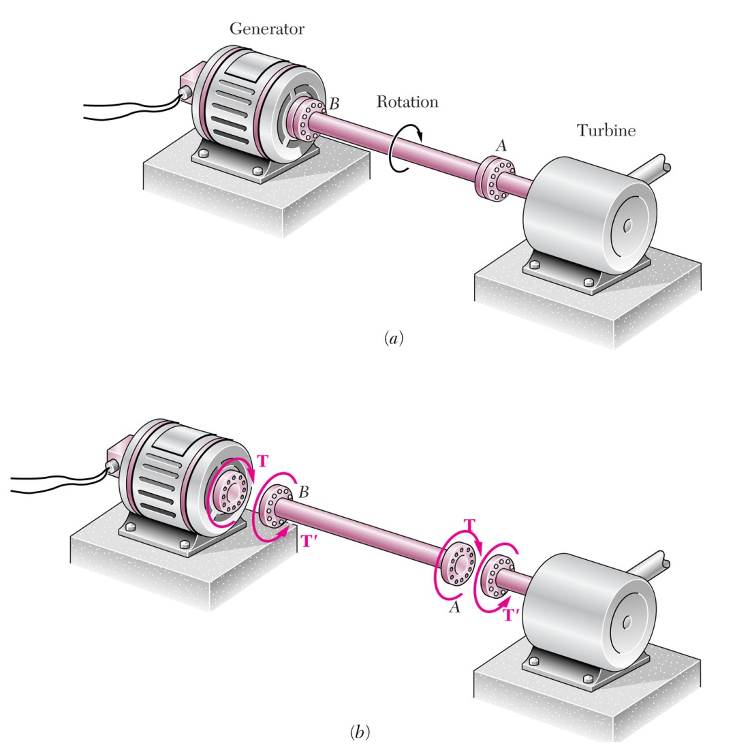
CHAPTER OUTLINE
Torsional Deformation of a Circular Shaft
The Torsion Formula
Power Transmission
Angle of Twist
Statically Indeterminate Torque-Loaded Members
Stress Concentration

Slide 4
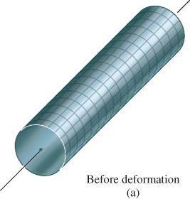
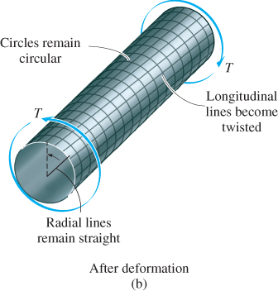
5.1 TORSIONAL DEFORMATION OF A CIRCULAR SHAFT
Torsion is a moment that twists/deforms a member about its longitudinal axis
By observation, if angle of rotation is small, length of shaft and its radius remain unchanged

Slide 5
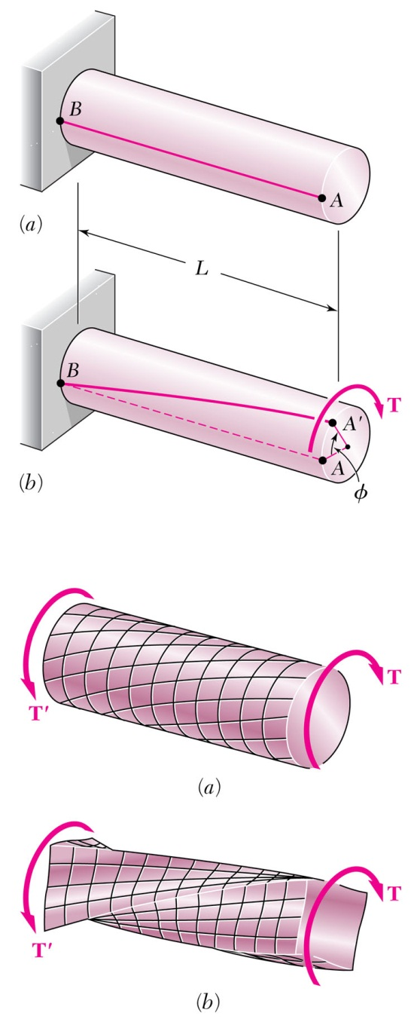
Shaft Deformations
From observation, the angle of twist of the shaft is proportional to the applied torque and to the shaft length.
When subjected to torsion, every cross section of a circular shaft remains plane and undistorted.
Cross-sections for hollow and solid circular shafts remain plain and undistorted because a circular shaft is axisymmetric.
Cross-sections of noncircular (non-axisymmetric) shafts are distorted when subjected to torsion.

Slide 6
Shaft Deformations

Slide 7
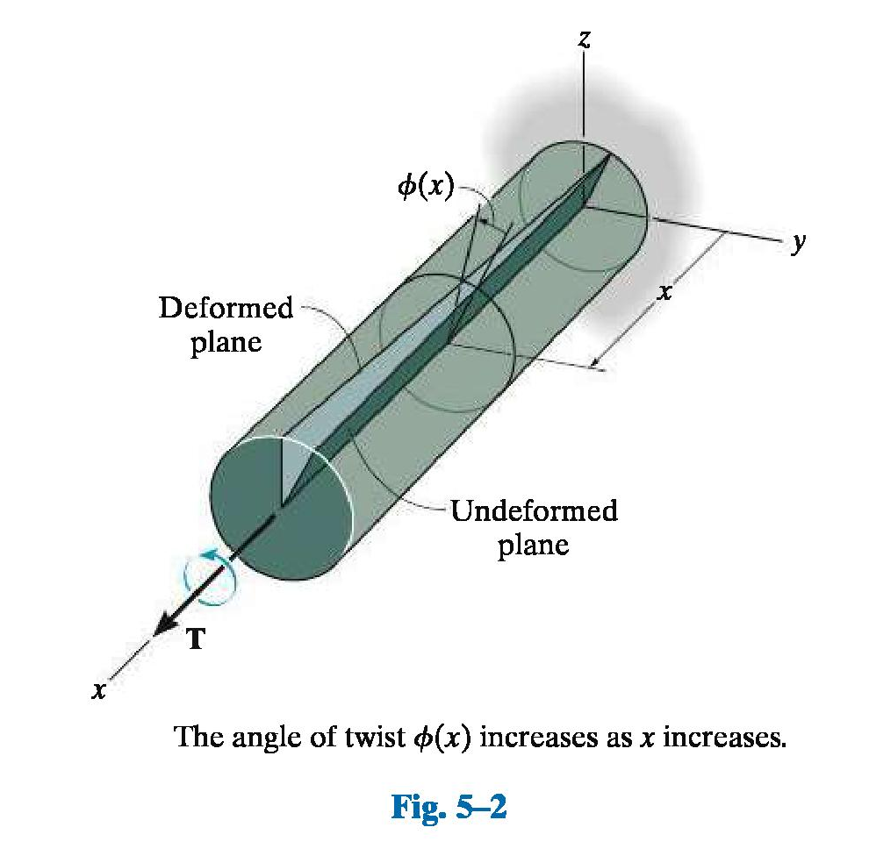
Shearing Strain

Slide 8
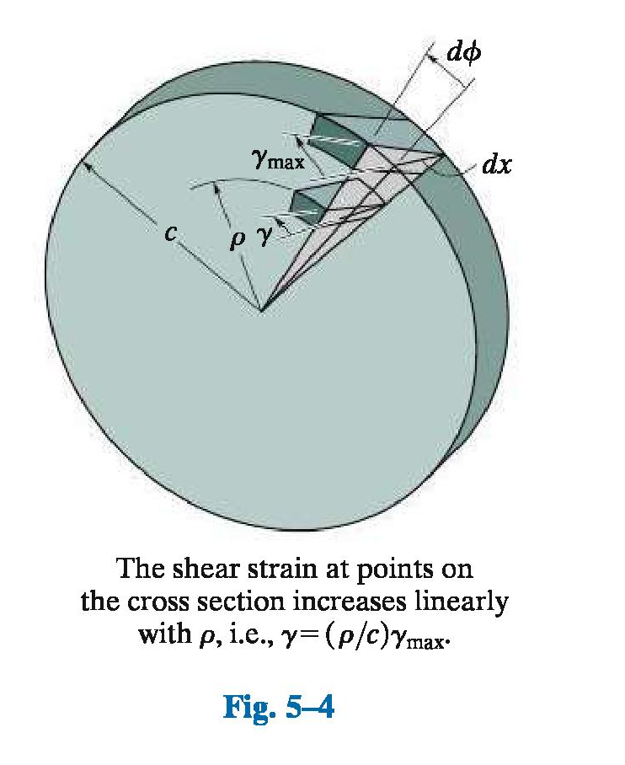
Shearing Strain

Slide 9
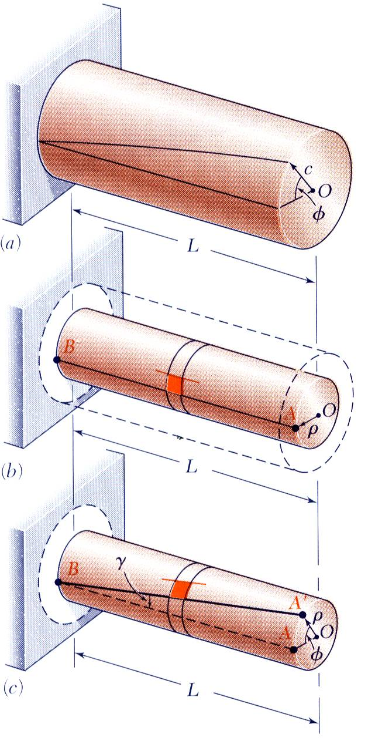
Shearing Strain
Consider an interior section of the shaft. As a torsional load is applied, an element on the interior cylinder deforms into a rhombus.
Since the ends of the element remain planar, the shear strain is equal to angle of twist.
It follows that
Shear strain is proportional to twist and radius

Slide 10
Stresses in Elastic Range
Multiplying the previous equation by the shear modulus,
From Hooke’s Law,
, so
The shearing stress varies linearly with the radial position in the section.
Recall that the sum of the moments from the internal stress distribution is equal to the torque on the shaft at the section,

Slide 11
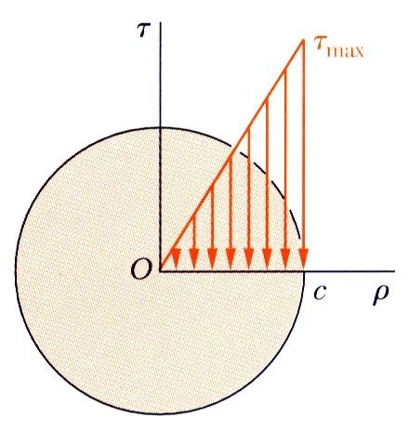
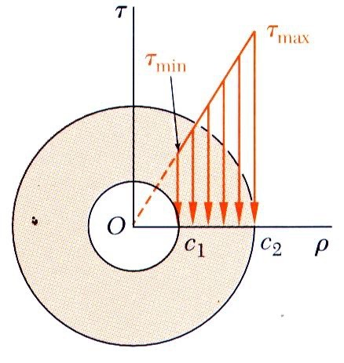
Stresses in Elastic Range
J = ¹ πc⁴
2
J = π (
c − c )
1
4 4
2
2 1

Slide 12
5.2 THE TORSION FORMULA
The integral in the equation can be represented as the polar moment of inertia, J, of shaft’s x-sectional area computed about its longitudinal axis
τ _{max} = max. shear stress in shaft, at the outer surface
T = resultant internal torque acting at x-section, from method of sections & equation of moment equilibrium applied about longitudinal axis
J = polar moment of inertia at x-sectional area
c = outer radius of the shaft

Slide 13
5.2 THE TORSION FORMULA
Shear stress at intermediate radial distance, ρ
Tρ
J
τ =
The above two equations are referred to as the torsion formula
Used only if shaft is circular, its material homogenous, and it behaves in an linear-elastic manner since the derivation is based on

Slide 14
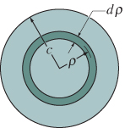

Polar Moment of Inertia
Solid shaft
J can be determined using area element in the form of a differential ring or annulus having thickness dρ and circumference 2πρ .
For this ring, dA = 2πρ dρ

Slide 15
Polar Moment of Inertia
Solid shaft
Hence,
π
2
J = c⁴
J is a geometric property of the circular area and is always positive. Common units used for its measurement are mm⁴ and m⁴.

Slide 16
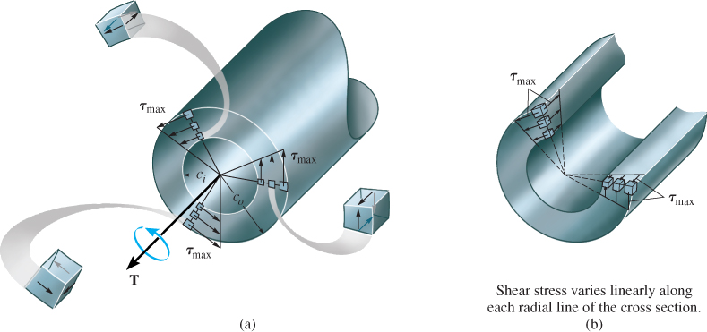
5.2 THE TORSION FORMULA
Tubular shaft
π
2
J = (c_{o}⁴ − c_{i}⁴)

Slide 17
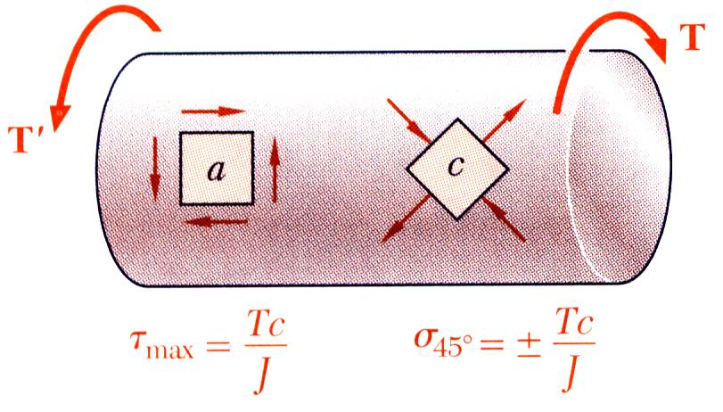
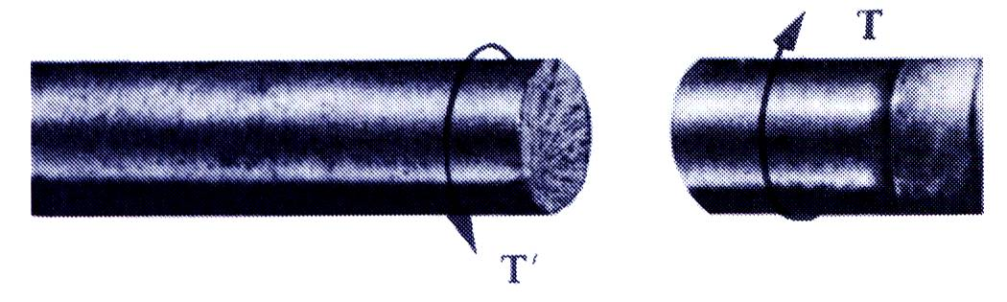
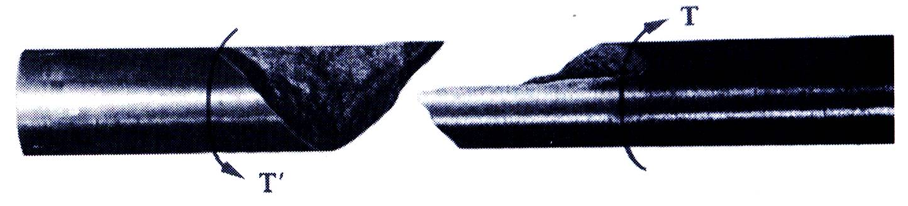
Torsional Failure Modes
Ductile materials generally fail in shear. Brittle materials are weaker in tension than shear.
When subjected to torsion, a ductile specimen breaks along a plane of maximum shear, i.e., a plane perpendicular to the shaft axis.
When subjected to torsion, a brittle specimen breaks along planes perpendicular to the direction in which tension is a maximum, i.e., along surfaces at 45º to the shaft axis.

Slide 18
5.2 THE TORSION FORMULA
Absolute maximum torsional stress
Need to find location where ratio Tc/J is maximum
Draw a torque diagram (internal torque τ vs. x along shaft)
Sign Convention: T is positive, by right-hand rule, is directed outward from the shaft
Once internal torque throughout shaft is determined, maximum ratio of Tc/J can be identified

Slide 19
5.2 THE TORSION FORMULA
Procedure for analysis
Internal loading
Section shaft perpendicular to its axis at point where shear stress is to be determined
Use free-body diagram and equations of equilibrium to obtain internal torque at section
Section property
Compute polar moment of inertia and x-sectional area
For solid section, J = πc⁴/2
For tube, J = π(c_{o}⁴ − c_{i}⁴)/2

Slide 20
5.2 THE TORSION FORMULA
Procedure for analysis
Shear stress
Specify radial distance ρ, measured from centre of x-section to point where shear stress is to be found
Apply torsion formula, τ = Tρ /J or τ_{max} = Tc/J
Shear stress acts on x-section in direction that is always perpendicular to ρ

Slide 21
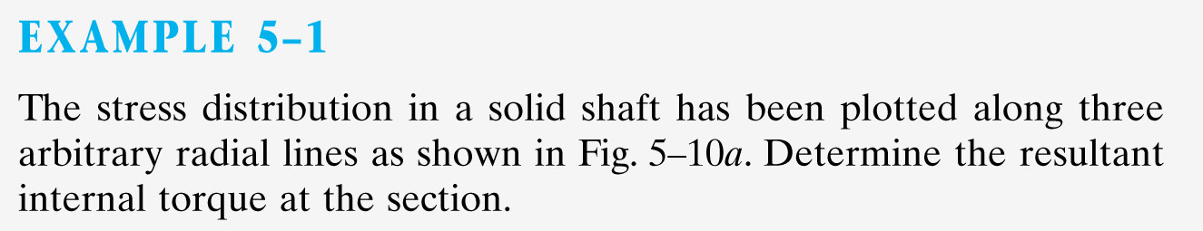
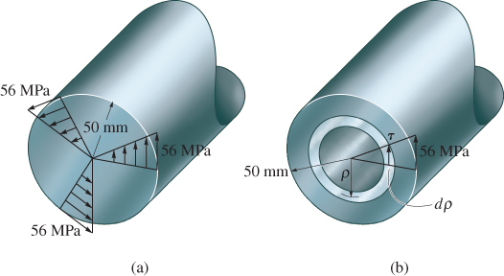

Slide 23
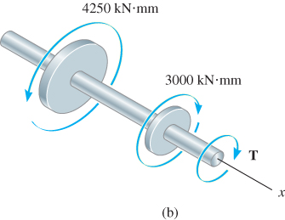
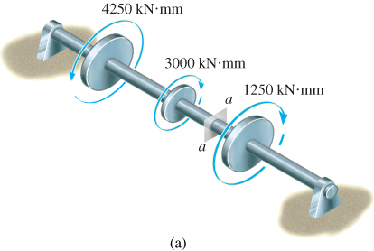
EXAMPLE 5.3
Shaft shown supported by two bearings and subjected to three torques.
Determine shear stress developed at points A (on the surface) and B (at ρ = 15 mm), located at section a-a of the shaft.

Slide 24
EXAMPLE 5.3 (SOLN)
Internal torque
Bearing reactions on shaft = 0, if shaft weight assumed to be negligible. Applied torques satisfy moment equilibrium about shaft’s axis.
Internal torque at section a-a determined from free-body diagram of left segment.

Slide 25
EXAMPLE 5.3 (SOLN)
Internal torque
Σ M_{x} = 0;
4250 kN·mm − 3000 kN·mm − T = 0
T = 1250 kN·mm
Section property
J = π/2(75 mm)⁴ = 4.97× 10⁷ mm⁴
Shear stress
Since point A is at ρ = c = 75 mm
τ_{B} = Tc/J = ... = 1.89 MPa

Slide 26
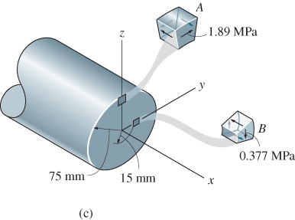
EXAMPLE 5.3 (SOLN)
Shear stress
Likewise for point B, at ρ = 15 mm
τ_{B} = Tρ /J = ... = 0.377 MPa
Directions of the stresses on elements A and B established from direction of resultant internal torque T.

Slide 27
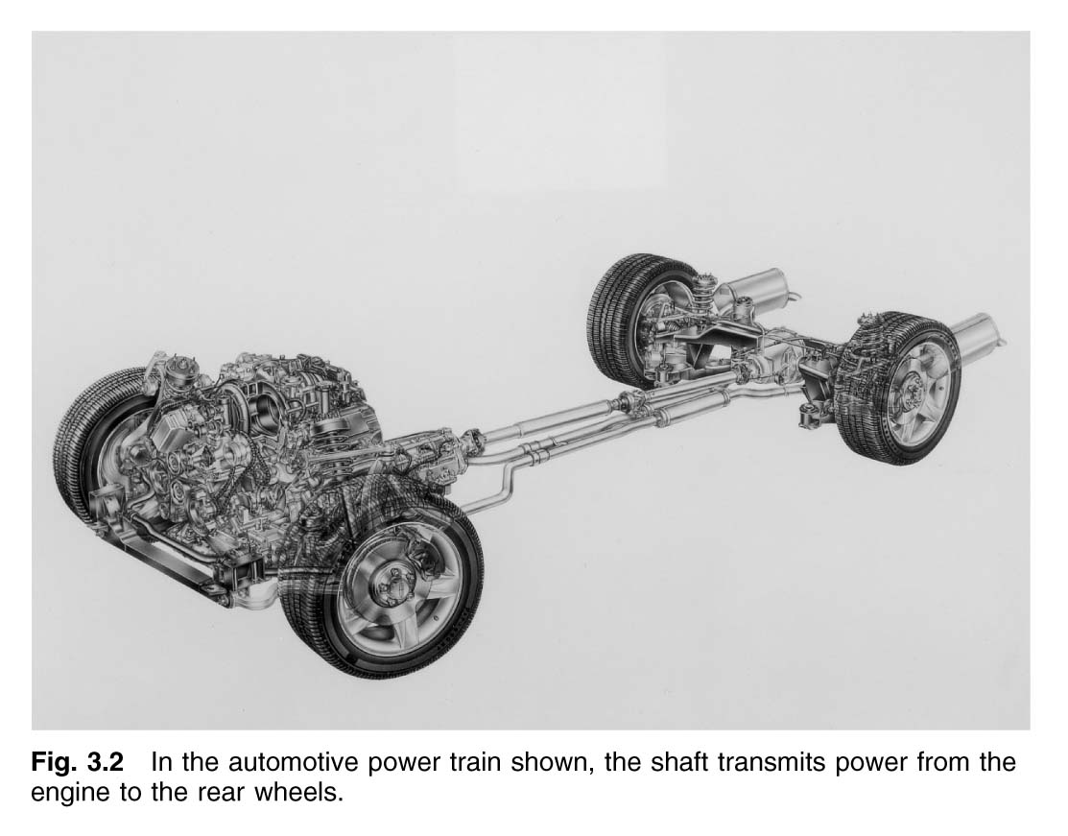
5.3 POWER TRANSMISSION
Shafts are used to transmit power are subjected to torques that depends on the power generated by the machine and the angular speed of the shaft.

Slide 28
5.3 POWER TRANSMISSION
Power is defined as work performed per unit of time
Instantaneous power is
Since shaft’s angular velocity ω = dθ/dt, we can also express power as
P = T (dθ/dt)
P = Tω
Frequency f of a shaft’s rotation is often reported. It measures the number of cycles per second and since 1 cycle = 2 π radians, and ω = 2πf, then power
Equation 5-11
P = 2πf T

Slide 29
5.3 POWER TRANSMISSION
Shaft Design
If power transmitted by shaft and its frequency of rotation is known, torque is determined from Eqn 5-11
Knowing T and allowable shear stress for material, τ_{allow} , we can find minimum design c by applying torsion formula,
J
c
T
τ_{allow}
=

Slide 30
5.3 POWER TRANSMISSION
Shaft Design
For solid shaft, substitute J = (π/2)c⁴ to determine c
For tubular shaft, substitute J = (π/2)(c_{o}² − c_{i}²) to determine c_{o} and c_{i}

Slide 31
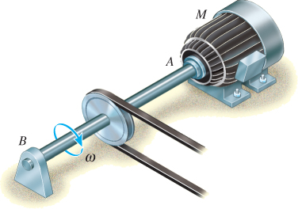
EXAMPLE 5.5
Solid steel shaft shown used to transmit 3750 W from attached motor M. Shaft rotates at ω = 175 rpm and the steel τ_{allow} = 100 MPa.
Determine required diameter of shaft to nearest mm.

Slide 32
EXAMPLE 5.5 (SOLN)
Torque on shaft determined from P = Tω,
Thus, P = 3750 N·m/s
175 rev
min
2π rad
1 rev
1 min
60 s
( )
( )
ω = = 18.33 rad/s
Thus, P = Tω, T = 204.6 N·m
J
c
π c⁴
2 c²
T
τ_{allow}
= =
. . .
c = 10.92 mm
Since 2c = 21.84 mm, select shaft with diameter of d = 22 mm

Slide 33
EXAMPLE 5.6 (SOLN)

Slide 34

ANGLE OF TWIST
For constant torque and cross-sectional area:

Slide 35
5.4 ANGLE OF TWIST
Angle of twist is important when analyzing reactions on statically indeterminate shafts
T(x) dx
J(x) G
L
φ =
∫₀
φ = angle of twist, in radians
T(x) = internal torque at arbitrary position x, found from method of sections and equation of moment equilibrium applied about shaft’s axis
J(x) = polar moment of inertia as a function of x
G = shear modulus of elasticity for material

Slide 36
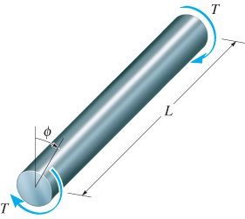
5.4 ANGLE OF TWIST
Constant torque and x-sectional area
TL
JG
φ =
If shaft is subjected to several different torques, or x-sectional area or shear modulus changes suddenly from one region of the shaft to the next, then apply Eqn 5-15 to each segment before vectorially adding each segment’s angle of twist:
TL
JG
φ =
Σ

Slide 37
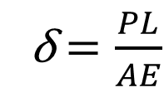

5.4 ANGLE OF TWIST
$$\text{}=\frac{TL}{JG}$$
φ = angle of twist, in radians
T = internal torque
J = polar moment of inertia
G = shear modulus of elasticity for material
Analogous to the load-displacement equation
δ $=\frac{PL}{AE}$

Slide 38
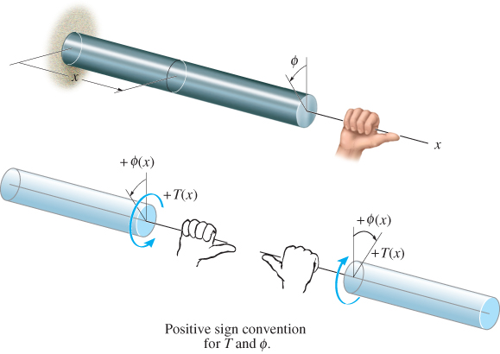
5.4 ANGLE OF TWIST
Sign convention
Use right-hand rule: torque and angle of twist are positive when thumb is directed outward from the shaft

Slide 39
5.4 ANGLE OF TWIST
Procedure for analysis
Internal torque
Use method of sections and equation of moment equilibrium applied along shaft’s axis
If torque varies along shaft’s length, section made at arbitrary position x along shaft is represented as T(x)
If several constant external torques act on shaft between its ends, internal torque in each segment must be determined and shown as a torque diagram

Slide 40
5.4 ANGLE OF TWIST
Procedure for analysis
Angle of twist
When circular x-sectional area varies along shaft’s axis, polar moment of inertia expressed as a function of its position x along its axis, J(x)
If J or internal torque suddenly changes between ends of shaft, φ = ∫ (T(x)/J(x)G) dx or φ = TL/JG must be applied to each segment for which J, T and G are continuous or constant
Use consistent sign convention for internal torque and also the set of units

Slide 41
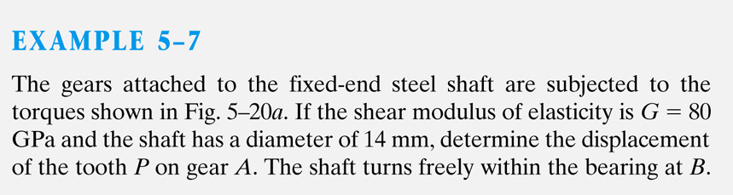
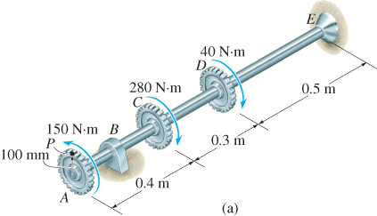
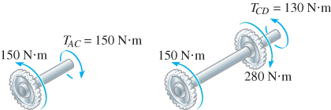

Slide 42
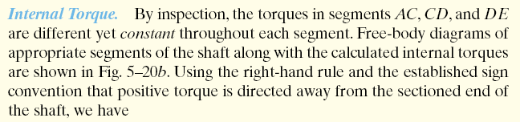
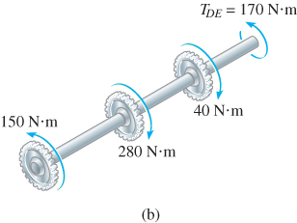

Slide 43

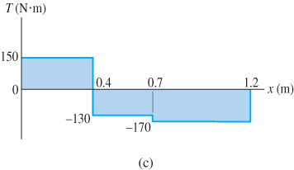

Slide 44
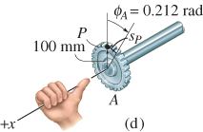

Slide 45
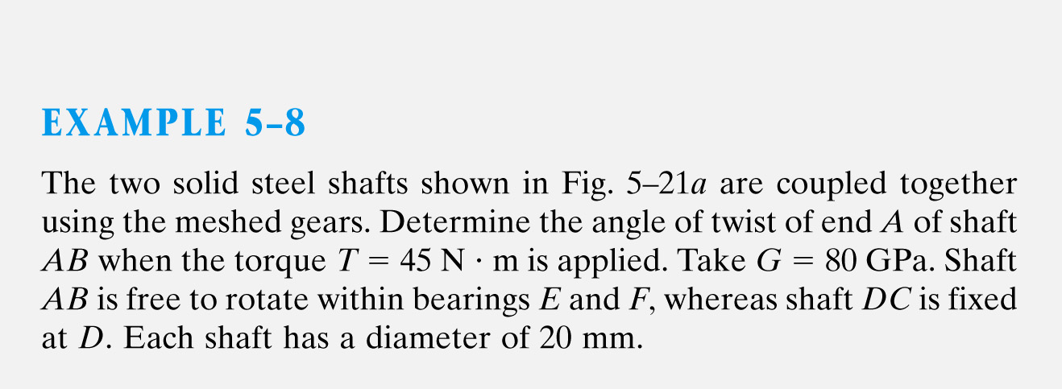
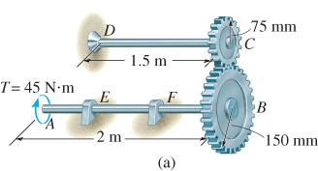

Slide 46
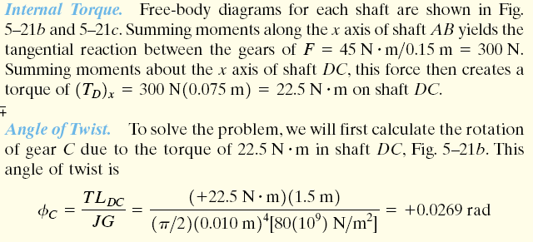
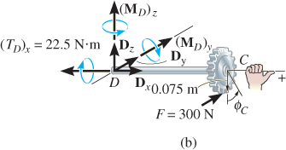

Slide 47

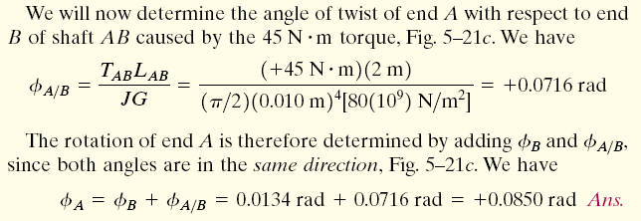
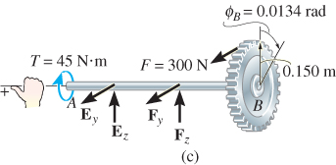

Slide 48
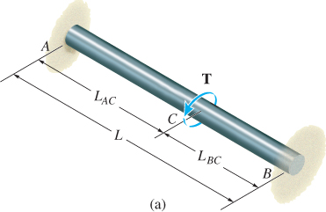
5.5 STATICALLY INDETERMINATE TORQUE-LOADED MEMBERS
A torsionally loaded shaft is statically indeterminate if moment equation of equilibrium, applied about axis of shaft, is not enough to determine unknown torques acting on the shaft

Slide 49
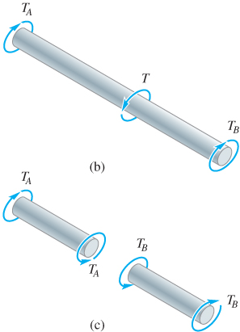
5.5 STATICALLY INDETERMINATE TORQUE-LOADED MEMBERS
From free-body diagram, reactive torques at supports A and B are unknown, Thus,
Σ M_{x} = 0; T − T_{A} − T_{B} = 0
Since problem is statically indeterminate, formulate the condition of compatibility; end supports are fixed, thus angle of twist of both ends should sum to zero
φ_{A/B} = 0

Slide 50
5.5 STATICALLY INDETERMINATE TORQUE-LOADED MEMBERS
Assume linear-elastic behavior, and using load-displacement relationship, φ = TL/JG, thus compatibility equation can be written as
T_{A} L_{AC}
JG
T_{B} L_{BC}
JG
− = 0
Solving the equations simultaneously, and realizing that
L = L_{AC} + L_{BC}, we get
L_{BC}
L
L_{AC}
L
T_{A} = T
( )
T_{B} = T
( )

Slide 51
5.5 STATICALLY INDETERMINATE TORQUE-LOADED MEMBERS
Procedure for analysis
Equilibrium
Draw a free-body diagram
Write equations of equilibrium about axis of shaft
Compatibility
Express compatibility conditions in terms of rotational displacement caused by reactive torques
Use torque-displacement relationship, such as
φ = TL/JG
Solve equilibrium and compatibility equations for unknown torques

Slide 52
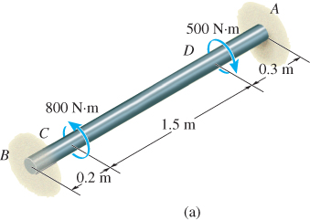
EXAMPLE 5.11
Solid steel shaft shown has a diameter of 20 mm. If it is subjected to two torques, determine reactions at fixed supports A and B.

Slide 53
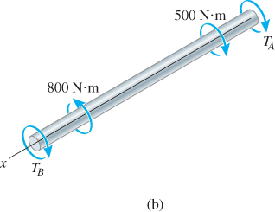
EXAMPLE 5.11 (SOLN)
Equilibrium
From free-body diagram, problem is statically indeterminate.
Σ M_{x} = 0;
− T_{B} + 800 N·m − 500 N·m − T_{A} = 0
Compatibility
Since ends of shaft are fixed, sum of angles of twist for both ends equal to zero. Hence,
φ_{A/B} = 0

Slide 54
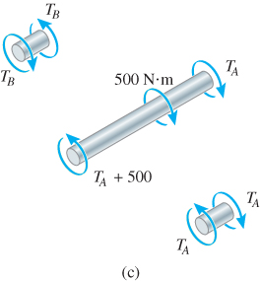
EXAMPLE 5.11 (SOLN)
Compatibility
The condition is expressed using the load-displacement relationship, φ = TL/JG.
. . .
1.8T_{A} − 0.2T_{B} = −750
Solving simultaneously, we get
T_{A} = −345 N·m T_{B} = 645 N·m

Slide 55
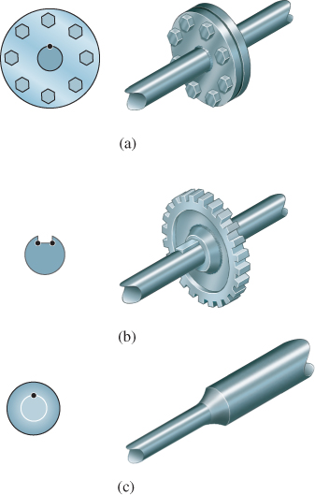
5.8 STRESS CONCENTRATION
Three common discontinuities of the x-section are:
  is a coupling, for connecting 2 collinear shafts together
  is a keyway used to connect gears or pulleys to a shaft
  is a shoulder fillet used to fabricate a single collinear shaft from 2 shafts with different diameters

Slide 56
5.8 STRESS CONCENTRATION
Dots on x-section indicate where maximum shear stress will occur
This maximum shear stress can be determined from torsional stress-concentration factor, K

Slide 57
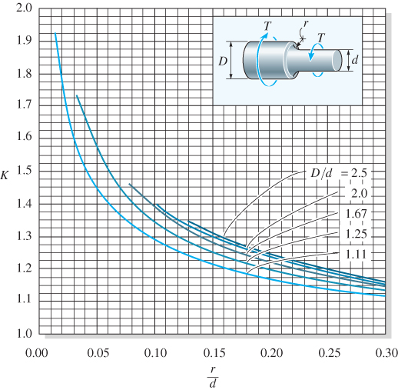
5.8 STRESS CONCENTRATION
K, can be obtained from a graph as shown
Find geometric ratio D/d for appropriate curve
Once r/d calculated, value of K found along ordinate
Maximum shear stress is then determined from
τ_{max} = K(Tc/J)

Slide 58
5.8 STRESS CONCENTRATION
IMPORTANT
Stress concentrations in shafts occur at points of sudden x-sectional change. The more severe the change, the larger the stress concentration
For design/analysis, not necessary to know exact shear-stress distribution on x-section. Instead, obtain maximum shear stress using stress concentration factor K
If material is brittle, or subjected to fatigue loadings, then stress concentrations need to be considered in design/analysis.

Slide 59
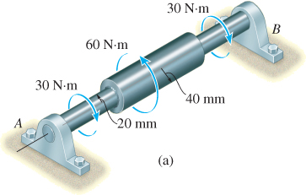
EXAMPLE 5.18
Stepped shaft shown is supported at bearings at A and B. Determine maximum stress in the shaft due to applied torques. Fillet at junction of each shaft has radius r = 6 mm.

Slide 60
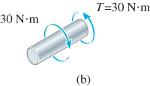
EXAMPLE 5.18 (SOLN)
Internal torque
By inspection, moment equilibrium about axis of shaft is satisfied. Since maximum shear stress occurs at rooted ends of smaller diameter shafts, internal torque (30 N·m) can be found by applying method of sections

Slide 61
EXAMPLE 5.18 (SOLN)
Maximum shear stress
From shaft geometry, we have
D
d
2(40 mm)
2(20 mm)
= = 2
r
d
6 mm)
2(20 mm)
= = 0.15
Thus, from the graph, K = 1.3
τ_{max} = K(Tc/J) = ... = 3.10 MPa

Slide 62
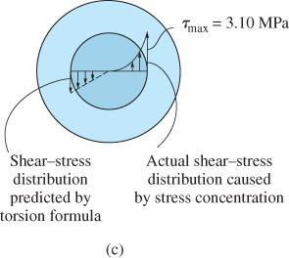
EXAMPLE 5.18 (SOLN)
Maximum shear stress
From experimental evidence, actual stress distribution along radial line of x-section at critical section looks similar to:

Slide 63
CHAPTER REVIEW
Torque causes a shaft with circular x-section to twist, such that shear strain in shaft is proportional to its radial distance from its centre
Provided that material is homogeneous and Hooke’s law applies, shear stress determined from torsion formula, τ = (Tc)/J
Design of shaft requires finding the geometric parameter, (J/C) = (T/τ_{allow})
Power generated by rotating shaft is reported, from which torque is derived; P = Tω

Slide 64
CHAPTER REVIEW
Angle of twist of circular shaft determined from
If torque and JG are constant, then
For application, use a sign convention for internal torque and be sure material does not yield, but remains linear elastic
L
T(x) dx
JG
φ =
∫₀
TL
JG
φ =
Σ

Slide 65
CHAPTER REVIEW
If shaft is statically indeterminate, reactive torques determined from equilibrium, compatibility of twist, and torque-twist relationships, such as φ = TL/JG
Solid noncircular shafts tend to warp out of plane when subjected to torque. Formulas are available to determine elastic shear stress and twist for these cases
Shear stress in tubes determined by considering shear flow. Assumes that shear stress across each thickness of tube is constant

Slide 66
CHAPTER REVIEW
Shear stress in tubes determined from
τ = T/2tA_{m}
Stress concentrations occur in shafts when x-section suddenly changes. Maximum shear stress determined using stress concentration factor, K (found by experiment and represented in graphical form). τ_{max} = K(Tc/J)
If applied torque causes material to exceed elastic limit, then stress distribution is not proportional to radial distance from centerline of shaft

Slide 67
CHAPTER REVIEW
Instead, such applied torque is related to stress distribution using the shear-stress-shear-strain diagram and equilibrium
If a shaft is subjected to plastic torque, and then released, it will cause material to respond elastically, causing residual shear stress to be developed in the shaft

Slide 68
Question 1
The shaft of the pulley assembly is to be redesigned. Knowing that the allowable shearing stress in each shaft is 60MPa, determine the smallest allowable diameter of a) Shaft AB, b) Shaft BC

Slide 69
Question 2
The two solid shafts and gears shown are used to transmit 12kW from the motor at A operating at a speed of 1260rpm, to machine tool at D. Knowing that each shaft has a diameter of 25mm, determine the maximum shearing stress a) in shaft AB, b) in shaft CD

