Slide 1
SETG 2363
Strength of Materials
Stress, Strain Under Axial Loading
Mohsin Mohd Sies
Nuclear Engineering,
Faculty of Chemical and Energy Engineering,
Universiti Teknologi Malaysia

Slide 2
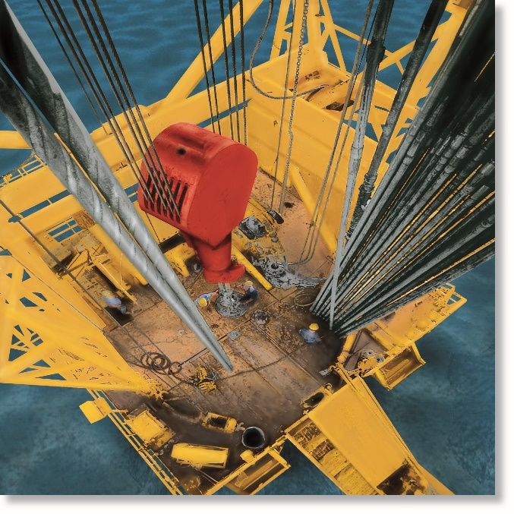
CHAPTER OBJECTIVES
Determine deformation of axially loaded members
Develop a method to find support reactions when it cannot be determined from equilibrium equations

Slide 3
CHAPTER OUTLINE
Elastic Deformation of an Axially Loaded Member
Principle of Superposition
Statically Indeterminate Axially Loaded Member
Force Method of Analysis for Axially Loaded Member

Slide 4
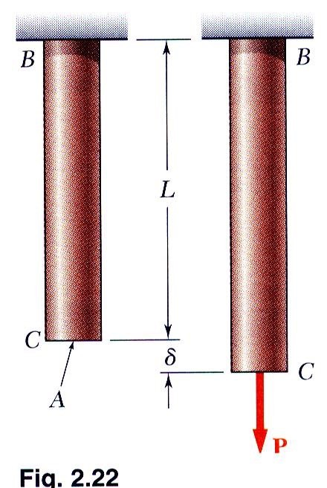
Deformations Under Axial Loading
From Hooke’s Law:
_{ε =} σ ₌ P
σ = Eε
E AE
From the definition of strain:
ε = ^{δ}
L
Equating and solving for the deformation,
_{δ =} PL
AE
With variations in loading, cross-section or material properties,
_{δ = ∑} P_{i} L_{i}
i ^{A}i ^{E}i

Slide 5
Load-Displacement Relationship
PL
AE
δ =

Slide 6

4.2 ELASTIC DEFORMATION OF AN AXIALLY LOADED MEMBER
Constant load and cross-sectional area
For constant cross-sectional area A, and homogenous material, E is constant
With constant external force P, applied at each end, then internal force P throughout length of bar is constant
PL
AE
Eqn. 4-2
δ =

Slide 7
4.2 ELASTIC DEFORMATION OF AN AXIALLY LOADED MEMBER
Constant load and cross-sectional area
If bar subjected to several different axial forces, or cross-sectional area or E is not constant, then the equation can be applied to each segment of the bar and added algebraically to get
∑
PL
AE
δ =

Slide 8
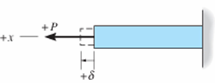
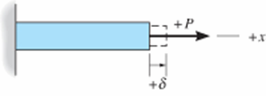
4.2 ELASTIC DEFORMATION OF AN AXIALLY LOADED MEMBER
Sign convention
Sign | Forces | Displacement
Positive (+) | Tension | Elongation
Negative (−) | Compression | Contraction

Slide 9
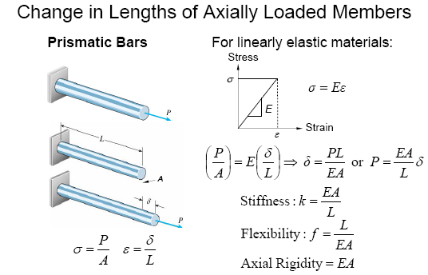
4.2 ELASTIC DEFORMATION OF AN AXIALLY LOADED MEMBER

Slide 10
4.2 ELASTIC DEFORMATION OF AN AXIALLY LOADED MEMBER
Procedure for analysis
Internal force
Use method of sections to determine internal axial force P in the member
If the force varies along member’s strength, section is made at the arbitrary location x from one end of member and force is represented as a function of x, i.e., P(x)
If several constant external forces act on member, internal force in each segment, between two external forces, must then be determined

Slide 11
4.2 ELASTIC DEFORMATION OF AN AXIALLY LOADED MEMBER
Procedure for analysis
Internal force
For any segment, internal tensile force is positive and internal compressive force is negative. Results of loading can be shown graphically by constructing the normal-force diagram
Displacement
When member’s cross-sectional area varies along its axis, the area should be expressed as a function of its position x, i.e., A(x)

Slide 12
4.2 ELASTIC DEFORMATION OF AN AXIALLY LOADED MEMBER
Procedure for analysis
Displacement
If cross-sectional area, modulus of elasticity, or internal loading suddenly changes, then Eqn 4-2 should be applied to each segment for which the quantity are constant
When substituting data into equations, account for proper sign for P, tensile loadings +ve, compressive −ve. Use consistent set of units. If result is +ve, elongation occurs, −ve means it’s a contraction

Slide 13
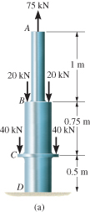
EXAMPLE 4.1
Composite A-36 steel bar shown made from two segments AB and BD. Area A_{AB} = 600 mm² and A_{BD} = 1200 mm².
Determine the vertical displacement of end A and displacement of B relative to C.

Slide 14
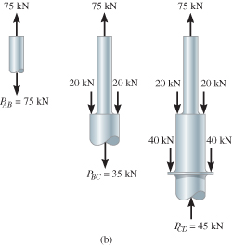
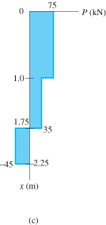
EXAMPLE 4.1 (SOLN)
Internal force
Due to external loadings, internal axial forces in regions AB, BC and CD are different.
Apply method of sections and equation of vertical force equilibrium as shown. Variation is also plotted.

Slide 15
EXAMPLE 4.1 (SOLN)
Displacement
From tables, E_{st} = 210(10³) MPa.
Use sign convention, vertical displacement of A relative to fixed support D is
∑
PL
AE
[+75 kN](1 m)(10⁶)
[600 mm² (210)(10³) kN/m²]
δ_{A} =
=
[+35 kN](0.75 m)(10⁶)
[1200 mm² (210)(10³) kN/m²]
+
[−45 kN](0.5 m)(10⁶)
[1200 mm² (210)(10³) kN/m²]
+
= +0.61 mm

Slide 16
EXAMPLE 4.1 (SOLN)
Displacement
Since result is positive, the bar elongates and so displacement at A is upward
Apply Equation 4-2 between B and C,
P_{BC} L_{BC}
A_{BC} E
[+35 kN](0.75 m)(10⁶)
[1200 mm² (210)(10³) kN/m²]
δ_{A} =
=
= +0.104 mm
Here, B moves away from C, since segment elongates

Slide 17
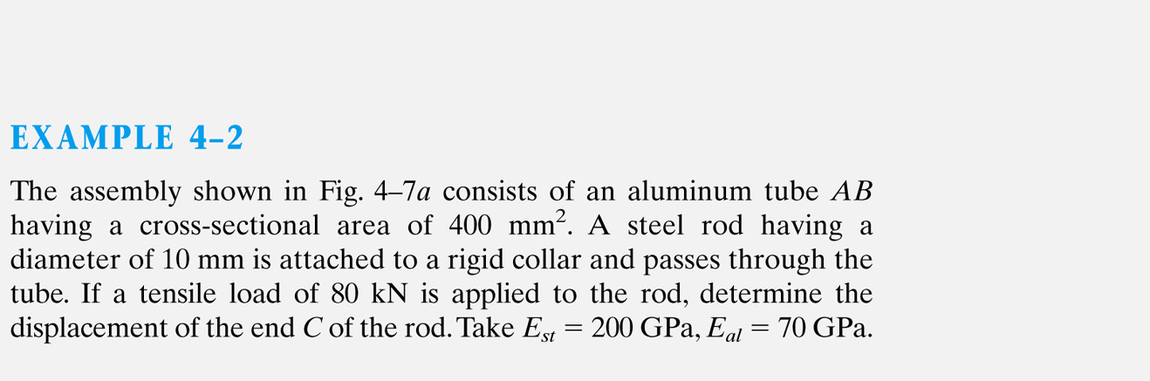
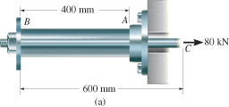


Slide 18
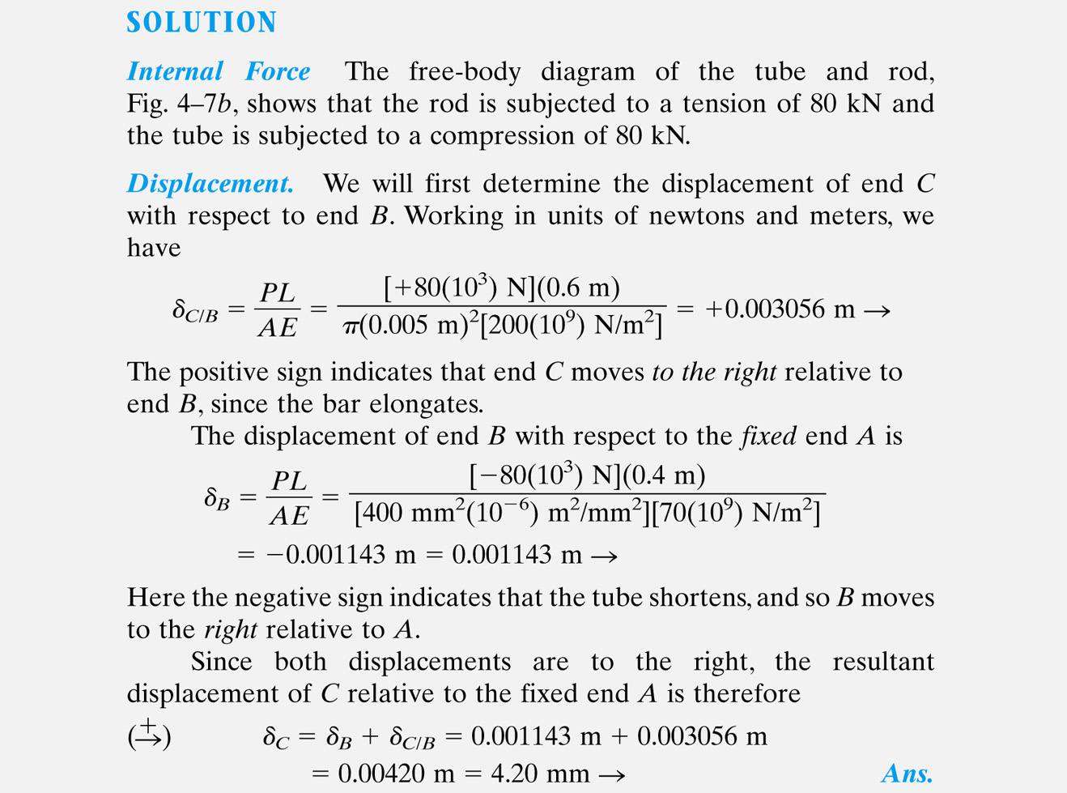

Slide 19
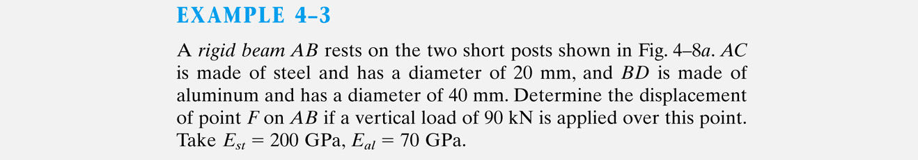

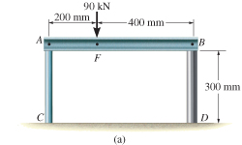
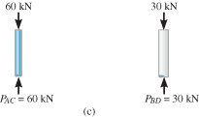

Slide 20
Support reaction at C and D were determined from equilibrium of AB
Displacement of the top of each post;
Post AC
Post BD

Slide 21

The displacement of point F is therefore;

Slide 22
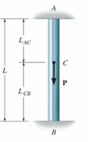
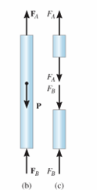
Statically Indeterminate Structure
For a bar fixed-supported at one end, equilibrium equations is sufficient to find the reaction at the support. Such a problem is statically determinate
If bar is fixed at both ends, then two unknown axial reactions occur, and the bar is statically indeterminate
+↑∑ F = 0;
F_{B} + F_{A} − P = 0

Slide 23
4.4 STATICALLY INDETERMINATE AXIALLY LOADED MEMBER

Slide 24
Compatibility Equation
To establish additional equation, consider geometry of deformation. Such an equation is referred to as a compatibility or kinematic condition
Since relative displacement of one end of bar to the other end is equal to zero, since end supports fixed,
δ_{A/B} = 0
This equation can be expressed in terms of applied loads using a load-displacement relationship, which depends on the material behavior

Slide 25
4.4 STATICALLY INDETERMINATE AXIALLY LOADED MEMBER
For linear elastic behavior, compatibility equation can be written as
F_{A} L_{AC}
AE
F_{B} L_{CB}
AE
−
= 0
Assume AE is constant, solve equations simultaneously,
L_{CB}
L
L_{AC}
L
( )
( )
F_{A} = P
F_{B} = P

Slide 26
4.4 STATICALLY INDETERMINATE AXIALLY LOADED MEMBER
Procedure for analysis
Equilibrium
Draw a free-body diagram of member to identify all forces acting on it
If unknown reactions on free-body diagram greater than no. of equations, then problem is statically indeterminate
Write the equations of equilibrium for the member

Slide 27
4.4 STATICALLY INDETERMINATE AXIALLY LOADED MEMBER
Procedure for analysis
Compatibility
Draw a diagram to investigate elongation or contraction of loaded member
Express compatibility conditions in terms of displacements caused by forces
Use load-displacement relations (δ=PL/AE) to relate unknown displacements to reactions
Solve the equations. If result is negative, this means the force acts in opposite direction of that indicated on free-body diagram

Slide 28
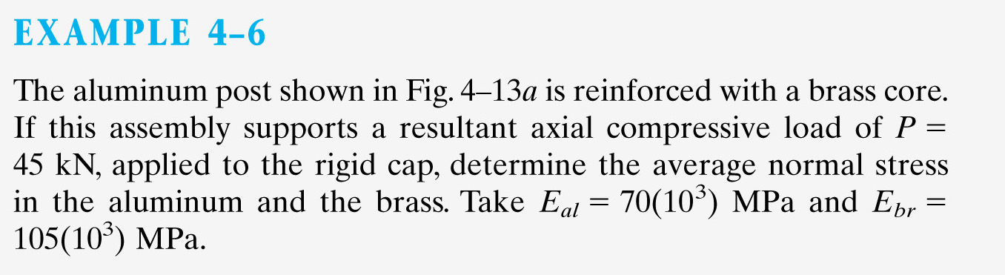
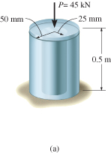
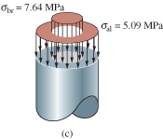

Slide 31
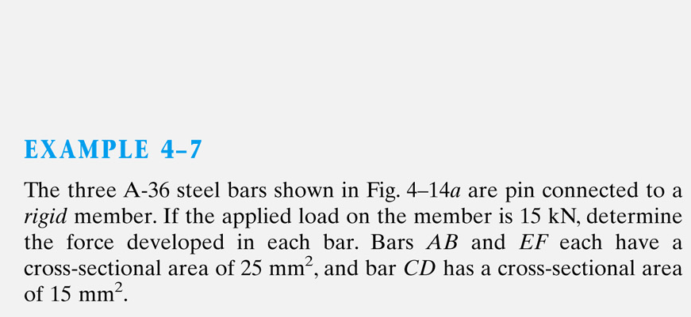
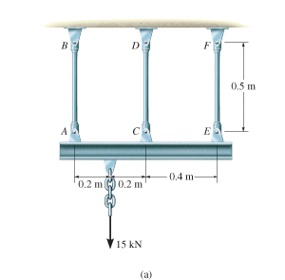

Slide 32
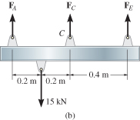

Slide 33
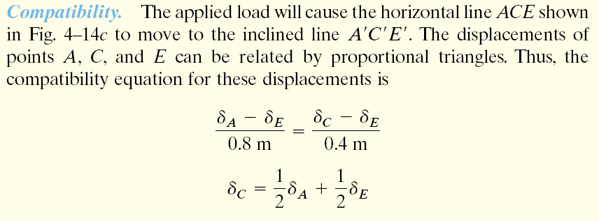

Slide 34
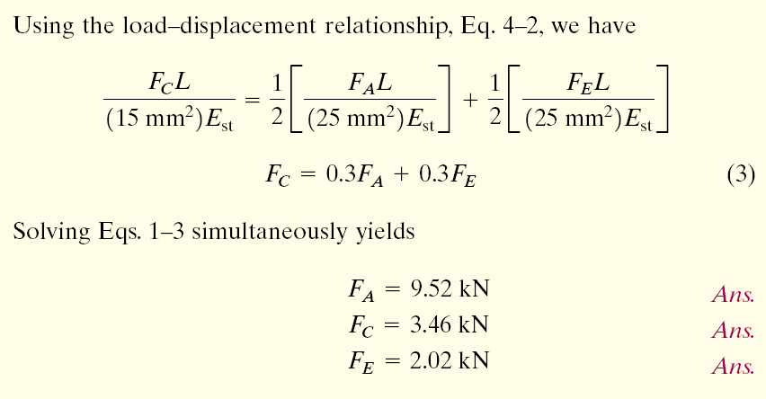

Slide 35
Principle of Superposition
After subdividing the load into components, the principle of superposition states that the resultant stress or displacement at the point can be determined by first finding the stress or displacement caused by each component load acting separately on the member.
Resultant stress/displacement determined algebraically by adding the contributions of each component

Slide 36
4.5 FORCE METHOD OF ANALYSIS FOR AXIALLY LOADED MEMBERS
Used to also solve statically indeterminate problems by using superposition of the forces acting on the free-body diagram
First, choose any one of the two supports as “redundant” and remove its effect on the bar
Thus, the bar becomes statically determinate
Apply principle of superposition and solve the equations simultaneously

Slide 37
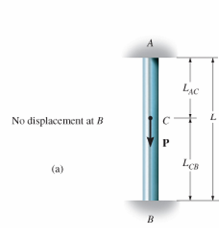
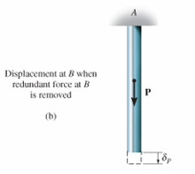
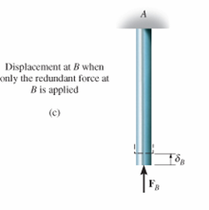
4.5 FORCE METHOD OF ANALYSIS FOR AXIALLY LOADED MEMBERS
From free-body diagram, we can determine the reaction at A
=
+

Slide 38
4.5 FORCE METHOD OF ANALYSIS FOR AXIALLY LOADED MEMBERS
Procedure for Analysis
Compatibility
Choose one of the supports as redundant and write the equation of compatibility.
Known displacement at redundant support (usually zero), equated to displacement at support caused only by external loads acting on the member plus the displacement at the support caused only by the redundant reaction acting on the member.

Slide 39
4.5 FORCE METHOD OF ANALYSIS FOR AXIALLY LOADED MEMBERS
Procedure for Analysis
Compatibility
Express external load and redundant displacements in terms of the loadings using load-displacement relationship
Use compatibility equation to solve for magnitude of redundant force

Slide 40
4.5 FORCE METHOD OF ANALYSIS FOR AXIALLY LOADED MEMBERS
Procedure for Analysis
Equilibrium
Draw a free-body diagram and write appropriate equations of equilibrium for member using calculated result for redundant force.
Solve the equations for other reactions

Slide 41
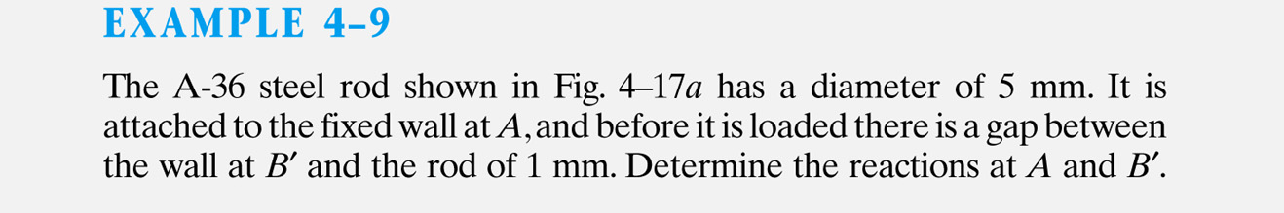
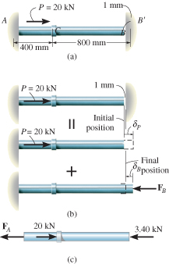


Slide 42
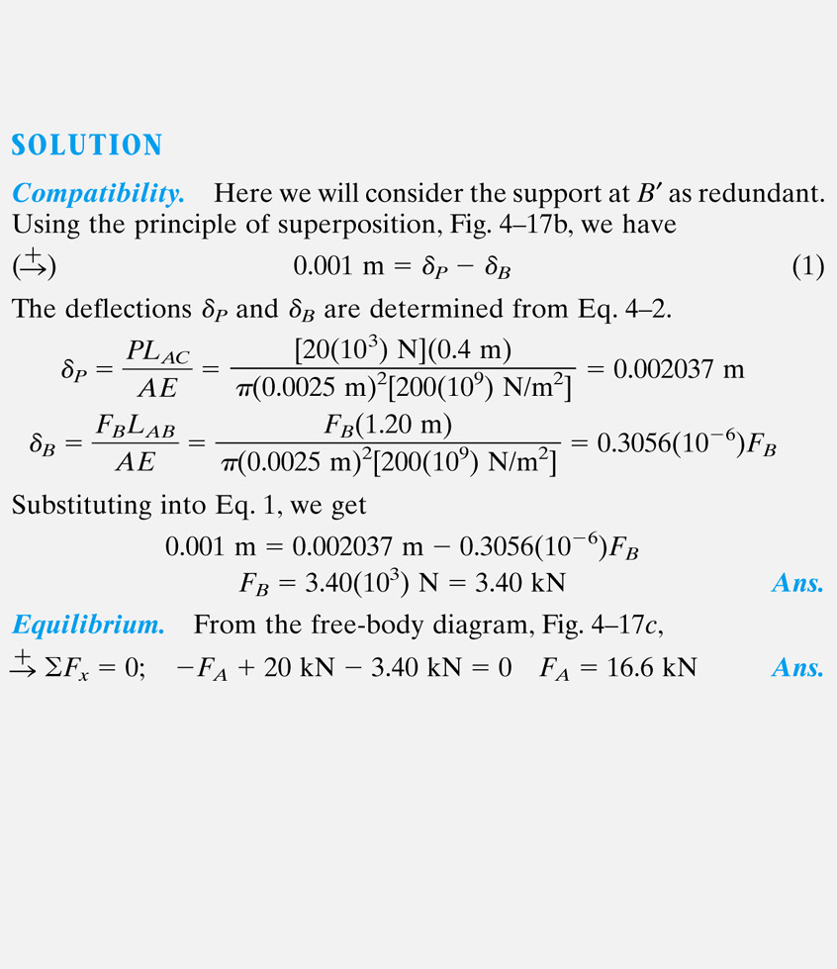

Slide 43

EXAMPLE 4.5
Steel rod shown has diameter of 5 mm. Attached to fixed wall at A, and before it is loaded, there is a gap between the wall at B’ and the rod of 1 mm.
Determine reactions at A and B’ if rod is subjected to axial force of P = 20 kN.
Neglect size of collar at C. Take E_{st} = 200 GPa

Slide 44

EXAMPLE 4.5 (SOLN)
Equilibrium
Assume force P large enough to cause rod’s end B to contact wall at B’. Equilibrium requires
+ F = 0;
− F_{A} − F_{B} + 20(10³) N = 0
Compatibility
Compatibility equation:
δ_{B/A} = 0.001 m

Slide 45

EXAMPLE 4.5 (SOLN)
Compatibility
Use load-displacement equations (Eqn 4-2), apply to AC and CB
F_{A} L_{AC}
AE
F_{B} L_{CB}
AE
δ_{B/A} = 0.001 m =
−
F_{A} (0.4 m) − F_{B} (0.8 m) = 3927.0 N·m
Solving simultaneously,
F_{A} = 16.6 kN F_{B} = 3.39 kN

