Slide 1
SETG 2363
Strength of Materials
Mechanical Properties of Materials
Mohsin Mohd Sies
Nuclear Engineering,
Faculty of Chemical and Energy Engineering,
Universiti Teknologi Malaysia

Slide 2
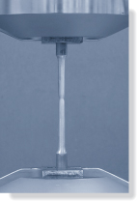
CHAPTER OBJECTIVES
Show relationship of stress and strain using experimental methods to determine stress-strain diagram of a specific material
Discuss the behavior described in the diagram for commonly used engineering materials
Discuss the mechanical properties and other test related to the development of mechanics of materials

Slide 3
CHAPTER OUTLINE
Tension and Compression Test
Stress-Strain Diagram
Stress-Strain Behavior of Ductile and Brittle Materials
Hooke’s Law
E, Modulus of Elasticity
Poisson’s Ratio
Shear Stress-Strain Diagram
G, Shear Modulus of Elasticity
Failure of Materials Due to Creep and Fatigue

Slide 4
3.1 TENSION & COMPRESSION TEST
Strength of a material can only be determined by experiment
One test used by engineers is the tension or compression test
This test is used primarily to determine the relationship between the average normal stress and average normal strain in common engineering materials, such as metals, ceramics, polymers and composites

Slide 5
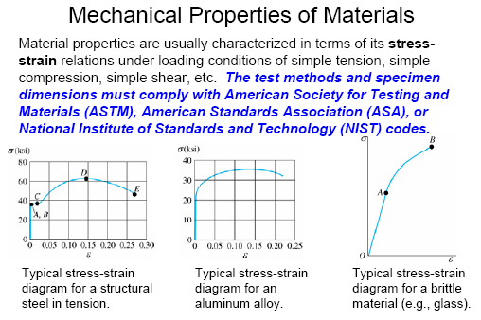

Slide 6

3.1 TENSION & COMPRESSION TEST
Performing the tension or compression test
Specimen of material is made into “standard” shape and size
Before testing, 2 small punch marks identified along specimen’s length
Measurements are taken of both specimen’s initial x-sectional area A₀ and gauge-length distance L₀; between the two marks
Seat the specimen into a testing machine shown below.

Slide 7
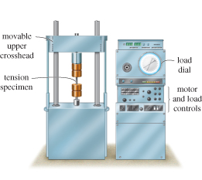
3.1 TENSION & COMPRESSION TEST
Performing the tension or compression test
Seat the specimen into a testing machine shown below
The machine will stretch specimen at slow constant rate until breaking point
At frequent intervals during test, data is recorded of the applied load P.

Slide 8
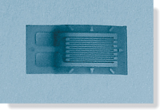
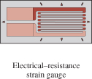
3.1 TENSION & COMPRESSION TEST
Performing the tension or compression test
Elongation δ = L − L₀ is measured using either a caliper or an extensometer
δ is used to calculate the normal strain in the specimen
Sometimes, strain can also be read directly using an electrical-resistance strain gauge (strain rosette)

Slide 9
3.2 STRESS-STRAIN DIAGRAM
A stress-strain diagram is obtained by plotting the various values of the stress and corresponding strain in the specimen
Conventional stress-strain diagram
Using recorded data, we can determine nominal or engineering stress by
P
A₀
σ =
Assumption: Stress is constant over the x-section and throughout region between gauge points

Slide 10
3.2 STRESS-STRAIN DIAGRAM
Conventional Stress-Strain Diagram
Likewise, nominal or engineering strain is found directly from strain gauge reading, or by
δ
L₀
ε =
Assumption: Strain is constant throughout region between gauge points
By plotting σ (ordinate) against ε (abscissa), we get a conventional stress-strain diagram

Slide 11
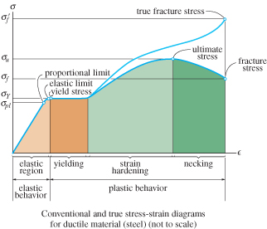
3.2 STRESS-STRAIN DIAGRAM
Conventional stress-strain diagram
Figure shows the characteristic stress-strain diagram for steel, a commonly used material for structural members and mechanical elements

Slide 12
3.2 STRESS-STRAIN DIAGRAM
Conventional stress-strain diagram
Elastic behavior.
A straight line
Stress is proportional to strain, i.e., linearly elastic
Upper stress limit, or proportional limit; σ_{pl}
If load is removed upon reaching elastic limit, specimen will return to its original shape

Slide 13
3.2 STRESS-STRAIN DIAGRAM
Conventional stress-strain diagram
Yielding.
Material deforms permanently; yielding; plastic deformation
Yield stress, σ_{Y}
Figure 3-4
Once yield point reached, specimen continues to elongate (strain) without any increase in load
Note figure not drawn to scale, otherwise induced strains is 10-40 times larger than in elastic limit
Material is referred to as being perfectly plastic

Slide 14
3.2 STRESS-STRAIN DIAGRAM
Conventional stress-strain diagram
Strain hardening.
Ultimate stress, σ_{u}
While specimen is elongating, its x-sectional area will decrease
Figure 3-4
Decrease in area is fairly uniform over entire gauge length

Slide 15
3.2 STRESS-STRAIN DIAGRAM
Conventional stress-strain diagram
Necking.
At ultimate stress, x-sectional area begins to decrease in a localized region
Figure 3-4
As a result, a constriction or “neck” tends to form in this region as specimen elongates further
Specimen finally breaks at fracture stress, σ_{f}

Slide 16
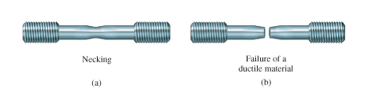
3.2 STRESS-STRAIN DIAGRAM
Conventional stress-strain diagram
Necking.
Specimen finally breaks at fracture stress, σ_{f}
Figure 3-4

Slide 17
3.3 STRESS-STRAIN BEHAVIOR OF DUCTILE & BRITTLE MATERIALS
Ductile materials
Defined as any material that can be subjected to large strains before it ruptures, e.g., mild steel
Such materials are used because it is capable of absorbing shock or energy, and if before becoming overloaded, will exhibit large deformation before failing
Ductility of material is to report its percent elongation or percent reduction in area at time of fracture

Slide 18
3.3 STRESS-STRAIN BEHAVIOR OF DUCTILE & BRITTLE MATERIALS
Ductile materials
Percent elongation is the specimen’s fracture strain expressed as a percent
Percent reduction in area is defined within necking region as
L_{f} − L₀
Percent elongation =
(100%)
L₀
A₀ − A_{f}
Percent reduction in area =
(100%)
A₀

Slide 19
3.3 STRESS-STRAIN BEHAVIOR OF DUCTILE & BRITTLE MATERIALS
Ductile materials
Most metals do not exhibit constant yielding behavior beyond the elastic range, e.g. aluminum
It does not have well-defined yield point, thus it is standard practice to define its yield strength using a graphical procedure called the offset method

Slide 20
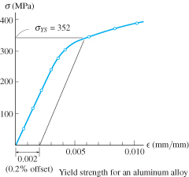
3.3 STRESS-STRAIN BEHAVIOR OF DUCTILE & BRITTLE MATERIALS
Ductile materials
Offset method to determine yield strength
Normally, a 0.2 % strain is chosen.
From this point on the ε axis, a line parallel to initial straight-line portion of stress-strain diagram is drawn.
The point where this line intersects the curve defines the yield strength.

Slide 21
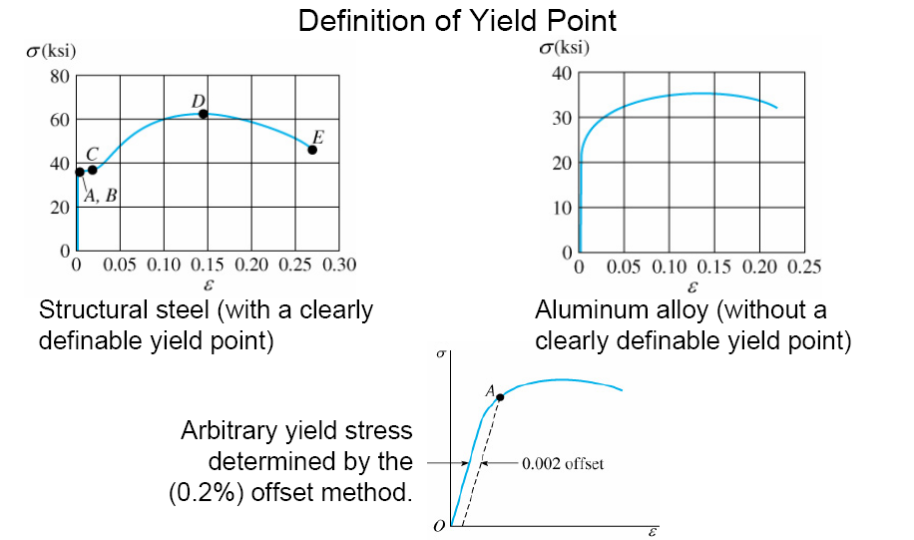
3.3 STRESS-STRAIN BEHAVIOR OF DUCTILE & BRITTLE MATERIALS

Slide 22
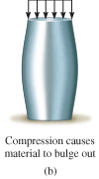
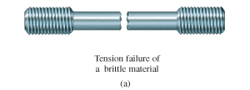
3.3 STRESS-STRAIN BEHAVIOR OF DUCTILE & BRITTLE MATERIALS
Brittle Materials
Material that exhibit little or no yielding before failure are referred to as brittle materials, e.g., gray cast iron
Brittle materials do not have a well-defined tensile fracture stress, since appearance of initial cracks in a specimen is quite random

Slide 23
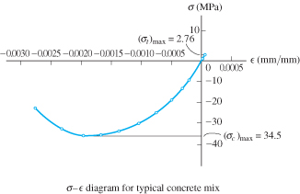
3.3 STRESS-STRAIN BEHAVIOR OF DUCTILE & BRITTLE MATERIALS
Brittle Materials
Instead, the average fracture stress from a set of observed tests is generally reported

Slide 24
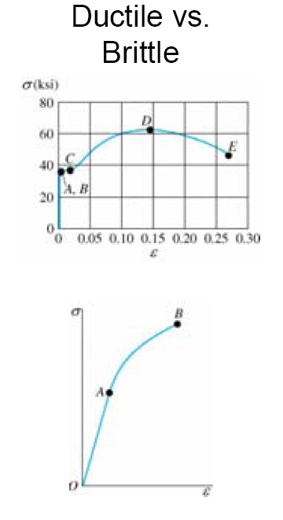

3.3 STRESS-STRAIN BEHAVIOR OF DUCTILE & BRITTLE MATERIALS

Slide 25
3.4 HOOKE’S LAW
Most engineering materials exhibit a linear relationship between stress and strain with the elastic region
Discovered by Robert Hooke in 1676 using springs, known as Hooke’s law
σ = Eε
E represents the constant of proportionality, also called the modulus of elasticity or Young’s modulus
E has units of stress, i.e., pascals, MPa or GPa.

Slide 26
3.4 HOOKE’S LAW
E is a mechanical property that indicates the stiffness of a material.
Materials that are very stiff exhibits large values of E (E_{steel} = 200GPa.
E only valid in linear elastic behavior and no longer valid once the σ–ε diagram ceases to be a straight line

Slide 27
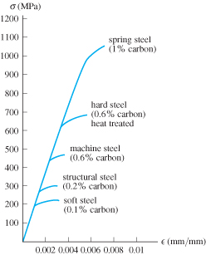
3.4 HOOKE’S LAW
As shown above, most grades of steel have same modulus of elasticity, E_{st} = 200 GPa
Modulus of elasticity is a mechanical property that indicates the stiffness of a material
Materials that are still have large E values, while spongy materials (vulcanized rubber) have low values

Slide 28
3.4 HOOKE’S LAW
IMPORTANT
Modulus of elasticity E, can be used only if a material has linear-elastic behavior.
Also, if stress in material is greater than the proportional limit, the stress-strain diagram ceases to be a straight line and the equation is not valid

Slide 29
3.4 HOOKE’S LAW
Strain hardening
If a specimen of ductile material (steel) is loaded into the plastic region and then unloaded, elastic strain is recovered as material returns to its equilibrium state
However, plastic strain remains, thus material is subjected to a permanent set

Slide 30
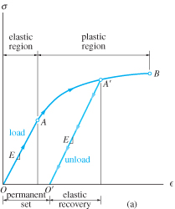
3.4 HOOKE’S LAW
Strain hardening
Specimen loaded beyond yield point A to A’
Inter-atomic forces have to be overcome to elongate specimen elastically, these same forces pull atoms back together when load is removed
Since E is the same, slope of line O’A’ is the same as line OA.
However, upon reloading, specimen will exhibit new and higher yield strength.

Slide 31
3.4 HOOKE’S LAW
Strain hardening
Load reapplied, atoms will be displaced until yielding occurs at or near A’, and stress-strain diagram continues along same path as before
New stress-strain diagram has higher yield point (A’), a result of strain-hardening
Specimen has a greater elastic region and less ductility

Slide 32
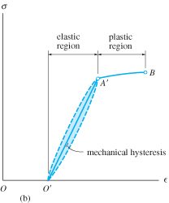
3.4 HOOKE’S LAW
Strain hardening
As specimen is unloaded and loaded, heat or energy may be lost
Colored area between the curves represents lost energy and is called mechanical hysteresis
It’s an important consideration when selecting materials to serve as dampers for vibrating structures and equipment

Slide 33
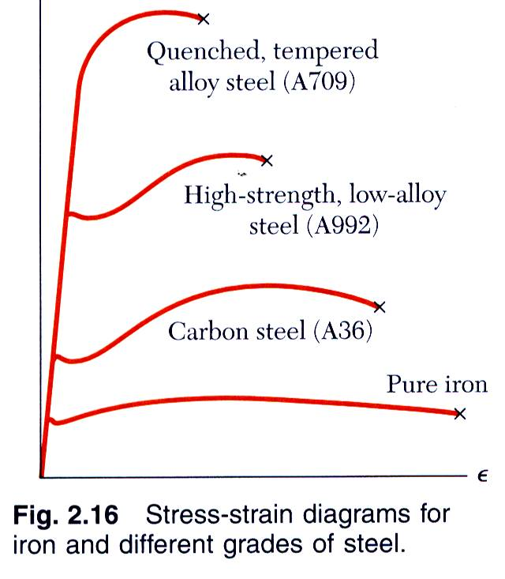
Hooke’s Law: Modulus of Elasticity
Below the yield stress
Strength is affected by alloying, heat treating, and manufacturing process but stiffness (Modulus of Elasticity) is not.

Slide 34
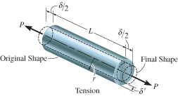
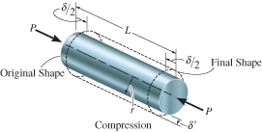
3.6 POISSON’S RATIO
When body subjected to axial tensile force, it elongates and contracts laterally
Similarly, it will contract and its sides expand laterally when subjected to an axial compressive force

Slide 35
3.6 POISSON’S RATIO
Strains of the bar are:
δ
L
δ’
r
ε_{long} =
ε_{lat} =
Early 1800s, S.D. Poisson realized that within elastic range, ratio of the two strains is a constant value, since both are proportional.
ε_{lat}
ε_{long}
Poisson’s ratio, ν = −

Slide 36
3.6 POISSON’S RATIO
ν is unique for homogenous and isotropic material
Why negative sign? Longitudinal elongation cause lateral contraction (-ve strain) and vice versa
Lateral strain is the same in all lateral (radial) directions
Note that, no force or stress acts in a lateral direction in order to strain the material; the strain is caused only by axial force.
Poisson’s ratio is dimensionless, 0 ≤ ν ≤ 0.5

Slide 37
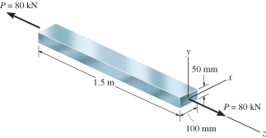
EXAMPLE 3.4
Bar is made of A-36 steel and behaves elastically.
Determine change in its length and change in dimensions of its cross section after load is applied.

Slide 38
EXAMPLE 3.4 (SOLN)
Normal stress in the bar is
P
A
σ_{z} =
= 16.0(10⁶) Pa
From tables, E_{st} = 200 GPa, strain in z-direction is
σ_{z}
E_{st}
ε_{z} =
= 80(10⁻⁶) mm/mm
Axial elongation of the bar is,
δ_{z} = ε_{z}L_{z} = [80(10⁻⁶)](1.5 m) = 0.12 mm

Slide 39
EXAMPLE 3.4 (SOLN)
Using ν_{st} = 0.32, contraction strains in both x and y directions are
ε_{x} = ε_{y} = −ν_{st}ε_{z} = −0.32[80(10⁻⁶)] = −25.6 μm/m
Thus changes in dimensions of cross-section are
δ_{x} = ε_{x}L_{x} = −[25.6(10⁻⁶)](0.1 m) = −2.56 μm
δ_{y} = ε_{y}L_{y} = −[25.6(10⁻⁶)](0.05 m) = −1.28 μm

Slide 40
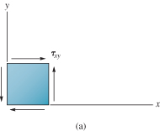
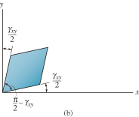
3.6 SHEAR STRESS-STRAIN DIAGRAM
Use thin-tube specimens and subject it to torsional loading
If the material is homogeneous and isotropic, then the shear stress as a result of torsional loading will caused uniform distortion.
Record measurements of applied torque and resulting angle of twist to construct shear stress and shear strain diagram.

Slide 41
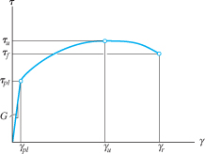
3.6 SHEAR STRESS-STRAIN DIAGRAM
Material will exhibit linear-elastic behavior till its proportional limit, τ_{pl}
Strain-hardening continues till it reaches ultimate shear stress, τ_{u}
Material loses shear strength till it fractures, at stress of τ_{f}

Slide 42
3.6 SHEAR STRESS-STRAIN DIAGRAM
Hooke’s law for shear
τ = Gγ
G is shear modulus of elasticity or modulus of rigidity
G can be measured as slope of line on τ-γ diagram, G = τ_{pl}/ γ_{pl}
The three material constants E, ν, and G is related by
E
2(1 + ν)
G =

Slide 43
EXAMPLE 3.6 (SOLN)

Slide 44
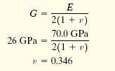
EXAMPLE 3.6 (SOLN)

Slide 45
3.7 FAILURE OF MATERIALS DUE TO CREEP & FATIGUE
Creep
Occurs when material supports a load for very long period of time, and continues to deform until a sudden fracture or usefulness is impaired
Is only considered when metals and ceramics are used for structural members or mechanical parts subjected to high temperatures
Other materials (such as polymers & composites) are also affected by creep without influence of temperature

Slide 46
*3.7 FAILURE OF MATERIALS DUE TO CREEP & FATIGUE
Fatigue
Defined as gradual deterioration of a material that is subjected to time varying loads.
Needs to be accounted for in design of connecting rods (e.g. steam/gas turbine blades, connections/supports for bridges, railroad wheels/axles and parts subjected to cyclic loading)
Fatigue occurs at a stress lesser than the material’s yield stress

Slide 47
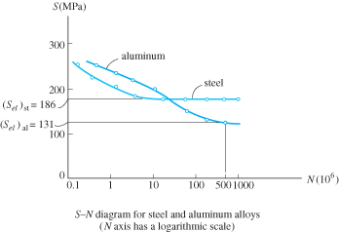
*3.7 FAILURE OF MATERIALS DUE TO CREEP & FATIGUE
Fatigue
Also referred to as the endurance or fatigue limit
Method to get value of fatigue
Series of specimens are subjected to a specified stress and cycled to failure.
Plot stress (S) against number of cycles-to-failure N
(S-N diagram) on logarithmic scale – also known as stress-cycled diagram.

Slide 48
Summary
σ = Eε
E is the modulus of elasticity or Young’s modulus
G is the shear modulus of elasticity or modulus of rigidity
τ = Gγ
ε_{lat}
ε_{long}
Poisson’s ratio, ν = −
The three material constants E, ν, and G is related by
E
2(1 + ν)
G =

