Slide 1
SETG 2363
Strength of Materials
Strain
Mohsin Mohd Sies
Nuclear Engineering,
Faculty of Chemical and Energy Engineering,
Universiti Teknologi Malaysia

Slide 2
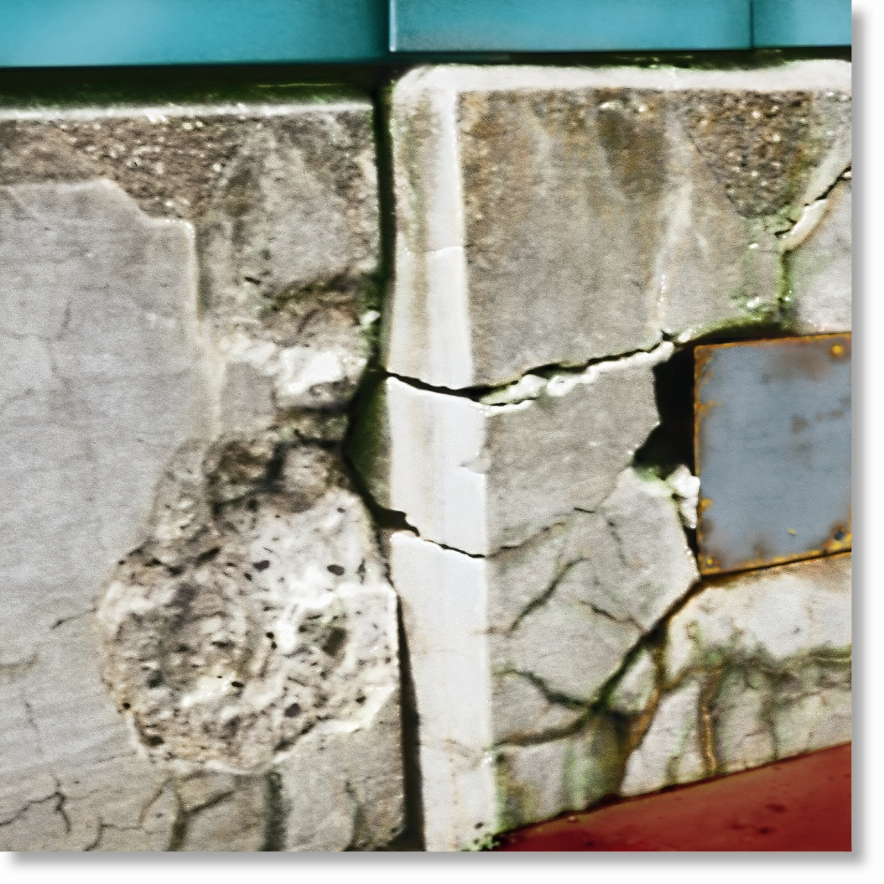
CHAPTER OBJECTIVES
Define concept of normal strain
Define concept of shear strain
Determine normal and shear strain in engineering applications

Slide 3
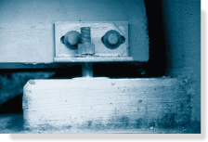
CHAPTER OUTLINE
Deformation
Strain

Slide 4
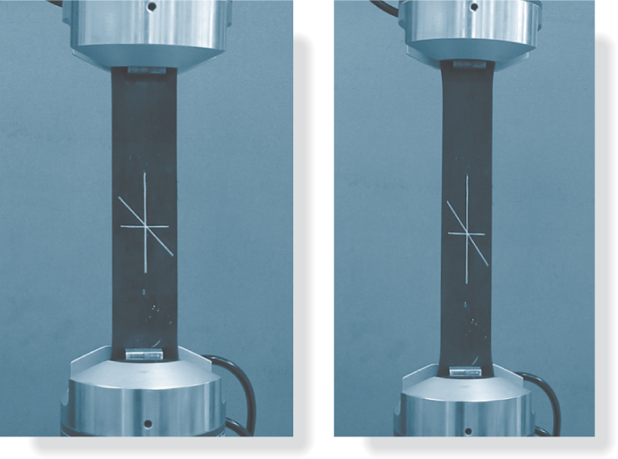
STRAIN

Slide 5
2.1 DEFORMATION
Deformation
Occurs when a force is applied to a body
Can be highly visible or practically unnoticeable
Can also occur when temperature of a body is changed
Is not uniform throughout a body’s volume, thus change in geometry of any line segment within body may vary along its length

Slide 6
2.1 DEFORMATION
To simplify study of deformation
Assume lines to be very short and located in neighborhood of a point, and
Take into account the orientation of the line segment at the point

Slide 7
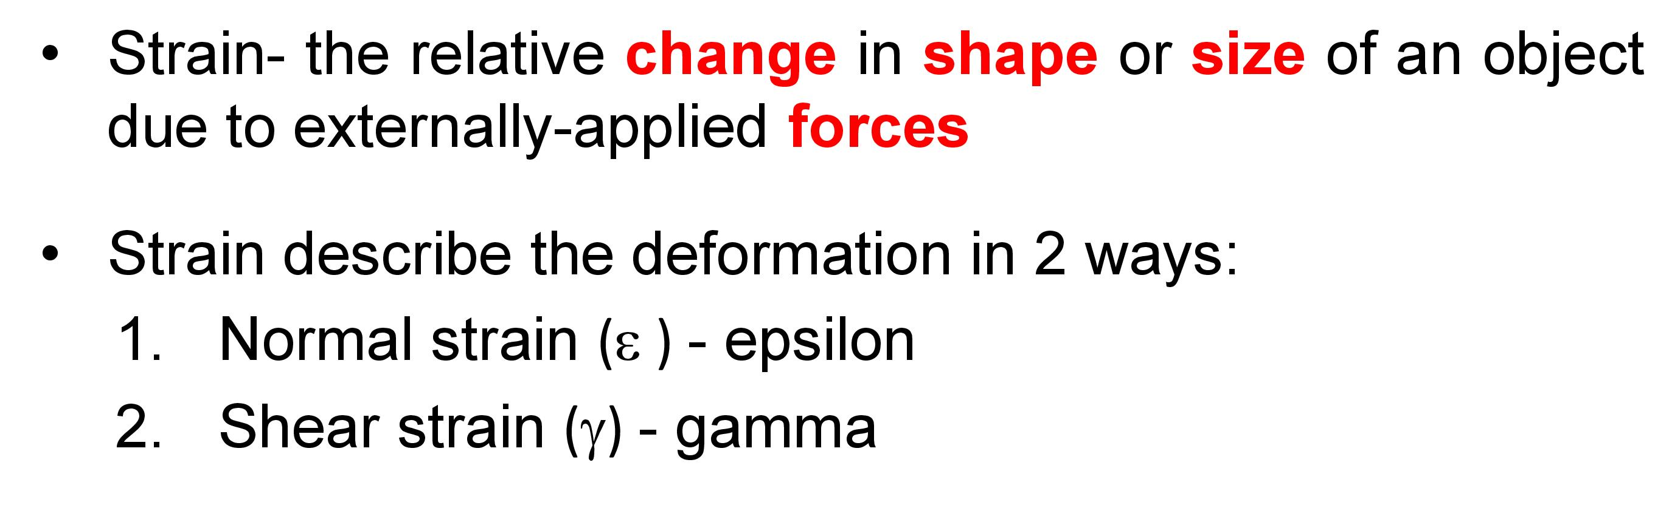
2.2 STRAIN

Slide 8
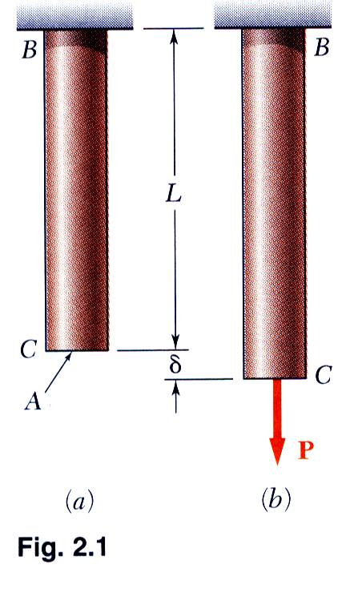
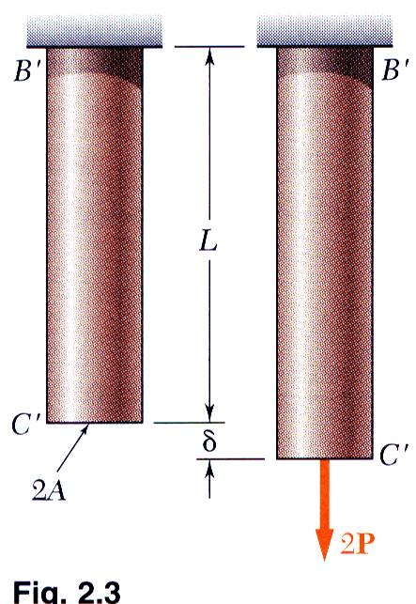
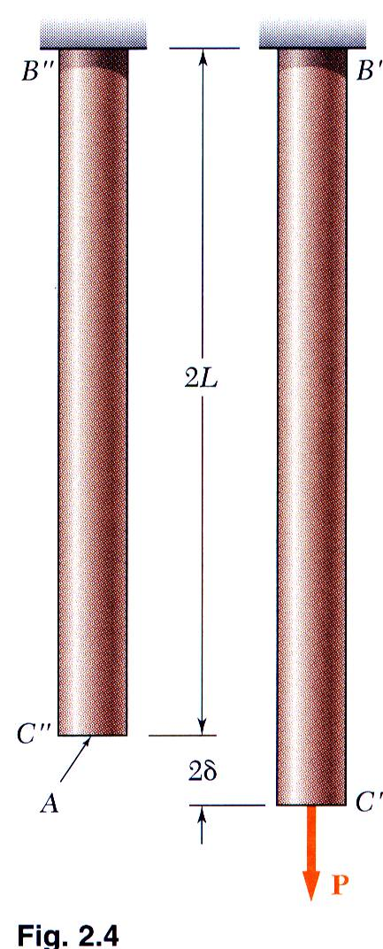
Normal Strain
2 - 8

Slide 9
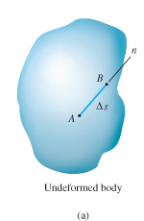
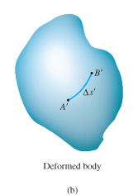
2.2 STRAIN
Normal strain
Defined as the elongation or contraction of a line segment per unit of length
Consider line AB in figure below
After deformation, Δs changes to Δs’

Slide 10
2.2 STRAIN
Normal strain
Defining average normal strain using ε_{avg} (epsilon)
As Δs → 0, Δs’ → 0
Δs’ − Δs
ε_{avg} =
Δs
lim
B→A along n
Δs’ − Δs
ε =
Δs

Slide 11
2.2 STRAIN
Normal strain
If normal strain ε is known, use the equation to obtain approx. final length of a short line segment in direction of n after deformation.
Hence, when ε is positive, initial line will elongate, if ε is negative, the line contracts
Δs’ ≈ (1 + ε) Δs

Slide 12
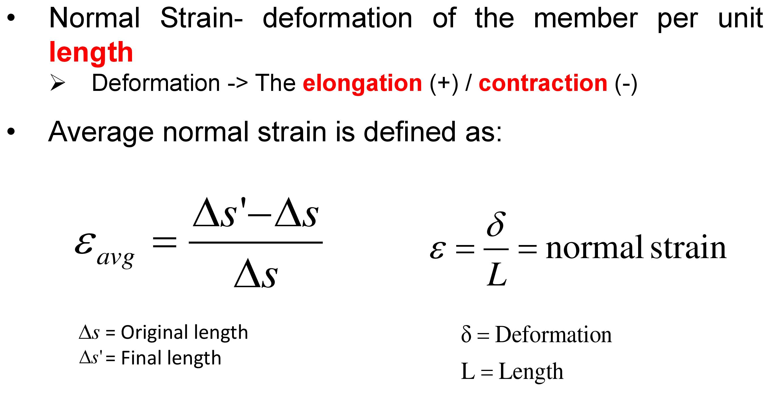
2.2 STRAIN

Slide 13
2.2 STRAIN

Slide 14
Normal Strain
2 - 14

Slide 15
2.2 STRAIN
Units
Normal strain is a dimensionless quantity, as it’s a ratio of two lengths
But common practice to state it in terms of meters/meter (m/m)
ε is small for most engineering applications, so is normally expressed as micrometers per meter (μm/m) where 1 μm = 10⁻⁶
Also expressed as a percentage,
e.g., 0.001 m/m = 0.1 %

Slide 16
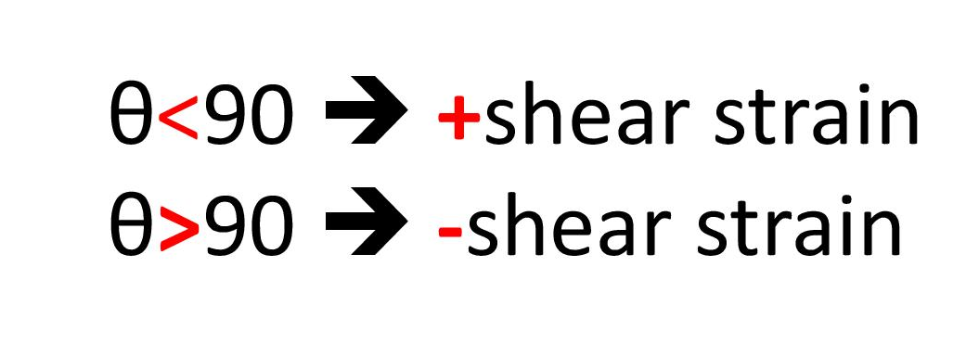
2.2 STRAIN
Shear strain
Defined as the change in angle that occurs between two line segments that were originally perpendicular to one another
This angle is denoted by γ (gamma) and measured in radians (rad).
π
2
lim
B→A along n
C →A along t
γ_{nt} =
−
θ’

Slide 17
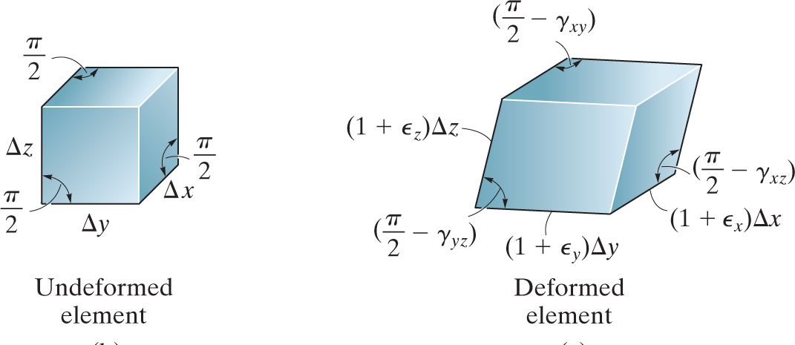
Shear Strain

Slide 18
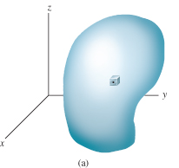
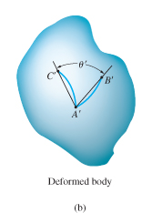
2.2 STRAIN
Shear strain
Consider line segments AB and AC originating from same point A in a body, and directed along the perpendicular n and t axes
After deformation, lines become curves, such that angle between them at A is θ’

Slide 19
2.2 STRAIN

Slide 20
2.2 STRAIN
Normal strains cause a change in its volume
Shear strains cause a change in its shape.
Small strain analysis
Most engineering design involves applications for which only small deformations are allowed
We’ll assume that deformations that take place within a body are almost infinitesimal, so normal strains occurring within material are very small compared to 1, i.e., ε << 1.

Slide 21
2.2 STRAIN
Small strain analysis
This assumption is widely applied in practical engineering problems, and is referred to as small strain analysis

Slide 22

EXAMPLE 2.1
Rod below is subjected to temperature increase along its axis, creating a normal strain of
ε_{z} = 40(10⁻³)z^{1/2,} where z is given in meters.
Determine
(a) displacement of end B of rod due to temperature increase,
(b) average normal strain in the rod.

Slide 23
EXAMPLE 2.1 (SOLN)
Since normal strain reported at each point along the rod, a differential segment dz, located at position z has a deformed length:
dz’ = [1 + 40(10⁻³)z^{1/2}] dz

Slide 24
EXAMPLE 2.1 (SOLN)
Sum total of these segments along axis yields deformed length of the rod, i.e.,
0.2 m
z’ = ∫₀ [1 + 40(10⁻³)z^{1/2}] dz
= z + 40(10⁻³)(⅔ z^{3/2})|₀
= 0.20239 m
0.2 m
Displacement of end of rod is
Δ_{B} = 0.20239 m − 0.2 m = 2.39 mm ↓

Slide 25
EXAMPLE 2.1 (SOLN)
Assume rod or “line segment” has original length of 200 mm and a change in length of 2.39 mm. Hence,
Δs’ − Δs
2.39 mm
ε_{avg} =
=
= 0.0119 mm/mm
Δs
200 mm

Slide 26
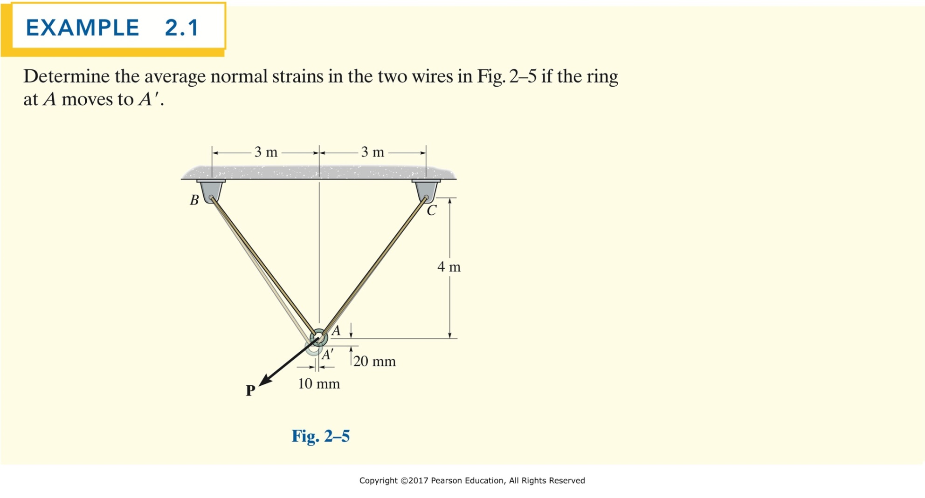
continued on next slide
Copyright ©2018 Pearson Education Ltd. All Rights Reserved.

Slide 27
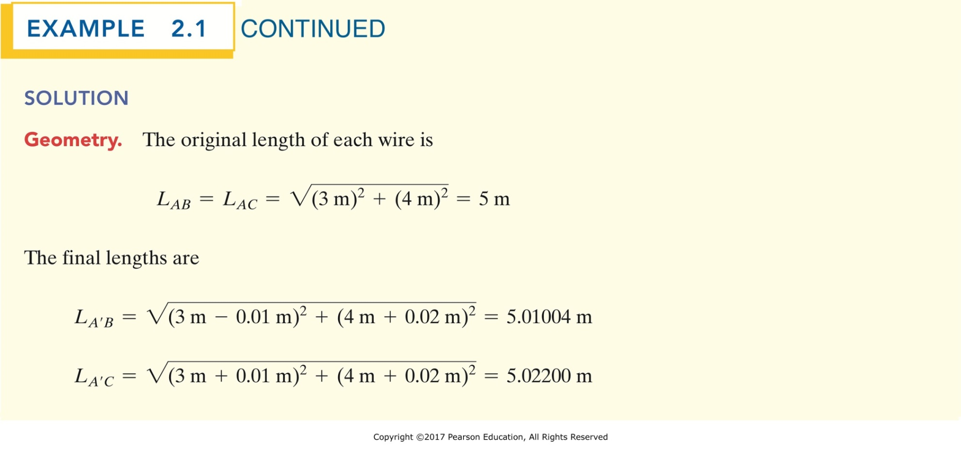
continued on next slide
Copyright ©2018 Pearson Education Ltd. All Rights Reserved.

Slide 28
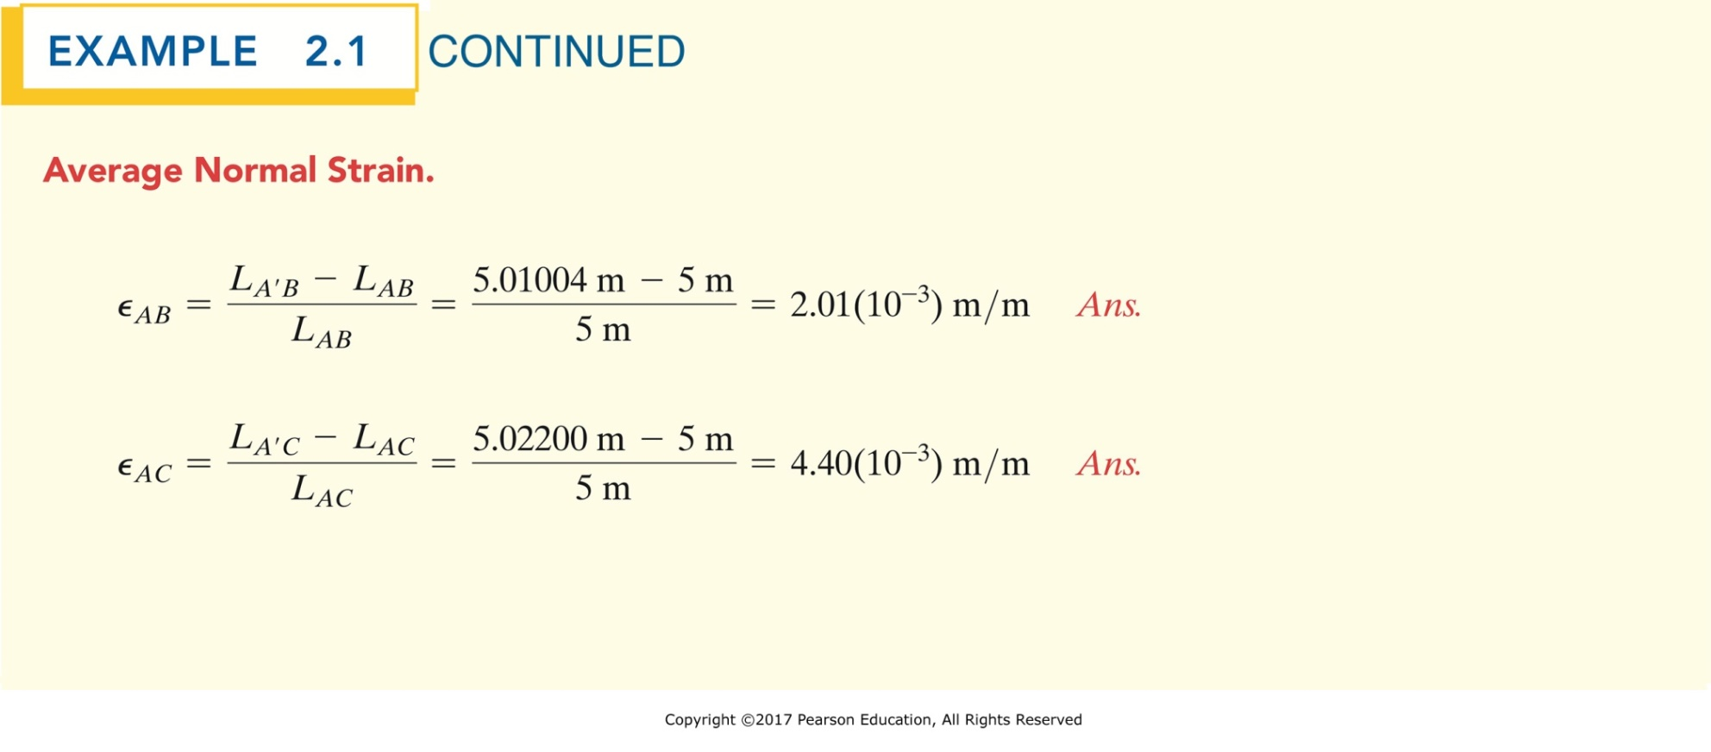
Copyright ©2018 Pearson Education Ltd. All Rights Reserved.

Slide 29

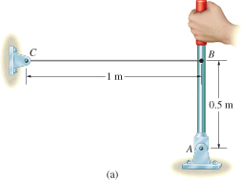
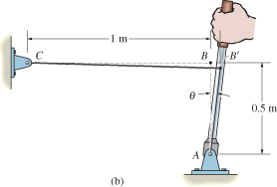
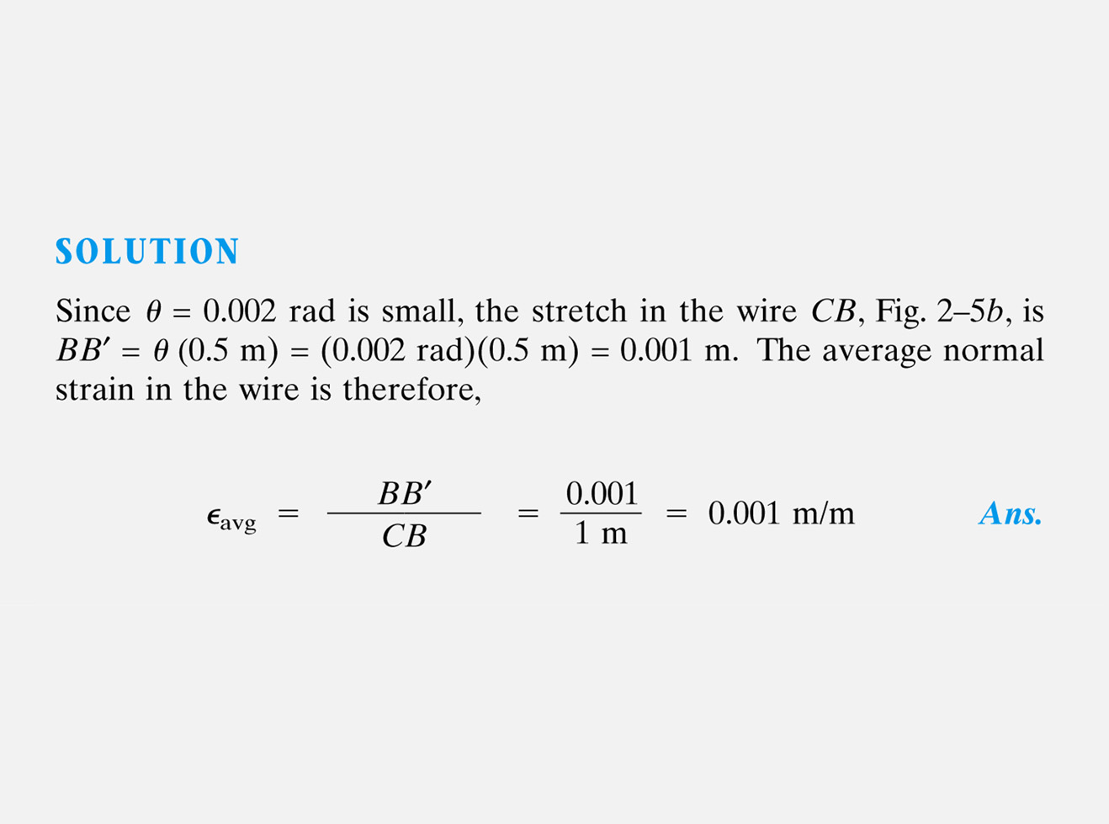

Slide 30
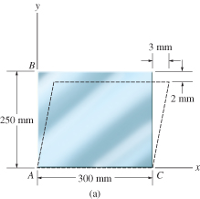
EXAMPLE 2.3
Plate is deformed as shown in figure. In this deformed shape, horizontal lines on the on plate remain horizontal and do not change their length.
Determine
average normal strain along side AB,
average shear strain in the plate relative to x and y axes

Slide 31
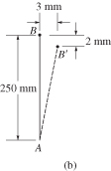
EXAMPLE 2.3 (SOLN)
(a) Line AB, coincident with y axis, becomes line AB’ after deformation. Length of line AB’ is
AB’ = √ (250 − 2)² + (3)² = 248.018 mm

Slide 32
EXAMPLE 2.3 (SOLN)
Therefore, average normal strain for AB is,
AB’ − AB
248.018 mm − 250 mm
(ε_{AB})_{avg} =
=
AB
250 mm
= −7.93(10⁻³) mm/mm
Negative sign means strain causes a contraction of AB.

Slide 33
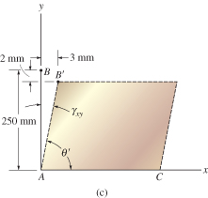
EXAMPLE 2.3 (SOLN)
Due to displacement of B to B’, angle BAC referenced from x, y axes changes to θ’.
Since γ_{xy} = π/2 − θ’, thus
(
3 mm
)
γ_{xy} = tan⁻¹
= 0.0121 rad
250 mm − 2 mm

Slide 34
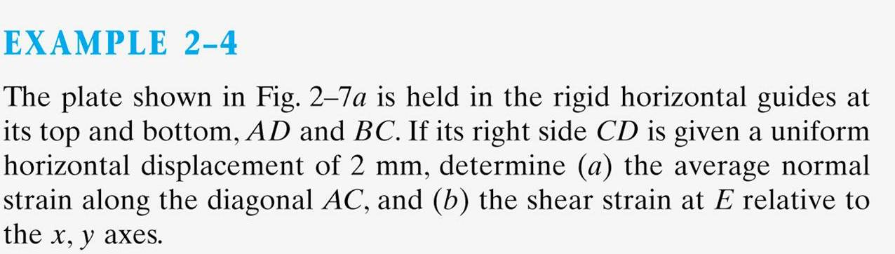
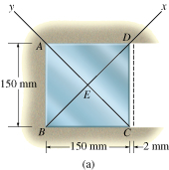


Slide 35
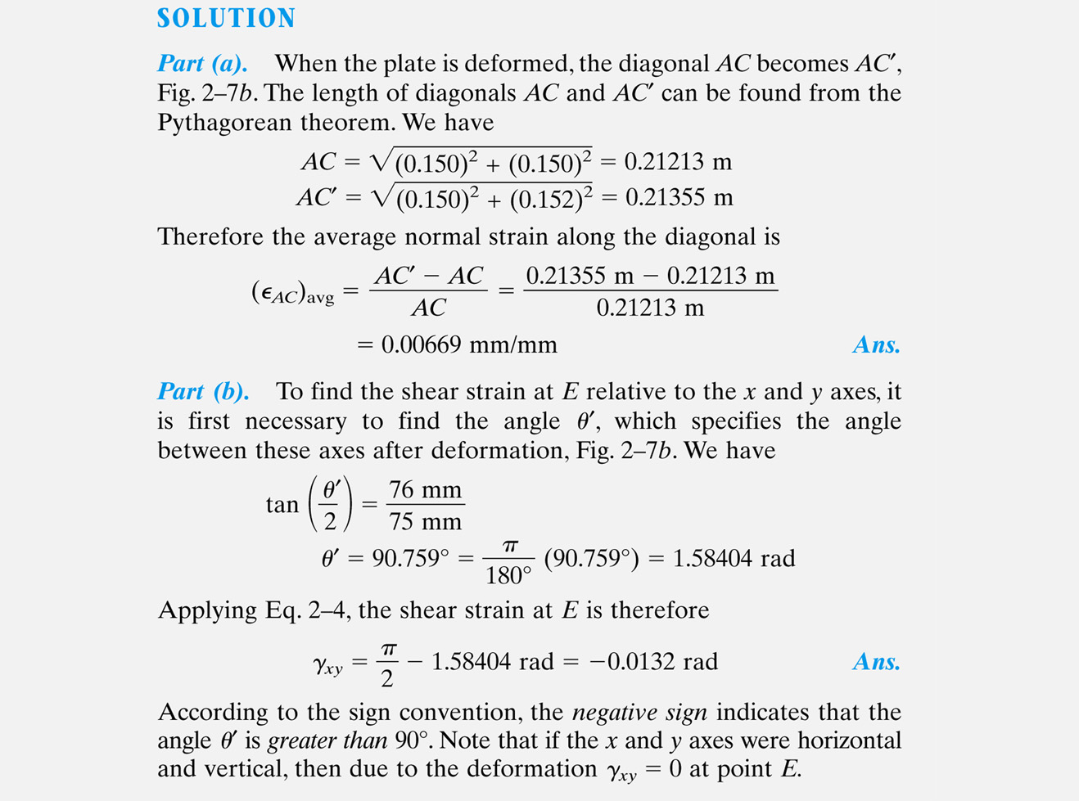
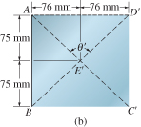

Slide 36
Temperature Effects on Structures
Thermal stress and strain are internally introduced into component or structure due to thermal expansion or contraction of the material. (+ expansion, - contraction)
Relatively modest temperature changes can cause comparable stresses and strains to those produced by ordinary external loads.
If the structure is free to expand or contract, only thermal strains will be introduced.
If expansion and contraction is constrained, thermal stresses (and possibly strains) will be introduced.

Slide 37
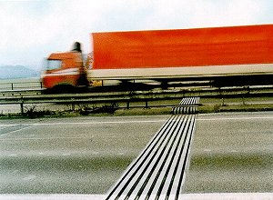
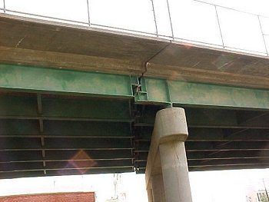

Slide 38
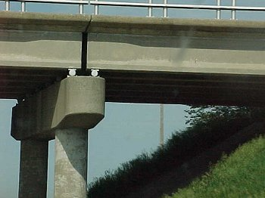

Slide 39
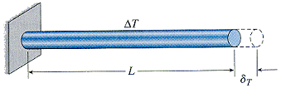

Linear coefficient of thermal expansion, α - relates thermal strain to changes in temperature (units: 1/K, 1/oC, 1/oF)
Assumptions
homogeneous material
isotropic material
temperature increase is uniform throughout material

Slide 40
Material | Room-Temperature CTE (x10⁻⁷ in/inºF)
Lead | 159
Aluminum | 128
Brass | 104
Bronze | 101
Steel, Stainless | 99
Copper | 93
Plaster | 76
Marble | 73
Nickel | 70
Iron, wrought | 67
Steel, carbon | 65
Iron, cast | 59
Concrete | 55
Concrete masonry | 52
Glass | 50

Slide 41
CHAPTER REVIEW
Loads cause bodies to deform, thus points in the body will undergo displacements or changes in position
Normal strain is a measure of elongation or contraction of small line segment in the body
Shear strain is a measure of the change in angle that occurs between two small line segments that are originally perpendicular to each other

Slide 42
CHAPTER REVIEW
Most engineering materials undergo small deformations, so normal strain ε << 1. This assumption of “small strain analysis” allows us to simplify calculations for normal strain, since first-order approximations can be made about their size

