Slide 1
SETG 2363
Material Engineering
(Strength of Materials)
Mohsin Mohd Sies
Nuclear Engineering,
Faculty of Chemical and Energy Engineering,
Universiti Teknologi Malaysia

Slide 2
What is Mechanics of Materials about
“How would a body deform under load”
A branch of mechanics
It studies the relationship of
  External loads applied to a deformable body, and
  The intensity of internal forces acting within the body
Deals with the behavior of solid bodies subjected to various types of loading
Study body’s stability when external forces are applied to it.
A thorough understanding of mechanical behavior is essential for the safe design of all structures.

Slide 3
What You Should Do
Learn the Vocabulary
Improve Your Skill at Drawing Free Body Diagrams
Learn About Material Behavior
Learn How To Solve Mechanics Problems. This is the largest part of the class. The solution procedure for most mechanics problems involves one or more of the following tasks:
  A statics analysis of a component to find the internal reactions (forces & moments)
  Determine stresses and strains in a component based on internal reactions
  Find the deformation of the component
  Compare calculated values of stress & deformation with known acceptable values
Improve Your Engineering Design Skills

Slide 4

Online Resource
https://engineeringstatics.org/

Slide 5
Vocabulary
This is a sampling of terms used in this subject
You are expected to understand the meaning of these terms.
You are also expected to know the correct units for material properties and other variables.

Slide 6
Vocabulary
Rigid Body
Deformable Body
Link
Truss
Normal Stress
Shear Stress
Bearing Stress
Ultimate Stress
Yield Stress
Failure Stress
Principal Stresses
Normal Strain
Shear Strain
Failure Strain
Yield Strain
Shear Modulus
Poisson’s Ratio
True Stress
Engineering Stress
True Strain
Elastic Behavior
Plastic Behavior
Thermal Expansion
Torsion
Torque
Angle of Twist
Static Indeterminacy
Power
Pure Bending
Area Moment of Inertia
Polar Moment of Inertia
Shear Force Diagram
Bending Moment Diagram
Transverse Shear
Cantilever Beam
Simply Supported Beam
Clamped Beam
Isotropic
Anisotropic
Homogeneous
Prismatic
Thin-Walled Member
Pressure Vessel

Slide 7
Vocabulary
Combined Loading
Stress Transformation
Mohr’s Circle
Plane Stress
Superposition
Elastic Curve
Column
Buckling
Euler Buckling
Plane Strain
Ductile Behavior
Brittle Behavior
Axial Stiffness
3-point Bending
4-point Bending
Modulus of Elasticity
Young’s Modulus
Modulus of Rigidity
Principal Strains
Flexural Stiffness

Slide 8
Types of structural members
Types of Structure
  Rigid Frame
    It is that type of structure in which the members are joined together by rigid joints e.g. welded joints.
  Truss (Pin connected joints)
    A type of structure formed by members in triangular form, the resulting figure is called a truss. In trusses, joints are pin connected and loads are applied at joints. No shear force & bending moment are produced. Only axial compression and axial tension is to be determined while analyzing a truss.

Slide 9
Types of structural members
Structural Members - Those parts that are interconnected in such a way so as to constitute a structure are called structural members.
  Beam
    Beam is a flexure member of the structure. It is subjected to transverse loading such as vertical loads, and gravity loads. These loads create shear and bending within the beam.
  Columns
    A long vertical member mostly subjected to compressive loads is called column

Slide 10
Types of structural members
  Rod
    Axial load member in tension.
  Strut
    A compressive member of a structure is called strut.
  Beam-Column
    A structural member subjected to compression as well as flexure is called beam column
  Grid
    A network of beam intersecting each other at right angles and subjected to vertical loads is called grid.

Slide 11
Types of structural members
  Cables and Arches
    Cables are usually suspended at their ends and are allowed to sag. The forces are then pure tension and are directed along the axis of the cable. Arches are similar to cables except hath they are inverted. They carry compressive loads that are directed along the axis of the arch.
  Plates and Slabs
    Plates are three dimensional flat structural components usually made of metal that are often found in floors and roofs of structures. Slabs are similar to plates except that they are usually made of concrete.

Slide 12
Chain of effects
Force
Stress
Deformation

Slide 13
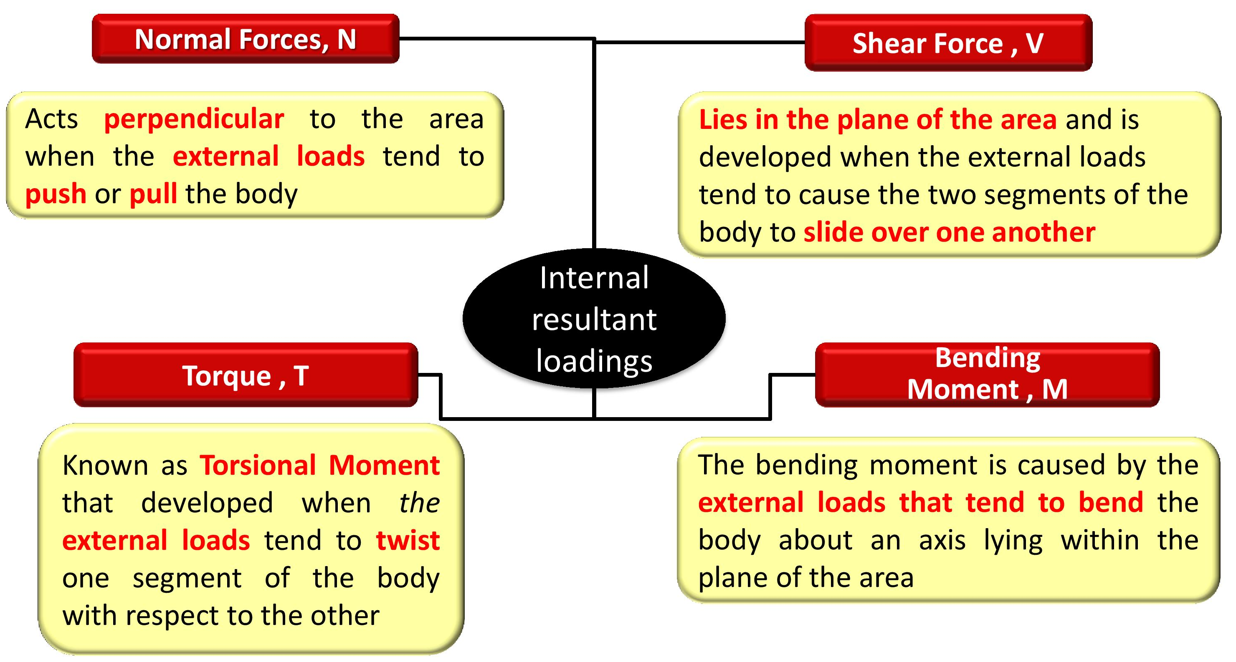
Types of loading forces

Slide 14
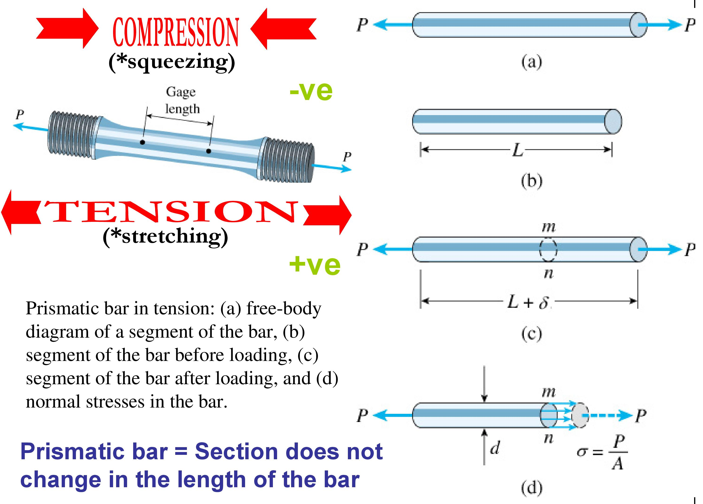
Types of stress and deformations

Slide 15
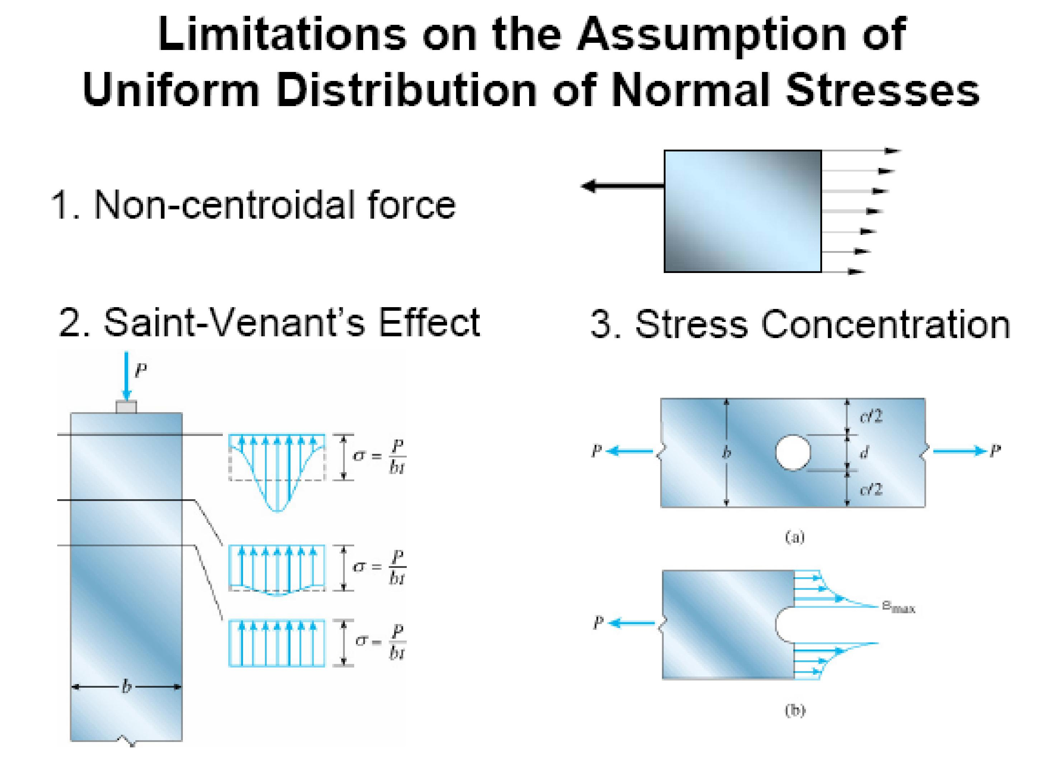

Slide 16
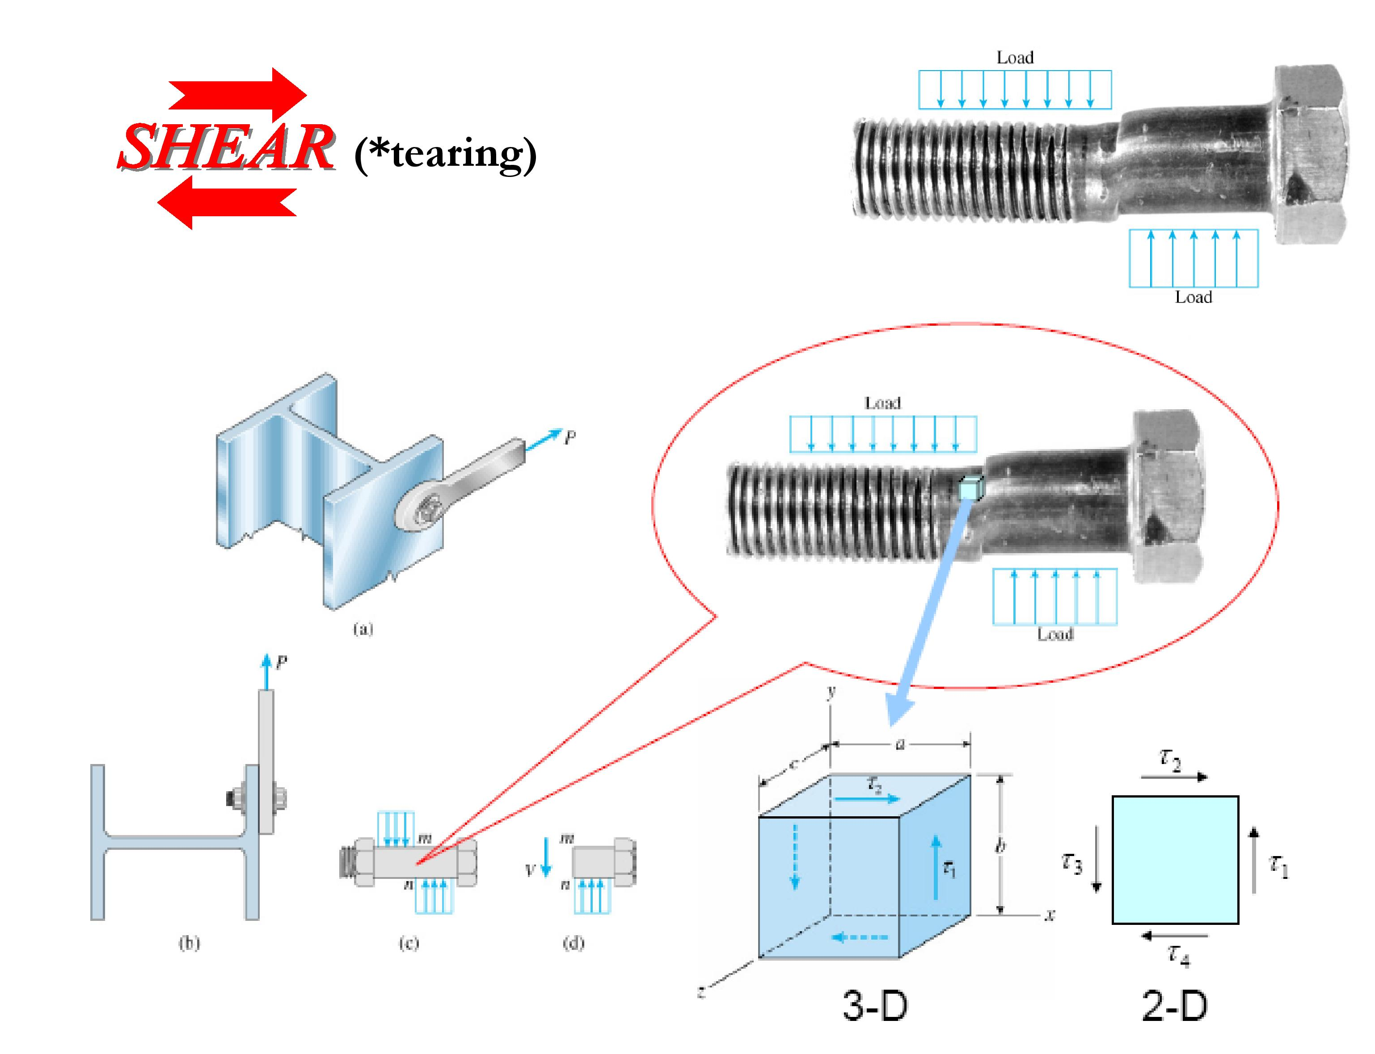

Slide 17
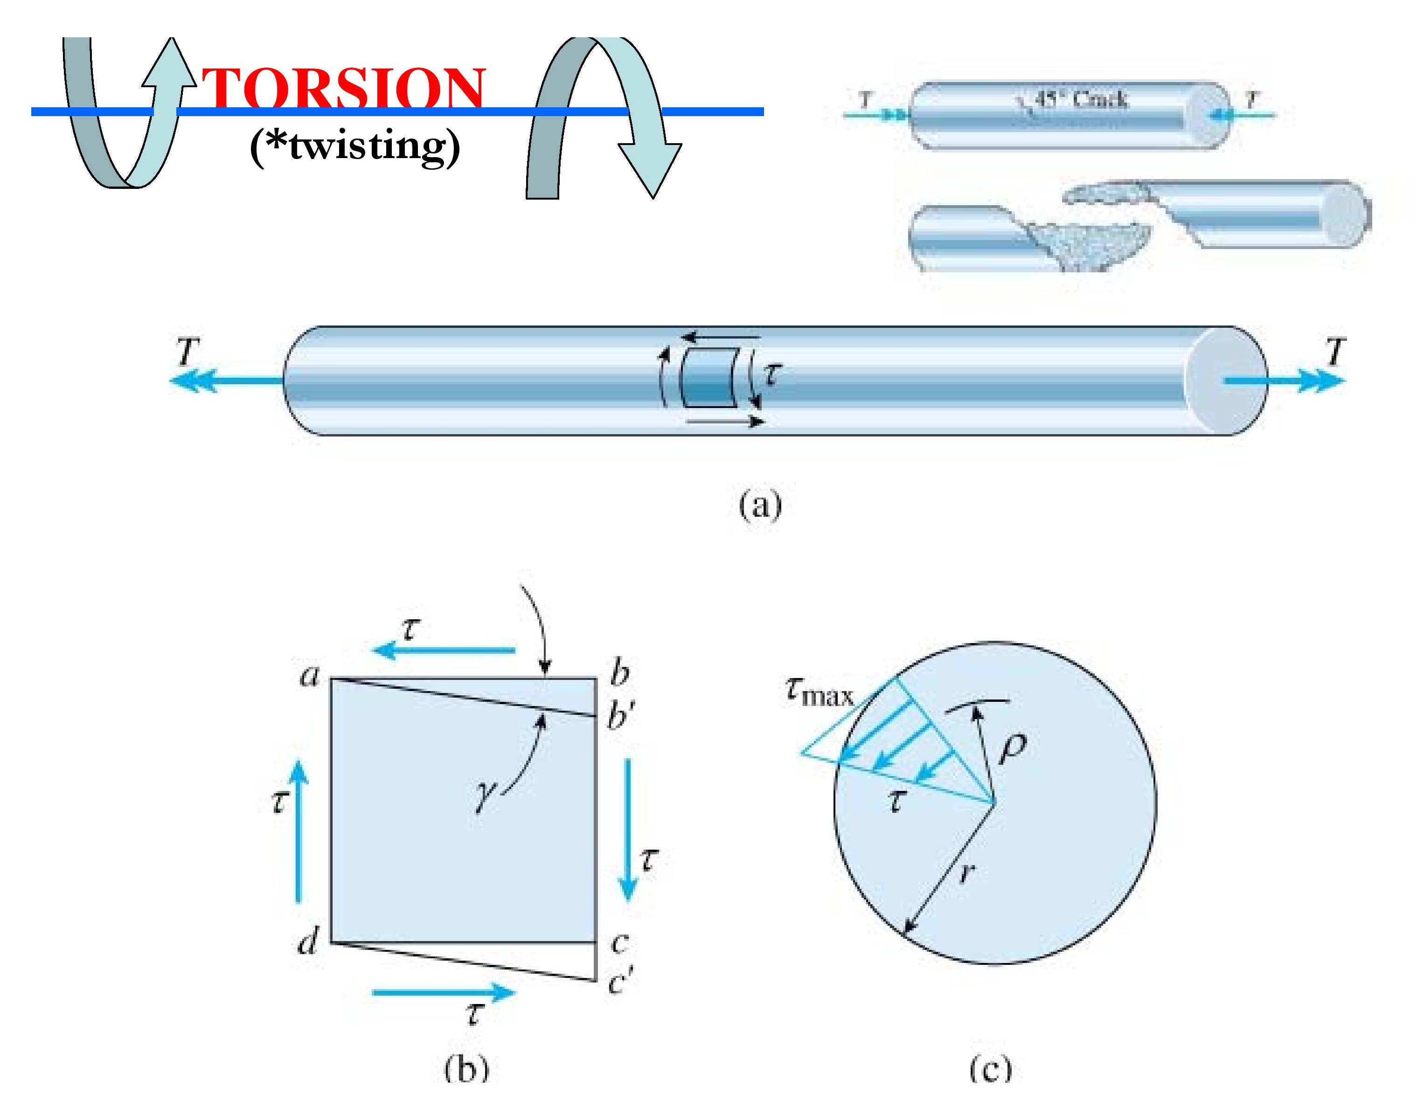

Slide 18
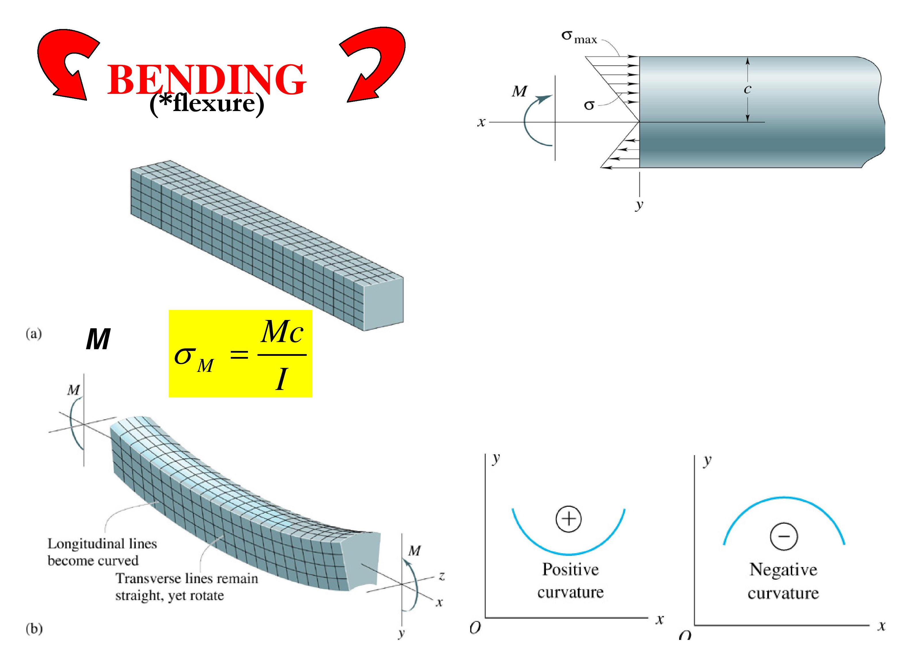

Slide 19
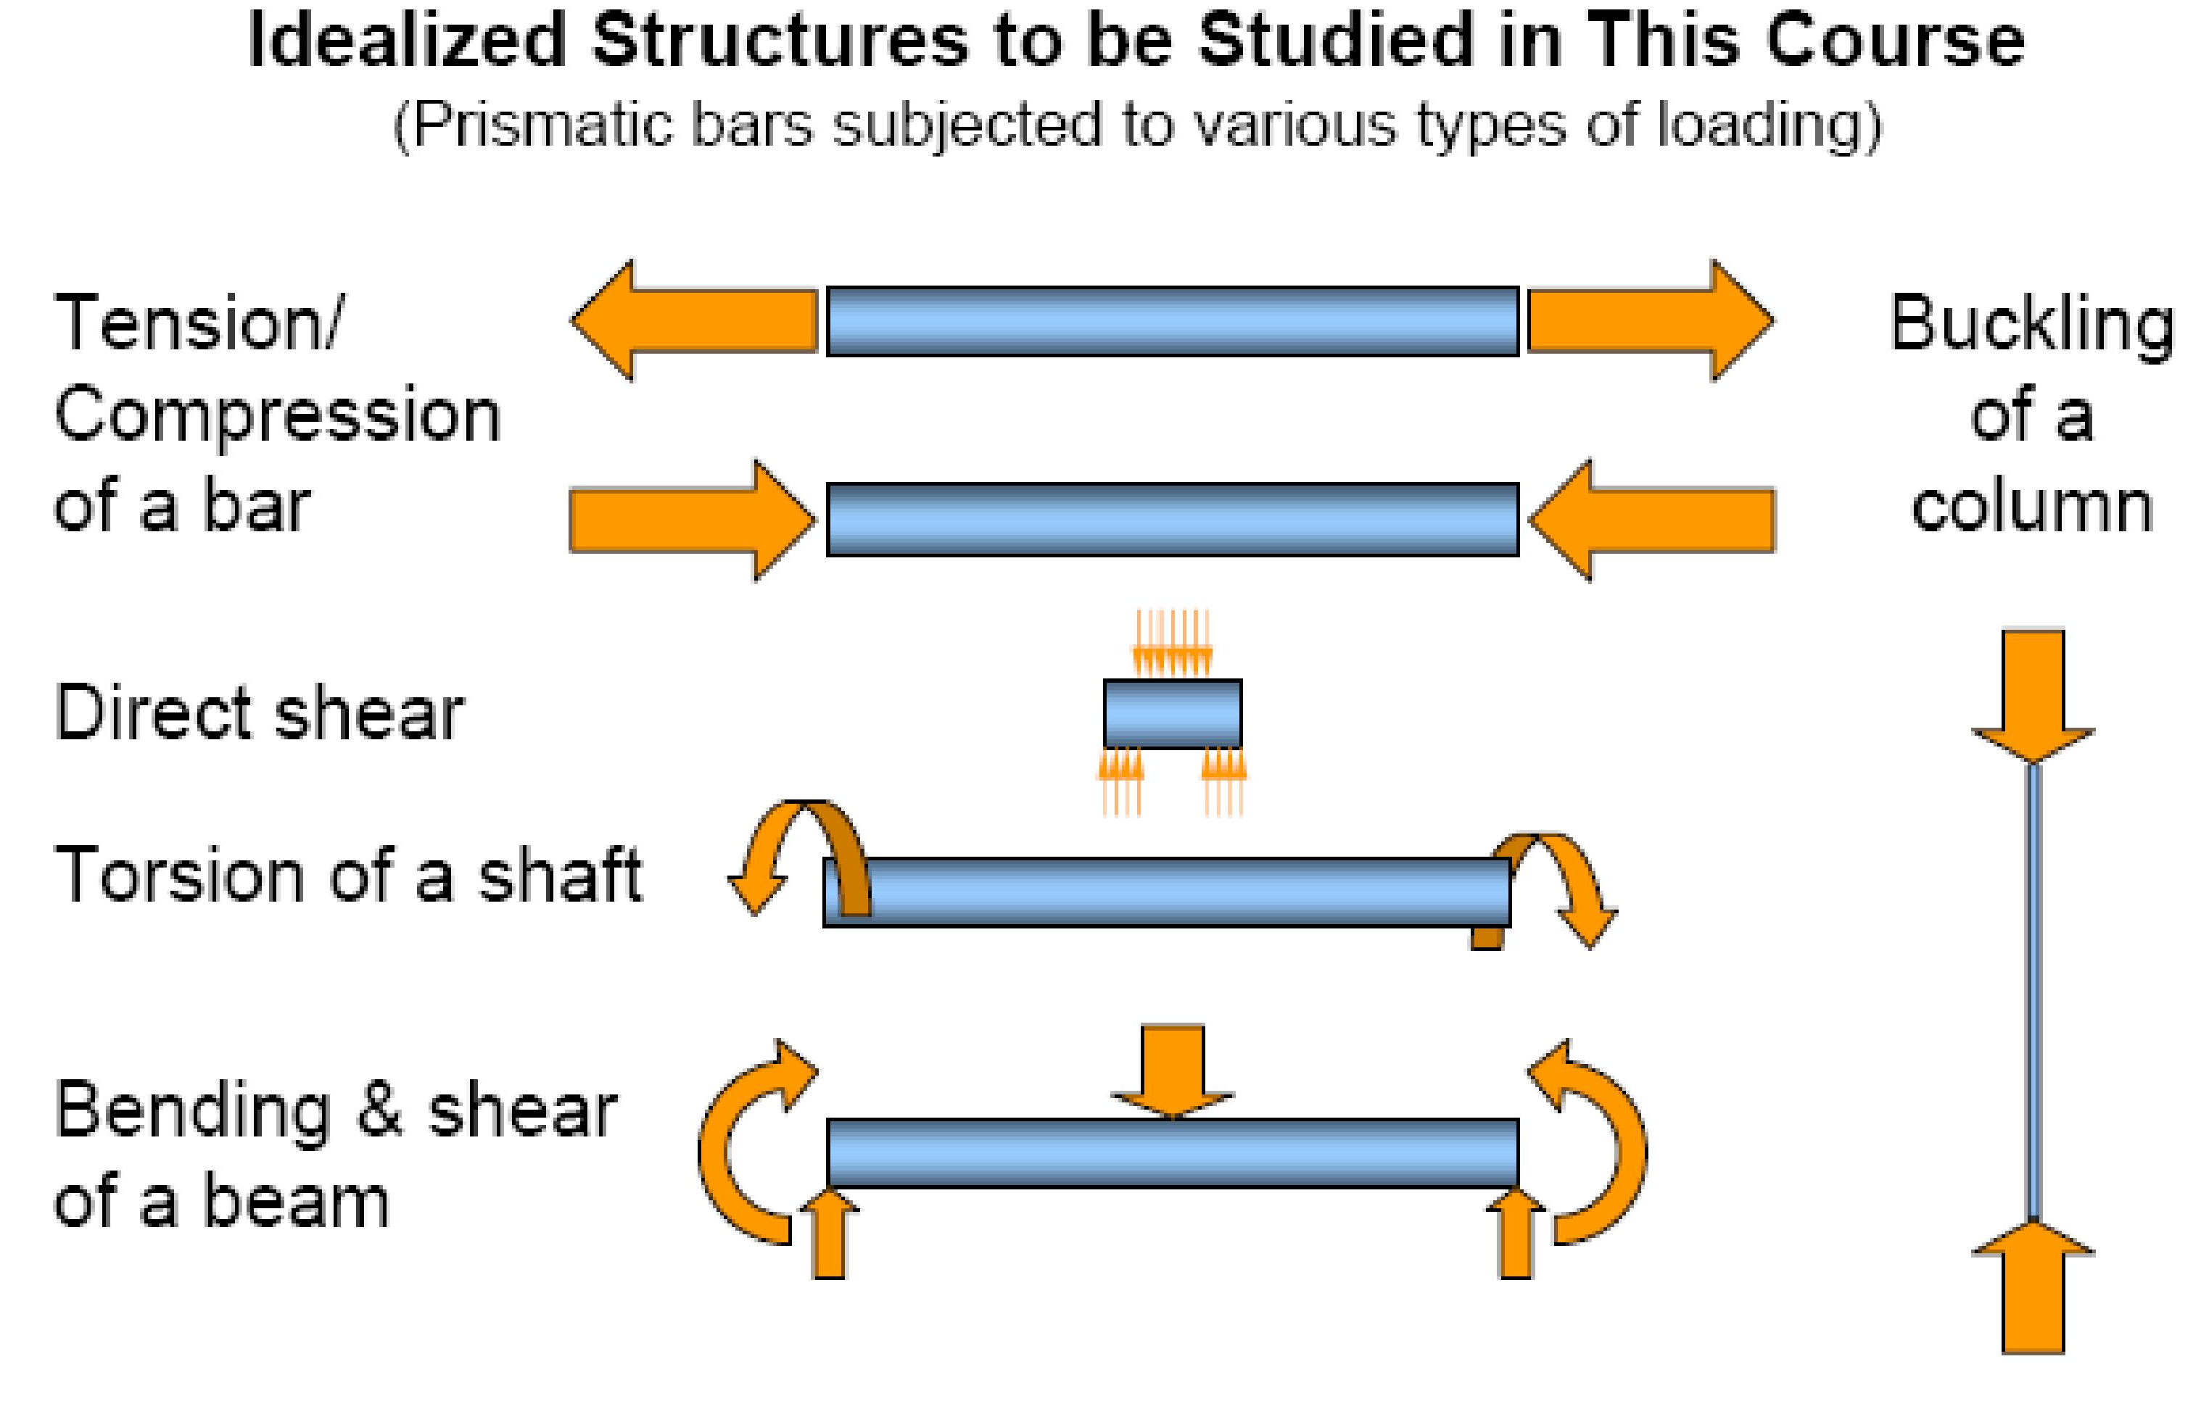

Slide 20
INTRODUCTION TO INTERNAL FORCES, M, N, V

Slide 21

Edition
Third
Beer • Johnston • DeWolf
INTRODUCTION TO INTERNAL FORCES, M, N, V
EXTERNAL FORCES are those which are applied to the boundary of a structure. This includes explicit externally applied forces as well as the forces that are applied by the supports to restrain the structure (as mostly learned from Statics course).
INTERNAL FORCES are those that are exerted on a portion of a structure by the rest of the structure. You would only see these forces if you were to make a cut in
the structure and separate it into two free body diagrams.
These are the forces that are represented by member shear and moment diagrams (which will be covered in this course).

Slide 22
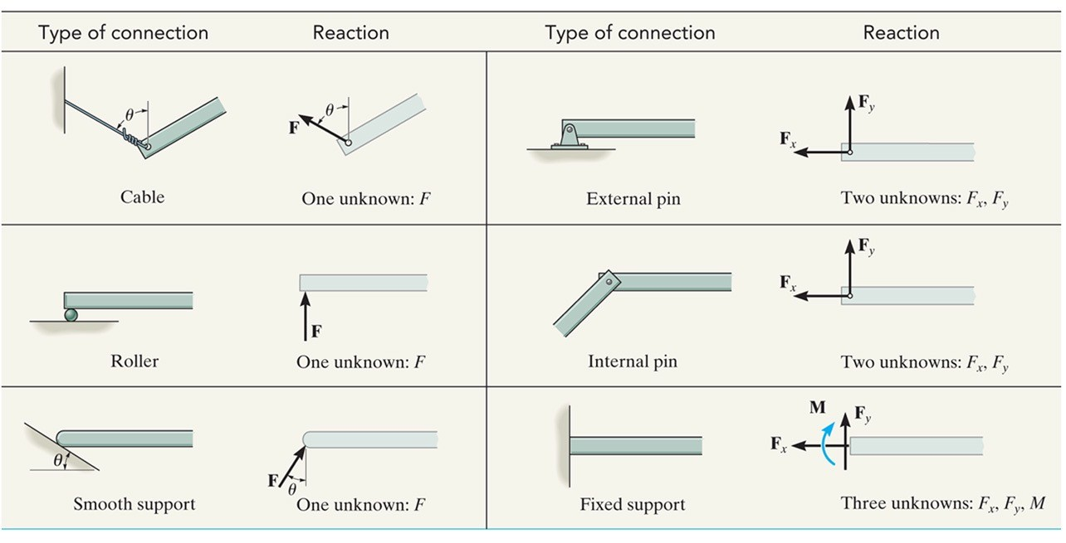
Edition
Third
Beer • Johnston • DeWolf
Statics: Types of Support Reactions

Slide 23
EQUILIBRIUM OF A DEFORMABLE BODY
Equations of equilibrium
For equilibrium
  balance of forces
  balance of moments
Draw a free-body diagram to account for all forces acting on the body
Apply the two equations to achieve equilibrium state
∑ F = 0
∑ M_{O} = 0

Slide 24
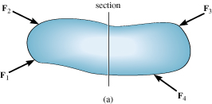
EQUILIBRIUM OF A DEFORMABLE BODY
Internal resultant loadings
For coplanar (2D) loadings:
  Normal force, N
  Shear force, V
  Bending moment, M

Slide 25
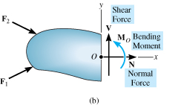
EQUILIBRIUM OF A DEFORMABLE BODY
Internal resultant loadings
For coplanar loadings:
  Apply ∑ F_{x} = 0 to solve for N
  Apply ∑ F_{y} = 0 to solve for V
  Apply ∑ M_{O} = 0 to solve for M

Slide 26
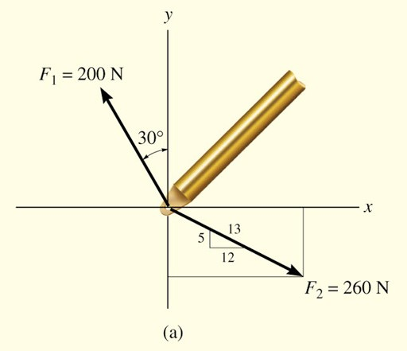
Edition
Third
Beer • Johnston • DeWolf
Statics: Force Resolution
Determine the x and y components of F₁ and F₂
acting on the boom shown.

Slide 27
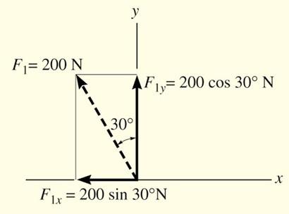
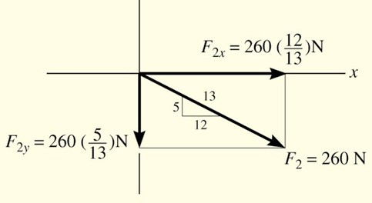
Edition
Third
Beer • Johnston • DeWolf
Statics: Force Resolution
Force F₁
Force F₂
⎛12⎞
F_{1x} = −200N sin 30 = −100N = 100N ←
= 173N ↑
F_{2x} = +260N ⎜ ⎟ = +240N
= 240N →
o
⎝13⎠
⎛ 5 ⎞
F = +200N cos 30º = +173N
F_{2y} = −260N ⎜ ⎟ = −100N
= 100N ↓
1y
⎝13⎠

Slide 28
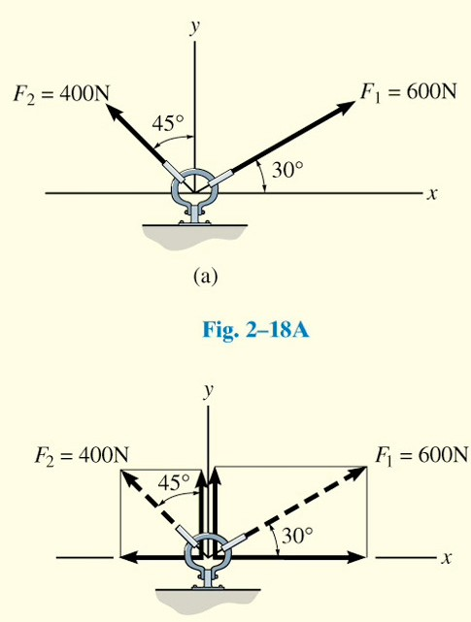
Edition
Third
Beer • Johnston • DeWolf
Statics: Addition of Forces (Example 1)

Slide 29
Edition
Third
Beer • Johnston • DeWolf
Statics: Addition of Forces
Resolve forces into x-y components:
F = + 600 N cos 30º F = + 600 N sin 30º F = − 400 N sin 45º
1x
1y
2x
F = + 400 N cos 45º
2y
Adding components:
→ F_{Rx} = ΣF_{x} F_{Rx} =
^{F}1x ^{+ F}2x
= 600N cos 30º + (- 400N sin 45º)
= 236.8N →
+↑ F_{Ry} = ΣF_{y}
F_{Ry} =
^{F}1y
F_{2y}
= 600N sin 30º + 400N cos 45º
= 582.8N ↑

Slide 30
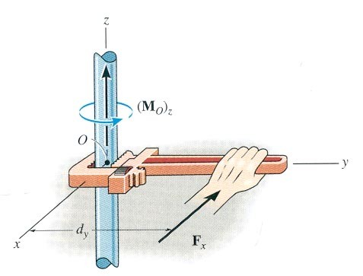
Edition
Third
Beer • Johnston • DeWolf
Moment of A Force (2-D)
The moment (M) of a force about a point provides a measure of the tendency for rotation (sometimes called a torque)

Slide 31
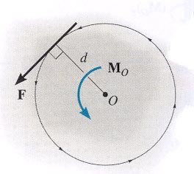
Edition
Third
Beer • Johnston • DeWolf
Moment in 2-D
MOMENT IN 2-D (continued)
In 2-D case, the magnitude of the moment is M_{o} = F d
d is the perpendicular distance from point O to the line of action of the force.
In 2-D, the direction of M_{O} is either clockwise or counterclockwise depending on the tendency for rotation.

Slide 32
Edition
Third
Beer • Johnston • DeWolf
Moment in 2-D
MOMENT IN 2-D (continued)
F
a
For example, M = Fd and the
b
O
direction is counterclockwise.
O
d
Often it is easier to determine M_{O} by using components of F as shown.
F_{y}
F
F_{x}
b
O
a
Using this approach, M_{O} = (F_{Y} a) – (F_{X} b). Note the different signs on the terms! The typical sign convention for a moment in 2-D is that counter-clockwise is considered positive. We can determine the direction of rotation by imagining the body pinned at O and deciding which way the body would rotate because of the force.

Slide 33
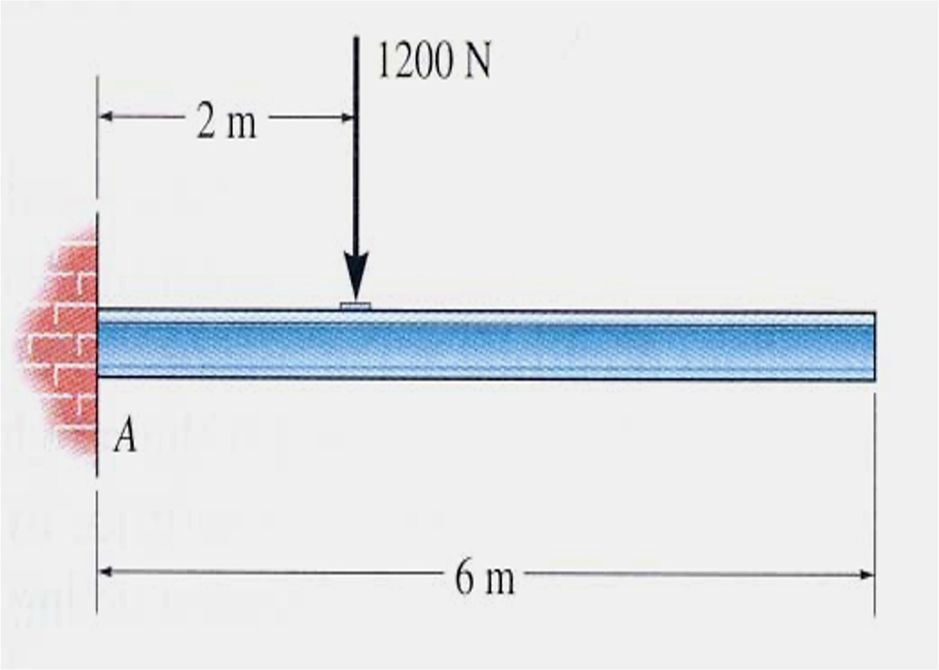
MECHANICS OF MATERIALS
Edition
Third
Beer • Johnston • DeWolf
Free-Body Diagram
PROCEDURE
Draw the outline shape. Imagine the body is isolated or ‘cut’ free from its constraints. Then, draw its outline shape.
Show all the external forces and moments. Typically these include:
  applied forces, (b) support reactions and (c) weight of the body.
Label loads and dimensions. All known forces and moments should be labeled with their magnitudes and directions. For unknown forces and couple moments, use letters like A_{x}, A_{y}, M_{A}, etc. Indicate any necessary directions.
Draw free-body diagram (FBD) for the uniform beam shown. The beam has a mass of 100kg.

Slide 34
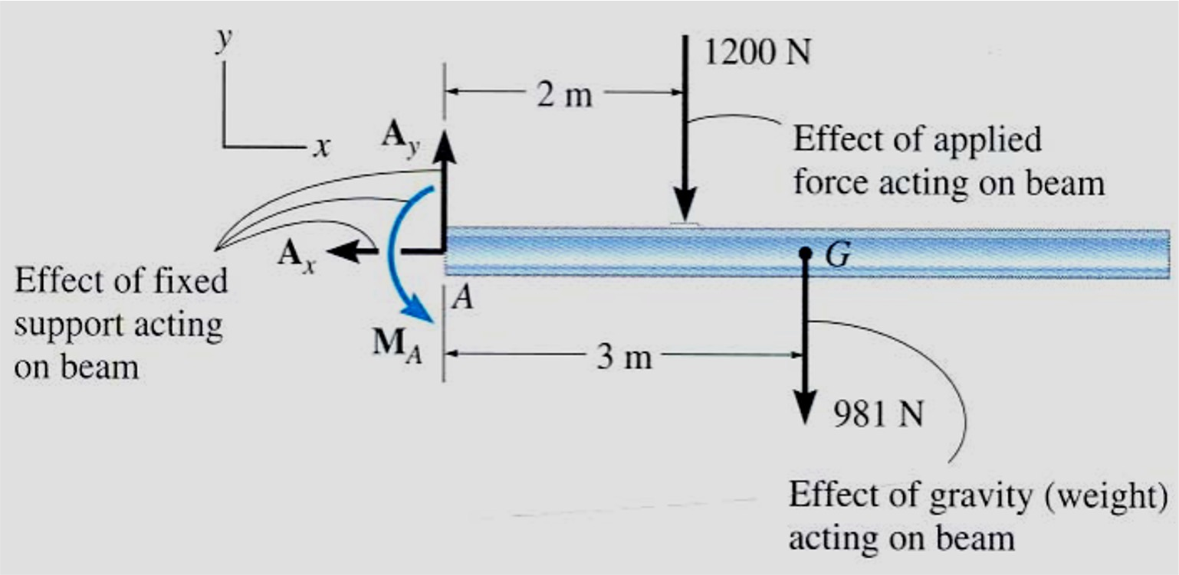
Edition
Third
Beer • Johnston • DeWolf
Free-Body Diagram (continue)
SOLUTION
Support at A is a fixed wall; so there are 3 reactions acting on the beam at A, denoted as A_{x}, A_{y}, M_{A} drawn in an arbitrary direction.
Magnitudes of these forces are unknown, and their sense has been assumed.
Weight of beam, W = 100(9.81) = 981 N, acts through the beam’s center of gravity G, 3 meters from A since the beam is uniform.
Complete FBD of beam

Slide 35
Edition
Third
Beer • Johnston • DeWolf
Structural Analysis
OBJECTIVES
Determine the forces in the members of a truss using the
method of joints and the method of sections
Analyze forces acting on the members of frames and machines composed of pin-connected members
© 2002 The McGraw-Hill Companies, Inc. All rights reserved.
8 - 13

Slide 36
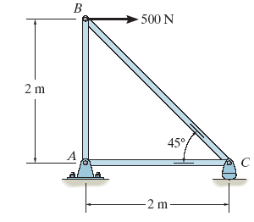

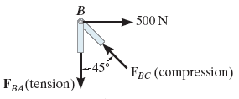
Edition
Third
Beer • Johnston • DeWolf
Method of Joints
For truss, we need to know the force in each members
Forces in the members are internal forces
For external force members, apply equations of equilibrium
Force system acting at each joint is coplanar and concurrent
∑F_{x} = 0 and ∑F_{y} = 0 must be satisfied for equilibrium

Slide 37
Edition
Third
Beer • Johnston • DeWolf
Method of Joints
Procedure for Analysis
Draw FBD with at least 1 known and 2 unknown forces
Find external reactions at the truss support
Determine the correct sense of the member
Orient the x and y axes
Apply ∑F_{x} = 0 and ∑F_{y} = 0
Use known forces to analyze the unknown forces

Slide 38
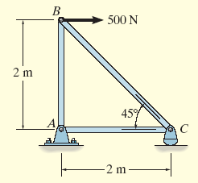
Edition
Third
Beer • Johnston • DeWolf
Example – Method of Joints
Determine the force in each member of the truss and indicate whether the members are in tension or compression.

Slide 39

Edition
Third
Beer • Johnston • DeWolf
Solution via Method of Joints
For Joint B:
⎯⎯⁺→ ΣF = 0;
x
500N − F sin 45º = 0
∴F = ^{500N} = 707.1N (C)
BC
BC
sin 45º
+↑ ΣF_{y} = 0;
F cos 45º − F = 0
BC BA
∴F = 500N (T)
BA

Slide 40
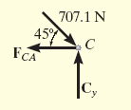
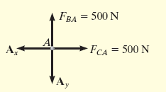
Edition
Third
Beer • Johnston • DeWolf
Solution via Method of Joints
For Joint C:
+ → ΣF_{x} = 0
−F + 707.1N cos 45º = 0
∴F = 500N(T)
CA
CA
+↑ ΣF_{y} = 0
C − 707.1N sin 45º = 0
∴C = 500N
y
y
For Joint A:
+ → ΣF_{x} = 0
500N − A_{x} = 0 ⇒ A_{x} = 500N
+↑ ΣF_{y} = 0;
500N − A_{y} = 0 ⇒ A_{y} = 500N

Slide 41
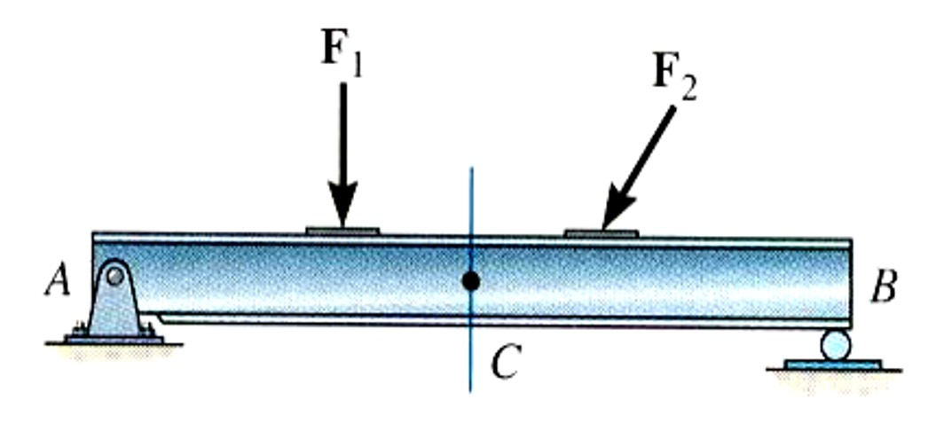
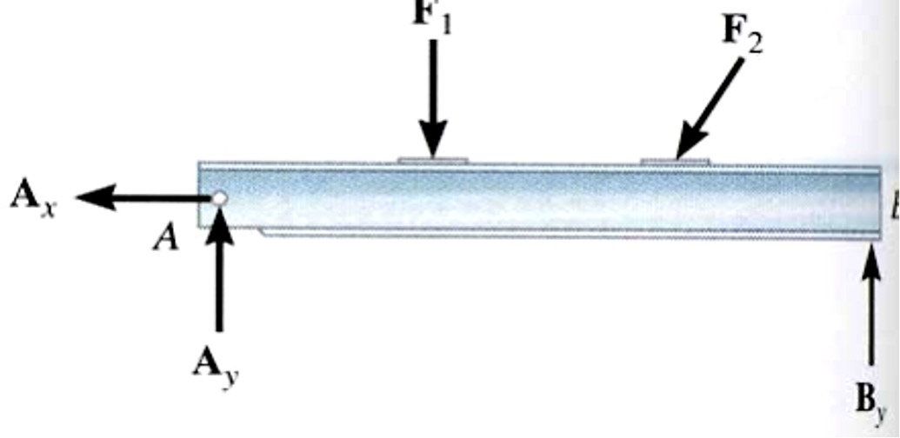
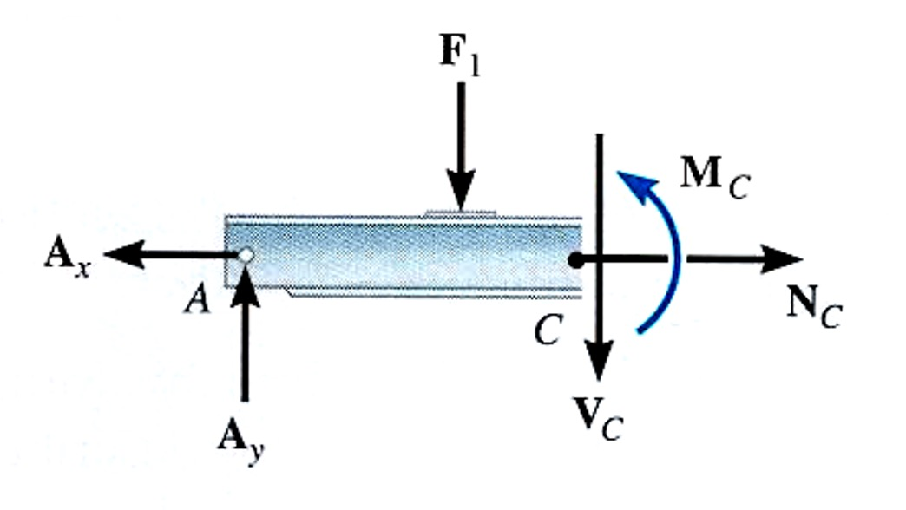
Edition
Third
Beer • Johnston • DeWolf
Internal Forces Developed in Structural Members
INTERNAL FORCES
Example: Determine the internal forces acting on the cross section at C.
Strategy:
First, determine the support reactions.
Next, cut beam at C and draw FBD on one of the halves of the beam. This FBD will include the internal forces acting at C.
Finally, apply equations of equilibrium to solve for these unknowns.

Slide 42
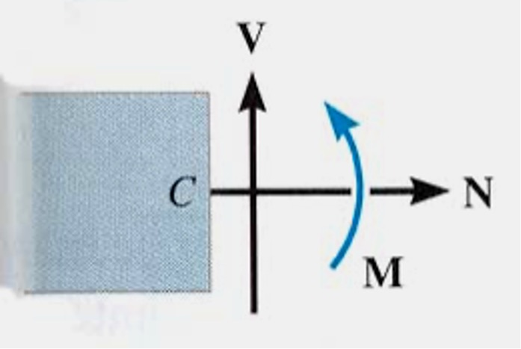
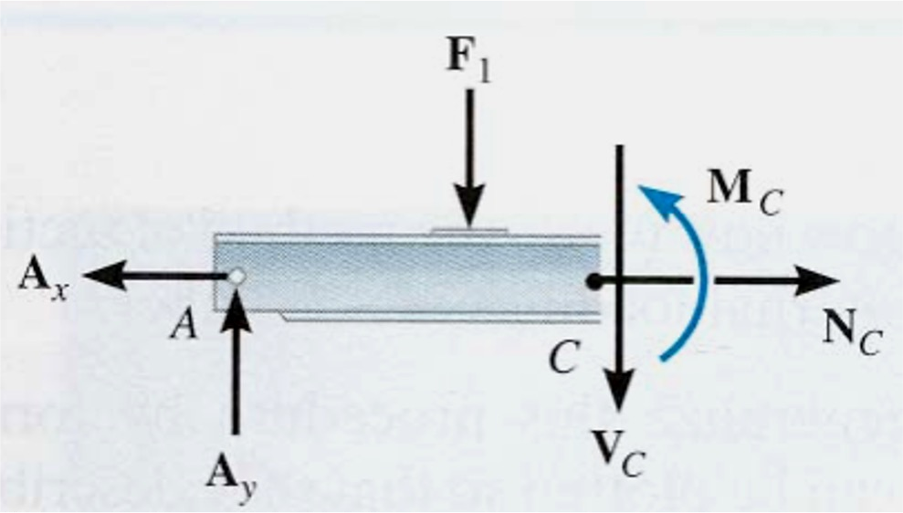
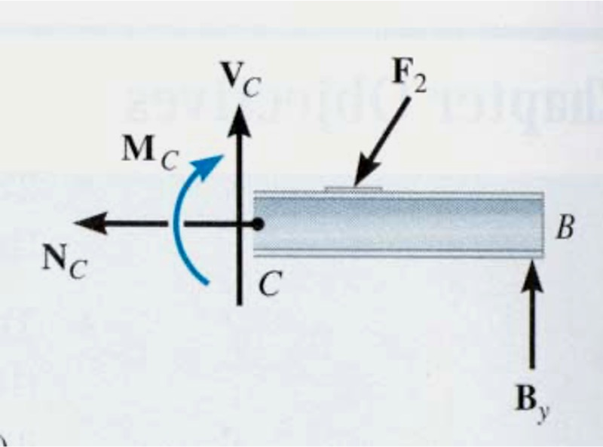
Edition
Third
Beer • Johnston • DeWolf
Internal Forces Developed in Structural Members
In 2-D cases, typical internal loads are normal or axial forces (N, acting perpendicular to the section), shear forces (V, acting along the surface), and the bending moment (M).
The loads on the left and right sides of the section at C are equal in magnitude but opposite in direction. This is because when the two sides are reconnected, the net loads are zero at the section.

Slide 43
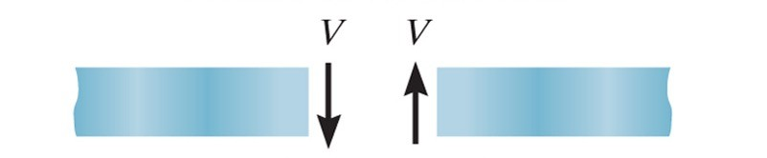

Edition
Third
Beer • Johnston • DeWolf
Segment Sign Convention
Positive internal shear force
Positive internal moment

Slide 44
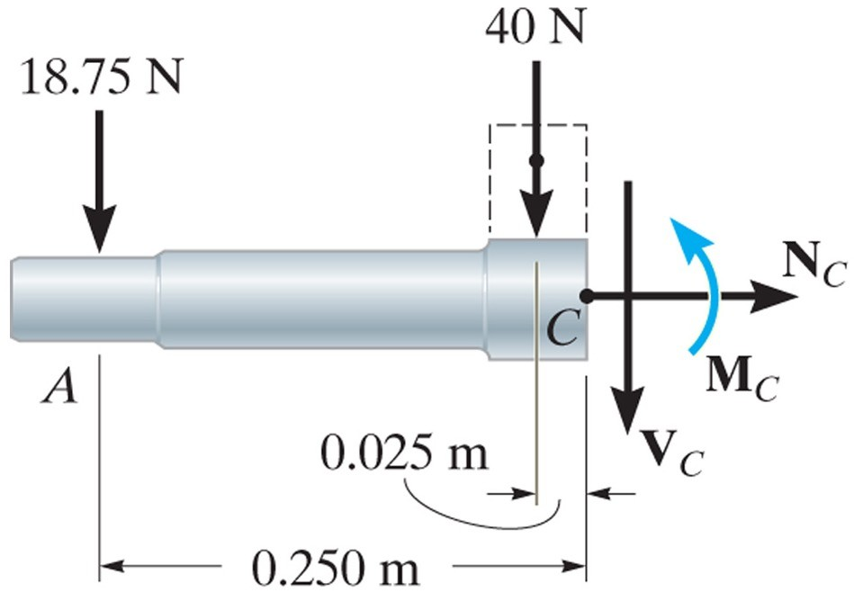
Edition
Third
Beer • Johnston • DeWolf
Left Segment Sign Convention
FBD of left segment:
The unknowns V and M indicated are acting in the positive sense on the right-hand face of the cut segment according to the established sign convention.

Slide 45
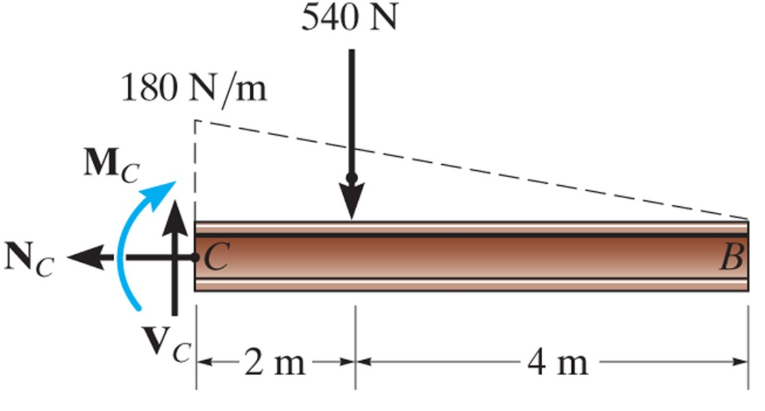
Edition
Third
Beer • Johnston • DeWolf
Right Segment Sign Convention
FBD of right segment:
The unknowns V and M indicated are acting in the positive sense on the left-hand face of the cut segment according to the established sign convention.

Slide 46
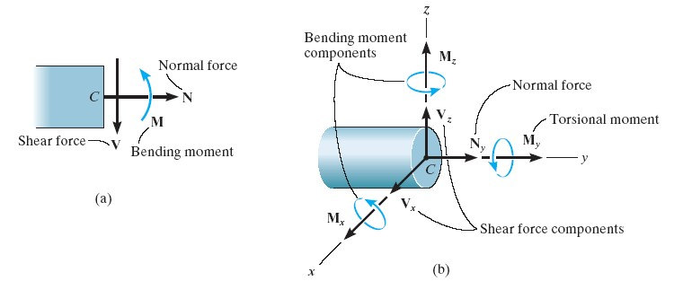
Edition
Third
Beer • Johnston • DeWolf
Internal Forces Developed in Structural Members
For 3-D, a general internal force and couple moment resultant will act at the section
N_{y} is the normal force, and V_{x} and V_{z} are the shear components
M_{y} is the torsional or twisting moment, and M_{x} and M_{z} are the bending moment components

Slide 47
Edition
Third
Beer • Johnston • DeWolf
Internal Forces Developed in Structural Members
Procedure for Analysis:
FBD
Equilibrium Equation
- Support Reactions
First, determine support reactions or joint forces you need by drawing a FBD of the entire structure and solving for the unknown reactions.
Take an imaginary cut at the place where you need to determine the internal forces. Then, decide which resulting section will be easier to analyze (usually the segment having the least loads).

Slide 48
Edition
Third
Beer • Johnston • DeWolf
Internal Forces Developed in Structural Members
3. Draw a FBD of the section you’ve decided to analyze. Remember to show the N, V, and M loads at the “cut” surface.
NOTE:
Keep all distributed loadings, couple moments and forces acting on the member in their exact locations.
Only N, V and M act at the section.
Determine the sense by inspection.
4. Apply equations of equilibrium (i.e. moment balance ΣM=0 and force balance ΣF=0) to the FBD drawn in step (3), and solve for the unknown internal loads.
NOTE:
Moments should be summed at the section. If negative result, the sense is opposite
•
•

Slide 49
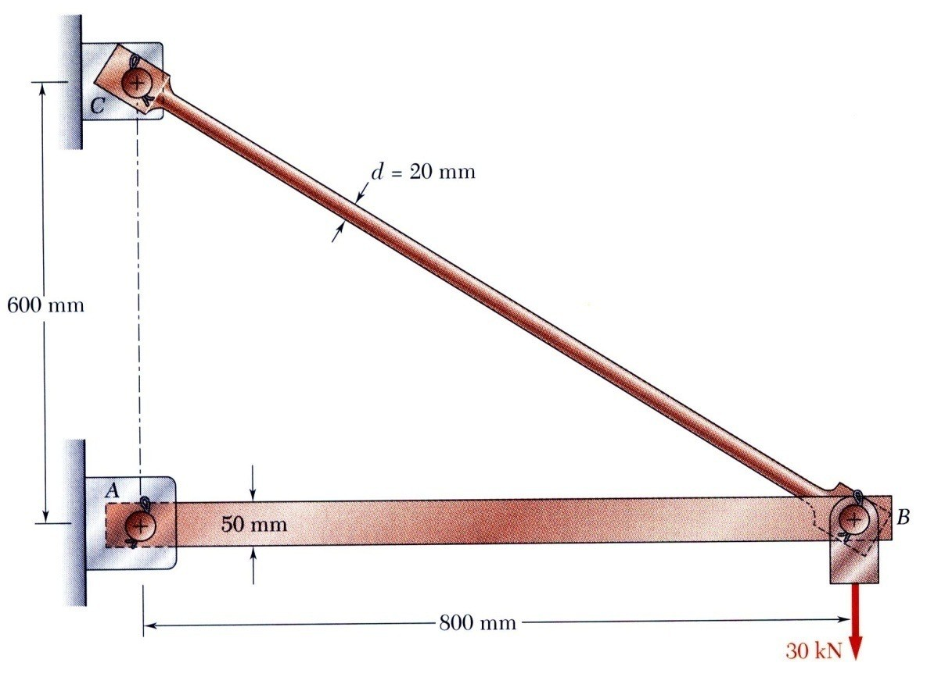
Edition
Third
Beer • Johnston • DeWolf
Review of Statics
The structure is designed to support a 30 kN load
The structure consists of a boom and rod joined by pins (zero moment connections) at the junctions and supports
Perform a static analysis to determine the internal force in each structural member and the reaction forces at the supports

Slide 50
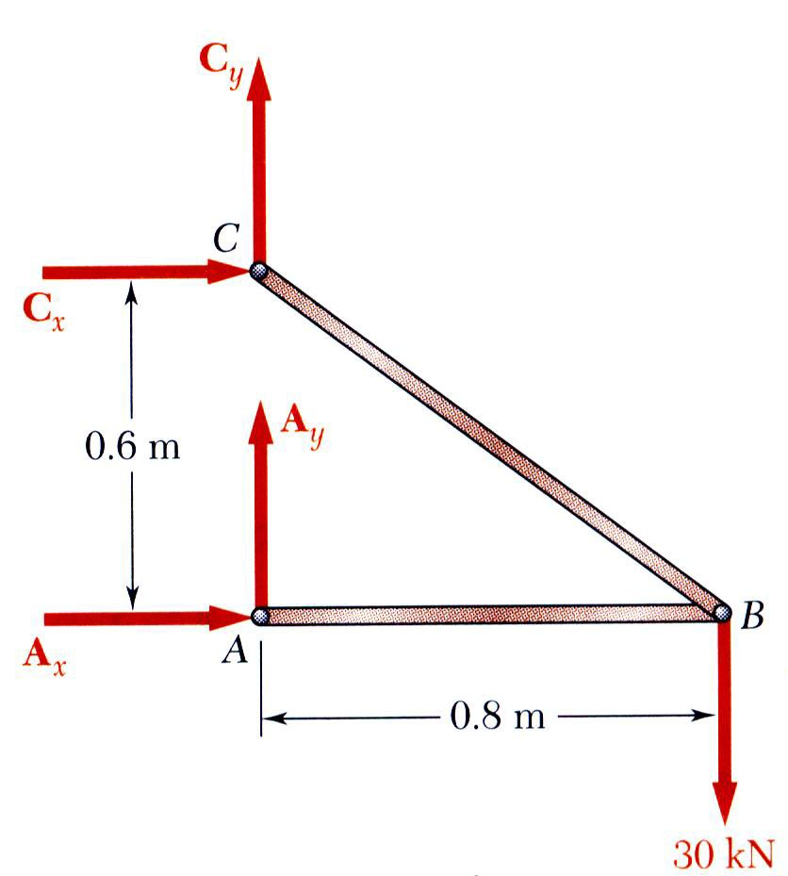
Edition
Third
Beer • Johnston • DeWolf
Structure Free-Body Diagram
Structure is detached from supports and the loads and reaction forces are indicated
Conditions for static equilibrium:
+ve
∑ M_{C} = 0: A_{x}(0.6m)− (30kN)(0.8m)= 0
A_{x} = 40kN
∑ F_{x} = 0: A_{x} + C_{x} = 0
C_{x} = −A_{x} = −40kN
∑ F_{y} = 0: A_{y} + C_{y} − 30kN = 0
A_{y} + C_{y} = 30kN
+ve
+ve
A_{y} and C_{y} can not be determined from these equations (4 unknowns in 2 equations)

Slide 51
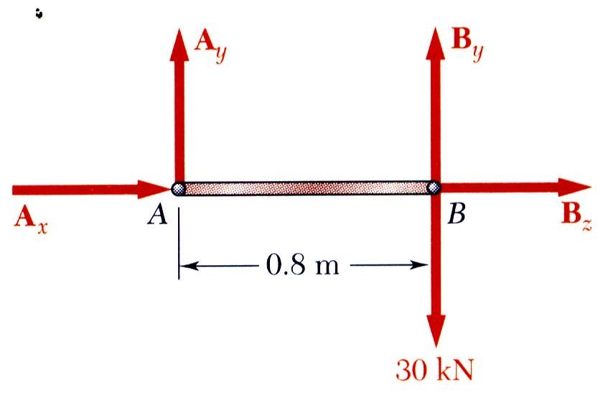
Edition
Third
Beer • Johnston • DeWolf
Component Free-Body Diagram
In addition to the complete structure, each component must satisfy the conditions for static equilibrium
Consider a free-body diagram for the boom:
∑ M_{B} = 0 : − A_{y} (0.8m) = 0
A_{y} = 0
substitute into the structure equilibrium equation
C_{y} = 30 kN
Results:
A = 40 kN → C_{x} = 40 kN ← C_{y} = 30 kN ↑
Reaction forces are directed along boom and rod

Slide 52
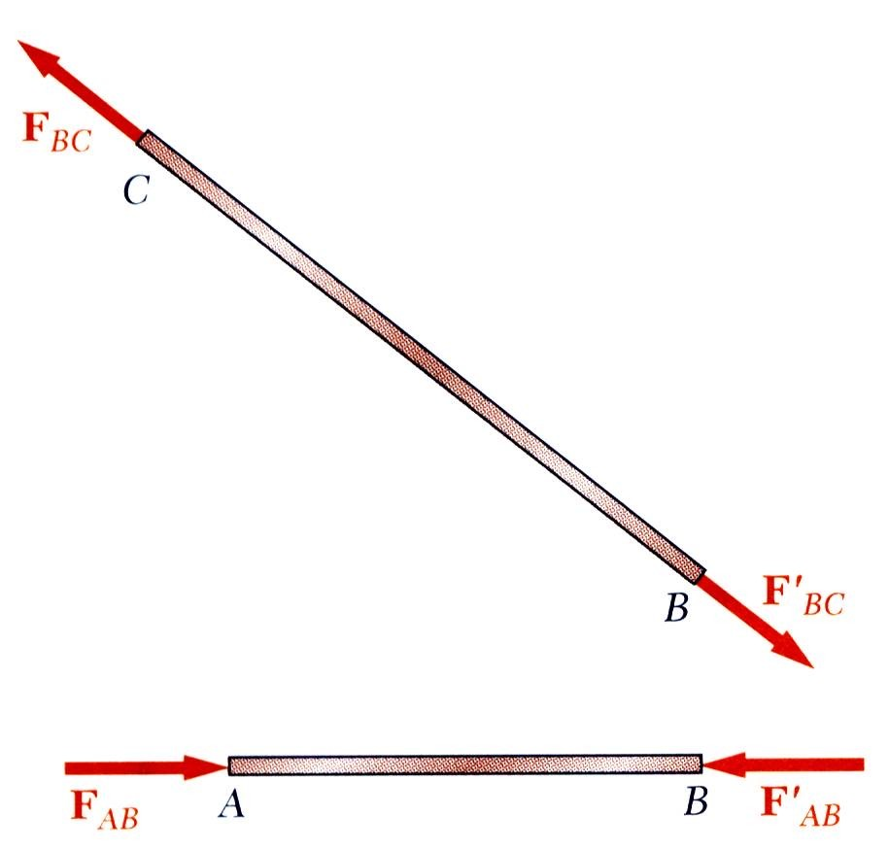
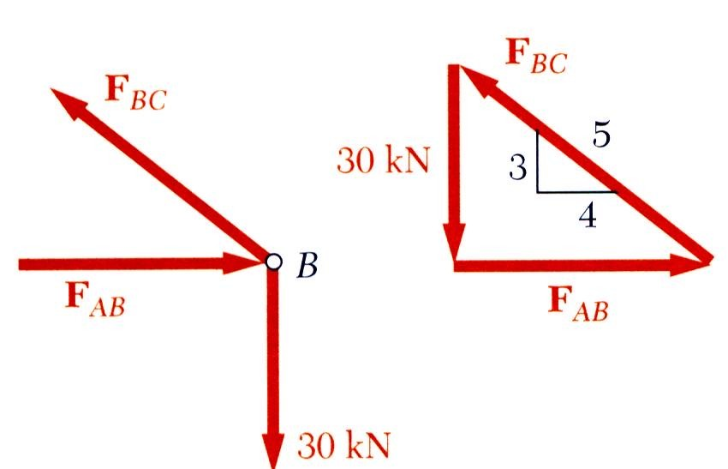
Edition
Third
Beer • Johnston • DeWolf
Method of Joints
The boom and rod are 2-force members, i.e., the members are subjected to only two forces which are applied at member ends
For equilibrium, the forces must be parallel to an axis between the force application points, equal in magnitude, and in opposite directions
Joints must satisfy the conditions for static equilibrium which may be expressed in the form of a force triangle:
∑ F_{B} = 0
F_{AB =} F_{BC =} 30 kN
4 5
F_{AB} = 40 kN
3
F_{BC} = 50 kN

Slide 53
Edition
Third
Beer • Johnston • DeWolf
Internal Forces
Knowing the forces at the ends of each the members, we can determine the internal forces in these member
C
^{F}BC
D
F’_{BC}
F’_{BC}
D
B
^{F}BC
Since the rod to keep in equilibrium the internal forces of 40 kN and 50 kN for rod AB dan BC respectively when 30 kN load is applied at B
Rod AB : Compression & Rod BC: Tensile

Slide 54
EQUILIBRIUM OF A DEFORMABLE BODY
Procedure for Analysis
Method of sections
  Choose segment to analyze
  Determine Support Reactions
  Draw free-body diagram for whole body
  Apply equations of equilibrium

Slide 55
EQUILIBRIUM OF A DEFORMABLE BODY
Procedure for analysis
Free-body diagram
  Keep all external loadings in exact locations before “sectioning”
  Indicate unknown resultants, N, V, M, and T at the section, normally at centroid C of sectioned area
  Coplanar system of forces only include N, V, and M
  Establish x, y, z coordinate axes with origin at centroid

Slide 56
EQUILIBRIUM OF A DEFORMABLE BODY
Procedure for analysis
Equations of equilibrium
  Sum moments at section, about each coordinate axes where resultants act
  This will eliminate unknown forces N and V, with direct solution for M (and T)
  Resultant force with negative value implies that assumed direction is opposite to that shown on free-body diagram

