Slide 1
SKPN 4123 Nuclear Reactor Materials
Chapter 2
Exercises
Mohsin Mohd Sies
Nuclear Engineering,
School of Chemical and Energy Engineering,
Universiti Teknologi Malaysia

Slide 2
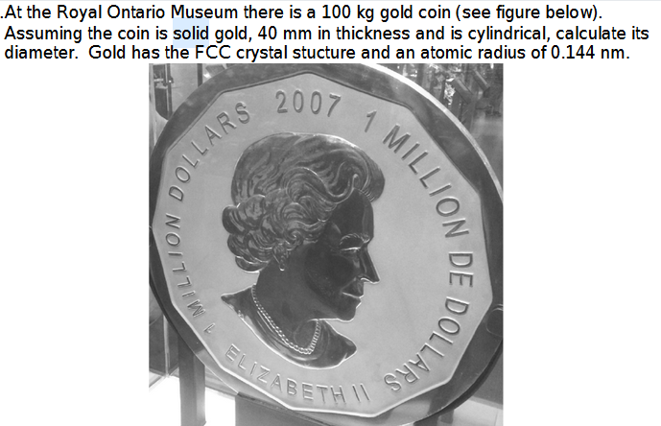

Slide 3
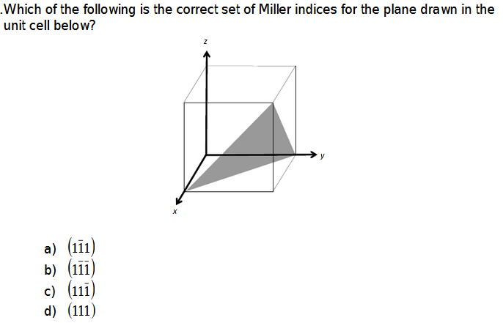

Slide 4
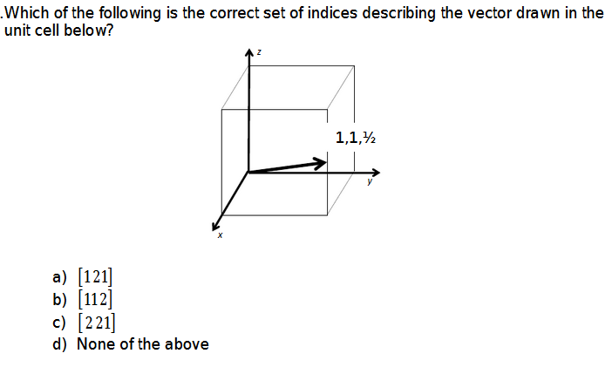

Slide 5
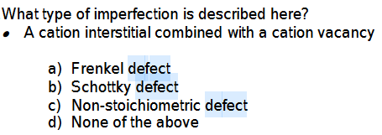

Slide 6
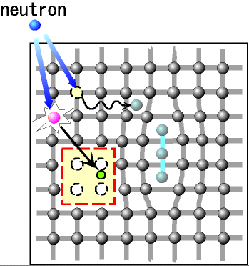
Quiz 1
If a target atom receives enough energy from the projectile by a collision, the atom go away from it original lattice site.
This is called as displacement.
If the receiving energy is too low, the hit atom will not be displaced.
The “********* energy ” for displacement, Ed, is almost ** eV in many metals.
A simple displacement makes an *********** ****and a vacancy.
The set of these two point defects is called a ******* pair.
displacement damage
******
************
neutron

