Slide 1
The Science and Engineering of Materials Donald R. Askeland – Pradeep P. Phulé
Atomic and Ionic Arrangements

Slide 2
Objectives of Chapter 3
To learn classification of materials based on atomic/ionic arrangements
To describe the arrangements in crystalline solids based on lattice, basis, and crystal structure

Slide 3
Chapter Outline
3.1 Short-Range Order versus Long-Range Order
3.2 Amorphous Materials: Principles and Technological Applications
3.3 Lattice, Unit Cells, Basis, and Crystal Structures
3.4 Allotropic or Polymorphic Transformations
3.5 Points, Directions, and Planes in the Unit Cell
3.6 Interstitial Sites
3.7 Crystal Structures of Ionic Materials
3.8 Covalent Structures

Slide 4
Section 3.1 Short-Range Order versus Long-Range Order
Short-range order - The regular and predictable arrangement of the atoms over a short distance - usually one or two atom spacings.
Long-range order (LRO) - A regular repetitive arrangement of atoms in a solid which extends over a very large distance.
Bose-Einstein condensate (BEC) - A newly experimentally verified state of a matter in which a group of atoms occupy the same quantum ground state.

Slide 5
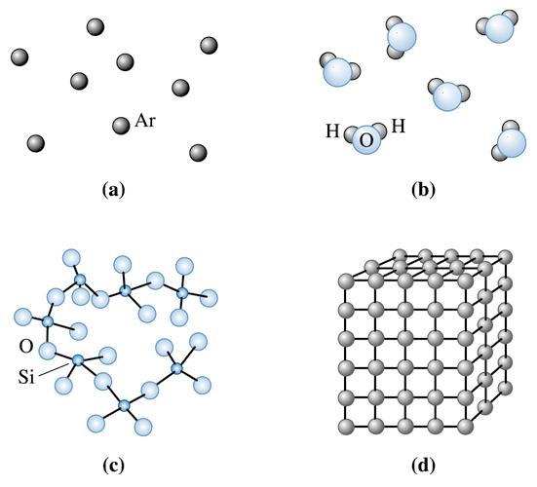
Figure 3.1 Levels of atomic arrangements in materials: (a) Inert monoatomic gases have no regular ordering of atoms: (b,c) Some materials, including water vapor, nitrogen gas, amorphous silicon and silicate glass have short-range order. (d) Metals, alloys, many ceramics and some polymers have regular ordering of atoms/ions that extends through the material.
(c) 2003 Brooks/Cole Publishing / Thomson Learning™

Slide 6
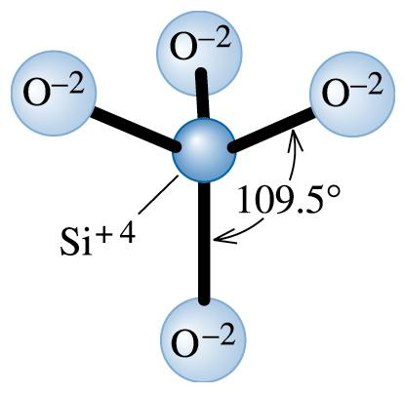
Figure 3.2 Basic Si-0 tetrahedron in silicate glass.
(c) 2003 Brooks/Cole Publishing / Thomson Learning™

Slide 7
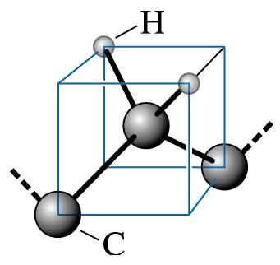
Figure 3.3 Tetrahedral arrangement of C-H bonds in polyethylene.
(c) 2003 Brooks/Cole Publishing / Thomson Learning™

Slide 8
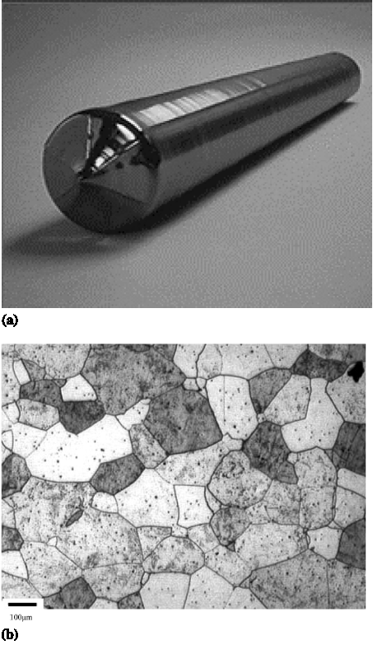
Figure 3.4 (a) Photograph of a silicon single crystal. (b) Micrograph of a polycrystalline stainless steel showing grains and grain boundaries (Courtesy Dr. M. Hua, Dr. I. Garcia, and Dr. A.J. Deardo.)

Slide 9
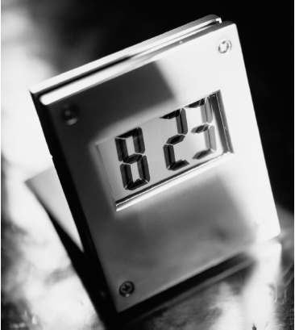
Figure 3.5 Liquid crystal display. These materials are amorphous in one state and undergo localized crystallization in response to an external electric field and are widely used in liquid crystal displays. (Courtesy of Nick Koudis/PhotoDisc/Getty Images.)

Slide 10
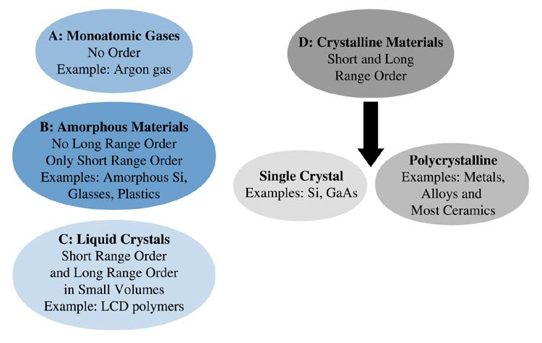
(c) 2003 Brooks/Cole Publishing / Thomson Learning™
Figure 3.7 Classification of materials based on the type of atomic order.

Slide 11
Section 3.2 Amorphous Materials: Principles and Technological Applications
Amorphous materials - Materials, including glasses, that have no long-range order, or crystal structure.
Glasses - Solid, non-crystalline materials (typically derived from the molten state) that have only short-range atomic order.
Glass-ceramics - A family of materials typically derived from molten inorganic glasses and processed into crystalline materials with very fine grain size and improved mechanical properties.

Slide 12
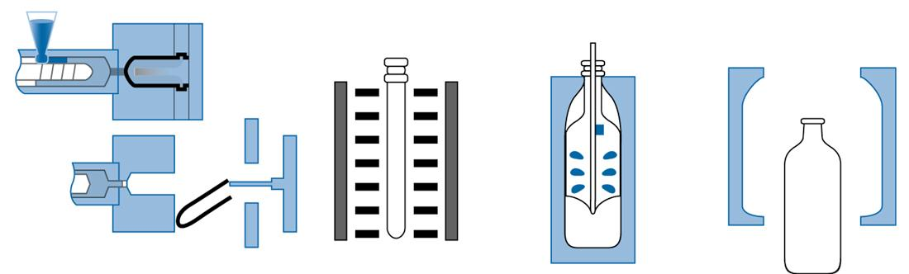
(c) 2003 Brooks/Cole Publishing / Thomson Learning™
Figure 3.9 (b) This figure shows a schematic of the blow-stretch process used for fabrication of a standard two-liter PET (polyethylene terephthalate) bottle from a preform. The stress induced crystallization leads to formation of small crystals that help reinforce the remaining amorphous matrix.

Slide 13
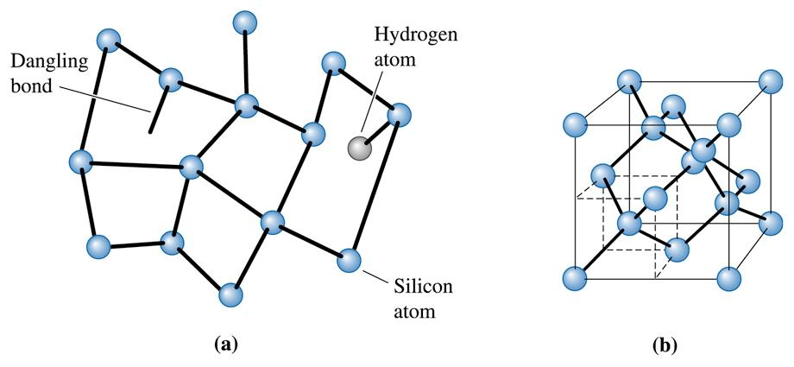
(c) 2003 Brooks/Cole Publishing / Thomson Learning™
Figure 3.10 Atomic arrangements in crystalline silicon and amorphous silicon. (a) Amorphous silicon. (b) Crystalline silicon. Note the variation in the inter-atomic distance for amorphous silicon.

Slide 14
Section 3.3 Lattice, Unit Cells, Basis, and Crystal Structures
Lattice - A collection of points that divide space into smaller equally sized segments.
Basis - A group of atoms associated with a lattice point.
Unit cell - A subdivision of the lattice that still retains the overall characteristics of the entire lattice.
Atomic radius - The apparent radius of an atom, typically calculated from the dimensions of the unit cell, using close-packed directions (depends upon coordination number).
Packing factor - The fraction of space in a unit cell occupied by atoms.

Slide 15
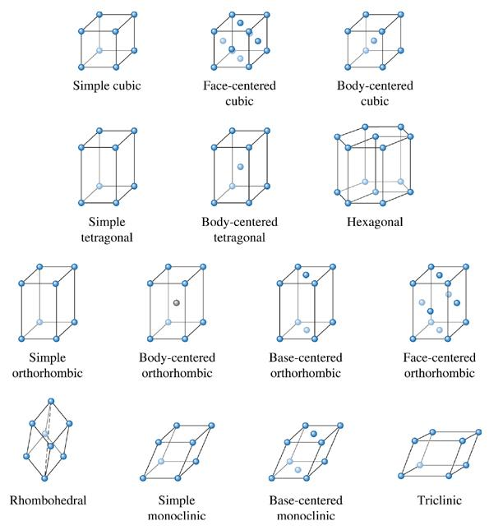
Figure 3.11 The fourteen types of Bravais lattices grouped in seven crystal systems. The actual unit cell for a hexagonal system is shown in Figures 3.12 and 3.16.
(c) 2003 Brooks/Cole Publishing / Thomson Learning™

Slide 16
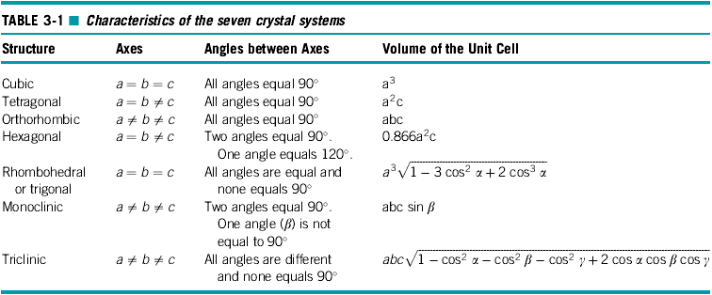

Slide 17
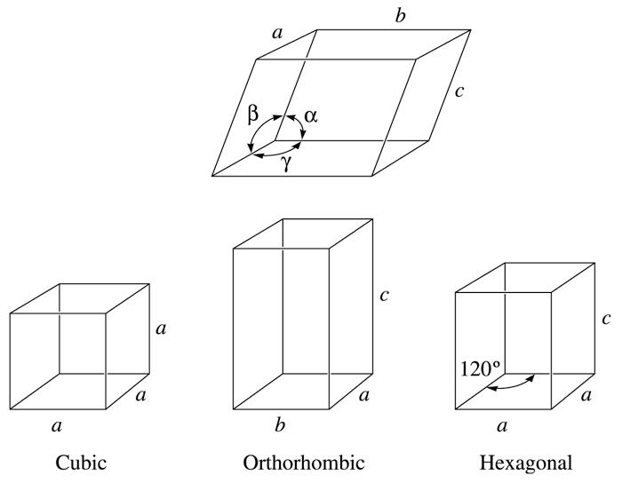
Figure 3.12 Definition of the lattice parameters and their use in cubic, orthorhombic, and hexagonal crystal systems.
(c) 2003 Brooks/Cole Publishing / Thomson Learning™

Slide 18
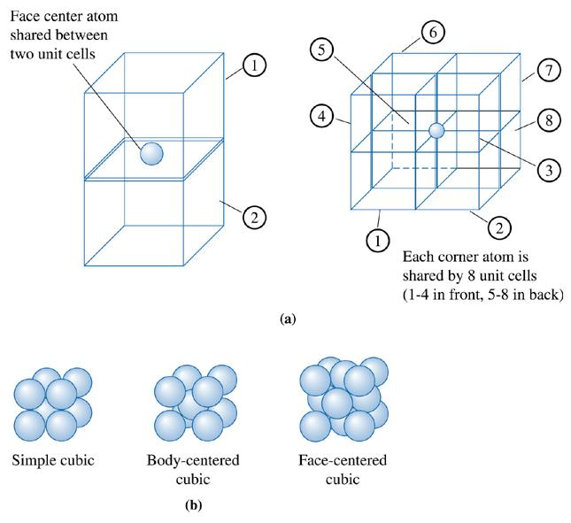
Figure 3.13 (a) Illustration showing sharing of face and corner atoms. (b) The models for simple cubic (SC), body centered cubic (BCC), and face-centered cubic (FCC) unit cells, assuming only one atom per lattice point.
(c) 2003 Brooks/Cole Publishing / Thomson Learning™

Slide 19
Example 3.1 Determining the Number of Lattice Points in Cubic Crystal Systems
Determine the number of lattice points per cell in the cubic crystal systems. If there is only one atom located at each lattice point, calculate the number of atoms per unit cell.
Example 3.1 SOLUTION
In the SC unit cell: lattice point / unit cell = (8 corners)1/8 = 1
In BCC unit cells: lattice point / unit cell = (8 corners)1/8 + (1 center)(1) = 2
In FCC unit cells: lattice point / unit cell = (8 corners)1/8 + (6 faces)(1/2) = 4
The number of atoms per unit cell would be 1, 2, and 4, for the simple cubic, body-centered cubic, and face-centered cubic, unit cells, respectively.

Slide 20
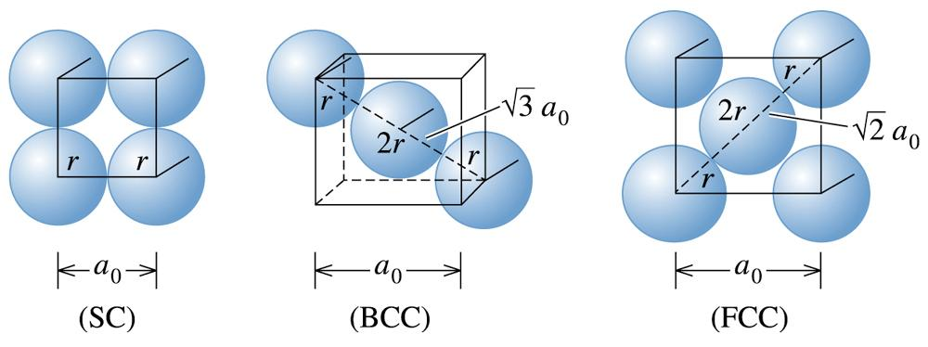
Example 3.2 Determining the Relationship between Atomic Radius and Lattice Parameters
Determine the relationship between the atomic radius and the lattice parameter in SC, BCC, and FCC structures when one atom is located at each lattice point.
(c) 2003 Brooks/Cole Publishing / Thomson Learning™
Figure 3.14 The relationships between the atomic radius and the Lattice parameter in cubic systems (for Example 3.2).

Slide 21
Example 3.2 SOLUTION
Referring to Figure 3.14, we find that atoms touch along the edge of the cube in SC structures.
In BCC structures, atoms touch along the body diagonal. There are two atomic radii from the center atom and one atomic radius from each of the corner atoms on the body diagonal, so
In FCC structures, atoms touch along the face diagonal of the cube. There are four atomic radii along this length—two radii from the face-centered atom and one radius from each corner, so:

Slide 22
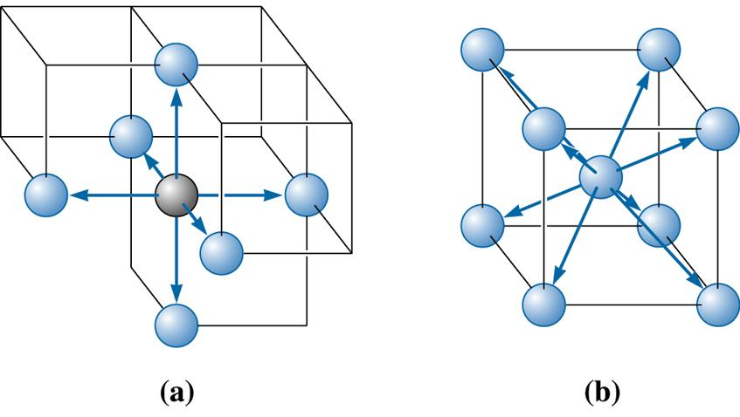
(c) 2003 Brooks/Cole Publishing / Thomson Learning™
Figure 3.15 Illustration of coordinations in (a) SC and (b) BCC unit cells. Six atoms touch each atom in SC, while the eight atoms touch each atom in the BCC unit cell.

Slide 23
Example 3.3 Calculating the Packing Factor
Calculate the packing factor for the FCC cell.
Example 3.3 SOLUTION
In a FCC cell, there are four lattice points per cell; if there is one atom per lattice point, there are also four atoms per cell. The volume of one atom is 4πr³/3 and the volume of the unit cell is .

Slide 24
Example 3.4 Determining the Density of BCC Iron
Determine the density of BCC iron, which has a lattice parameter of 0.2866 nm.
Example 3.4 SOLUTION
Atoms/cell = 2, a₀ = 0.2866 nm = 2.866 × 10⁻⁸ cm
Atomic mass = 55.847 g/mol
Volume of unit cell = = (2.866 × 10⁻⁸ cm)³ = 23.54 × 10⁻²⁴ cm³/cell
Avogadro’s number N_{A} = 6.02 × 10²³ atoms/mol

Slide 25
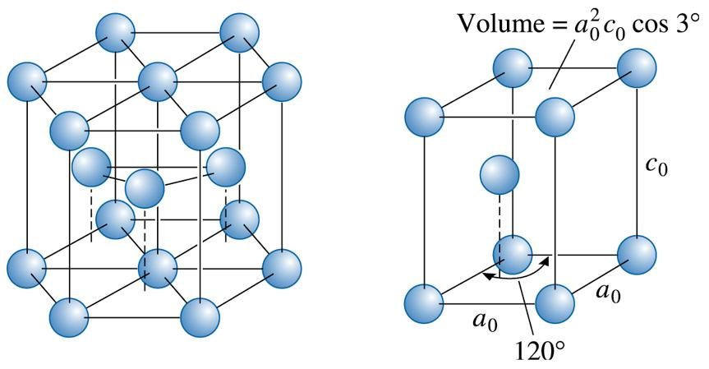
(c) 2003 Brooks/Cole Publishing / Thomson Learning™
Figure 3.16 The hexagonal close-packed (HCP) structure (left) and its unit cell.

Slide 26
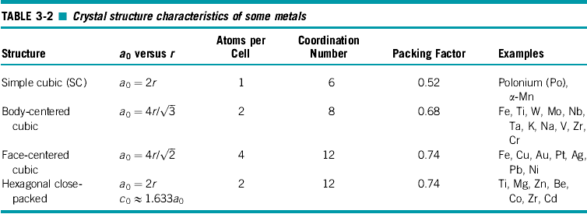

Slide 27
Section 3.4 Allotropic or Polymorphic Transformations
Allotropy - The characteristic of an element being able to exist in more than one crystal structure, depending on temperature and pressure.
Polymorphism - Compounds exhibiting more than one type of crystal structure.

Slide 28

Figure 3.17 Oxygen gas sensors used in cars and other applications are based on stabilized zirconia compositions. (Image courtesy of Bosch © Robert Bosch GmbH.)

Slide 29
Example 3.5 Calculating Volume Changes in Polymorphs of Zirconia
Calculate the percent volume change as zirconia transforms from a tetragonal to monoclinic structure.[9] The lattice constants for the monoclinic unit cells are: a = 5.156, b = 5.191, and c = 5.304 Å, respectively. The angle β for the monoclinic unit cell is 98.9. The lattice constants for the tetragonal unit cell are a = 5.094 and c = 5.304 Å, respectively.[10] Does the zirconia expand or contract during this transformation? What is the implication of this transformation on the mechanical properties of zirconia ceramics?

Slide 30
Example 3.5 SOLUTION
The volume of a tetragonal unit cell is given by V = a²c = (5.094)² (5.304) = 134.33 Å³.
The volume of a monoclinic unit cell is given by V = abc sin β = (5.156) (5.191) (5.304) sin(98.9) = 140.25 Å³.
Thus, there is an expansion of the unit cell as ZrO2 transforms from a tetragonal to monoclinic form.
The percent change in volume
= (final volume initial volume)/(initial volume) 100
= (140.25 - 134.33 Å³)/140.25 Å³ * 100 = 4.21%.
Most ceramics are very brittle and cannot withstand more than a 0.1% change in volume. The conclusion here is that ZrO₂ ceramics cannot be used in their monoclinic form since, when zirconia does transform to the tetragonal form, it will most likely fracture. Therefore, ZrO₂ is often stabilized in a cubic form using different additives such as CaO, MgO, and Y₂O₃.

Slide 31
Example 3.6 Designing a Sensor to Measure Volume Change
To study how iron behaves at elevated temperatures, we would like to design an instrument that can detect (with a 1% accuracy) the change in volume of a 1-cm³ iron cube when the iron is heated through its polymorphic transformation temperature. At 911ºC, iron is BCC, with a lattice parameter of 0.2863 nm. At 913ºC, iron is FCC, with a lattice parameter of 0.3591 nm. Determine the accuracy required of the measuring instrument.
Example 3.6 SOLUTION
The volume of a unit cell of BCC iron before transforming is:
V_{BCC} = = (0.2863 nm)³ = 0.023467 nm³

Slide 32
Example 3.6 SOLUTION (Continued)
The volume of the unit cell in FCC iron is:
V_{FCC} = = (0.3591 nm)³ = 0.046307 nm³
But this is the volume occupied by four iron atoms, as there are four atoms per FCC unit cell. Therefore, we must compare two BCC cells (with a volume of 2(0.023467) = 0.046934 nm³) with each FCC cell. The percent volume change during transformation is:
The 1-cm³ cube of iron contracts to 1 - 0.0134 = 0.9866 cm³ after transforming; therefore, to assure 1% accuracy, the instrument must detect a change of:
ΔV = (0.01)(0.0134) = 0.000134 cm³

Slide 33
Section 3.5 Points, Directions, and Planes in the Unit Cell
Miller indices - A shorthand notation to describe certain crystallographic directions and planes in a material. Denoted by [ ] brackets. A negative number is represented by a bar over the number.
Directions of a form - Crystallographic directions that all have the same characteristics, although their ‘‘sense’’ is different. Denoted by h i brackets.
Repeat distance - The distance from one lattice point to the adjacent lattice point along a direction.
Linear density - The number of lattice points per unit length along a direction.
Packing fraction - The fraction of a direction (linear-packing fraction) or a plane (planar-packing factor) that is actually covered by atoms or ions.

Slide 34
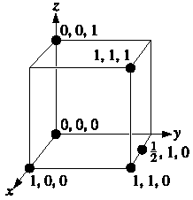
Figure 3.18 Coordinates of selected points in the unit cell. The number refers to the distance from the origin in terms of lattice parameters.

Slide 35
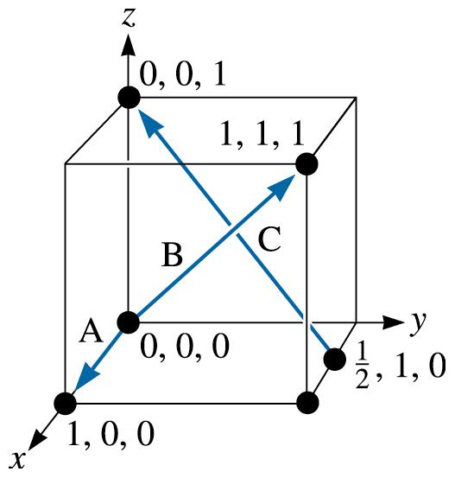
Example 3.7 Determining Miller Indices of Directions
Determine the Miller indices of directions A, B, and C in Figure 3.19.
Figure 3.19 Crystallographic directions and coordinates (for Example 3.7).
(c) 2003 Brooks/Cole Publishing / Thomson Learning™

Slide 36
Example 3.7 SOLUTION
Direction A
1. Two points are 1, 0, 0, and 0, 0, 0
2. 1, 0, 0, -0, 0, 0 = 1, 0, 0
3. No fractions to clear or integers to reduce
4. [100]
Direction B
1. Two points are 1, 1, 1 and 0, 0, 0
2. 1, 1, 1, -0, 0, 0 = 1, 1, 1
3. No fractions to clear or integers to reduce
4. [111]
Direction C
1. Two points are 0, 0, 1 and 1/2, 1, 0
2. 0, 0, 1 -1/2, 1, 0 = -1/2, -1, 1
3. 2(-1/2, -1, 1) = -1, -2, 2

Slide 37
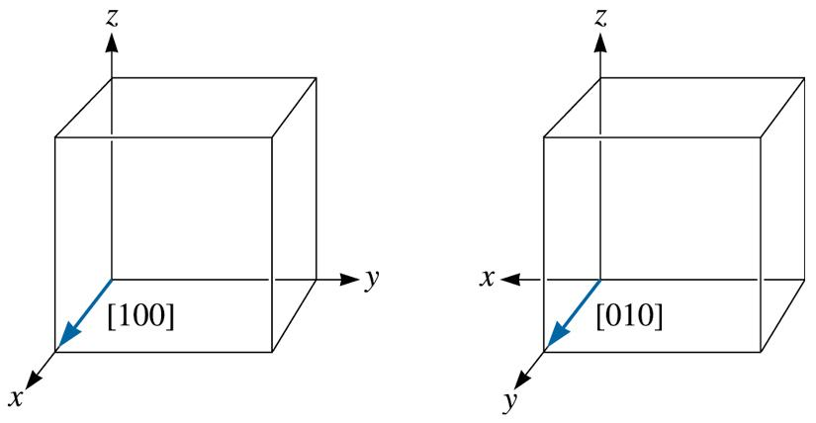
(c) 2003 Brooks/Cole Publishing / Thomson Learning™
Figure 3.20 Equivalency of crystallographic directions of a form in cubic systems.

Slide 38
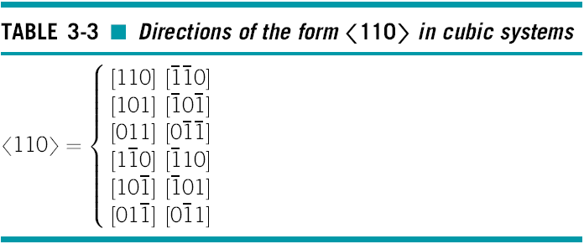

Slide 39
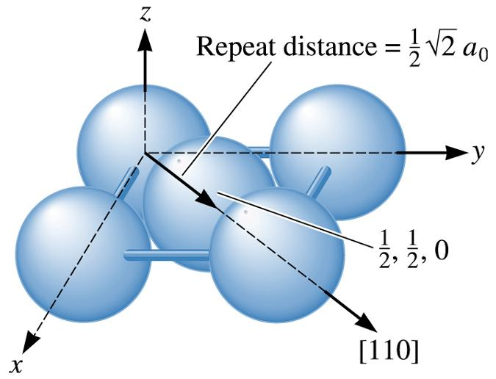
Figure 3.21 Determining the repeat distance, linear density, and packing fraction for [110] direction in FCC copper.
(c) 2003 Brooks/Cole Publishing / Thomson Learning™

Slide 40
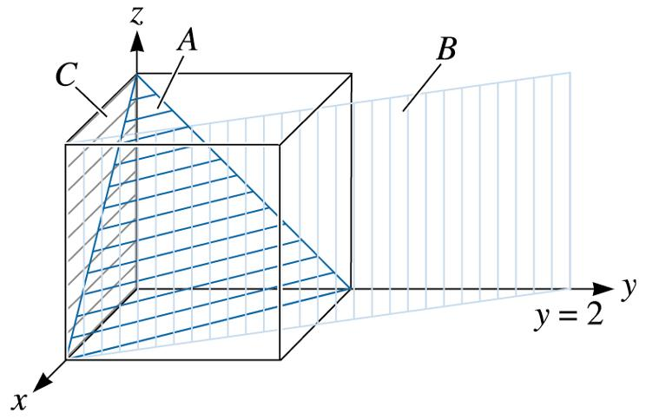
Example 3.8 Determining Miller Indices of Planes
Determine the Miller indices of planes A, B, and C in Figure 3.22.
Figure 3.22 Crystallographic planes and intercepts (for Example 3.8)
(c) 2003 Brooks/Cole Publishing / Thomson Learning™

Slide 41
Example 3.8 SOLUTION
Plane A
1. x = 1, y = 1, z = 1
2.1/x = 1, 1/y = 1,1 /z = 1
3. No fractions to clear
4. (111)
Plane B
1. The plane never intercepts the z axis, so x = 1, y = 2, and z =
2.1/x = 1, 1/y =1/2, 1/z = 0
3. Clear fractions:
1/x = 2, 1/y = 1, 1/z = 0
4. (210)
Plane C
1. We must move the origin, since the plane passes through 0, 0, 0. Let’s move the origin one lattice parameter in the y-direction. Then, x = , y = -1, and z =
2.1/x = 0, 1/y = 1, 1/z = 0
3. No fractions to clear.

Slide 42
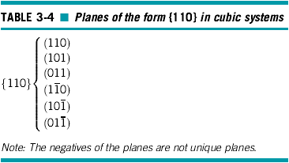

Slide 43
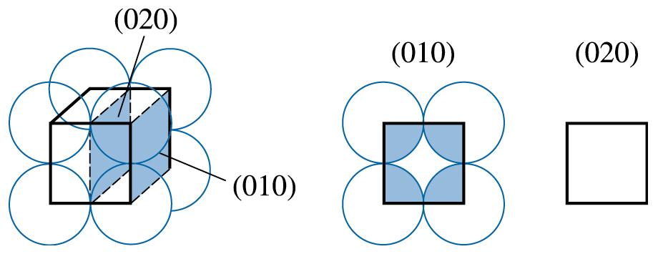
Example 3.9 Calculating the Planar Density and Packing Fraction
Calculate the planar density and planar packing fraction for the (010) and (020) planes in simple cubic polonium, which has a lattice parameter of 0.334 nm.
Figure 3.23 The planer densities of the (010) and (020) planes in SC unit cells are not identical (for Example 3.9).
(c) 2003 Brooks/Cole Publishing / Thomson Learning™

Slide 44
Example 3.9 SOLUTION
The total atoms on each face is one. The planar density is:
The planar packing fraction is given by:
However, no atoms are centered on the (020) planes. Therefore, the planar density and the planar packing fraction are both zero. The (010) and (020) planes are not equivalent!

Slide 45
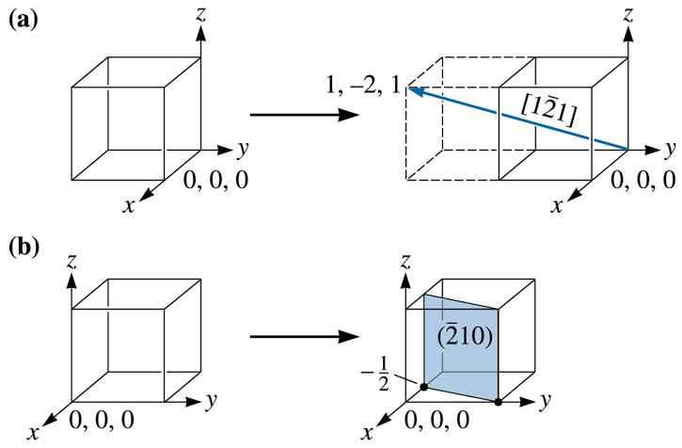
Example 3.10 Drawing Direction and Plane
Draw (a) the direction and (b) the plane in a cubic unit cell.
Figure 3.24 Construction of a (a) direction and (b) plane within a unit cell (for Example 3.10)
(c) 2003 Brooks/Cole Publishing / Thomson Learning™

Slide 46
Example 3.10 SOLUTION
a. Because we know that we will need to move in the negative y-direction, let’s locate the origin at 0, +1, 0. The ‘‘tail’’ of the direction will be located at this new origin. A second point on the direction can be determined by moving +1 in the x-direction, 2 in the y-direction, and +1 in the z direction [Figure 3.24(a)].
b. To draw in the plane, first take reciprocals of the indices to obtain the intercepts, that is:
x = 1/-2 = -1/2 y = 1/1 = 1 z = 1/0 =
Since the x-intercept is in a negative direction, and we wish to draw the plane within the unit cell, let’s move the origin +1 in the x-direction to 1, 0, 0. Then we can locate the x-intercept at 1/2 and the y-intercept at +1. The plane will be parallel to the z-axis [Figure 3.24(b)].

Slide 47
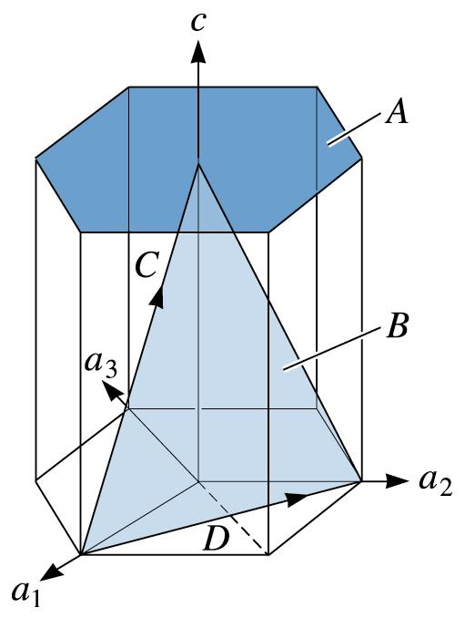
Figure 3.25 Miller-Bravais indices are obtained for crystallographic planes in HCP unit cells by using a four-axis coordinate system. The planes labeled A and B and the direction labeled C and D are those discussed in Example 3.11.
(c) 2003 Brooks/Cole Publishing / Thomson Learning™

Slide 48
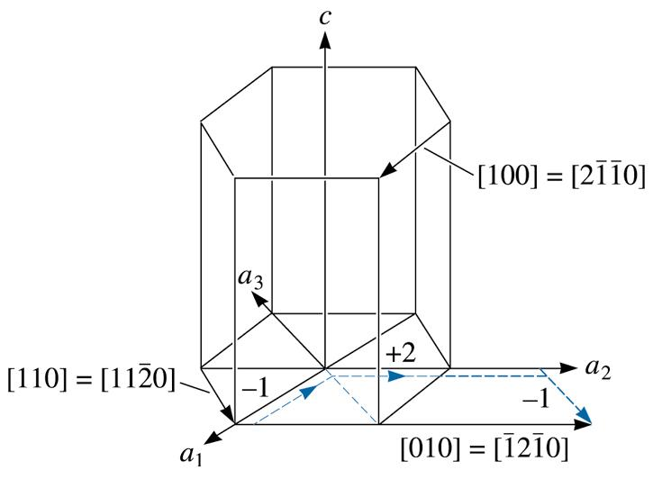
(c) 2003 Brooks/Cole Publishing / Thomson Learning™
Figure 3.26 Typical directions in the HCP unit cell, using both three-and-four-axis systems. The dashed lines show that the [1210] direction is equivalent to a [010] direction.

Slide 49
Example 3.11 Determining the Miller-Bravais Indices for Planes and Directions
Determine the Miller-Bravais indices for planes A and B and directions C and D in Figure 3.25.
Figure 3.25 Miller-Bravais indices are obtained for crystallographic planes in HCP unit cells by using a four-axis coordinate system. The planes labeled A and B and the direction labeled C and D are those discussed in Example 3.11.
(c) 2003 Brooks/Cole Publishing / Thomson Learning™

Slide 50
Example 3.11 SOLUTION
Plane A
1. a₁ = a₂ = a₃ = , c = 1
2. 1/a₁ = 1/a₂ = 1/a₃ = 0, 1/c = 1
3. No fractions to clear
4. (0001)
Plane B
1. a₁ = 1, a₂ = 1, a₃ = -1/2, c = 1
2. 1/a₁ = 1, 1/a₂ = 1, 1/a₃ = -2, 1/c = 1
3. No fractions to clear
4.
Direction C
1. Two points are 0, 0, 1 and 1, 0, 0.
2. 0, 0, 1, -1, 0, 0 = 1, 0, 1
3. No fractions to clear or integers to reduce.
4.

Slide 51
Example 3.11 SOLUTION (Continued)
Direction D
1. Two points are 0, 1, 0 and 1, 0, 0.
2. 0, 1, 0, -1, 0, 0 = -1, 1, 0
3. No fractions to clear or integers to reduce.
4.

Slide 52
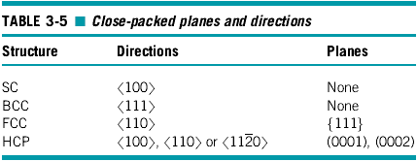

Slide 53
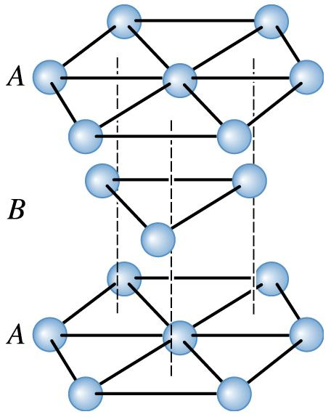
Figure 3.27 The ABABAB stacking sequence of close-packed planes produces the HCP structure.
(c) 2003 Brooks/Cole Publishing / Thomson Learning™

Slide 54
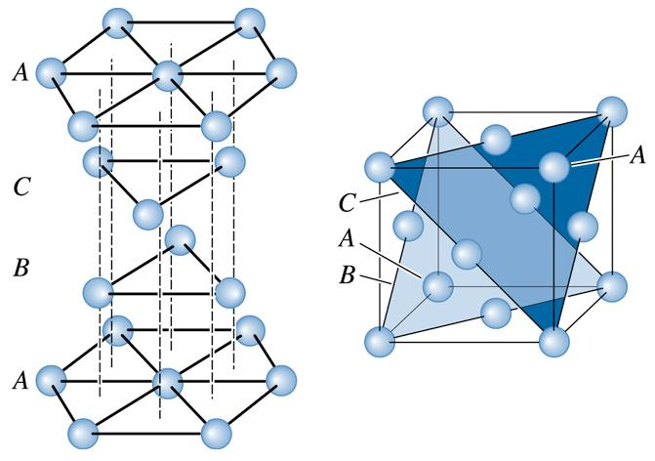
(c) 2003 Brooks/Cole Publishing / Thomson Learning™
Figure 3.28 The ABCABCABC stacking sequence of close-packed planes produces the FCC structure.

Slide 55
Section 3.6 Interstitial Sites
Interstitial sites - Locations between the ‘‘normal’’ atoms or ions in a crystal into which another - usually different - atom or ion is placed. Typically, the size of this interstitial location is smaller than the atom or ion that is to be introduced.
Cubic site - An interstitial position that has a coordination number of eight. An atom or ion in the cubic site touches eight other atoms or ions.
Octahedral site - An interstitial position that has a coordination number of six. An atom or ion in the octahedral site touches six other atoms or ions.
Tetrahedral site - An interstitial position that has a coordination number of four. An atom or ion in the tetrahedral site touches four other atoms or ions.

Slide 56
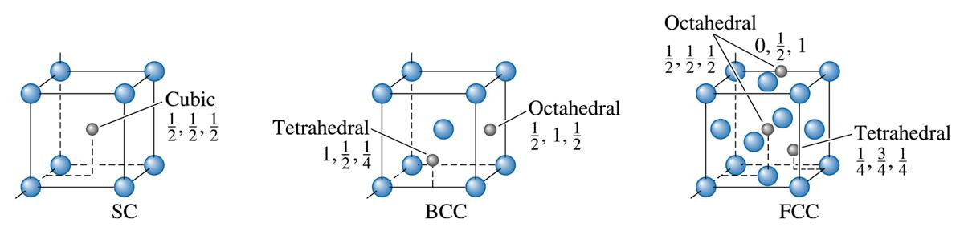
(c) 2003 Brooks/Cole Publishing / Thomson Learning™
Figure 3.29 The location of the interstitial sites in cubic unit cells. Only representative sites are shown.

Slide 57
Example 3.12 Calculating Octahedral Sites
Calculate the number of octahedral sites that uniquely belong to one FCC unit cell.
Example 3.12 SOLUTION
The octahedral sites include the 12 edges of the unit cell, with the coordinates
plus the center position, 1/2, 1/2, 1/2.

Slide 58
Example 3.12 SOLUTION (Continued)
Each of the sites on the edge of the unit cell is shared between four unit cells, so only 1/4 of each site belongs uniquely to each unit cell.
Therefore, the number of sites belonging uniquely to each cell is:
(12 edges) (1/4 per cell) + 1 center location
= 4 octahedral sites

Slide 59
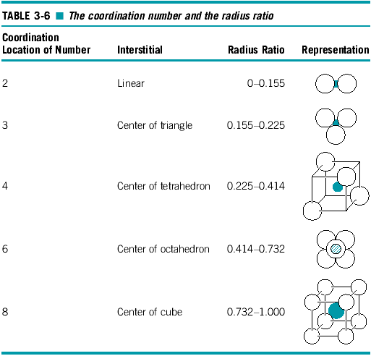
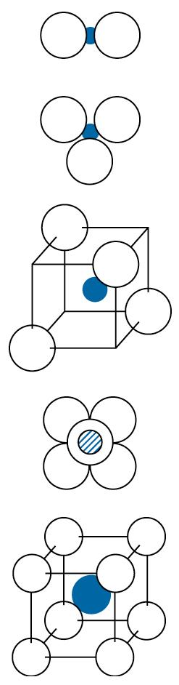

Slide 60
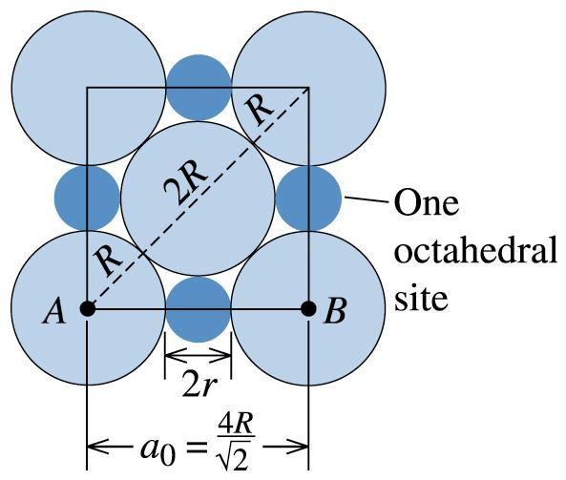
Example 3.13 Design of a Radiation-Absorbing Wall
We wish to produce a radiation-absorbing wall composed of 10,000 lead balls, each 3 cm in diameter, in a face-centered cubic arrangement. We decide that improved absorption will occur if we fill interstitial sites between the 3-cm balls with smaller balls. Design the size of the smaller lead balls and determine how many are needed.
Figure 3.30 Calculation of an octahedral interstitial site (for Example 3.13).
(c) 2003 Brooks/Cole Publishing / Thomson Learning™

Slide 61
Example 3.13 SOLUTION
First, we can calculate the diameter of the octahedral
sites located between the 3-cm diameter balls. Figure 3.30 shows the arrangement of the balls on a plane containing an octahedral site.
Length AB = 2R + 2r = 2R
r = R – R = ( - 1)R
r/R = 0.414
This is consistent with Table 3-6. Since r = R = 0.414, the radius of the small lead balls is
r = 0.414 * R = (0.414)(3 cm/2) = 0.621 cm.
From Example 3-12, we find that there are four octahedral sites in the FCC arrangement, which also has four lattice points. Therefore, we need the same number of small lead balls as large lead balls, or 10,000 small balls.

Slide 62
Section 3.7 Crystal Structures of Ionic Materials
Factors need to be considered in order to understand crystal structures of ionically bonded solids:
  Ionic Radii
  Electrical Neutrality
  Connection between Anion Polyhedra
  Visualization of Crystal Structures Using Computers

Slide 63
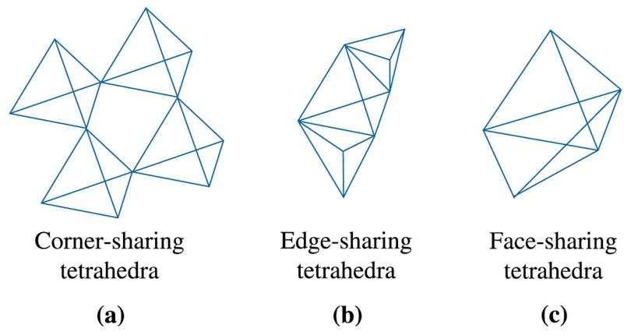
(c) 2003 Brooks/Cole Publishing / Thomson Learning™
Figure 3.31 Connection between anion polyhedra. Different possible connections include sharing of corners, edges, or faces. In this figure, examples of connections between tetrahedra are shown.

Slide 64
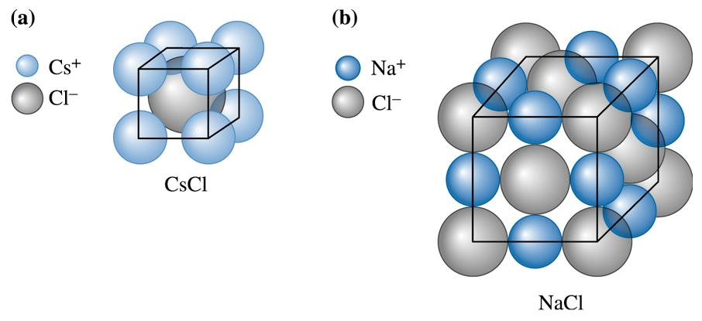
(c) 2003 Brooks/Cole Publishing / Thomson Learning™
Figure 3.32 (a) The cesium chloride structure, a SC unit cell with two ions (Cs⁺ and CI⁻) per lattice point. (b) The sodium chloride structure, a FCC unit cell with two ions (Na⁺ + CI⁻) per lattice point. Note: Ion sizes not to scale.

Slide 65
Example 3.14 Radius Ratio for KCl
For potassium chloride (KCl), (a) verify that the compound has the cesium chloride structure and (b) calculate the packing factor for the compound.
Example 3.14 SOLUTION
a. From Appendix B, r_{K}+ = 0.133 nm and r_{Cl}- = 0.181 nm, so:
r_{K}+/ r_{Cl}- = 0.133/0.181 = 0.735
Since 0.732 < 0.735 < 1.000, the coordination number for each type of ion is eight and the CsCl structure is likely.

Slide 66
Example 3.14 SOLUTION (Continued)
b. The ions touch along the body diagonal of the unit cell, so:
a₀ = 2r_{K}+ + 2r_{Cl}- = 2(0.133) + 2(0.181) = 0628 nm
a₀ = 0.363 nm

Slide 67
Example 3.15 Illustrating a Crystal Structure and Calculating Density
Show that MgO has the sodium chloride crystal structure and calculate the density of MgO.
Example 3.15 SOLUTION
From Appendix B, r_{Mg}+2 = 0.066 nm and r_{O}-2 = 0.132 nm, so:
r_{Mg}+2 /r_{O}-2 = 0.066/0.132 = 0.50
Since 0.414 < 0.50 < 0.732, the coordination number for each ion is six, and the sodium chloride structure is possible.

Slide 68
Example 3.15 SOLUTION
The atomic masses are 24.312 and 16 g/mol for magnesium and oxygen, respectively. The ions touch along the edge of the cube, so:
a₀ = 2 r_{Mg}+2 + 2r_{O}-2 = 2(0.066) + 2(0.132) = 0.396 nm = 3.96 × 10⁻⁸ cm

Slide 69
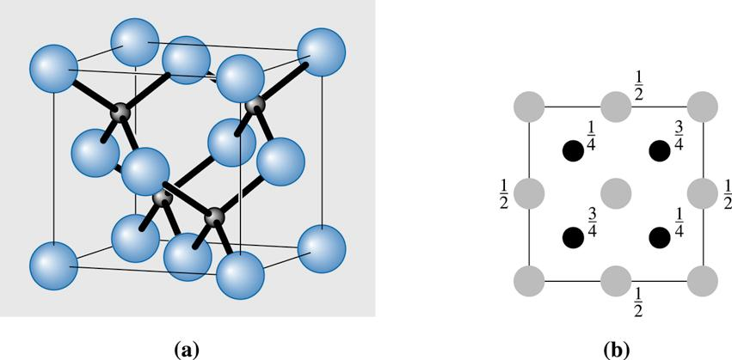
(c) 2003 Brooks/Cole Publishing / Thomson Learning™
Figure 3.33 (a) The zinc blende unit cell, (b) plan view.

Slide 70
Example 3.16 Calculating the Theoretical Density of GaAs
The lattice constant of gallium arsenide (GaAs) is 5.65 Å. Show that the theoretical density of GaAs is 5.33 g/cm³.
Example 3.16 SOLUTION
For the ‘‘zinc blende’’ GaAs unit cell, there are four Ga and four As atoms per unit cell.
From the periodic table (Chapter 2):
Each mole (6.023 × 10²³ atoms) of Ga has a mass of 69.7 g. Therefore, the mass of four Ga atoms will be (4 * 69.7/6.023 × 10²³) g.

Slide 71
Example 3.16 SOLUTION (Continued)
Each mole (6.023 × 10²³ atoms) of As has a mass of 74.9 g.
Therefore, the mass of four As atoms will be (4 * 74.9/6.023 × 10²³) g. These atoms occupy a volume of (5.65 × 10⁻⁸)³ cm³.
Therefore, the theoretical density of GaAs will be 5.33 g/cm³.

Slide 72
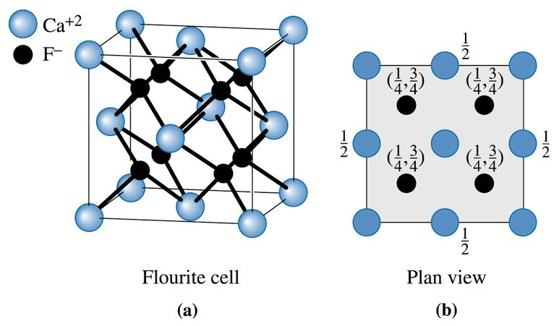
(c) 2003 Brooks/Cole Publishing / Thomson Learning™
Figure 3.34 (a) Fluorite unit cell, (b) plan view.

Slide 73
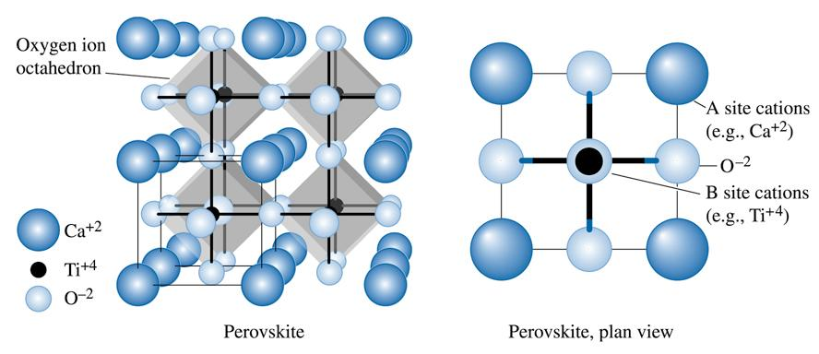
(c) 2003 Brooks/Cole Publishing / Thomson Learning
Figure 3.35 The perovskite unit cell showing the A and B site cations and oxygen ions occupying the face-center positions of the unit cell. Note: Ions are not show to scale.

Slide 74
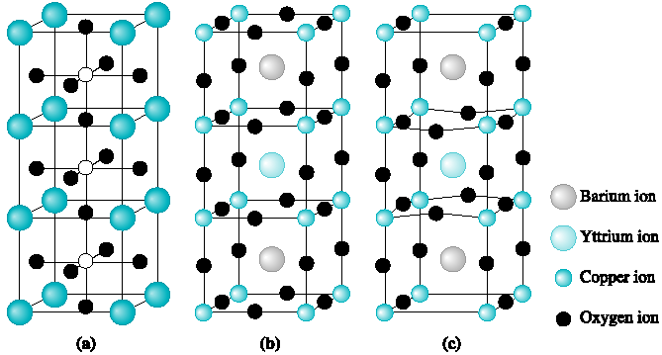
Figure 3.36 Crystal structure of a new high T_{c} ceramic superconductor based on a yttrium barium copper oxide. These materials are unusual in that they are ceramics, yet at low temperatures their electrical resistance vanishes. (Source: ill.fr/dif/3D-crystals/superconductor.html; © M. Hewat 1998.)

Slide 75
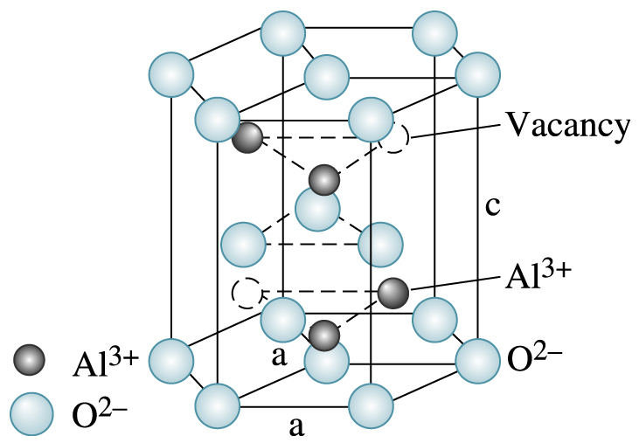
(c) 2003 Brooks/Cole Publishing / Thomson Learning
Figure 3.37 Corundum structure of alpha-alumina (α-AI₂0₃).

Slide 76
Section 3.8 Covalent Structures
Covalently bonded materials frequently have complex structures in order to satisfy the directional restraints imposed by the bonding.
Diamond cubic (DC) - A special type of face-centered cubic crystal structure found in carbon, silicon, and other covalently bonded materials.

Slide 77
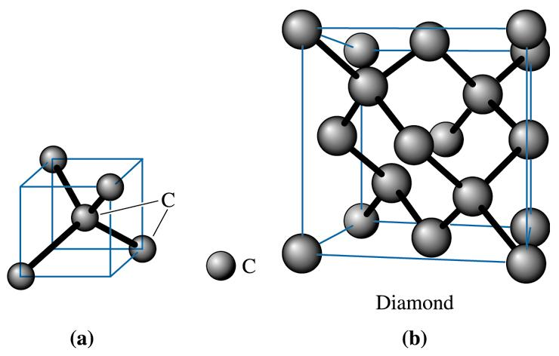
(c) 2003 Brooks/Cole Publishing / Thomson Learning
Figure 3.38 (a) Tetrahedron and (b) the diamond cubic (DC) unit cell. This open structure is produced because of the requirements of covalent bonding.

Slide 78
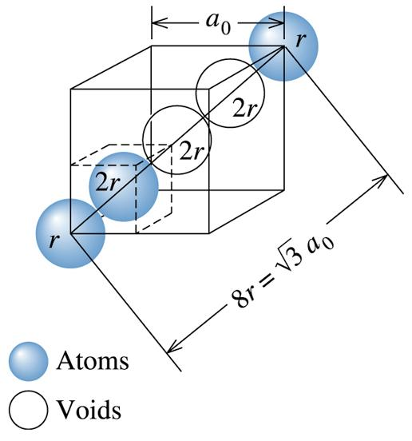
Example 3.17 Determining the Packing Factor for Diamond Cubic Silicon
Determine the packing factor for diamond cubic silicon.
(c) 2003 Brooks/Cole Publishing / Thomson Learning
Figure 3.39 Determining the relationship between lattice parameter and atomic radius in a diamond cubic cell (for Example 3.17).

Slide 79
Example 3.17 SOLUTION
We find that atoms touch along the body diagonal of the cell (Figure 3.39). Although atoms are not present at all locations along the body diagonal, there are voids that have the same diameter as atoms. Consequently:
Compared to close packed structures this is a relatively open structure.

Slide 80
Example 3.18 Calculating the Radius, Density, and Atomic Mass of Silicon
The lattice constant of Si is 5.43 Å . What will be the radius of a silicon atom? Calculate the theoretical density of silicon. The atomic mass of Si is 28.1 gm/mol.
Example 3.18 SOLUTION
For the diamond cubic structure,
Therefore, substituting a = 5.43 Å, the radius of silicon atom = 1.176 Å .
There are eight Si atoms per unit cell.

Slide 81
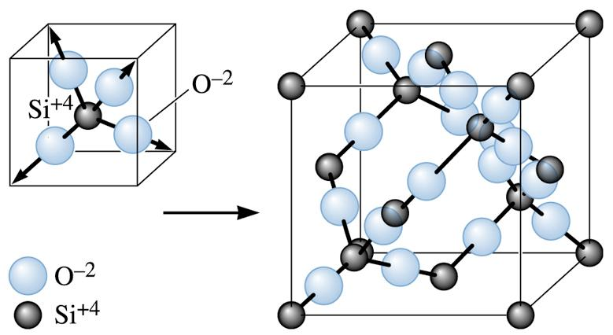
(c) 2003 Brooks/Cole Publishing / Thomson Learning
Figure 3.40 The silicon-oxygen tetrahedron and the resultant β-cristobalite form of silica.

Slide 82
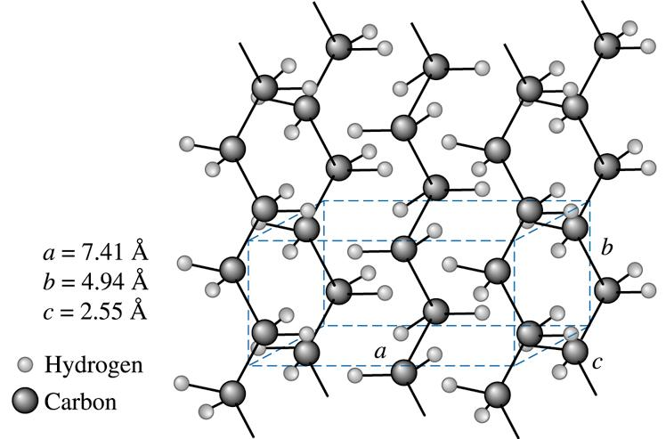
(c) 2003 Brooks/Cole Publishing / Thomson Learning
Figure 3.41 The unit cell of crystalline polyethylene.

Slide 83
Example 3.19 Calculating the Number of Carbon and Hydrogen Atoms in Crystalline Polyethylene
How many carbon and hydrogen atoms are in each unit cell of crystalline polyethylene? There are twice as many hydrogen atoms as carbon atoms in the chain. The density of polyethylene is about 0.9972 g/cm³.
Example 3.19 SOLUTION
If we let x be the number of carbon atoms, then 2x is the number of hydrogen atoms. From the lattice parameters shown in Figure 3.41:
x = 4 carbon atoms per cell
2x = 8 hydrogen atoms per cell

Slide 84
Section 3.9 Diffraction Techniques for Crystal Structure Analysis
Diffraction - The constructive interference, or reinforcement, of a beam of x-rays or electrons interacting with a material. The diffracted beam provides useful information concerning the structure of the material.
Bragg’s law - The relationship describing the angle at which a beam of x-rays of a particular wavelength diffracts from crystallographic planes of a given interplanar spacing.
In a diffractometer a moving x-ray detector records the 2y angles at which the beam is diffracted, giving a characteristic diffraction pattern

Slide 85
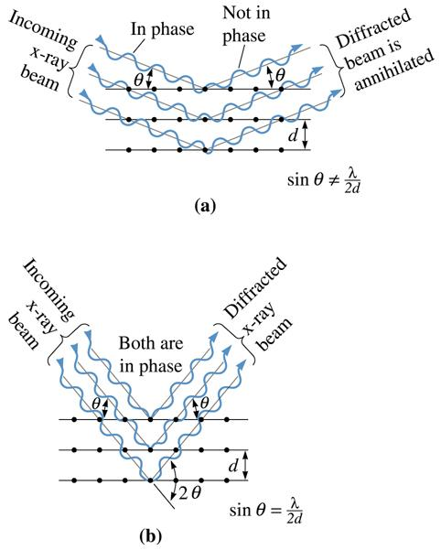
Figure 3.43 (a) Destructive and (b) reinforcing interactions between x-rays and the crystalline material. Reinforcement occurs at angles that satisfy Bragg’s law.
(c) 2003 Brooks/Cole Publishing / Thomson Learning

Slide 86
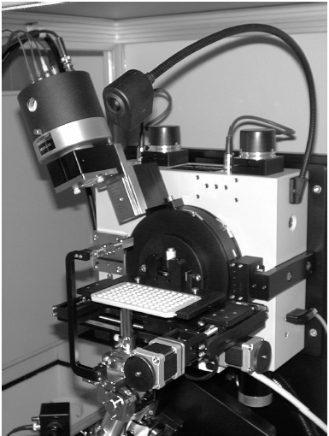
Figure 3.44 Photograph of a XRD diffractometer. (Courtesy of H&M Analytical Services.)

Slide 87
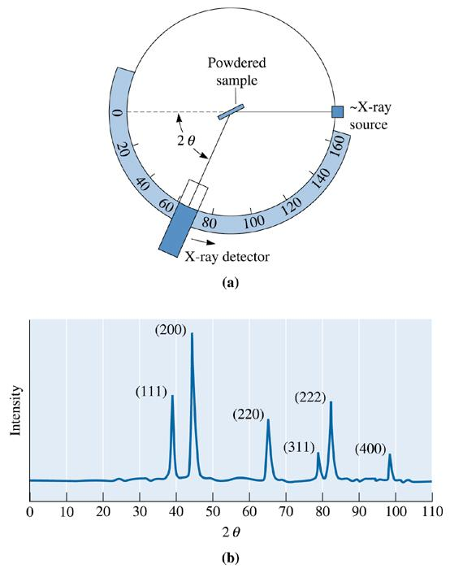
Figure 3.45 (a) Diagram of a diffractometer, showing powder sample, incident and diffracted beams. (b) The diffraction pattern obtained from a sample of gold powder.
(c) 2003 Brooks/Cole Publishing / Thomson Learning

Slide 88
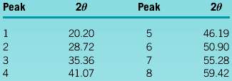
Example 3.20 Examining X-ray Diffraction
The results of a x-ray diffraction experiment using x-rays with λ = 0.7107 Å (a radiation obtained from molybdenum (Mo) target) show that diffracted peaks occur at the following 2θ angles:
Determine the crystal structure, the indices of the plane producing each peak, and the lattice parameter of the material.

Slide 89
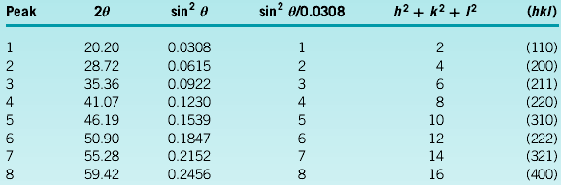
Example 3.20 SOLUTION
We can first determine the sin² θ value for each peak, then divide through by the lowest denominator, 0.0308.

Slide 90
Example 3.20 SOLUTION (Continued)
We could then use 2θ values for any of the peaks to calculate the interplanar spacing and thus the lattice parameter. Picking peak 8:
2θ = 59.42 or θ = 29.71
Å
Å
This is the lattice parameter for body-centered cubic iron.

Slide 91

Figure 3.46 Photograph of a transmission electron microscope (TEM) used for analysis of the microstructure of materials. (Courtesy of JEOL USA, Inc.)

Slide 92

Figure 3.47 A TEM micrograph of an aluminum alloy (Al-7055) sample. The diffraction pattern at the right shows large bright spots that represent diffraction from the main aluminum matrix grains. The smaller spots originate from the nano-scale crystals of another compound that is present in the aluminum alloy. (Courtesy of Dr. JÖrg M.K. Wiezorek, University of Pittsburgh.)

Slide 93

(c) 2003 Brooks/Cole Publishing / Thomson Learning
Figure 3.48 Directions in a cubic unit cell for Problem 3.51

Slide 94

(c) 2003 Brooks/Cole Publishing / Thomson Learning
Figure 3.49 Directions in a cubic unit cell for Problem 3.52.

Slide 95

(c) 2003 Brooks/Cole Publishing / Thomson Learning
Figure 3.50 Planes in a cubic unit cell for Problem 3.53.

Slide 96

(c) 2003 Brooks/Cole Publishing / Thomson Learning
Figure 3.51 Planes in a cubic unit cell for Problem 3.54.

Slide 97

(c) 2003 Brooks/Cole Publishing / Thomson Learning
Figure 3.52 Directions in a hexagonal lattice for Problem 3.55.

Slide 98

(c) 2003 Brooks/Cole Publishing / Thomson Learning
Figure 3.53 Directions in a hexagonal lattice for Problem 3.56.

Slide 99

(c) 2003 Brooks/Cole Publishing / Thomson Learning
Figure 3.54 Planes in a hexagonal lattice for Problem 3.57.

Slide 100

(c) 2003 Brooks/Cole Publishing / Thomson Learning
Figure 3.55 Planes in a hexagonal lattice for Problem 3.58.

Slide 101

(c) 2003 Brooks/Cole Publishing / Thomson Learning
Figure 3.56 XRD pattern for Problem 3.107.

Slide 102

(c) 2003 Brooks/Cole Publishing / Thomson Learning
Figure 3.57 XRD pattern for Problem 3.108.

Slide 103
The Science and Engineering of Materials
Donald R. Askeland – Pradeep P. Phulé
Imperfections in the Atomic and Ionic Arrangements

Slide 104
Objectives of Chapter 4
Introduce the three basic types of imperfections: point defects, line defects (or dislocations), and surface defects.
Explore the nature and effects of different types of defects.

Slide 105
Chapter Outline
4.1 Point Defects
4.2 Other Point Defects
4.3 Dislocations
4.4 Observing Dislocations
4.5 Significance of Dislocations
4.6 Schmid’s Law
4.7 Influence of Crystal Structure
4.8 Surface Defects
4.9 Importance of Defects

Slide 106
Section 4.1 Point Defects
Point defects - Imperfections, such as vacancies, that are located typically at one (in some cases a few) sites in the crystal.
Extended defects - Defects that involve several atoms/ions and thus occur over a finite volume of the crystalline material (e.g., dislocations, stacking faults, etc.).
Vacancy - An atom or an ion missing from its regular crystallographic site.
Interstitial defect - A point defect produced when an atom is placed into the crystal at a site that is normally not a lattice point.
Substitutional defect - A point defect produced when an atom is removed from a regular lattice point and replaced with a different atom, usually of a different size.

Slide 107

(c) 2003 Brooks/Cole Publishing / Thomson Learning
Figure 4.1 Point defects: (a) vacancy, (b) interstitial atom, (c) small substitutional atom, (d) large substitutional atom, (e) Frenkel defect, (f) Schottky defect. All of these defects disrupt the perfect arrangement of the surrounding atoms.

Slide 108
Example 4.1 The Effect of Temperature on Vacancy Concentrations
Calculate the concentration of vacancies in copper at room temperature (25ºC). What temperature will be needed to heat treat copper such that the concentration of vacancies produced will be 1000 times more than the equilibrium concentration of vacancies at room temperature? Assume that 20,000 cal are required to produce a mole of vacancies in copper.
Example 4.1 SOLUTION
The lattice parameter of FCC copper is 0.36151 nm. The basis is 1, therefore, the number of copper atoms, or lattice points, per cm³ is:

Slide 109
Example 4.1 SOLUTION (Continued)
At room temperature, T = 25 + 273 = 298 K:
We could do this by heating the copper to a temperature at which this number of vacancies forms:

Slide 110

Example 4.2 Vacancy Concentrations in Iron
Determine the number of vacancies needed for a BCC iron crystal to have a density of 7.87 g/cm³. The lattice parameter of the iron is 2.866 × 10⁻⁸ cm.
Example 4.2 SOLUTION
The expected theoretical density of iron can be calculated from the lattice parameter and the atomic mass.

Slide 111


Example 4.2 SOLUTION (Continued)
Let’s calculate the number of iron atoms and vacancies that would be present in each unit cell for the required density of 7.87 g/cm³:
Or, there should be 2.00 – 1.9971 = 0.0029 vacancies per unit cell. The number of vacancies per cm³ is:

Slide 112
Example 4.3 Sites for Carbon in Iron
In FCC iron, carbon atoms are located at octahedral sites at the center of each edge of the unit cell (1/2, 0, 0) and at the center of the unit cell (1/2, 1/2, 1/2). In BCC iron, carbon atoms enter tetrahedral sites, such as 1/4, 1/2, 0. The lattice parameter is 0.3571 nm for FCC iron and 0.2866 nm for BCC iron. Assume that carbon atoms have a radius of 0.071 nm. (1) Would we expect a greater distortion of the crystal by an interstitial carbon atom in FCC or BCC iron? (2) What would be the atomic percentage of carbon in each type of iron if all the interstitial sites were filled?

Slide 113

(c) 2003 Brooks/Cole Publishing / Thomson Learning
Figure 4.2 (a) The location of the ¼, ½, 0 interstitial site in BCC metals, showing the arrangement of the normal atoms and the interstitial atom (b) ½, 0, 0 site in FCC metals, (for Example 4.3). (c) Edge centers and cube centers are some of the interstitial sites in the FCC structure (Example 4.3).

Slide 114


Example 4.3 SOLUTION
1. We could calculate the size of the interstitial site at the 1/4, 1/2, 0 location with the help of Figure 4.2(a). The radius R_{BCC} of the iron atom is:
From Figure 4.2(a), we find that:
For FCC iron, the interstitial site such as the 1/2, 0, 0 lies along directions. Thus, the radius of the iron atom and the radius of the interstitial site are [Figure 4.2(b)]:

Slide 115

Example 4.3 SOLUTION (Continued)
The interstitial site in the BCC iron is smaller than the interstitial site in the FCC iron. Although both are smaller than the carbon atom, carbon distorts the BCC crystal structure more than the FCC crystal. As a result, fewer carbon atoms are expected to enter interstitial positions in BCC iron than in FCC iron.

Slide 116


Example 4.3 SOLUTION (Continued)
2. We can find a total of 24 interstitial sites of the type 1/4, 1/2, 0; however, since each site is located at a face of the unit cell, only half of each site belongs uniquely to a single cell. Thus: (24 sites)(1/2) = 12 interstitial sites per unit cell
Atomic percentage of carbon in BCC iron would be:
In FCC iron, the number of octahedral interstitial sites is: (12 edges) (1/4) + 1 center = 4 interstitial sites per unit cell
Atomic percentage of carbon in BCC iron would be:

Slide 117
Example 4.4 Dopants in Germanium Semiconductor
Three separate samples of germanium (Ge) crystals contain small concentrations of either silicon (Si), arsenic (As), or boron (B) as dopants. Based on the valence of these elements, what type of semiconductivity is expected from these materials? Assume that these elements will occupy Ge sites.
Example 4.4 SOLUTION
When Si is added to Ge, silicon atoms can form four bonds with neighboring Ge atoms. As a result, there is no need to donate or accept an electron. The resultant material then does not show either ‘‘n-type’’ or ‘‘p-type’’ conductivity.
When we add As, we expect n-type conductivity since each As atom brings in five valence electrons.
When we add small concentrations of B to Ge we expect p-type conductivity for the resultant material, since B has a valence of 3.

Slide 118
Section 4.2 Other Point Defects
Interstitialcy - A point defect caused when a ‘‘normal’’ atom occupies an interstitial site in the crystal.
Frenkel defect - A pair of point defects produced when an ion moves to create an interstitial site, leaving behind a vacancy.
Schottky defect - A point defect in ionically bonded materials. In order to maintain a neutral charge, a stoichiometric number of cation and anion vacancies must form.
KrÖger-Vink notation - A system used to indicate point defects in materials. The main body of the notation indicates the type of defect or the element involved.

Slide 119

(c) 2003 Brooks/Cole Publishing / Thomson Learning
Figure 4.3 When a divalent cation replaces a monovalent cation, a second monovalent cation must also be removed, creating a vacancy.

Slide 120


Example 4.5 Application of the Kröger-Vink Notation
Write the appropriate defect reactions for (1) incorporation of magnesium oxide (MgO) in nickel oxide (NiO), and (2) formation of a Schottky defect in alumina (Al₂O₃).
Example 4.5 SOLUTION
1. MgO is the guest and NiO is the host material. We will assume that Mg⁺² ions will occupy Ni⁺² sites and oxygen anions from MgO will occupy O⁻² sites of NiO.
2. Thus describes one vacancy of an Al⁺³. Similarly, represents an oxygen ion vacancy.

Slide 121

Example 4.6 Point Defects in Stabilized Zirconia for Solid Electrolytes
Write the appropriate defect reactions for the incorporation of calcium oxide (CaO) in zirconia (ZrO₂) using the Kröger-Vink notation.
Example 4.6 SOLUTION
We will assume that Ca⁺² will occupy Zr⁺⁴ sites. If we send one Ca⁺² to Zr⁺⁴, the site will have an effective negative charge of -2 (instead of having a charge of +4 we have a charge of +2). We have used one Zr⁺⁴ site and site balance would require us to utilize two oxygen sites. We can send one O⁻² from CaO to one of the O⁻² sites in ZrO₂. The other oxygen site must be used and since mass balance must also be maintained we will have to keep this site vacant.

Slide 122
Section 4.3 Dislocations
Dislocation - A line imperfection in a crystalline material.
Screw dislocation - A dislocation produced by skewing a crystal so that one atomic plane produces a spiral ramp about the dislocation.
Edge dislocation - A dislocation introduced into the crystal by adding an ‘‘extra half plane’’ of atoms.
Mixed dislocation - A dislocation that contains partly edge components and partly screw components.
Slip - Deformation of a metallic material by the movement of dislocations through the crystal.

Slide 123

(c) 2003 Brooks/Cole Publishing / Thomson Learning
Figure 4.4 the perfect crystal (a) is cut and sheared one atom spacing, (b) and (c). The line along which shearing occurs is a screw dislocation. A Burgers vector b is required to close a loop of equal atom spacings around the screw dislocation.

Slide 124

Figure 4.5 The perfect crystal in (a) is cut and an extra plane of atoms is inserted (b). The bottom edge of the extra plane is an edge dislocation (c). A Burgers vector b is required to close a loop of equal atom spacings around the edge dislocation. (Adapted from J.D. Verhoeven, Fundamentals of Physical Metallurgy, Wiley, 1975.)

Slide 125

Figure 4.6 A mixed dislocation. The screw dislocation at the front face of the crystal gradually changes to an edge dislocation at the side of the crystal. (Adapted from W.T. Read, Dislocations in Crystals. McGraw-Hill, 1953.)

Slide 126

Figure 4.7 Schematic of slip line, slip plane, and slip (Burgers) vector for (a) an edge dislocation and (b) for a screw dislocation. (Adapted from J.D. Verhoeven, Fundamentals of Physical Metallurgy, Wiley, 1975.)

Slide 127

Figure 4.8 (a) When a shear stress is applied to the dislocation in (a), the atoms are displaced, causing the dislocation to move one Burgers vector in the slip direction (b). Continued movement of the dislocation eventually creates a step (c), and the crystal is deformed. (Adapted from A.G. Guy, Essentials of Materials Science, McGraw-Hill, 1976.) (b) Motion of caterpillar is analogous to the motion of a dislocation.

Slide 128


Slide 129

Example 4.7 Dislocations in Ceramic Materials
A sketch of a dislocation in magnesium oxide (MgO), which has the sodium chloride crystal structure and a lattice parameter of 0.396 nm, is shown in Figure 4.9. Determine the length of the Burgers vector.
Figure 4.9 An edge dislocation in MgO showing the slip direction and Burgers vector (for Example 4.7). (Adapted from W.D. Kingery, H.K. Bowen, and D.R. Uhlmann, Introduction to Ceramics, John Wiley, 1976.) for Example 4.7)

Slide 130

Example 4.7 SOLUTION
In Figure 4.9, we begin a clockwise loop around the dislocation at point x, then move equal atom spacings to finish at point y. The vector b is the Burgers vector. Because b is a [110] direction, it must be perpendicular to {110} planes. The length of b is the distance between two adjacent (110) planes. From Equation 3-7,
Note that this formula for calculating the magnitude of the Burgers vector will not work for non-cubic systems. It is better to consider the magntiude of the Burgers vector
as equal to the repeat distance in the slip direction.

Slide 131

Example 4.8 Burgers Vector Calculation
Calculate the length of the Burgers vector in copper.
Figure 4.10 (a) Burgers vector for FCC copper. (b) The atom locations on a (110) plane in a BCC unit cell (for example 4.8 and 4.9, respectively)
(c) 2003 Brooks/Cole Publishing / Thomson Learning

Slide 132
Example 4.8 SOLUTION
Copper has an FCC crystal structure. The lattice parameter of copper (Cu) is 0.36151 nm. The close-packed directions, or the directions of the Burgers vector, are of the form . The repeat distance along the directions is one-half the face diagonal, since lattice points are located at corners and centers of faces [Figure 4.10(a)].
The length of the Burgers vector, or the repeat distance, is:
b = 1/2(0.51125 nm) = 0.25563 nm

Slide 133
Example 4.9 Identification of Preferred Slip Planes
The planar density of the (112) plane in BCC iron is 9.94 × 10¹⁴ atoms/cm². Calculate (1) the planar density of the (110) plane and (2) the interplanar spacings for both the (112) and (110) planes. On which plane would slip normally occur?
Figure 4.10 (a) Burgers vector for FCC copper. (b) The atom locations on a (110) plane in a BCC unit cell (for example 4.8 and 4.9, respectively)
(c) 2003 Brooks/Cole Publishing / Thomson Learning

Slide 134


Example 4.9 SOLUTION
1. The planar density is:
2. The interplanar spacings are:
The planar density and interplanar spacing of the (110) plane are larger than those for the (112) plane; therefore, the (110) plane would be the preferred slip plane.

Slide 135
Section 4.4 Observing Dislocations
Etch pits - Tiny holes created at areas where dislocations meet the surface. These are used to examine the presence and number density of dislocations.
Slip line - A visible line produced at the surface of a metallic material by the presence of several thousand dislocations.
Slip band - Collection of many slip lines, often easily visible.

Slide 136

(c) 2003 Brooks/Cole Publishing / Thomson Learning
Figure 4.11 A sketch illustrating dislocations, slip planes, and etch pit locations. (Source: Adapted from Physical Metallurgy Principles, Third Edition, by R.E. Reed-Hill and R. Abbaschian, p. 92, Figs. 4-7 and 4-8. Copyright (c) 1992 Brooks/Cole Thomson Learning. Adapted by permission.)

Slide 137

Figure 4.12 Optical image of etch pits in silicon carbide (SiC). The etch pits correspond to intersection points of pure edge dislocations with Burgers vector a/3 and the dislocation line direction along [0001] (perpendicular to the etched surface). Lines of etch pits represent low angle grain boundaries (Courtesy of Dr. Marek Skowronski, Carnegie Mellon University.)

Slide 138



(c) 2003 Brooks/Cole Publishing / Thomson Learning
(c) 2003 Brooks/Cole Publishing / Thomson Learning
(c)2003 Brooks/Cole, a division of Thomson Learning, Inc. Thomson Learning™ is a trademark used herein under license.
Figure 4.13 Electron photomicrographs of dislocations in Ti₃Al: (a) Dislocation pileups (x26,500). (b) Micrograph at x 100 showing slip lines and grain boundaries in AI. (c) Schematic of slip bands development.

Slide 139
Section 4.5 Significance of Dislocations
Plastic deformation refers to irreversible deformation or change in shape that occurs when the force or stress that caused it is removed.
Elastic deformation - Deformation that is fully recovered when the stress causing it is removed.
Dislocation density - The total length of dislocation line per cubic centimeter in a material.

Slide 140
Section 4.6 Schmid’s Law
Schmid’s law -The relationship between shear stress, the applied stress, and the orientation of the slip system—that is,
Critical resolved shear stress - The shear stress required to cause a dislocation to move and cause slip.

Slide 141

(c)2003 Brooks/Cole, a division of Thomson Learning, Inc. Thomson Learning™ is a trademark used herein under license.
Figure 4.14 (a) A resolved shear stress τ is produced on a slip system. (Note: (ø + λ) does not have to be 90°.) (b) Movement of dislocations on the slip system deforms the material. (c) Resolving the force.

Slide 142

Example 4.10 Calculation of Resolved Shear Stress
Apply the Schmid’s law for a situation in which the single crystal is at an orientation so that the slip plane is perpendicular to the applied tensile stress.
(c) 2003 Brooks/Cole Publishing / Thomson Learning
Figure 14.15 When the slip plane is perpendicular to the applied stress σ, the angle λ is 90° and no shear stress is resolved.

Slide 143
Example 4.10 SOLUTION
Suppose the slip plane is perpendicular to the applied stress σ, as in Figure 4.15. Then, ø = 0º, λ = 90º, cos λ = 0, and therefore τ_{r} = 0. As noted before, the angles f and l can but do not always add up to 90º. Even if the applied stress s is enormous, no resolved shear stress develops along the slip direction and the dislocation cannot move. Slip cannot occur if the slip system is oriented so that either λ or ø is 90º.

Slide 144
Example 4.11 Design of a Single Crystal Casting Process
We wish to produce a rod composed of a single crystal of pure aluminum, which has a critical resolved shear stress of 148 psi. We would like to orient the rod in such a manner that, when an axial stress of 500 psi is applied, the rod deforms by slip in a 45º direction to the axis of the rod and actuates a sensor that detects the overload. Design the rod and a method by which it might be produced.
Example 4.11 SOLUTION
Dislocations begin to move when the resolved shear stress τ_{r} equals the critical resolved shear stress, 148 psi. From Schmid’s law:
τ_{r} = σ cos λ cos ø; or
148 psi = (500 psi) cos λ cos ø

Slide 145

Example 4.11 SOLUTION (Continued)
Because we wish slip to occur at a 45º angle to the axis of the rod, λ = 45º, and:
Therefore, we must produce a rod that is oriented such that λ = 45º and ø = 65.2º. Note that ø and λ do not add to 90º.
We might do this by a solidification process. We would orient a seed crystal of solid aluminum at the bottom of a mold. Liquid aluminum could be introduced into the mold. The liquid begins to solidify from the starting crystal and a single crystal rod of the proper orientation is produced.

Slide 146
Section 4.7 Influence of Crystal Structure
Critical Resolved Shear Stress
Number of Slip Systems
Cross-slip - A change in the slip system of a dislocation.

Slide 147


Slide 148
Example 4.12 Ductility of HCP Metal Single Crystals and Polycrystalline Materials
A single crystal of magnesium (Mg), which has a HCP crystal structure, can be stretched into a ribbon-like shape four to six times its original length. However, polycrystalline Mg and other metals with a HCP structure show limited ductilities. Use the values of critical resolved shear stress for metals with different crystal structures and the nature of deformation in polycrystalline materials to explain this observation.

Slide 150
Example 4.12 SOLUTION
From Table 4-2, we note that for HCP metals such as Mg, the critical resolved shear stress is low (50–100 psi). We also note that slip in HCP metals will occur readily on the basal plane—the primary slip plane. When a single crystal is deformed, assuming the basal plane is suitably oriented with applied stress, a very large deformation can occur. This explains why single crystal Mg can be stretched into a ribbon four to six times the original size.
When we have a polycrystalline Mg, the deformation is not as simple. Each crystal must deform such that the strain developed in any one crystal is accommodated by its neighbors. In HCP metals, there are no intersecting slip systems, thus dislocations cannot glide over from one slip plane in one crystal (grain) onto another slip plane in a neighboring crystal. As a result, polycrystalline HCP metals such as Mg show limited ductility.

Slide 151
Section 4.8 Surface Defects
Surface defects - Imperfections, such as grain boundaries, that form a two-dimensional plane within the crystal.
Hall-Petch equation - The relationship between yield strength and grain size in a metallic material—that is,
ASTM grain size number (n) - A measure of the size of the grains in a crystalline material obtained by counting the number of grains per square inch a magnification × 100.
Small angle grain boundary - An array of dislocations causing a small misorientation of the crystal across the surface of the imperfection.

Slide 152

Figure 4.16 (a) The atoms near the boundaries of the three grains do not have an equilibrium spacing or arrangement. (b) Grains and grain boundaries in a stainless steel sample. (Courtesy Dr. A. Deardo.)

Slide 153

(c) 2003 Brooks/Cole Publishing / Thomson Learning
Figure 4.17 The effect of grain size on the yield strength of steel at room temperature.

Slide 154

Example 4.13 Design of a Mild Steel
The yield strength of mild steel with an average grain size of 0.05 mm is 20,000 psi. The yield stress of the same steel with a grain size of 0.007 mm is 40,000 psi. What will be the average grain size of the same steel with a yield stress of 30,000 psi? Assume the Hall-Petch equation is valid and that changes in the observed yield stress are due to changes in dislocation density.
Example 4.13 SOLUTION
Thus, for a grain size of 0.05 mm the yield stress is
20 × 6.895 MPa = 137.9 MPa.
(Note:1,000 psi = 6.895 MPa). Using the Hall-Petch equation

Slide 155


Example 4.13 SOLUTION (Continued)
For the grain size of 0.007 mm, the yield stress is 40 × 6.895 MPa = 275.8 MPa. Therefore, again using the Hall-Petch equation:
Solving these two equations K = 18.43 MPa-mm^{1/2}, and σ₀ = 55.5 MPa. Now we have the Hall-Petch equation as
σ_{y} = 55.5 + 18.43 d^{-1/2}
If we want a yield stress of 30,000 psi or 30 × 6.895 = 206.9 MPa, the grain size will be 0.0148 mm.

Slide 156

Figure 4.18 Microstructure of palladium (x 100). (From ASM Handbook, Vol. 9, Metallography and Microstructure (1985), ASM International, Materials Park, OH 44073.)

Slide 157
Example 4.14 Calculation of ASTM Grain Size Number
Suppose we count 16 grains per square inch in a photomicrograph taken at magnification × 250. What is the ASTM grain size number?
Example 4.14 SOLUTION
If we count 16 grains per square inch at magnification × 250, then at magnification × 100 we must have:
N = (250/100)² (16) = 100 grains/in.² = 2^{n-1}
Log 100 = (n – 1) log 2
2 = (n – 1)(0.301)
n = 7.64

Slide 158

Figure 4.19 The small angle grain boundary is produced by an array of dislocations, causing an angular mismatch θ between lattices on either side of the boundary.
(c) 2003 Brooks/Cole Publishing / Thomson Learning

Slide 159

(c) 2003 Brooks/Cole Publishing / Thomson Learning
Figure 4.20 Application of a stress to the perfect crystal (a) may cause a displacement of the atoms, (b) causing the formation of a twin. Note that the crystal has deformed as a result of twinning.

Slide 160

(c) 2003 Brooks/Cole Publishing / Thomson Learning
Figure 4.20 (c) A micrograph of twins within a grain of brass (x250).

Slide 161


Slide 162

Figure 4.21 Domains in ferroelectric barium titanate. (Courtesy of Dr. Rodney Roseman, University of Cincinnati.) Similar domain structures occur in ferromagnetic and ferrimagnetic materials.

Slide 163
Section 4.9 Importance of Defects
Effect on Mechanical Properties via Control of the Slip Process
Strain Hardening
Solid-Solution Strengthening
Grain-Size Strengthening
Effects on Electrical, Optical, and Magnetic Properties

Slide 164

(c)2003 Brooks/Cole, a division of Thomson Learning, Inc. Thomson Learning™ is a trademark used herein under license.
Figure 4.22 If the dislocation at point A moves to the left, it is blocked by the point defect. If the dislocation moves to the right, it interacts with the disturbed lattice near the second dislocation at point B. If the dislocation moves farther to the right, it is blocked by a grain boundary.

Slide 165
Example 4.15 Design/Materials Selection for a Stable Structure
We would like to produce a bracket to hold ceramic bricks in place in a heat-treating furnace. The bracket should be strong, should possess some ductility so that it bends rather than fractures if overloaded, and should maintain most of its strength up to 600ºC. Design the material for this bracket, considering the various crystal imperfections as the strengthening mechanism.
Example 4.15 SOLUTION
In order to serve up to 600ºC, the bracket should not be produced from a polymer material. Instead, a metal or ceramic would be considered.

Slide 166
Example 4.15 SOLUTION (Continued)
In order to have some ductility, dislocations must move and cause slip. Because slip in ceramics is difficult, the bracket should be produced from a metallic material.
We might add carbon to the iron as interstitial atoms or substitute vanadium atoms for iron atoms at normal lattice points. These point defects continue to interfere with dislocation movement and help to keep the strength stable.
Of course, other design requirements may be important as well. For example, the steel bracket may deteriorate by oxidation or may react with the ceramic brick.

Slide 167

Figure 4.23 Microstructure of iron, for Problem 4-54 (x500). (From ASM Handbook, Vol. 9, Metallography and Microstructure (1985), ASM International, Materials Park, OH 44073.)

Slide 168

Figure 4.24 The microstructure of BMT ceramics obtained by compaction and sintering of BMT powders. (Courtesy of H. Shirey.)

Slide 169
The Science and Engineering of Materials, 4th ed
Donald R. Askeland – Pradeep P. Phulé
Chapter 11 – Dispersion Strengthening by Phase Transformations and Heat Treatment

Slide 170
Objectives of Chapter 11
Discuss dispersion strengthening by studying a variety of solid-state transformation processes including precipitation or age hardening and the eutectoid reaction.
Examine how nonequilibrium phase transformations—in particular, the martensitic reaction—can provide strengthening.

Slide 171
Chapter Outline
11.1 Nucleation and Growth in Solid-State Reactions
11.2 Alloys Strengthened by Exceeding the Solubility Limit
11.3 Age or Precipitation Hardening
11.4 Applications of Age-Hardened Alloys
11.5 Microstructural Evolution in Age or Precipitation Hardening
11.6 Effects of Aging Temperature and Time

Slide 172
Chapter Outline (Continued)
11.7 Requirements for Age Hardening
11.8 Use of Age-Hardenable Alloys at High Temperatures
11.9 The Eutectoid Reaction
11.10 Controlling the Eutectoid Reaction
11.11 The Martensitic Reaction and Tempering
11.12 The Shape-Memory Alloys (SMAs)

Slide 173
Section 11.1 Nucleation and Growth in Solid-State Reactions
Strain energy - The energy required to permit a precipitate to fit into the surrounding matrix during nucleation and growth of the precipitate.
Avrami relationship - Describes the fraction of a transformation that occurs as a function of time. This describes most solid-state transformations that involve diffusion, thus martensitic transformations are not described.

Slide 174

©2003 Brooks/Cole, a division of Thomson Learning, Inc. Thomson Learning™ is a trademark used herein under license.
Figure 11.1 Sigmoidal curve showing the rate of transformation of FCC iron at a constant temperature. The incubation time t₀ and the time τ for the 50% transformation are also shown.

Slide 175

©2003 Brooks/Cole, a division of Thomson Learning, Inc. Thomson Learning™ is a trademark used herein under license.
Figure 11.2 The effect of temperature on recrystallization of cold-worked copper.

Slide 176

©2003 Brooks/Cole, a division of Thomson Learning, Inc. Thomson Learning™ is a trademark used herein under license.
Figure 11.3 (a) The effect of temperature on the rate of a phase transformation is the product of the growth rate and nucleation rate contributions, giving a maximum transformation rate at a critical temperature. (b) Consequently, there is a minimum time (t_{min}) required for the transformation, given by the “C-curve”.

Slide 177
Example 11.1 Activation Energy for the Recrystallization of Copper
Determine the activation energy for the recrystallization of copper from the sigmoidal curves in Figure 11.2.
Figure 11.2 The effect of temperature on recrystallization of cold-worked copper.
©2003 Brooks/Cole, a division of Thomson Learning, Inc. Thomson Learning™ is a trademark used herein under license.

Slide 178

Figure 11.4 Arrhenius plot of transformation rate versus reciprocal temperature for recrystallization of copper (for Example 11.1.
©2003 Brooks/Cole, a division of Thomson Learning, Inc. Thomson Learning™ is a trademark used herein under license.

Slide 179

Example 11.1 SOLUTION
From Figure 11.2, the times required for 50% transformation at several different temperatures can be calculated:
The rate of transformation is an Arrhenius equation, so a plot of ln (rate) versus 1/T (Figure 11.4 and Equation 11-4) allows us to calculate the constants in the equation. Taking natural log of both sides of Equation 11-4:
ln(Growth rate) = ln A – (Q/RT)

Slide 180


Example 11.1 SOLUTION (Continued)
Thus, if we plot ln(Growth rate) as a function of 1/T, we expect a straight line that has a slope of - Q/R.

Slide 181
Section 11.2 Alloys Strengthened by Exceeding the Solubility Limit
Widmanstätten structure - The precipitation of a second phase from the matrix when there is a fixed crystallographic relationship between the precipitate and matrix crystal structures.
Interfacial energy - The energy associated with the boundary between two phases.
Dihedral angle - The angle that defines the shape of a precipitate particle in the matrix.
Coherent precipitate - A precipitate whose crystal structure and atomic arrangement have a continuous relationship with the matrix from which the precipitate is formed.

Slide 182

©2003 Brooks/Cole, a division of Thomson Learning, Inc. Thomson Learning™ is a trademark used herein under license.
Figure 11.5 The aluminum-copper phase diagram and the microstructures that may develop curing cooling of an Al-4% Cu alloy.

Slide 183

Figure 11.6 (a) Widmanstätten needles in a Cu-Ti alloy (× 420). (From ASM Handbook, Vol. 9, Metallography and Microstructure (1985), ASM International, Materials Park, OH 44073.) (b) Continuous θ precipitate in an Al-4% Cu alloy, caused by slow cooling (× 500). (c) Precipitates of lead at grain boundaries in copper (× 500).

Slide 184

©2003 Brooks/Cole, a division of Thomson Learning, Inc. Thomson Learning™ is a trademark used herein under license.
Figure 11.7 The effect of surface energy and the dihedral angle on the shape of a precipitate.

Slide 185

©2003 Brooks/Cole, a division of Thomson Learning, Inc. Thomson Learning™ is a trademark used herein under license.
Figure 11.8 (a) A noncoherent precipitate has no relationship with the crystal structure of the surrounding matrix. (b) A coherent precipitate forms so that there is a definite relationship between the precipitate’s and the matrix’s crystal structure.

Slide 186
Section 11.3 Age or Precipitation Hardening
Age hardening - A special dispersion-strengthening heat treatment. By solution treatment, quenching, and aging, a coherent precipitate forms that provides a substantial strengthening effect. Also known as precipitation hardening, it is a form of dispersion strengthening.

Slide 187

Section 11.4 Applications of Age-Hardened Alloys
Figure 11.9 (a) A stress-strain curve showing the increase in strength of a bake-hardenable steel as a result of strain hardening and precipitation hardening. (Source: U.S. Steel Corporation, Pittsburgh, PA.)

Slide 188

Figure 11.9 (b) A graph showing the increase in the yield strength of a bake hardenable steel (Source: Bethlehem Steel, PA.) (c) A TEM micrograph of a steel containing niobium (Nb) and manganese (Mn). The niobium react with carbon (C) and forms NbC precipitates that lead to strengthening. (Courtesy of Dr. A.J. Deardo, Dr. I. Garcia, Dr. M. Hua, University of Pittsburgh.)

Slide 189
Section 11.5 Microstructural Evolution in Age or Precipitation Hardening
Step 1: Solution Treatment
Step 2: Quench
Step 3: Age
Guinier-Preston (GP) zones - Tiny clusters of atoms that precipitate from the matrix in the early stages of the age-hardening process.

Slide 190

©2003 Brooks/Cole, a division of Thomson Learning, Inc. Thomson Learning™ is a trademark used herein under license.
Figure 11.10 The aluminum-rich end of the aluminum-copper phase diagram showing the three steps in the age-hardening heat treatment and the microstructures that are produced.

Slide 191
Example 11.2 Composition of Al-4% Cu Alloy Phases
Compare the composition of the a solid solution in the Al-4% Cu alloy at room temperature when the alloy cools under equilibrium conditions with that when the alloy is quenched.
Figure 11.5 The aluminum-copper phase diagram and the microstructures that may develop curing cooling of an Al-4% Cu alloy.
©2003 Brooks/Cole, a division of Thomson Learning, Inc. Thomson Learning™ is a trademark used herein under license.

Slide 192
Example 11.2 SOLUTION
From Figure 11.5, a tie line can be drawn at room temperature. The composition of the α determined from the tie line is about 0.02% Cu. However, the composition of the α after quenching is still 4% Cu. Since α contains more than the equilibrium copper content, the α is supersaturated with copper.

Slide 193

Example 11.3 Design of an Age-Hardening Treatment
The magnesium-aluminum phase diagram is shown in Figure 11.11. Suppose a Mg-8% Al alloy is responsive to an age-hardening heat treatment. Design a heat treatment for the alloy.
Figure 11.11 Portion of the aluminum-magnesium phase diagram.
©2003 Brooks/Cole, a division of Thomson Learning, Inc. Thomson Learning™ is a trademark used herein under license.

Slide 194
Example 11.3 SOLUTION
Step 1: Solution-treat at a temperature between the solvus and the eutectic to avoid hot shortness. Thus, heat between 340ºC and 451ºC.
Step 2: Quench to room temperature fast enough to prevent the precipitate phase β from forming.
Step 3: Age at a temperature below the solvus, that is, below 340ºC, to form a fine dispersion of β phase.

Slide 195

Figure 11.12 An electron micrograph of aged Al-15% Ag showing coherent g0 plates and round GP zones (40,000). (Courtesy of J.B. Clark.)

Slide 196

Section 11.6 Effects of Aging Temperature and Time
Figure 11.13 The effect of aging temperature and time on the yield strength of an Al-4% Cu alloy.
©2003 Brooks/Cole, a division of Thomson Learning, Inc. Thomson Learning™ is a trademark used herein under license.

Slide 197
Example 11.4 Effect of Aging Heat Treatment Time on the Strength of Aluminum Alloys
The operator of a furnace left for his hour lunch break without removing the Al-4% Cu alloy from the furnace used for the aging treatment. Compare the effect on the yield strength of the extra hour of aging for the aging temperatures of 190ºC and 260ºC.
Figure 11.13 The effect of aging temperature and time on the yield strength of an Al-4% Cu alloy.
©2003 Brooks/Cole, a division of Thomson Learning, Inc. Thomson Learning™ is a trademark used herein under license.

Slide 198
Example 11.4 SOLUTION
At 190ºC, the peak strength of 400 MPa (60,000 psi) occurs at 2 h (Figure 11.13). After 3 h, the strength is essentially the same.
At 260ºC, the peak strength of 340 MPa (50,000 psi) occurs at 0.06 h. However, after 1 h, the strength decreases to 250 MPa (40,000 psi).
Thus, the higher aging temperature gives lower peak strength and makes the strength more sensitive to aging time.

Slide 199
Section 11.7 Requirements for Age Hardening
The alloy system must display decreasing solid solubility with decreasing temperature.
The matrix should be relatively soft and ductile, and the precipitate should be hard and brittle.
The alloy must be quenchable.
A coherent precipitate must form.

Slide 200
Section 11.8 Use of Age-Hardenable Alloys at High Temperatures

Slide 201

Figure 11.14 Microstructural changes that occur in age-hardened alloys during fusion welding: (a) microstructure in the weld at the peak temperature, and (b) microstructure in the weld after slowly cooling to room temperature.
©2003 Brooks/Cole, a division of Thomson Learning, Inc. Thomson Learning™ is a trademark used herein under license.

Slide 202
Section 11.9 The Eutectoid Reaction
Austenite - The name given to the FCC crystal structure of iron.
Ferrite - The name given to the BCC crystal structure of iron that can occur as α or δ.
Cementite - The hard, brittle ceramic-like compound Fe₃C that, when properly dispersed, provides the strengthening in steels.
Pearlite - A two-phase lamellar microconstituent, containing ferrite and cementite, that forms in steels cooled in a normal fashion or isothermally transformed at relatively high temperatures.

Slide 203

©2003 Brooks/Cole, a division of Thomson Learning, Inc. Thomson Learning™ is a trademark used herein under license.
Figure 11.15 The Fe-Fe₃C phase diagram ( a portion of the Fe-C diagram). The vertical line at 6.67% C is the stoichiometric compound Fe₃C.

Slide 204

Figure 11.16 Growth and structure of pearlite: (a) redistribution of carbon and iron, and (b) photomicrograph of the pearlite lamellae (2000). (From ASM Handbook, Vol. 7, (1972), ASM International, Materials Park, OH 44073.)

Slide 205
Example 11.5 Phases and Composition of Pearlite
Calculate the amounts of ferrite and cementite present in pearlite.
Example 11.5 SOLUTION
Since pearlite must contain 0.77% C, using the lever rule:

Slide 206
Example 11.6 Tungsten Carbide (WC)-Cobalt (Co) Composite and Pearlite
Tungsten carbide-cobalt composites, known as cemented carbides or carbides, are used as bits for cutting tools and drills (Chapter 1). What features are similar between these ‘‘cemented carbides’’ and pearlite, a microconstituent in steels? What are some of the major differences?
Example 11.6 SOLUTION
In both materials, we take advantage of the toughness of one phase (ferrite or cobalt metal, in the case of pearlite in steel and WC-Co, respectively) and the hard ceramic like phase (WC and Fe₃C, in WC-Co and steel, respectively). The metallic phase helps with ductility and the hard phase helps with strength.

Slide 207
Example 11.6 SOLUTION (Continued)
The difference is, WC and Co are two separate compounds that are sintered together using the powder metallurgy route. Pearlite is a microconstituent made up of two phases derived from same two elements (Fe-C).
Another difference is in pearlite, the phases are formed via a eutectoid reaction. No such reaction occurs in the formation of WC-Co composites. Typically, WC-Co microstructure consists mainly of WC grains that are ‘‘glued’’ by cobalt grains. In pearlite, the metal-like ferrite phase dominates.

Slide 208

©2003 Brooks/Cole, a division of Thomson Learning, Inc. Thomson Learning™ is a trademark used herein under license.
Figure 11.17 The evolution of the microstructure of hypoeutectoid and hypoeutectoid steels during cooling. In relationship to the Fe-Fe₃C phase diagram.

Slide 209

Figure 11.18 (a) A hypoeutectoid steel showing primary α (white) and pearlite (× 400). (b) A hypereutectoid steel showing primary Fe3C surrounding pearlite (× 800). (From ASM Handbook, Vol. 7, (1972), ASM International, Materials Park, OH 44073.)

Slide 210
Example 11.7 Phases in Hypoeutectoid Plain Carbon Steel
Calculate the amounts and compositions of phases and microconstituents in a Fe-0.60% C alloy at 726ºC.
Example 11.7 SOLUTION
The phases are ferrite and cementite. Using a tie line and working the lever law at 726ºC, we find:

Slide 211
Example 11.7 SOLUTION (Continued)
All of the austenite at 727ºC will have eutectoid composition (i.e., it will contain 0.77% C) and will transform to pearlite; all of the proeutectoid ferrite will remain as primary ferrite.

Slide 212
Section 11.10 Controlling the Eutectoid Reaction
Controlling the Amount of the Eutectoid
Controlling the Austenite Grain Size
Controlling the Cooling Rate
Controlling the Transformation Temperature
TTT diagram - The time-temperature-transformation diagram describes the time required at any temperature for a phase transformation to begin and end.
Isothermal transformation - When the amount of a transformation at a particular temperature depends on the time permitted for the transformation.

Slide 213


Slide 214

©2003 Brooks/Cole, a division of Thomson Learning, Inc. Thomson Learning™ is a trademark used herein under license.
Figure 11.19 The effect of interlamellar spacing (λ) of on the yield strength of pearlite.

Slide 215

©2003 Brooks/Cole, a division of Thomson Learning, Inc. Thomson Learning™ is a trademark used herein under license.
Figure 11.20 The effect of the austenite transformation temperature on the interlamellar spacing of pearlite.

Slide 216

©2003 Brooks/Cole, a division of Thomson Learning, Inc. Thomson Learning™ is a trademark used herein under license.
Figure 11.21 The time-temperature-transformation (TTT) diagram for an eutectoid steel.

Slide 217

©2003 Brooks/Cole, a division of Thomson Learning, Inc. Thomson Learning™ is a trademark used herein under license.
Figure 11.22 The sigmoidal curve is related to the start and finish times on the TTT diagram for steel. In this case, austenite is transforming to pearlite.

Slide 218

Figure 11.23 (a) Upper bainite (gray, feathery plates) (× 600). (b) Lower bainite (dark needles) (× 400). (From ASM Handbook, Vol. 8, (1973), ASM International, Materials Park, OH 44073.)

Slide 219

©2003 Brooks/Cole, a division of Thomson Learning, Inc. Thomson Learning™ is a trademark used herein under license.
Figure 11.24 The effect of transformation temperature on the properties of an eutectoid steel.

Slide 220

Example 11.8 Design of a Heat Treatment to Generate Pearlite Microstructure
Design a heat treatment to produce the pearlite structure shown in Figure 11.16(b).
Figure 11.16 Growth and structure of pearlite: (b) photomicrograph of the pearlite lamellae (× 2000). (From ASM Handbook, Vol. 7, (1972), ASM International, Materials Park, OH 44073.)

Slide 221
Example 11.8 (Continued)
©2003 Brooks/Cole, a division of Thomson Learning, Inc. Thomson Learning™ is a trademark used herein under license.
Figure 11.21 The time-temperature-transformation (TTT) diagram for an eutectoid steel.

Slide 222

Example 11.8 SOLUTION
Interlamellar spacing of the pearlite:
If we assume that the pearlite is formed by an isothermal transformation, we find from Figure 11.20 that the transformation temperature must have been approximately 700ºC. From the TTT diagram (Figure 11.21), our heat treatment must have been:
1. Heat the steel to about 750ºC and hold—perhaps for 1 h—to produce all austenite. A higher temperature may cause excessive growth of austenite grains.
2. Quench to 700ºC and hold for at least 10⁵ s (the P_{f} time).
3. Cool to room temperature.

Slide 223
Example 11.9 Heat Treatment to Generate Bainite Microstructure
Excellent combinations of hardness, strength, and toughness are obtained from bainite. One heat treatment facility austenitized an eutectoid steel at 750ºC, quenched and held the steel at 250ºC for 15 min, and finally permitted the steel to cool to room temperature. Was the required bainitic structure produced?

Slide 224
©2003 Brooks/Cole, a division of Thomson Learning, Inc. Thomson Learning™ is a trademark used herein under license.
Figure 11.21 The time-temperature-transformation (TTT) diagram for an eutectoid steel.

Slide 225
Example 11.9 SOLUTION
After heating at 750ºC, the microstructure is 100% γ. After quenching to 250ºC, unstable austenite remains for slightly more than 100 s, when fine bainite begins to grow. After 15 min, or 900 s, about 50% fine bainite has formed and the remainder of the steel still contains unstable austenite.
The heat treatment was not successful! The heat treatment facility should have held the steel at 250ºC for at least 10⁴ s, or about 3 h.

Slide 226
Section 11.11 The Martensitic Reaction and Tempering
Martensite - A metastable phase formed in steel and other materials by a diffusionless, athermal transformation.
Displacive transformation - A phase transformation that occurs via small displacements of atoms or ions and without diffusion. Same as athermal or martensitic transformation.
Tempering - A low-temperature heat treatment used to reduce the hardness of martensite by permitting the martensite to begin to decompose to the equilibrium phases.

Slide 227

©2003 Brooks/Cole, a division of Thomson Learning, Inc. Thomson Learning™ is a trademark used herein under license.
Figure 11.25 (a) The unit cell of BCT martensite is related to the FCC austenite unit cell. (b) As the percentage of carbon increases, more interstitial sites are filled by the carbon atoms and the tetragonal structure of the martensite becomes more pronounced.

Slide 228
Example 11.10 Design of a Heat Treatment for a Dual Phase Steel
Unusual combinations of properties can be obtained by producing a steel whose microstructure contains 50% ferrite and 50% martensite; the martensite provides strength and the ferrite provides ductility and toughness. Design a heat treatment to produce a dual phase steel in which the composition of the martensite is 0.60% C.

Slide 229
Example 11.10 SOLUTION
The heat treatment temperature is fixed by the requirement that the martensite contain 0.60% C. From the solubility line between the γ and the α + γ regions, we find that 0.60% C is obtained in austenite when the temperature is about 750ºC. To produce 50% martensite, we need to select a steel that gives 50% austenite when the steel is held at 750ºC. If the carbon content of the steel is x, then:
Our final design is:
1. Select a hypoeutectoid steel containing 0.31% C.
2. Heat the steel to 750ºC and hold (perhaps for 1 h, depending on the thickness of the part) to produce a structure containing 50% ferrite and 50% austenite, with 0.60% C in the austenite.
3. Quench the steel to room temperature. The austenite transforms to martensite, also containing 0.60% C.

Slide 230

©2003 Brooks/Cole, a division of Thomson Learning, Inc. Thomson Learning™ is a trademark used herein under license.
Figure 11.26 The effect of carbon content on the hardness of martensite in steels.

Slide 231

Figure 11.27 (a) Lath martensite in low-carbon steel (× 80). (b) Plate martensite in high-carbon steel (× 400). (From ASM Handbook, Vol. 8, (1973), ASM International, Materials Park, OH 44073.)

Slide 232

©2003 Brooks/Cole, a division of Thomson Learning, Inc. Thomson Learning™ is a trademark used herein under license.
Figure 11.28 Effect of tempering temperature on the properties of and eutectoid steel.

Slide 233

Figure 11.29 Tempered martensite in steel (× 500). (From ASM Handbook, Vol. 9, Metallography and Microstructure (1985), ASM International Materials Park, OH 44073.)

Slide 234
Section 11.12 The Shape-Memory Alloys (SMAs)
Shape-memory effect -The ability of certain materials to develop microstructures that, after being deformed, can return the material to its initial shape when heated (e.g. Ni-Ti alloys).
Smart materials - Materials that can sense an external stimulus (e.g., stress, pressure, temperature change, magnetic field, etc.) and initiate a response. Passively smart materials can sense external stimulus, actively smart materials have sensing and actuation capabilities.

Slide 235

Example 11.11 Design of a Coupling for Tubing
At times, you need to join titanium tubing in the field. Design a method for doing this quickly.
Figure 11.30 Use of memory alloys for coupling tubing: A memory alloy coupling is expanded (a) so it fits over the tubing (b). When the coupling is reheated, it shrinks back to its original diameter (c), squeezing the tubing for a tight fit (for Example 11.11).
©2003 Brooks/Cole, a division of Thomson Learning, Inc. Thomson Learning™ is a trademark used herein under license.

Slide 236
Example 11.11 SOLUTION
We can take advantage of the shape-memory effect for this application (Figure 11.30). Ahead of time, we can set a Ni-Ti coupling into a small diameter, then deform it into a larger diameter in the martensitic state. In the field, the coupling, which is in the martensitic state, is slipped over the tubing and heated above Af (at a low enough temperature so that the titanium tubing is not contaminated). The coupling contracts back to its predetermined shape as a result of the shape-memory effect, producing a strong mechanical bond to join the tubes.

Slide 237
Example 11.12 Selection of Material for a Self-Expandable Cardiovascular Stent
Close to a half million people in the world have coronary stents. These are mostly made from 316 stainless steel, but some are made from platinum. How would you go about designing a material for making a cardiovascular stent?[15] A conventional stent is essentially a slotted tube that is inserted into an artery. This procedure is typically done by doctors after a procedure known as an angioplasty is conducted.

Slide 238
Example 11.12 SOLUTION
We can consider using Ni-Ti shape-memory alloys. Currently, the cardiovascular stents are made mostly from 316 stainless steel.
A number of issues such as the use of a nonmagnetic material, biocompatibility, corrosion resistance, mechanical properties, and durability must be considered carefully, especially for biomedical applications. Most likely, the cost of the material or stent would also play a small part in the total cost of the procedure.

Slide 239

©2003 Brooks/Cole, a division of Thomson Learning, Inc. Thomson Learning™ is a trademark used herein under license.
Figure 11.31 The effect of temperature on the crystallization of polypropylene (for Problems 11.2, 11.4, and 11.106).

Slide 240

©2003 Brooks/Cole, a division of Thomson Learning, Inc. Thomson Learning™ is a trademark used herein under license.
Figure 11.32 Hypothetical phase diagram (for Problem 11.38).

Slide 241

Figure 11.33 The Zr0₂-Ca0 phase diagram. A polymorphic phase transformation occurs for pure Zr0₂. Adding 16 to 26% Ca0 produces a single cubic zirconia phase at all temperatures (for Problem 11.62).
©2003 Brooks/Cole, a division of Thomson Learning, Inc. Thomson Learning™ is a trademark used herein under license.

Slide 242

Figure 11.34 Binary phase diagrams for the (a) copper-zinc, (b) copper-tin, (c) copper-aluminum, and (d) copper-berrylium systems (for Problems 11.16 and 11.62).
©2003 Brooks/Cole, a division of Thomson Learning, Inc. Thomson Learning™ is a trademark used herein under license.

Slide 243

©2003 Brooks/Cole, a division of Thomson Learning, Inc. Thomson Learning™ is a trademark used herein under license.
Figure 11.35 The eutectoid portion of the Fe-Fe₃C phase diagram (for Problems 11.78, 11.86, 11.87, and 11.88)

Slide 244

©2003 Brooks/Cole, a division of Thomson Learning, Inc. Thomson Learning™ is a trademark used herein under license.
Figure 11.36 The effect of temperature on the crystallization of polypropylene (for Problems 11.4 and 11.106).

