Slide 1

SETG 2363
Material Engineering
18 FEBRUARY 2020
Mohsin Mohd Sies
Nuclear Engineering,
Faculty of Chemical and Energy Engineering,
Universiti Teknologi Malaysia
Credits: Dr Zulhairun Abdul Karim

Slide 2
Crystal Growth,
Grains,
Defects and Deformations

Slide 3
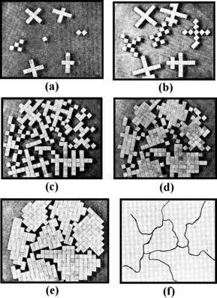
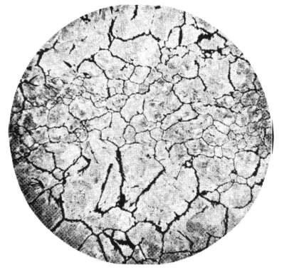
Crystal Growth, Grains, Grain Boundaries
(a) First Observation of Grain Boundaries By Sorby with a Optical Microscope (×9).
H. C. Sorby, J. Iron and Steel Inst., 1 (1887), 225.
Early Photomicrograph of Blister Steel made by Sorby (magnification ×9) and Described ‘A Mass of Grains (“System”), which Cohere less strongly than Separate Parts of Individual Crystals’.
Rosenhain’s Visual Representation of the Evolution of the ‘Inter-crystalline Junction’ as the ‘Accidental’ Meeting Line of Adjacent Growing Crystals of Different Orientation, Stuck together by the Residue Amorphous Glue.

Slide 4
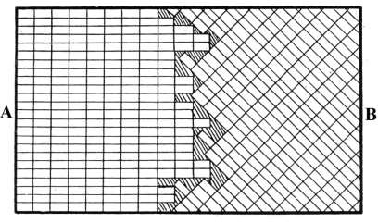
Early Theories of Grain Boundary Structure in 1900s-1920s Amorphous Cement Theory
It is proposed that a thin layer of amorphous metal may be formed and may persist in the intercrystalline boundaries, even in the absence of strain. ( W. Rosenhain, D. Ewen:
J. Inst. Metals, 8 (1912), 149~185.)

Slide 5
Plastic deformation
Material remains intact
Original crystal structure is not destroyed
Crystal distortion is extremely localized
Possible mechanisms:
  Translational glide (slipping)
  Twin glide (twinning)

Slide 6
Translational glide
The principle mode of plastic deformation
Slip planes: preferred planes with greatest interplanar distance, e.g., (111) in fcc crystals
Slip directions: with lowest resistance, e.g., closed packed direction
Slip lines: intersection of a slip plane with a free surface
Slip band: many parallel slip lines very closely spaced together
Slip plane
Slip line

Slide 7
Existence of defects
Theoretical yield strength predicted for perfect crystals is much greater than the measured strength.
The large discrepancy puzzled many scientists until Orowan, Polanyi, and Taylor (1934).
The existence of defects (specifically, dislocations) explains the discrepancy.

Slide 8
Defects
Point defects: vacancies, interstitial atoms, substitional atoms, etc.
Line defects: dislocations (edge, screw, mixed)
  Most important for plastic deformation
Surface defects: grain boundaries, phase boundaries, free surfaces, etc.

Slide 9
























Point Defects
Point defects: (a) vacancy, (b) interstitial atom, (c) small substitutional atom, (d) large substitutional atom, (e) Frenkel defect, and (f) Schottky defect.

Slide 10
Vacancies
A vacancy is produced when an atom or an ion is missing from its normal site in the crystal structure.
When atoms or ions are missing (i.e., when vacancies are present), the overall randomness or entropy of the material increases, which increases the thermodynamic stability of a crystalline material.
Vacancies are introduced into metals and alloys during solidification, at high temperatures, or as a consequence of radiation damage.

Slide 11
Interstitial Defects
An interstitial defect is formed when an extra atom or ion is inserted into the crystal structure at a normally unoccupied position
Interstitial atoms or ions, although much smaller than the atoms or ions located at the lattice points, are still larger than the interstitial sites that they occupy
Consequently, the surrounding crystal region is compressed and distorted.
Interstitial atoms such as hydrogen are often present as impurities, whereas carbon atoms are intentionally added to iron to produce steel.
For small concentrations, carbon atoms occupy interstitial sites in the iron crystal structure, introducing a stress in the localized region of the crystal in their vicinity.

Slide 12
Interstitial Defects
the introduction of interstitial atoms is one important way of increasing the strength of metallic materials.
Unlike vacancies, once introduced, the number of interstitial atoms or ions in the structure remains nearly constant, even when the temperature is changed.

Slide 13
Frenkel Defect
vacancy-­‐interstitial pair formed when an ion jumps from a normal lattice point to an interstitial site, leaving behind a vacancy.
Although, this is usually associated with ionic materials, a Frenkel defect can occur in metals and covalently bonded materials.

Slide 14
Schottky Defect
Is unique to ionic materials and is commonly found in many ceramic materials.
When vacancies occur in an ionically bonded material, a stoichiometric number of anions and cations must be missing from regular atomic positions if electrical neutrality is to be preserved.
For example, one Mg²⁺ vacancy and one O^{2-­‐} vacancy in MgO constitute a Schottky pair.
In ZrO₂, for one Zr⁴⁺ vacancy, there will be two O^{2-­‐} vacancies.

Slide 15
Dislocations
Dislocations are line imperfections typically introduced into a crystal during solidification of the material or when the material is deformed permanently.
Although dislocations are present in all materials, including ceramics and polymers, they are particularly useful in explaining deformation and strengthening in metallic materials.
We can identify three types of dislocations:
edge dislocation
screw dislocation
mixed dislocation

Slide 16
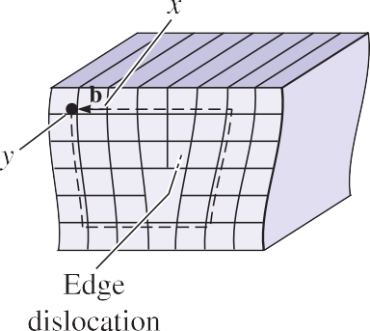
Edge Dislocations
An edge dislocation can be illustrated by slicing partway through a perfect crystal, spreading the crystal apart, and partly filling the cut with an extra half plane of atoms.

Slide 17

Screw Dislocations
The screw dislocation can be illustrated by cutting partway through a perfect crystal and then skewing the crystal by one atom spacing.

Slide 18
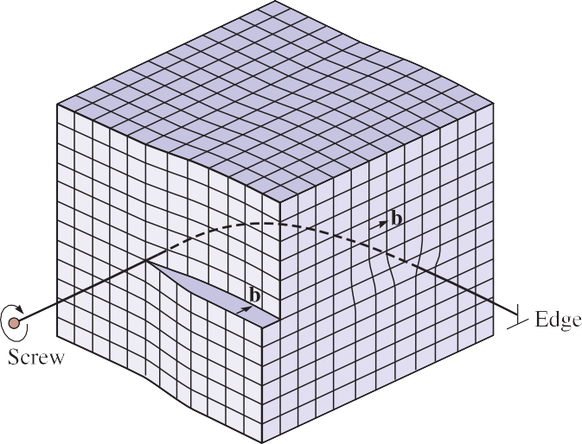
Mixed Dislocation
Mixed dislocations have both edge and screw components, with a transition region between them.
A mixed dislocation. The screw dislocation at the front face of the crystal gradually changes to an edge dislocation at the side of the crystal.

Slide 19
Dislocation Motion
When a sufficiently large shear stress is applied to a crystal containing a dislocation, the dislocation can move through a process known as slip.
The bonds across the slip plane between the atoms in the column to the right of the dislocation shown are broken.
The atoms in the column to the right of the dislocation below the slip plane are shifted slightly so that they establish bonds with the atoms of the edge dislocation.

Slide 20
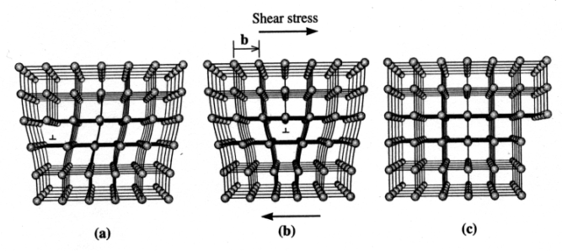
Glide of an edge dislocation
Break one bond at a time, much easier than breaking all the bonds along the slip plane simultaneously, and thus lower yield stress.
D.R. Askeland and P.P. Phule, The Science and Engineering of Materials, Brooks/Cole (2003).

Slide 21

Dislocation Motion
Slip plane
(b)
e

Slide 22
Dislocation Motion
This process of progressively breaking and reforming bonds requires far less energy than the energy that would be required to instantaneously break all of the bonds across the slip plane.
The crystal deforms via the propagation of dislocations because it is an energetically favorable process.

Slide 23
Slip
The dislocation moves in a slip system that requires the least expenditure of energy.
Several important factors determine the most likely slip systems that will be active:
the slip direction should have a small repeat distance or high linear density. The close-­‐packed directions in metals and alloys satisfy this criterion and are the usual slip directions.
Slip occurs most easily between planes of atoms that are smooth (so there are smaller “hills and valleys” on the surface) and between planes that are far apart (or have a relatively large interplanar spacing).

Slide 24
Slip
Dislocations do not move easily in materials such as silicon, which have covalent bonds. Because of the strength and directionality of the bonds, the materials typically fail in a brittle manner before the force becomes high enough to cause appreciable slip. Dislocations also play a relatively minor role in the deformation of polymers.
Materials with ionic bonding, including many ceramics such as MgO, also are resistant to slip. Movement of a dislocation disrupts the charge balance around the anions and cations, requiring that bonds between anions and cations be broken.

Slide 25
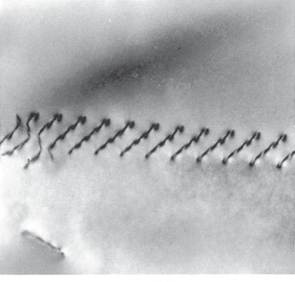
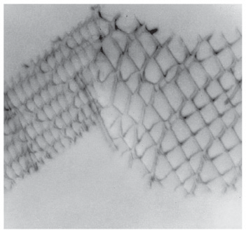
Slip
Electron micrographs of dislocations in Ti3Al: Dislocation pileups (x 36,500).

Slide 26
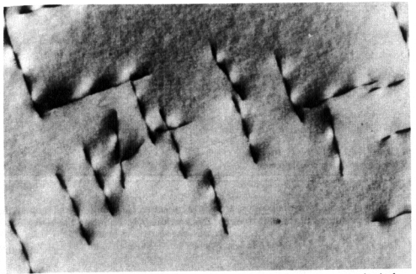
Observation of dislocations
Transmission Electron microscopy (TEM): diffraction images of dislocations appear as dark lines.
M.F. Ashby and D.R.H. Jones, Engineering Materials 1, 2nd ed. (2002)

Slide 27
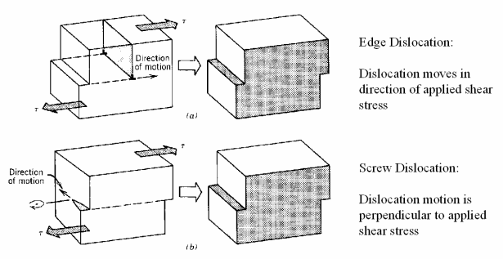
Motion of dislocations
William D. Callister, Jr., Materials Science and Engineering, An Introduction, John Wiley & Sons, Inc. (2003)

Slide 28



http://engineering.utm.my/chemicalenergy/
www.utm.my
Innovative · Entrepreneurial · Global
schoolchemicalenergyutm
utm_fcee
skt_utm

