Slide 1

SETG 2363
Material Engineering
18 FEBRUARY 2020
Mohsin Mohd Sies
Nuclear Engineering,
Faculty of Chemical and Energy Engineering,
Universiti Teknologi Malaysia
Credits: Dr Zulhairun Abdul Karim

Slide 2
CHAPTER 3 –
STRUCTURES OF METALS
PART II

Slide 3
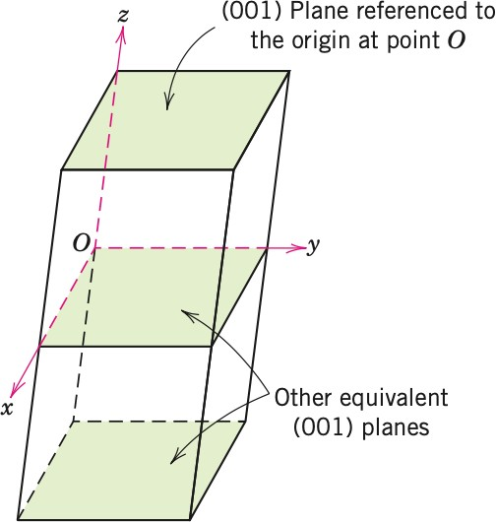
CHAPTER 3
SETG 2363 SN02 2024/2025-1
www.utm.my
Innovative · Entrepreneurial · Global
I LEARNING OUTCOMES
By the end of this chapter, students will be able to:
Describe what crystalline and noncrystalline (amorphous) materials are
Learn how atoms and ions in solids are arranged in space and identify the basic building blocks of solids
Describe the difference between atomic structure and crystal structure for solid material
Compute the densities for metal having body- centered (BCC) and face-centered cubic (FCC) structures
Write the designation for atom position, direction indices and Miller indices for crystals

Slide 4
Points, Directions, and Planes in the Unit Cell
Miller indices - A shorthand notation to describe certain crystallographic directions and planes in a material. Denoted by [ ] brackets. A negative number is represented by a bar over the number.
Directions of a form - Crystallographic directions that all have the same characteristics, although their ‘‘sense’’ is different. Denoted by h i brackets.
Repeat distance - The distance from one lattice point to the adjacent lattice point along a direction.
Linear density - The number of lattice points per unit length along a direction.
Packing fraction - The fraction of a direction (linear-packing fraction) or a plane (planar-packing factor) that is actually covered by atoms or ions.

Slide 5
CHAPTER 3
SETG 2363 SN02 2024/2025-1
www.utm.my
Innovative · Entrepreneurial · Global
I 3.12 CRYSTALLOGRAPHIC POINTS, DIRECTIONS, AND PLANES
CRYSTALLOGRAPHIC POINTS
To locate atom positions in cubic cells, we use rectangular x, y, and z axes (Cartesian coordinate system).
Atom position is represented in parenthesis with commas, such as (x, y, z).
In a cubic unit cell;
  Y axis is the direction to the right,
  X axis is the direction coming out of the paper,
  Z axis is the direction towards top
  Negative directions are the opposite of positive directions

Slide 6
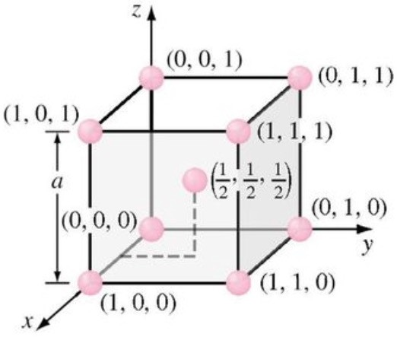
CHAPTER 3
SETG 2363 SN02 2024/2025-1
www.utm.my
Innovative · Entrepreneurial · Global
Point coordinates specified for all atom positions for a BCC unit cell.

Slide 7
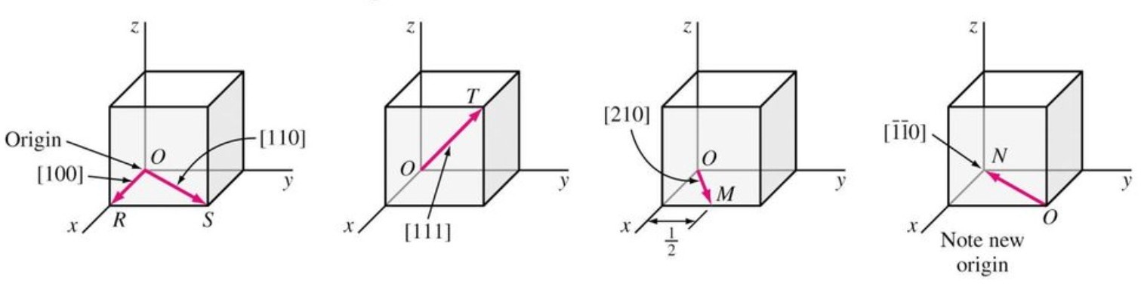
CHAPTER 3
SETG 2363 SN02 2024/2025-1
www.utm.my
Innovative · Entrepreneurial · Global
I 3.12 CRYSTALLOGRAPHIC POINTS, DIRECTIONS, AND PLANES
CRYSTALLOGRAPHIC DIRECTIONS
Often it is necessary to refer to specific directions in crystal lattice. This is especially important for metals and alloys with properties that vary with crystallographic orientation.
To indicate a direction in a cubic cell, we draw a direction vector from an
origin, which is usually a corner of the cubic cell. The position coordinates of the unit cell where the direction vector emerges from the cubic surfaces after being converted to integers are the direction indices.
Direction indices are the vector components of the direction resolved and reduces to the smallest integers. The direction is represented in bracket with no commas, such as [u v w].

Slide 8
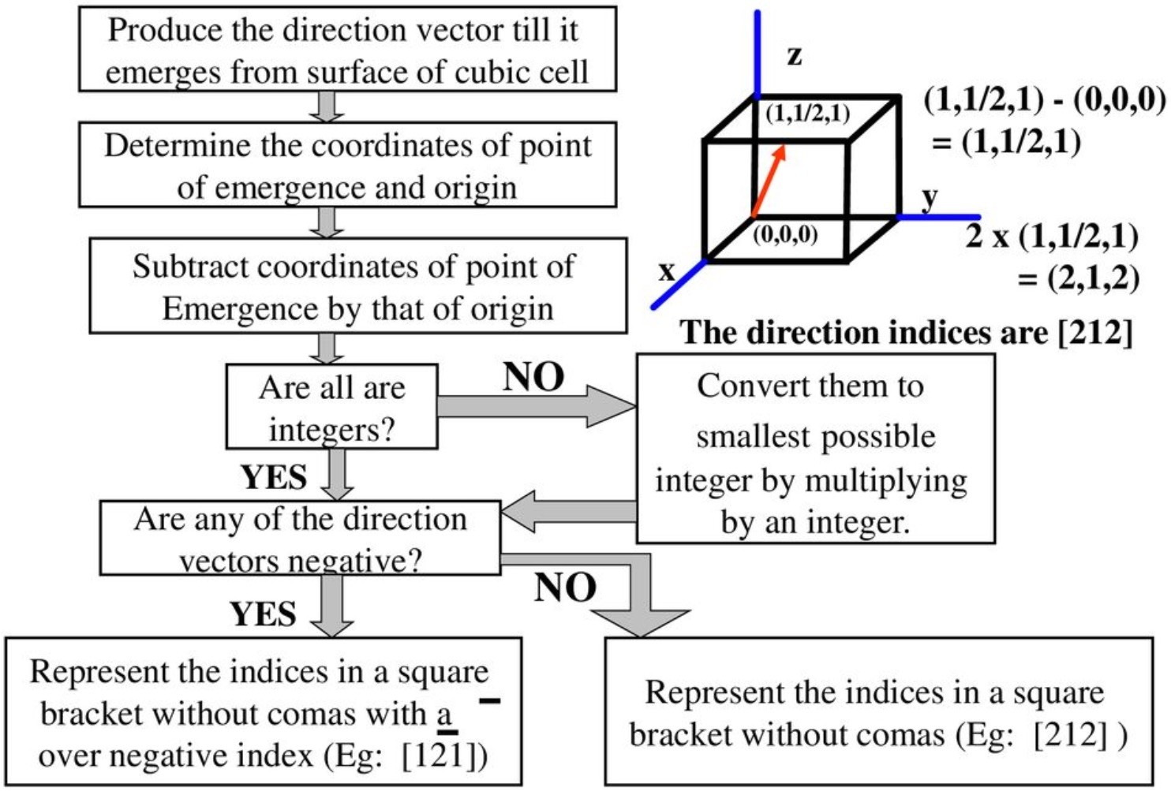
CHAPTER 3
SETG 2363 SN02 2024/2025-1
www.utm.my
Innovative · Entrepreneurial · Global
I PROCEDURE TO FIND DIRECTION INDICES

Slide 9
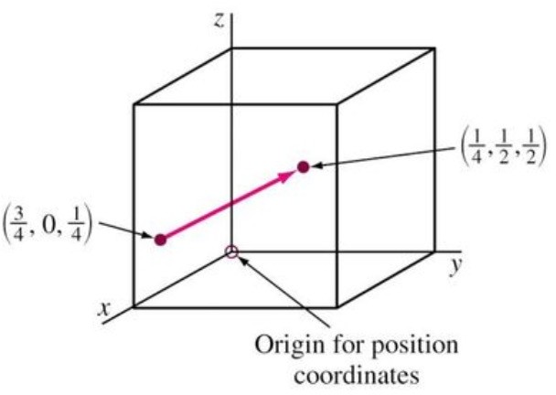
CHAPTER 3
SETG 2363 SN02 2024/2025-1
www.utm.my
Innovative · Entrepreneurial · Global
I EXAMPLE
Determine direction indices of the given vectors: Origin coordinates are (3/4, 0, 1/4).
Emergence coordinates are (1/4, 1/2, 1/2).
Solution:
Subtracting emergence coordinates with the origin coordinate;
(1/4, 1/2, 1/2) - (3/4, 0, 1/4)
= (-1/2, 1/2, 1/4)
Multiply by 4 to convert all the fractions into integers;
4(-1/2, 1/2, 1/4) = (-2, 2, 1)
Therefore, the direction indices are [2 2 1].

Slide 10
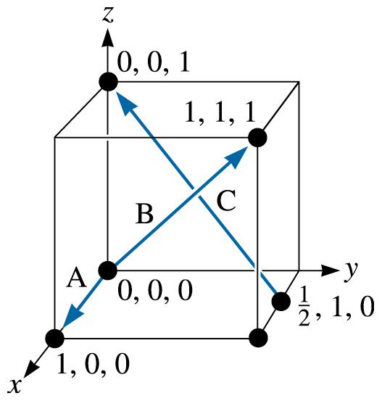
Example 3.7 Determining Miller Indices of Directions
Determine the Miller indices of directions A, B, and C in Figure 3.19.
Figure 3.19 Crystallographic directions and coordinates (for Example 3.7).
(c) 2003 Brooks/Cole Publishing / Thomson Learning™

Slide 11
Example 3.7 SOLUTION
Direction A
1. Two points are 1, 0, 0, and 0, 0, 0
2. 1, 0, 0, -0, 0, 0 = 1, 0, 0
3. No fractions to clear or integers to reduce
4. [100]
Direction B
1. Two points are 1, 1, 1 and 0, 0, 0
2. 1, 1, 1, -0, 0, 0 = 1, 1, 1
3. No fractions to clear or integers to reduce
4. [111]
Direction C
1. Two points are 0, 0, 1 and 1/2, 1, 0
2. 0, 0, 1 -1/2, 1, 0 = -1/2, -1, 1
3. 2(-1/2, -1, 1) = -1, -2, 2

Slide 12
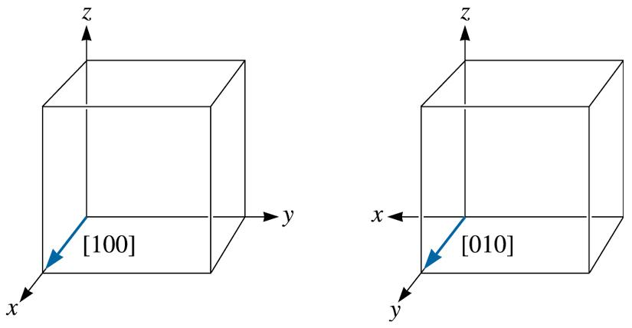
Equivalency of crystallographic directions
(c) 2003 Brooks/Cole Publishing / Thomson Learning™
Figure 3.20 Equivalency of crystallographic directions of a form in cubic systems.

Slide 13
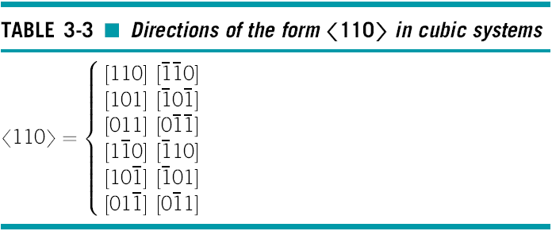
Equivalency of crystallographic directions

Slide 14
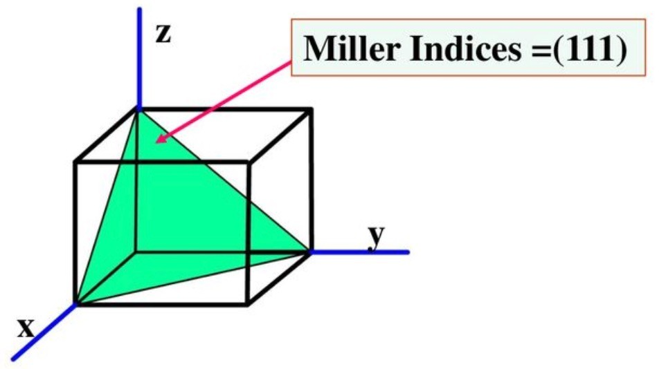
CHAPTER 3
SETG 2363 SN02 2024/2025-1
www.utm.my
Innovative · Entrepreneurial · Global
I 3.12 CRYSTALLOGRAPHIC POINTS, DIRECTIONS, AND PLANES
CRYSTALLOGRAPHIC PLANES
MILLER INDICES are used to refer to specific lattice planes of atoms.
They are reciprocals of the fractional intercepts (with fractions cleared) that the plane makes with the crystallographic x, y, and z axes of three nonparallel edges of the cubic cell.
NOTE: Direction indices of a direction perpendicular to a crystal plane are same as miller indices of the plane.

Slide 15
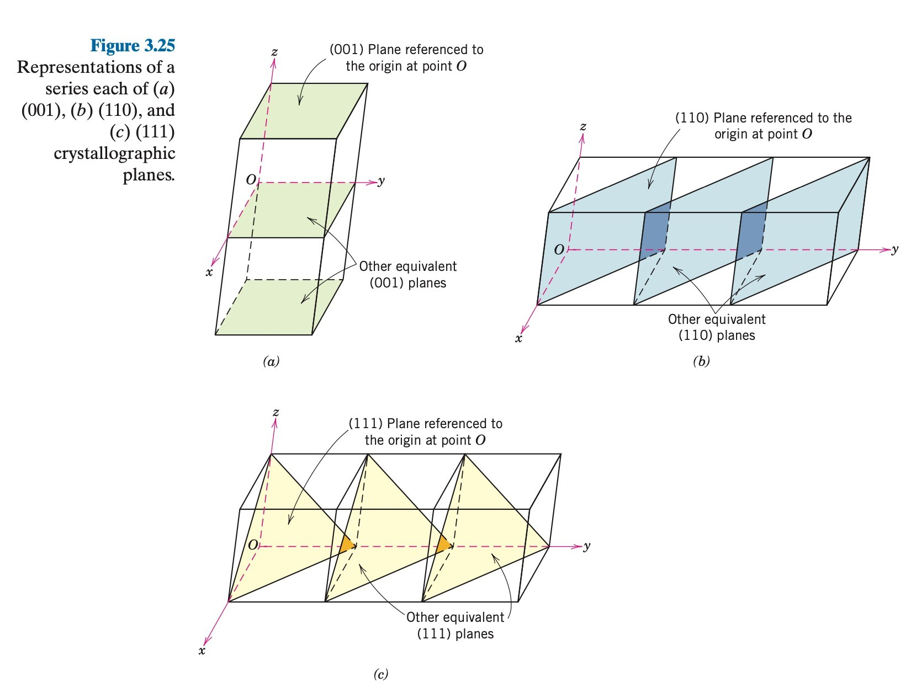
SETG 2363 SN02 2024/2025-1

Slide 16
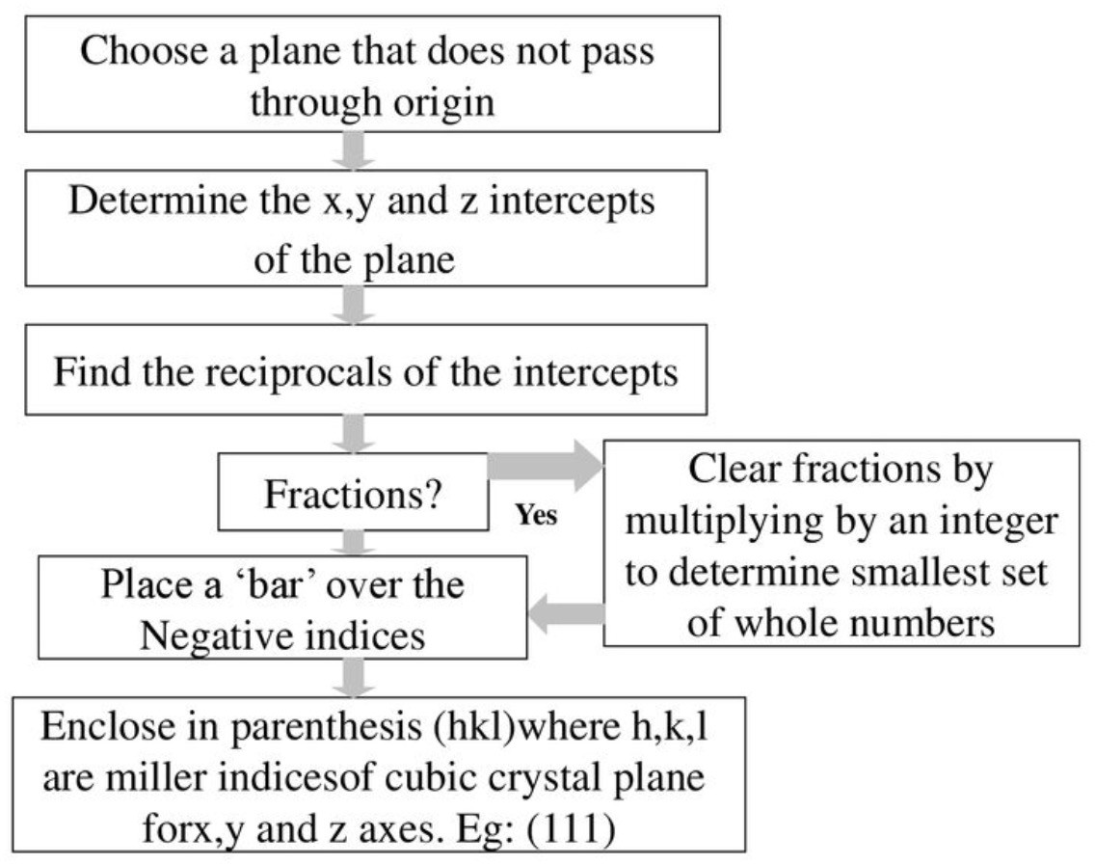
CHAPTER 3
SETG 2363 SN02 2024/2025-1
www.utm.my
Innovative · Entrepreneurial · Global
I PROCEDURE TO FIND MILLER INDICES

Slide 17
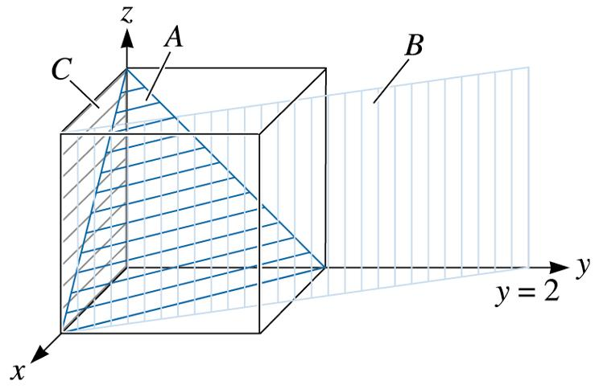
Example 3.8 Determining Miller Indices of Planes
Determine the Miller indices of planes A, B, and C in Figure 3.22.
Figure 3.22 Crystallographic planes and intercepts (for Example 3.8)
(c) 2003 Brooks/Cole Publishing / Thomson Learning™

Slide 18
Example 3.8 SOLUTION
Plane A
1. x = 1, y = 1, z = 1
2.1/x = 1, 1/y = 1,1 /z = 1
3. No fractions to clear
4. (111)
Plane B
1. The plane never intercepts the z axis, so x = 1, y = 2, and z =
2.1/x = 1, 1/y =1/2, 1/z = 0
3. Clear fractions:
1/x = 2, 1/y = 1, 1/z = 0
4. (210)
Plane C
1. We must move the origin, since the plane passes through 0, 0, 0. Let’s move the origin one lattice parameter in the y-direction. Then, x = , y = -1, and z =
2.1/x = 0, 1/y = 1, 1/z = 0
3. No fractions to clear.

Slide 19
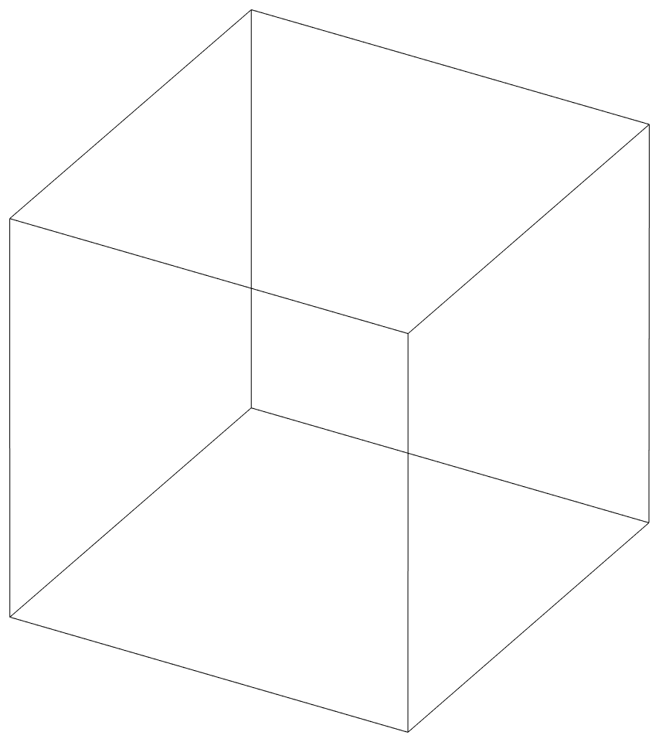
CHAPTER 3
SETG 2363 SN02 2024/2025-1
www.utm.my
Innovative · Entrepreneurial · Global
I EXERCISE: Sketch within a cubic unit cell the following planes:
z
(a) (012)
(b) (313)
(c) (101)
(d) (211)
(e) (221)
(f) (632)
y
x

Slide 20
CHAPTER 3
SETG 2363 SN02 2024/2025-1
www.utm.my
Innovative · Entrepreneurial · Global
I EXERCISE: Sketch within a cubic unit cell the following planes:
z
(a) (012)
y
x

Slide 21
CHAPTER 3
SETG 2363 SN02 2024/2025-1
www.utm.my
Innovative · Entrepreneurial · Global
I EXERCISE: Sketch within a cubic unit cell the following planes:
z
(b) (313)
y
x

Slide 22
CHAPTER 3
SETG 2363 SN02 2024/2025-1
www.utm.my
Innovative · Entrepreneurial · Global
I EXERCISE: Sketch within a cubic unit cell the following planes:
z
y
x

Slide 23
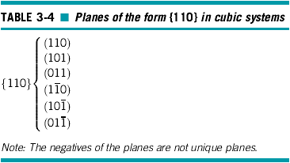

Slide 24
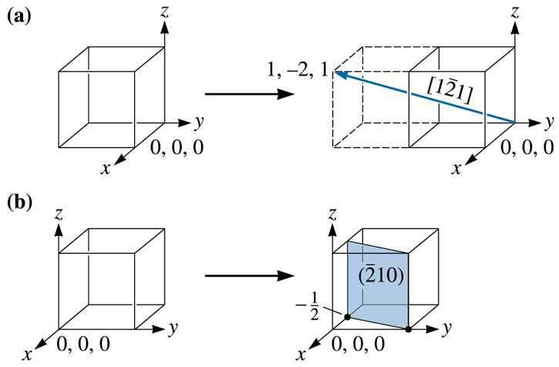


Example 3.10 Drawing Direction and Plane
$$[\text{1}\bar{\text{2}}1]$$
Draw (a) the direction and (b) the plane in a cubic unit cell.
$$[\bar{2}\text{10}]$$
Figure 3.24 Construction of a (a) direction and (b) plane within a unit cell (for Example 3.10)
(c) 2003 Brooks/Cole Publishing / Thomson Learning™

Slide 25

Example 3.10 SOLUTION
a. Because we know that we will need to move in the negative y-direction, let’s locate the origin at 0, +1, 0. The ‘‘tail’’ of the direction will be located at this new origin. A second point on the direction can be determined by moving +1 in the x-direction, 2 in the y-direction, and +1 in the z direction [Figure 3.24(a)].
b. To draw in the plane, first take reciprocals of the indices to obtain the intercepts, that is:
x = 1/-2 = -1/2 y = 1/1 = 1 z = 1/0 =
Since the x-intercept is in a negative direction, and we wish to draw the plane within the unit cell, let’s move the origin +1 in the x-direction to 1, 0, 0. Then we can locate the x-intercept at 1/2 and the y-intercept at +1. The plane will be parallel to the z-axis [Figure 3.24(b)].
$$[\bar{2}\text{10}]$$

Slide 26
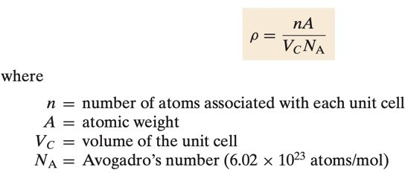
CHAPTER 3
SETG 2363 SN02 2024/2025-1
www.utm.my
Innovative · Entrepreneurial · Global
I 3.5 DENSITY COMPUTATIONS—METALS
A knowledge of the crystal structure of a metallic solid permits computation of its theoretical density ρ through the relationship:

Slide 27
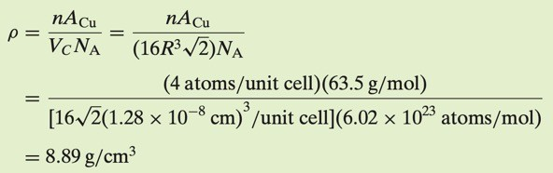
CHAPTER 3
SETG 2363 SN02 2024/2025-1
www.utm.my
Innovative · Entrepreneurial · Global
I 3.5 DENSITY COMPUTATIONS—METALS
Example: Copper has an atomic radius of 0.128 nm, an FCC crystal structure, and an atomic weight of 63.5 g/mol. Compute its theoretical density.
Solution:
Since the crystal structure is FCC, n, the number of atoms per unit cell, is 4. Furthermore, the atomic weight A is given as 63.5 g/mol. The unit cell volume V for FCC is 16R³ 2^{½} , where R, the atomic radius, is 0.128 nm.

Slide 28
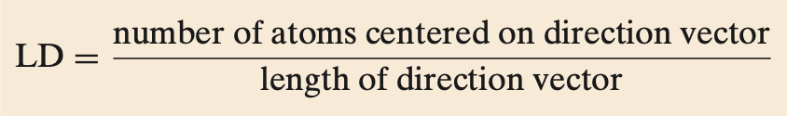
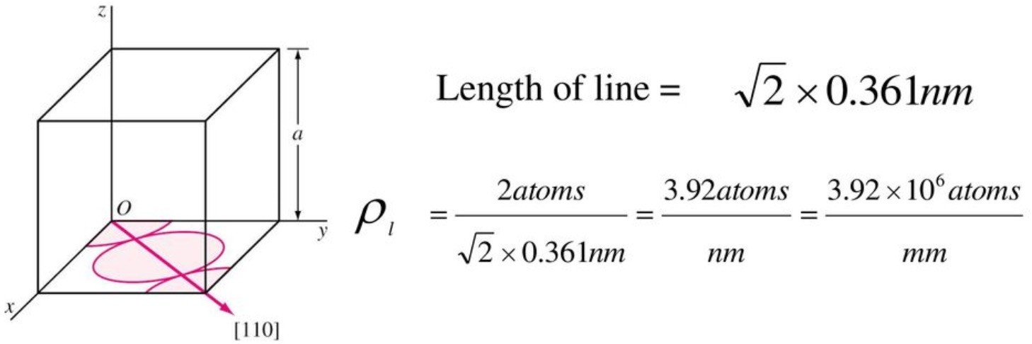
CHAPTER 3
SETG 2363 SN02 2024/2025-1
www.utm.my
Innovative · Entrepreneurial · Global
I 3.15 LINEAR AND PLANAR ATOMIC DENSITY
Linear density (LD) is defined as the number of atoms per unit length whose centers lie on the direction vector for a specific crystallographic direction; that is
Where the units of linear density are reciprocal length (e.g., nm⁻¹, m⁻¹).
Example: For the FCC copper crystal (a = 0.361 nm), the [110] direction intersects 2 half diameters and 1 full diameter (equals to 2 atomic diameter).

Slide 29
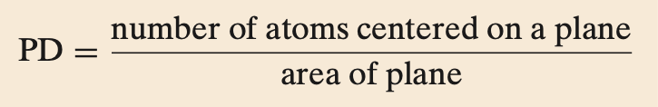

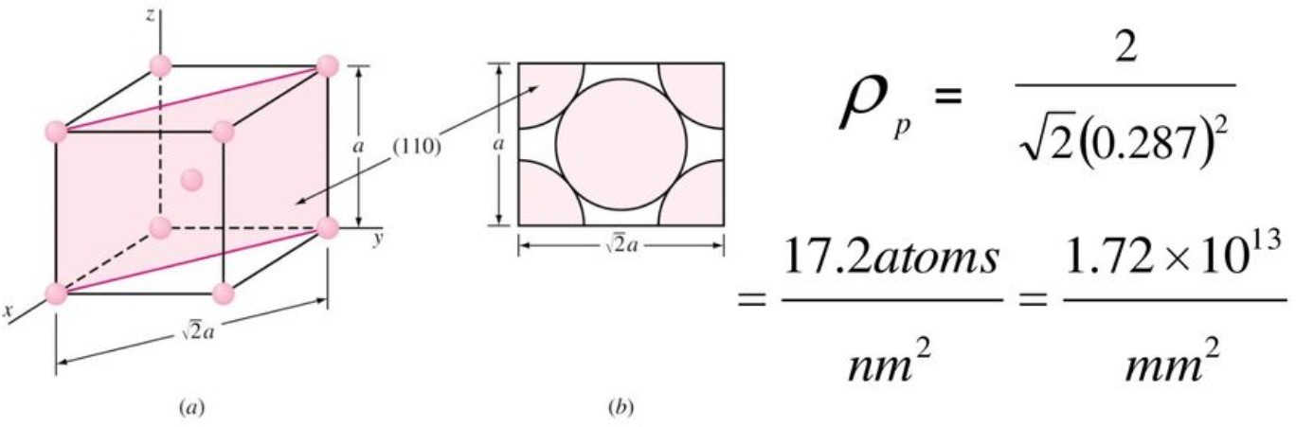
CHAPTER 3
SETG 2363 SN02 2024/2025-1
www.utm.my
Innovative · Entrepreneurial · Global
I 3.15 LINEAR AND PLANAR ATOMIC DENSITY
Planar density (PD) is taken as the number of atoms per unit area that are centered on a particular crystallographic plane;
The units for planar density are reciprocal area (e.g., nm⁻², m⁻²).
Example: In Iron (BCC, a = 0.287 nm), the (100) intersects the centers of 5 atoms
(four ¼ and one full atom = 2 atoms). The area of the (100) plane = a 2 × 𝑎 =
_{𝑎}2
2

Slide 30
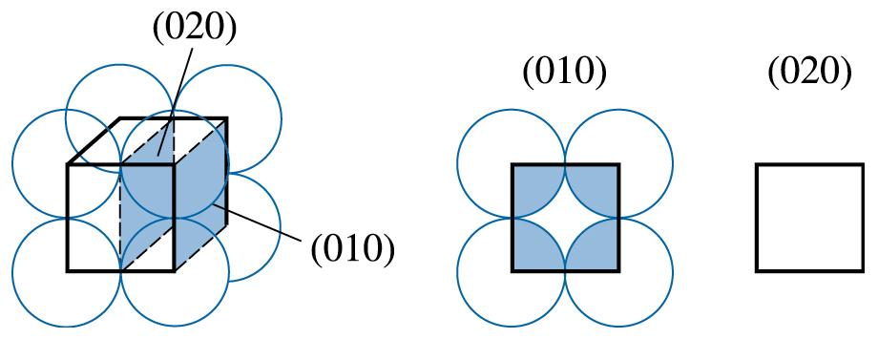
Example 3.9 Calculating the Planar Density and Packing Fraction
Calculate the planar density and planar packing fraction for the (010) and (020) planes in simple cubic polonium, which has a lattice parameter of 0.334 nm.
Figure 3.23 The planer densities of the (010) and (020) planes in SC unit cells are not identical (for Example 3.9).
(c) 2003 Brooks/Cole Publishing / Thomson Learning™

Slide 31
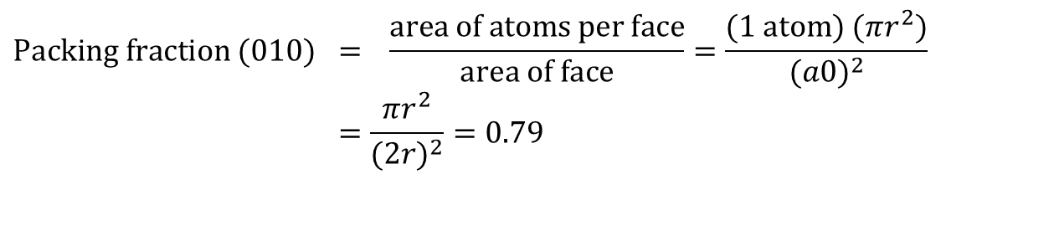
Example 3.9 SOLUTION
The total atoms on each face is one. The planar density is:
The planar packing fraction is given by:
$$\text{Packing} \text{fraction} (\text{010}) = \frac{\text{area} \text{of} \text{atoms} \text{per} \text{face}}{\text{area} \text{of} \text{face}}=\frac{(1 \text{atom}) (πr^{2})}{(a0)^{2}} \\ =\frac{πr^{2}}{(2r)^{2}}=0.79$$
However, no atoms are centered on the (020) planes. Therefore, the planar density and the planar packing fraction are both zero. The (010) and (020) planes are not equivalent!

Slide 32
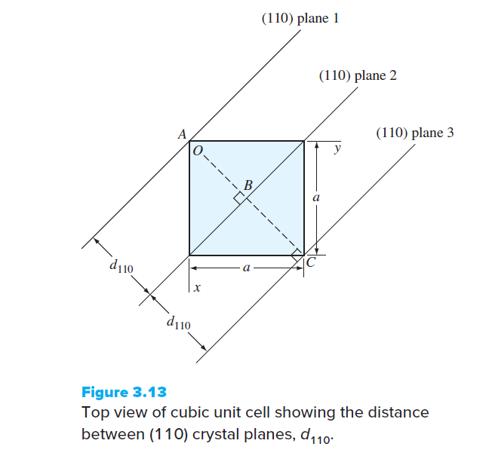
Interplanar Spacing
SETG 2363 SN02 2024/2025-1
www.utm.my
Innovative · Entrepreneurial · Global
The distance from a plane and another parallel plane with the same indices that is closest to it.

Slide 33

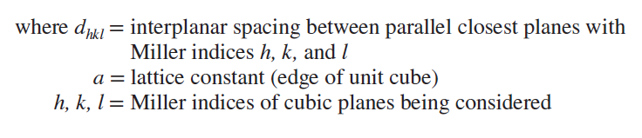
Interplanar Spacing
SETG 2363 SN02 2024/2025-1
www.utm.my
Innovative · Entrepreneurial · Global

Slide 34
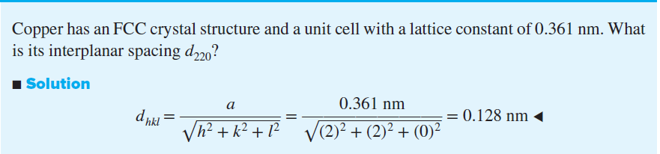
Example
SETG 2363 SN02 2024/2025-1
www.utm.my
Innovative · Entrepreneurial · Global

Slide 35
Diffraction Techniques for Crystal Structure Analysis
Diffraction - The constructive interference, or reinforcement, of a beam of x-rays or electrons interacting with a material. The diffracted beam provides useful information concerning the structure of the material.
Bragg’s law - The relationship describing the angle at which a beam of x-rays of a particular wavelength diffracts from crystallographic planes of a given interplanar spacing.
In a diffractometer a moving x-ray detector records the 2y angles at which the beam is diffracted, giving a characteristic diffraction pattern

Slide 36
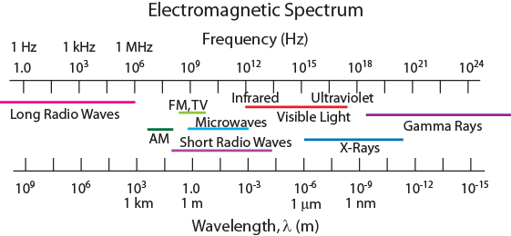
X-Ray Diffraction (XRD) to Determine Crystal Structure
Diffraction gratings must have spacings comparable to the wavelength of diffracted radiation.
Can’t resolve spacings < λ
Spacing is the distance between parallel planes of atoms.

Slide 37
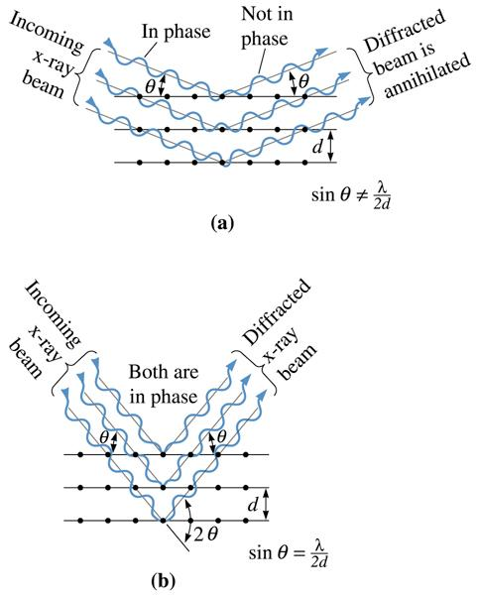
Figure 3.43 (a) Destructive and (b) reinforcing interactions between x-rays and the crystalline material. Reinforcement occurs at angles that satisfy Bragg’s law.
(c) 2003 Brooks/Cole Publishing / Thomson Learning

Slide 38
X-Rays to Determine Crystal Structure
• Incoming X-rays diffract from crystal planes.
“1”
detector
incoming
reflections must
X-rays
“2”
“1”
be in phase for
outgoing X-rays
a detectable signal
extra
“2”
λ
distance
θ
θ
Adapted from Fig. 3.20, Callister & Rethwisch 8e.
travelled
by wave “2”
spacing
d
between
planes
Measurement of critical angle, θ_{c}, allows computation of planar spacing, d.
X-ray
intensity
n λ
d =
(from
2 sin
θ
c
detector)
θ
θ
c

Slide 39
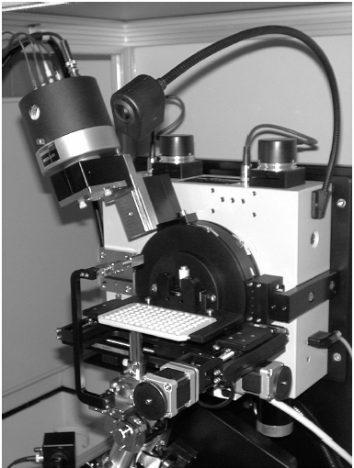
Figure 3.44 Photograph of a XRD diffractometer. (Courtesy of H&M Analytical Services.)

Slide 40
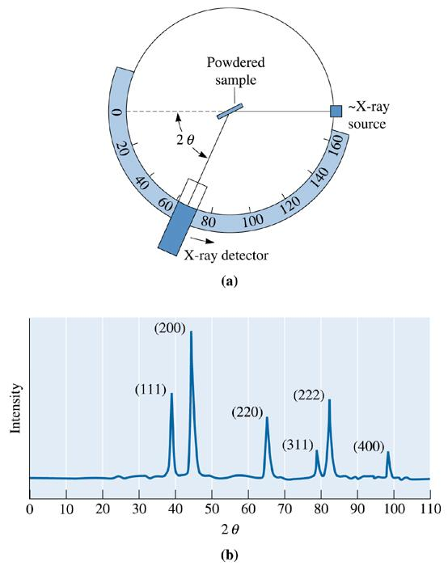
Figure 3.45 (a) Diagram of a diffractometer, showing powder sample, incident and diffracted beams. (b) The diffraction pattern obtained from a sample of gold powder.
(c) 2003 Brooks/Cole Publishing / Thomson Learning

Slide 41
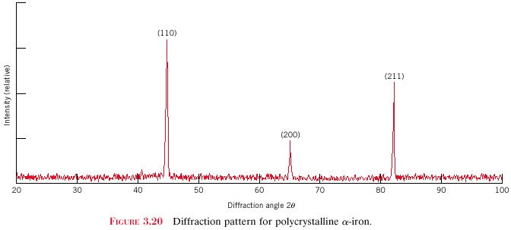
X-Ray Diffraction Pattern
z
z
z
c
c
c
y
(110)
y
y
a
b
a
b
a
b
x
x
x
(211)
Intensity (relative)
(200)
Diffraction angle 2θ
Diffraction pattern for polycrystalline α-iron (BCC)
Adapted from Fig. 3.22, Callister 8e.

Slide 42
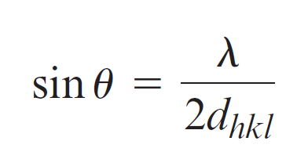
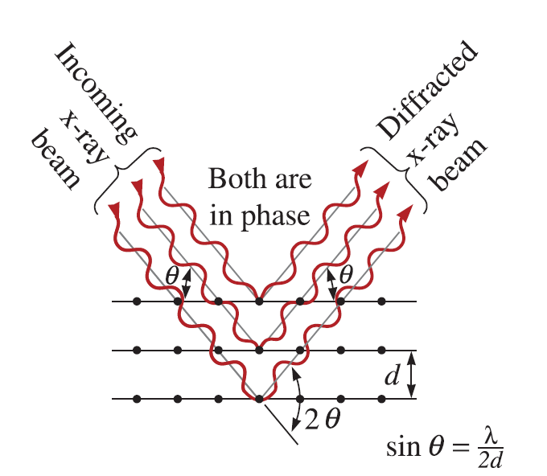
Bragg’s Law

Slide 43
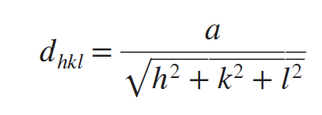

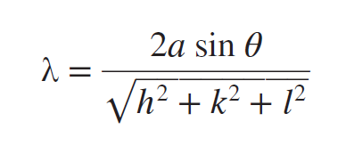
Combining Interplanar Spacing with Bragg Equation
giving

Slide 44

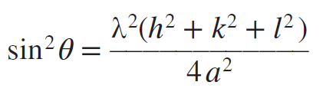
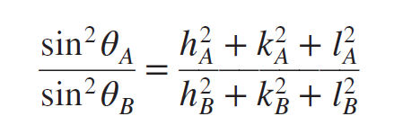
Combining Interplanar Spacing with Bragg Equation
Squaring both sides and solving for
Taking ratios of two
where θ_{A} and θ_{B} are two diffracting angles associated with the principal diffracting planes {h_{A}k_{A}l_{A}} and {h_{B}k_{B}l_{B}}, respectively

Slide 45
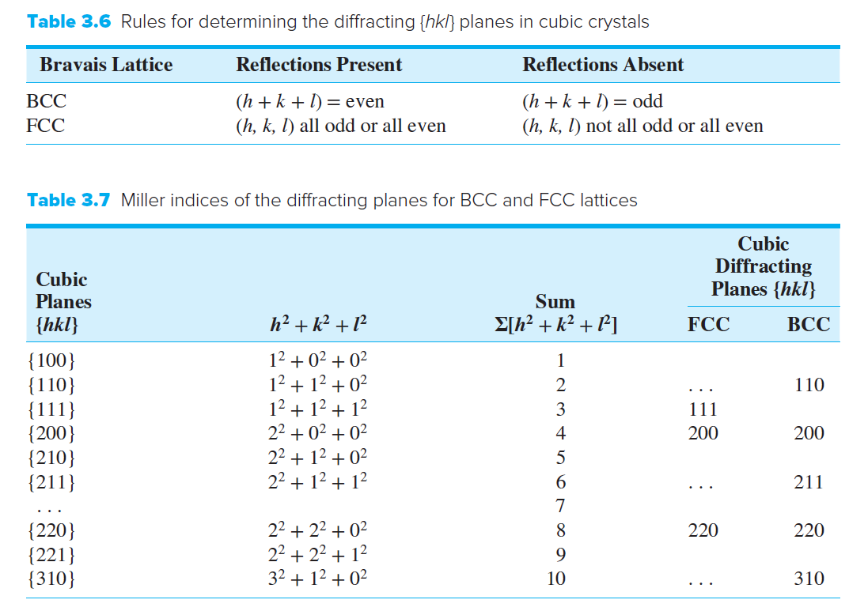
Interpreting Experimental XRD Data for Metals with Cubic Crystal Structures

Slide 46
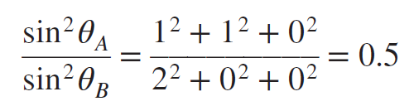
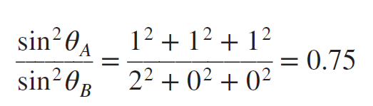
Interpreting Experimental XRD Data for Metals with Cubic Crystal Structures
From Table 3.7, for BCC, principal diffracting planes are (110) and (200),
And for FCC, principal diffracting planes are (111) and (200),

Slide 47
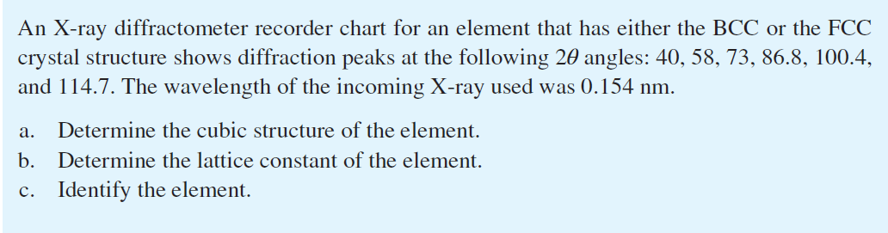
Example

Slide 48
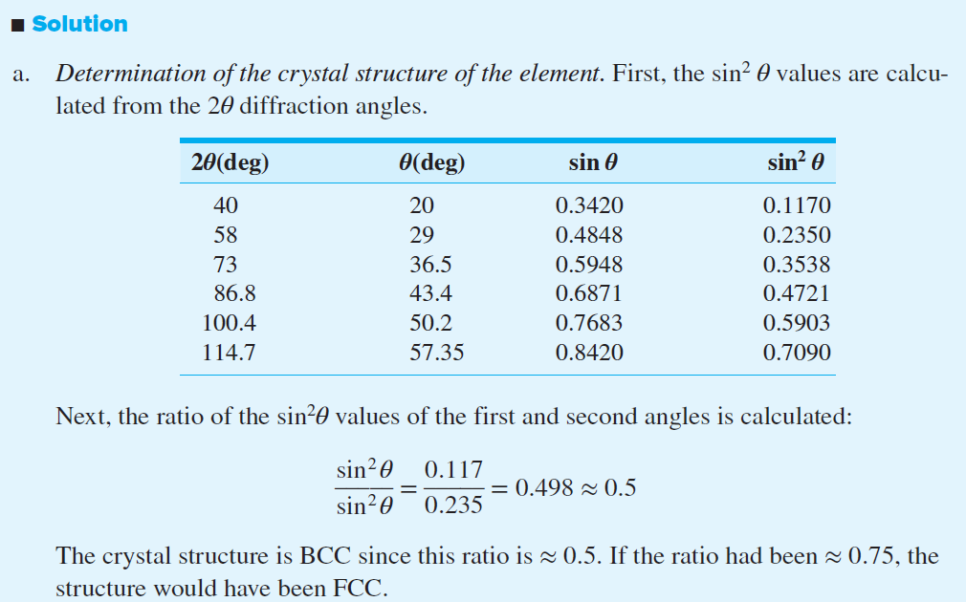

Slide 49
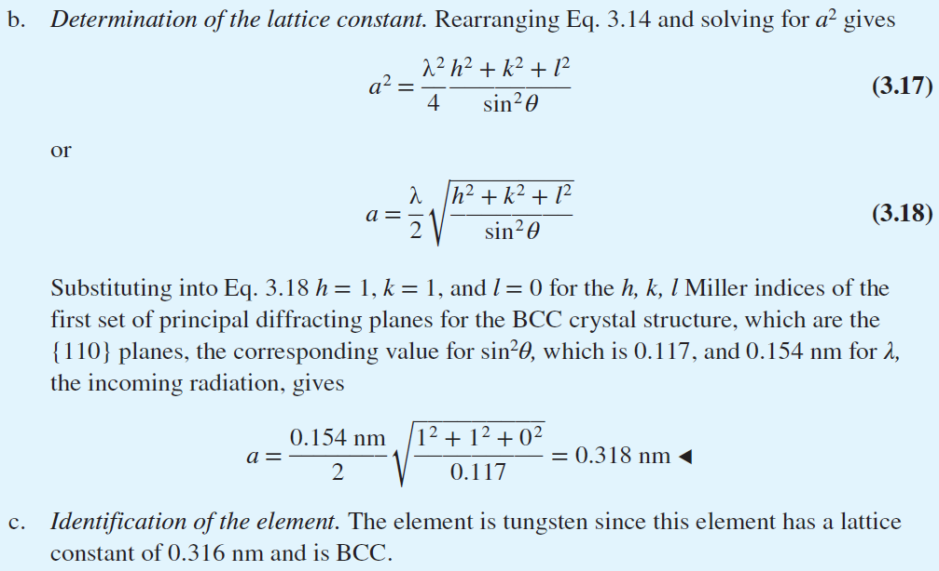

Slide 50
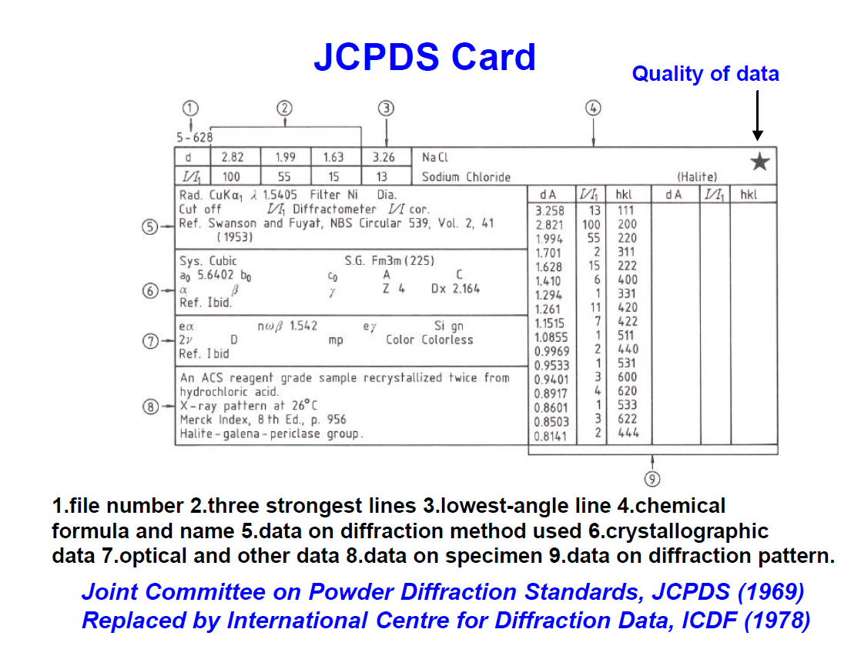
Database for Diffraction Data

Slide 51
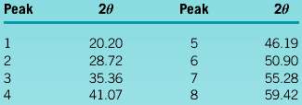
Example Examining X-ray Diffraction
The results of an x-ray diffraction experiment using x-rays with λ = 0.7107 Å (a radiation obtained from molybdenum (Mo) target) show that diffracted peaks occur at the following 2θ angles:
Determine the crystal structure, the indices of the plane producing each peak, and the lattice parameter of the material.

Slide 52
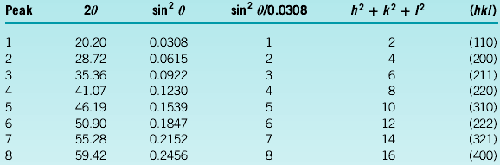
Example SOLUTION
We can first determine the sin² θ value for each peak, then divide through by the lowest denominator, 0.0308.

Slide 53
Example SOLUTION (Continued)
We could then use 2θ values for any of the peaks to calculate the interplanar spacing and thus the lattice parameter. Picking peak 8:
2θ = 59.42 or θ = 29.71
Å
Å
This is the lattice parameter for body-centered cubic iron.

Slide 54
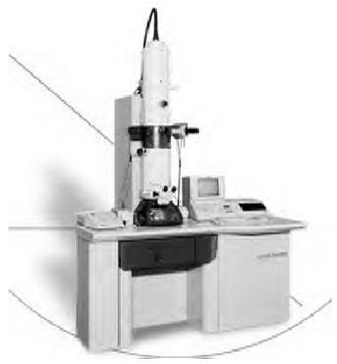
Figure 3.46 Photograph of a transmission electron microscope (TEM) used for analysis of the microstructure of materials. (Courtesy of JEOL USA, Inc.)

Slide 55
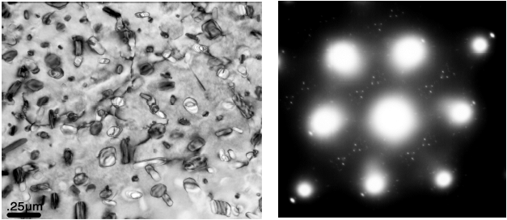
Figure 3.47 A TEM micrograph of an aluminum alloy (Al-7055) sample. The diffraction pattern at the right shows large bright spots that represent diffraction from the main aluminum matrix grains. The smaller spots originate from the nano-scale crystals of another compound that is present in the aluminum alloy. (Courtesy of Dr. JÖrg M.K. Wiezorek, University of Pittsburgh.)

Slide 58



http://engineering.utm.my/chemicalenergy/
www.utm.my
Innovative · Entrepreneurial · Global
schoolchemicalenergyutm
utm_fcee
skt_utm

