Slide 1

SETG 2363
Material Engineering
18 FEBRUARY 2020
Mohsin Mohd Sies
Nuclear Engineering,
Faculty of Chemical and Energy Engineering,
Universiti Teknologi Malaysia
Credits: Dr Zulhairun Abdul Karim

Slide 2
CHAPTER 3 –
STRUCTURES OF METALS

Slide 3
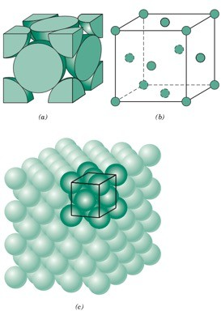
CHAPTER 3
SETG 2363 SN02 2024/2025-1
www.utm.my
Innovative · Entrepreneurial · Global
I LEARNING OUTCOMES
By the end of this chapter, students will be able to:
Describe what crystalline and noncrystalline (amorphous) materials are
Learn how atoms and ions in solids are arranged in space and identify the basic building blocks of solids
Describe the difference between atomic structure and crystal structure for solid material
Compute the densities for metal having body- centered (BCC) and face-centered cubic (FCC) structures
Write the designation for atom position, direction indices and Miller indices for crystals

Slide 4
CHAPTER 3
SETG 2363 SN02 2024/2025-1
www.utm.my
Innovative · Entrepreneurial · Global
I 3.1 INTRODUCTION
Solids materials may be classified according to the regularity of which atoms or ions are arrange.
Solid can be classified to 3 categories according to its atom arrangement.
Crystalline solid: Atoms or molecules are spatially arranged. All metals, many ceramic and certain polymers form crystalline structure.
Non-crystalline or amorphous solid (no rigid pattern): Mostly atoms are arrange in random. Example, glass.
Polycrystalline solid: Atoms or molecules are spatially arranged but arrangement of crystalline in solid are random. Example, steel.

Slide 5
CHAPTER 3
SETG 2363 SN02 2024/2025-1
www.utm.my
Innovative · Entrepreneurial · Global
I 3.2 CRYSTAL STRUCTURES – FUNDAMENTAL CONCEPTS
A crystalline material is one in which the atoms are situated in a repeating or periodic array over large atomic distances; that is, long-range order exists, such that upon solidification, the atoms position themselves in a repetitive three-dimensional pattern, in which each atom is bonded to its nearest- neighbor atoms.
Some of the properties of crystalline solids depend on the crystal structure of the material, the manner in which atoms, ions, or molecules are spatially arranged. Crystal structure may vary from relatively simple structures for metals to exceedingly complex ones, as displayed by some of the ceramic and polymeric materials.
Lattice means a three-dimensional array of points coinciding with atom positions (or sphere centers). When describing crystalline structures, atoms (or ions) are thought of as being solid spheres having well-defined diameters. This is termed the atomic hard-sphere model in which spheres representing nearest-neighbor atoms touch one another.

Slide 6
Lattice, Unit Cells, Basis, and Crystal Structures
Lattice - A collection of points that divide space into smaller equally sized segments.
Basis - A group of atoms associated with a lattice point.
Unit cell - A subdivision of the lattice that still retains the overall characteristics of the entire lattice.
Atomic radius - The apparent radius of an atom, typically calculated from the dimensions of the unit cell, using close-packed directions (depends upon coordination number).
Packing factor - The fraction of space in a unit cell occupied by atoms.

Slide 7
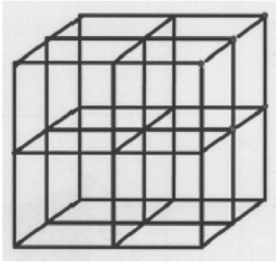
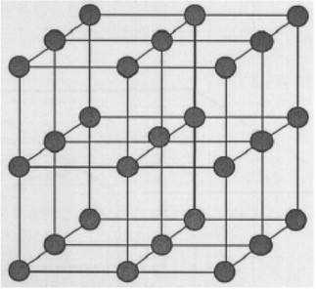
CHAPTER 3
SETG 2363 SN02 2024/2025-1
www.utm.my
Innovative · Entrepreneurial · Global
I 3.2 CRYSTAL STRUCTURES – FUNDAMENTAL CONCEPTS
Space lattice is a network of lines in three-dimensions containing infinite number of lattice point.
Atoms in crystalline solids occupy the lattice point.

Slide 8
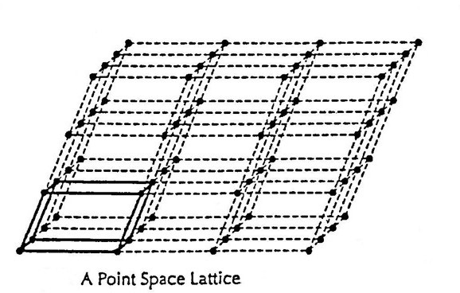
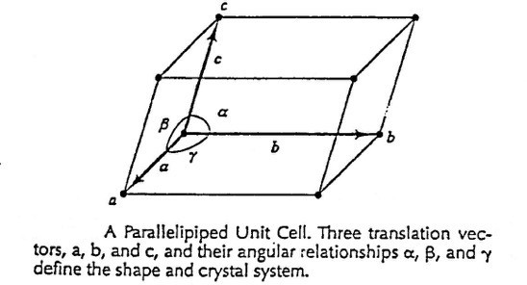
Lattice point

Slide 9
CHAPTER 3
SETG 2363 SN02 2024/2025-1
www.utm.my
Innovative · Entrepreneurial · Global
I 3.3 UNIT CELLS
The atomic order in crystalline solids indicates that small groups of atoms form a repetitive pattern.
In describing crystal structures, it is often convenient to sub-unit cell divide the structure into small repeating entities called unit cells.
A unit cell is chosen to represent the symmetry of the crystal structure, wherein all the atom positions in the crystal may be generated by translations of the unit cell integral distances along each of its edges.
The unit cell is the basic structural unit or building block of the crystal structure and defines the crystal structure by virtue of its geometry and the atom positions within.

Slide 10
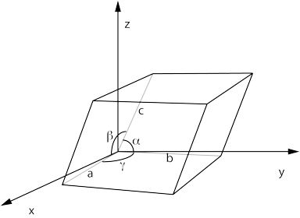
CHAPTER 3
SETG 2363 SN02 2024/2025-1
www.utm.my
Innovative · Entrepreneurial · Global
I 3.3 UNIT CELLS
The crystal structure may be defined as the collection of lattice.
The shape and size of the unit cell can be described by three lattice vector.
Lattice vector of unit cell is define by lattice parameter (lattice constant) which is:
  Length or dimension of cell unit: a, b and c
  Angle between axis : α, β, γ
There are 7 different unit cell systems.
From that types it will form of 14 types of repeat unit cell (also known as Bravais Lattice).

Slide 11
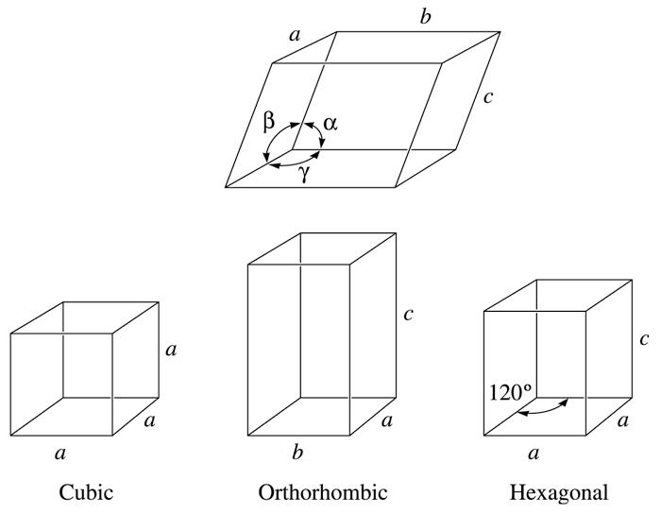
Figure 3.12 Definition of the lattice parameters and their use in cubic, orthorhombic, and hexagonal crystal systems.
(c) 2003 Brooks/Cole Publishing / Thomson Learning™

Slide 12
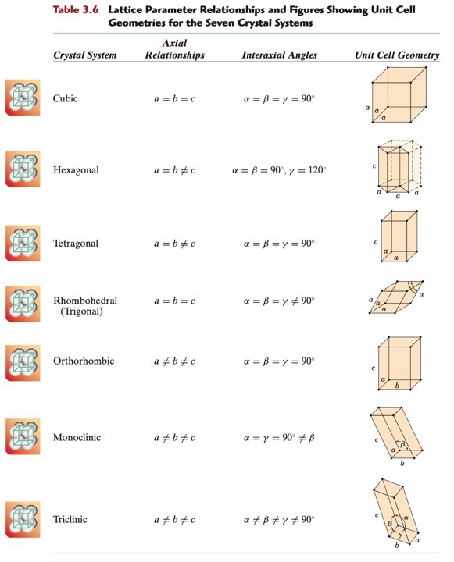
Page 62

Slide 13
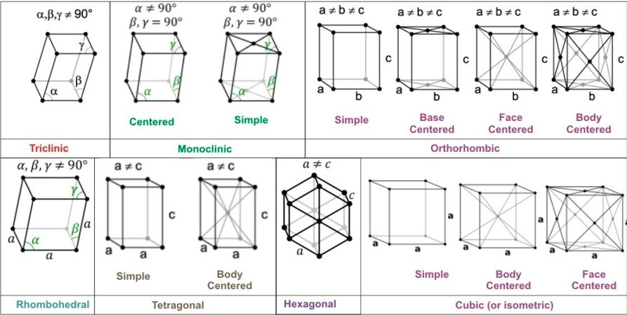
https://www.toppr.com/guides/chemistry/the-solid-state/space-lattice-or-crystal-lattice-and-unit-cell/

Slide 14
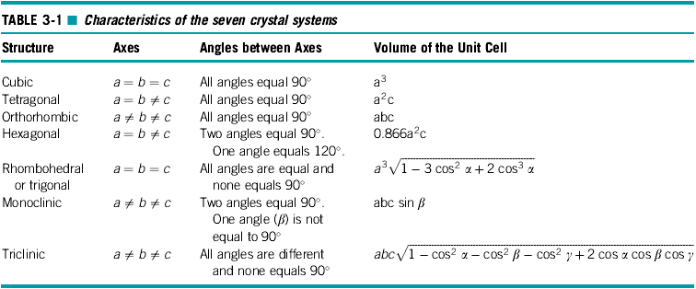

Slide 15
CHAPTER 3
SETG 2363 SN02 2024/2025-1
www.utm.my
Innovative · Entrepreneurial · Global
I 3.4 METALLIC CRYSTAL STRUCTURE
Simple cubic is a simplest unit cell in cubic crystal system.
All edge length are same which is one unit (a = b = c : α = β = γ = 90º)
Every edge of unit cell has one lattice point which represent atom or ion or molecule in crystal.
One edge of unit cell must link with two of similar lattice point. It means that, all 8 corners in cubic will contain 8 of similar atoms.
The actual number of atom of unit cell can be calculated by:
N _{f}
N
N_{T} = Actual number of atom
N_{i} = Number of atom at cubic centre
N_{f} = Number of atom at cubic face N_{c} = Number of atom at cubic corner
N_{T} = N_{i} +
₊ c
2 8
The actual atom number in unit cell of simple cubic (SC) is 1 then each corner of atom contain 1/8 of atom volume.

Slide 16
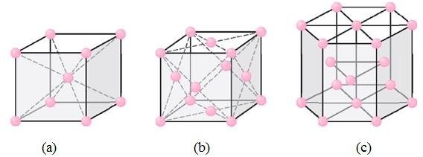
CHAPTER 3
SETG 2363 SN02 2024/2025-1
www.utm.my
Innovative · Entrepreneurial · Global
I 3.4 METALLIC CRYSTAL STRUCTURE
Three relatively simple crystal structures are found for most of the common metals:
face-centered cubic, body-centered cubic, and hexagonal close-packed.

Slide 17
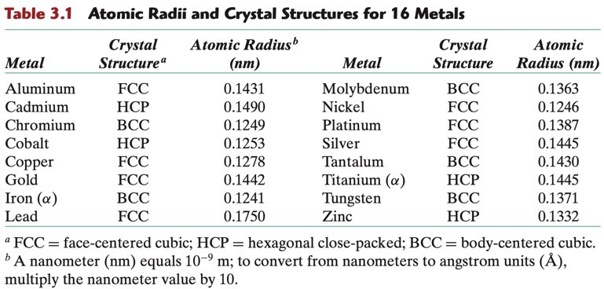
CHAPTER 3
SETG 2363 SN02 2024/2025-1
www.utm.my
Innovative · Entrepreneurial · Global
I 3.4 METALLIC CRYSTAL STRUCTURE
Three relatively simple crystal structures are found for most of the common metals:
face-centered cubic, body-centered cubic, and hexagonal close-packed.

Slide 18
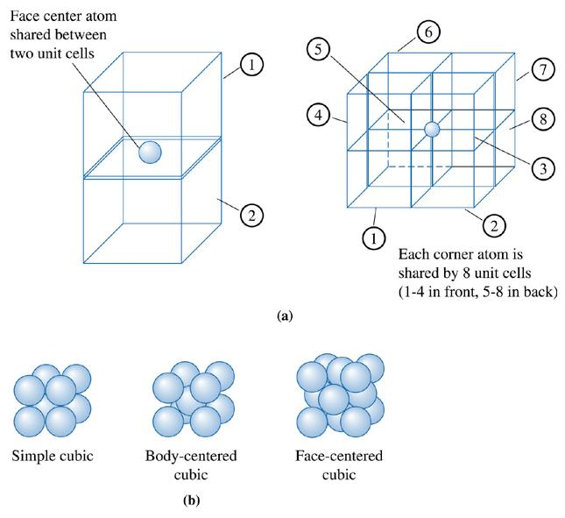
Figure 3.13 (a) Illustration showing sharing of face and corner atoms. (b) The models for simple cubic (SC), body centered cubic (BCC), and face-centered cubic (FCC) unit cells, assuming only one atom per lattice point.
(c) 2003 Brooks/Cole Publishing / Thomson Learning™

Slide 19
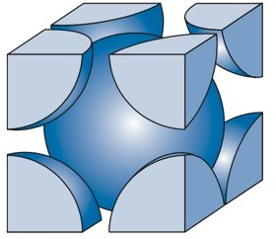
CHAPTER 3
SETG 2363 SN02 2024/2025-1
www.utm.my
Innovative · Entrepreneurial · Global
I 3.4 BODY-CENTRED CUBIC (BCC)
In a BCC unit cell, atoms are located at all eight corners and a single atom at the cube center.
Consider the following BCC cell. Each atom has eight neighbors.
The number of neighbors is called the coordination number (CN) of the crystal structure.
At each corner, we have 1/8 of an atom (an octant).
At the centre, we have one full atom.
Therefore, the total number of atoms in a BCC unit cell is (8 x 1/8) + 1 = 2.
N =1+ ⁰ + ⁸ = 2 atoms / unit cell
BCC
2 8

Slide 20
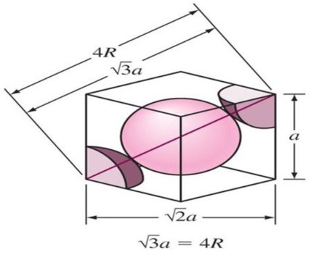

CHAPTER 3
SETG 2363 SN02 2024/2025-1
www.utm.my
Innovative · Entrepreneurial · Global
I 3.4 BODY-CENTRED CUBIC (BCC)
Center and corner atoms touch one another along cube diagonals, and unit cell length a and atomic radius R are related through:
AC ² = AD² + DC ²
= a² + a²
= 2a²
AC = 2a
AB² = AC ² + CB²
= 2a² + a²
AB = 3a but AB = 4R then
3a = 4R _{a =} 4R
3

Slide 21
CHAPTER 3
SETG 2363 SN02 2024/2025-1
www.utm.my
Innovative · Entrepreneurial · Global
I 3.4 BODY-CENTRED CUBIC (BCC)
Example: Iron at 20ºC is BCC with atoms of atomic radius 0.124 nm. Calculate the lattice constant a for the edge of the iron unit cell (1nm = 10⁻⁹ m).
3a = 4R
_{a =} 4R ₌ 4(0.124)
3 3
= 0.2864 nm

Slide 22
Example 3.4 Determining the Density of BCC Iron
Determine the density of BCC iron, which has a lattice parameter of 0.2866 nm.
Example 3.4 SOLUTION
Atoms/cell = 2, a₀ = 0.2866 nm = 2.866 × 10⁻⁸ cm
Atomic mass = 55.847 g/mol
Volume of unit cell = = (2.866 × 10⁻⁸ cm)³ = 23.54 × 10⁻²⁴ cm³/cell
Avogadro’s number N_{A} = 6.02 × 10²³ atoms/mol

Slide 23

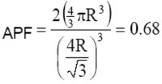
CHAPTER 3
SETG 2363 SN02 2024/2025-1
www.utm.my
Innovative · Entrepreneurial · Global
I 3.4 BODY-CENTRED CUBIC (BCC)
The atomic packing factor (APF) is defined as the fraction of solid sphere volume in a unit cell, or:
Both the total atom and unit cell volumes may be calculated in terms of the atomic radius R. The volume for a sphere is 4/3πR³, and since there are two atoms per BCC unit cell, the total BCC atom (or sphere) volume is:
V_{S} = (2) 4/3πR³ = 8/3πR³
For total unit cell volume, a³ expressed in terms of R, therefore:
This means that 68% of BCC unit cell is filled with matter and 32% is empty space.

Slide 24
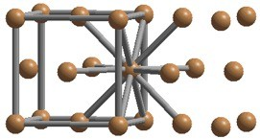
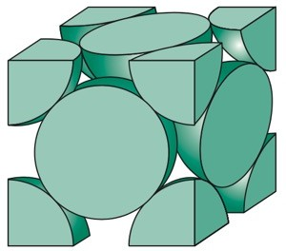
CHAPTER 3
SETG 2363 SN02 2024/2025-1
www.utm.my
Innovative · Entrepreneurial · Global
I 3.4 FACE-CENTRED CUBIC (FCC)
In a FCC unit cell, atoms are located at all eight corners and an atom at the center of each face.
Each atom in an FCC unit cells has 12 neighbors.
At each corner (8 corners), we have 1/8 of an atom (an octant).
At the centre of each face (6 faces), we have half of one atom.
Therefore, the total number of atoms in an FCC unit cell is (8 x 1/8) + (6 x 1/2) = 4.
N = 0 + ⁶ + ⁸ = 4 atom / unit cell
FCC
2 8

Slide 25
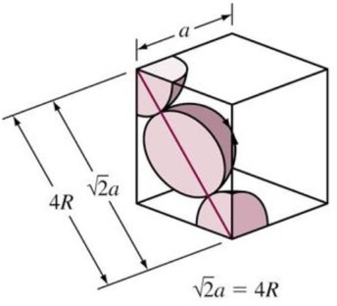
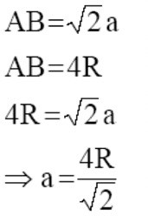
CHAPTER 3
SETG 2363 SN02 2024/2025-1
www.utm.my
Innovative · Entrepreneurial · Global
I 3.4 FACE-CENTRED CUBIC (FCC)
Center and corner atoms touch one another along cube face, and unit cell length a and atomic radius R are related through:

Slide 26
Example 3.1 Determining the Number of Lattice Points in Cubic Crystal Systems
Determine the number of lattice points per cell in the cubic crystal systems. If there is only one atom located at each lattice point, calculate the number of atoms per unit cell.
Example 3.1 SOLUTION
In the SC unit cell: lattice point / unit cell = (8 corners)1/8 = 1
In BCC unit cells: lattice point / unit cell = (8 corners)1/8 + (1 center)(1) = 2
In FCC unit cells: lattice point / unit cell = (8 corners)1/8 + (6 faces)(1/2) = 4
The number of atoms per unit cell would be 1, 2, and 4, for the simple cubic, body-centered cubic, and face-centered cubic, unit cells, respectively.

Slide 27
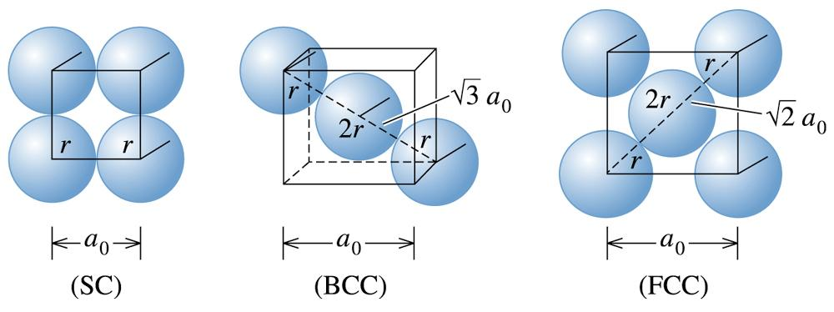
Example 3.2 Determining the Relationship between Atomic Radius and Lattice Parameters
Determine the relationship between the atomic radius and the lattice parameter in SC, BCC, and FCC structures when one atom is located at each lattice point.
(c) 2003 Brooks/Cole Publishing / Thomson Learning™
Figure 3.14 The relationships between the atomic radius and the Lattice parameter in cubic systems (for Example 3.2).

Slide 28
Example 3.2 SOLUTION
Referring to Figure 3.14, we find that atoms touch along the edge of the cube in SC structures.
In BCC structures, atoms touch along the body diagonal. There are two atomic radii from the center atom and one atomic radius from each of the corner atoms on the body diagonal, so
In FCC structures, atoms touch along the face diagonal of the cube. There are four atomic radii along this length—two radii from the face-centered atom and one radius from each corner, so:

Slide 29
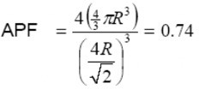
CHAPTER 3
SETG 2363 SN02 2024/2025-1
www.utm.my
Innovative · Entrepreneurial · Global
I 3.4 BODY-CENTRED CUBIC (BCC)
The atomic packing factor (APF) is defined as the fraction of solid sphere volume in a unit cell, or:
Both the total atom and unit cell volumes may be calculated in terms of the atomic radius R. The volume for a sphere is 4/3πR³, and since there are four atoms per FCC unit cell, the total FCC atom (or sphere) volume is:
V_{S} = (4) 4/3πR³ = 16/3πR³
For total unit cell volume, a³ expressed in terms of R, therefore:
This means that 74% of FCC unit cell is filled with matter and 26% is empty space.

Slide 30
Example 3.3 Calculating the Packing Factor
Calculate the packing factor for the FCC cell.
Example 3.3 SOLUTION
In a FCC cell, there are four lattice points per cell; if there is one atom per lattice point, there are also four atoms per cell. The volume of one atom is 4πr³/3 and the volume of the unit cell is .

Slide 31
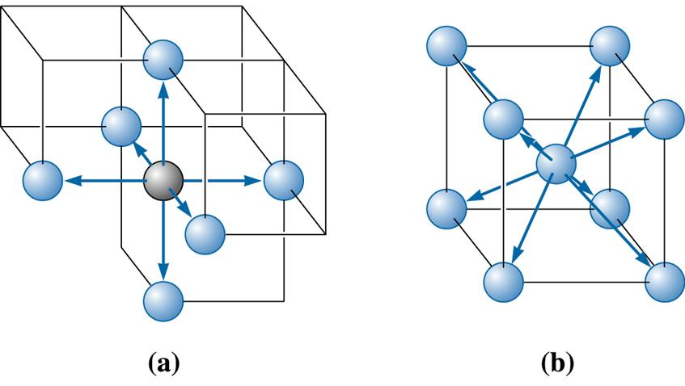
(c) 2003 Brooks/Cole Publishing / Thomson Learning™
Figure 3.15 Illustration of coordinations in (a) SC and (b) BCC unit cells. Six atoms touch each atom in SC, while the eight atoms touch each atom in the BCC unit cell.

Slide 32
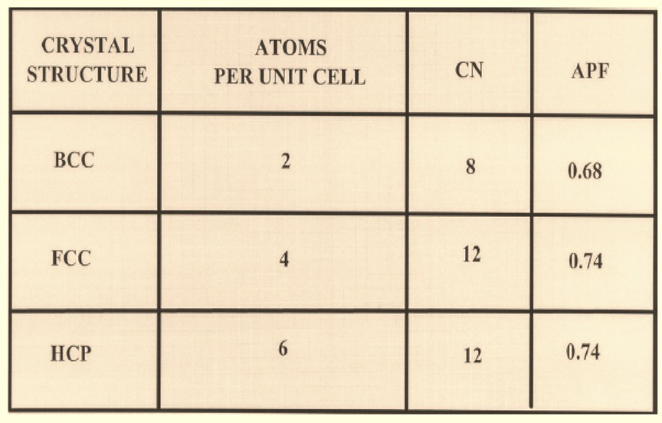
CHAPTER 3
SETG 2363 SN02 2024/2025-1
www.utm.my
Innovative · Entrepreneurial · Global

Slide 33
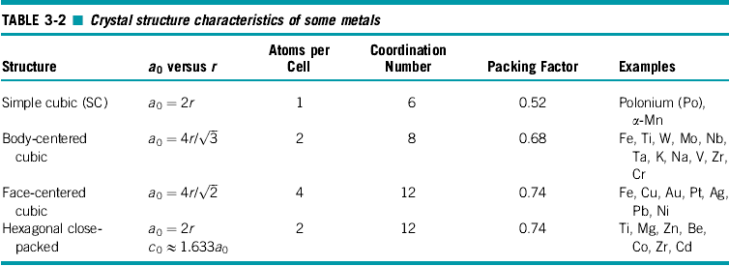

Slide 34
Example 3.6 Designing a Sensor to Measure Volume Change
To study how iron behaves at elevated temperatures, we would like to design an instrument that can detect (with a 1% accuracy) the change in volume of a 1-cm³ iron cube when the iron is heated through its polymorphic transformation temperature. At 911ºC, iron is BCC, with a lattice parameter of 0.2863 nm. At 913ºC, iron is FCC, with a lattice parameter of 0.3591 nm. Determine the accuracy required of the measuring instrument.
Example 3.6 SOLUTION
The volume of a unit cell of BCC iron before transforming is:
V_{BCC} = = (0.2863 nm)³ = 0.023467 nm³

Slide 35
Example 3.6 SOLUTION (Continued)
The volume of the unit cell in FCC iron is:
V_{FCC} = = (0.3591 nm)³ = 0.046307 nm³
But this is the volume occupied by four iron atoms, as there are four atoms per FCC unit cell. Therefore, we must compare two BCC cells (with a volume of 2(0.023467) = 0.046934 nm³) with each FCC cell. The percent volume change during transformation is:
The 1-cm³ cube of iron contracts to 1 - 0.0134 = 0.9866 cm³ after transforming; therefore, to assure 1% accuracy, the instrument must detect a change of:
ΔV = (0.01)(0.0134) = 0.000134 cm³

Slide 36
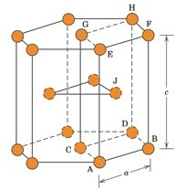
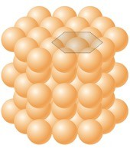
CHAPTER 3
SETG 2363 SN02 2024/2025-1
www.utm.my
Innovative · Entrepreneurial · Global
I 3.4 HEXAGONAL CLOSE-PACKED (HCP)
HCP structure is represented as an atom at each of 12 corners of the hexagonal prism, 2 atoms at the top and bottom face, and 3 atoms in between the top and bottom surface.
Atoms attain higher APF in HCP structure than simple hexagonal structure.
Each HCP unit cell has six 1/6 atoms at each top and bottom plane, two half atoms at top and bottom plane, and three full atom in the middle plane.
Therefore HCP has (2 x 6 x 1/6) + (2 x 1/2) + 3 = 6 atoms.
CN for HCP structure is 12, and APF is 0.74.
The ideal c/a ratio is 1.633. Example; cobalt (a = 0.2507, c/a = 1.62; zinc (a = 0.2665 nm, c/a = 1.85).

Slide 37



http://engineering.utm.my/chemicalenergy/
www.utm.my
Innovative · Entrepreneurial · Global
schoolchemicalenergyutm
utm_fcee
skt_utm

