Slide 1

SETG 2363
Material Engineering
18 FEBRUARY 2020
Mohsin Mohd Sies
Nuclear Engineering,
Faculty of Chemical and Energy Engineering,
Universiti Teknologi Malaysia
Credits: Dr Zulhairun Abdul Karim

Slide 2
CHAPTER 2 – ATOMIC STRUCTURE AND INTERATOMIC BONDING

Slide 3
Chapter 2: Atomic Structure & Interatomic Bonding
ISSUES TO ADDRESS...
• What promotes bonding?
• What types of bonds are there?
• What properties are inferred from bonding?

Slide 4
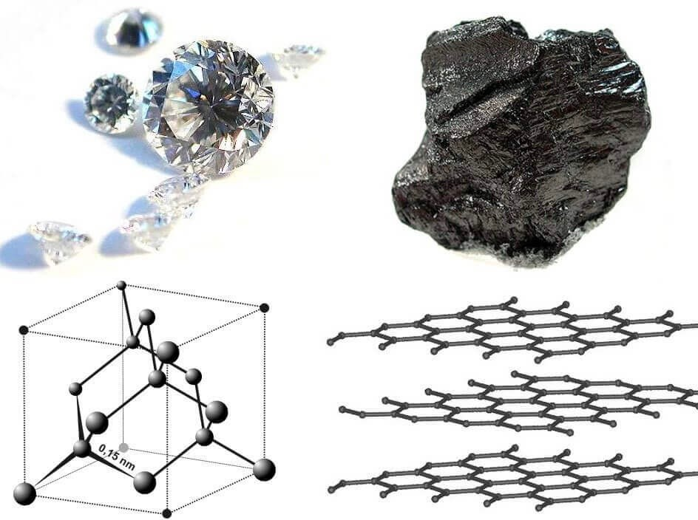
CHAPTER 2
SETG 2363 SN02 2024/2025-1
www.utm.my
Innovative · Entrepreneurial · Global
I WHY STUDY ATOMIC STRUCTURE AND INTERATOMIC BONDING?
An important reason to have an
understanding of interatomic bonding in solids is that, in some instances, the type of bond allows us to explain a material’s properties.
For example, consider carbon, which may exist as both graphite and diamond.
Whereas graphite is relatively soft
and has a “greasy” feel to it, diamond is the hardest known material.
This dramatic disparity in properties
is directly attributable to a type of
interatomic bonding found in graphite that does not exist in diamond.
Diamond vs Graphite
https://www.petragems.com/blog/difference-between-diamond-and-graphite/

Slide 5
CHAPTER 2
SETG 2363 SN02 2024/2025-1
www.utm.my
Innovative · Entrepreneurial · Global
I 2.1 INTRODUCTION
Some of the important properties of solid materials depend on geometrical atomic arrangements, and also the interactions that exist among constituent atoms or molecules.
We will be covering atomic structure, electron configurations in atoms and
the periodic table, and the various types of primary and secondary interatomic bonds that hold together the atoms comprising a solid.
COURSE LEARNING OUTCOME - describe types of atomic bonding (ionic, covalent, metallic, secondary) and relate bonding to materials properties.

Slide 6
CHAPTER 2
SETG 2363 SN02 2024/2025-1
www.utm.my
Innovative · Entrepreneurial · Global
I 2.2 ATOMIC STRUCTURE - FUNDAMENTAL CONCEPTS
Each atom consists of a very small nucleus composed of protons and neutrons, which is encircled by moving electrons.
Both electrons and protons are electrically charged, the charge magnitude being
1.60 × 10⁻¹⁹ C (coulomb). Electrons are negatively charged, protons are positive,
while neutrons are electrically neutral.
Protons and neutrons have approximately the same mass, 1.67 × 10⁻²⁷ kg (1 amu), significantly larger than that of an electron, 9.11 × 10⁻³¹ kg.
ATOMIC NUMBER, Z - Each chemical element is characterized by the number of protons in the nucleus.
ATOMIC MASS, A - of a specific atom may be expressed as the sum of the masses of protons and neutrons within the nucleus. Although the number of protons is the same for all atoms of a given element, the number of neutrons (N) may vary (ISOTOPES).
ATOMIC MASS UNIT, amu may be used for computations of atomic weight.
In one MOLE of a substance there are 6.022 × 10²³ (Avogadro’s number) atoms or molecules.
1 amu/atom (or molecule) = 1 g/mol

Slide 7
The Structure of the Atom
The atomic number of an element is equal to the number of electrons or protons in each atom.
The atomic mass of an element is equal to the average number of protons and neutrons in the atom.
The Avogadro number of an element is the number of atoms or molecules in a mole.
The atomic mass unit of an element is the mass of an atom expressed as 1/12 the mass of a carbon atom.

Slide 8
Atomic Structure (Freshman Chem.)
atom – electrons – 9.11 x 10⁻³¹ kg
protons
neutrons
atomic number = # of protons in nucleus of atom
= # of electrons of neutral species
A [=] atomic mass unit = amu = 1/12 mass of ¹²C
Atomic wt = wt of 6.022 x 10²³ molecules or atoms
1 amu/atom = 1g/mol
C 12.011
H 1.008 etc.
} 1.67 x 10⁻²⁷ kg

Slide 9
AVAGADRO’S NUMBER = 6.022 x 10²³ = N_{A}
ATOMIC OR MOLECULAR WEIGHT =
N_{A} x WEIGHT PER ATOM.
number of neutrons = N
number of protons = Z
A= Z + N

Slide 10
Example 2.1 Calculate the Number of Atoms in Silver
Calculate the number of atoms in 100 g of silver.
Example 2.1 SOLUTION
The number of silver atoms is =
=5.58 × 10²³

Slide 11
Example 2.2 Nano-Sized Iron-Platinum Particles For Information Storage
Scientists are considering using nano-particles of such magnetic materials as iron-platinum (Fe-Pt) as a medium for ultrahigh density data storage. Arrays of such particles potentially can lead to storage of trillions of bits of data per square inch—a capacity that will be 10 to 100 times higher than any other devices such as computer hard disks. If these scientists considered iron (Fe) particles that are 3 nm in diameter, what will be the number of atoms in one such particle?

Slide 12
Example 2.2 SOLUTION
The radius of a particle is 1.5 nm.
Volume of each iron magnetic nano-particle
= (4/3)π(1.5 × 10⁻⁷ cm)³
= 1.4137 × 10⁻²⁰ cm³
Density of iron = 7.8 g/cm³. Atomic mass of iron is 56 g/mol.
Mass of each iron nano-particle
= 7.8 g/cm³ × 1.4137 × 10⁻²⁰ cm³
= 1.102 × 10⁻¹⁹ g.
One mole or 56 g of Fe contains 6.023 × 10²³ atoms, therefore, the number of atoms in one Fe nano-particle will be 1186.

Slide 13
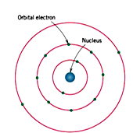
BOHR ATOM

Slide 14
Atomic Structure
Valence electrons determine all of the following properties
    Chemical
    Electrical
    Thermal
    Optical

Slide 15
CHAPTER 2
SETG 2363 SN02 2024/2025-1
www.utm.my
Innovative · Entrepreneurial · Global
I 2.4 THE PERIODIC TABLE
All the elements have been classified according to electron configuration in the periodic table.
The elements are situated with increasing atomic number, in seven horizontal
rows called periods.
All elements arrayed in a given column or group have similar valence electron structures, as well as chemical and physical properties.
Group 1-2 are alkali and the alkaline earth metals, Group 7 are halogens, Group 8
are inert or noble gases, and the middle part of the periodic table comprised of the transition metals.
As may be noted from the periodic table, most of the elements really come under the metal classification. These are sometimes termed electropositive elements, indicating that they are capable of giving up their few valence electrons to become positively charged ions.
The elements situated on the right-hand side of the table are electronegative; that
is, they readily accept electrons to form negatively charged ions, or sometimes they share electrons with other atoms.
As a general rule, electronegativity increases in moving from left to right and
from bottom to top. Atoms are more likely to accept electrons if their outer shells are almost full, and if they are less “shielded” from (i.e., closer to) the nucleus.

Slide 16
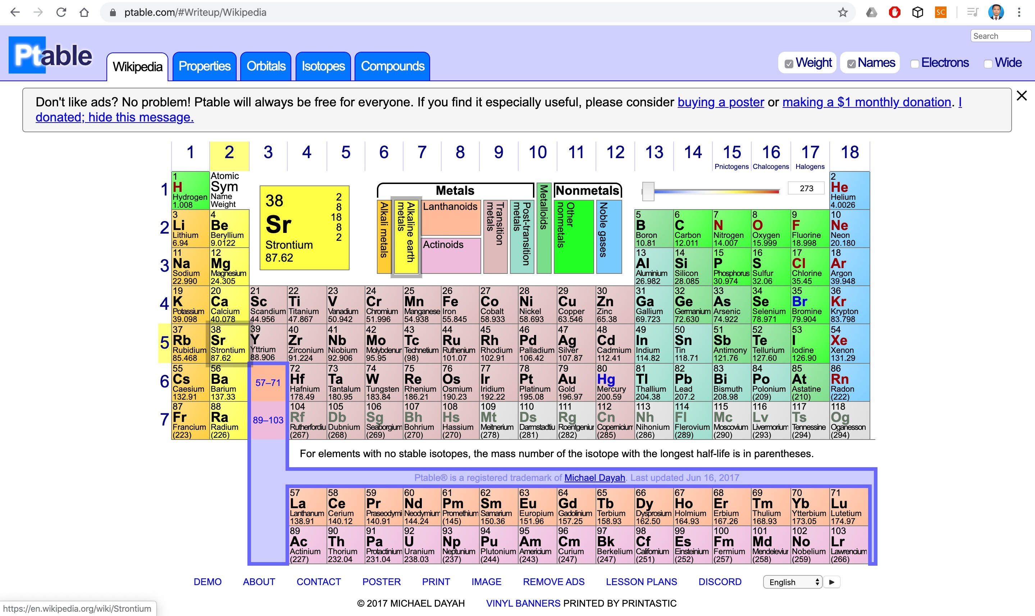
https://ptable.com/#Writeup/Wikipedia

Slide 17
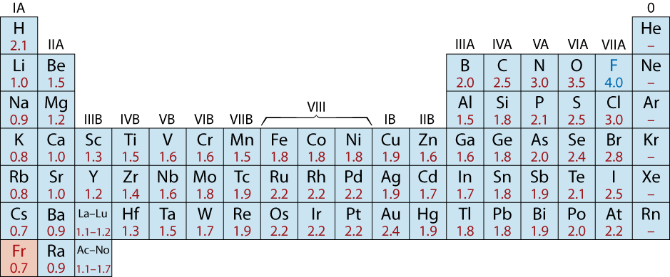
Electronegativity
• Ranges from 0.7 to 4.0,
• Large values: tendency to acquire electrons.
Smaller electronegativity
Larger electronegativity
Adapted from Fig. 2.7, Callister & Rethwisch 8e. (Fig. 2.7 is adapted from Linus Pauling, The Nature of the Chemical Bond, 3rd edition, Copyright 1939 and 1940, 3rd edition. Copyright 1960 by Cornell University.

Slide 18
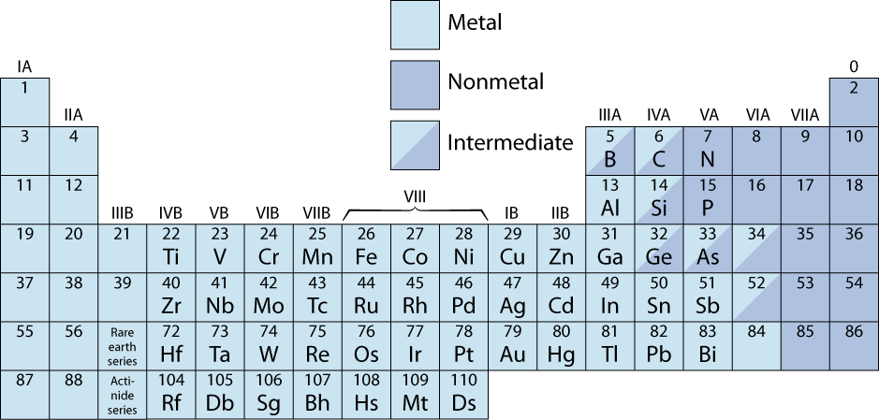
The Periodic Table
• Columns: Similar Valence Structure
give up 1e⁻
inert gases
give up 2e⁻
accept 2e⁻
accept 1e⁻
H
give up 3e⁻
He
Li
Be
O
F
Ne
Na
Mg
S
Cl
Ar
Adapted from Fig. 2.6, Callister & Rethwisch 8e.
K
Ca
Sc
Se
Br
Kr
Rb
Sr
Y
Te
I
Xe
Cs
Ba
Po
At
Rn
Fr
Ra
Electropositive elements:
Readily give up electrons
to become + ions.
Electronegative elements:
Readily acquire electrons
to become - ions.

Slide 19
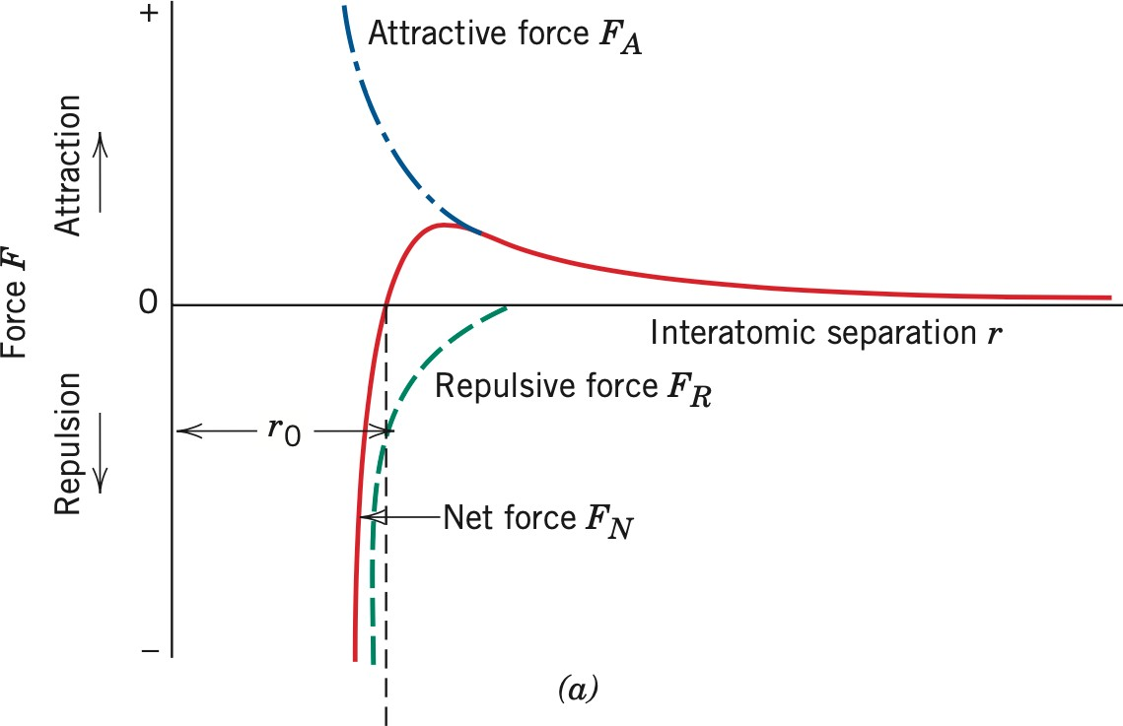
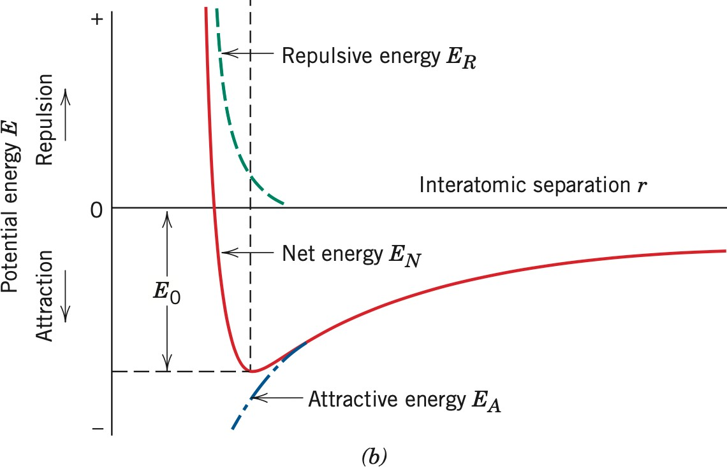
CHAPTER 2
SETG 2363 SN02 2024/2025-1
www.utm.my
Innovative · Entrepreneurial · Global
I 2.5 BONDING FORCES AND ENERGIES
The physical properties of materials can be predicated based on the interatomic forces that bind the atoms together.
At large distances, the interactions are negligible, but as the atoms approach, each
exerts forces on the other.
These forces are of two types, attractive and repulsive, and the magnitude of each is a function of the separation or interatomic distance.
The dependence of repulsive, attractive, and net forces on interatomic separation for two isolated atoms.
The dependence of repulsive, attractive, and net potential energies on interatomic separation for two
isolated atoms.

Slide 20
The dependence of repulsive, attractive, and net forces on interatomic separation for two isolated atoms.
The dependence of repulsive, attractive, and net potential energies on interatomic separation for two
isolated atoms.
The magnitude of the attractive force F_{A} varies with the distance.
Ultimately, the outer electron shells of the two atoms begin to overlap, and a strong repulsive force F_{R} comes into play.
The net force F_{N} between the two atoms is just the sum of both attractive and
repulsive components; F_{N} = F_{A} + F_{R}.
Then a state of equilibrium exists. The centers of the two atoms will remain separated by the equilibrium spacing r0. For many atoms, r0 is approximately 0.3 nm.
Once in this position, the two atoms will counteract any attempt to separate them by
an attractive force, or to push them together by a repulsive action.
Bonding energy represents the energy that would be required to separate these two atoms to an infinite separation.

Slide 21
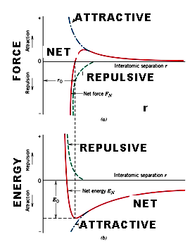
FORCES AND ENERGIES

Slide 22
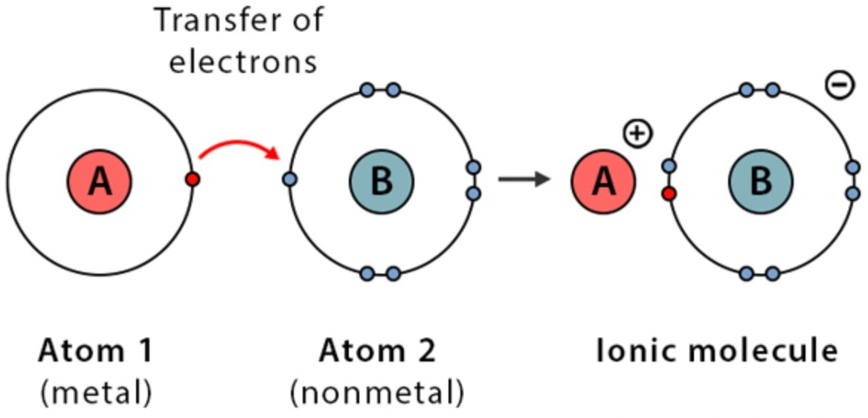
CHAPTER 2
SETG 2363 SN02 2024/2025-1
www.utm.my
Innovative · Entrepreneurial · Global
I 2.6 PRIMARY INTERATOMIC BONDING – IONIC BONDING
IONIC BONDING is always found in compounds that are composed of both metallic and nonmetallic elements, elements that are situated at the horizontal extremities of the periodic table.
Atoms of a metallic element easily give up their valence electrons to the
nonmetallic atoms.
Example: Sodium chloride (NaCl). The atoms exist as ions.
The attractive bonding forces are coulombic due to the positive and negative ions.
Ionic bonding is termed nondirectional; that is, the magnitude of the bond is equal in all directions around an ion.
Bonding energies, which generally range between 600 and 1500 kJ/mol (3 and 8 eV/atom), are relatively large, as reflected in high melting temperatures.
Ionic materials are characteristically hard and brittle and, furthermore, electrically
and thermally insulative.

Slide 23
Ionic Bonding
• Occurs between + and - ions.
• Requires electron transfer.
• Large difference in electronegativity required.
• Example: NaCl
Na (metal)
Cl (nonmetal)
unstable
unstable
electron
Na (cation)
+
-
Cl (anion)
stable
Coulombic
stable
Attraction

Slide 24
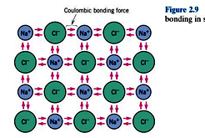



Slide 25
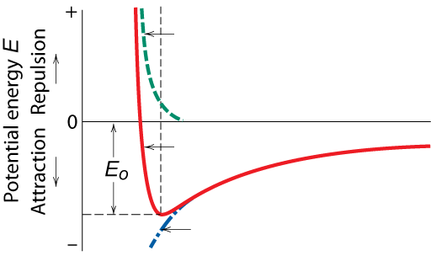

Ionic Bonding
Energy – minimum energy most stable
  Energy balance of attractive and repulsive terms
A
B
E_{N} = E_{A} + E_{R} =
−
+
r
r
n
Repulsive energy E_{R}
Interatomic separation r
Net energy E_{N}
Adapted from Fig. 2.8(b), Callister & Rethwisch 8e.
Attractive energy E_{A}

Slide 26
Examples: Ionic Bonding
• Predominant bonding in Ceramics
NaCl
MgO
CaF
2
CsCl
Give up electrons
Acquire electrons
Adapted from Fig. 2.7, Callister & Rethwisch 8e. (Fig. 2.7 is adapted from Linus Pauling, The Nature of the Chemical Bond, 3rd edition, Copyright 1939 and 1940, 3rd edition. Copyright 1960 by Cornell University.

Slide 27
CHAPTER 2
SETG 2363 SN02 2024/2025-1
www.utm.my
Innovative · Entrepreneurial · Global
I 2.6 PRIMARY INTERATOMIC BONDING – COVALENT BONDING
In covalent bonding, stable electron configurations are assumed by the sharing of electrons between adjacent atoms.
Two atoms that are covalently bonded will each contribute at least one electron to
the bond, and the shared electrons may be considered to belong to both atoms.
Example methane (CH₄). The carbon atom has four valence electrons, whereas each of the four hydrogen atoms has a single valence electron.
The covalent bond is directional; that is, it is between specific atoms and may exist
only in the direction between one atom and another that participates in the electron sharing.
Many nonmetallic elemental molecules (H₂, Cl₂, F₂, etc.) as well as molecules containing dissimilar atoms, such as CH₄, H₂O, HNO₃, and HF, are covalently bonded. Most polymers are covalently bonded.
Covalent bonding can also be found in elemental solids such as diamond (carbon),
silicon, and germanium and other solid compounds composed of elements that are
located on the right-hand side of the periodic table, such as gallium arsenide (GaAs), indium antimonide (InSb), and silicon carbide (SiC).
Covalent bonds may be very strong, as in diamond, which is very hard and has a
very high melting temperature, >3550◦C (6400◦F), or they may be very weak, as
with bismuth, which melts at about 270◦C (518◦F).

Slide 28
Covalent Bonding
similar electronegativity ∴ share electrons
bonds determined by valence – s & p orbitals dominate bonding
Example: CH₄
shared electrons
C: has 4 valence e⁻,
needs 4 more
H
from carbon atom
CH
4
H: has 1 valence e⁻,
needs 1 more
H
C
H
shared electrons
Electronegativities
are comparable.
from hydrogen
H
atoms
Adapted from Fig. 2.10, Callister & Rethwisch 8e.

Slide 29
CHAPTER 2
SETG 2363 SN02 2024/2025-1
www.utm.my
Innovative · Entrepreneurial · Global
I 2.6 PRIMARY INTERATOMIC BONDING – METALLIC BONDING
METALLIC BONDING is found in metals and their alloys.
Metallic bonding is found in the periodic table for Group IA and IIA elements and, in fact, for all elemental metals.
Metallic materials have one, two, or at most, three valence electrons.
With this model, these valence electrons are not bound to any particular atom in the solid and are more or less free to drift throughout the entire metal.
They may be thought of as belonging to the metal as a whole, or forming a “sea of
electrons” or an “electron cloud.”
The remaining nonvalence electrons and atomic nuclei form what are called ion
cores, which possess a net positive charge equal in magnitude to the total valence electron charge per atom.
Bonding may be weak or strong; energies range from 68 kJ/mol (0.7 eV/atom) for
mercury to 849 kJ/mol (8.8 eV/atom) for tungsten. Their respective melting
temperatures are −39 and 3410◦C (−38 and 6170◦F).
At room temperature, most metals and their alloys fail in a ductile manner; that is, fracture occurs after the materials have experienced significant degrees of permanent deformation. They are intrinsically brittle as a consequence of the electrically charged nature of their component ions.

Slide 30
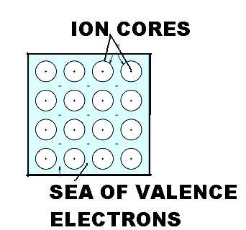
METALLIC BONDING

Slide 31
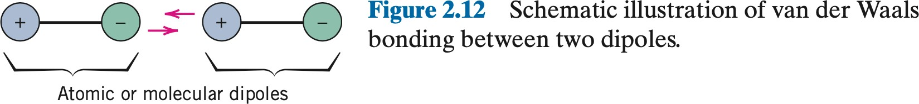
CHAPTER 2
SETG 2363 SN02 2024/2025-1
www.utm.my
Innovative · Entrepreneurial · Global
I 2.7 SECONDARY BONDING / VAN DER WAALS BONDING
Secondary, van der Waals, or physical bonds are weak in comparison to the primary or chemical ones; bonding energies are typically on the order of only 10 kJ/mol (0.1 eV/atom).
Secondary bonding is evidenced for the inert gases, which have stable electron
structures, and, in addition, between molecules in molecular structures that are covalently bonded.
Secondary bonding forces arise from atomic or molecular dipoles.
The bonding results from the coulombic attraction between the positive end of one dipole and the negative region of an adjacent one.
Dipole interactions occur between induced dipoles, between induced dipoles and polar molecules (which have permanent dipoles), and between polar molecules.

Slide 32
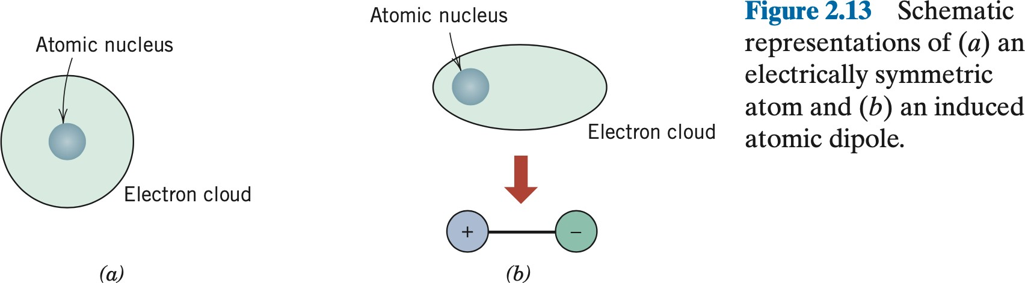
CHAPTER 2
SETG 2363 SN02 2024/2025-1
www.utm.my
Innovative · Entrepreneurial · Global
I 2.7 SECONDARY BONDING / VAN DER WAALS BONDING
FLUCTUATING INDUCED DIPOLE BONDS
A dipole may be created or induced in an atom or molecule that is normally electrically symmetric; that is, the overall spatial distribution of the electrons is symmetric with respect to the positively charged nucleus.
All atoms are experiencing constant vibrational motion that can cause instantaneous and short-lived distortions of this electrical symmetry for some of the atoms or molecules, and the creation of small electric dipoles.
One of these dipoles can in turn produce a displacement of the electron distribution
of an adjacent molecule or atom, which induces the second one also to become a
dipole that is then weakly attracted or bonded to the first; this is one type of van der Waals bonding.
These attractive forces may exist between large numbers of atoms or molecules,
which forces are temporary and fluctuate with time.

Slide 33
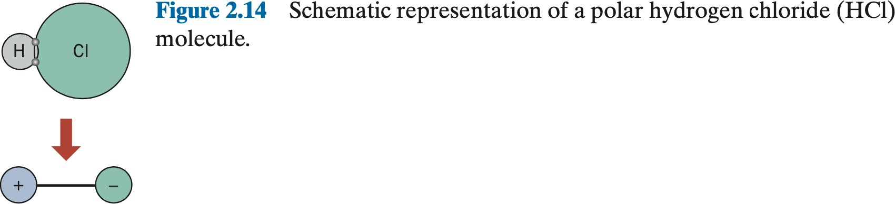
CHAPTER 2
SETG 2363 SN02 2024/2025-1
www.utm.my
Innovative · Entrepreneurial · Global
I 2.7 SECONDARY BONDING / VAN DER WAALS BONDING
POLAR MOLECULE-INDUCED DIPOLE BONDS
Permanent dipole moments exist in some molecules by virtue of an asymmetrical arrangement of positively and negatively charged regions; such molecules are termed polar molecules.
Example: Hydrogen chloride molecule; a permanent dipole moment arises from net positive and negative charges that are respectively associated with the hydrogen and chlorine ends of the HCl molecule.
Polar molecules can also induce dipoles in adjacent nonpolar molecules, and a bond will form as a result of attractive forces between the two molecules. Furthermore, the magnitude of this bond will be greater than for fluctuating induced dipoles.

Slide 34
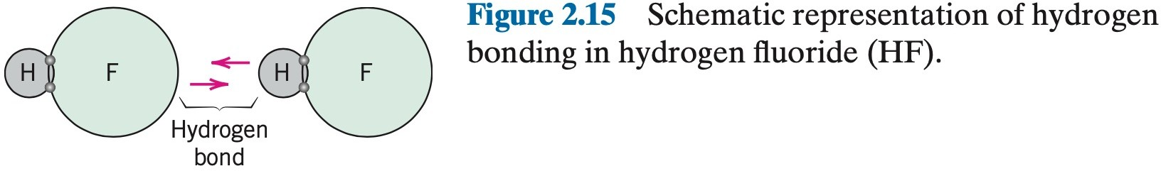
CHAPTER 2
SETG 2363 SN02 2024/2025-1
www.utm.my
Innovative · Entrepreneurial · Global
I 2.7 SECONDARY BONDING / VAN DER WAALS BONDING
PERMANENT DIPOLE BONDS
The strongest secondary bonding type, the hydrogen bond, is a special case of polar molecule bonding. It occurs between molecules in which hydrogen is covalently bonded to fluorine (as in HF), oxygen (as in H₂O), or nitrogen (as in
NH₃).
For each H—F, H—O, or H—N bond, the single hydrogen electron is shared with the other atom.
Thus, the hydrogen end of the bond is essentially a positively charged bare proton
that is unscreened by any electrons.
This highly positively charged end of the molecule is capable of a strong attractive force with the negative end of an adjacent molecule.
This single proton forms a bridge between two negatively charged atoms. The
magnitude of the hydrogen bond is generally greater than that of the other types of secondary bonds and may be as high as 51 kJ/mol (0.52 eV/molecule).

Slide 35
SECONDARY BONDING
Arises from interaction between dipoles
• Fluctuating dipoles
asymmetric electron
ex: liquid H
2
clouds
H
2
H
2
+
-
+
-
H
H
H
H
secondary
secondary
bonding
Adapted from Fig. 2.13, Callister & Rethwisch 8e.
bonding
• Permanent dipoles-molecule induced
-general case:
+
-
secondary
+
-
bonding
Adapted from Fig. 2.15,
Callister & Rethwisch 8e.
-ex: liquid HCl
H
Cl
secondary
H
Cl
bonding
-ex: polymer
secondary bonding
secondary bonding

Slide 36
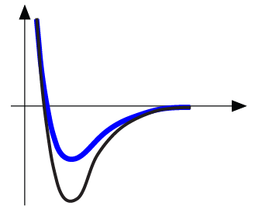
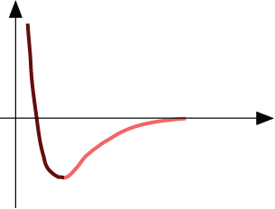
Properties From Bonding: T_{m}
• Bond length, r
• Melting Temperature, T_{m}
Energy
r
• Bond energy, E_{o}
r
o
r
Energy
smaller T_{m}
unstretched length
larger T_{m}
r
o
r
E_{o}
=
T_{m} is larger if E_{o} is larger.
“bond energy”

Slide 37
Properties From Bonding : α
• Coefficient of thermal expansion, α
length,
L
o
coeff. thermal expansion
unheated, T
1
Δ
L
Δ
L
=
α
(
T
-
T
)
L
2
1
heated, T
2
o
• α ~ symmetric at r_{o}
Energy
unstretched length
r
o
r
α is larger if E_{o} is smaller.
larger α
E_{o}
E_{o}
smaller α

Slide 38
Summary: Primary Bonds
Ceramics
Large bond energy
large T_{m}
large E
small α
(Ionic & covalent bonding):
Metals
Variable bond energy
moderate T_{m}
moderate E
moderate α
(Metallic bonding):
Polymers
Directional Properties
Secondary bonding dominates
small T_{m}
small E
large α
(Covalent & Secondary):
secondary bonding

Slide 39
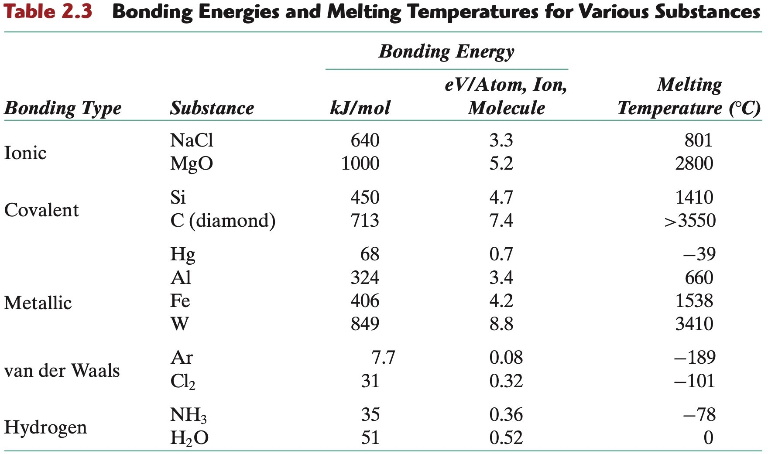
CHAPTER 2
SETG 2363 SN02 2024/2025-1
www.utm.my
Innovative · Entrepreneurial · Global

Slide 40
Summary: Bonding
Type
Bond Energy
Comments
Ionic
Large!
Nondirectional (ceramics)
Covalent
Variable
Directional
(semiconductors, ceramics
polymer chains)
large-Diamond
small-Bismuth
Metallic
Variable
large-Tungsten
Nondirectional (metals)
small-Mercury
Secondary
smallest
Directional
inter-chain (polymer)
inter-molecular

Slide 41



http://engineering.utm.my/chemicalenergy/
www.utm.my
Innovative · Entrepreneurial · Global
schoolchemicalenergyutm
utm_fcee
skt_utm

