Slide 1

SETG 2363
Material Engineering
18 FEBRUARY 2020
Mohsin Mohd Sies
Nuclear Engineering,
Faculty of Chemical and Energy Engineering,
Universiti Teknologi Malaysia
Credits: Dr Zulhairun Abdul Karim

Slide 3
MATERIAL ENGINEERING
SETG 2363 SN02 2024/2025-1
www.utm.my
Innovative · Entrepreneurial · Global
I COURSE OUTLINE
PART 1 is introductory of Materials Engineering. (Microstructure – properties relationship of materials) Topics include classification of materials (metals, ceramics, polymers, composites and semiconductors); atomic bonds; crystal structure; crystalline defects and solid solutions; and phase diagrams. Main emphasis is on metals because metals are structurally the simplest to characterize and a sound knowledge of structure-property relation of metals can be extended to the study of ceramics and polymers.
PART 2 deals with Mechanics of Materials. (Deformation of materials under loading) Topics cover stress and deformation of members under axial loading, torsion in circular shafts, analysis and design of beams for bending, and stress transformation. Throughout the course, strong emphasis is placed on drawing a free-body diagram and selecting appropriate coordinate system using the correct sign convention.

Slide 4
MATERIAL ENGINEERING
SETG 2363 SN02 2024/2025-1
www.utm.my
Innovative · Entrepreneurial · Global
I COURSE LEARNING OUTCOMES
By the end of the course, students should be able to:
describe structure-property of traditional and modern engineering materials (metals, ceramics, polymers and composites) and choose class of materials for a given application (i.e. simple material selection);
describe types of atomic bonding (ionic, covalent, metallic, secondary) and relate bonding to materials properties;
describe and compare crystal structure and point defects in metals (FCC and BCC) and draw crystallographic direction and planar indices in isometric of cubic unit cells;
describe and differentiate eutectoid and eutectic phase diagrams of binary systems, perform simple calculations (lever rule) to quantify phase composition and fraction using phase diagram, and predict microstructure as function of temperature and composition;

Slide 5
analyze structural members under axial load and torsion and determine the corresponding internal force, stress and deformation;
solve problem related to the location of centroid, moment of inertia and normal stress due to bending in a beam of given cross section;
solve the problem related to the shear force, bending moment diagrams of beams based on allowable normal stress;
apply Mohr’s circle method to determine stress transformation at a point (principal stresses and planes, maximum shear stress, average normal stress);
function effectively as an individual, and as a member or leader in diverse teams or multidisciplinary settings.

Slide 6
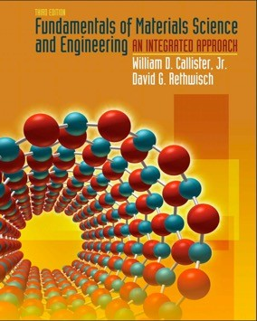
MATERIAL ENGINEERING
SETG 2363 SN02 2024/2025-1
www.utm.my
Innovative · Entrepreneurial · Global
I TEXTBOOKS
Topics Covered (Part 1):
Chapter 1: Introduction
Chapter 2: Atomic Structure and Interatomic Bonding Chapter 3: Structures of Metals and Ceramics Chapter 5: Imperfections in Solids
Chapter 10: Phase Diagrams
Fundamentals of Materials Science and Engineering 3rd Edition

Slide 7
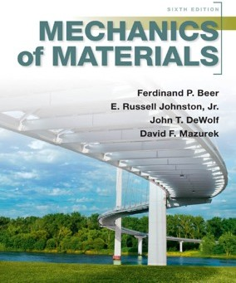
MATERIAL ENGINEERING
SETG 2363 SN02 2024/2025-1
www.utm.my
Innovative · Entrepreneurial · Global
I TEXTBOOKS
Topics Covered (Part 2):
  Chapter 1: Introduction: Concept of Stress
  Chapter 2: Stress and Strain – Axial Loading
  Chapter 3: Torsion
  Chapter 4: Pure Bending
  Chapter 5: Analysis and Design of Beams for Bending
  Chapter 7: Transformations of Stress
Mechanics of Materials
6th Edition

Slide 8
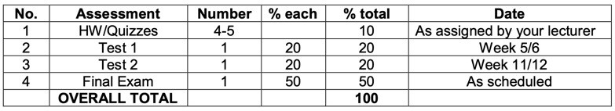
MATERIAL ENGINEERING
SETG 2363 SN02 2024/2025-1
www.utm.my
Innovative · Entrepreneurial · Global
I GRADING
I ACADEMIC HONESTY AND PLAGIARISM
The University has a strict policy on academic integrity. Any form of plagiarism or academic dishonesty will NOT be tolerated in SETG 2363.
If you have any questions, please consult me.

Slide 9



http://engineering.utm.my/chemicalenergy/
www.utm.my
Innovative · Entrepreneurial · Global
schoolchemicalenergyutm
utm_fcee
skt_utm

Slide 10



CHAPTER 1
SETG 2363 SN02 2024/2025-1
www.utm.my
Innovative · Entrepreneurial · Global
I INTRODUCTION
A familiar item that is fabricated from three different material types is the beverage container. Beverages are marketed in aluminum (metal) cans (left), glass (ceramic) bottles (center), and plastic (polymer) bottles (right).

Slide 11
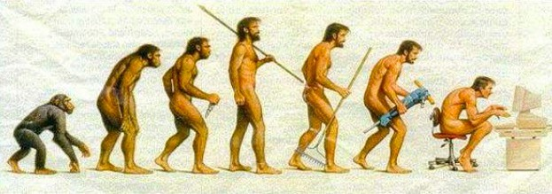
CHAPTER 1
SETG 2363 SN02 2024/2025-1
www.utm.my
Innovative · Entrepreneurial · Global
I 1.1 HISTORICAL PERSPECTIVE
Historically, the development and advancement of societies have been intimately tied to the members’ ability to produce and manipulate materials to fill their needs.
Early civilizations have been designated by the level of their materials
development (Stone Age, Bronze Age, Iron Age).
It was discovered that the properties of a material could be altered by heat treatments and by the addition of other substances.
Relatively recently that scientists came to understand the relationships between the structural elements of materials and their properties.

Slide 12
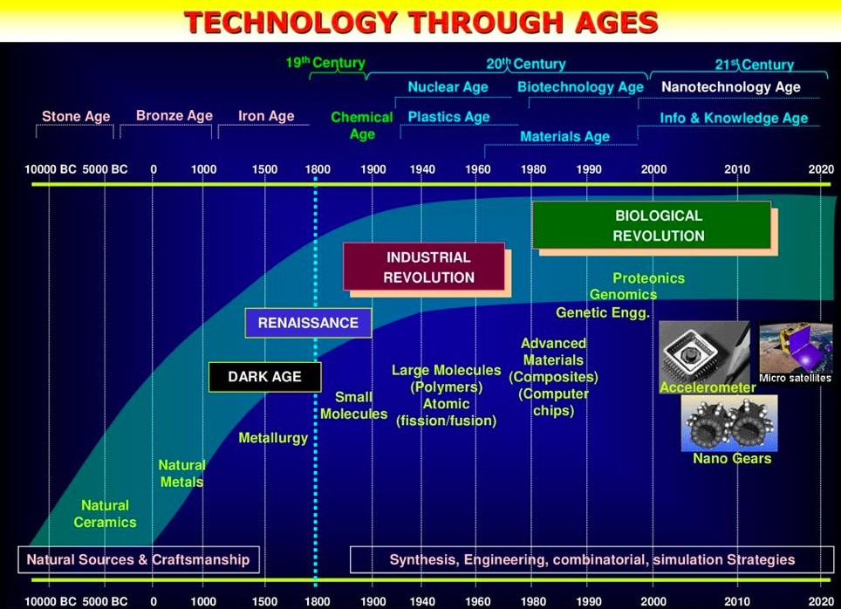

Slide 13
CHAPTER 1
SETG 2363 SN02 2024/2025-1
www.utm.my
Innovative · Entrepreneurial · Global
I 1.2 MATERIALS SCIENCE versus MATERIAL ENGINEERING
“MATERIALS SCIENCE” involves investigating the relationships that exist between the structures and properties of materials.
“MATERIALS ENGINEERING” is, on the basis of these structure–property correlations, designing or engineering the structure of a material to produce a
predetermined set of properties.
The role of a materials scientist is to develop or synthesize new materials.
Materials engineer is called upon to create new products or systems using existing materials, and/or to develop techniques for processing materials.
Above are the four components of the discipline of materials science and engineering and their interrelationship.
The structure of a material will depend on how it is processed, and a material’s performance will be a function of its properties.

Slide 14
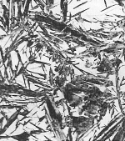
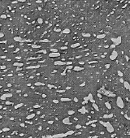
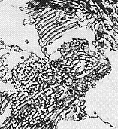
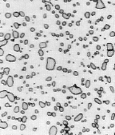
Structure, Processing, & Properties
• Properties depend on structure
ex: hardness vs structure of steel
(d)
6
00
5
00
30 μm
(c)
Data obtained from Figs. 10.30(a)
and 10.32 with 4 wt% C composition,
and from Fig. 11.14 and associated
discussion, Callister & Rethwisch 8e.
Micrographs adapted from (a) Fig.
10.19; (b) Fig. 9.30;(c) Fig. 10.33;
and (d) Fig. 10.21, Callister & Rethwisch 8e.
4
00
(b)
(a)
Hardness (BHN)
3
00
4 μm
2
00
30 μm
30 μm
100
0.01
0.1
1
10
100
1000
Cooling Rate (ºC/s)
• Processing can change structure
ex: structure vs cooling rate of steel

Slide 15
Types of Materials
Metals:
  Strong, ductile
  High thermal & electrical conductivity
  Opaque, reflective.
Polymers/plastics: Covalent bonding → sharing of e’s
  Soft, ductile, low strength, low density
  Thermal & electrical insulators
  Optically translucent or transparent.
Ceramics: ionic bonding (refractory) – compounds of metallic & non-metallic elements (oxides, carbides, nitrides, sulfides)
  Brittle, glassy
  Non-conducting (insulators)
Notes:
Metals have high thermal & electrical conductivity because valence electrons are free to roam

Slide 16
ELECTRICAL
• Electrical Resistivity of Copper:
6
Adapted from Fig. 18.8, Callister & Rethwisch 8e. (Fig. 18.8 adapted from: J.O. Linde, Ann Physik 5, 219 (1932); and C.A. Wert and R.M. Thomson, Physics of Solids, 2nd edition, McGraw-Hill Company, New York, 1970.)
5
Cu + 3.32 at%Ni
4
Cu + 2.16 at%Ni
Resistivity, ρ
deformed Cu + 1.12 at%Ni
3
(10⁻⁸ Ohm-m)
2
Cu + 1.12 at%Ni
1
“Pure” Cu
0
-200
-100
0
T (ºC)
• Adding “impurity” atoms to Cu increases resistivity.
• Deforming Cu increases resistivity.

Slide 17

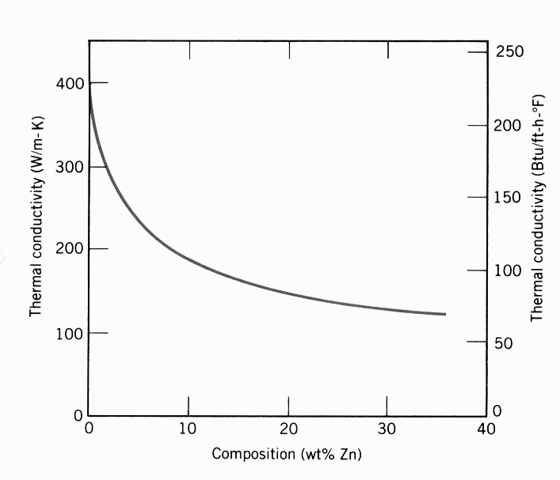
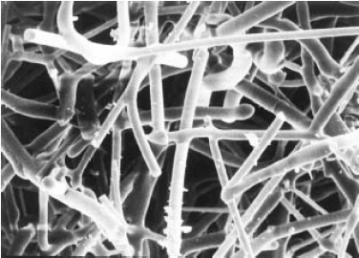
THERMAL
• Space Shuttle Tiles:
-- Silica fiber insulation
offers low heat conduction.
• Thermal Conductivity
of Copper:
-- It decreases when
you add zinc!
Adapted from chapter-opening photograph, Chapter 17, Callister & Rethwisch 3e. (Courtesy of Lockheed
Missiles and Space
Company, Inc.)
400
300
(W/m-K)
Thermal Conductivity
200
100
0
0
10
20
30
40
Composition (wt% Zinc)
Adapted from
Fig. 19.4W, Callister 6e. (Courtesy of Lockheed Aerospace Ceramics Systems, Sunnyvale, CA)
(Note: "W" denotes fig. is on CD-ROM.)
Adapted from Fig. 19.4, Callister & Rethwisch 8e. (Fig. 19.4 is adapted from Metals Handbook: Properties and Selection: Nonferrous alloys and Pure Metals, Vol. 2, 9th ed., H. Baker, (Managing Editor), American Society for Metals, 1979, p. 315.)
100 μm

Slide 18
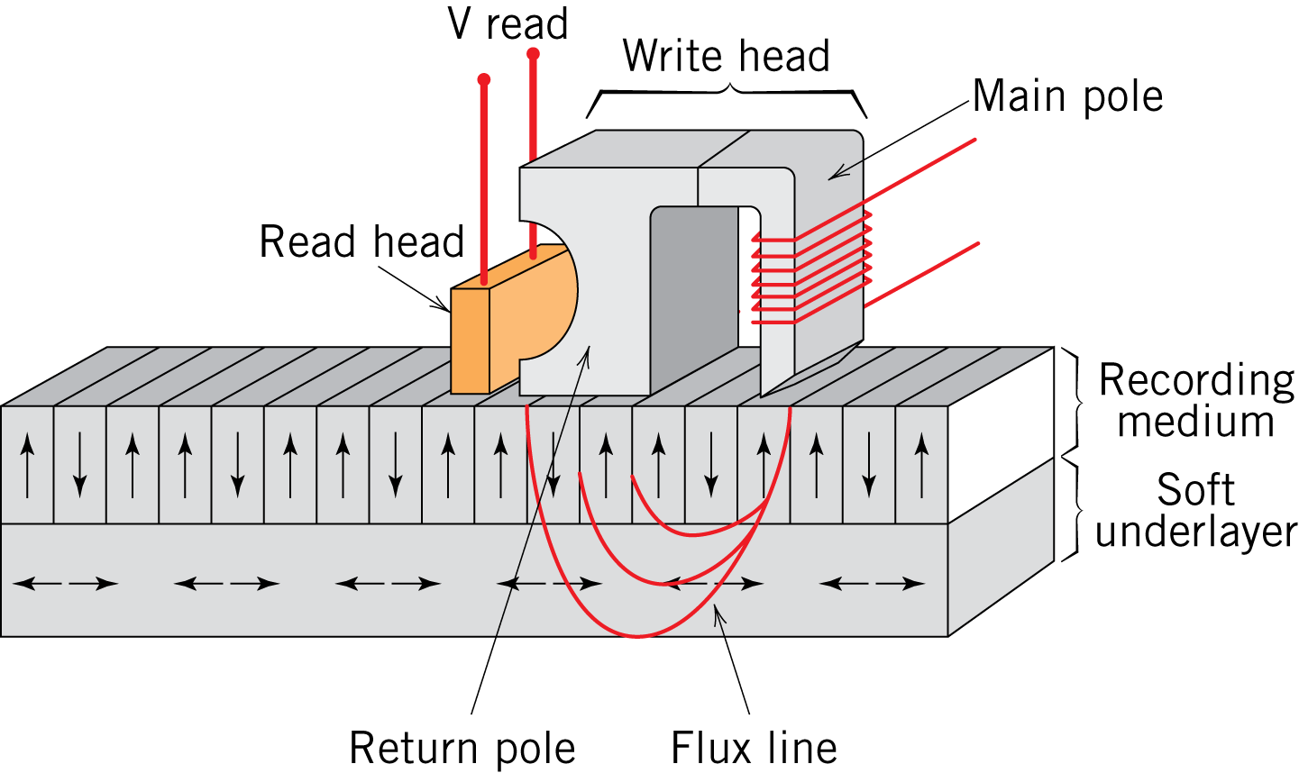
MAGNETIC
• Magnetic Storage:
-- Recording medium
is magnetized by
recording head.
• Magnetic Permeability
vs. Composition:
-- Adding 3 atomic % Si
makes Fe a better
recording medium!
Fe+3%Si
Magnetization
Fe
Magnetic Field
Adapted from C.R. Barrett, W.D. Nix, and
A.S. Tetelman, The Principles of
Engineering Materials, Fig. 1-7(a), p. 9,
Electronically reproduced
by permission of Pearson Education, Inc.,
Upper Saddle River, New Jersey.
Fig. 20.23, Callister & Rethwisch 8e.

Slide 19
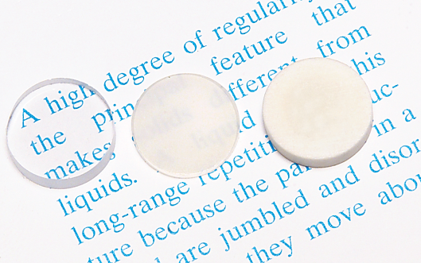
OPTICAL
• Transmittance:
-- Aluminum oxide may be transparent, translucent, or
opaque depending on the material structure.
polycrystal:
low porosity
polycrystal:
high porosity
single crystal
Adapted from Fig. 1.2,
Callister & Rethwisch 8e.
(Specimen preparation,
P.A. Lessing; photo by S. Tanner.)

Slide 20
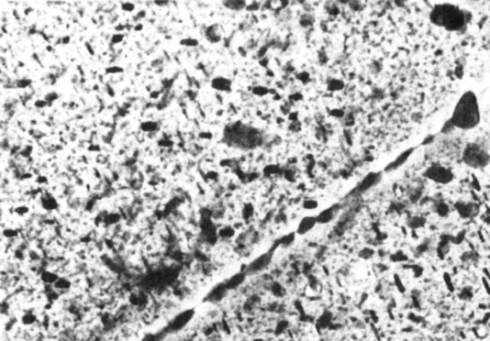

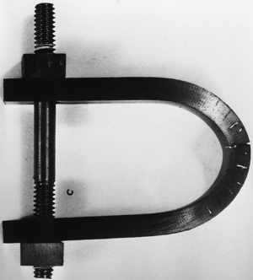
DETERIORATIVE
• Stress & Saltwater...
-- causes cracks!
• Heat treatment: slows
crack speed in salt water!
10
-8
“as-is”
“held at
160ºC for 1 hr
crack speed (m/s)
before testing”
10
-10
Alloy 7178 tested in
saturated aqueous NaCl
solution at 23ºC
increasing load
Adapted from Fig. 11.20(b), R.W. Hertzberg, "Deformation and Fracture Mechanics of Engineering Materials" (4th ed.), p. 505, John Wiley and Sons, 1996. (Original source: Markus O. Speidel, Brown Boveri Co.)
Adapted from chapter-opening photograph, Chapter 16, Callister & Rethwisch 3e.
(from Marine Corrosion, Causes, and Prevention, John Wiley and Sons, Inc., 1975.)
-- material:
7150-T651 Al "alloy"
(Zn,Cu,Mg,Zr)
4 μm
Adapted from Fig. 11.26,
Callister & Rethwisch 8e. (Provided courtesy of G.H. Narayanan and A.G. Miller, Boeing Commercial Airplane Company.)

Slide 21
CHAPTER 1
SETG 2363 SN02 2024/2025-1
www.utm.my
Innovative · Entrepreneurial · Global
I 1.3 WHY STUDY MATERIALS?
Answer: DECISION MAKING.
Applied scientist or engineer, whether mechanical, civil, chemical, or electrical, will at one time or another be exposed to a design problem involving materials.
Many times, a materials problem is one of selecting the right material from the many thousands that are available.
How strong? How stable?
How heavy? How much the cost?
Often, some compromise is inevitable.
The more familiar an engineer or scientist is with the various characteristics
and structure–property relationships, as well as processing techniques of materials, the more proficient and confident he or she will be in making judicious materials choices based on these criteria.

Slide 22
The Materials Selection Process
1.
Pick Application
Determine required Properties
Properties: mechanical, electrical, thermal,
magnetic, optical, deteriorative.
2.
Properties
Identify candidate Material(s)
Material: structure, composition.
3.
Material
Identify required Processing
Processing: changes structure and overall shape
ex: casting, sintering, vapor deposition, doping
forming, joining, annealing.

Slide 23
CHAPTER 1
SETG 2363 SN02 2024/2025-1
www.utm.my
Innovative · Entrepreneurial · Global
I 1.4 CLASSIFICATION OF MATERIALS
Solid materials have been generally grouped into three basic classifications:
metals, ceramics, and polymers.
Most materials fall into one distinct grouping or another, although there are some intermediates.
There are the composites, combinations of two or more of the above three
basic material classes.
Another classification is advanced materials—those used in high-
technology applications— viz. semiconductors, biomaterials, smart materials, and nanoengineered materials.

Slide 24
CHAPTER 1
SETG 2363 SN02 2024/2025-1
www.utm.my
Innovative · Entrepreneurial · Global
I 1.4.1 METALS
Materials in this group are composed of one or more metallic elements (such as iron, aluminum, copper, titanium, gold, and nickel), and often also non-metallic elements (for example, carbon, nitrogen, and oxygen) in relatively small amounts.
Atoms in metals and their alloys are arranged in a very orderly manner (pack
atom arrangement).
In comparison to the ceramics and polymers, metals are relatively dense.
In terms of mechanical characteristics, metals are relatively stiff and strong, yet are ductile (i.e., capable of large amounts of deformation without fracture), and are resistant to fracture, which accounts for their widespread use in structural
applications.
Metallic materials have large numbers of nonlocalized electrons; that is, these electrons are not bound to particular atoms. Therefore, metals are extremely good conductors of electricity and heat, and are not transparent to visible light; a polished metal surface has a lustrous appearance.
Some of the metals (viz., Fe, Co, and Ni) have desirable magnetic properties.

Slide 25
CHAPTER 1
SETG 2363 SN02 2024/2025-1
www.utm.my
Innovative · Entrepreneurial · Global
I 1.4.2 CERAMICS
Ceramics are compounds between metallic and nonmetallic elements; they are most frequently oxides, nitrides, and carbides.
Examples, aluminum oxide (or alumina, Al2O3), silicon dioxide (or silica, SiO2), silicon carbide (SiC), silicon nitride (Si3N4), traditional ceramics—those
composed of clay minerals (i.e., porcelain), as well as cement and glass.
Ceramic materials are relatively stiff and strong—stiffnesses and strengths are comparable to those of the metals, but they are extremely brittle (lack ductility) and are highly susceptible to fracture.
Ceramics are typically insulative to the passage of heat and electricity (i.e., have
low electrical conductivities.
Ceramics are more resistant to high temperatures and harsh environments
than metals and polymers.
Ceramics may be transparent, translucent, or opaque, and some of the oxide ceramics (e.g., Fe3O4) exhibit magnetic behavior.

Slide 26
CHAPTER 1
SETG 2363 SN02 2024/2025-1
www.utm.my
Innovative · Entrepreneurial · Global
I 1.4.3 POLYMERS
Polymers include the familiar plastic and rubber materials. Many of them are organic compounds that are chemically based on carbon, hydrogen, and other nonmetallic elements (viz. O, N, and Si).
Polymers have very large molecular structures, often chain-like in nature with
a backbone of carbon atoms.
Some familiar polymers are polyethylene (PE), nylon, poly(vinyl chloride) (PVC), polycarbonate (PC), polystyrene (PS), and silicone rubber.
Polymers typically have low densities, not as stiff nor as strong as metals and ceramics.
Many of the polymers are extremely ductile and pliable (i.e., plastic), which means they are easily formed into complex shapes.
In general, they are relatively inert chemically and unreactive in a large number
of environments.
One major drawback of the polymers is their tendency to soften and/or
decompose at modest temperatures, which, in some instances, limits their use.
Furthermore, they have low electrical conductivities (insulative) and are
nonmagnetic.

Slide 27
CHAPTER 1
SETG 2363 SN02 2024/2025-1
www.utm.my
Innovative · Entrepreneurial · Global
I 1.4.4 COMPOSITES
A composite is composed of two (or more) individual materials, which come from metals, ceramics, and polymers.
The design goal of a composite is to achieve a combination of properties that is not displayed by any single material, and also to incorporate the best
characteristics of each of the component materials.
One of the most common and familiar composites is fiberglass, in which small glass fibers are embedded within a polymeric material (normally an epoxy or polyester).
The glass fibers are relatively strong and stiff (but also brittle), whereas the
polymer is ductile (but also weak and flexible). Thus, the resulting fiberglass is relatively stiff, strong, flexible, and ductile. In addition, it has a low density.
Another example is the “carbon fiber-reinforced polymer” (or “CFRP”)
composite—carbon fibers that are embedded within a polymer. CFRP are stiffer and stronger than the glass fiber-reinforced materials yet they are more
expensive.
The CFRP composites are used in some aircraft and aerospace applications, as well as high-tech sporting equipment (e.g., bicycles, golf clubs, tennis rackets, and skis/snowboards).

Slide 28
CHAPTER 1
SETG 2363 SN02 2024/2025-1
www.utm.my
Innovative · Entrepreneurial · Global
I 1.5 ADVANCED MATERIALS
Advanced materials are used in a device or product that operates or functions using relatively intricate and sophisticated principles such as in electronic equipment, computers, fiber-optic systems, spacecraft, aircraft, and military rocketry.
These advanced materials are typically traditional materials whose properties have been enhanced, unique, and also newly developed, high-performance materials.
Advanced materials include semiconductors, biomaterials, smart materials, and nanoengineered materials.
SEMICONDUCTORS have electrical properties that are intermediate between the electrical conductors (viz. metals and metal alloys) and insulators (viz. ceramics and polymers). Semiconductors have a unique atomic structure that allows their conductivity to be controlled by stimulation with electric currents, electromagnetic fields, or even light.

Slide 29
BIOMATERIALS are employed in components implanted into the human body for replacement of diseased or damaged body parts. These materials must not produce toxic substances and must be compatible with body tissues (i.e., must not cause adverse biological reactions). All of the above materials—metals, ceramics, polymers, composites, and semiconductors—may be used as biomaterials.
SMART MATERIAL (or system) include some type of sensor (that detects an input signal) and an actuator (that performs a responsive and adaptive function). Actuators may be called upon to change shape, position, natural frequency, or mechanical characteristics in response to changes in temperature, light intensity, electric fields, and/or magnetic fields.
NANOENGINEERED MATERIALS is in regards with the manipulation of atoms and molecules to form new structures and, thus, design new materials that are built from simple atomic-level constituents (i.e., “materials by design”). This ability to carefully arrange atoms provides opportunities to develop mechanical, electrical, magnetic, and other properties that are not otherwise possible. The “nano” prefix denotes that the dimensions of these structural entities are on the order of a nanometer (10⁻⁹ m)—as a rule, less than 100 nanometers (equivalent to approximately 500 atom diameters). Examples: carbon nanotubes, graphene, boron nitride, etc.

Slide 30
CHAPTER 1
SETG 2363 SN02 2024/2025-1
www.utm.my
Innovative · Entrepreneurial · Global
I 1.6 MODERN MATERIALS’ NEEDS
In spite of the tremendous progress that has been made in the discipline of materials science and engineering within the past few years, there still remain technological challenges, including the development of even more sophisticated and specialized materials, as well as consideration of the environmental impact of materials production.
Significant quantities of energy are involved in transportation. Reducing the weight of transportation vehicles (automobiles, aircraft, trains, etc.), as well as
increasing engine operating temperatures, will enhance fuel efficiency. New high- strength, low-density structural materials remain to be developed, as well as
materials that have higher-temperature capabilities, for use in engine components.
There is a need to find new, economical sources of energy and to use present
resources more efficiently. We need to find alternative materials for solar cells
which currently employ some rather complex and expensive materials. New
materials still need to be developed for more efficient fuel cells, and also for
better catalysts to be used in the production of hydrogen.
In some materials manufacturing processes, toxic substances are produced, and the ecological impact of their disposal must be considered. We need to find ways to create materials from renewable, more environmental friendly source.

Slide 31
Activity
Appreciation of Materials Engineering
  High end chip design and production
  Organize groups of three
  Find info on the topic
  Record a 5 minute video of yourselves talking to each other like (nerdy) friends about the incredible aspects of chip design and production.
  Upload video to Youtube or elearning.

Slide 32
http://engineering.utm.my/chemicalenergy/
www.utm.my
Innovative · Entrepreneurial · Global
schoolchemicalenergyutm
utm_fcee
skt_utm

