Slide 1
LECTURE 06
GAS UTILIZATION
AND
EQUIPMENT
Course Outcome ;
Discuss and compare the various uses and factors affecting the use of natural gas in various sectors as well as describe and compare energy generating equipment used in each sector of natural gas utilization

Slide 3

NATIONAL ENERGY BALANCE –
1997 vs 2017
1997 → 2017; Still dependent of fossil fuels with little contribution of renewable energy sources

Slide 4
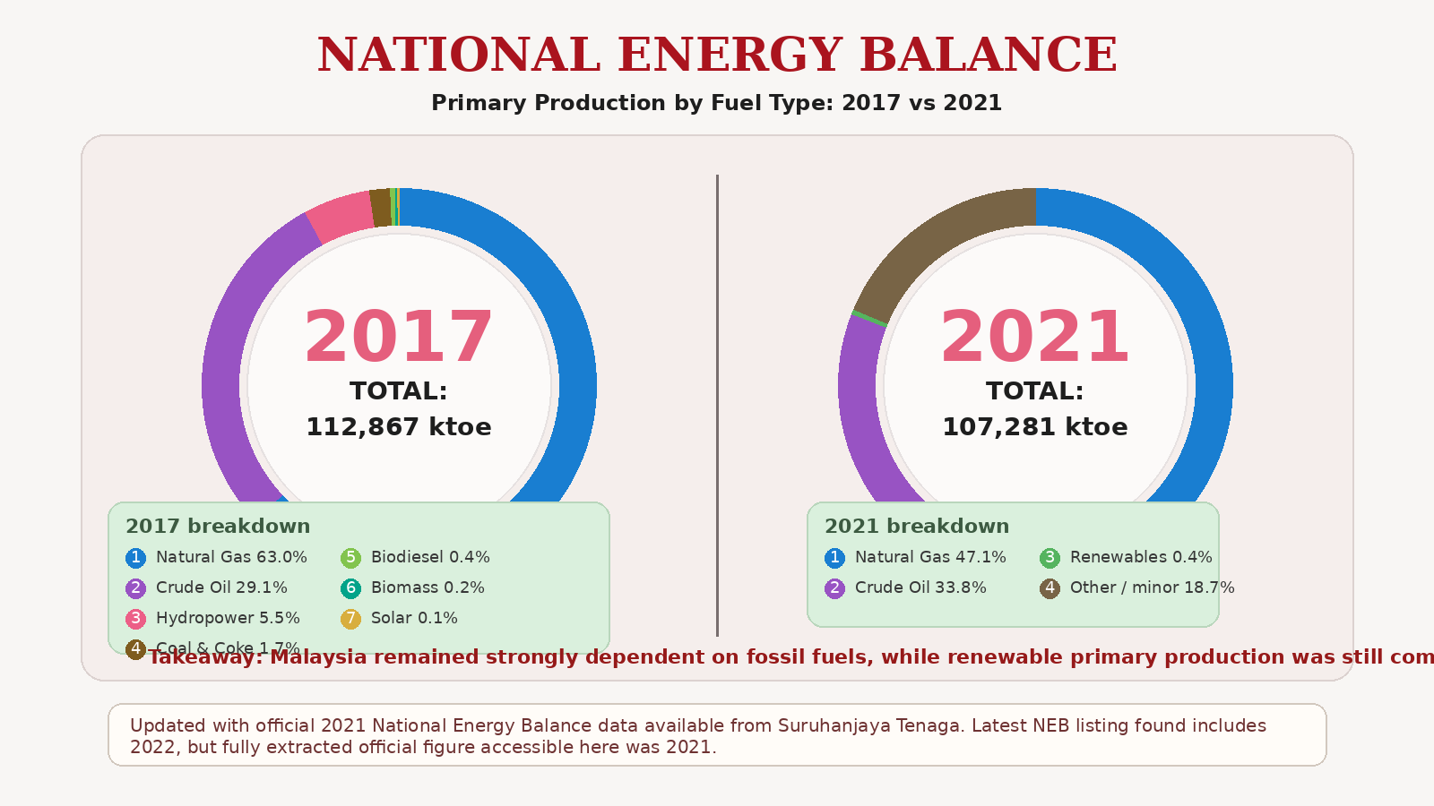

Slide 5
NATIONAL ENERGY BALANCE
1997 vs 2017
Non energy use includes energy products used as raw materials in different sectors (e.g. petrochemical) that is not consumed as a fuel or transformed into another fuel

Slide 6
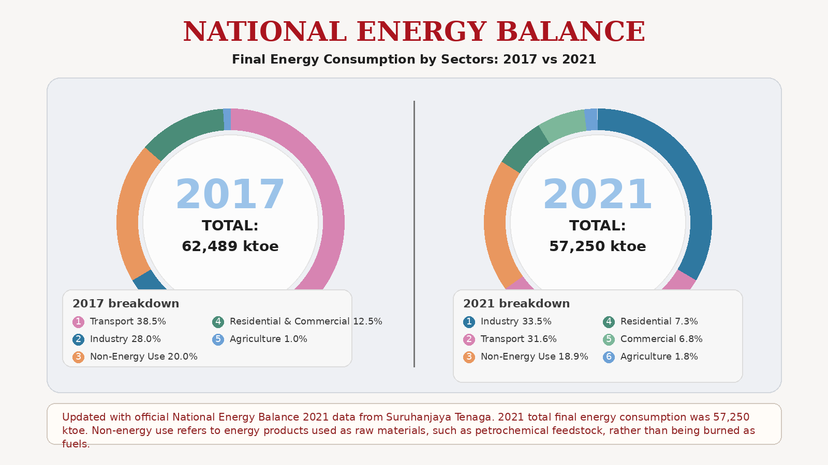

Slide 7
PRIMARY COMMERCIAL
HYDROCARBON GASES
Natural gas components
  Methane
  Ethane
  Propane
  Butane
  C₅₊₊
Liquified Petroleum Gas (LPG)
  Pure Propane
  Pure Butane
  Mixture of Propane (30-40 % w/w) & Butane (60-70 % w/w)

Slide 8
Typical Malaysian hydrocarbon gas compositions
NG
LPG

Slide 9
UTILISATION OF LIQUIFIED PETROLEUM
GAS (LPG)
Industry
  LPG mixture
  Pure propane & Butane
Domestic
  LPG mixture
Commercial
  LPG mixture
  Heating
  Drying
  Transportation ???
  Petrochemical feedstock
  Cooking
  Transportation

Slide 10
ADVANTAGES OF LIQUIFIED PETROLEUM
GAS (LPG)
Over liquid fuels
  Easy handling (moveable cylinder & storage tank
  Less pollution
  Cleaner working environment
  Higher quality products
  Direct use
Over natural gas
  Higher Calorific Value
  Easy handling (moveable cylinder & storage tank

Slide 11
DISADVANTAGES OF LIQUIFIED PETROLEUM GAS (LPG)
Over liquid fuels
  lower Calorific Value
  LPG leaf-over
    e.g. for 50 kg cylinder, about 5.78 kg of leaf-over with propane and butane fraction of ~ 2.17 w/w% and 97.82 w/w%, respectively
Over natural gas
  Higher pollution
  More dangerous
  Process interruption ??? - Frequent filling

Slide 12
ADVANTAGES & DISADVANTAGES NATURAL GAS (NG)
Advantages
  Clean fuel
    low pollution
    direct firing
    clean handling
  Reliability of supply
    Via pipeline – no storage / pumping
  Safety
    Low S.G.
    High lean (low) flammability limit
Disadvantages
  Low calorific value
  Low flame speed (not suitable for diffusion flame type burners)
  Low radiation flame - Not suitable for certain applications such as processes requiring high radiation heat transfer

Slide 14
NATURAL GAS (NG) MARKETS
Residential
  Cooking/baking…., , heating, drying, cooling etc
Commercial
  Cooking/baking….., heating, drying, cooling etc
  Transportation fuel
Industrial
  Low & high temperature applications, e.g. heating, drying, melting etc.
  Petrochemical feedstock
Power generation
  Energy to drive gas turbine, steam turbine
  Fuel cells

Slide 15
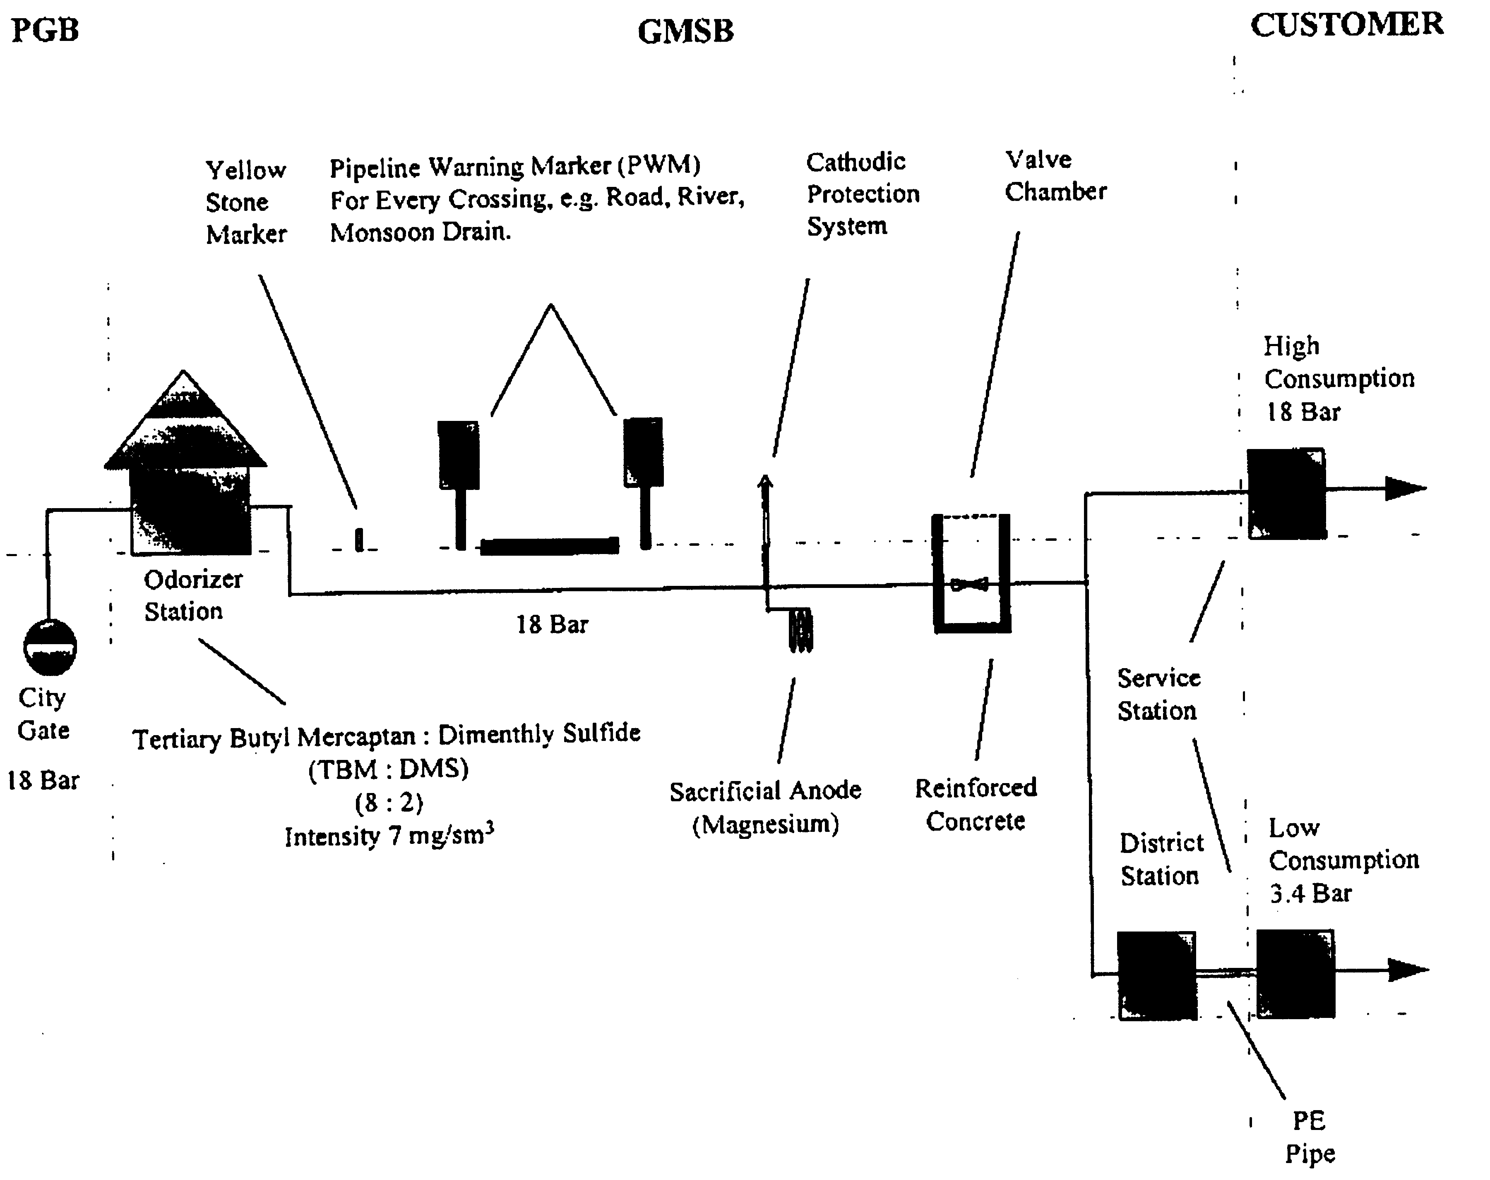
NATURAL GAS DISTRIBUTION
(Residential, commercial & industrial sectors)

Slide 16
FACTORS INFLUENCING NATURAL
GAS UTILISATION
Sources of gas (locally produced vs import)
Infrastructures ( existing pipeline vs newly built)
Weather
Energy intensive vs non-energy intensive industries
Population density
Alternative fuels (price)
Government policy

Slide 17
Classification of Gas Utilization
Residential: cooking, heating, drying, cooling, water heating
Commercial: cooking, heating, cooling, drying, water heating, NGV
Industrial fuel use: low-temperature processes, high-temperature processes
Power: gas turbine, steam turbine, combined cycle, fuel cells
Transportation: CNG and gas-to-liquid fuels
Cooling: absorption cooling and district cooling
Petrochemical feedstock: natural gas, ethane, propane, butane → ammonia, methanol, ethylene, propylene → plastics, fertilizers, detergents, fibers, solvents, rubber, and medical product

Slide 18
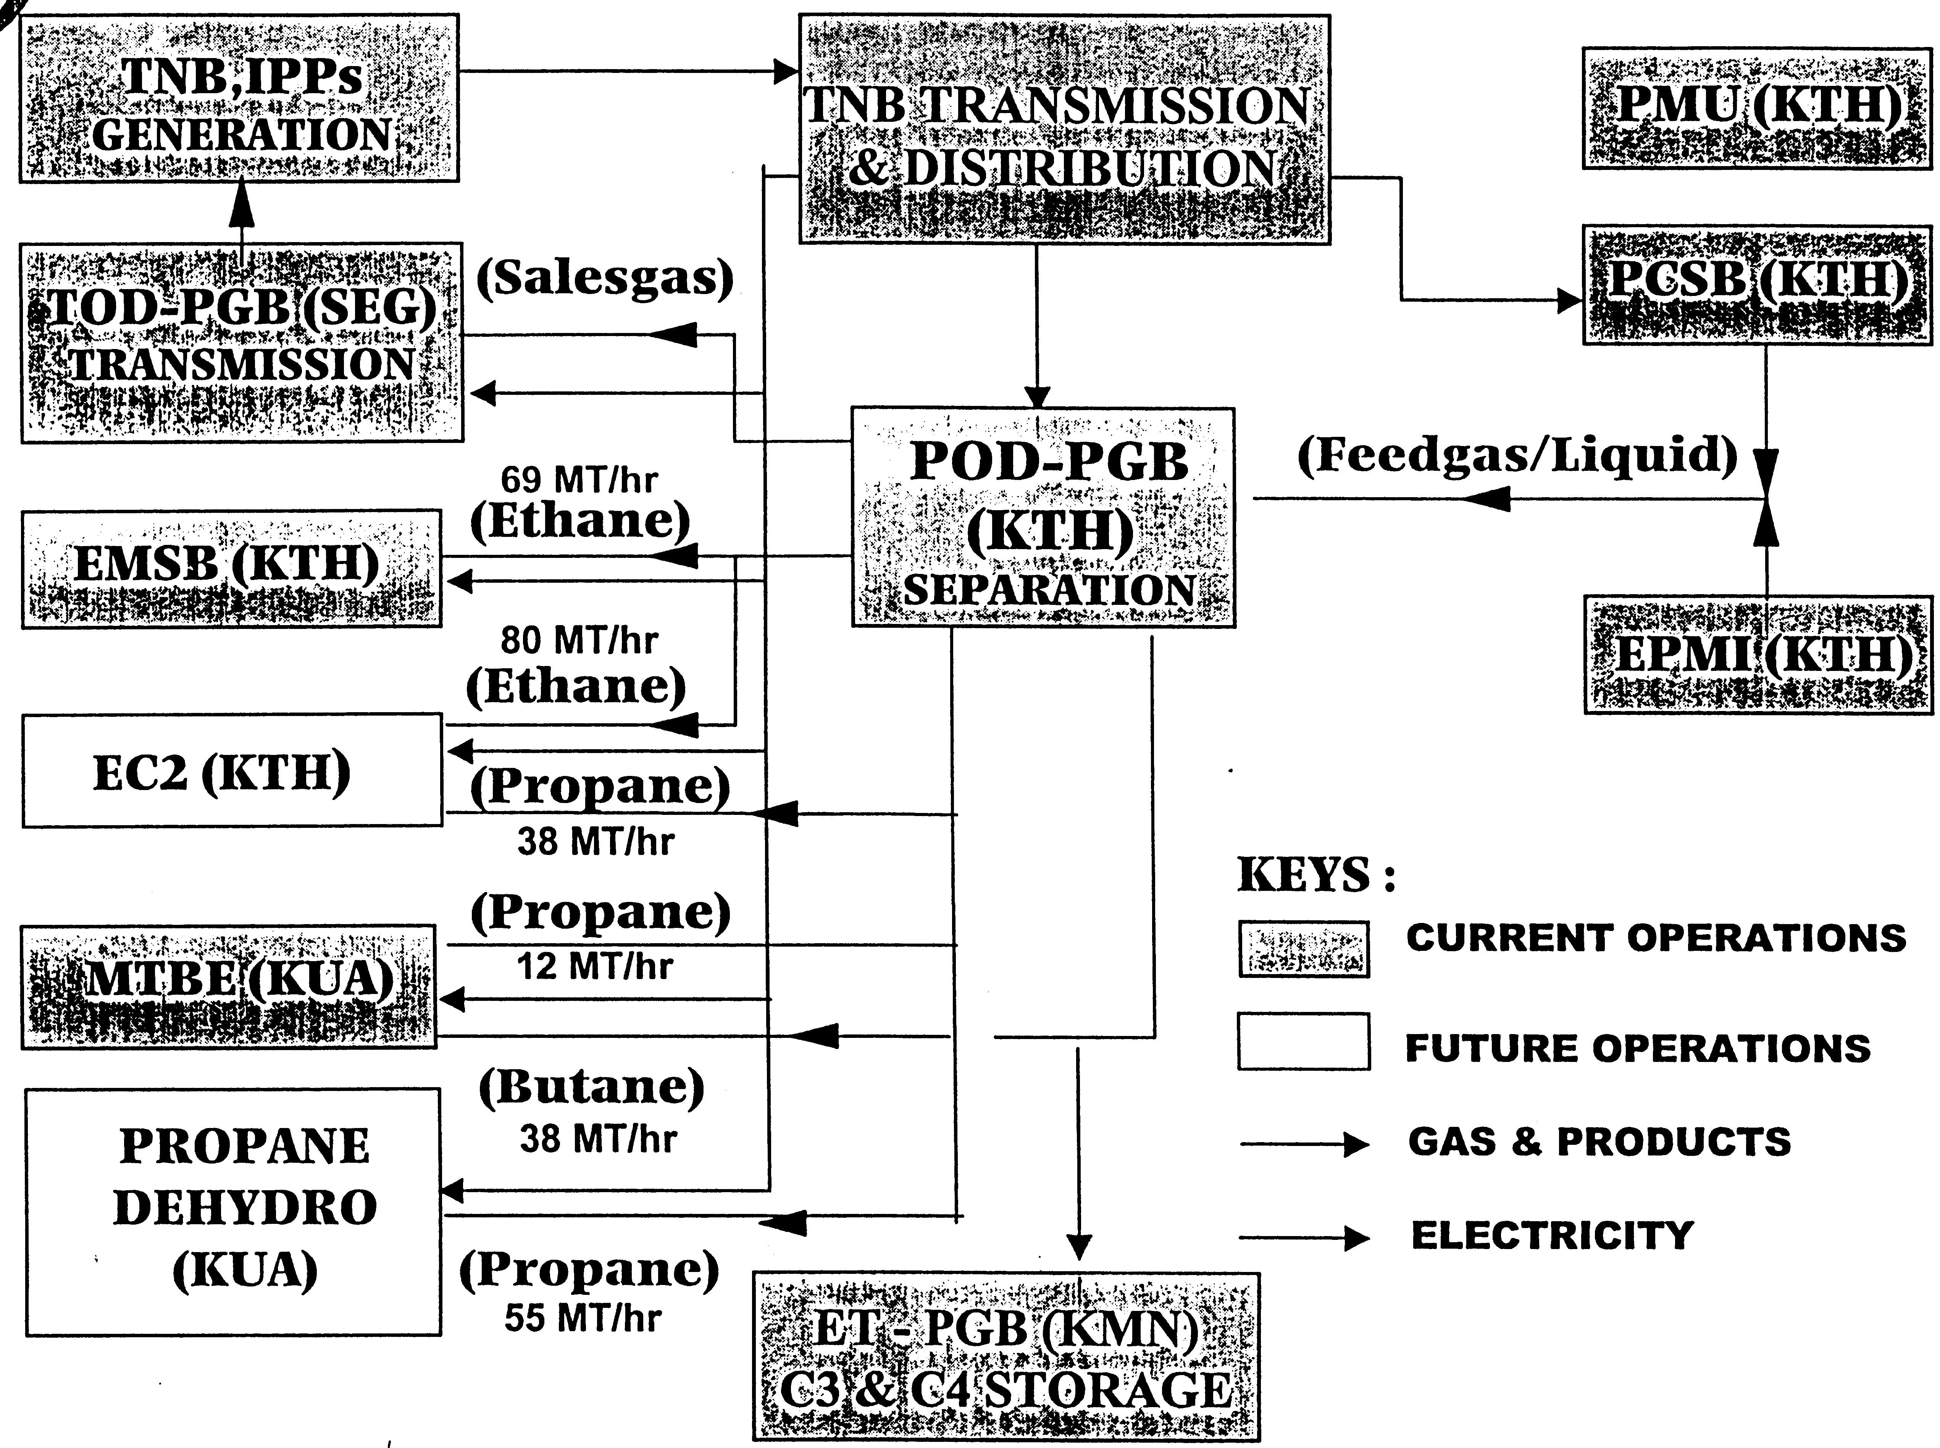
PETROCHEMICAL FEEDSTOCK
Natural gas
Ethane
Propane
Butane

Slide 19
PETROCHEMICAL FEEDSTOCK
Petrochemical feedstock
  Natural gas
  Ethane
  Propane
  Butane
Main downstream chemical building blocks:
  Ammonia
  Methanol
  Ethylene
  Propylene

Slide 20
PETROCHEMICAL FEEDSTOCK
Main end-use areas:
  Plastics
  Fertilizers
  Detergents and soaps
  Tires and rubber products
  Fibers, textiles, and clothing materials
  Paints, solvents, adhesives, and insulation
  Medical and healthcare products such as IV and blood bags

Slide 22
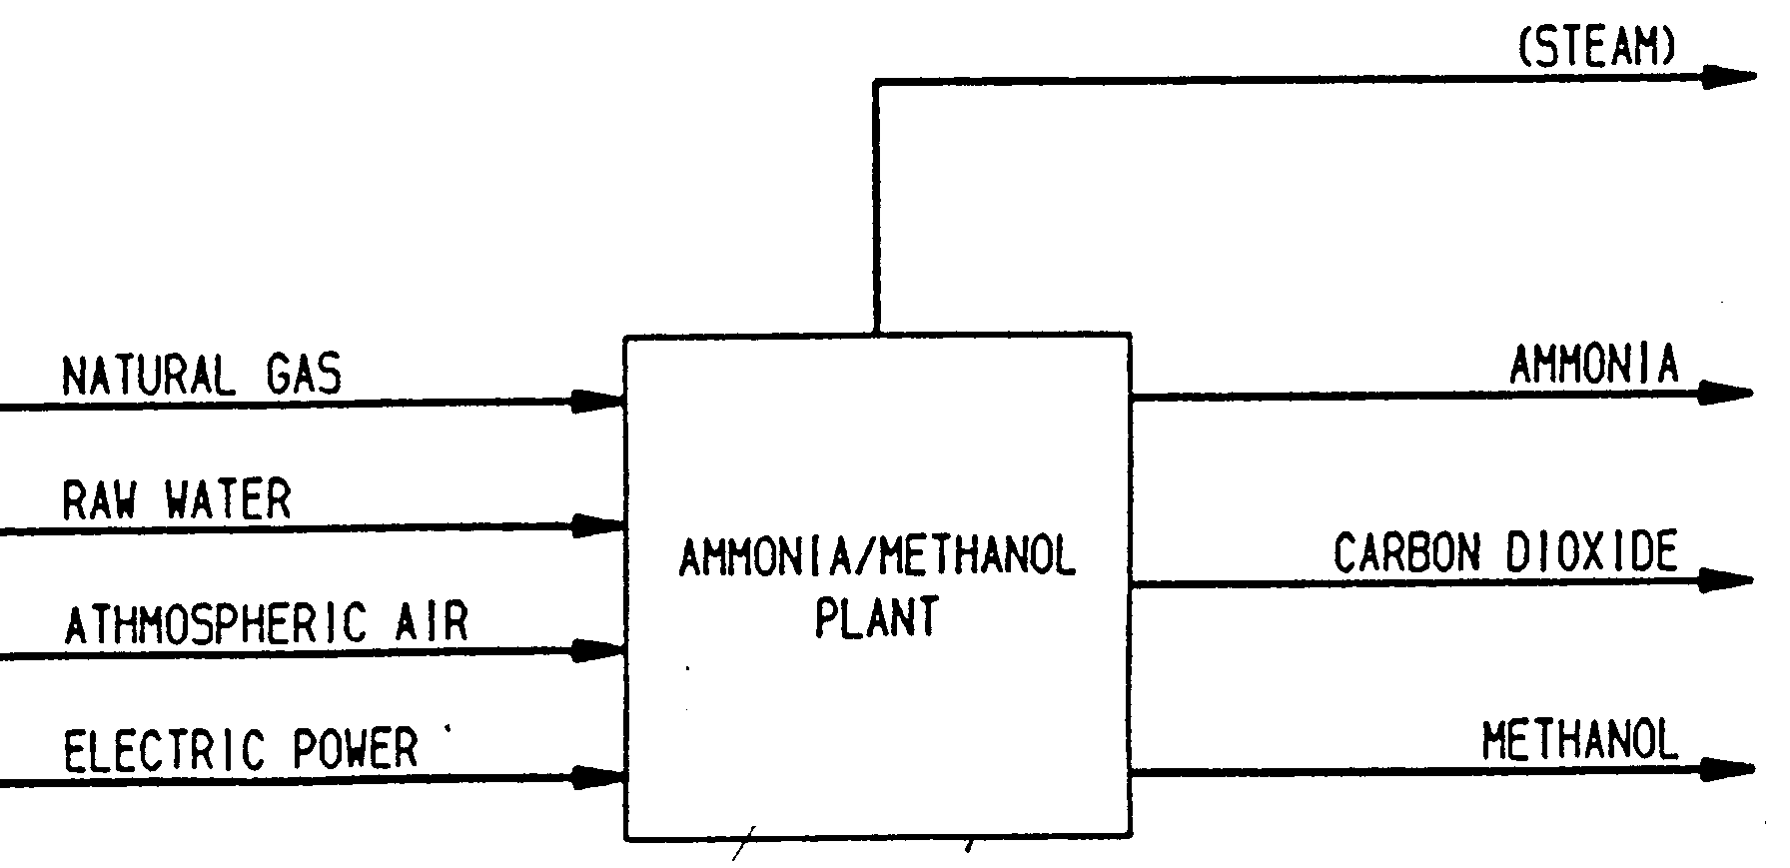
PETROCHEMICAL FEEDSTOCK
(NATURAL GAS)

Slide 23
PETROCHEMICAL FEEDSTOCK
(ETHANE)
Ethylene-based products
  Low density polyethylene (LDPE)
  high density polyethylene (HDPE)
  linear low density polyethylene (LLDPE)
Films
  Heavy duty film, carrier bag
Injection Moulding
  Housewares, toys
Rotational Moulding
  Septic tanks, water tanks, containers - UV stabilised
Monofilament
  Fishing nets, ropes & blending

Slide 24
PETROCHEMICAL FEEDSTOCK
(PROPANE)
Polypropylene based products
Household goods
Containers
thin wall articles
Food packaging
Garment
Packaging Film
Adhesive tape
food snack packaging
Tape
Flexible bulk containers
woven bags, ropes,
Carpet backing

Slide 25
RESIDENTIAL & COMMERCIAL UTILISATION OF NATURAL GAS
Residential
  Emphasis on temperature climatic zones
  Houses / condominiums / apartments etc
  Use for space / water heating, cooking , drying etc
Commercial
  Focus on service sector
  Significant variety in gas usage / demand
  Space heating / cooling, water heating, cooking, drying, NGV

Slide 26
INDUSTRIAL UTILISATION OF
NATURAL GAS
Low temperature application (i.e. less than 500 ºC)
  Heating
  Cooling
  Drying
  Cooking / baking etc
High temperature application (i.e. more than 500 ºC)
  Ferrous/non-ferrous industry
  Ceramic industry
  Glass industry
  Flame processing etc.

Slide 27
NATURAL GAS UTILISATION IN POWER (ELECTRICITY) GENERATION
Prime mover
Combined cycle
  Gas + steam turbines
Steam turbine
  oil, coal, nat. gas
Gas turbine
Efficiency Capital cost
Highest most expensive
Lowest least expensive

Slide 28
NATURAL GAS FOR POWER GENERATION
Advantages
Infrastructure
  Direct & reliable supply from pipeline
Environment
  Pollution
  Handling
  safety
Large and growing gas reserves
High and high efficiency energy-generating technologies
  Combined cycle
  Co-generation
  Tri-generation
  Fuel cells (emerging technology)

Slide 29
NATURAL GAS AS
TRANSPORTATION FUEL
Direct use
  Compressed natural gas (CNG) in newly-built or converted petrol / diesel engines
Indirect use
  Synthetic fuels – i.e. gas-to-liquid technology (conversion of natural gas to liquid fuels such as gasoline, methanol etc., e.g. SHELL Middle Distillate Synthesis (SMDS) plant in Bintulu)

Slide 30
NATURAL GAS VEHICLES
Advantages
Safety
  Lighter than air (S.G. ~ 0.6)
  High lean (low) flammability / explosion limit (~ 5% v/v)
  High ignition temperature (~ 630 ºC)
  Easily detected (odouriser added)
  Strong / durable storage design (higb pressure ~ 3000 psi) – can withstand direct impact from a car speeding at 90 km/hr or a small calibre bullet
High octane rating
  efficient burning
  less knocking
Clean burning
  Low unburned fuel, CO & NOx emissions

Slide 31
NATURAL GAS VEHICLES
Benefits to Nation
Cleaner environment
Positive effect on nation’s cash balance (reduce cash outflow by minimising import of crude oils)
Reduce dependence on liquid petroleum (extend life of oil reserves)
Spin off industries
Cost savings (healthcare, pollution reduction / monitoring etc)

Slide 32

NATURAL GAS VEHICLES
Benefits to customers (vehicle’s owners)
Substantial savings (50%) in fuel cost – current price ~ RM0.68 liter
Lower maintenance cost
Contributes to cleaner environment
Better safety
Extended travel range
25% road tax deduction
Dual fuel (petrol & NG) system possible

Slide 33
NATURAL GAS VEHICLES
Limitations
More frequent filling
Slight reduction in acceleration power (10-15%)
Additional weight
Boot space reduction
Limited filling stations ????

Slide 34
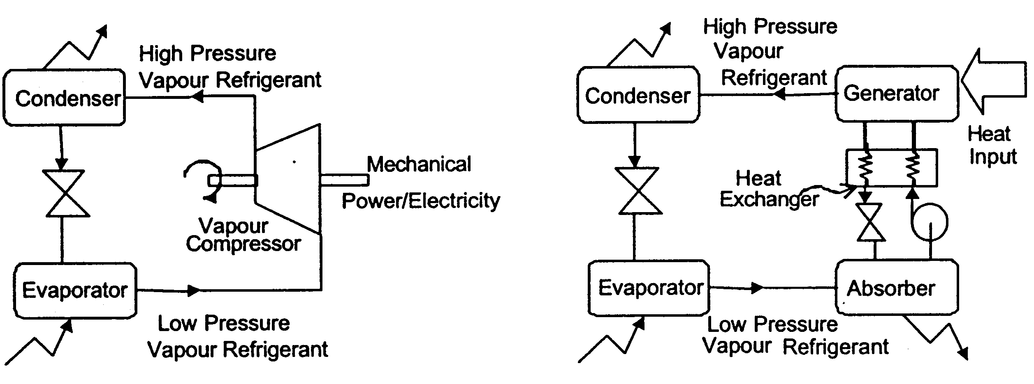
NATURAL GAS COOLING
(Air-Conditioning)
Vapor compression chiller vs Vapor absorption chiller
- compressor uses electricity - require heat (e.g. from NG)
- refrigerants – CFC, Freon - no refrigerents (only working
fluid (e.g. ammonia / water)
- heating / cooling purposes
- use little electricity

Slide 35
NATURAL GAS COOLING
Advantages
low running cost – low electrical power demand
no major moving parks – extending equipment life
requires less maintenance and fewer repairs
environmentally friendly - clean properties of natural gas, work without the use of chlorofluorocarbons (CFCs)
higher Coefficients of Performance (COP)
efficient part-load operation
established technology
less space taking

Slide 36
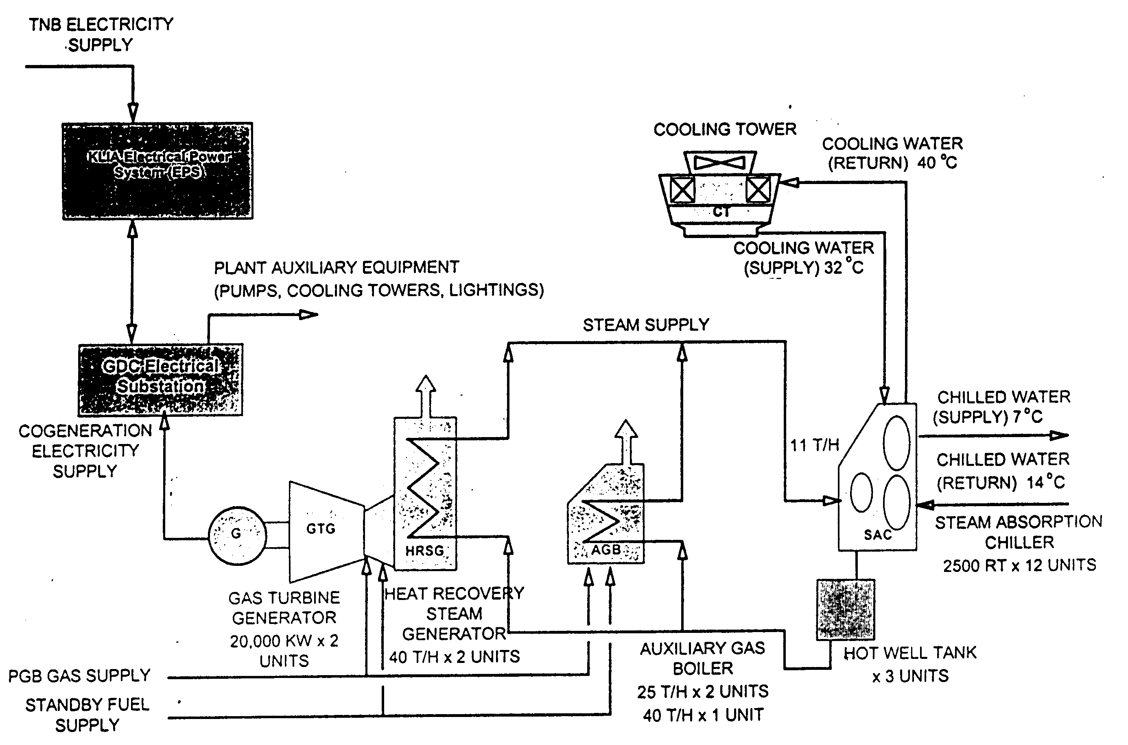
NATURAL GAS DISTRICT COOLING
(GDC)
a centralized energy plant generating thermal media (chilled water) for air-conditioning requirements of several building in a district

Slide 37
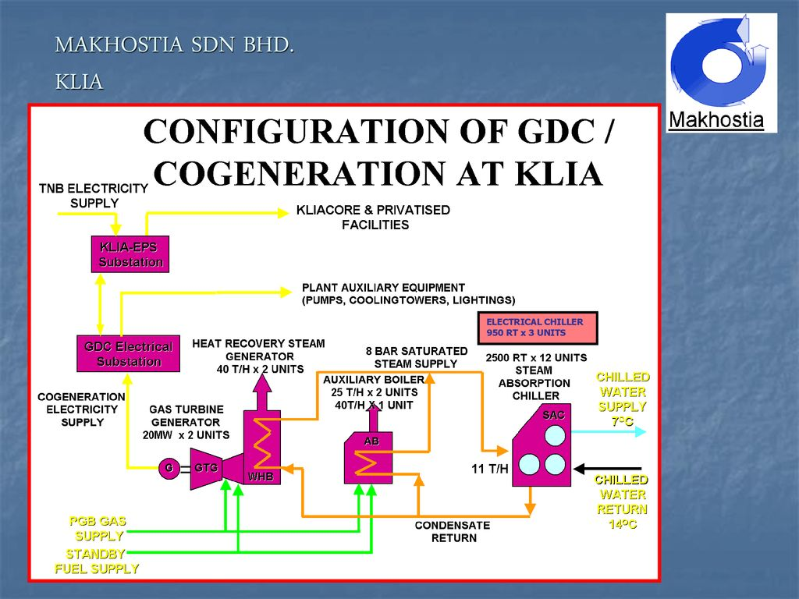

Slide 38
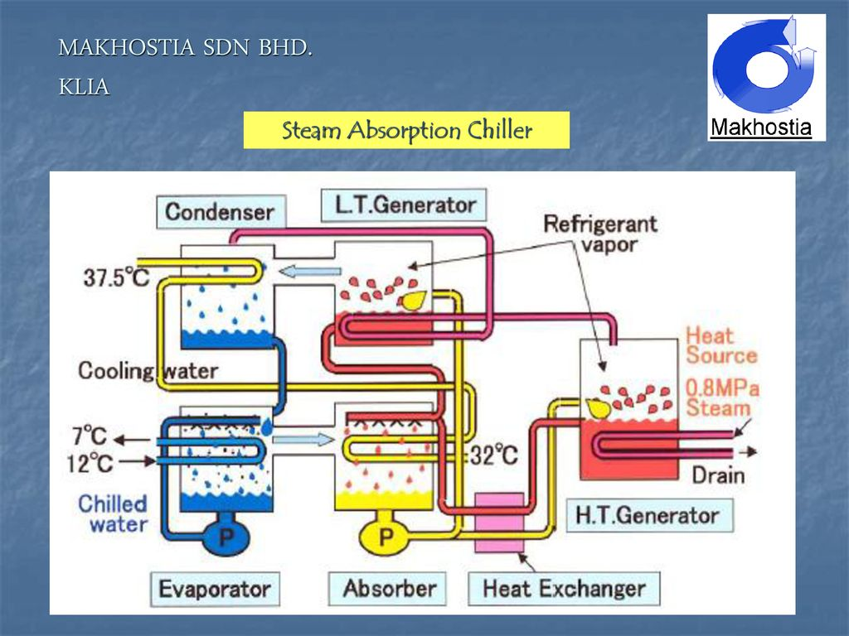

Slide 39
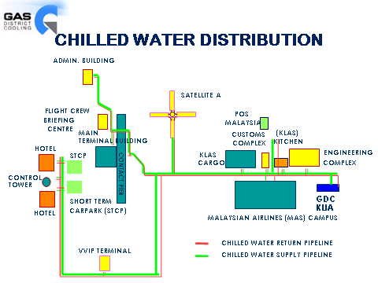

Slide 40
NATURAL GAS DISTRICT COOLING
Advantages
More economical due to higher energy efficiency and low fuel cost with the use of a single system over a wide area and to various types of buildings
Less dependence on the national electricity grid
Savings in capital investment through the elimination of individual structures for a building's air-conditioning need. Instead, all air-conditioning costs can be written off as operational expenses, with obvious tax advantages in the long run
Higher system reliability with three sources of fuel supply: gas, electricity and diesel
Environment-friendly with the use clean fuel gas. While the absorption chillers use non CFC-based refrigerant
Reduced air pollution, vibration and noise
Space saving and aesthetic appeal since chillers and cooling towers are not needed in each building within a commercial district, the extra space can be used for green lungs or recreational purpose.

Slide 41
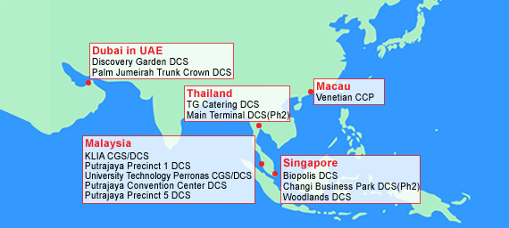

Slide 42
GAS UTILIZATION EQUIPMENT
Power generation equipment such as gas turbines, steam turbines, and combined-cycle plants.
Co-generation and tri-generation systems for simultaneous production of power, heating, and cooling.
Steam absorption chillers and heat pump systems for cooling and heat recovery applications.
Internal combustion engines and natural gas vehicle systems, including refueling methods.
Combustion equipment such as burners, furnaces, and boilers used in industrial heating processes.

Slide 43
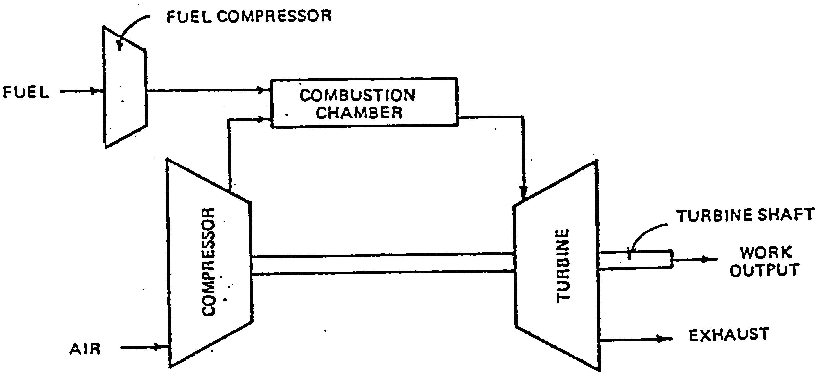
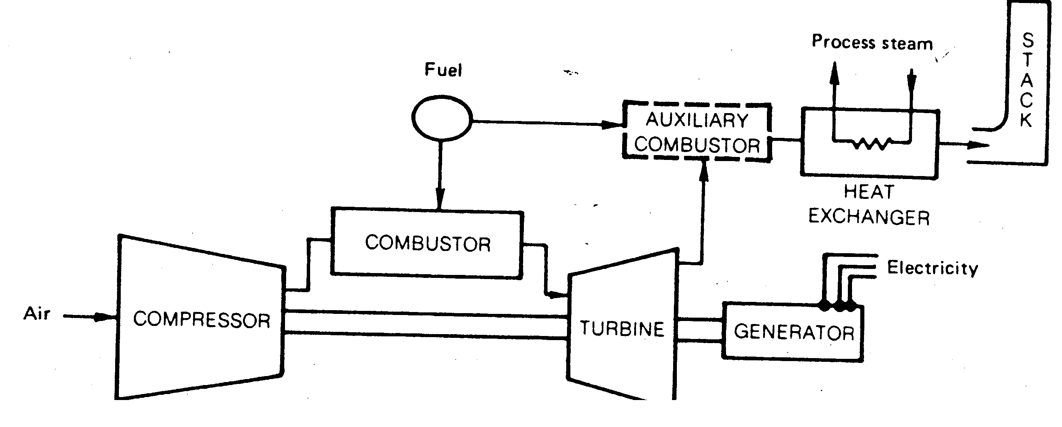
GAS UTILISATION EQUIPMENT
(Power generation)
Gas turbine
  Brayton cycle
  Electricity produced by passing high velocity exhaust thru turbine blades, producing mechanical power (cutting magnetic fields to produce electricity)
  overall efficiencies of 25-30% - the higher the temperature the higher the efficiency of the turbine - limited by the gas turbine (blade) material
  Energy recovery from turbine exhaust (~ 500-800 ºC) , i.e. 60-70% of inlet fuel energy
    Preheat combustion air
    Generate steam
    Heat process water
    Direct firing
    Space heating
    Air conditioning
  Advantages & disadvantages

Slide 44
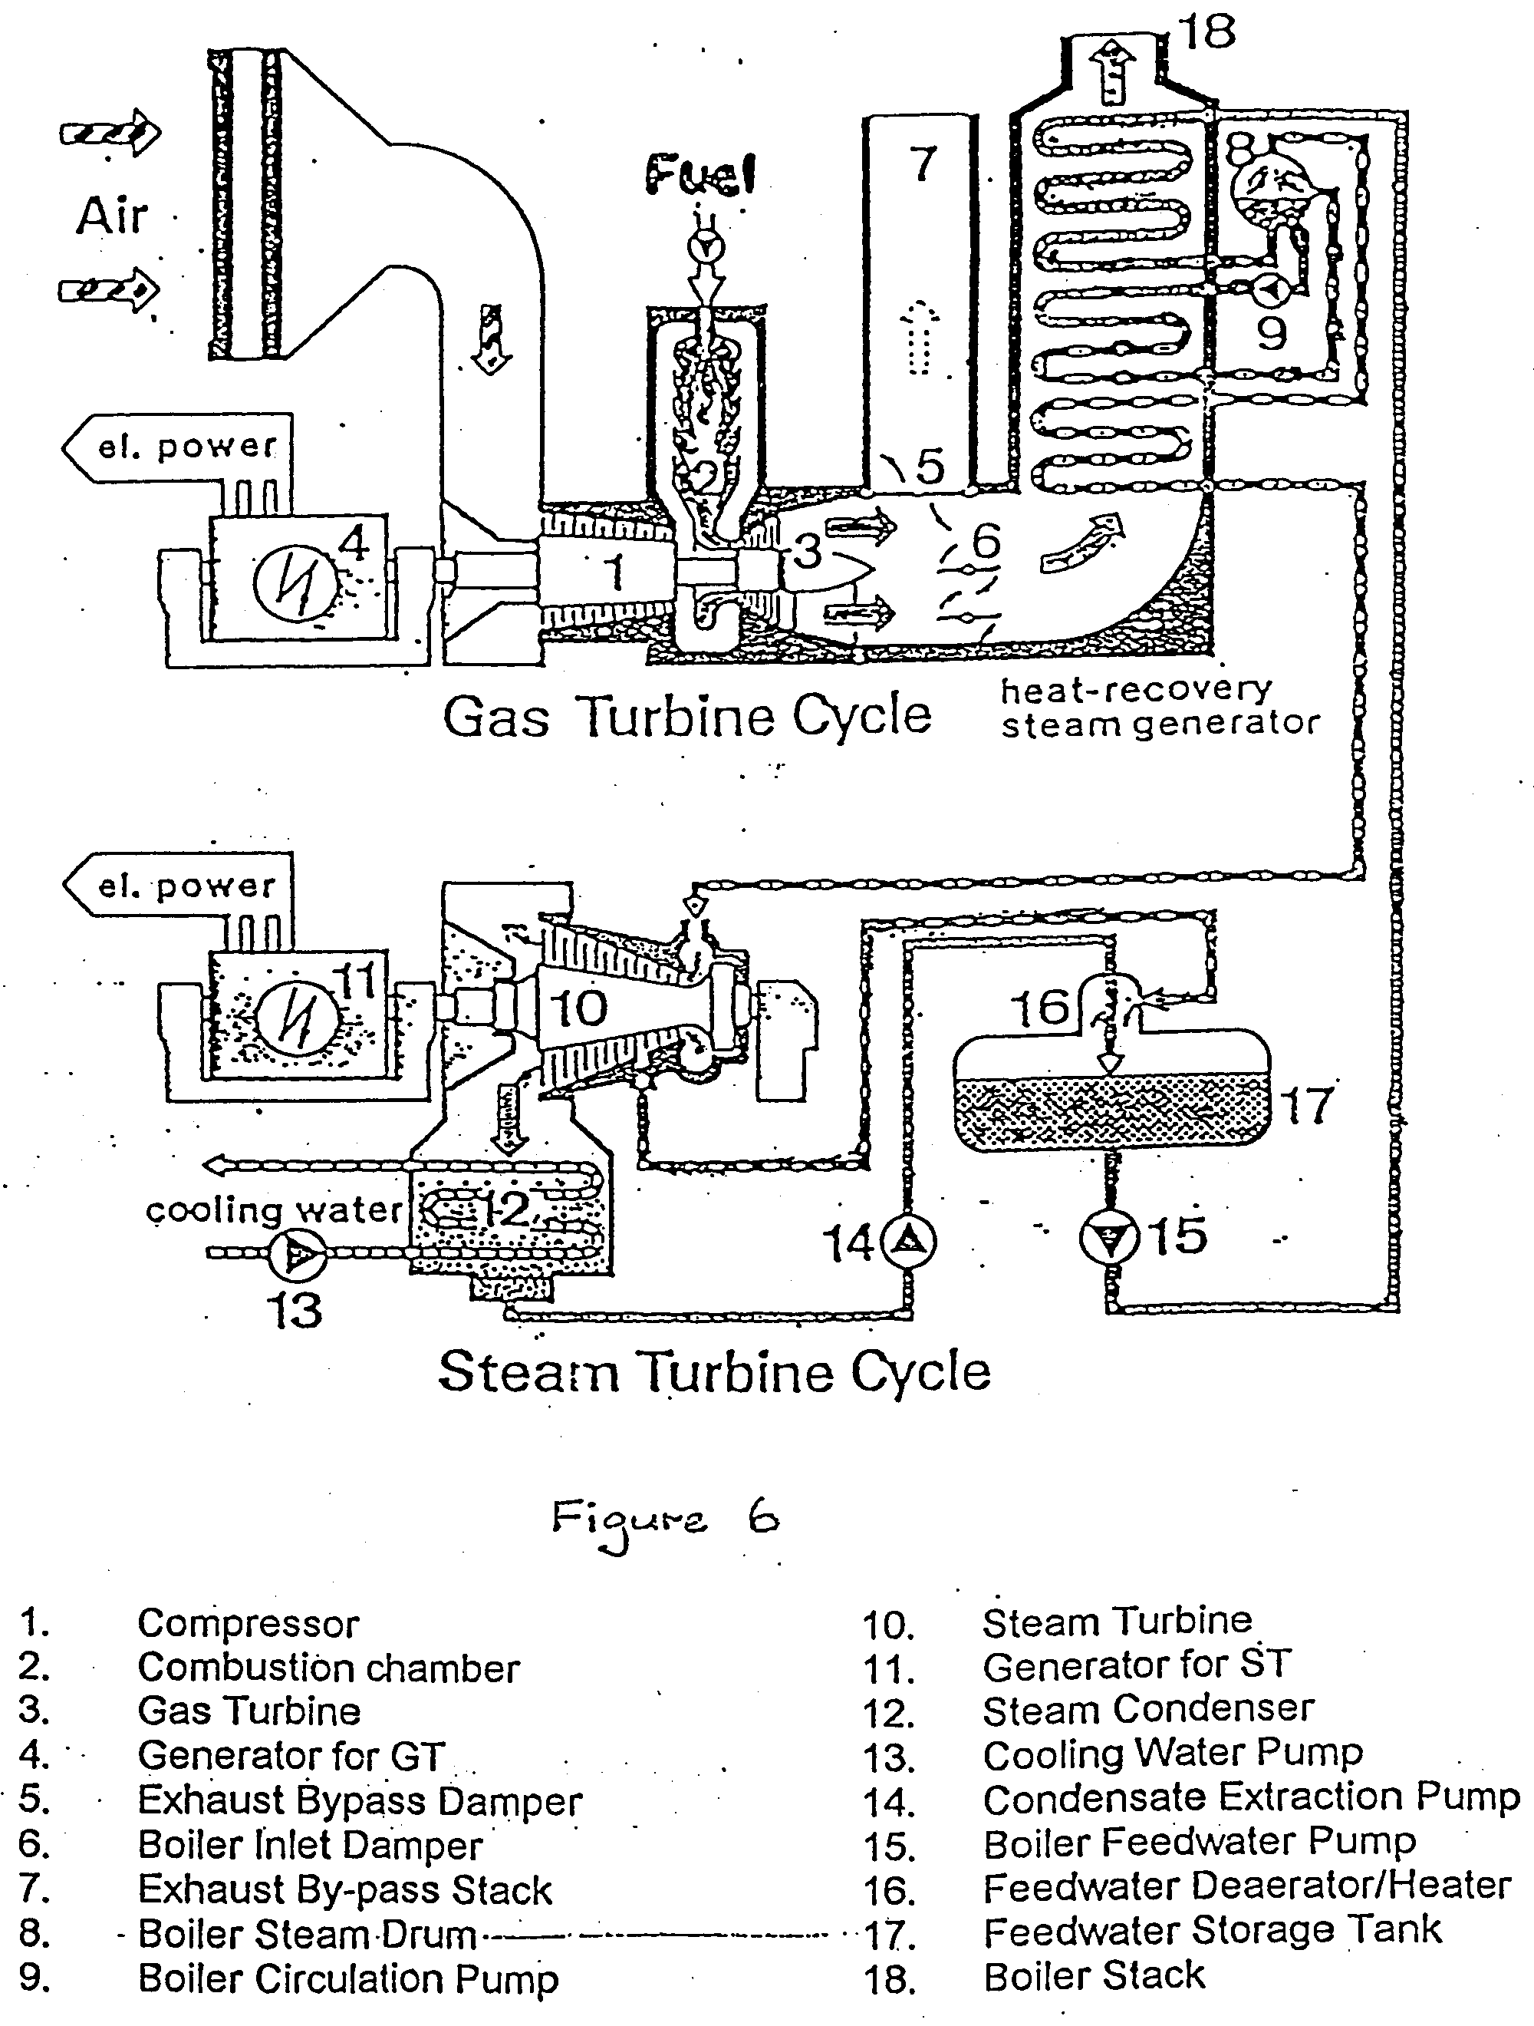
GAS UTILISATION EQUIPMENT
(Power generation)
Combined-cycle for power plant - (CCPP)
  Improved overall efficiency ~ 40-55%
  Less thermal pollution (boiler stack temp. ~ 200-300 ºC)

Slide 45
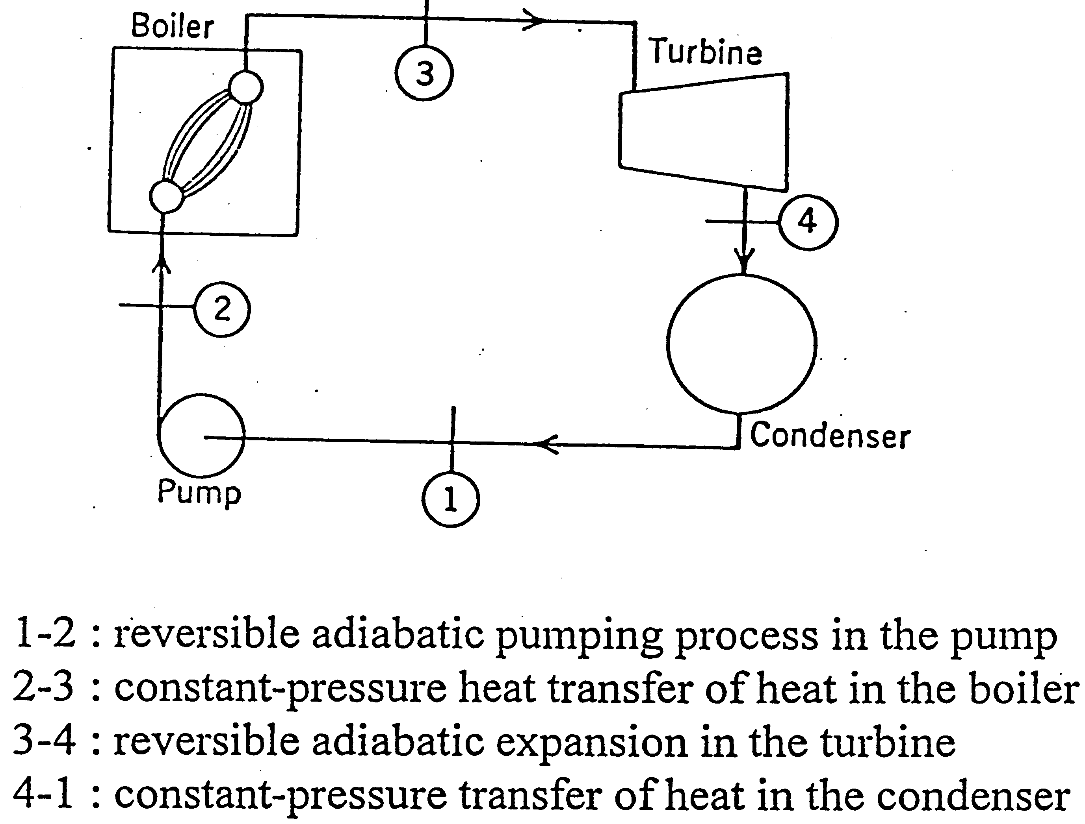
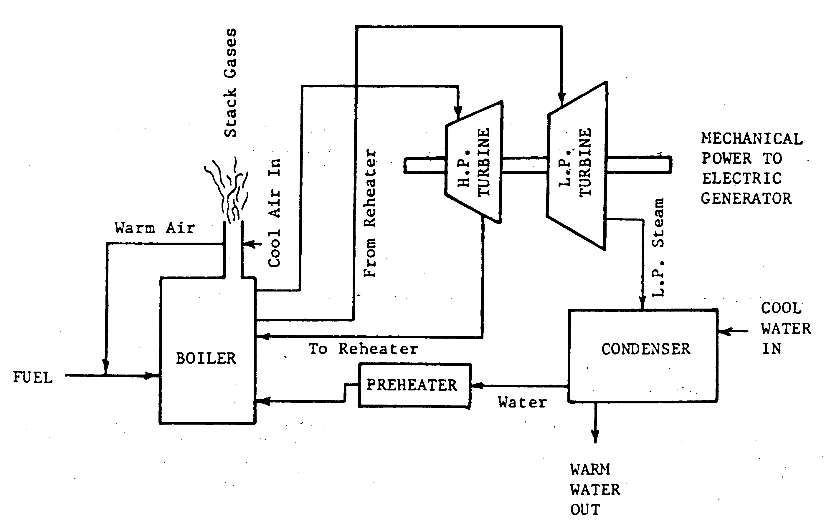
GAS UTILISATION EQUIPMENT
(Power generation)
Steam turbine
  Gas, liquid or solid fuelling
  Rankine cycle
  Electricity produced by expanding high velocity superheated steam through power turbine blades producing mechanical power (cutting magnetic fields to produce electricity)
  overall efficiencies of 25-45%
  Improving mechanical efficiency of boiler/steam turbine
    raising temperature and pressure of steam input to turbine
    decreasing temperature and pressure of turbine exhaust
    Steam staging – i.e. expanding steam in high pressure turbine stages and then returning steam to to boiler for preheating and then expand in lower pressure stages
    preheating the boiler feed water
  Advantages & disadvantages

Slide 46
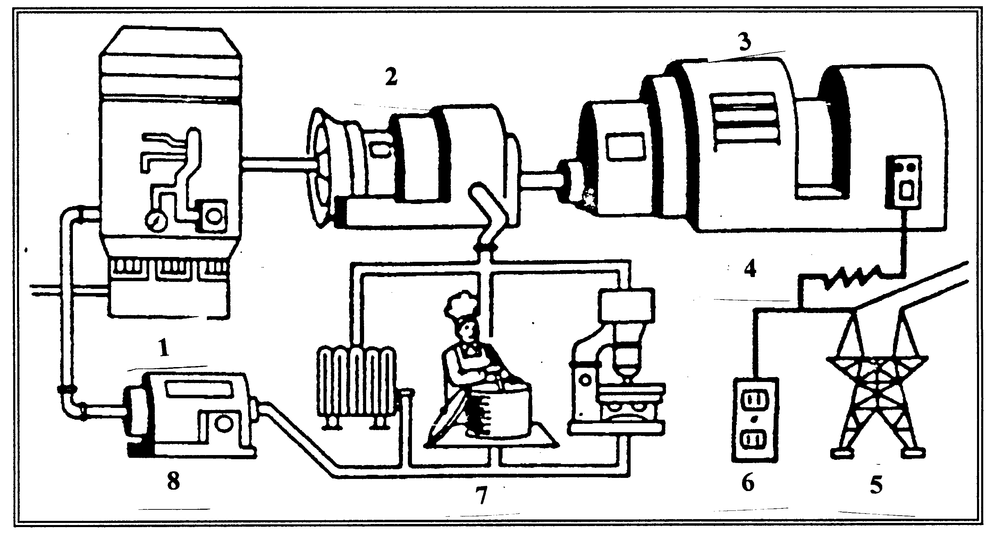
GAS UTILISATION EQUIPMENT
(Co-generation)
a sequential production of thermal energy and electric energy from a single energy source
also known as combined heat and power (CHP)
improve efficiency of power generation from 30-35% to 65-80%
1. fuel burned in a boiler produces steam
2. to drive a turbine
3. that is linked to an electric generator
4. the generator produces electricity
5. that is either sold to utility
6. used in-houses or both
7. the steam expelled from the turbine is used for heating or manufacturing
As the steam cools either during use or in a condenser, it becomes water and is piped back into the boiler.

Slide 47
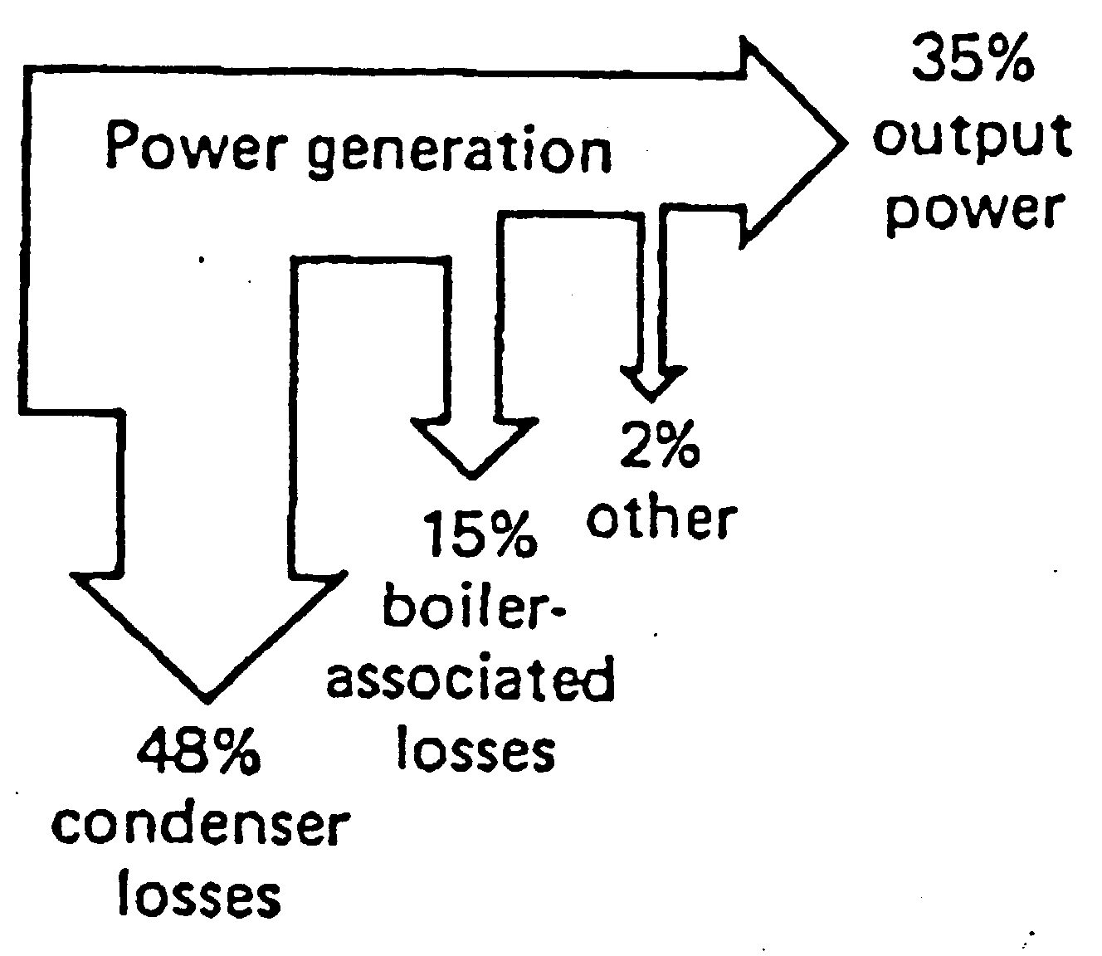
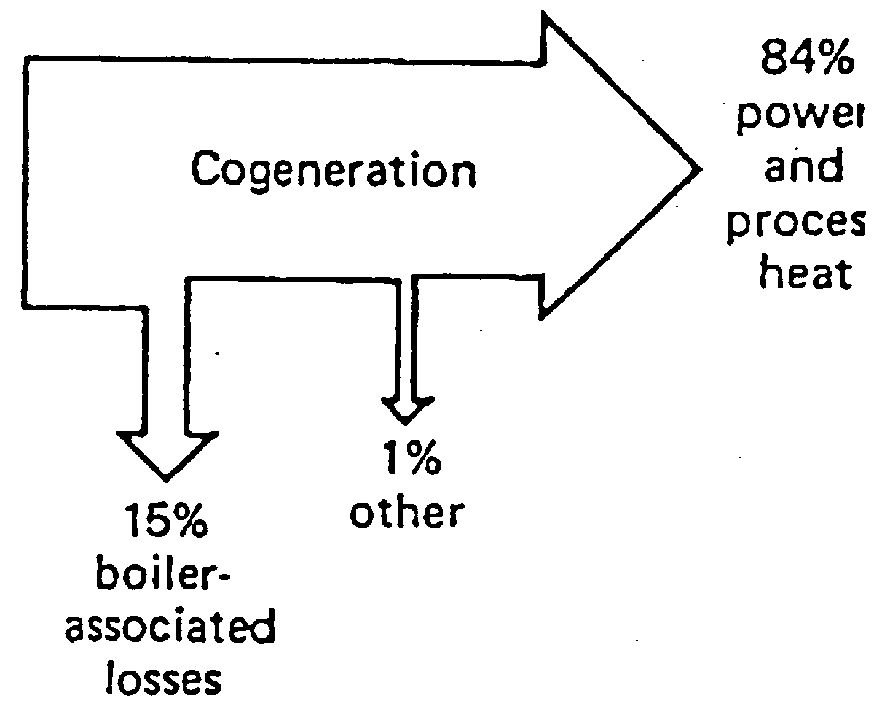
GAS UTILISATION EQUIPMENT
(Co-generation Benefits)
Improved efficiency of energy utilisation (65-80%)
Cost reductions
  fuel cost
  electric utility bills
  production or operating cost
Maximised return on investment capital
Security of power supply
Energy independence
Operating flexibility - electrical and heat load can be managed
Respecting the environment
  reduce air and thermal pollution as no additional combustion devices needed

Slide 48
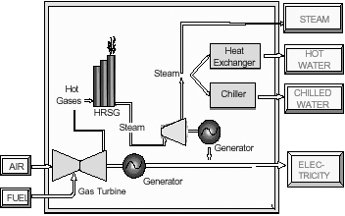
GAS UTILISATION EQUIPMENT
(Tri-generation)
concept of deriving three different forms of energy from the primary energy source, namely, heating, cooling and power generation
Also referred to as CHCP (combined heating, cooling and power generation)

Slide 49
GAS UTILISATION EQUIPMENT
(Steam absorption chiller)
Heat input/source is utilised to produce cooling effect for space conditioning or for refrigeration
Heat source
  direct fired source
    usually natural gas burner
  in-direct fired source
    low pressure steam
    hot water
    waste process heat

Slide 50
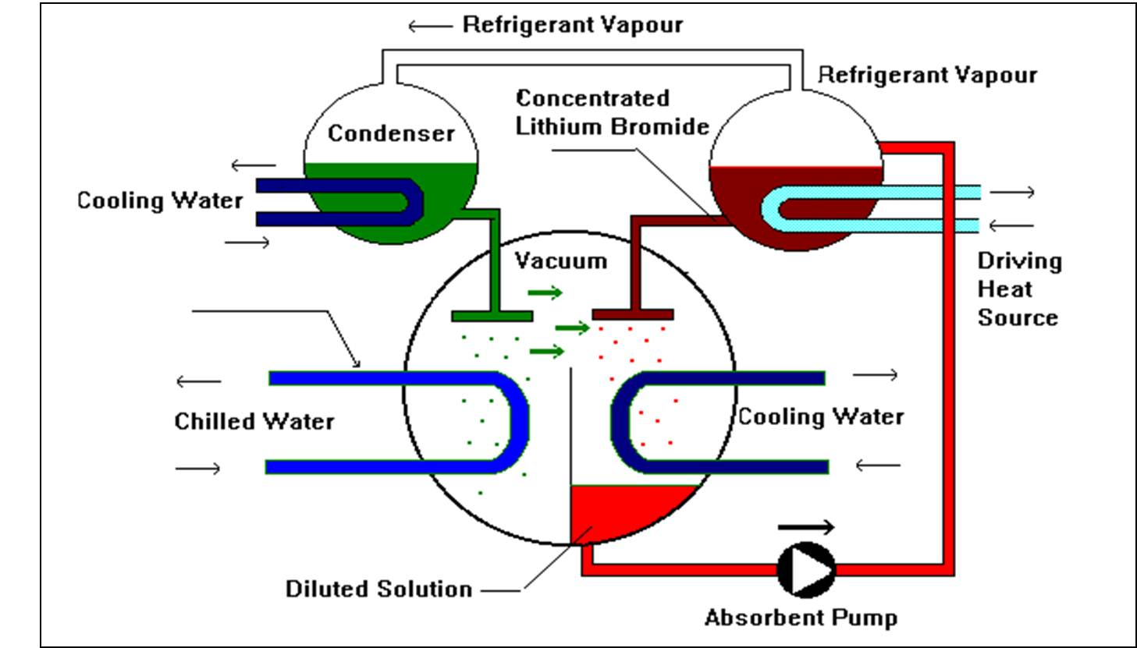

Slide 51
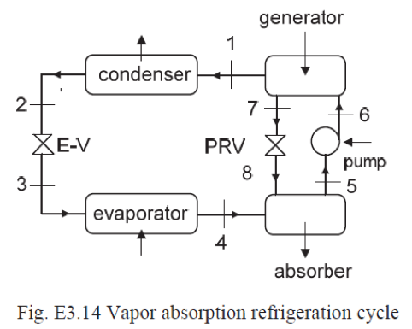
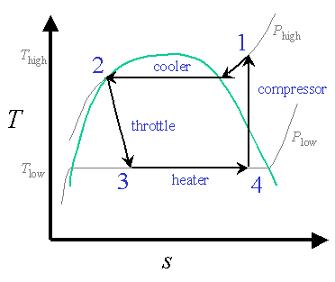
Vapour compression refrigeration
Pumping Vapour vs. pumping liquid

Slide 52
GAS UTILISATION EQUIPMENT
(Power generation - Internal Combustion Engines)
Spark ignition engine
  Petrol
  Gas (e.g. Nat. gas)
Compression ignition engine
  Diesel
Main advantage over gas / steam tubines
  High shaft thermal efficiencies, > 40% (high electrical conversion efficiency)
Main disadvantages over gas / steam tubines
  Small scale
  Cooling requirement

Slide 53
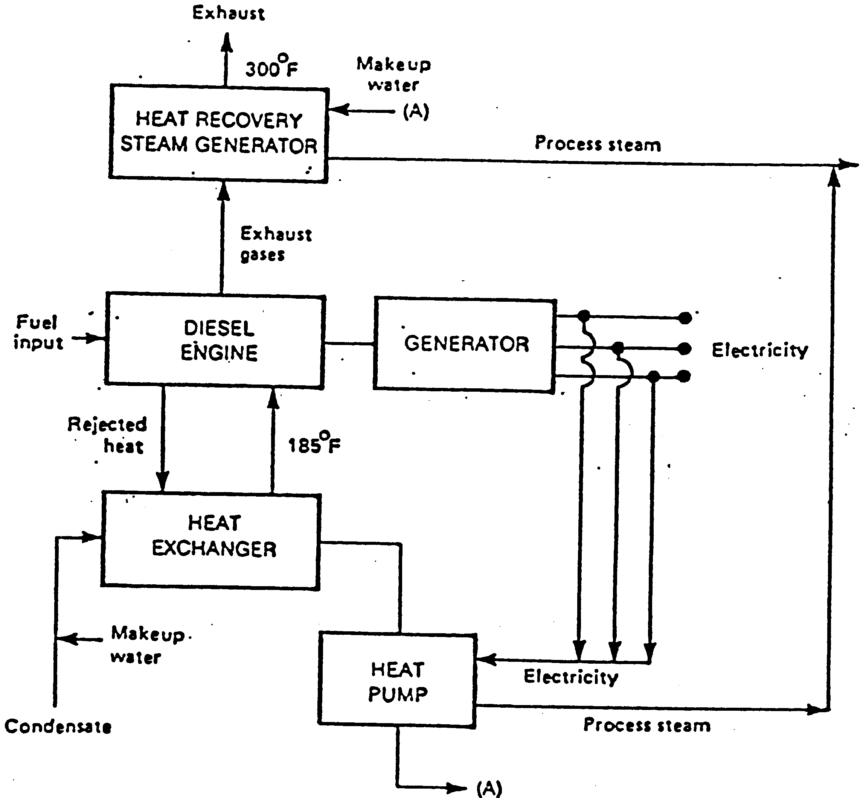
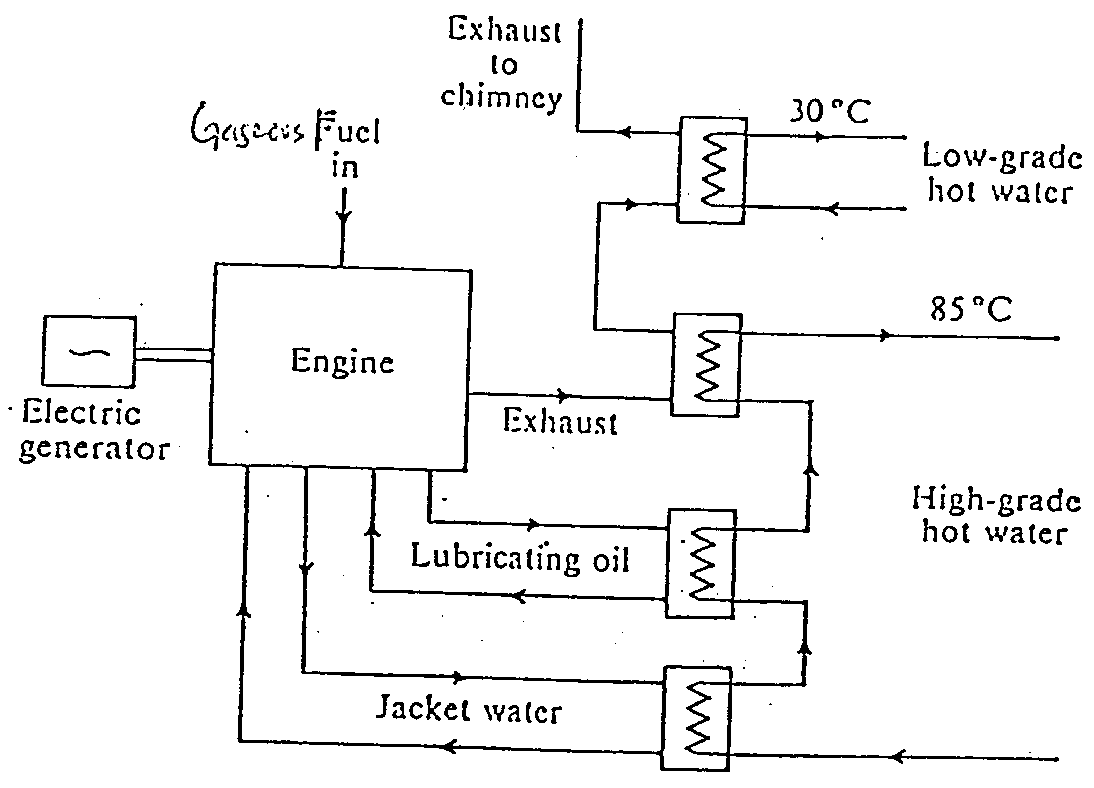
GAS UTILISATION EQUIPMENT
(Power generation - Internal Combustion Engines)
Diesel engine
  Onsite / back-up power generator
  High overall efficiency
  Cogeneration possible
  Pollution !
    NOx
    Particulate matters
Gas engine (as compared to diesel)
  Cleaner burning
  Lower overall efficiency
  Exhaust recovery (direct / indirect use)

Slide 54
GAS UTILISATION EQUIPMENT
(Gas vehicles)
Gaseous transportation fuels
  Natural gas
    Cost common
    Increasingly popular
    Safety
  LPG
    Not many
    Safety !!!!
  Hydrogen
    Space shuttle
    Fuel cells (electric) vehicle

Slide 55
GAS UTILISATION EQUIPMENT
(Natural gas vehicles - NGV)
Bi-fuel
  Two fuel system (only one is used at any one time )
    Petrol
    Nat. gas (or LPG)
  Both carburettor and fuel-injection spark-ignition petrol converted engines
  Need conversion kits
    Compressed nat. gas cylinder
    Gas/air mixer
    Fuel switch
    Nat. gas line
    Regulator
    Solenoid valve

Slide 56
GAS UTILISATION EQUIPMENT
(Natural gas vehicles - NGV)
Dual-fuel
  Two fuel system (both fuels used simultaneously )
    Diesel
    Nat. gas
  Converted diesel (compression ignition) engine
    Pilot fuel - diesel for combustion initiation
    Main fuel - Nat. gas
  Disadvantage
    Complicated engine design (i.e. fuel line/ injection & ignition)
  Advantage
    Less particulates , hydrocarbons and NOx emissions as compared to 100% diesel fuelling

Slide 57
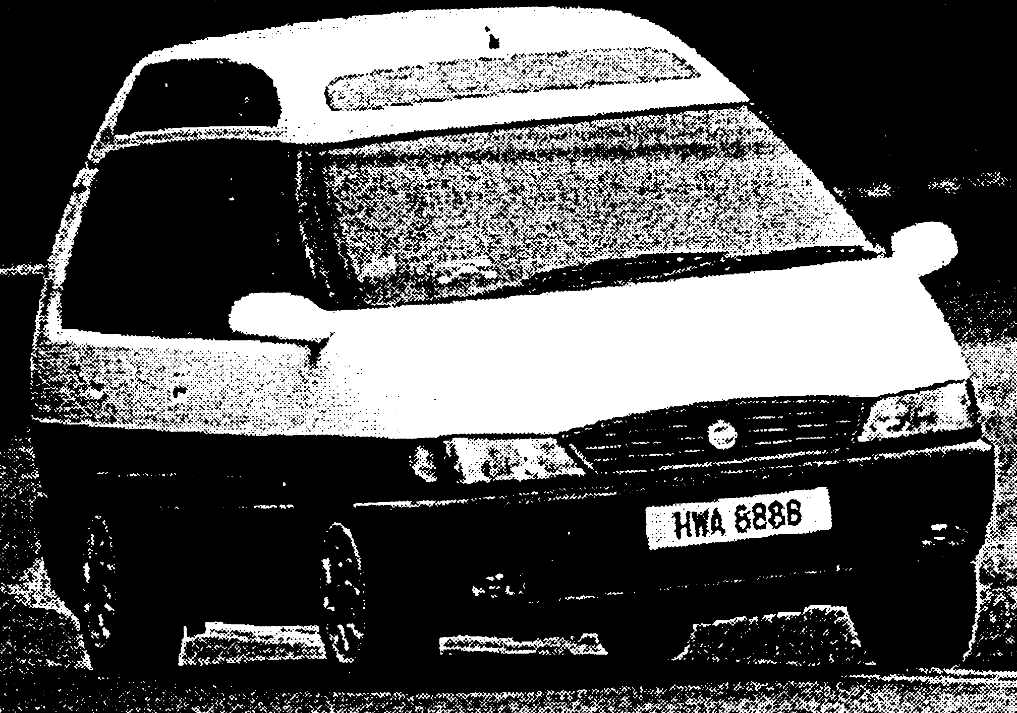
GAS UTILISATION EQUIPMENT
(Natural gas vehicles - NGV)
Mono-gas fuel
  100% natural gas fuelling
  Engine design based on natural gas properties
  Offers a lot of benefits
    Environmental-friendly
    Cost savings (road tax, fuel & maintenance)
  Mono-gas KLIA taxi

Slide 58
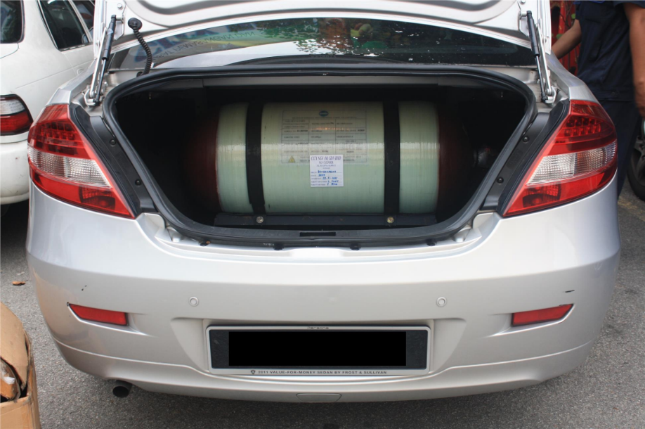
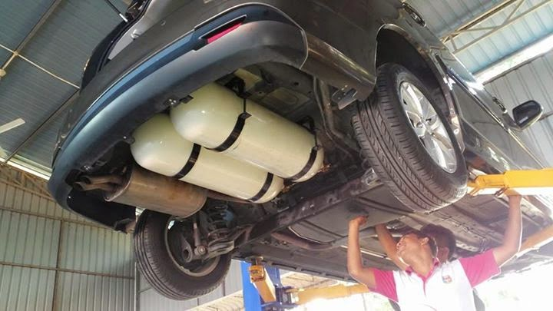
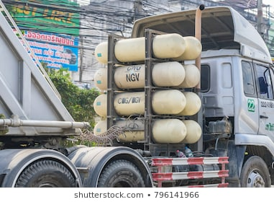

Slide 59
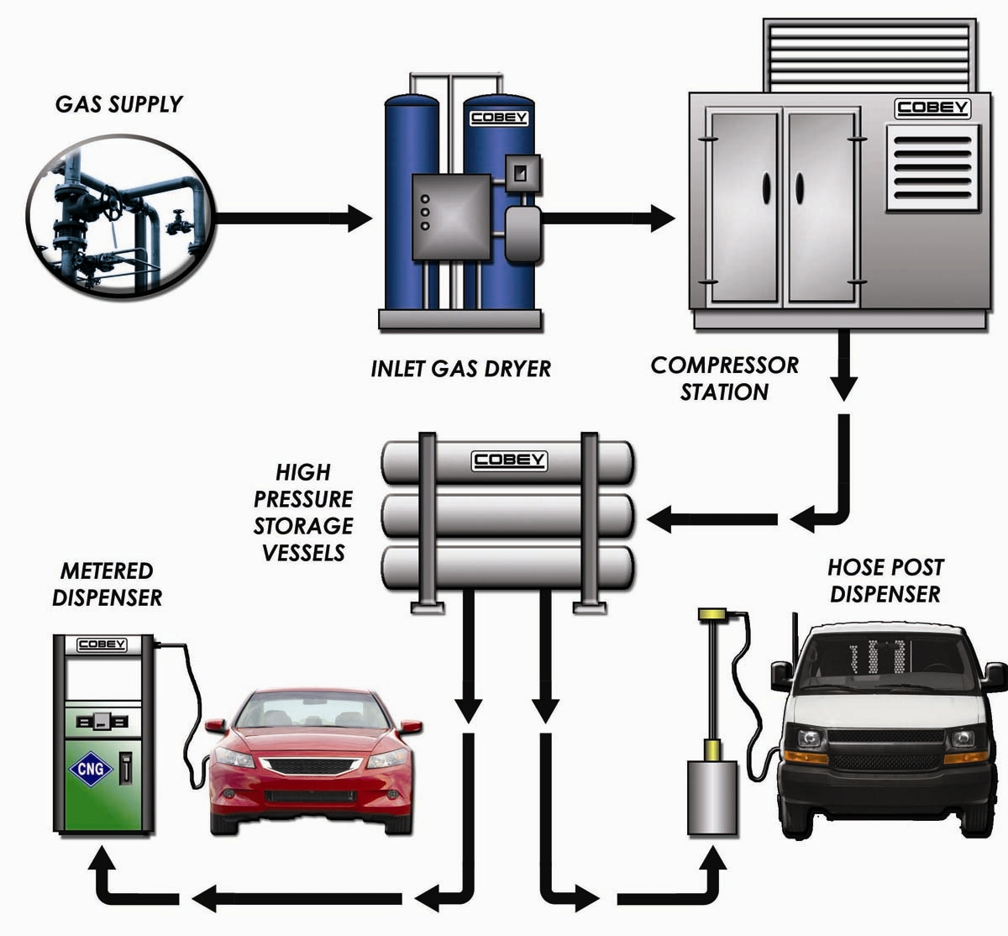

Slide 60
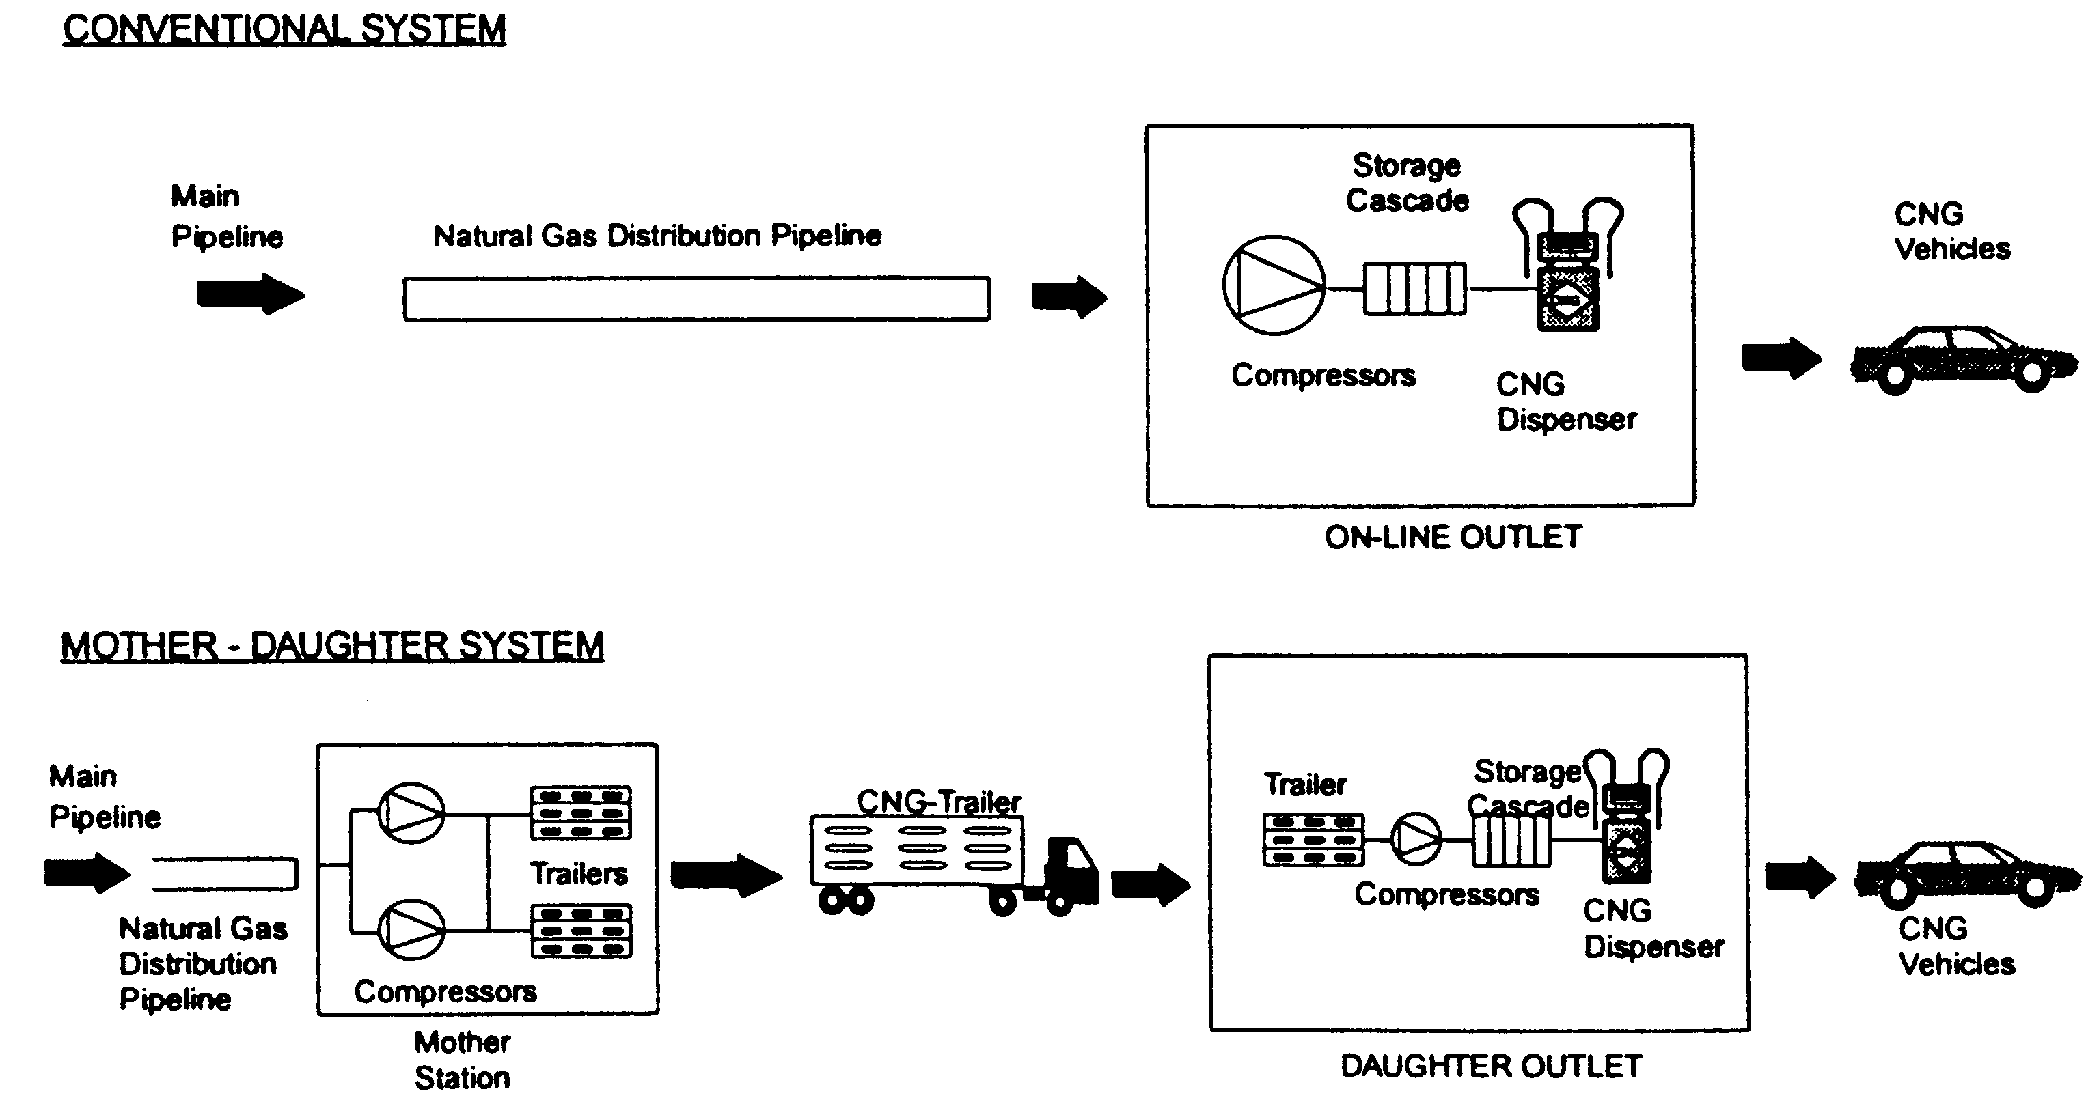
GAS UTILISATION EQUIPMENT
(Natural gas vehicle re-fuelling system)
Local distribution
  Directly re-fuelled from pipeline
No local distribution
  Mother-daughter system

Slide 61
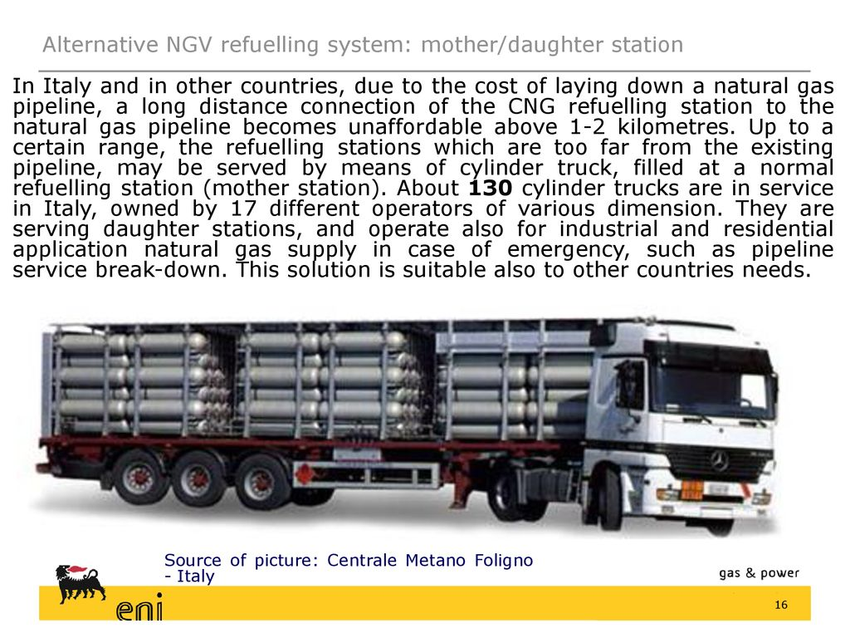

Slide 62
GAS UTILISATION EQUIPMENT
(Natural gas vehicle re-fuelling mode)
Fast-fill
  Currently available in Malaysia
  Same as conventional petrol / disel re-fuelling
  3-5 mins
  Retail / public excess refuelling outlets
Slow-fill
  Known as time or trickle fill system
  6-8 hrs
  Home refueling outlet (NZ, Italy, USA ???)
  District refuelling outlet/depot – number of vehicles fuelled from on-site NGV fuel dispensing manifolds

Slide 63
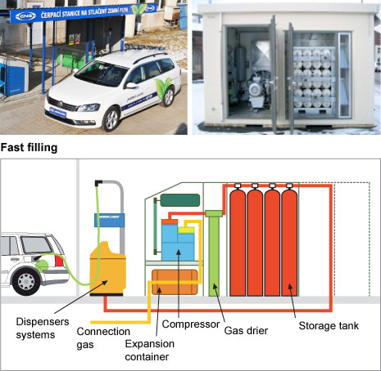

Slide 64
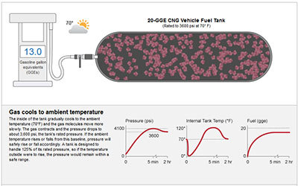

Slide 65
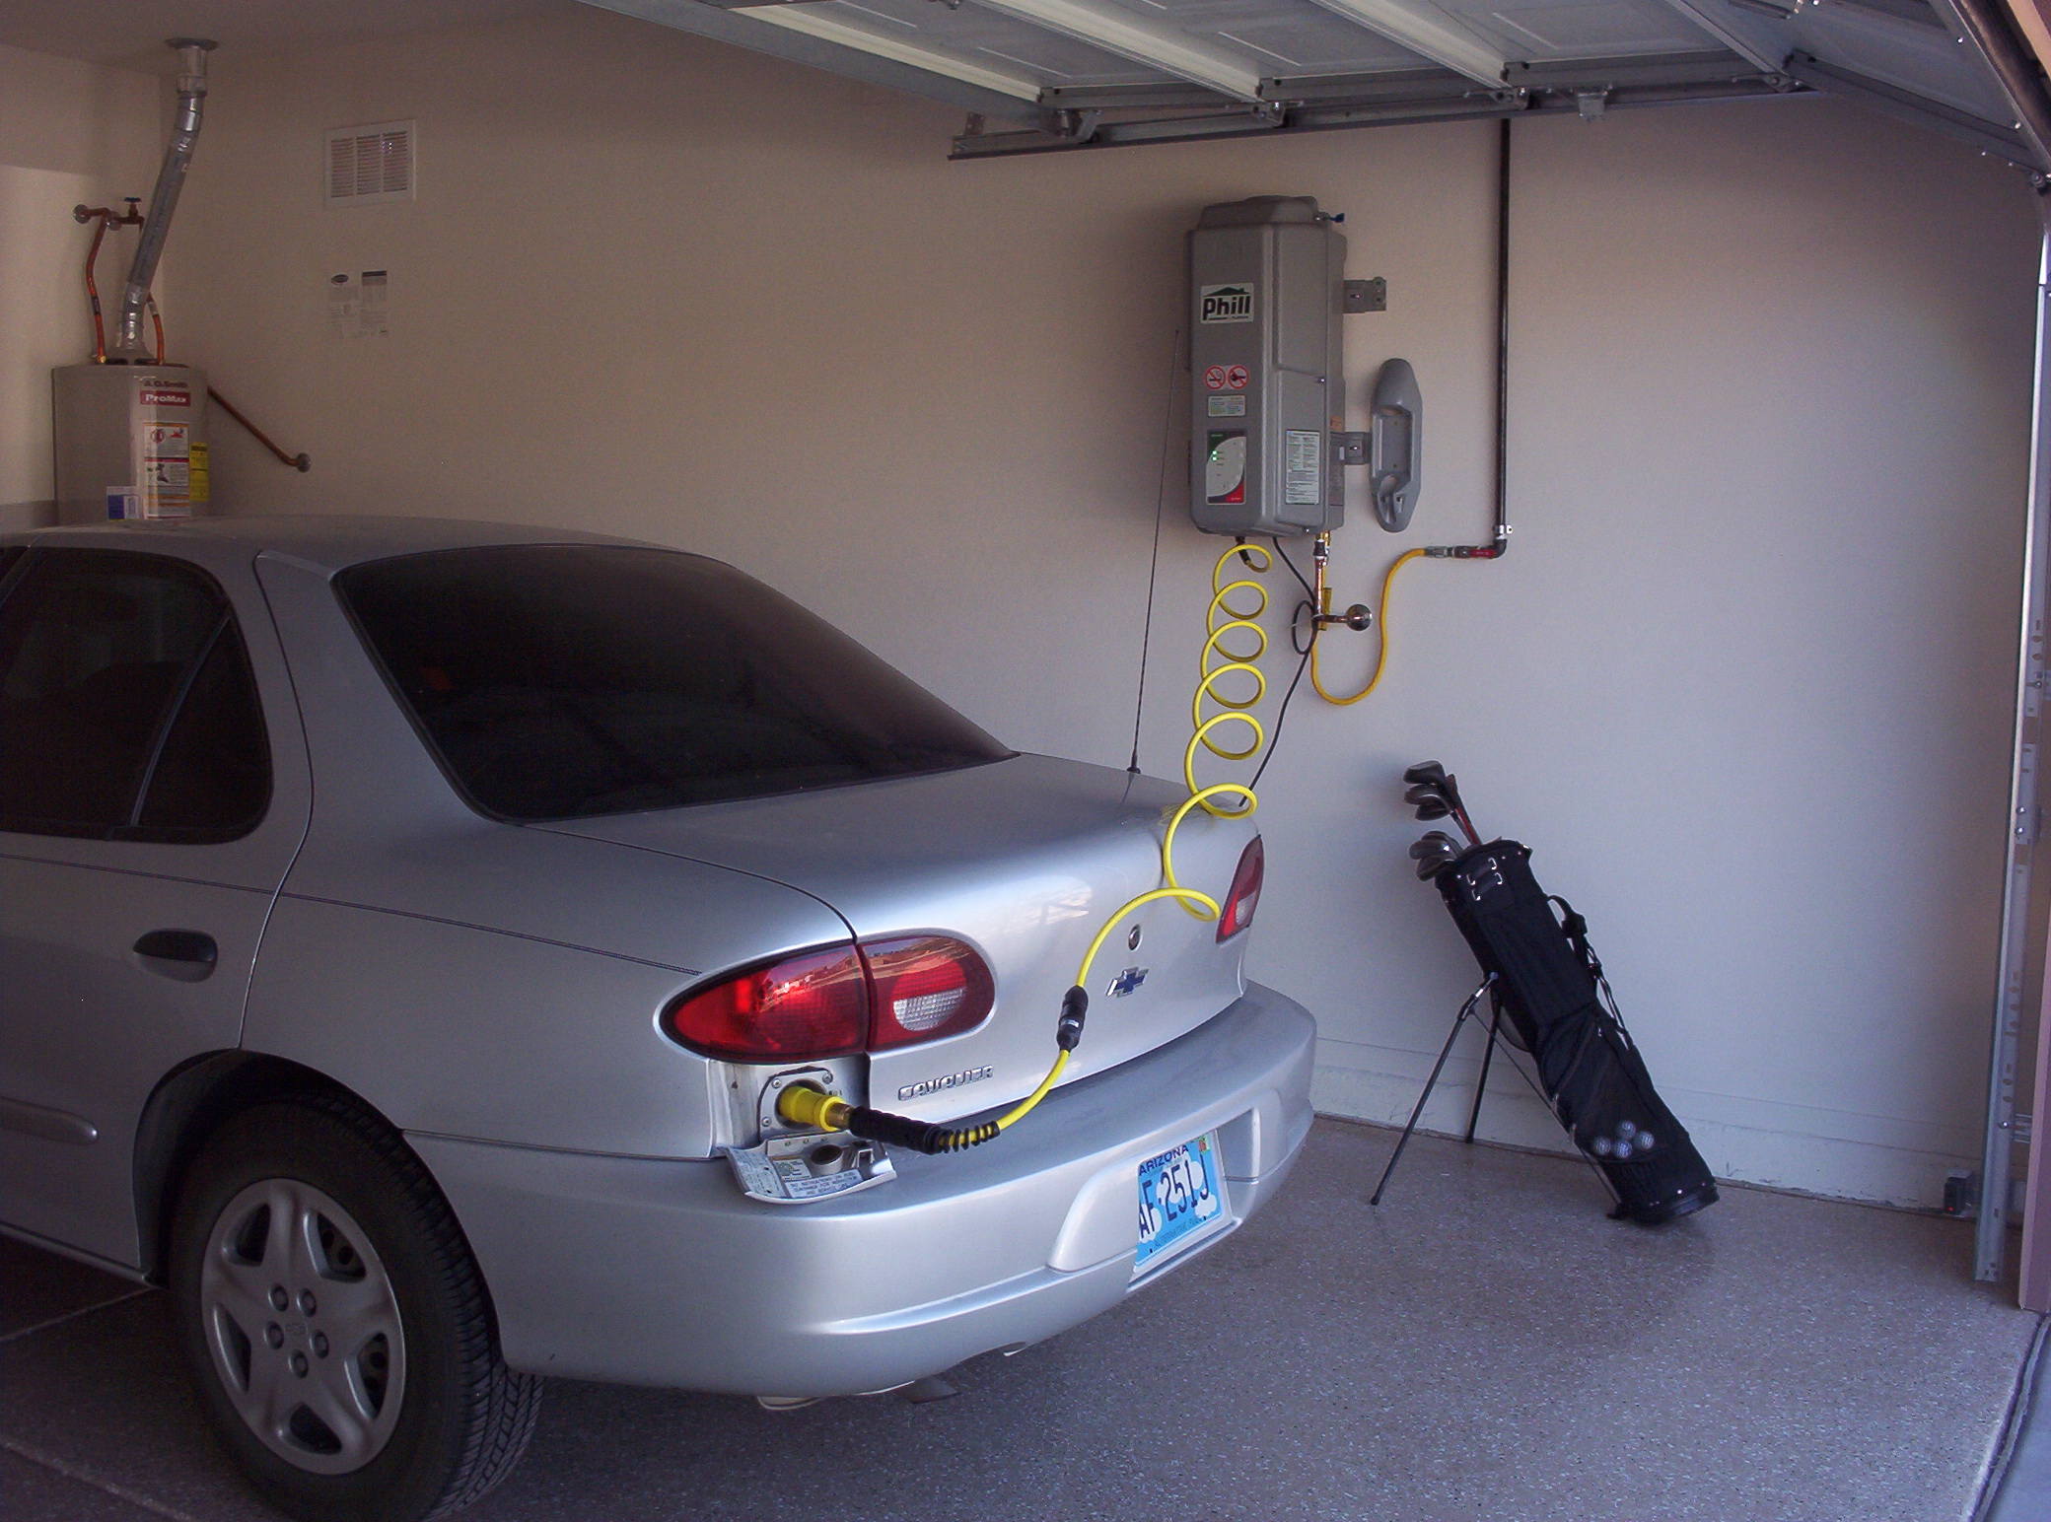

Slide 66
GAS UTILISATION EQUIPMENT
(Steam absorption chiller)
Heat input/source is utilised to produce cooling effect for space conditioning or for refrigeration
Heat source
  direct fired source
    usually natural gas burner
  in-direct fired source
    low pressure steam
    hot water
    waste process heat

Slide 67
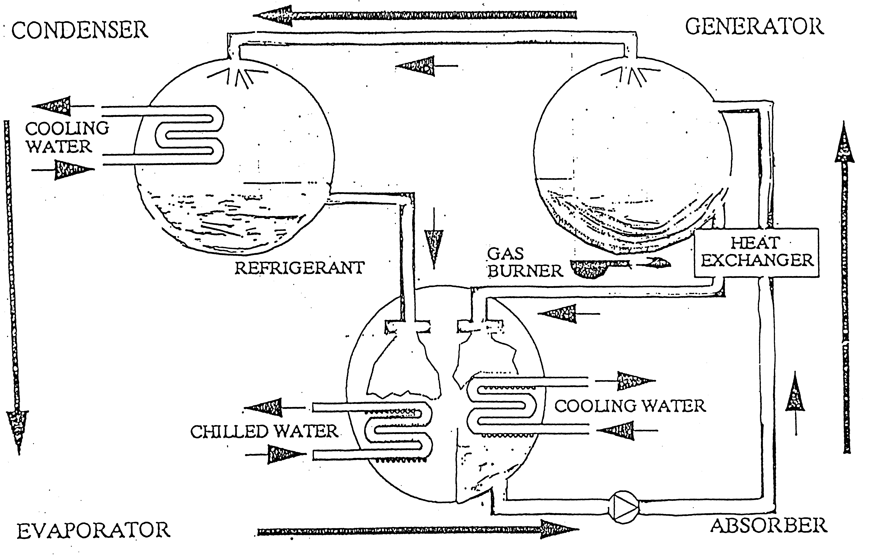
GAS UTILISATION EQUIPMENT
(Steam absorption chiller – Components)
Absorber
Generator
Condenser
Evaporator
Heat exchanger

Slide 68
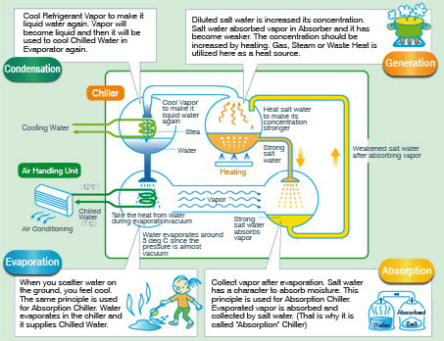

Slide 69
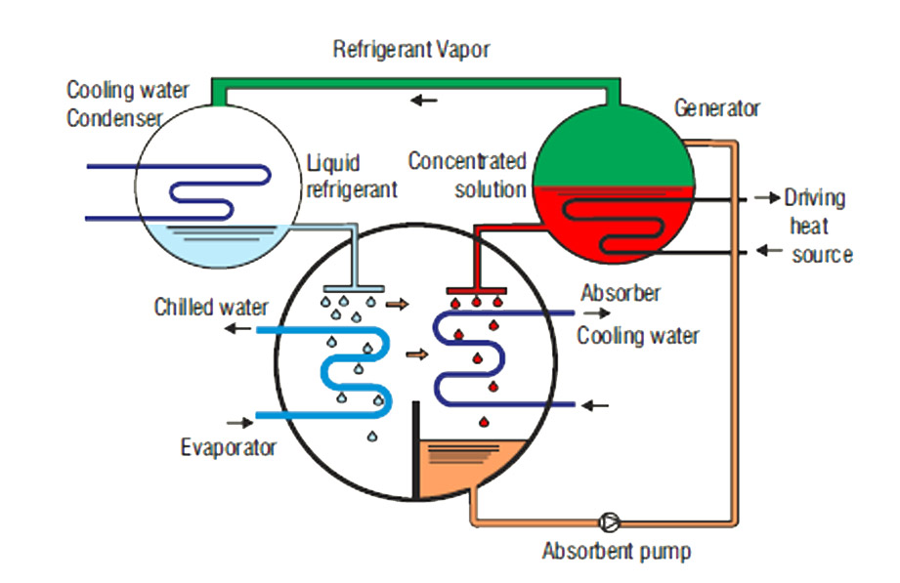

Slide 71
GAS UTILISATION EQUIPMENT
(Steam absorption chiller – Working fluids)
Working fluids are cooling medium containing a mixture of refrigerant & absorbent
Working fluids | (Refrigerant) Absorbent | Features
Water / lithium bromide (H₂O /LiBr) | (Water) Lithium Bromide | operate under vacuum (10-800 mbara) large commercial chillers e.g. KLIA
Ammonia/water (NH₃/ H₂O) | (Ammonia) Water | operate above atmosphere small refrigerator and residential unitary systems

Slide 72
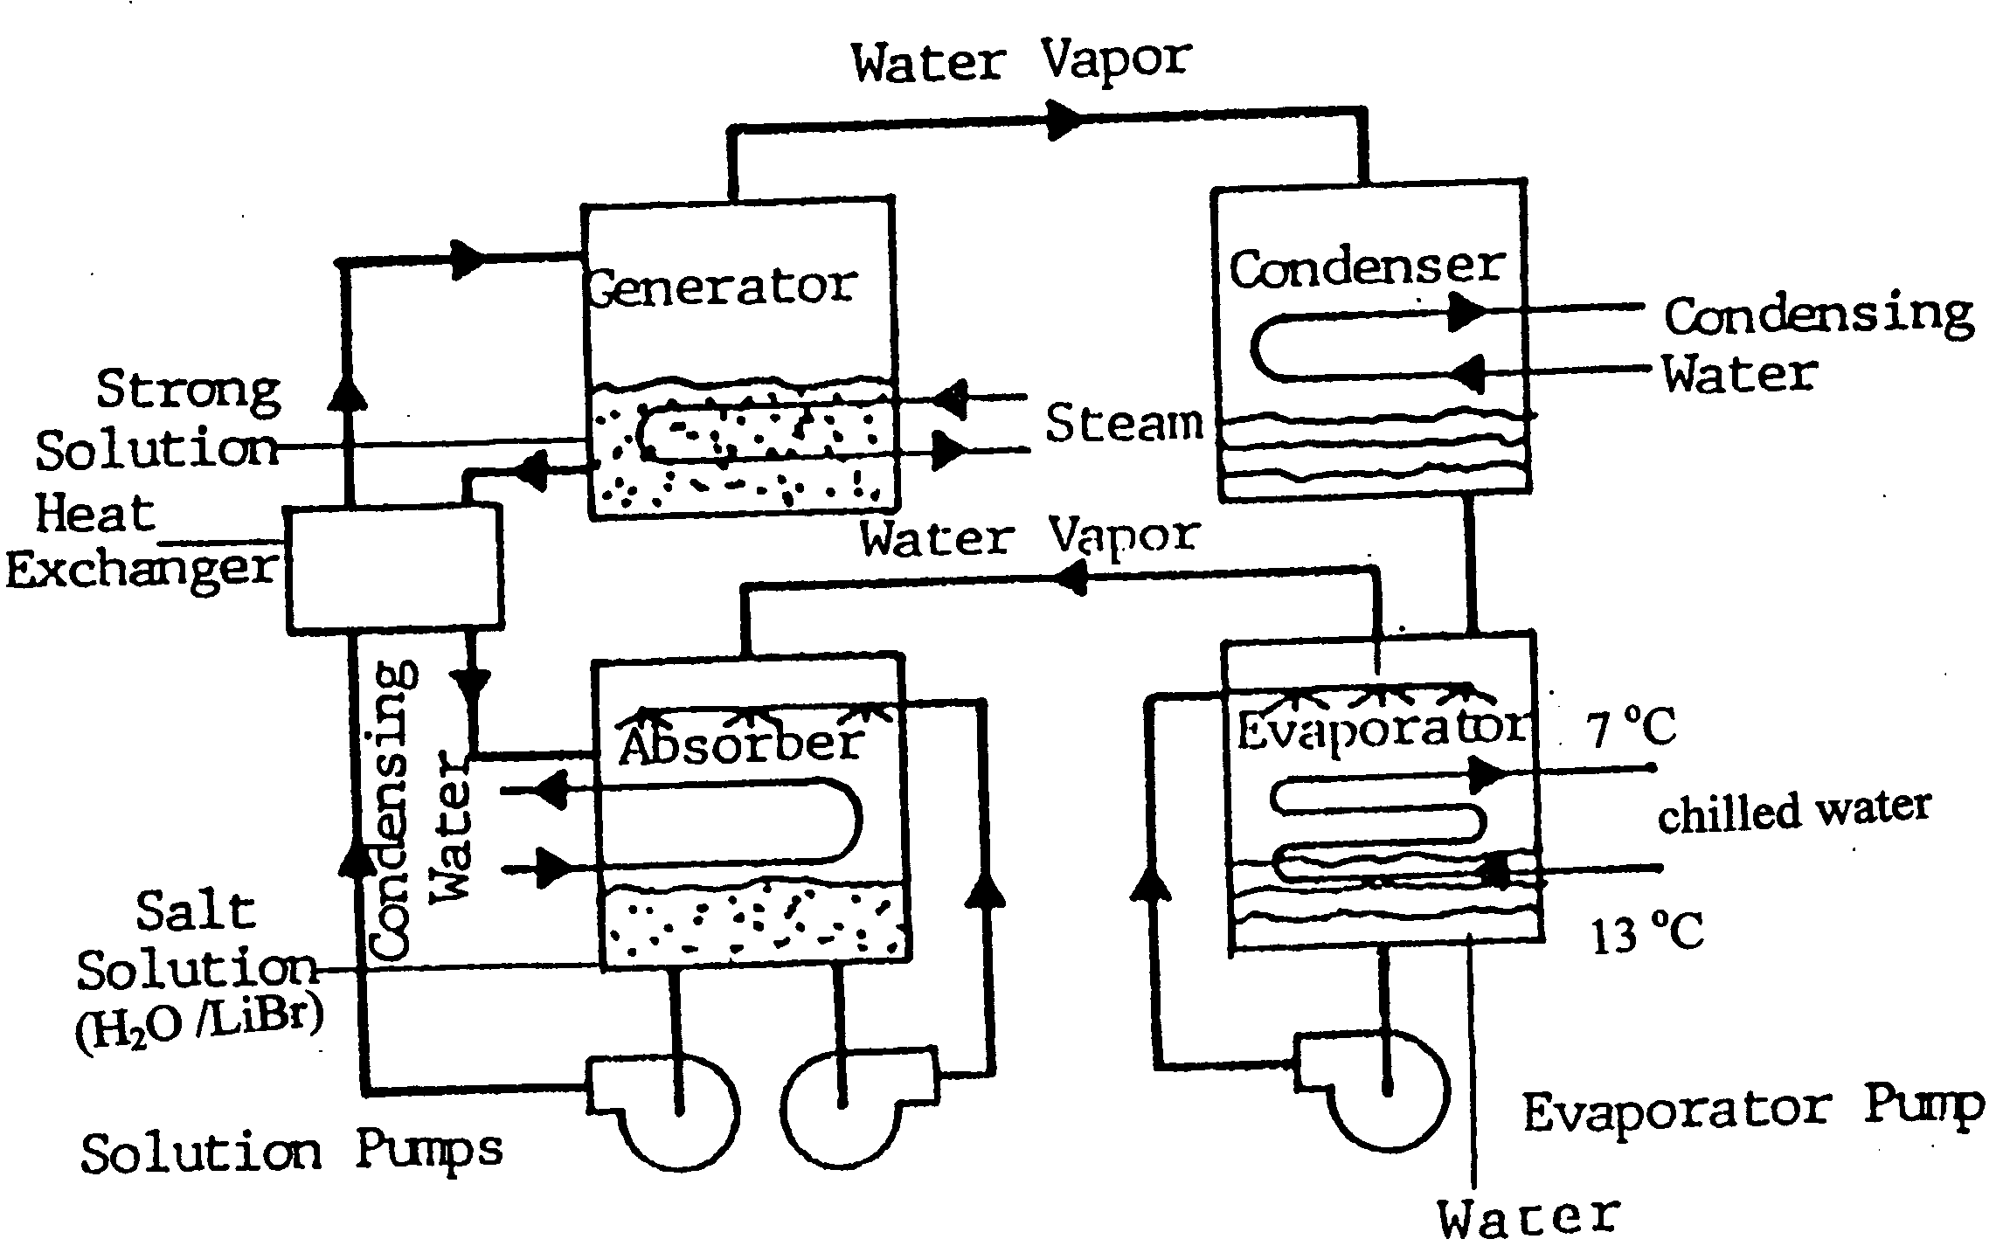
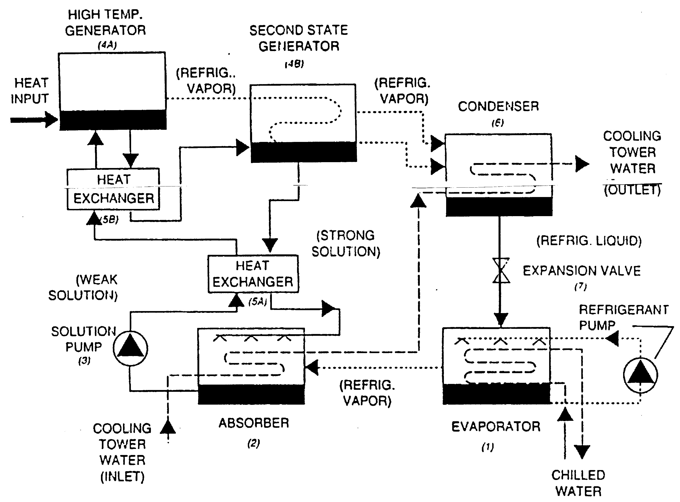
GAS UTILISATION EQUIPMENT
(Commercial steam absorption chillers)
Single effect chiller Double effect chiller

Slide 73
GAS UTILISATION EQUIPMENT
(Steam absorption chiller - Comments)
Compared to electric cooling (vapor compression refrig.)
  Less efficient (COP_{sac} = 1.1 vs COP_{ec} = 6)
  Capital cost 1.5-2.5 times higher
  Economically feasible in areas with high electrical demand rates, low natural gas summer rates and rebate and incentive plans offered by government (Malaysian case) or local gas utility companies
While no absorption chiller exceeds the raw COP of a vapor compression system, LiBr-H₂O double-effect absorption chillers offer a system-level efficiency advantage when low-cost thermal energy and minimal electrical input are available, thanks to their low pumping requirement and potential integration with CHP.

Slide 74
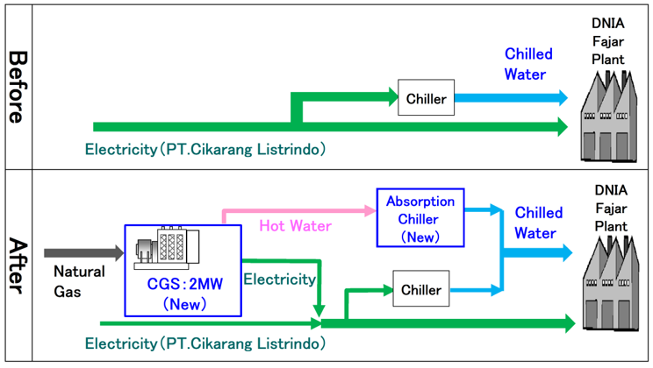

Slide 75
GAS UTILISATION EQUIPMENT
(Heat Pump)
A device which extract heat (rejected) from a source that is normally at too low temperature to be used directly, making it available as useful heat at a higher temperature
Typical sources of reject heat
  waste heat (exhaust)
  process effluent
  cooling water
  humid air etc.
Generally used for drying processes

Slide 76
GAS UTILISATION EQUIPMENT
(Heat pump - characteristics)
As compared to conventional heat recovery
  Upgrade recovered heat rather than simple heat recovery
    extend the temperature range over which waste heat is recoverable
  Require high grade energy
    efficient heating system rather than a heat recovery device
  Limited to applications involving temperatures below about 120°C

Slide 77
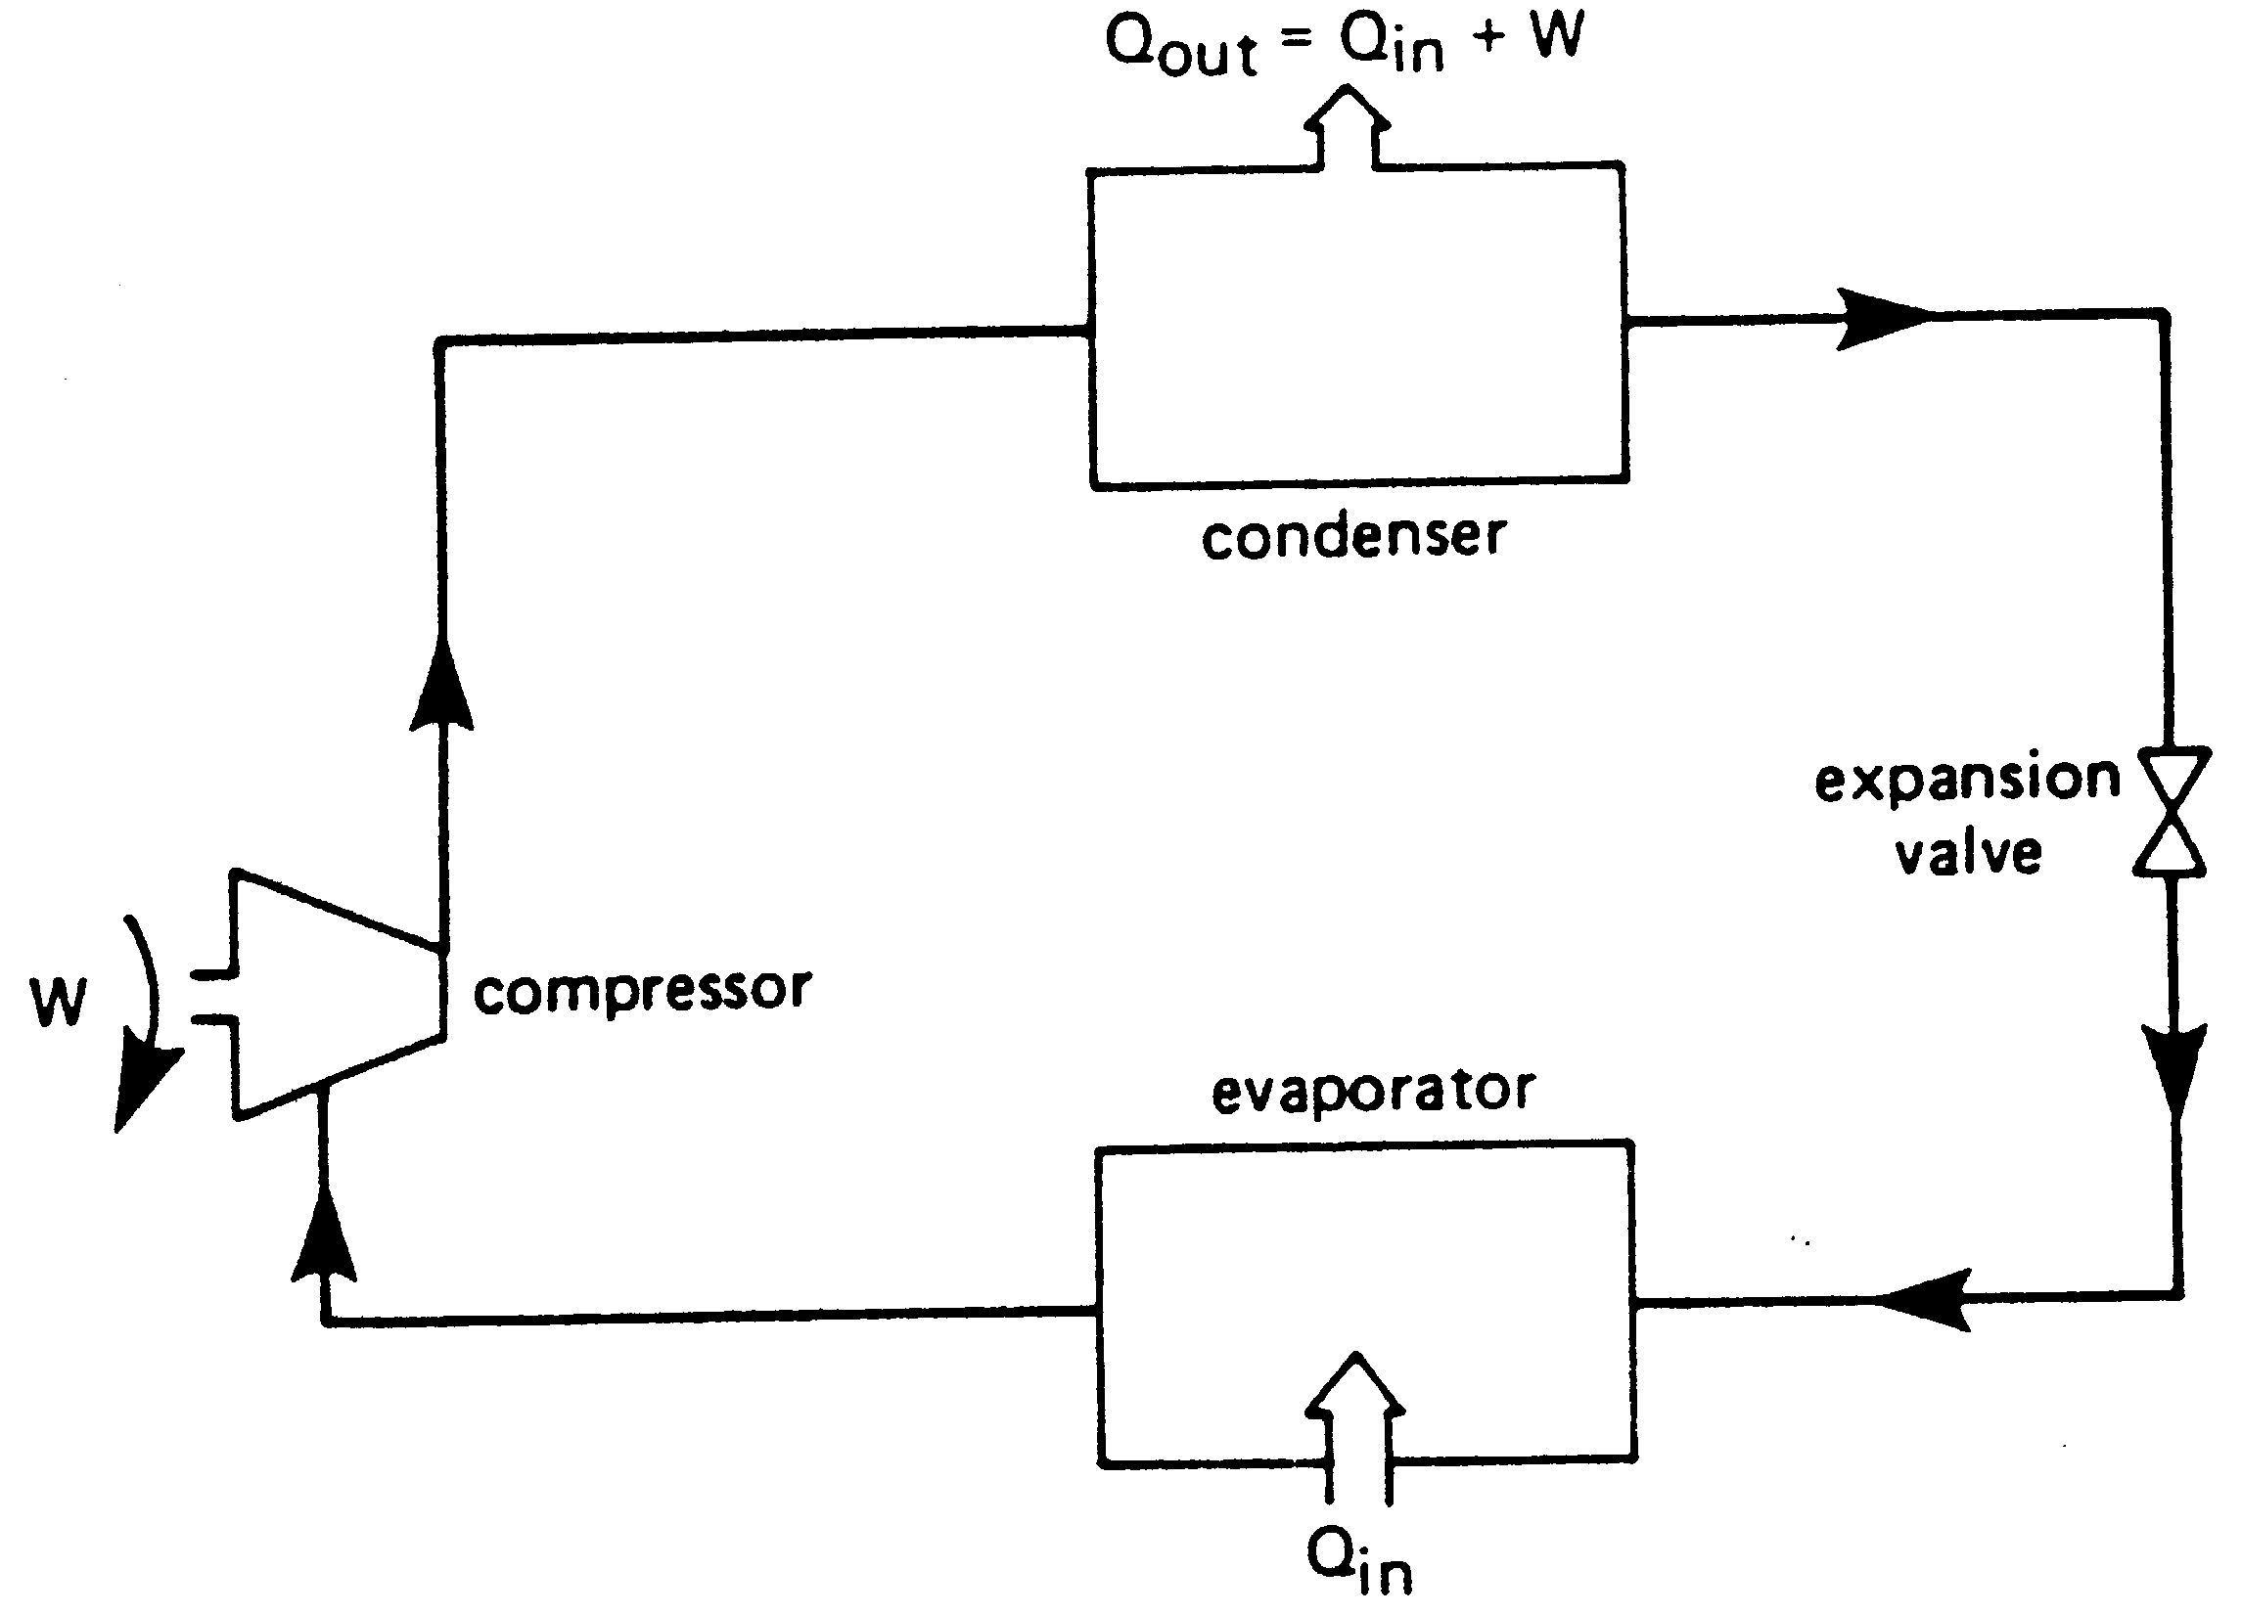
GAS UTILISATION EQUIPMENT
(Vapor compression heat pump – operating cycle)
Reject heat is transferred to working fluids (e.g. Freon) in evaporator
Evaporated vapor is compressed to a higher temperature and pressure
Heat is transferred from high temp. & pressure compressed vapor to load to be heated & as a result working fluid condenses
High pressure liquid passes through expansion valve where its pressure and hence temperature are lowered
Low temperature working fluid enters evaporator to complete cycle

Slide 78
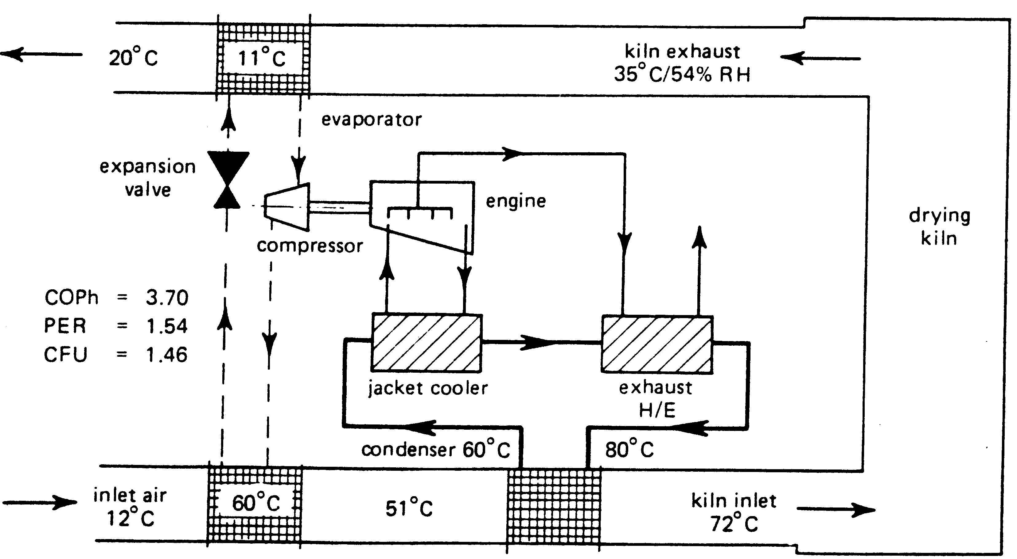
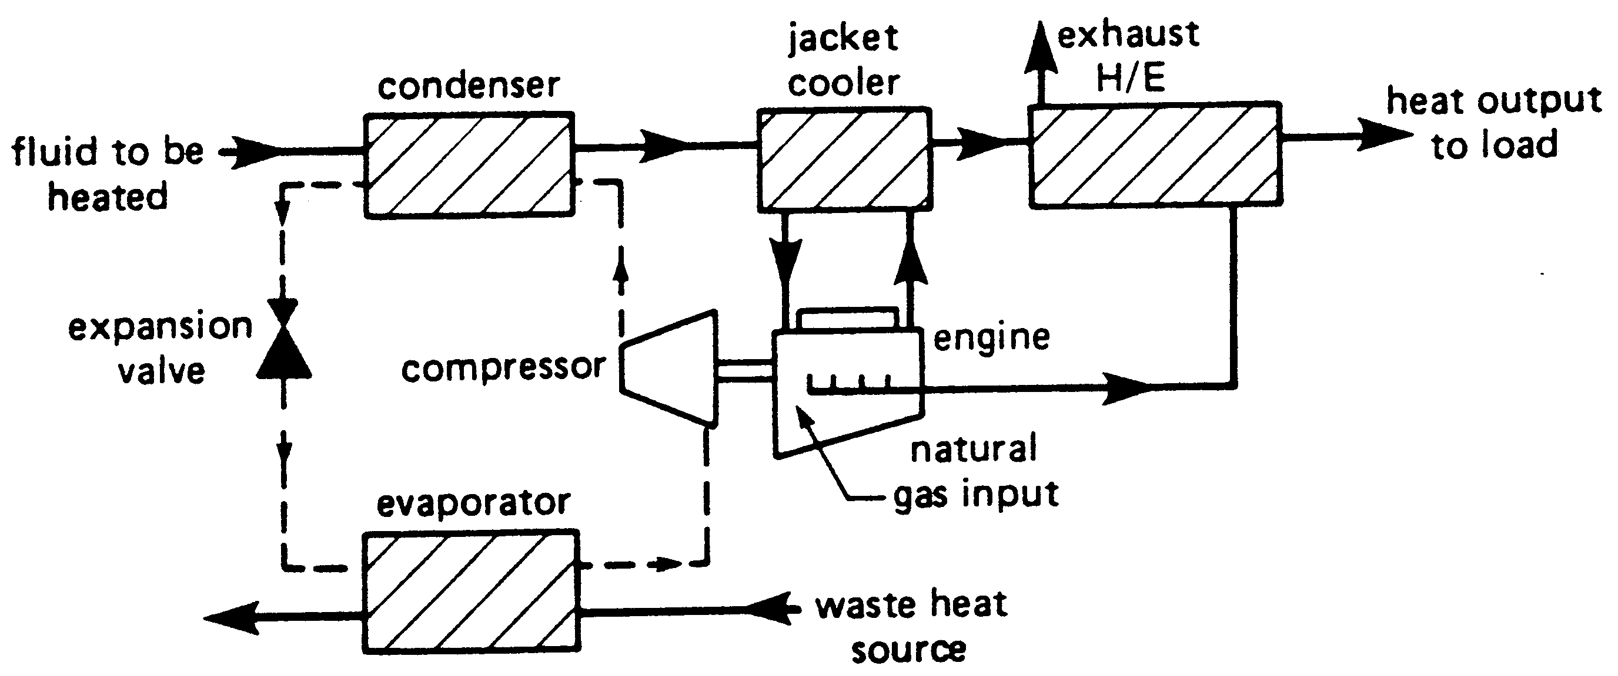
GAS UTILISATION EQUIPMENT
(Gas engine driven heat pump – operating cycle)
Natural gas fuelling internal combustion engine to drive compressor
Additional high grade heat (~ 55% of the energy input) can be recovered from engine jacket and exhaust system
  size of heat pump components will be smaller for a given total heat output for a gas engine heat pump than for an electric motor heat pump
  maximum load outlet temperature will be higher for a given refrigerant system design

Slide 79
GAS UTILISATION EQUIPMENT
(Burner)
A device to burn fuels under control to produce useful heat
Functions of a burner
  Deliver fuel and air to combustion chamber
  Mix fuel and air
  Provide continuous and stable ignition of air/fuel mixture
Related applications
  Stationary
    Boiler
    Furnace
    Incinerator
  Mobile
    Vehicles (car, bus, truck etc)
    Aircraft

Slide 80
GAS UTILISATION EQUIPMENT
(Burner)
Types of a burner
  Solid burner
  Liquid burner
  Gas burner
Main characteristic difference of these burners is method of combustible mixture preparation prior to combustion

Slide 81
GAS UTILISATION EQUIPMENT
(Gas burner classification)
non-aerated
  fuel and air are rapidly mixed just after the burner head; known as raw or neat or luminous or rapid fuel-air mixing burners
partially-aerated
  fuel is mixed with air in the burner just before burner head; known as partially-premixed burners
fully-aerated
  fuel and air are fully mixed before entering the burner head; known as premixed-burners
Based on method of combustible (air-fuel) mixture preparation prior to combustion

Slide 82
GAS UTILISATION EQUIPMENT
(Gas burner – aeration method or combustion air supply)
Mechanical
  Use fan / blower / compressor
Non-mechanical
  Based on draft (flow) effect due to pressure difference created from
    Chimney / stack
    Venturi-type device
  Forced draft → forced burner Power burners
  Induced draft → induced burner
  Natural draft → natural draft /
  atmospheric burner

Slide 83
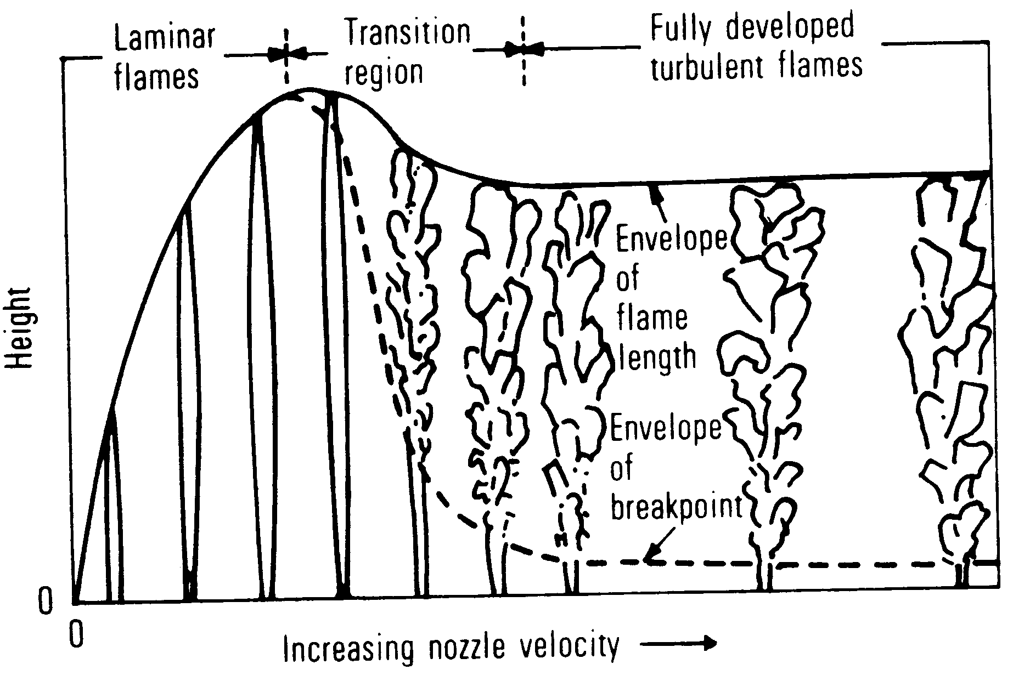
GAS UTILISATION EQUIPMENT
(Gas burner classification – flow characteristics)
Laminar-flame type burner
  Laminar flow (Low Reynolds numbers)
  Parameters of flow & state (velocity, pressure, temperature, density & species concentrations) do not fluctuate significantly
Turbulent-flame type burner
  Turbulent flow (High Reynolds numbers)
  Parameters of flow & state fluctuate randomly
Based on flow or aero dynamics
of combustion

Slide 84
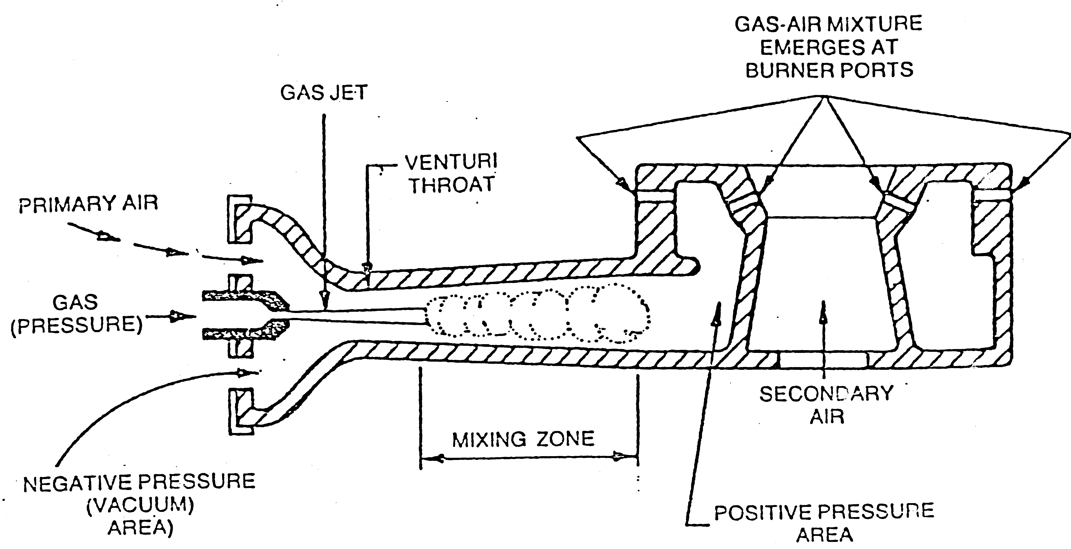
GAS UTILISATION EQUIPMENT
(Atmospheric gas burner)
Combustion air is supplied by means of kinetic energy of the gas issuing from the orifice within a venturi-mixer
Can be either partially aerated (partially-premixed) or non-aerated (diffusion) burner depending on how combustion air is introduced
Types, applications, advantages & disadvantages

Slide 85
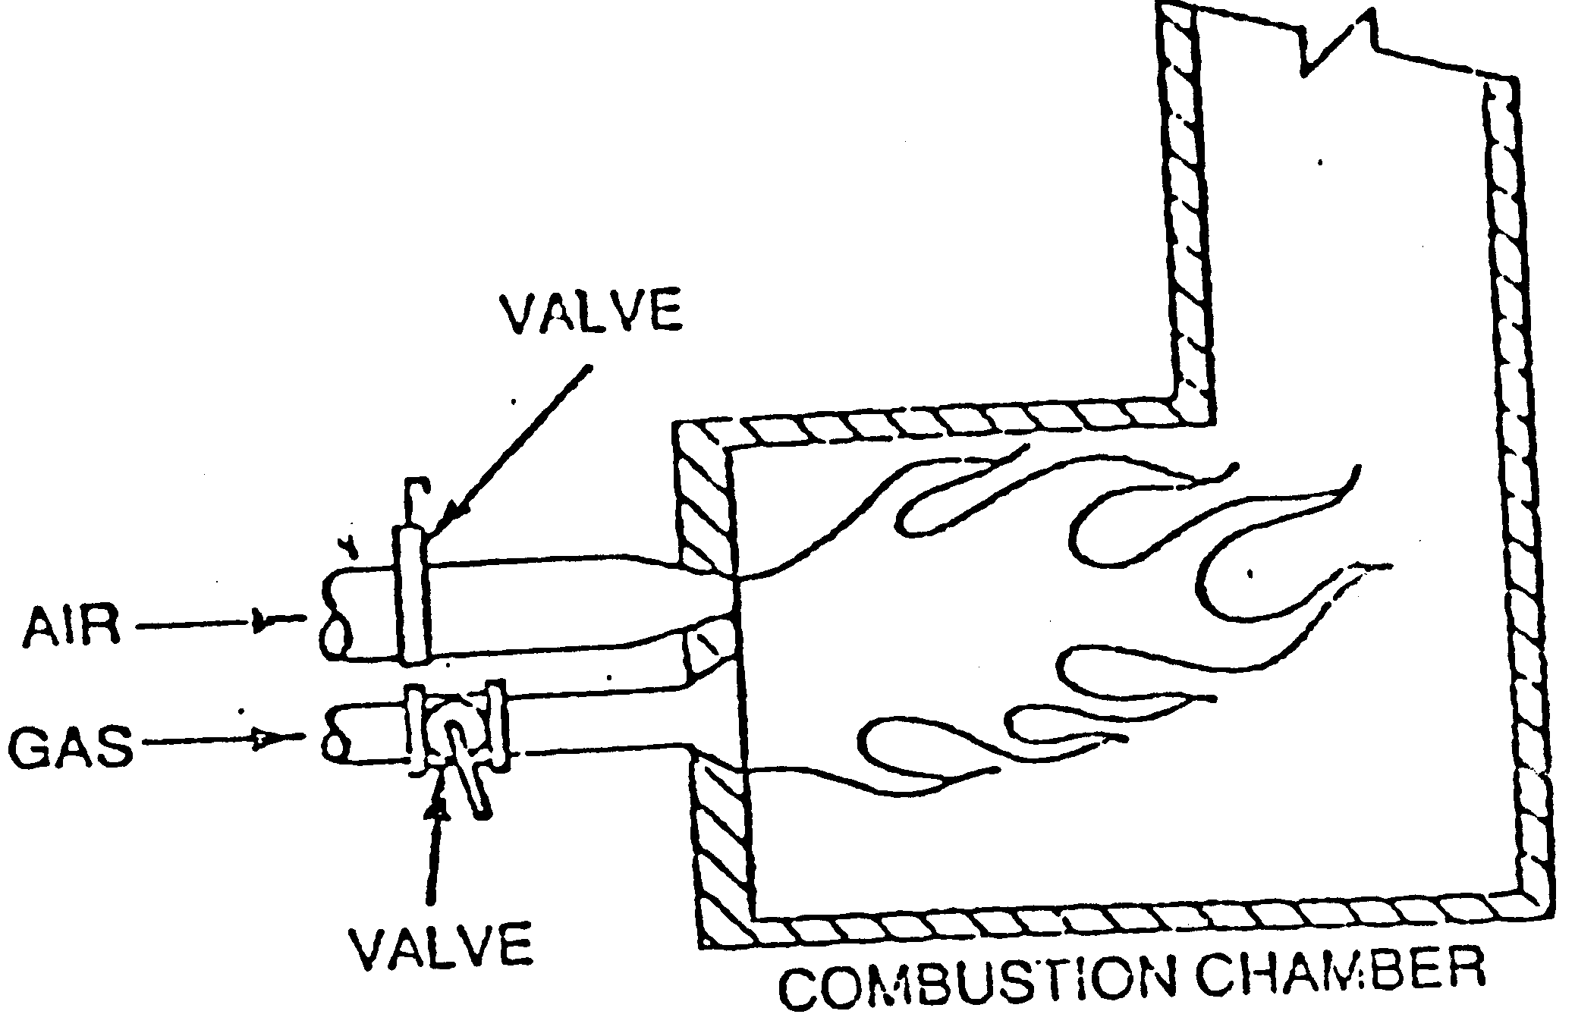
GAS UTILISATION EQUIPMENT
(Power gas burner – Forced burner)
Diffusion burner
  Fuel and air are rapidly mixed just and subsequently burned after burner head
  Known as post-aerated / non-aerated / non-premixed / raw / neat / luminous or rapid fuel-air mixing burners
  Applications, advantages & disadvantages

Slide 86
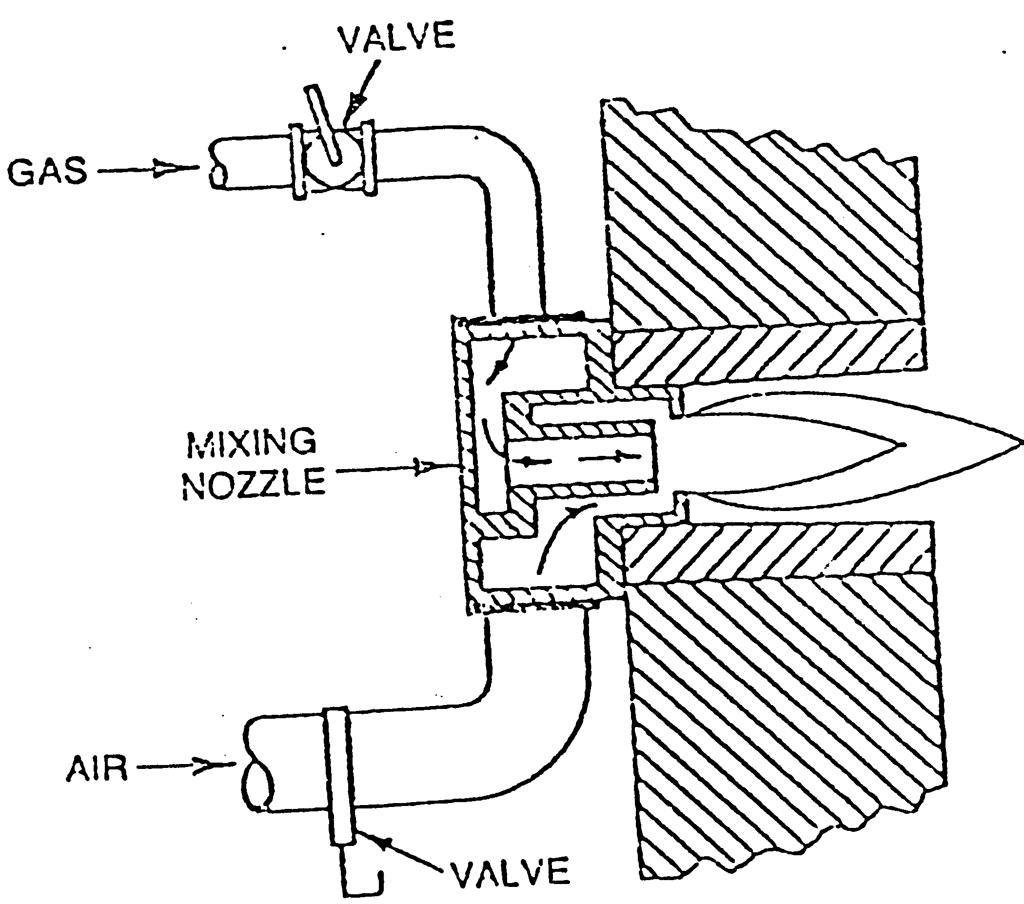
GAS UTILISATION EQUIPMENT
(Power gas burner – Forced burner)
Nozzle mixing burner
  Fuel and air (at pressure) are rapidly mixed inside burner head
  Known as tunnel mixing / packaged / partially premixed or rapid fuel-air mixing burners
  Applications, advantages & disadvantages

Slide 87
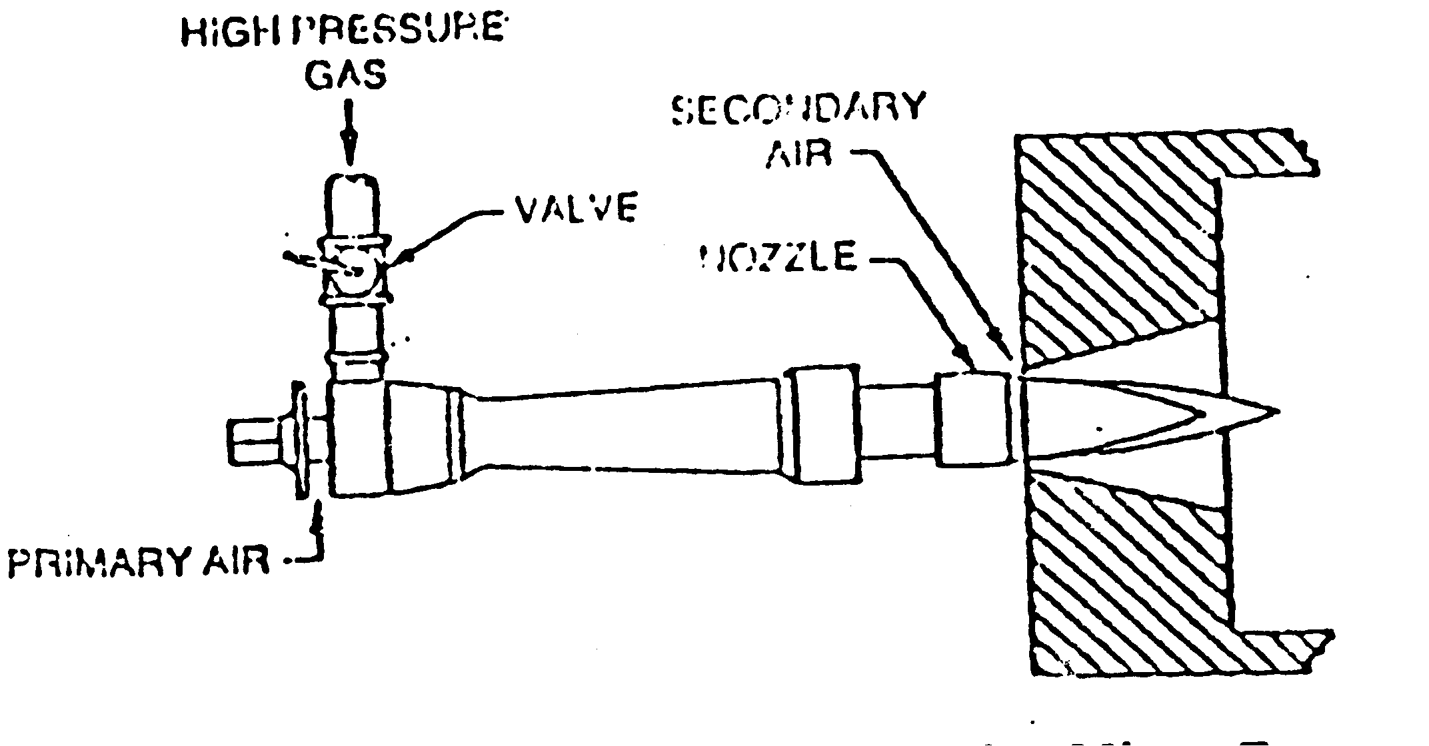
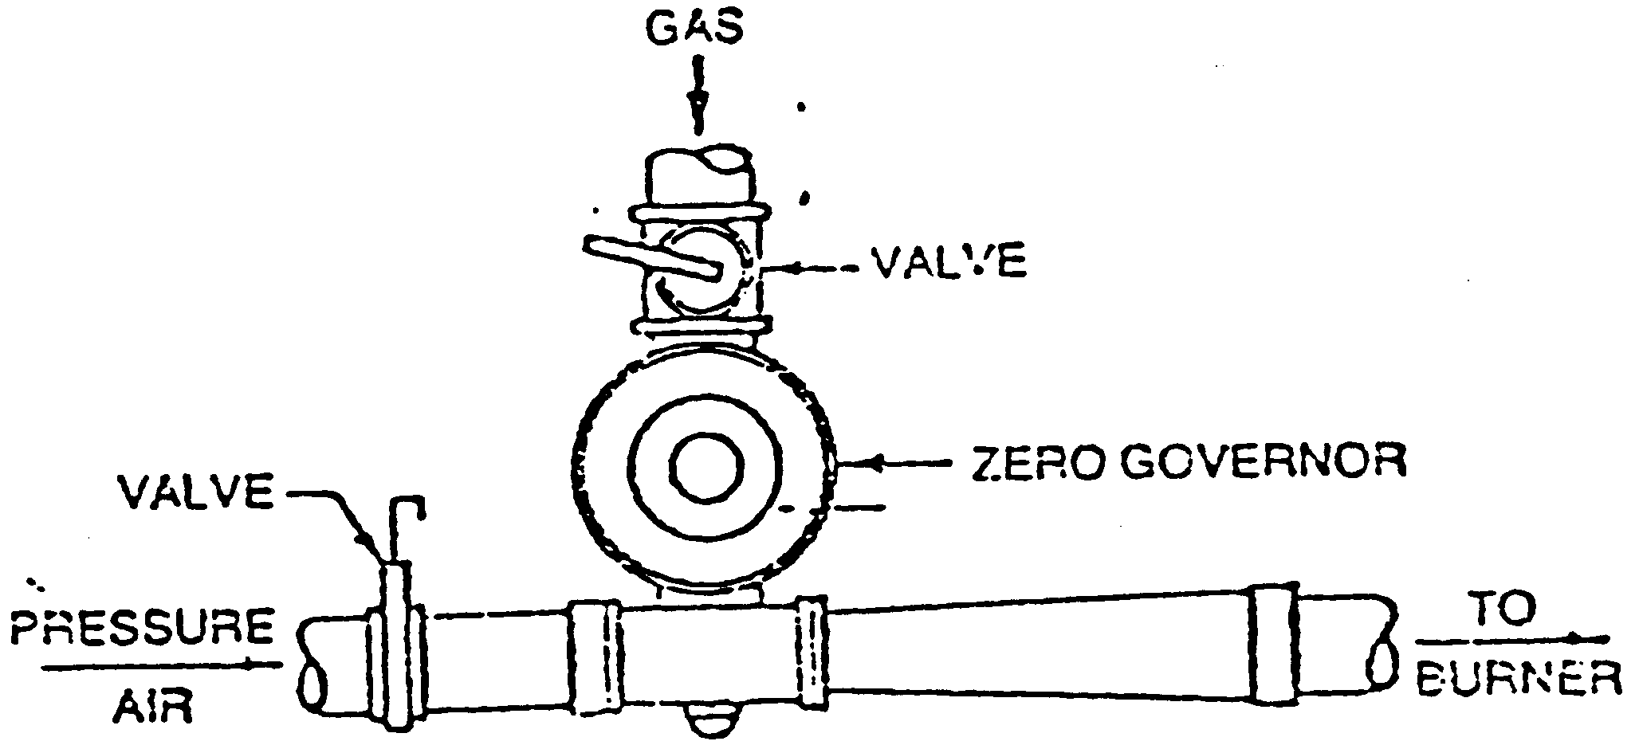

GAS UTILISATION EQUIPMENT
(Power gas burner – premixing burner)
Gas jet mixer type
  Operate similar to atmospheric burner
  Fuel is supplied at pressure
Air jet mixer type
  Fuel is supplied proportionately to combustion air (at pressure)
  Known as air blast burner
Machine (compressor) mixer type
  Fuel & air (may be at relatively low pressure) are mixed in a compressor
  Safety requirement is critical !!!!

Slide 88

GAS UTILISATION EQUIPMENT
(Power gas burner – pressure burner)
Fuel & air (may be at relatively low pressure) are mixed in a compressor
A single or multiple burners may be used
A wide range of input rates & air/fuel mixture combinations
Safety requirement (back fire protection – i.e. flame arrestor)

Slide 89

GAS UTILISATION EQUIPMENT
(Radiant burner)
Laminar flow
Heat converted to radiant energy
surface temp. 800-1350 ºC (low NOx)
for space heating & industrial process heating
radiation surface
  porous material
  metal wire gauze or tubes (single, U shape or W shape)

Slide 90

GAS UTILISATION EQUIPMENT
(Catalytic burner)
Combustion on surface of catalyst (e.g. rhodium, platinum, oxides metals) at very low temperature ( ~ 450 ºC for NG, well below ignition temp. ~650 ºC ) but heat generated is same as normal high temperature combustion
Advantages
  CO is not a combustion intermediate
  NOx levels are very low
  Relatively high radiant efficiency
Disadvantages
  Some fuel passes through a catalyst unburned
  Needs catalyst preheating to about 250 ºC before reaction becomes self-sustaining

Slide 91
GAS UTILISATION EQUIPMENT
(Catalytic burner)
Combustion on surface of catalyst (e.g. rhodium, platinum, oxides metals) at very low temperature ( ~ 450 ºC for NG, well below ignition temp. ~650 ºC ) but heat generated is same as normal high temperature combustion
Advantages
  CO is not a combustion intermediate
  NOx levels are very low
  Relatively high radiant efficiency
Disadvantages
  Some fuel passes through a catalyst unburned
  Needs catalyst preheating to about 250 ºC before reaction becomes self-sustaining

Slide 92

GAS UTILISATION EQUIPMENT
(Dual fuel burner )
Combination burner designed for rapid fuel change from one fuel to another (e.g. oil to gas)
Widely used in industrial boiler firing

Slide 93

GAS UTILISATION EQUIPMENT
(Gas-oxy burner )
Uses oxygen in place of air to get higher flame temperature and heat transfer rates (e.g. NG/oxygen flames have maximum flame temperature 2700 ºC as compared to NG/air flames of 1950 ºC)
Applications : welding, glass working, steel melting, flame cutting etc.
Advatanges
  increased flame temperature & burning velocity , this reduced fuel consumption
  reduced ignition temperature
  less heat loss to the flue
  no harmful pollutants such as CO & NOx
  increased production and improved product quality

Slide 94

GAS UTILISATION EQUIPMENT
(Package burner )
Very common in industrial low temperature applications
Semi-automatic or fully automatic firing mode

Slide 95

GAS UTILISATION EQUIPMENT
(Heat recovery burner )
Waste heat recovery (conventional)
  Air pre-heater
  Economizer

Slide 96

GAS UTILISATION EQUIPMENT
(Heat recovery burner )
Recuperative burner
  Burners which have internal recuperator to exchange heat from hot products to combustion air in integrated into a single unit
  Air preheat up to 600 ºC possible

Slide 97

GAS UTILISATION EQUIPMENT
(Heat recovery burner )
Regenerative burner
  Burners which have cyclic heat inter-changers (e.g. ‘nugget-shaped ceramic’ inter-changer) which alternatively receive heat from hot flue gases and transfer to air before combustion

Slide 98
GAS UTILISATION EQUIPMENT
(Furnace)
A type of heat exchanger where the fuel is burned in an enclosure to heat a process material contained in tubular coils, tubes or in an enclosure itself
Also known (in many refining processes) as direct-fired heaters, heaters, fired heaters and tube-still heaters
Mostly in high temp. application industries such as, ceramic, ferrous / nonferrous, glass etc. and refining industries for
  Drying
    direct
    indirect
  Heating

Slide 99

GAS UTILISATION EQUIPMENT
(Process refining furnace – main components)
Burner
  deliver heat to the furnace
  oil , gas or oil/gas burners
Radiant section
  hottest area in a furnace
  heat transfer to process materials radiation primarily from flames and flue gases, through hot refractory on walls also radiates heat
Convection section
  convection heat transfer from flue gases preheats process materials before they go to the radiant section

Slide 100


GAS UTILISATION EQUIPMENT
(Process refining furnace )

Slide 101



GAS UTILISATION EQUIPMENT
Types of furnace – based on orientation of tubes in radiant section
Vertical Horizontal
Vertical cylindrical furnace Foor-fired box furnace Side-fired box furnace

Slide 102

GAS UTILISATION EQUIPMENT
Types of furnace – based on air supply and flue gases removal methods
induced, forced or natural draft

Slide 103
GAS UTILISATION EQUIPMENT
Gas-fired furnace - classification
Method of firing
  Directly-fired
    Process materials directly contact with hot heating gases
  Indirectly-fired
    Process materials contact with radiation heat transferred from solid partition , e.g. refractory or some other metals, muffle, radiant tube etc
method of load handling
  intermittent (batch)
  continuous

Slide 104

GAS UTILISATION EQUIPMENT
Directly-fired furnace – Tunnel or roller hearth kiln (furnace) used in ceramic industry

Slide 105

GAS UTILISATION EQUIPMENT
Boiler
a pressure vessel type of heat exhange equipment where water is heated (heat energy from flue gases) to produce hot water or steam
Efficiency of heat transfer from the flue gases to water is dependent upon travel time of flue gases through tubes of boiler

Slide 106
GAS UTILISATION EQUIPMENT
Boiler Classification
steam or hot water
fire tube or water tube
horizontal flue or vertical flue
type of boiler and burner combinations (package and non-package)

Slide 107
GAS UTILISATION EQUIPMENT
Boiler Classification - Steam And Hot Water Boilers
Steam boilers
  low pressure for building space heating etc
  high pressure for power generation (steam turbine), dry cleaning etc.
Hot water boilers
  Low-medium pressure for conventional space heating of commercial and industrial buildings or commercial space heating applications involving long runs of distribution piping (e.g. at airports, universities and hospitals)

Slide 108


GAS UTILISATION EQUIPMENT
Boiler Classification - Fire Tube boiler
Hot flue gases generated in furnace of boiler, flow through fire tubes transferring their heat to boiler water within shell surrounds fire tubes
Water or steam pressure on boiler tubes is exerted on outside which tends to collapse tubes
Requires tubes to be made relatively thick and heavy, placing practical limits on size of fire tube boilers

Slide 109


GAS UTILISATION EQUIPMENT
Boiler Classification - Water tube boiler
hot flue gases flow around the outside of water tubes - pressure on the tubes is from the inside
This arrangement allows water tube boilers to contain high operating pressures as compared to fire tube boilers
Water tube boilers can be built in large sizes to operate at highly operating pressures, such as large steam generators for power plant operation

Slide 110


Slide 111


GAS UTILISATION EQUIPMENT
Boiler Classification - Horizontal flue boiler
Flue gases are drawn horizontally across the boiler's heating -surface in a number of (horizontal tubes) passes
As number of passes in boiler is increased, efficiency of boiler is increased
Pressure drop or draft loss across boiler increase with increasing number of passes – uses fan assist or forced draft type of burner

Slide 112


