Slide 1
LECTURE 05
FUEL INTERCHANGEABILITY & VENTING SYSTEM
Course Outcome ;
Explain the fundamental concept of fuel interchangeability and venting system

Slide 2
FUEL INTERCHANGEABILITY

Slide 3
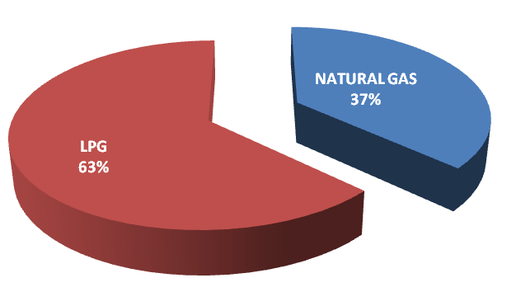
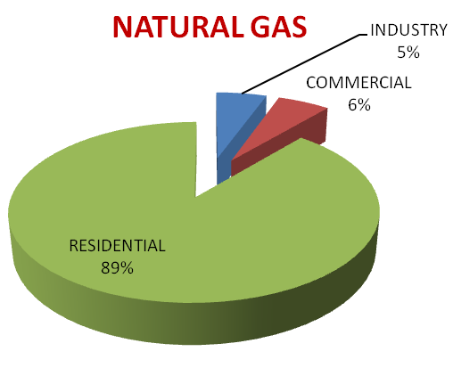
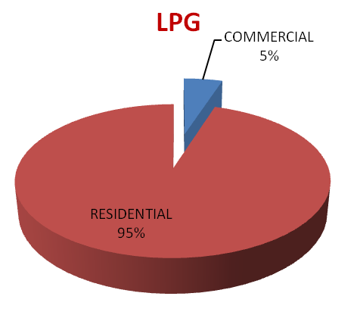

GAS MALAYSIA : NO OF CUSTOMERS
As of Dec 2014 - Total Customers : 38318
(Source : Gas Malaysia Annual Report 2014)

Slide 4
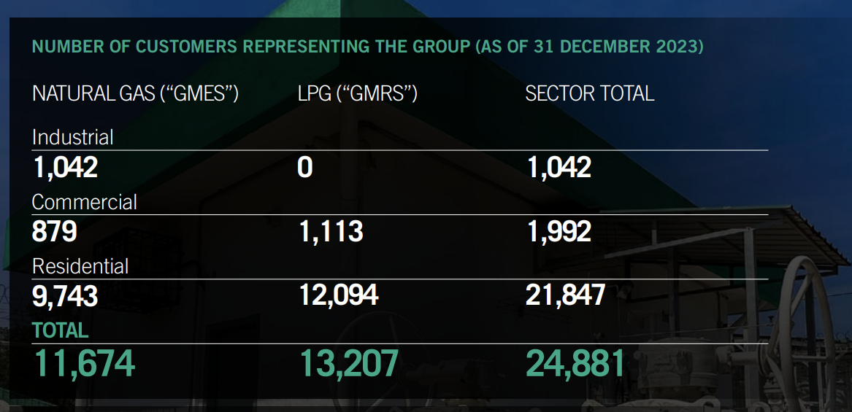
GAS MALAYSIA : NO OF CUSTOMERS
(9 %)
(7.5 %)
(8.4 %)
(83.5 %)
(91.6 %)
(47 %)
(53 %)
As of Dec 2023 - Total Customers : 24,881
(Source : Gas Malaysia Annual Report 2023)

Slide 5
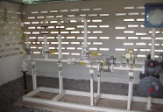
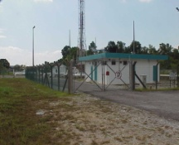
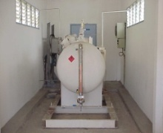
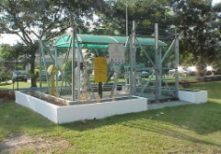
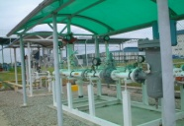


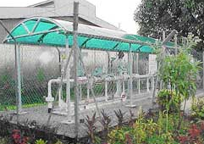
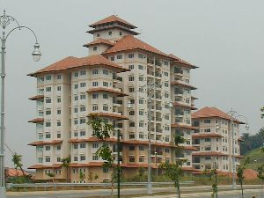
NATURAL GAS SUPPLY CONCEPT
M
Internal Piping
Equipment
> 20 psig
Appliances
Service
Station
COGENERATION
INDUSTRIAL /
1000 psig
M
Internal Piping
Equipment
20 psig
Appliances
Service
Station
Odoriser
Distribution Line
Low Pressure
Line
City Gate
Station
(35 ~ 50 psig)
M
300 mm H₂O
RESIDENTIAL
PGU
Area
0.43 psig
Feeder Line
Station
(150~260 psig)
District
Station
M
Internal Piping
4.3 psig
M
Regulating
3000 mm H₂O
M
Station
Multiple End User
COMMERCIAL
M
=
METER
M
Internal Piping
PGU - Peninsular Gas Utilisation
4.3 psig
Service
3000 mmH
2
O
Single Development
Station
i.e. Hospital/Hotel

Slide 6
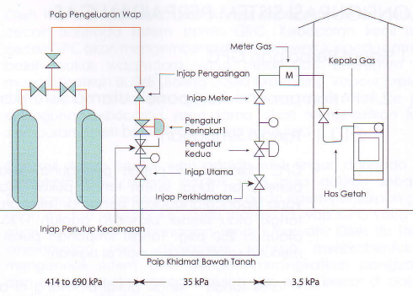

GPC - Gas Piping and Control
~ 60-100 psig ~ 5 psig ~ 0.5 psig

Slide 7
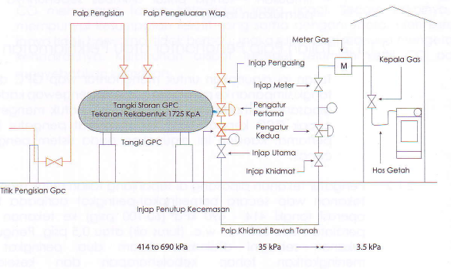

~ 60-100 psig ~ 5 psig ~ 0.5 psig

Slide 8
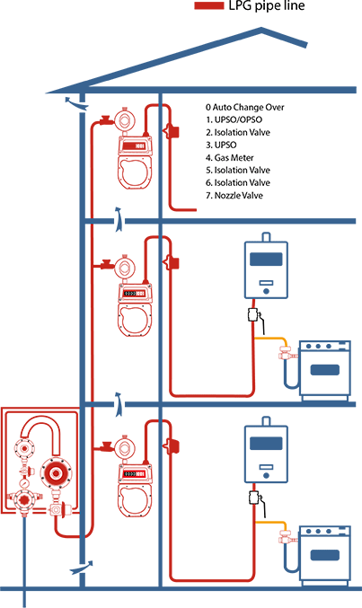
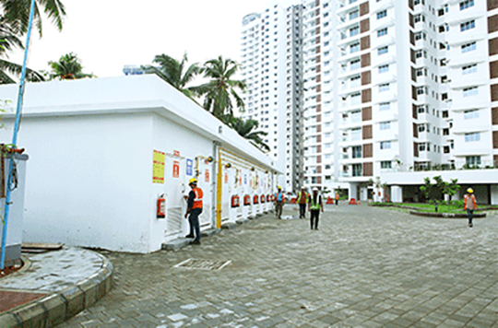

Slide 9
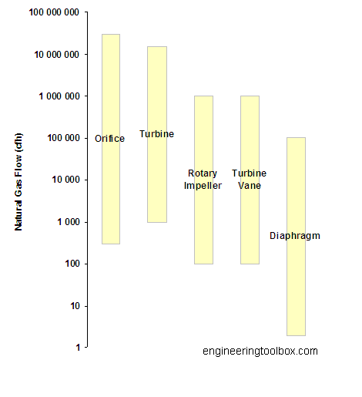
Metering capacities of typical natural gas meters
Low to moderate (up to ~ 100 psi) pressure gas appliance

Slide 11
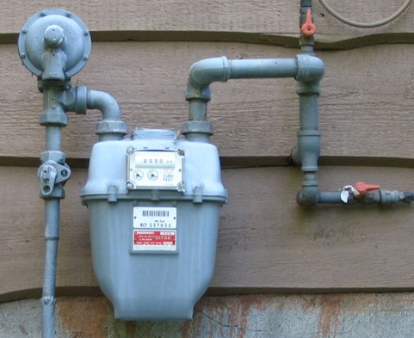
DIAPHRAGM GAS METER
Service
regulator
Main shut
off valve
Gas
meter
Isolation
valve
A diaphragm meter is a positive displacement instrument which is used to measure the volume of gas that passes through it. This is accomplished through the known volume that is displaced for each stroke of the diaphragm.

Slide 12
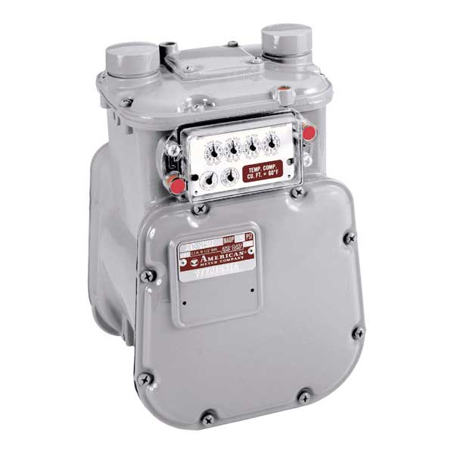

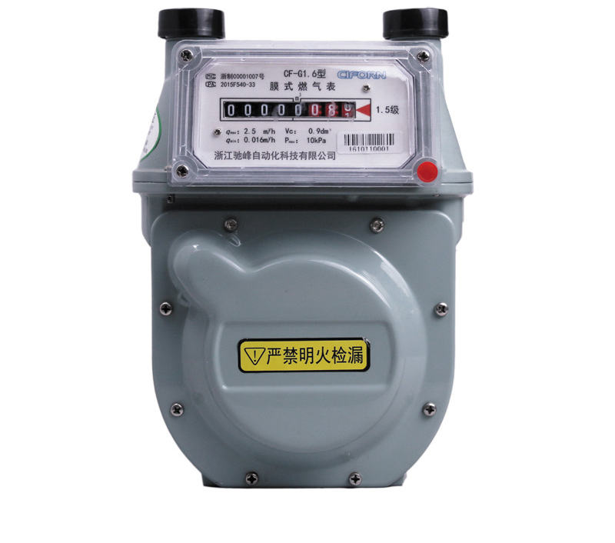
Analog display meter Digital display meter

Slide 13
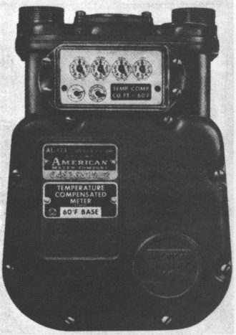
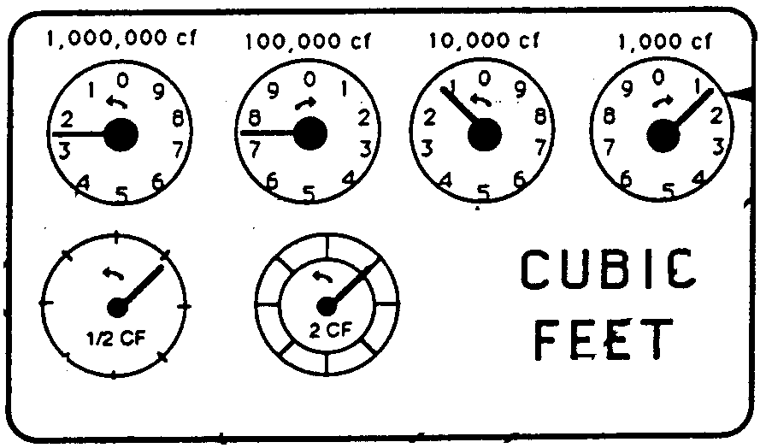
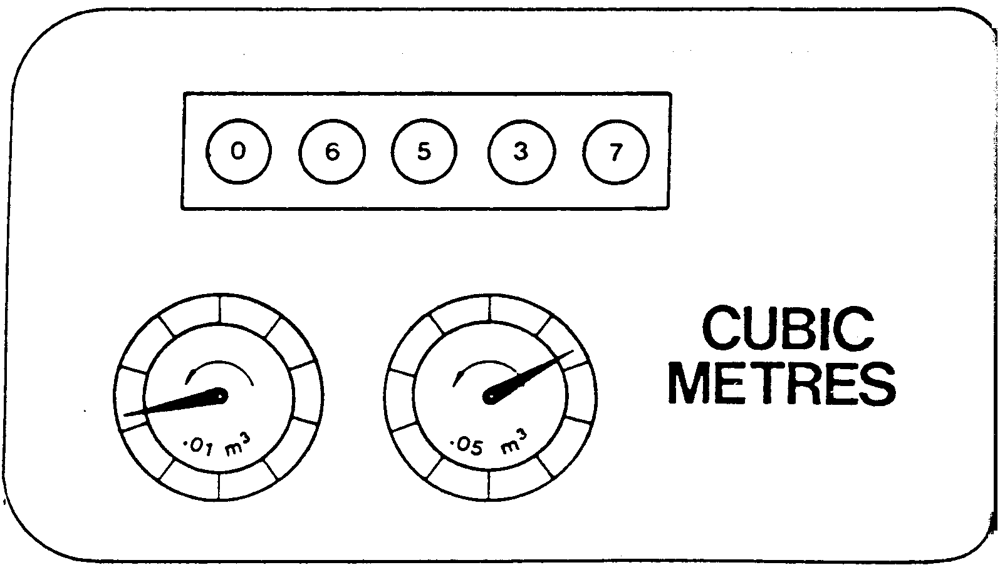
METER CLOCKING
  Gas meter clocking is a simple method of measuring the volumetric flowrate of gas flowing into the gas appliance
  It determines the total amount of energy input (i.e. burner input or loading) supplied to the gas appliance
Test dial
Test dial

Slide 14
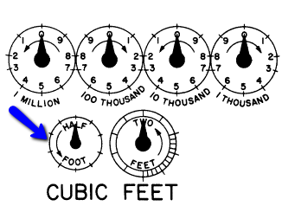
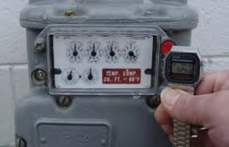
  The method measures the time (seconds) taken for the gas meter’s smallest scale known as ‘test dial’ to complete one revolution on the dial
Consumption dial
Test dial

Slide 15
  The measured volumetric flowrate of the gas can be estimated by the following expression;
  where
  V = volumetric flowrate (ft³h, m³/h)
  3600 = number of seconds per hour
  t = number of seconds for test dial to complete one revolution
  D = ‘test dial’ size (e.g. 0.5 cfh, or 0.05 m³)

Slide 16
Meter Clocking - example
    Estimate appliance input rate of natural gas (35 MJ/m³) firing from gas meter clocking using ‘test dial’ 0.05 m³ which recorded 40 seconds on a stopwatch for one complete revolution
    = 4.5 m³ / h
    Burner input = (4.5 m³/h) (35 MJ/m³) (1000 kJ/MJ)(h/3600s)
    = 43.75 kJ/s (kW)

Slide 17

GAS UTILISATION EQUIPMENT
(Burner)
A device to burn fuels under control to produce useful heat
Functions of a burner
  Deliver fuel and air to combustion chamber
  Mix fuel and air
  Provide continuous and stable ignition of air/fuel mixture

Slide 18
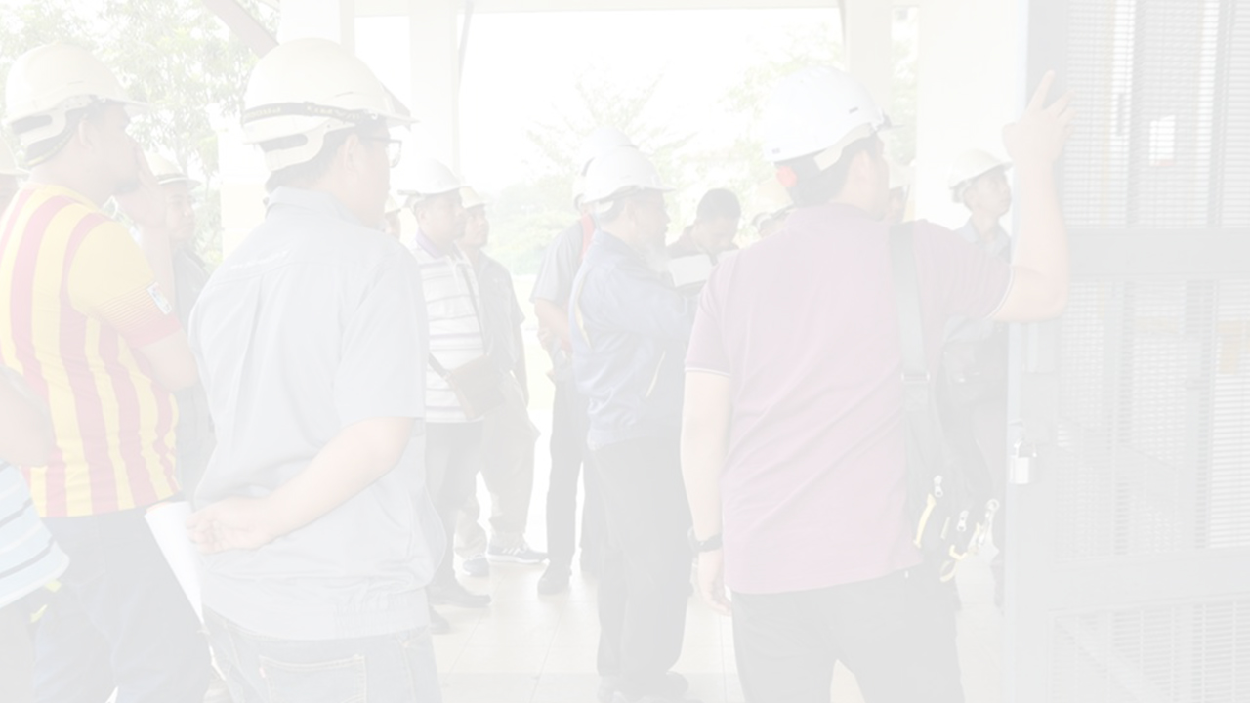
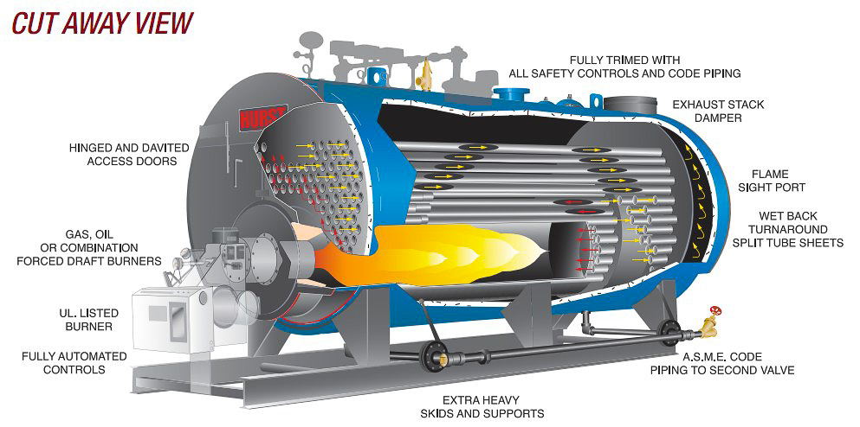

Boiler

Slide 19
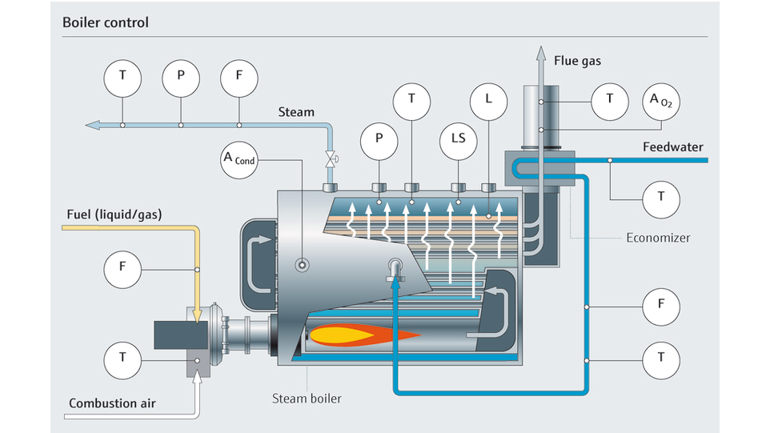
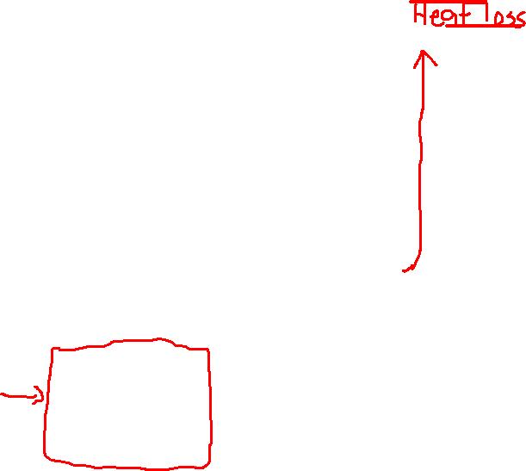
Boiler Control

Slide 20

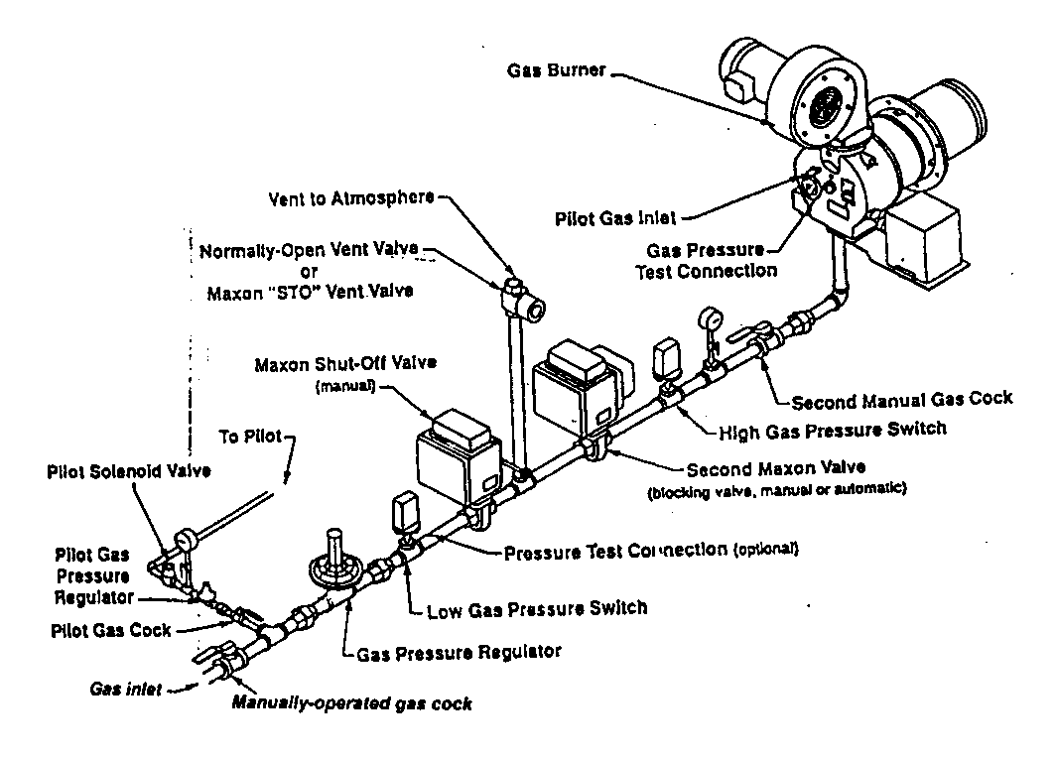
BURNER SYSTEM
gas supply valve train burner system

Slide 21
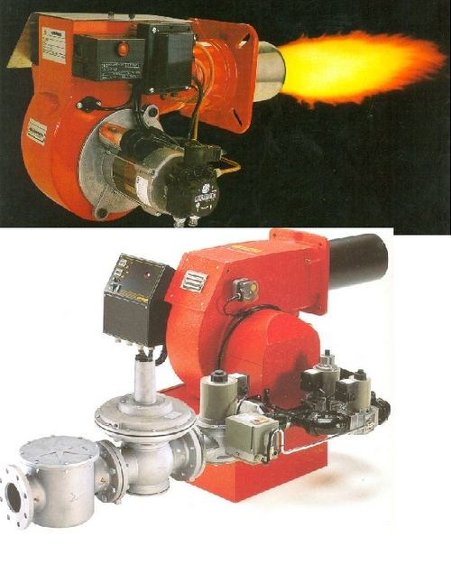
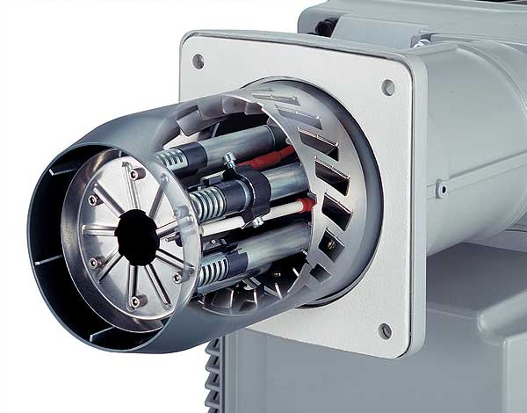
BURNER HEAD
VALVE TRAIN

Slide 22
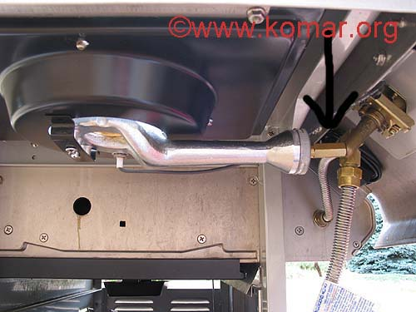
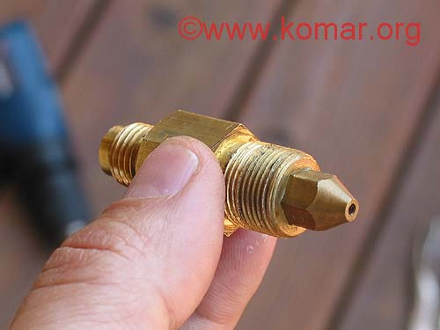
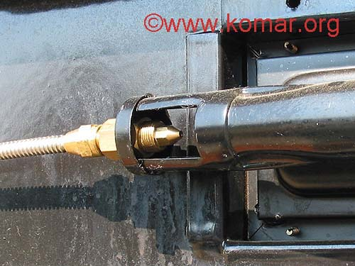

ATMOSPHERIC (LOW PRESSURE) BURNER
nozzle
/orifice

Slide 23
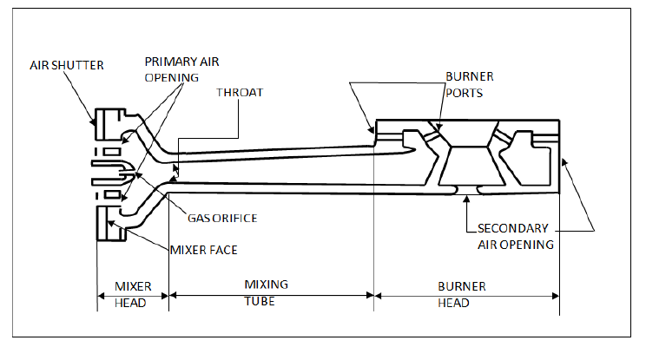

COMPONENTS OF ATMOSPHERIC (LOW PRESSURE) BURNER

Slide 24
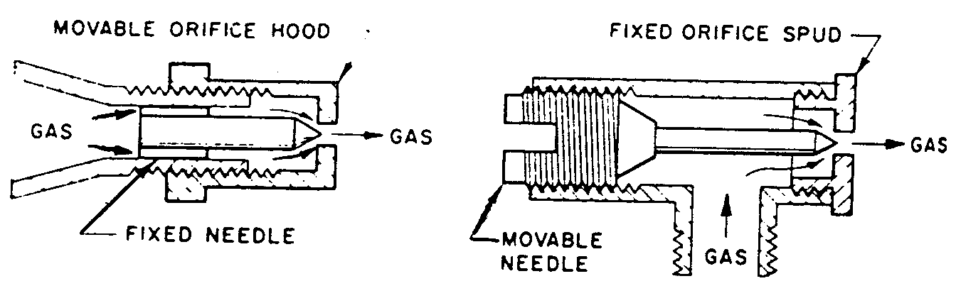
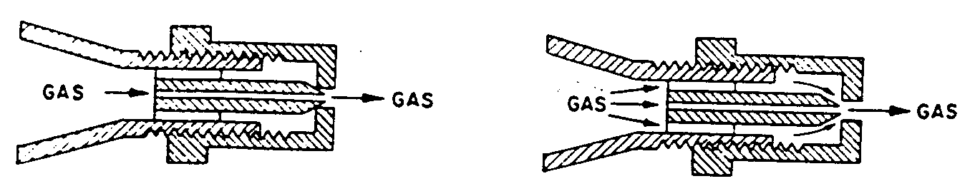
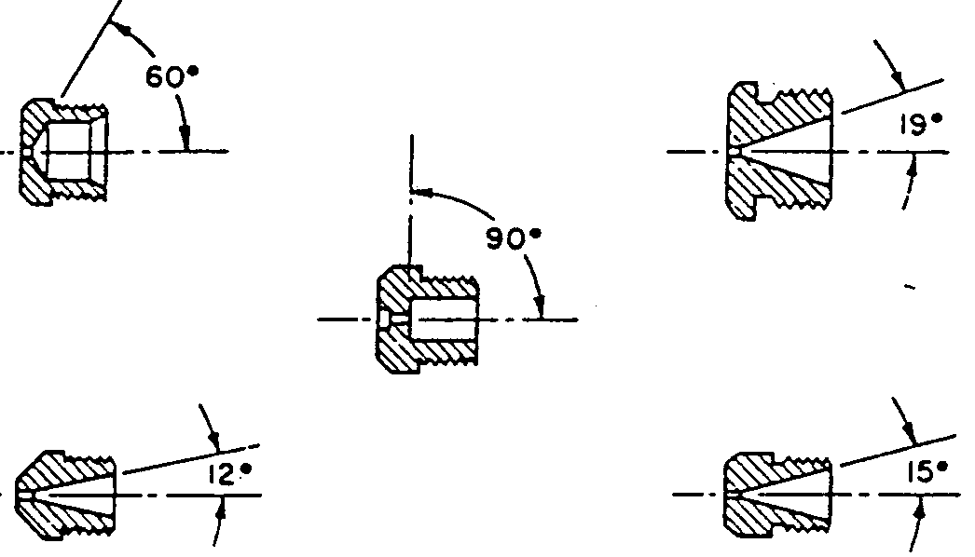
Gas Burner Orifice
An orifice is an opening used to control the direction and amount of gas that is discharged to a burner
Universal/Cap orifice
Fixed orifice
Adjustable orifice

Slide 25
GASEOUS FUEL INTERCHANGEABILITY
Gas Interchangeability - The ability to substitute one gaseous fuel for another in a combustion application without materially changing the operational performance of the application (its safety, efficiency or emissions)
ISO Definition of Natural Gas Interchangeability:
A measure of the degree to which the combustion characteristics of one gas resemble those of another gas.
Two gases are said to be interchangeable when one gas may be substituted for the other without affecting the operation of gas burning appliances or equipment.

Slide 26
The needs for interchangeability of fuel
  Fuel supply shortage (e.g. LPG vs NG)
  Fuel price fluctuations
  Environmental concerns (e.g. Combustion of LPG vs NG)
Main factors influencing decision
  Infrastructure (pipeline location)
  Intensive vs non-intensive energy consumption

Slide 27
General considerations
  Equal heat input
    Heat input of natural gas = heat input of fuel being replaced (e.g. LPG)
  Heat release pattern
    Temperature distribution
    Flame shape / luminosity / radiation intensity
  Combustion or flame stability
    Flame speed & flammability limit
  Combustion air requirement
    Air supply devices such as blower, fan, compressor etc
  Handling capability
    Flue gas venting
    Burner types
    Piping, valves & controls (size and operating range)

Slide 28
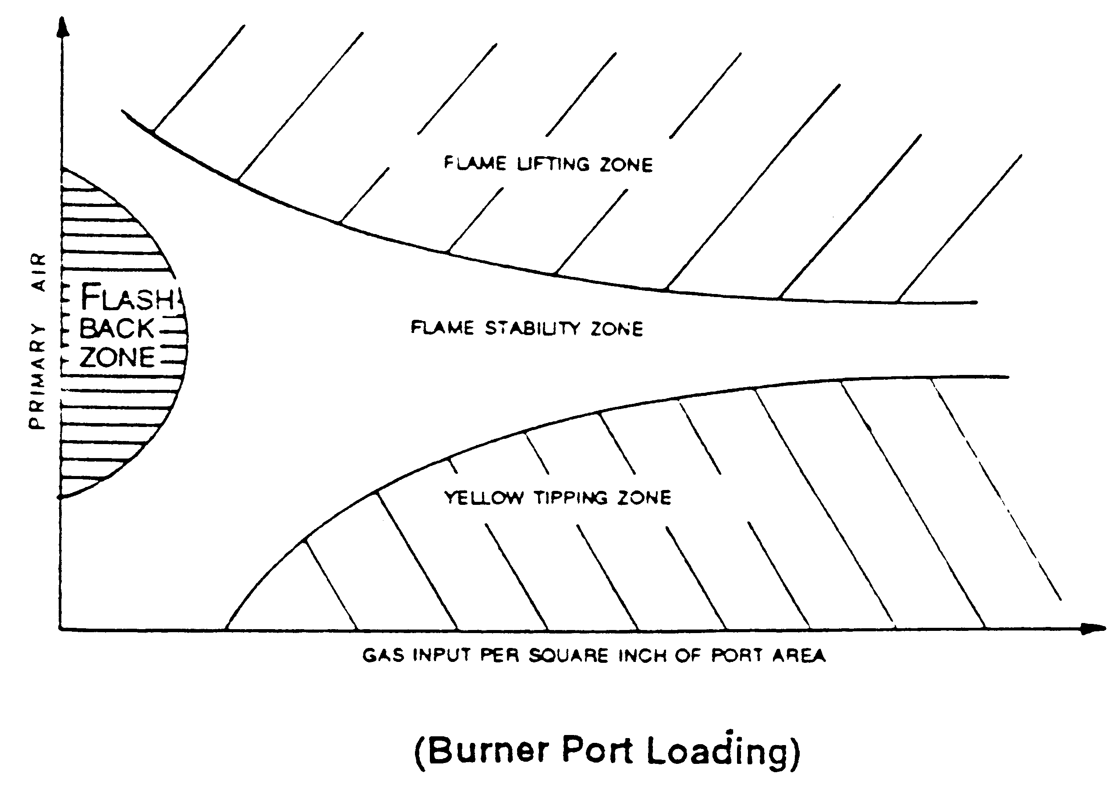
Flame Stability Diagram

Slide 29
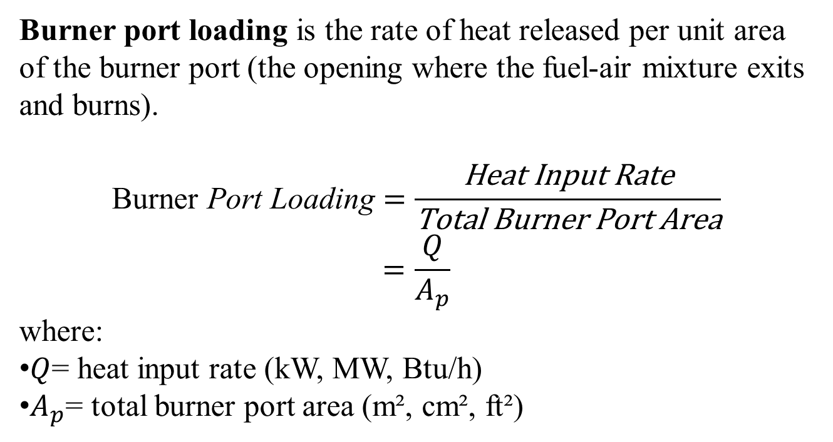
Burner port loading
Burner port loading is the rate of heat released per unit area of the burner port (the opening where the fuel-air mixture exits and burns).
$$\text{Burner} \text{Port} \text{Loading}=\frac{\text{Heat} \text{Input} \text{Rate}}{\text{Total} \text{Burner} \text{Port} \text{Area}}$$
$$=\frac{Q}{A_{p}}$$
where:
$Q$= heat input rate (kW, MW, Btu/h)
$A_{p}$= total burner port area (m², cm², ft²)

Slide 30
Burner port loading
It indicates how intensely the burner operates.
Low port loading
  Stable flame
  Lower flame speed
  Less risk of flame lift-off
  Larger burner required
High port loading
  More compact burner
  Higher gas exit velocity
  Risk of flame lift-off or blow-off if too high
  May increase noise and emissions
Burner port loading is commonly used to:
  Size gas burners
  Compare burner designs
  Ensure flame stability
  Prevent flashback and blow-off
  Design industrial furnaces, boilers, and combustors

Slide 31
Burner port loading
The Stability Spectrum
Too High (Overloading / Lift-off): If the port loading is too high, the mixture exit velocity will far exceed the flame burning velocity. The flame will detach from the burner ports, "lift off," and become unstable. In severe cases, this causes the flame to blow out completely, risking the accumulation of unburned fuel.
Too Low (Underloading / Flashback): If the port loading is too low, the exit velocity drops below the flame burning velocity. The flame front will travel backward into the burner body. This is known as flashback. It can overheat the burner head, cause structural damage, and create a serious safety hazard.
The Sweet Spot (Stable Flame): Proper port loading ensures that the mixture velocity and the burning velocity balance out perfectly at the port exit, anchoring a crisp, stable flame.

Slide 32
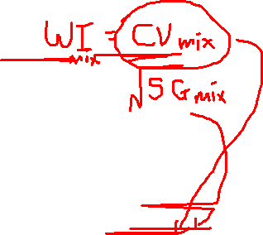
WHAT ARE THE PARAMETERS GOVERNING FUEL INTERCHANGEABILITY?
“Are fuel with the same calorific/heating value all interchangeable?”
The answer is: “not necessarily”.
Fuel interchangeability relates to more than just a parameter for calorific/ heating value. It is governed by fuel quality, a function of fuel composition.
Other factors that affect the interchangeability of a fuel include its specific gravity, combustion indices (Wobbe Index) , etc.

Slide 33
Example 1 (Self study)
Component | Fuel mixture 1 | Fuel mixture 2
CH₄ | 59.25 mol% | 40 mol%
H₂ |  | 60 mo%
N₂ | 40.75 mol%
Gross Heating Value (kcal/m³) | ? | ?
Specific Gravity | ? | ?
Wobbe Index (kcal/m³) | ? | ?
Compare the fuel properties of the above fuel mixture.
What conclusion can you deduce?

Slide 34


Slide 35
Mixture 1 (primarily CH₄ and N₂):
Moderate heating value, relatively higher specific gravity.
Lower Wobbe index, indicating moderate energy density per unit flow.
Mixture 2 (CH₄ and predominantly H₂):
Slightly lower heating value, significantly lower specific gravity (lighter gas).
Higher Wobbe index, indicating higher energy delivery per unit of volume flow due to low molecular weight.

Slide 36
Example 2 (Self study)
Component | Fuel mixture 1 | Fuel mixture 2
CH₄ |  | 92.98 mol%
H₂ | 100 mol%
N₂ |  | 7.02 mol %
Gross Heating Value (kcal/m³) | ? | ?
Specific Gravity | ? | ?
Wobbe Index (kcal/m³) | ? | ?
Compare the fuel properties of the above fuel mixture.
What conclusion can you deduce?

Slide 38

Important fuel properties
  Components of gaseous fuel
  Relative Density (Specific gravity)
  Calorific or heating value
  Wobbe Index
  Ignition temperature
  Flammability Limit

Slide 39

Wobbe Index (WI)
The three important variables affecting the performance of burner system are ;
    the size of the orifice
    the pressure across it (or the supply pressure if the combustion zone is at ambient pressure)
    and the calorific value of the fuel, which determines the heat release rate.
  Wobbe Index, which defines the rate of combustion energy generation, is the most accepted parameter for interchangeability ; an indicator of the inter-changeability of fuel gases

Slide 40
    For a given pressure of fuel gas at the burner, the flow rate (V) is proportional to the calorific value (CV) and inversely proportional to the square root of the specific gravity of the gas (SG).
  The usefulness of the Wobbe Index is that for any given pressure and orifice, all gas mixtures that have the same Wobbe Index will deliver the same amount of heat.

Slide 41

    Wobbe Index of gas mixture
  .

Slide 42
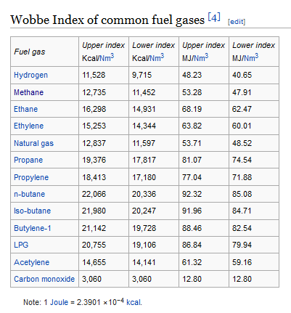


Slide 43
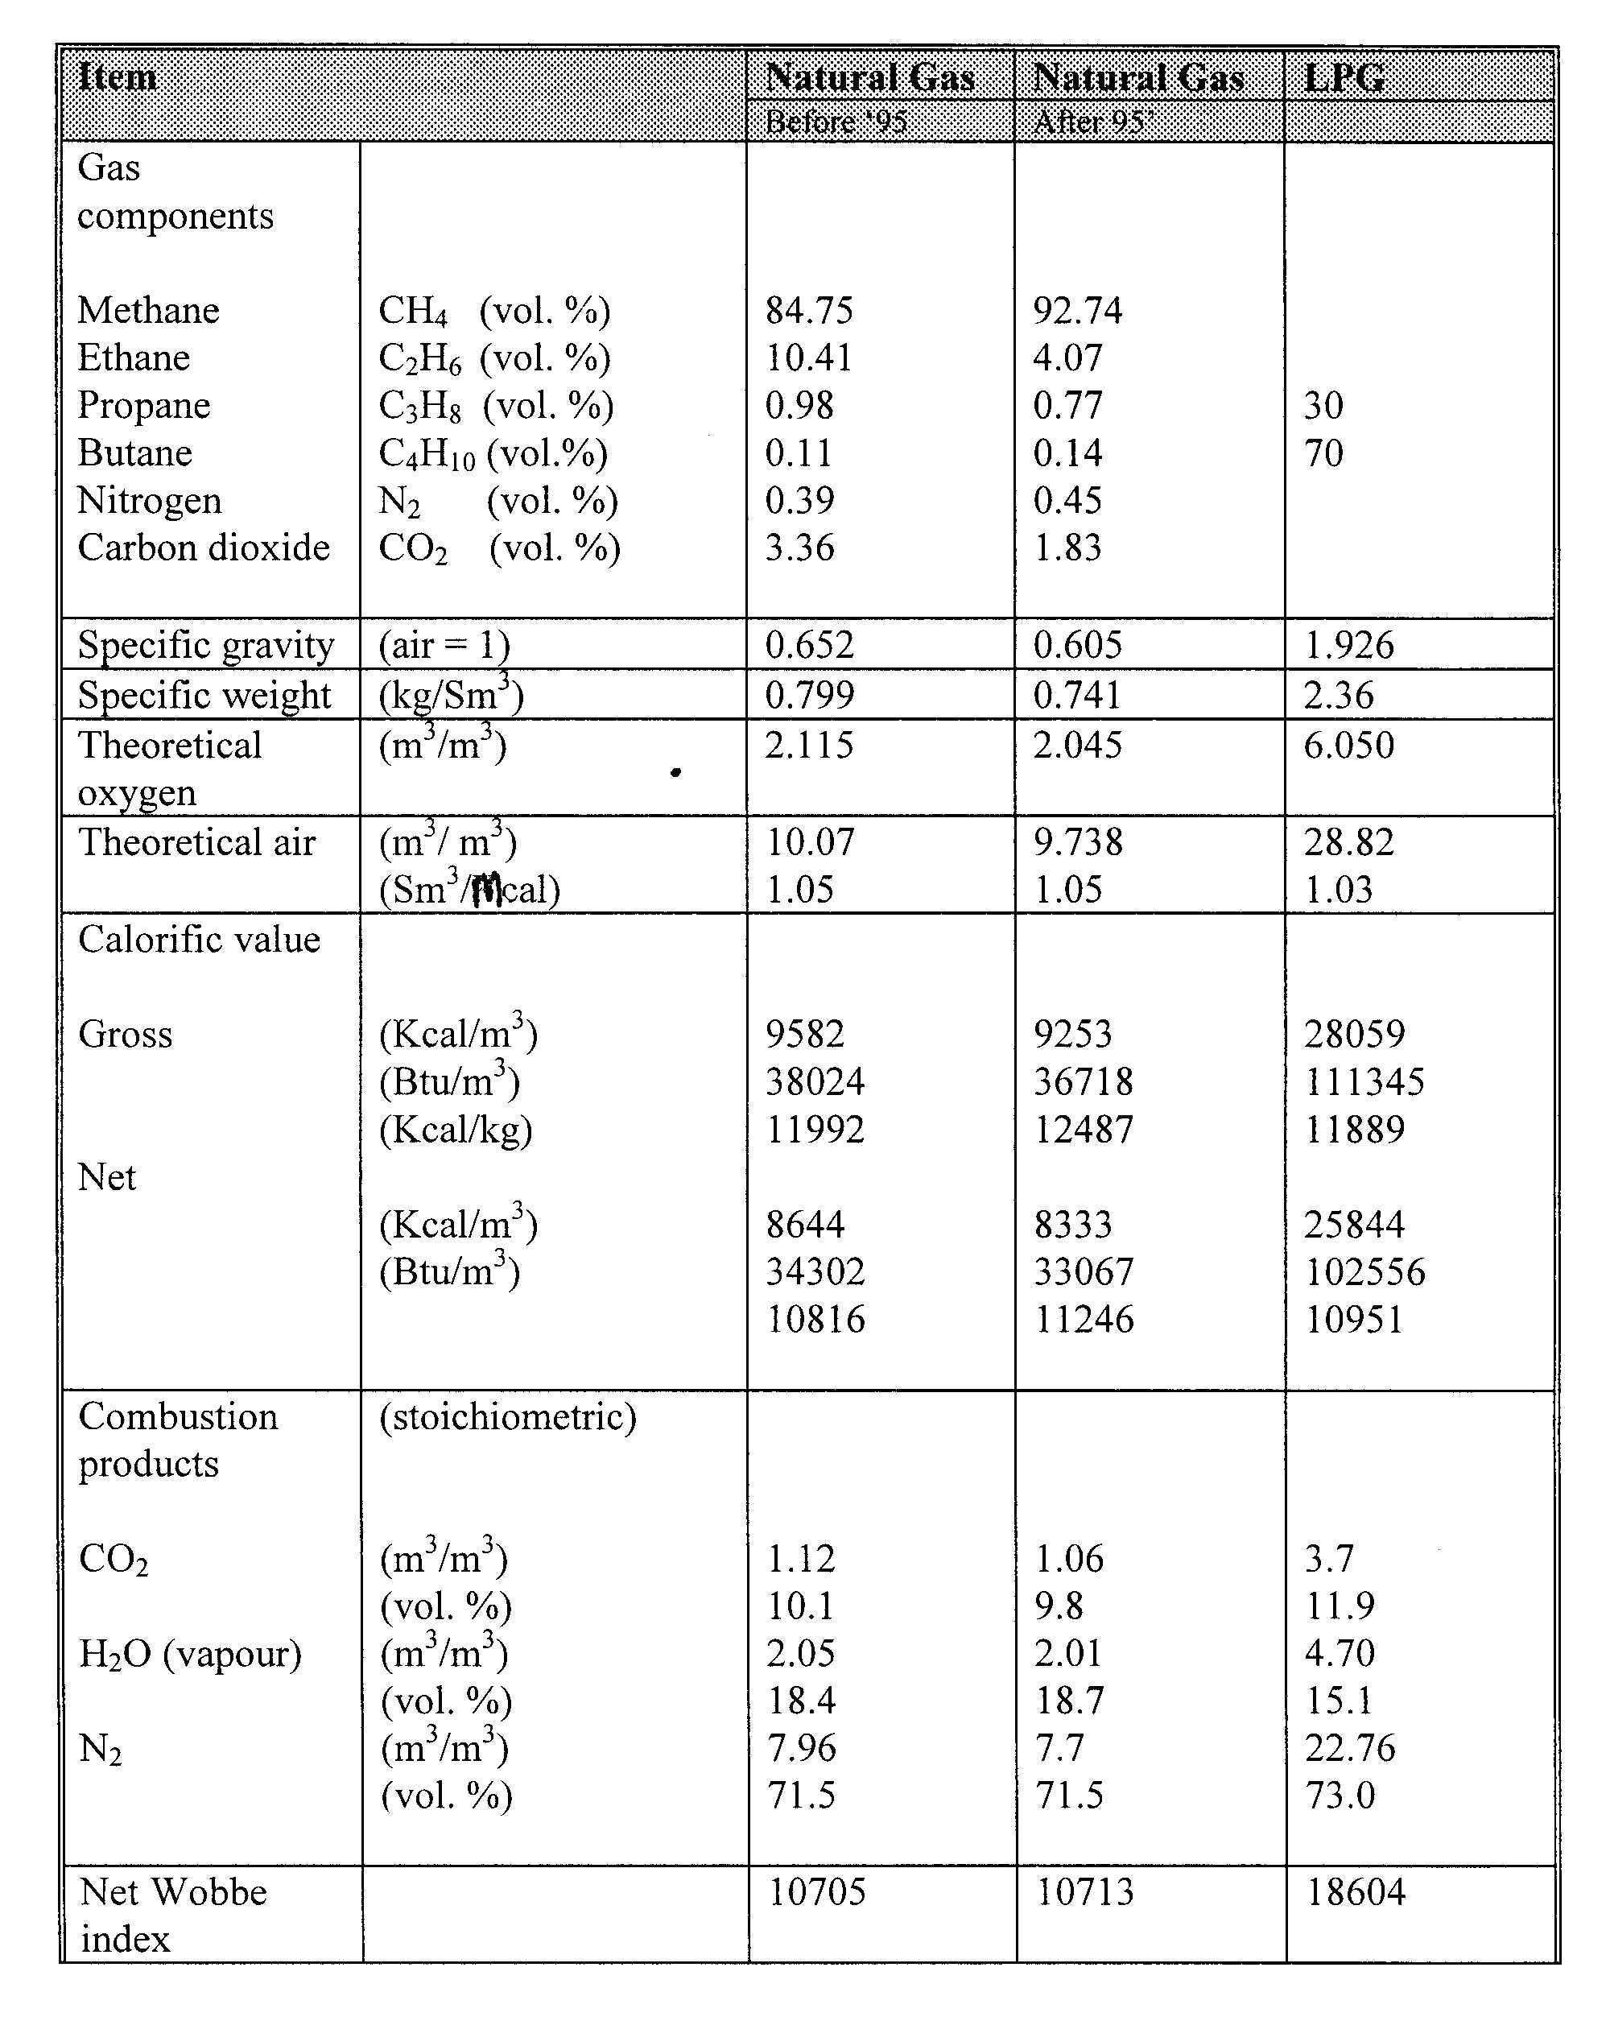

Comparison of LPG and NG combustion properties

Slide 44
CONVERSION OF OTHER FUELS TO NATURAL GAS
  Conversion from other gaseous fuels
      Can be often quite simple, depending on the type of burner and the characteristics of other fuel
      In general, if two gases have the same Wobbe index, then they can be interchanged with no significant physical changes to burner
      Problems such as air requirements, combustion stability often encountered
  Conversion from solid or liquid fuels
      In most cases require a completely new burner

Slide 45
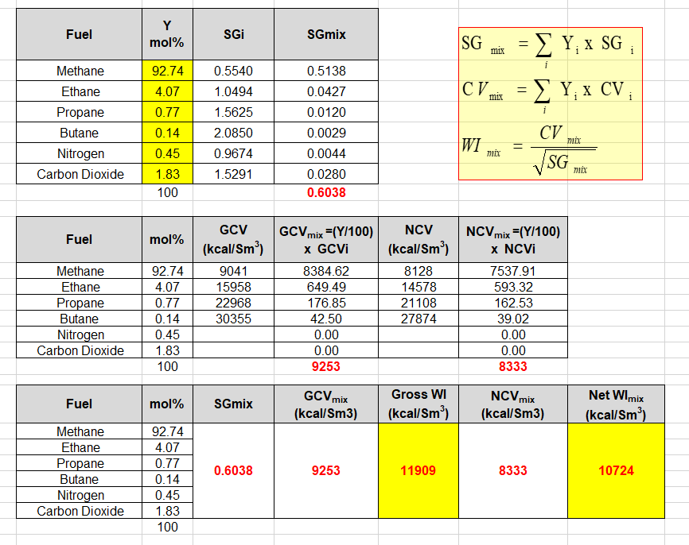
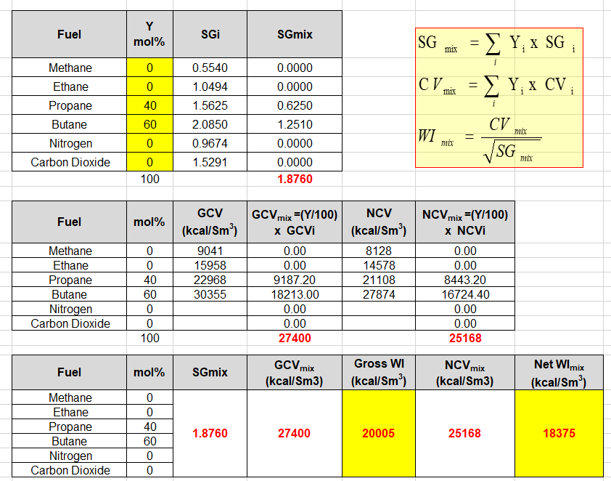
NATURAL GAS
LPG
Notes:
Burner conversion – Slides 69-98

Slide 46
General Guideline for Interchangeability
(Wobbe Index Matching):
±5% difference in Wobbe Index → Typically acceptable for safe and efficient burner operation without modifications.
±4% or tighter → Preferred for sensitive or high-efficiency appliances, e.g., low-NOx burners, premix systems.
> ±5% → Usually not interchangeable without retuning, as it may:
  Affect flame stability
  Cause incomplete combustion (CO emissions)
  Overheat or underfire the burner
Wobbe Index Difference | Interchangeability
≤ ±4% | Excellent – fully interchangeable
±5% | Acceptable in many systems
> ±5% | Caution – retuning or redesign needed

Slide 47
International Examples:
European Standard (EN 437):
  Defines gas families (H, L, etc.) and considers gases interchangeable within the same family if their WI is within certain bands (~±5%).
U.S. Gas Industry Practice:
  Often uses the A.G.A. Interchangeability Criteria, which includes:
    Wobbe Index ±4–5%
    Flame lifting index, yellow tipping, etc., for more sensitive checks.

Slide 48

NATURAL GAS BURNER CONVERSION
- e.g. LPG to NG -
Conversion requirements
  Same energy input
  Same or acceptable air/fuel ratio
  Same or better productivity or production quality
P₁
P₂
V
ρ
Combustion
chamber
fuel
d
nozzle
ΔP = P₁-P₂

Slide 49
Basic flow and energy equations
  Flow equation
  where
  V = volumetric gas flow rate
  d = nozzle diameter
  P = gas pressure
  SG = Specific gravity
  k = constant
  ΔP = pressure drop across the nozzle

Slide 50

  Energy equation
  where
  Q = heat input
  CV_{fuel} = gas calorific or heating value
Requirement 1 : same energy input, i.e. Q_{NG} = Q_{LPG}

Slide 51

  ….rearranging equation (5)
  WI is Wobbe number or Wobbe Index, an indication of interchangeability of fuel gas.
  Gaseous fuel having the same WI can be interchanged with no significant physical changes to the burner

Slide 52

  …… Interchangeability correlation
  equation (7) shows that if the WI of the substitutes gas (i.e. NG) is different from that of the replaced gas (i.e. LPG), it can be successfully interchanged by two ways
  - orifice nozzle replacement or modification
  - gas pressure adjustment
Gas orifice diameter
(burner design parameter)
Gas pressure
(burner operation parameter)
Wobbe Index
(Fuel properties : CV & SG )
depend on fuel composition

Slide 53

  Method 1 : Nozzle replacement or modification
    Keeping the pressure drop term constant and rearranging equation (7)
  Method 2 : Gas pressure adjustment
    Keeping the nozzle or orifice diameter term constant and rearranging equation (7)

Slide 54
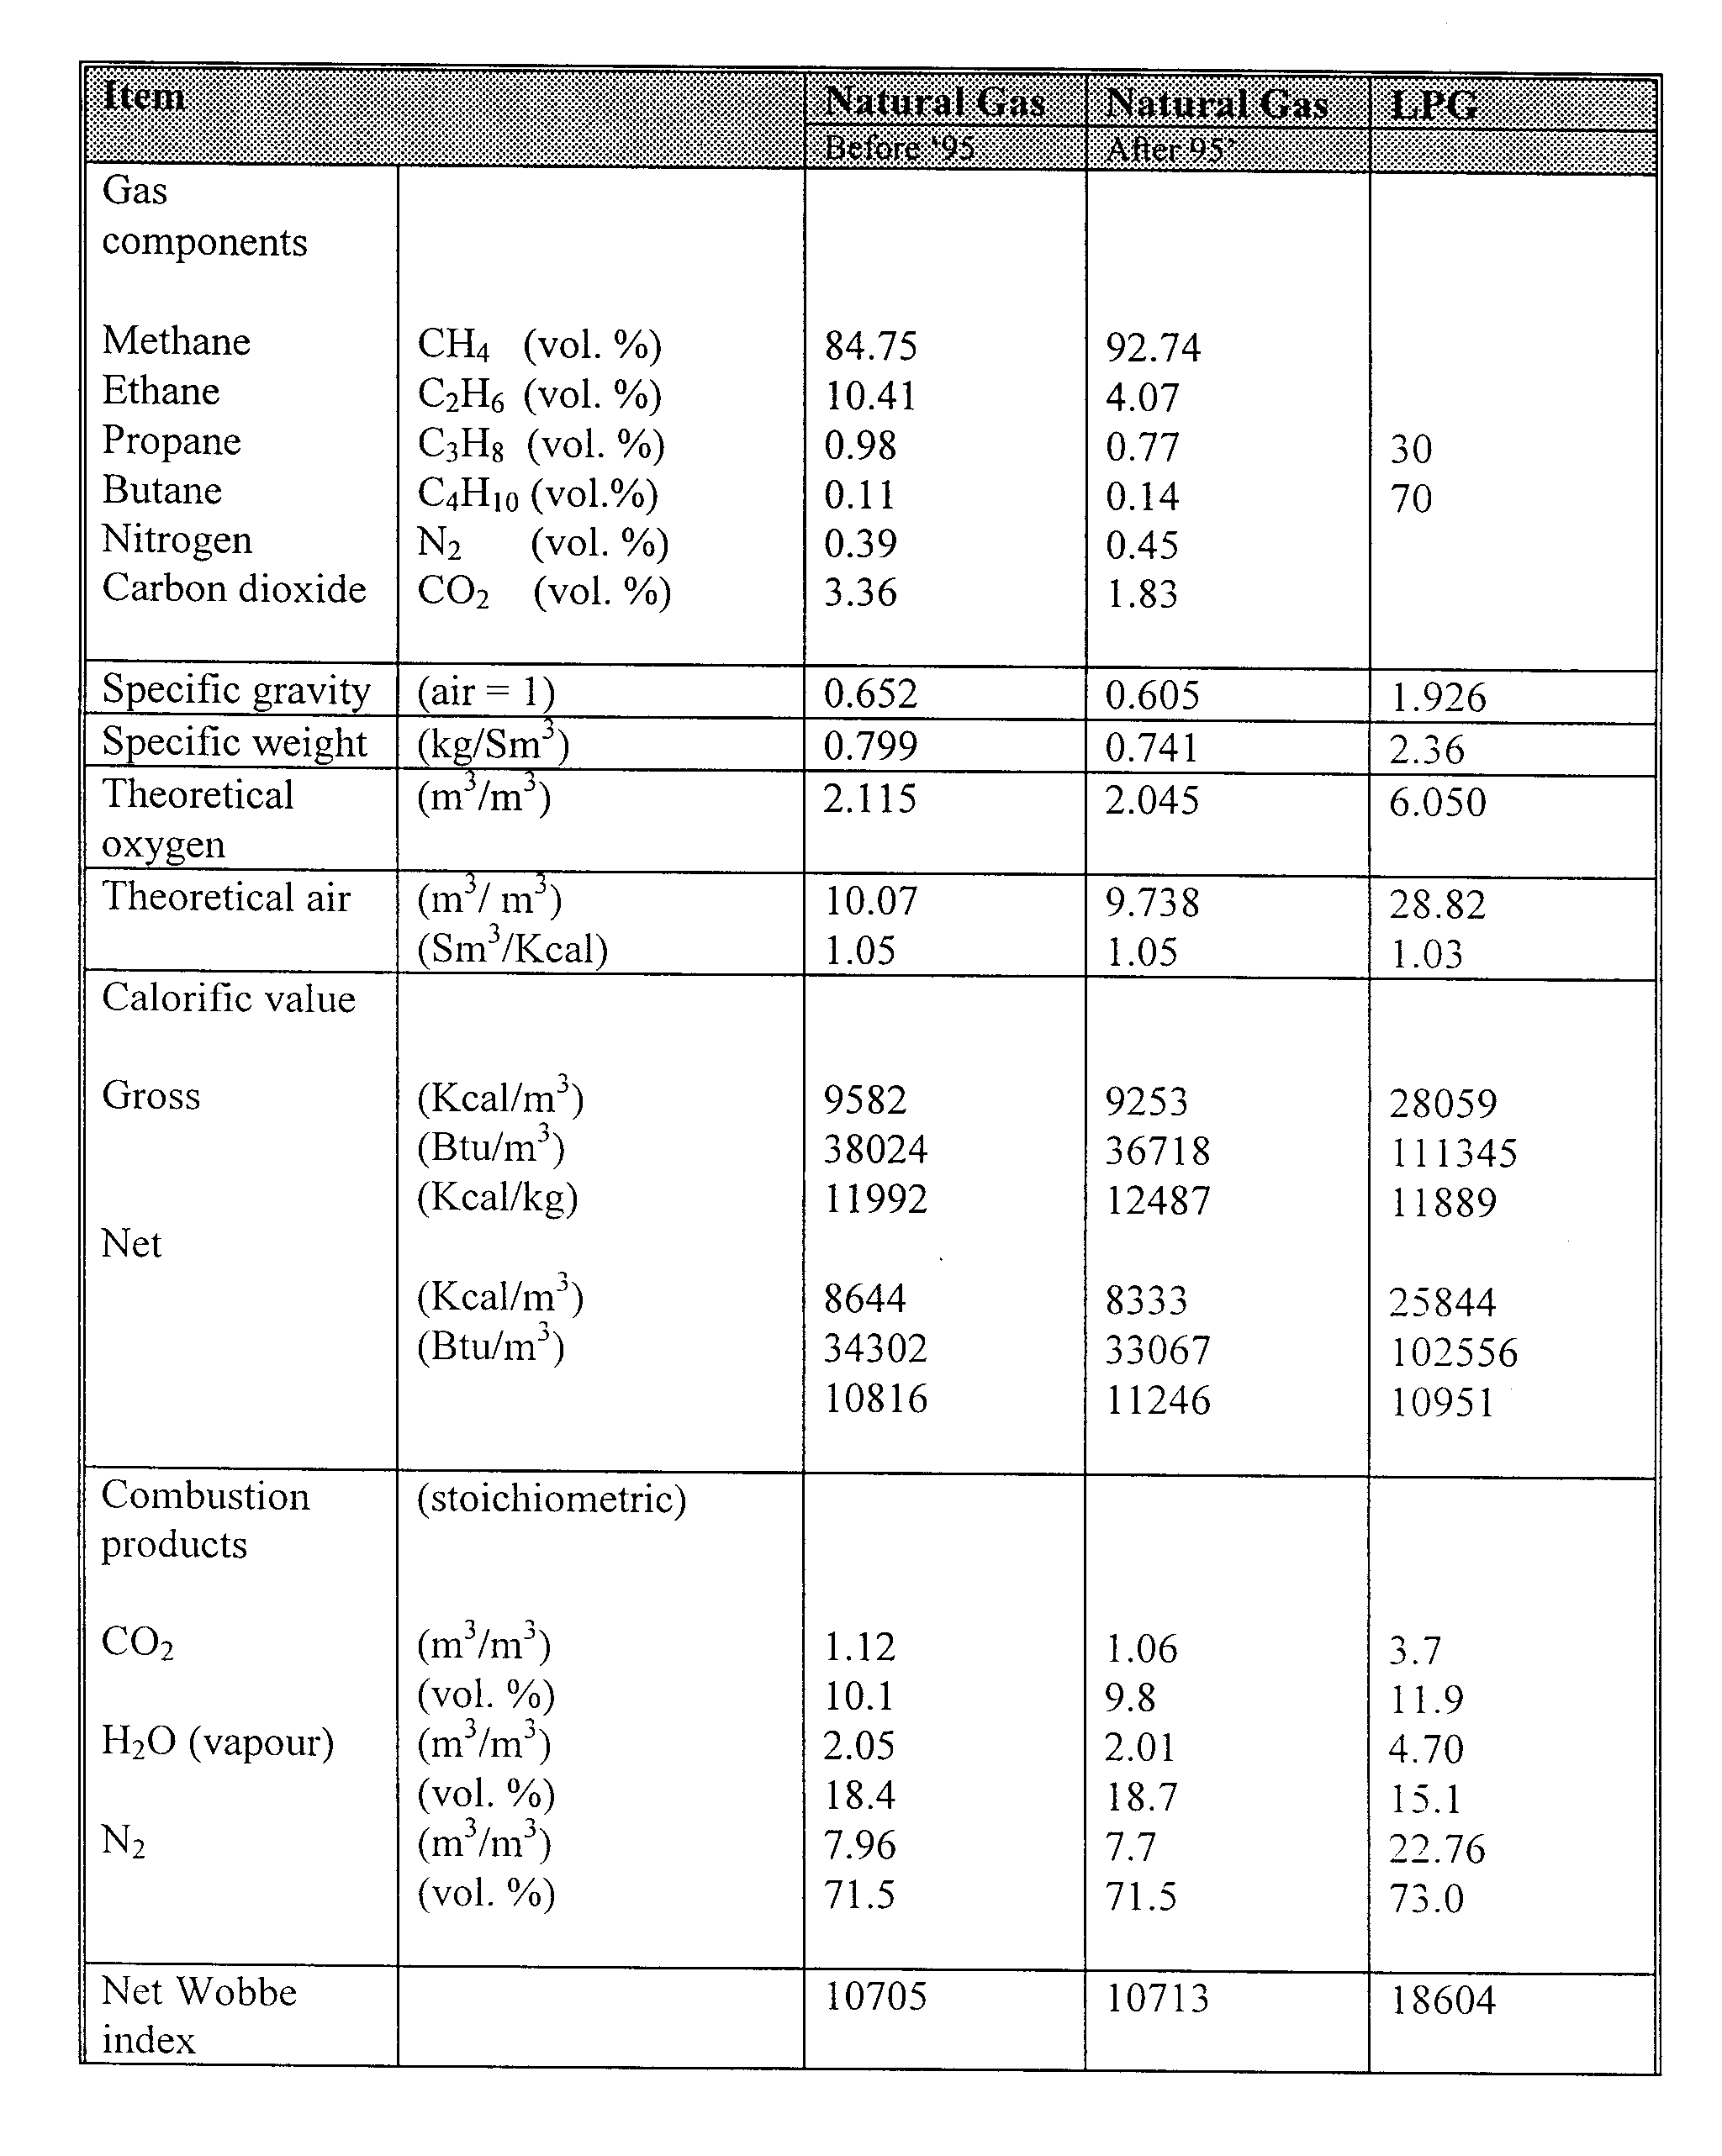

Exercise (Burner conversion analysis)
Compare the conversion requirements of LPG firing appliance to natural gas (after ‘95) with fuel composition as shown above and deduce conclusions with respect to
    Gas volume
    Gas supply pressure
    Nozzle or orifice diameter

Slide 55
Burner conversion analysis
To maintain the same heat input, the volumetric flow rate of natural gas should be approximately ______ times of that LPG.
The volumetric flow rate of natural gas is approximately _____ times of that LPG if neither nozzle modification nor pressure adjustment is made.
If the gas pressure adjustment method is to be adopted, the gas supply pressure of natural gas should be approximately _______ times of that LPG.
If the nozzle modification adjustment method is to be adopted, the nozzle diameter of natural gas should be approximately _______ times of that LPG.
The energy supplied by natural gas is approximately _________ % of the actual energy requirement (as supplied by LPG ) if neither nozzle modification nor pressure adjustment is made.

Slide 56

IMPORTANT GAS BURNER CONVERSION FORMULA
GAS VOLUMETRIC RATIO FOR SAME HEAT INPUT
GAS VOLUMETRIC RATIO
(WITHOUT GAS PRESSURE ADJUSTMENT AND NOZZLE MODIFICATION)
FUEL PROPERTIES
GAS PRESSURE ADJUSTMENT
GAS VOLUMETRIC RATIO WITHOUT GAS PRESSURE ADJUSTMENT AND NOZZLE MODIFICATION TO THAT OF SAME HEAT INPUT
NOZZLE MODIFICATION
Notes:
Burner conversion – Slides 69-98

Slide 57
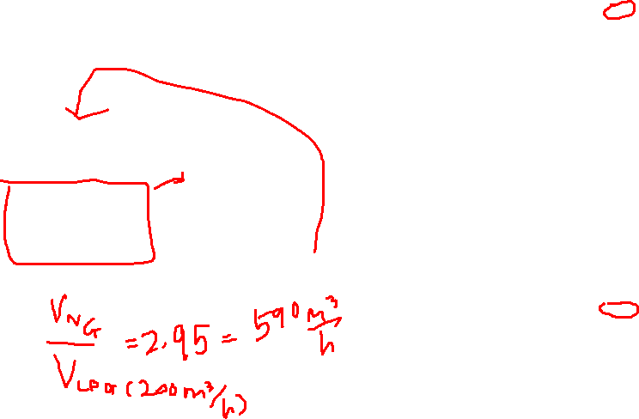
Burner conversion analysis
To maintain the same heat input, the volumetric flow rate of natural gas should be approximately ______ times of that LPG.

Slide 58
Burner conversion analysis
The volumetric flow rate of natural gas is approximately _____ times of that LPG if neither nozzle modification nor pressure adjustment is made.

Slide 59

Burner conversion analysis
If the gas pressure adjustment method is to be adopted, the gas supply pressure of natural gas should be approximately _______ times of that LPG.

Slide 60

Burner conversion analysis
If the nozzle modification adjustment method is to be adopted, the nozzle diameter of natural gas should be approximately _______ times of that LPG.

Slide 61

Burner conversion analysis
The energy supplied by natural gas is approximately _________ % of the actual energy requirement (as supplied by LPG ) if neither nozzle modification nor pressure adjustment is made.

Slide 63
  Requirement 2 : same air-fuel ratio
  After the energy input adjustment is successfully achieved, the combustion air should be adjusted to get a proper air-fuel ratio, and hence temperature profile
  This can be calculated from the energy based theoretical air (TA ) requirement, defined as a ratio of combustion air supplied (Sm³) to heat generated (kcal, kW, BTU etc.)

Slide 64
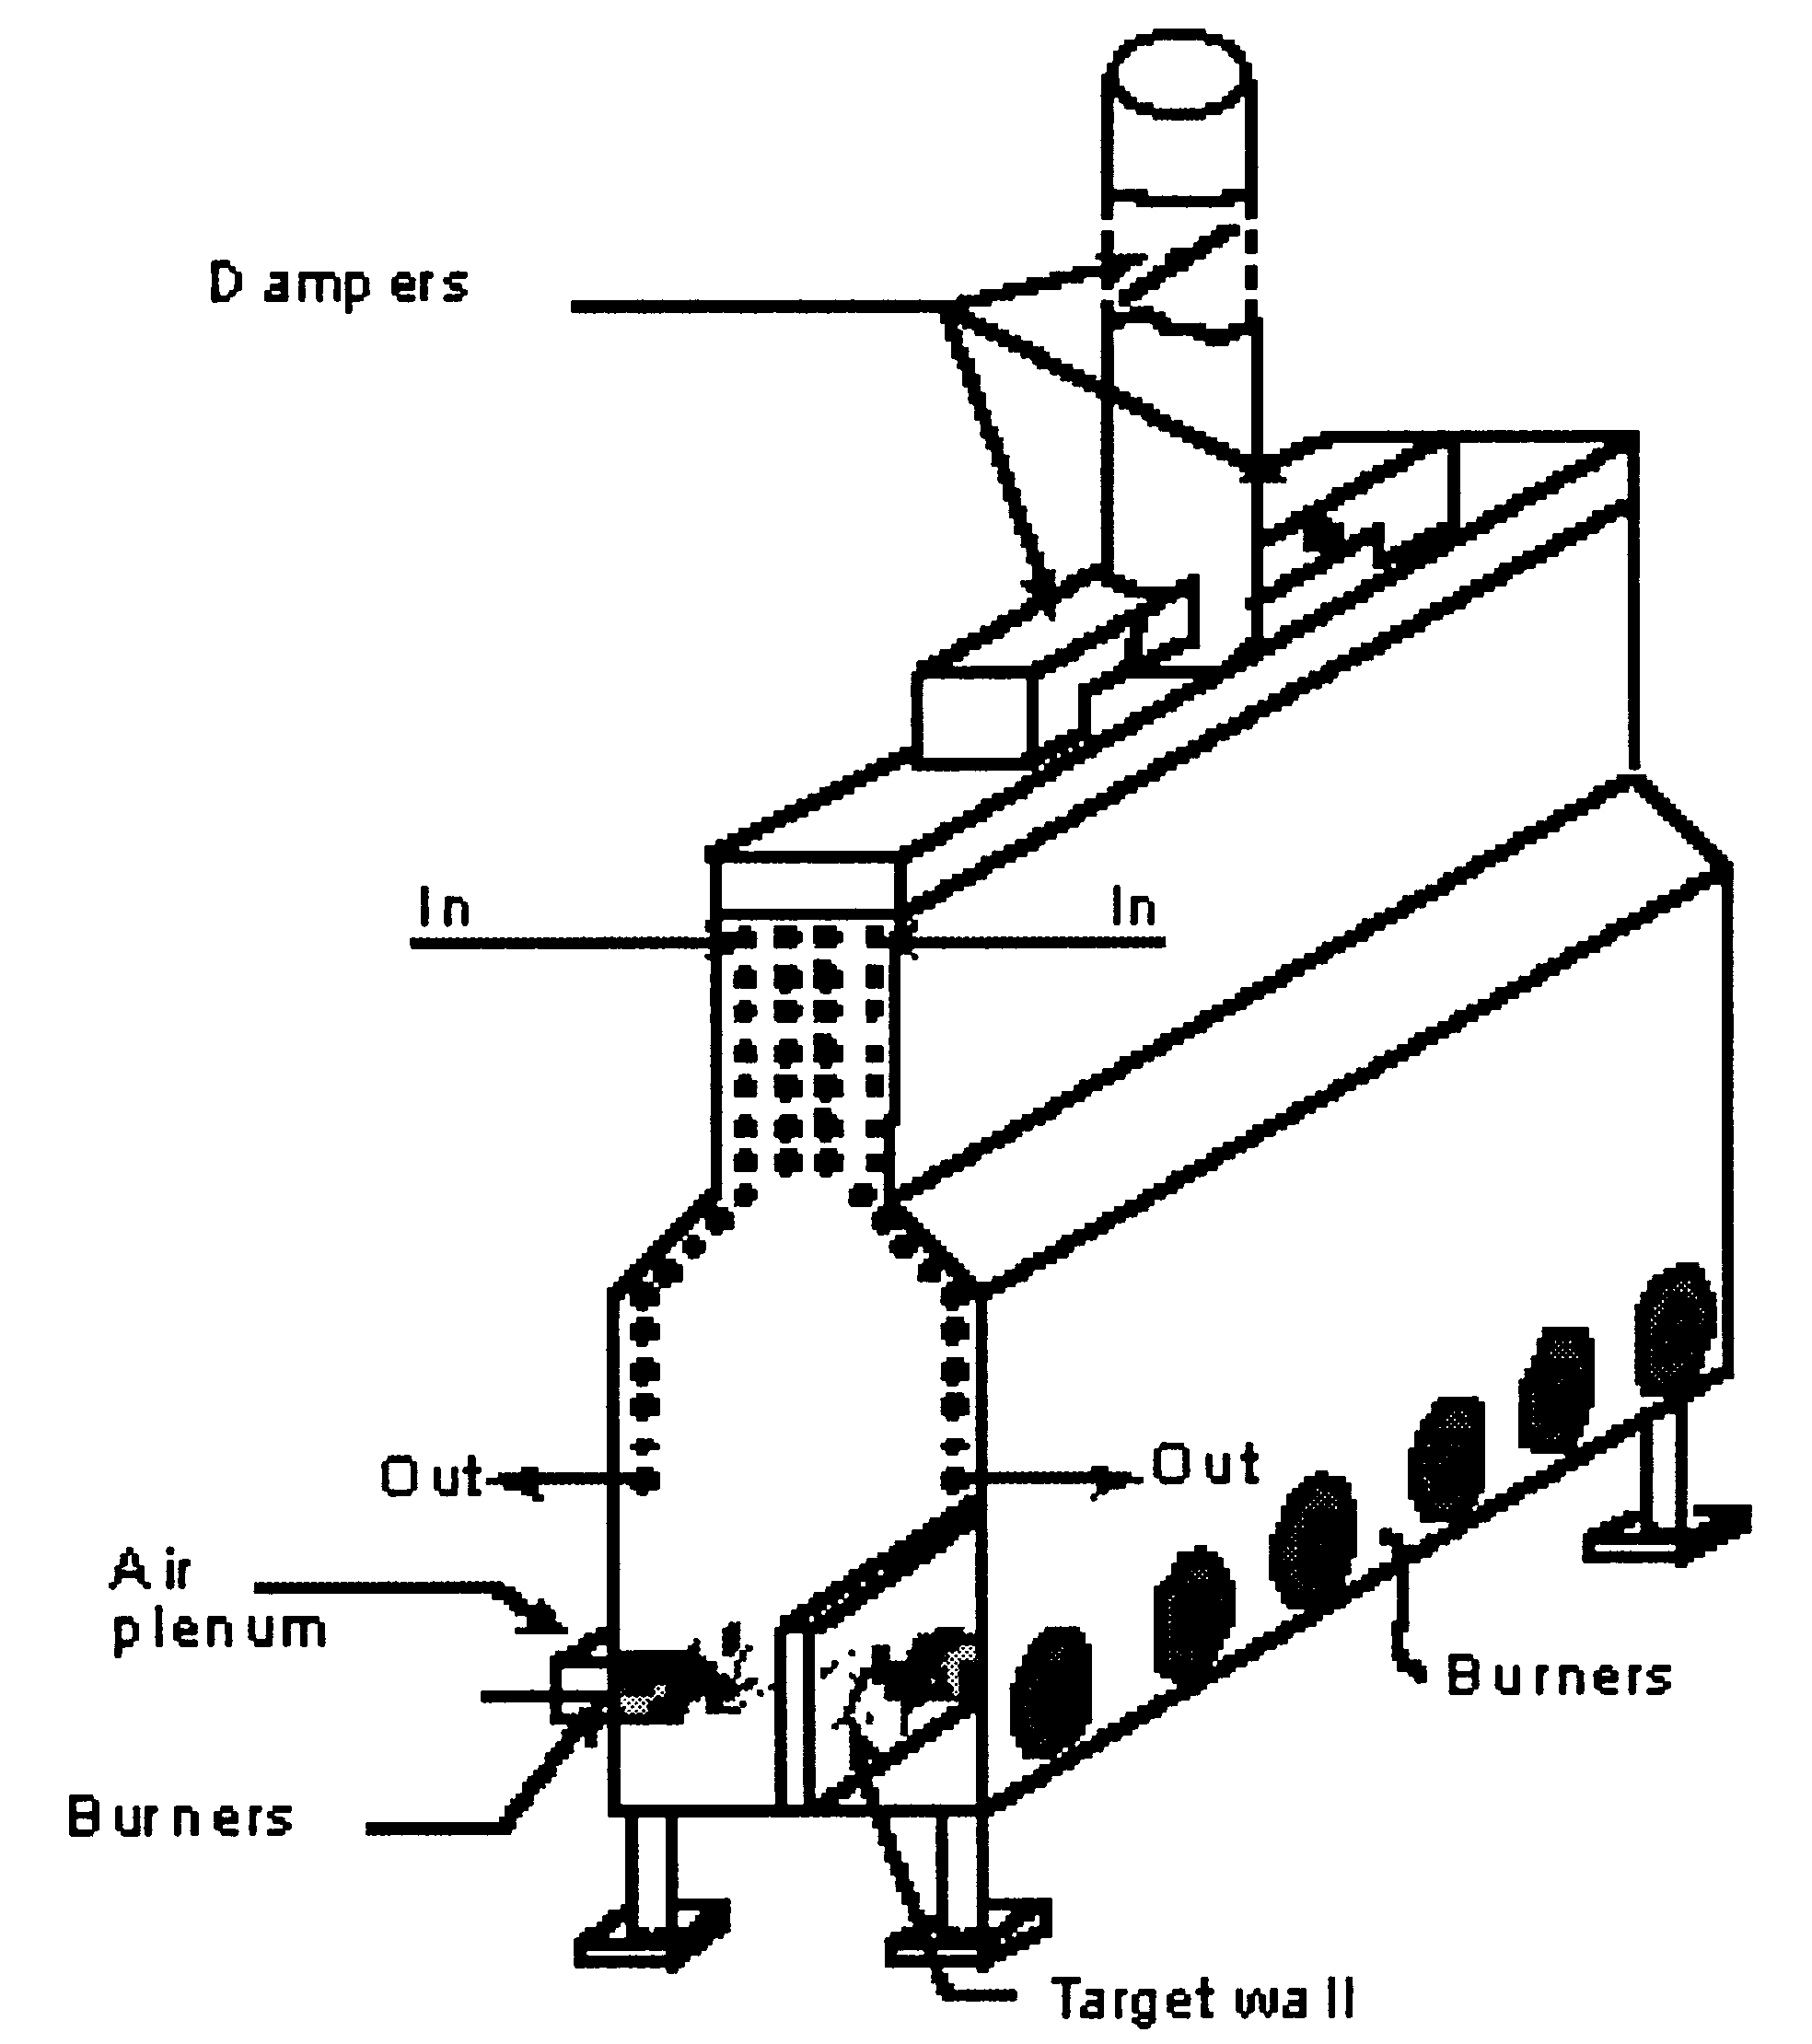
  Same air-fuel ratio : Desired Temperature Profile
NG firing temp profile should be similar to that LPG firing temperature profile

Slide 65

Fuel + Oxygen → HEAT + combustion gases
From Air
(21 mol% Oxygen & 79 mol% Nitrogen)
Transport medium of generated HEAT
Consist of generally more than 70% Nitrogen ; Molecular weight of combustion gas ~ molecular weight of Air

Slide 66
LPG
NG
Average molecular weight (AMW) of flue gases ~ Air (28.87)

Slide 67
Typical Natural Gas Characteristics
Typical LPG Characteristics in the Peninsular Malaysia
Theoretical air | NG | LPG
Sm³/Mcal | ~ 1.022 | ~1.027
Notes:
Combustion/Fuel properties – Slides 33 – 52

Slide 68

Final confirmation methods
  After natural gas conversion, same performance and productivity are required….hence confirmation methods should be considered
    Flow rate of natural gas should be corrected based on the following equation
V_{i} = Flow rate of gas as recorded by a rotameter
V_{a} = Actual flow rate of gas
T = absolute temperature
P = absolute pressure
SG = Specific gravity of gas
c = design base of meter
a = actual gas conditions

Slide 69
    Flue gas analysis
        Oxygen or CO measurement is recommended to check whether proper air/gas ratio and firing is obtained
        This is also for safety and furnace/boiler efficiency analysis
    Pressure measurements
        Pressure, both air and gas, should be measured at suitable points to check the firing condition and also their maintenance
    Heating up period
        If the energy input and air/gas ratio are the same as for LPG firing, the same heating up period should be obtained
        This is very important for small appliances which have no gas meter
    Product confirmation
        Check for product defect, rate and efficiency – higher productivity and efficiency and lower production defects are desired.

Slide 70
Important considerations of capacity of equipment used in burner conversion
Natural gas firing requires higher gas flow rate and the capacity of the maximum flow rate or pressure limitation should be considered for the following equipment

Slide 71
VENTILATION & VENTING

Slide 72
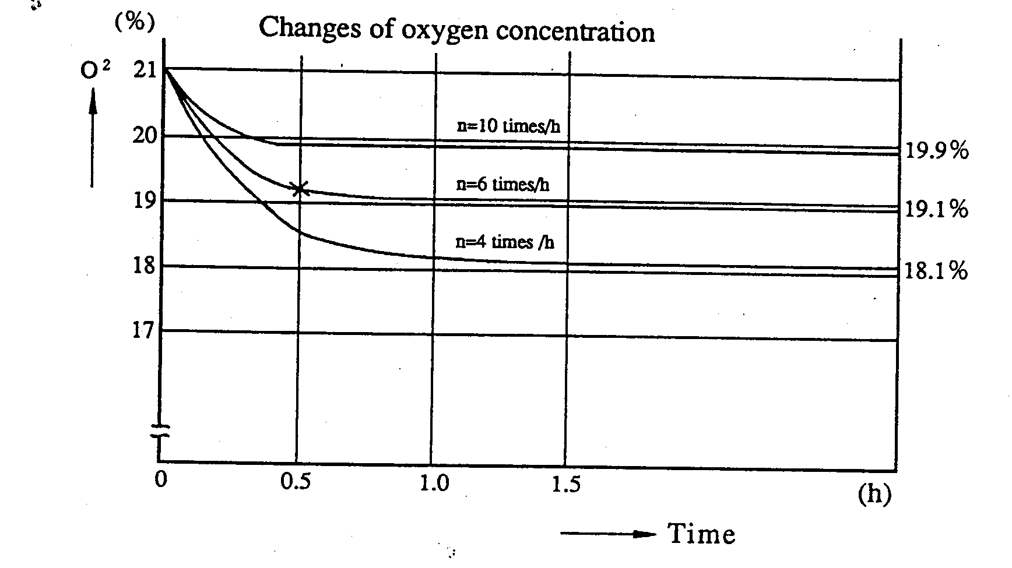
VENTILATION
What is ventilation?
  Ventilation is the replacement of air in a room with air from the outside so that the air can circulate freely in the room.
Why is ventilation so important?
  Safety
    gas appliance & operator :- proper discharge of combustion products – Improper discharge of combustion gases from the gas appliances will cause a steady accumulation of exhaust gases in a room and thus prevent the intake of fresh/combustion air- this may result in incomplete combustion due to an insufficient supply of oxygen and harmful carbon monoxide (CO) is generated

Slide 73
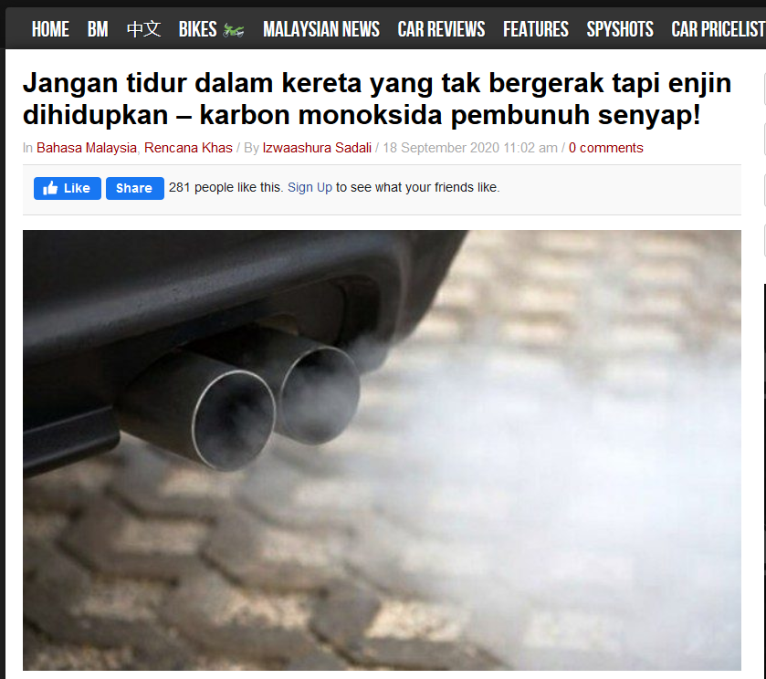

Effects of CO exposure on humans

Slide 74
Ventilation methods
Conditions of proper ventilation
  Openings for air discharge is provided , e.g., window, gap, exhaust port, flue pipe
  Openings for air-intake, e.g, window, gas, air inlet
  Power which causes an aerial flow is provided, e.g, for of wind, natural ventilation with temperature gradient, forced ventilation with fan
  Ventilation with force
  of wind
Wind
direction

Slide 75

Notes:
Typical traditional house – naturally designed with natural venting & ventilation

Slide 76
  Natural ventilation with
  temperature gradient
  Forced ventilation

Slide 77



VENTING SYSTEM
What is venting?
  A process of discharging or removal of combustion products or flue gases from combustion appliances to atmosphere

Slide 78
Venting and Ventilation
  Venting, the process of removing products of combustion
  Ventilation, the process of supplying of fresh air, must be considered together
  They are both part of the same system and must balance each other
Functions of a venting and ventilation system
  Removes flue gases
    Carbon dioxide (CO₂) - Carbon dioxide does not support combustion, but when it dissolves in water vapour, it forms carbonic acid. Carbonic acid corrodes steel venting pipes
    Water vapour (H₂0) - If this water vapour were to condense inside the dwelling over a period of time, the resulting damage would be catastrophic

Slide 79
    Nitrogen (N₂) - Nitrogen is a colourless, odourless gas. This product of combustion is not harmful nor is it used for heating purposes.
    Carbon Monoxide (CO) - Carbon monoxide is a product of incomplete combustion. It must be vented from the building because it is deadly.
  Prevents damage from condensation
    When flue gas temperature is low, the water vapour (in the flue products) condenses.
    Condensation can cause corrosion inside the heat exchanger, flue passages and vent pipes

Slide 80
  Protects from fire hazard
    The flue gas temperature at the inlet to the draft diverter may reach 4800 ºF (2490 ºC), and the outlet temperatures may reach approximately 300 – 3500 ºF (149 – 177ºC).
    These temperatures constitute a fire hazard, so to control the levels of flue gas temperature, the correct vent type, Gas Code clearances, and draft control equipment must be installed
  Provides air circulation
    When the combustion process produces hot flue gases that are lighter than the cooler surrounding air, the lighter air tends to rise.
    As these gases leave the dwelling via the venting system, the pressure inside is lowered.
    The negative pressure draws fresh outside air in, thus circulating air inside the building

Slide 81
Types of venting
  A chimney or vent system operates because there is a draft in the system
    Draft is the force that draws the combustion products up the vent/chimney
    The draft can be created by means of natural (non-mechanical) or forced (mechanical) venting
    Atmospheric or gravity or natural draft venting
The difference in weight (bouyancy) between the hot and hot flue gases and the surrounding air causes the draft which makes the venting system function – thus, the vent draft action relies on the bouyancy of hot flue gases

Slide 82


    The venting force is directly related to factors
      Density of the hot flue gases which depends on average gas temperature in the vent
      Height of the gravity vent
    Gas appliances using this type of venting system are known as natural draft or atmospheric gas burner

Slide 83

Venting pipe
Hood
P_{v}
Negative pressure or vacuum zone (pressure less than atmospheric)
Dilution (atmospheric) air induced into the draf hood as
P_{atm} > P_{v}
Dilution (atmospheric) air induced into the draf hood as
P_{atm} > P_{v}
P_{atm}
High velocity hot flue gas from combustion device
Notes:
How natural draft hood works?
High velocity hot flue gases from combustion device flow into the draft hood and towards constricted area connecting the hood and venting pipe.
According to Boyle’s law (PV=constant), this will generate negative pressure inside area on the upper part draft hood & around the constricted area.
As the surrounding air is at atmospheric pressure which is higher than the pressure inside the draft hood, the atmospheric (dilution) air will be naturally induced into the draft hood and push the flue gases up into the venting pipe
The higher velocity and hotter flue gases, the more negative pressure generated inside the hood & more dilution air will induced
Hence, the diameter of the hood is crucial and must be correctly designed – too large the diameter will prompt larger induced air and hence may cause flue gas overcooling

Slide 84
    Mechanical (forced or induced) draft venting

Slide 85
    Induced draft firing furnace

Slide 86
DRAFT CONTROL SYSTEM
For maximum appliance operating efficiency, the amount and force of the draft must be correctly controlled;
  A draft that is too strong will pull in too much combustion air and overfire the appliance
  A draft that is too weak will affect the flame properties and reduce the efficiency
Two types of draft control equipment, depending on the type of burner and appliance, i.e.
  draft hoods or draft diverters
  baromatic dampers

Slide 87
Draft hood or draft diverter
  Appliances that utilise natural draft type of burners are designed to operate with draft hoods (or diverters)
  Primary function of the draft hood is to provide a neutral overfire draft (pressure) condition in the combustion zone
Negative pressure or vacuum zone (pressure less than atmospheric)
P_{v}
Dilution (atmospheric) air induced into the draf hood as
P_{atm} > P_{v}

Slide 88

Barometric draft
  Barometric draft controls (or barometric dampers) are used on gas appliances that operate with a controlled negative over-fire draft in the combustion chamber.
  This type of draft control is used when the venting system provides a negative pull on the combustion chamber to remove flue gases.

Slide 89
  Operation of barometric control
    The gate of the draft control will open and allow just the right amount of diluted air into the appliance venting system to achieve the required over fire condition in the combustion chamber of the appliance.
    A pressure difference (between the interior (negative) updraft condition of the vent and exterior atmospheric pressure condition of the surrounding) will exist across the gate of the barometric control.
Gate opening inward to regulate an increasing updraft
Gate opening outward to relieve down draft condition

Slide 90





Slide 91
Types of barometric draft controls
  Single acting barometric draft controls
    Do not relieve downdraft conditions but will close off completely if experiencing any back pressure
  Double acting barometric damper
    The strong feature of a double-acting barometric damper is its ability to open both inward and outward
    It opens inward to regulate the dilution air and opens outward to relieve down-draft and spillage

Slide 92
Operation of a double acting barometric damper
  Updraft
  When the vent draw increases, the atmospheric pressure on the outside of the damper pushes against the gate, allowing extra dilution air in to reduce the draft draw (side view A)
  Down draft
  If the pressure increases inside the venting system, the gate swings out to relieve a down­draft (side view B)

Slide 93
The location of the draft control is important
  For gas firing equipment the preferred location is in a Bull-Head Tee
  On a correctly installed bullhead tee the flue gases make a right angle turn behind the control in such a manner that the direction of the flue gases is not directly toward the gate of the draft control

Slide 94

VENTING PROBLEMS
Spillage of the flue gases
  May be due to overloading or down-draft opposing flow of the flue gases
  A venting system can be overloaded by having
    Appliance over-firing
    Appliance venting system restricted or blocked
    Appliance venting system too small
    Appliance venting system poorly designed

Slide 95
  Outdoor winds can impose pressures at the terminal (exhaust ends) of the vent, disturbing natural draft
    If wind creates a negative pressure at the vent terminal, it will tend to increase the flow out of the terminal (referred as updraft)
    If wind creates a positive pressure at the vent terminal, it will tend to restrict the flow out of the terminal (referred as downdraft)

Slide 96
Condensation
  Condensation of the water vapour within the appliance venting system is caused mainly by the flue gases being excessively cooled (below the dew point temperature of the flue mixture) after their exit from the draft diverter
  Excessive cooling of the flue gases may be due to
    long lateral vent runs through unheated areas
    or venting into an outside masonry chimney
  To avoid excessive cooling, insulated venting is required to maintain sufficient flue gas temperature

Slide 97
  Condensation may also be caused by having the chimney or appliance vent too large (i.e. its cross section area) or having the appliances under-fired
    This causes the flue gases travel through the appliance vent very slowly, allowing sufficient heat transfer to take place reducing the flue gas temperature to the critical level
    The possible effects of condensation is corrosion which may occur inside the appliance heat exchanger, flue passages and vent pipes where the water condenses

Slide 98
VENTING PRACTICE AND DESIGN (MS 930)
Factors that affect venting system design and operation
  Vent Gas Temperature :- The hotter the vent gases the lighter they are and the greater is the force that expels them through the vent
  Heat Loss :- As the gases cool they become more dense and the draft effect is lessened
  Vent Height :- The taller the columns of hot gases the more will be the driving force tending to displace them
  Vent System Capacity :- Every vent system has a maximum input, beyond which no more flow can be accommodated
  Restriction to Flow :- Small sized venting restrictions or changes in direction of the vent all cause resistance to flow and impede good venting
  Ambient Temperature :- The cooler the air, the heavier it will be and the greater the motive force will be to move gases through the vent system.

