Slide 1
LECTURE 04
COMBUSTION CALCULATIONS
(Part B )
ENERGY BALANCE CALCULATIONS
Course Outcome
Perform and analyse mass and energy balances of a system involving combustion reaction

Slide 2
GENERAL ENERGY BALANCE
A = any reactant or product
n_{A} = moles of A produced or consumed
v_{A} = stoichiometric coefficient of A
= standard heat of combustion
= enthalpy of reactant / product
Reactants Products
Flow rate ?
T ºC?
Flow rate ?
T ºC?
Fuel
Air
CO₂ ,H₂O,
CO, N₂ ,O₂ ….
Q = ΔH =?

Slide 3

Why Perform Combustion Analysis?
ENERGY

Slide 4
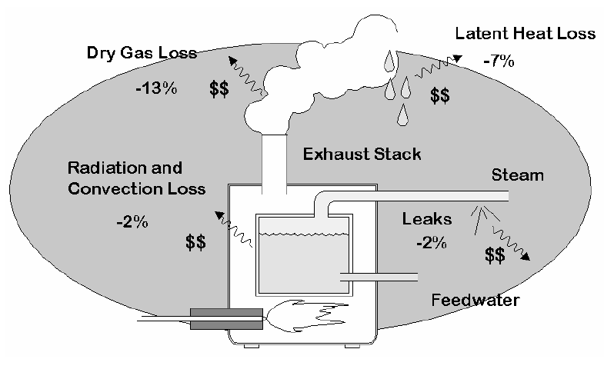
Boiler Heat Losses

Slide 5
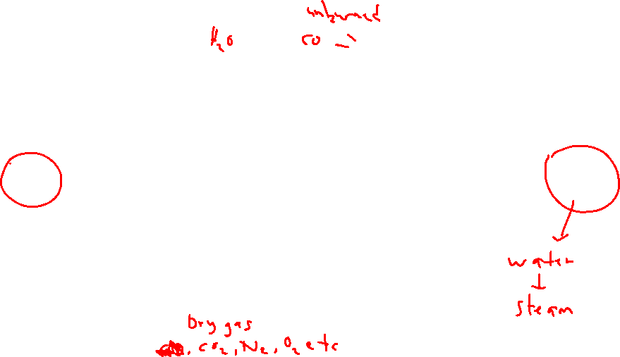
Heat Balance – Sankey Diagram
Latent
Loss
Potential + Radiation
+ Convection Losses
Heat
Input
Useful
Heat
Gross CV Net CV
Sensible Loss
Uncounted Losses e.g. opening, conveyor etc
Assuming the main source of energy/heat input comes only from the fuel and air only acts a source of oxidant unless it is preheated (usually from 25ºC) to a specific elevated temperature

Slide 6

Heat Input
  Energy from fuel :- heating or calorific value (HV or CV ) - Quantity of heat release from combustion of unit weight or volume of fuel (MJ/kg or Kcal/kg or Kcal/ m³ or MJ/m³)
    Higher or gross CV (HCV or HHV) – when liquid water as a combustion product – taking account the presence of water vapor in flue gases
    Lower or net CV (LCV or LHV) – when vapour water as a combustion product - the difference between higher CV and the heat absorbed (latent heat) by water in having its phase changing to vapour
  Energy from air :- usually not counted unless at elevated temperature (preheated air)

Slide 7
Heating /Calorific Values of Selected Fuels at 25ºC and 1 atm

Slide 8
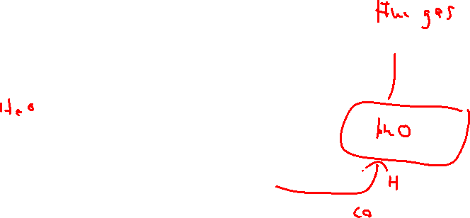
Heat Losses in Flue Gas
Heat losses in the products of combustion or flue gas can be classified into several types;
  Dry Flue Gas Loss - Heat is lost in the "dry" products of combustion, which carry only sensible heat since no change of state was involved , i.e., the total enthalpy of the various component gases (CO₂, N₂, O₂, SO_{x} , NO_{x}) at the dry flue gas temperature
  Moisture Loss – Heat lost due to combustion of hydrogen (in form of water vapour (sensible heat) or liquid water (latent heat if gross calorific or heating value is considered)
  Potential heat , i.e. the available heat due to the presence of carbon monoxide (CO) and unburned fuel

Slide 9

Heat Loss Analysis In Flue Gas
Gross CV based heat loss
Net CV based heat loss should exclude the heat condensation of water vapour at 25ºC

Slide 10

Sensible heat in dry flue gas
n_{i} = molar or volumetric flowrate of flue gas component, i…. (CO₂, N₂, O₂, SO_{x} , NO_{x})
Heat in moisture (vapour)
Potential heat in due to the presence of combustibles in flue gas

Slide 11
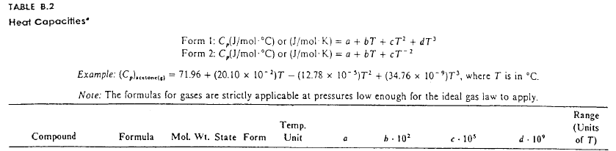

Heat Capacities

Slide 12
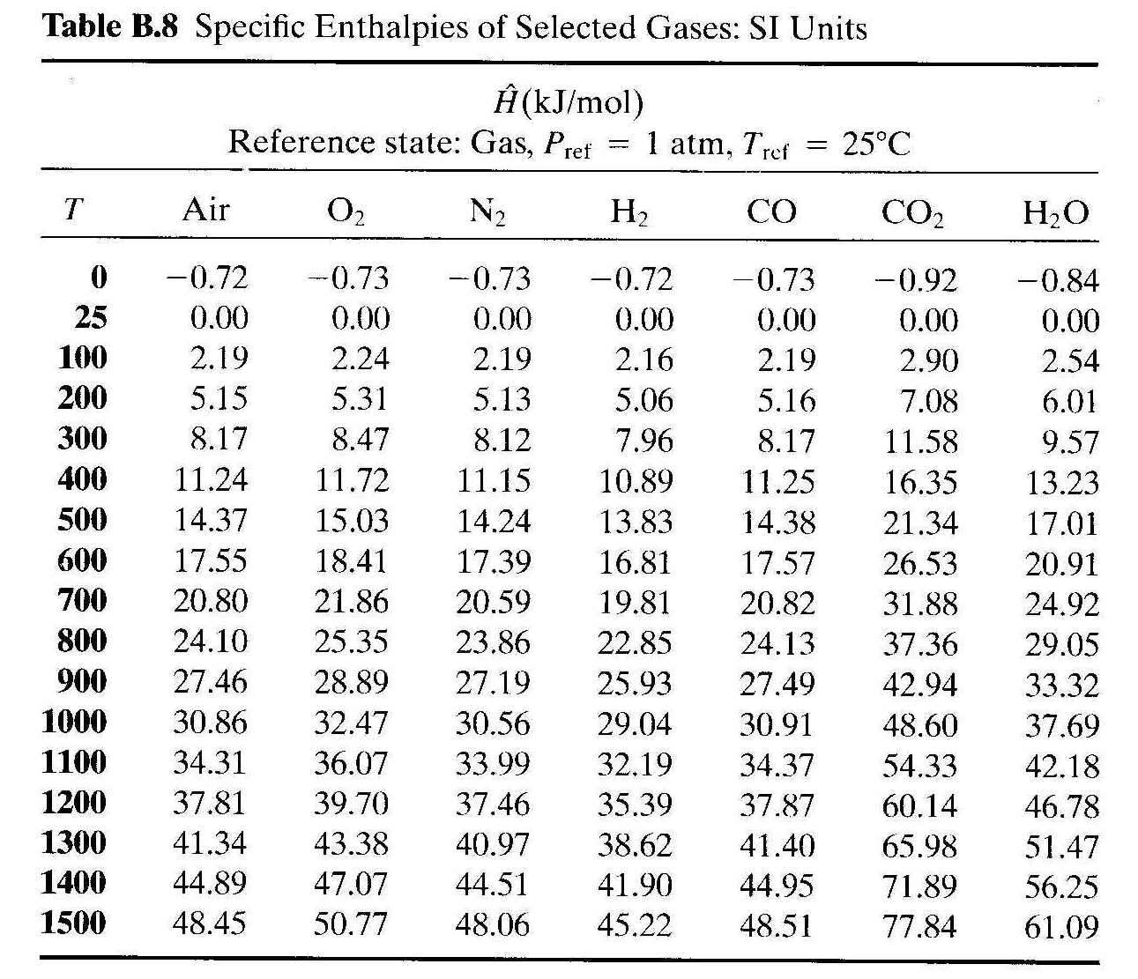

Vapor only

Slide 13
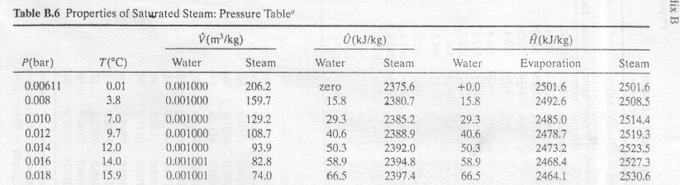
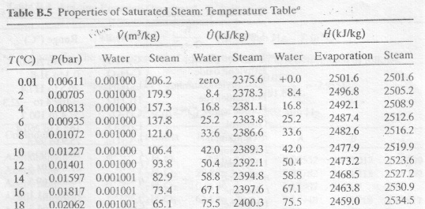
Water / Steam Properties

Slide 14
Other Sources of Heat Losses
Loss due to radiation and convection
  This loss occurs from the external surfaces of a combustion equipment
Losses from unaccounted sources such as
  conveyer opening
  incombustibles (ash)
  blowdown
  moisture in air or fuel
  Standby

Slide 15
Combustion Efficiency
Combustion efficiency is a measurement of how well the fuel is being burned .
The combustion efficiency calculation considers both the flue gas temperature and the net heat and moisture losses.
  This would include losses from dry gas plus losses from the moisture and losses from the unburned fuel as well as the production of CO
Flue gas loss is a measure of the heat carried away by dry flue gases and the moisture loss. It is a good indicator of appliance efficiency.

Slide 16
The flue gas temperature is the temperature of the combustion gases (dry and water vapor) leaving the appliance, and reflects the energy that did not transfer from the fuel to the heat exchanger.
  The lower the flue gas temperature, the more effective the heat exchanger design or heat transfer and the higher the fuel-to-air/water/steam efficiency is.
  However, if the flue gas temperature is too low (i.e. below the dew point temp), water vapour will be condensed and could cause to a chimney such as downdraft or corrosion.

Slide 17

Percentage of Combustion efficiency
For maximum combustion efficiency low excess air is desirable
Burners resulting in low levels of unburned fuel & CO while operating at low excess air levels are considered efficient
Well designed burners firing gaseous and liquid fuels operate at excess air levels of 15% and result in negligible unburned fuel - less heat from the combustion process is being used to heat excess air, which increases the available heat for the load.
Combustion efficiency is not the same for all fuels and, generally, gaseous and liquid fuels burn more efficiently than solid fuels

Slide 18
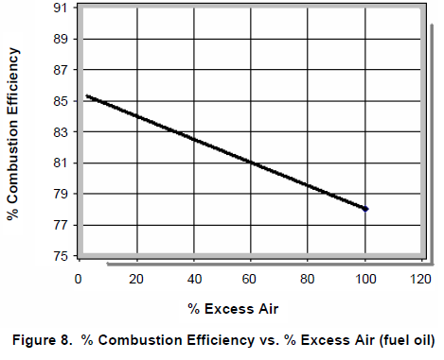
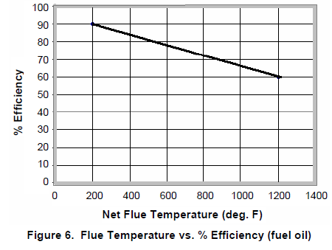


Slide 19
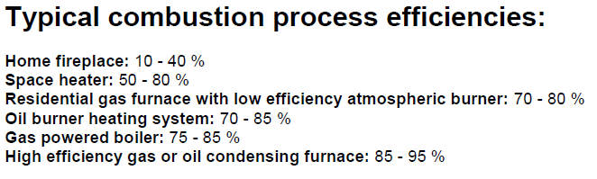

Slide 20
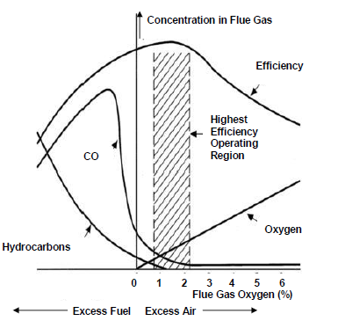

Slide 21





Thermal Efficiency
Thermal efficiency is a measure of the effectiveness of the heat exchanger of combustion system.
  It measures the ability of the exchanger to transfer heat from the combustion process to process heating medium such as water , steam or air.
  It accounts for the effectiveness of the heat exchanger as well as the radiation and convection losses
  sometimes known as fuel-to-air/water/steam efficiency
What is the maximum theoretical thermal efficiency??

Slide 22
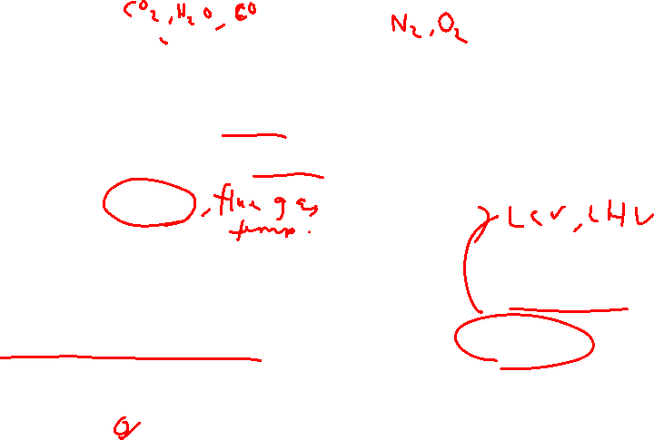
Example 6
Methane is completely burned with 10% excess air in a boiler. 90 % of the methane burns to form CO₂ and the remaining 10% to form CO. Both air and methane enter the boiler at 25ºC and the combustion products leaving the boiler is at 300ºC.
On the basis of 1 kmol of the methane and the lower fuel heating value, develop a sankey diagram showing the percentage of useful heat and heat losses from various sources with respect to the net calorific value of the fuel.
Heat losses due to radiation, convection and from other uncounted sources is negligible.

Slide 23
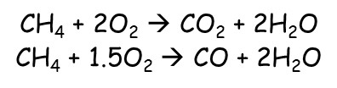

PFD and summary of Mass Balance
900
100
2000
250
8276
mol/hr CO2
mol/hr CO
mol/hr H2O
mol/hr O2
mol/hr N2
Methane
1000 mol/hr
25 ºC
300 ºC
Air
10 % excess air
10476 mol/hr
25 ºC
Q

Slide 24
Heat Balance – Sankey diagram
Latent
Loss (H₂O)
Potential (CO) + Radiation
+ Convection Losses
Heat
Input
Useful
Heat
Gross CV Net CV
Sensible Loss
(N₂, O₂, CO₂)
Uncounted Losses e.g. opening, conveyor etc
Assuming the main source of energy/heat input comes only from the fuel and air only acts a source of oxidant unless it is preheated (usually from 25ºC) to a specific elevated temperature

Slide 25
Heating /Calorific Values of Selected Fuels at 25ºC and 1 atm

Slide 26
Sensible heat in dry flue gas
n_{i} = molar or volumetric flowrate of flue gas component, i…. (CO₂, N₂, O₂, SO_{x} , NO_{x})
Heat in moisture (vapour)
Potential heat in due to the presence of combustibles in flue gas

Slide 27
Vapor only

Slide 28
ENERGY BALANCE TABLE
Reference : All gases at 25ºC & 1 atm
Table B8
 | kJ/mol
TEMP | O2 | N2 | CO | CO2 | H2O
300 | 8.47 | 8.12 | 8.17 | 11.58 | 9.57
Combustion Efficiency

Slide 29

ENERGY BALANCE TABLE
Reference : All gases at 25ºC & 1 atm
Table B8
 | kJ/mol
TEMP | O2 | N2 | CO | CO2 | H2O
300 | 8.47 | 8.12 | 8.17 | 11.58 | 9.57
Thermal Efficiency
th

Slide 30
Example 7 (Repeat Example 6)
Methane is completely burned with 10% excess air in a boiler to generate saturated steam. 90 % of the methane burns to form CO₂ and the remaining 10% to form CO. both air and methane enter the boiler at 25ºC and the combustion products leaving the boiler is at 300ºC. Heat losses due to radiation, convection and from other uncounted sources is assumed to be approximately 5% of the total heat input
On the basis of 1 kmol/h of the methane and the lower fuel heating value,
develop a sankey diagram showing the percentage of useful heat and heat losses from various sources with respect to the net calorific value of the fuel.
estimate the flow rate (kg/hr) of steam produced, if the water enters the boiler at 25ºC and leaves as saturated vapor at 1 atm.

Slide 31
PFD and summary of Mass Balance
H2O (l), 25oC
m_{w} kg/h
900
100
2000
250
8276
mol/hr CO2
mol/hr CO
mol/hr H2O
mol/hr O2
mol/hr N2
Methane
1000 mol/hr
25 ºC
300 ºC
Air
10 % excess air
10476 mol/hr
25 ºC
H2O (saturated vapor), 1 atm

Slide 32
ENERGY BALANCE TABLE
Reference : All gases at 25ºC & 1 atm
Table B8
 | kJ/mol
TEMP | O2 | N2 | CO | CO2 | H2O
300 | 8.47 | 8.12 | 8.17 | 11.58 | 9.57
Thermal Efficiency

Slide 33
ENERGY BALANCE TABLE
Reference : All gases at 25ºC & 1 atm
Table B8
 | kJ/mol
TEMP | O2 | N2 | CO | CO2 | H2O
300 | 8.47 | 8.12 | 8.17 | 11.58 | 9.57
Thermal Efficiency

Slide 34

Useful heat (Q_{useful}) is the net available heat for steam production

Slide 35
Example 8
Methane is burned with air in an atmospheric gas boiler where saturated steam is produced at 1 atm. The methane enters the boiler at a rate of 10 m³/hr (STP) and 25ºC and the water enters the boiler at 25ºC. The methane is assumed to be completely burned in X % excess air to form CO₂ and H₂O. The flue gas leaving the boiler is at T_{g} ºC. Heat losses due to radiation, convection and from other uncounted sources is assumed to be approximately 5% of the total heat input.
Sketch a process flow diagram of the above process
Based on the lower heating value, construct a sankey diagram showing the percentage of heat available and losses from various sources.
Calculate the combustion and thermal efficiencies of the above process
Estimate the flow rate (kg/hr) of steam produced.
Excess air (%) | Air temp (ºC) | Flue gas temp (T_{g} ºC)
10 | 25 | 300
50 | 25 | 300
10 | 25 | 200
10 | 200 | 300

Slide 36
Boiler Analysis
Excess air (%) | Air temp (ºC) | Flue gas temp (ºC) | Thermal eff. (%) | Steam produced (kg/hr)
10 | 25 | 300 | 82.75 | 115.0
50 | 25 | 300 | 78.92 | 109.8
10 | 25 | 200 | 87.27 | 121.5
10 | 200 | 300 | 83.25 | 124.1
(i)
(ii)
(iii)
(iv)
Compare and draw conclusions on the effect of the following boiler operating parameters on the thermal efficiency and steam production
excess air (i & ii)
flue gas temperature (i & iii)
air temperature (i & iv)
Which operating parameter has the most significant effect?

Slide 37

Example 8 – Process Flow Diagram (PFD)
H2O (l), 25oC
m kg/h
??
446
892
89.2
3691.2
mol/hr CO2
mol/hr H2O
mol/hr O2
mol/hr N2
Methane
10 m³/hr (STP)
446 mol/hr)
??
25oC
T_{g} ºC
??
??
??
Air
10 % excess air
4672.4 mol/hr
T_{air} ºC
??
??
H2O (v), 1 atm
CH4 | + | 2 | O2 |  | CO2 + | 2 | H20

Slide 38
Useful heat (Q_{useful}) is the net available heat for steam production

Slide 39
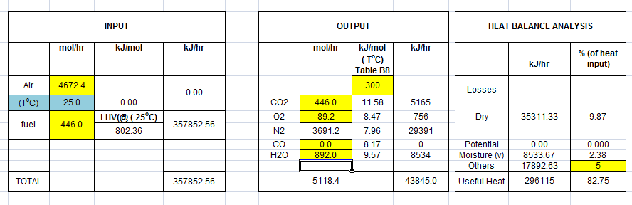
Example 7 – Summary of Mass and Heat Balance
Reference temp. (25ºC) ; CO₂, CO, N₂, O₂, H₂O ( gases)

Slide 40
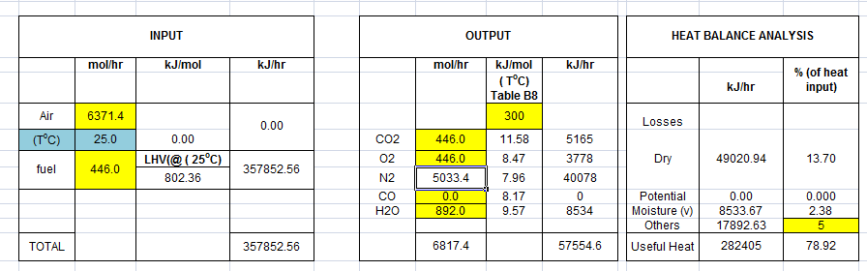
Example 8
Repeat example 7 to estimate the combustion and thermal efficiencies and also the flow rate (kg/hr) of steam if the combustion excess air is 50%.
Reference temp. (25ºC) ; CO₂, CO, N₂, O₂, H₂O ( gases)
Q_{steam} = m_{w} (h_{s} – h_{f})
282405 = m_{w} (2676 – 104.8)
m_{w} ~ 109.8 kg/hr

Slide 41
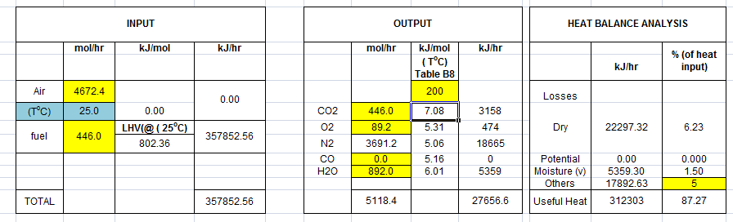

Example 9
Repeat example 7 to estimate the thermal efficiency and the flow rate (kg/hr) of steam if the flue gas leaving the boiler is further reduced to 200ºC.
Reference temp. (25ºC) ; CO₂, CO, N₂, O₂, H₂O ( gases)
Q_{steam} = m_{w} (h_{s} – h_{f})
312303 = m_{w} (2676 – 104.8)
m_{w} ~ 121.5 kg/hr

Slide 42
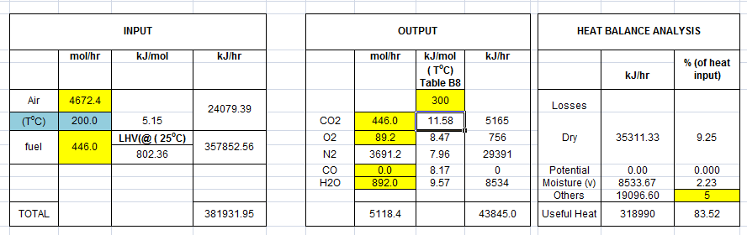

Example 10
Repeat example 7 to estimate the thermal efficiency and the flow rate (kg/hr) of steam if the combustion air is preheated to 200ºC.
Reference temp. (25ºC) ; CO₂, CO, N₂, O₂, H₂O ( gases)

Slide 43
Boiler Analysis
Excess air (%) | Air temp (ºC) | Flue gas temp (ºC) | Thermal eff. (%) | Steam produced (kg/hr)
10 | 25 | 300 | 82.75 | 115.0
50 | 25 | 300 | 78.92 | 109.8
10 | 25 | 200 | 87.27 | 121.5
10 | 200 | 300 | 83.25 | 124.1

Slide 44
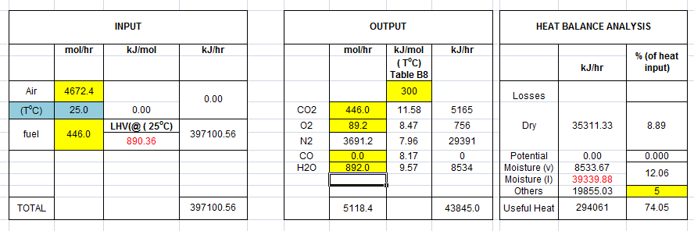
Example 11
Repeat example 7 to solve questions (b) and (c) on the basis of higher heating value.
Reference temp.n( 25ºC) ; CO₂, CO, N₂, O₂ (gas) ; H₂O (l)

Slide 45
Example 9 (Do by your own)
Steam boiler power plant in a petroleum refinery has an overall thermal efficiency on net calorific value of 85% and an output of 100,000 kg steam per hour. The steam is produced at a pressure of 20 bar and is superheated to 250ºC from feed water at 25ºC. The volumetric composition of hydrocarbon gas mixture that is used to fire the boiler is as follows; H₂=24%, CH₄=17%, C₂H₆=17% and C₃H₈= 42%. Assuming the fuel and 10% excess air are fed into the boiler at 25ºC and undergo complete reaction (main combustion products are CO₂ and H₂O). The temperature (ºC) of the flue gas leaving the boiler is 200ºC.
Estimate the volumetric flowrate (Standard Cubic Meter per Hour (SCMH)) of hydrocarbon gas mixture. (5689.4 SCMH)
Estimate the percentage of uncounted heat losses (radiation, convection etc) from the boiler (7.45%)

Slide 46
Process Flow Diagram
H2O (l), 25ºC C
100,000 kg/h
(h_{f}=104.8 kJ/kg)
H/C mixture
? kmol/h
? m3/hr (STP)
? mol% CO2
? mol% H2O
? Mol% O2
? mol% N2
25ºC
200 ºC
Air (10% Excess)
? kmol/h
25ºC
H2O (v), 20 bar, 250ºC
(h_{g}=2902 kJ/kg)

Slide 47
the volumetric flowrate (SCMH) of hydrocarbon gas mixture required.
 | Y %mol | LHV (kJ/kmol) | LHV_{mixt} (kJ/kmol)
CH4 | 17 | 802340 | 1295638
C2H6 | 17 | 1427870
C3H8 | 42 | 2043960
H2 | 24 | 241830
LHV = | 1295638 |  | kJ/kmol
Qs = | 279720000 |  | kJ/h | [100000 x (2902-104.8)]
Qf = | 329082353 |  | kJ/h | (Qs/0.85)
nf = | 254 |  | kmol/h | [Qf/LHV_{mixt} ]
Vf= | 5689.4 |  | SCMH | [22.4 x nf]

Slide 48
the percentage of uncounted heat losses (radiation, convection etc) from the boiler
Summary of mass balance
H2O (l), 25oC (h_{f}=104.8 kJ/kg)
100,000 kg/h
H/C mixture
254 kmol/hr
200 ºC
449.6 kmol/hr CO2
703.6 kmol/hr H 2O
3316.2 kmol/hr N2
80.14 kmol/hr O2
25oC
Air
4197.7 kmol/hr
25oC
H2O (v), 20 bar, 250 oC, (h_{g}=2902 kJ/kg)

Slide 51

Adiabatic Flame Temperature Calculation
If n_{f} moles of fuel is completely burned under adiabatic condition, the energy balance equation becomes
Where…. T_{ad} is the product temperature, which by definition is the adiabatic or theoretical flame temperature

Slide 52
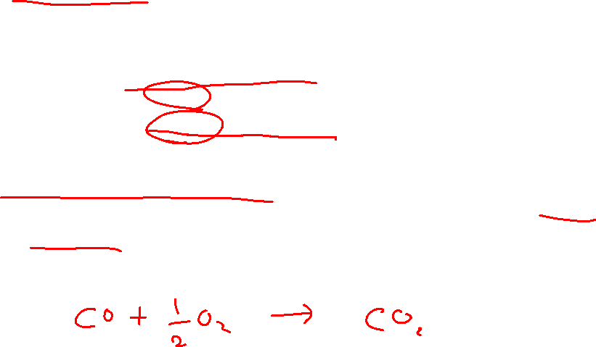
Example 10
Waste gas from a refinery containing mainly carbon monoxide is burned with 120 % excess air in a reactor. Both the fuel and air are fed at 25ºC. The engineer designing the reactor must calculate the highest temperature that the reactor walls will have to withstand so that an appropriate material of construction can be chosen. On the basis of 1 mol of carbon monoxide, estimate the flame temperature assuming complete combustion.

Slide 53
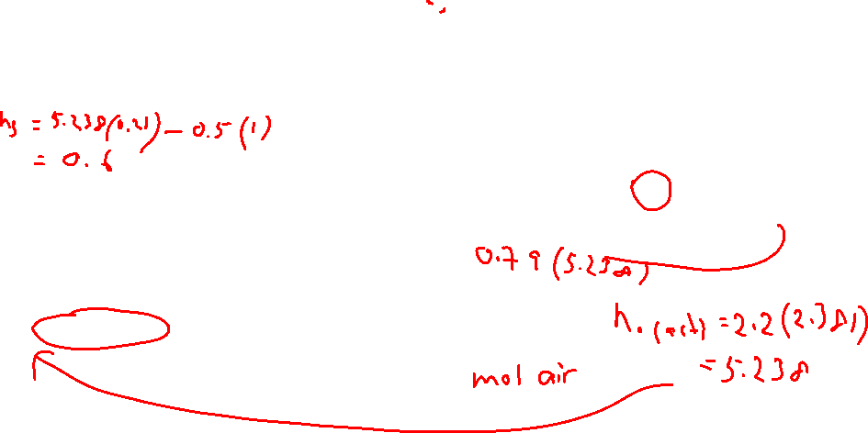
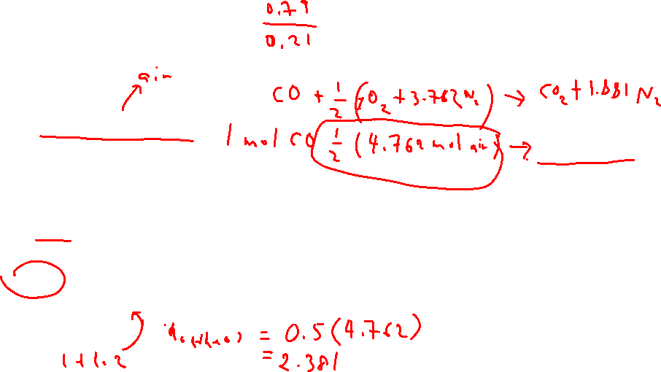
Summary of mass balance
Basis : 1 mol CO
CO + ½O₂ → CO₂
CO
1 mol
T_{ad} ºC
1 mol CO2
4.138 mol N2
0.6 mol O2
25oC
Air
X = 120% (2.2)
5.238 mol
25oC

Slide 54
Reference : all gases at 25ºC

Slide 55
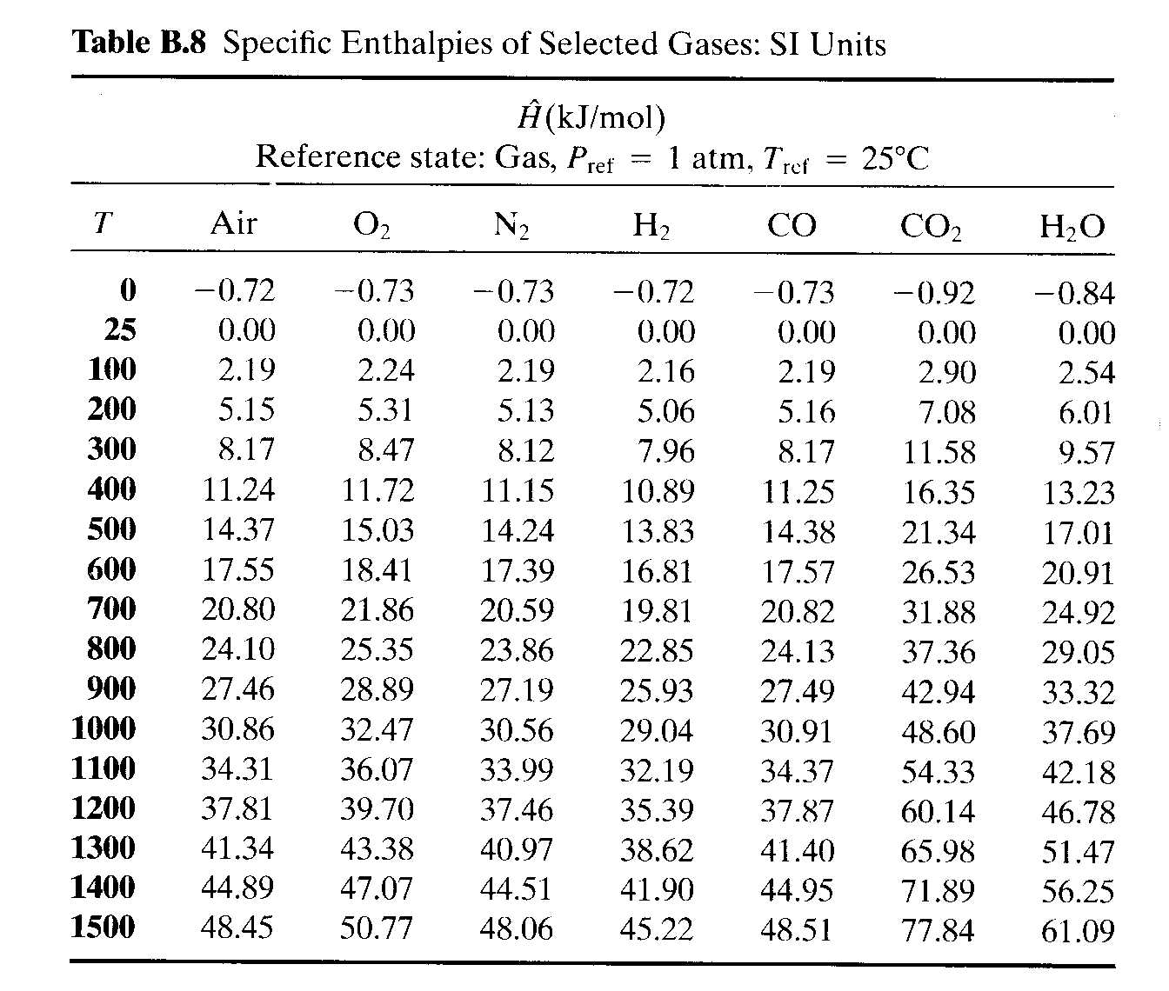

Reference : all gases at 25ºC

Slide 56

Reference : all gases at 25ºC
Trial & Error + Interpolation
(= 261.6-282.99)
(= 284.3-282.99)

Slide 57
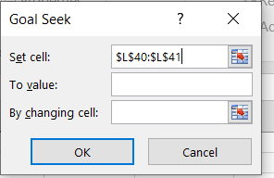
USING MICROSOFT EXCEL : DATA → WHAT IF ANALYSIS → GOAL SEEK
Reference : all gases at 25ºC
Goal seeking
Total output – Total input = 0
Target value

