Slide 1
LECTURE 04
COMBUSTION CALCULATIONS
(Part A)
MASS BALANCE CALCULATIONS
Course Outcome
Perform and analyse mass and energy balances of a system involving combustion reaction

Slide 2
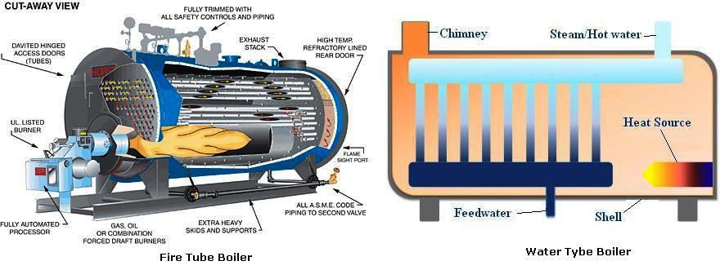
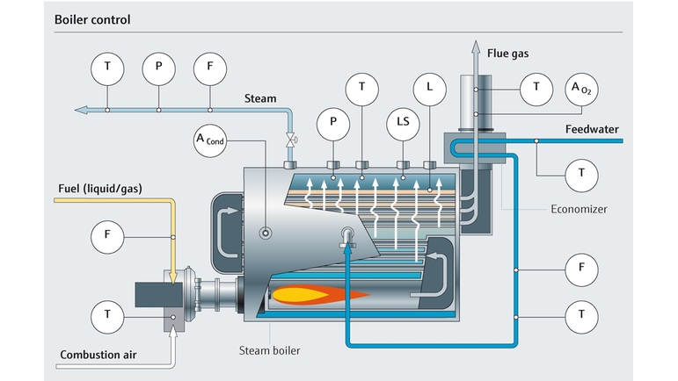

Slide 3
Categories of Combustion Processes
MASS BALANCE – REVIEW (SECT 4.8)
Complete combustion
  Stoichiometric
  Excess air or fuel lean
Incomplete combustion
  Excess fuel or fuel rich or deficient air
  In practice, combustion will never be complete even though at stoichiometric or excess air conditions…….due to non-uniformity of fuel and air mixture and complexity of combustion reaction

Slide 4
Excess Air Requirement
The ideal operating range is a setting with excess air.
Incomplete
Complete
WHY??
Eff.
Flue gas components
CO₂
Solid fuel high
Liquid fuel moderate
Gas fuel low
Ideal operating range of burners
Stoichiometric line
CO
O₂
smoke
Excess Fuel
Excess Air

Slide 5
Why Perform Combustion Analysis?

Slide 6
Combustion calculations
Fuel properties (Lec 02 & 03)
Mass balance
Energy balance
Combustion products
Combustion efficiency
Thermal efficiency
Excess air requirement
Air-fuel ratio
Flame temperature
Etc.

Slide 7
Gas Mixture Properties recalling mass & energy balance …. and thermodynamics
Mol of a substance is a term used for the mass of the substance numerically equal to the molecular mass of the substance. Thus mol can be expressed as
  Mol is especially useful in the case of gaseous fuels because the equations of chemical reactions are also mol equations.
  Avogadro's law states that under the same conditions of pressure and temperature, a fixed volume of any gas contains the same number of molecules. In other words, the molecular volume of all the gases is the same under the same condition of pressure and temperature.

Slide 8
Mol fraction may be defined as the ratio of the mols of the constituent gas in a given volume of mixture to the total mols of the mixture occupying the same volume.
similarly, the mass fraction of the constituent gas, xi
by definition the sum of all the constituents mole (or mass) fraction must be unity

Slide 9
Properties of Gas Mixtures
  Gibbs-Dalton's law states that the pressure, internal energy and entropy of a mechanical homogeneous mixture of gases which do not react chemically with one another are equal to the sum of the corresponding pressure, internal energy and entropy of the constituent gases when each has the temperature of the mixture and volume equal to the volume of the mixture.
P = P₁+ P₂+ P₃+ P₄+ P₅+ ….
U = U₁+ U₂+ U₃+ U₄+ U₅+ ….
H = H₁+ H₂+ H₃+ H₄+ H₅ + ….
S = S₁+ S₂+ S₃+ S₄+ S₅ + ….
V= V₁= V₂= V₃= V₄= V₅ =….
T= T₁= T₂= T₃= T₄= T₅ =….

Slide 10
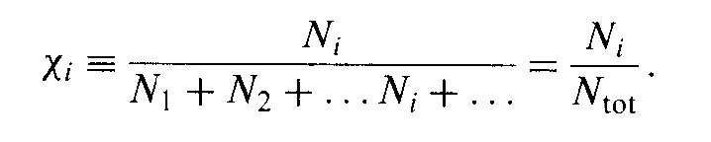
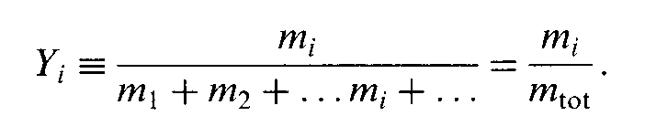
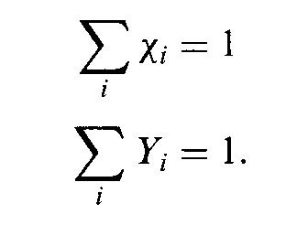
Mixtures
Mole fraction of species i
Mass fraction of species i
The sum must be unity

Slide 11
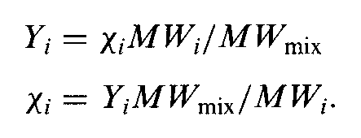
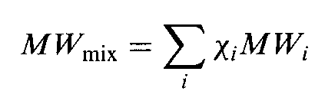
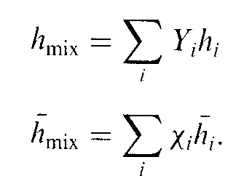
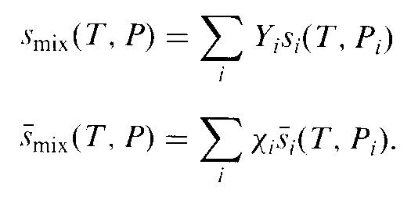
Can relate mole and mass fractions via molecular weight;
Average intensive properties of mixtures

Slide 12
Ideal Gas Mixtures - Dalton Law
Suppose n_{A} moles of substance A, n_{B} moles of B and n_{C} moles of C and so on, are contained in a volume V at temperature T and total pressure P.
The partial pressure p_{A} of A in the mixture is defined as the pressure exerted by n_{A} moles of A alone occupied at the same total volume V only for ideal gases at the same temperature T
From ideal gas law : PV = nRT …. (1)
From partial pressure: p_{A}V = n_{A}RT …. (2)
Dividing Eq. (1) by Eq. (2) : or p_{A} = y_{A} P
Thus, the ideal partial pressure of ideal gas add up to the total
pressure P
Σp_{i} = p_{A} + p_{B} + p_{C} + ... = (y_{A} + y_{B} + y_{C} + ... )P = P

Slide 13
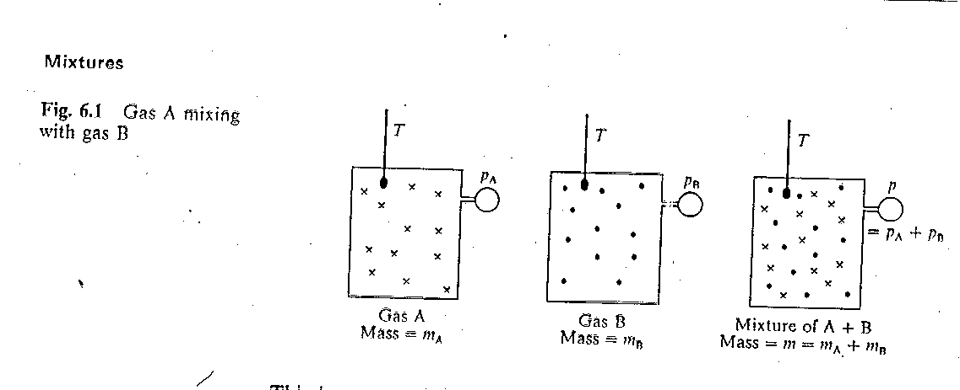
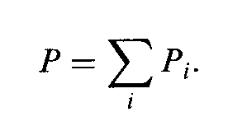
Mixtures
Using Dalton's law
Partial pressure

Slide 14
Ideal Gas Mixture - Amagat Law
Suppose n_{A} moles of substance A, n_{B} moles of B and n_{C} moles of C and so on, are contained in a volume V at temperature T and total pressure P.
The partial volume v_{A} of A in the mixture is defined as the volume that would be occupied by n_{A} moles of A alone only for ideal gases at the total pressure P at the same temperature T of the mixture
From ideal gas law : PV = nRT …. (1)
From partial pressure: Pv_{A} = n_{A} RT …. (2)
Dividing Eq. (1) by Eq. (2) : or v_{A} = y_{A} V
Thus the ideal partial volume of
ideal gas add up to the total volume V :
v_{A} + v_{B} + v_{C} + ... = (y_{A} + y_{B} + y_{C} + ... )V = V
Thus, vol % ~ mol %

Slide 15
Conservation of mass
m = m₁+ m₂+ m₃+ m₄+ m₅
Ideal gas law
PV = nRT , thus P₁V=n₁R₁T , P₂V=n₂R₂T T …….. P_{i}V=n_{i}R_{i}T or
PV = mRT , thus P₁V=m₁R₁T , P₂V=m₂R₂T T …….. P_{i}V=m_{i}R_{i}T
the universal gas constant (R) for any gas is
8.314 m³-Pa/mol-K
0.08314 liter-bar/mol-K
0.08206 liter-atm/mol-K
8.314 J/mol-K (J ~ m³-Pa)

Slide 16
For the gas mixture
(P₁+ P₂+ P₃+ P₄+ P₅ ….)V = (m₁R₁ + m₂R₂ + m₃R₃ + m₄R₄ + ….)T
PV = mRT
Average gas constant of gas mixture
Average molecular mass (weight) of gas mixture

Slide 17
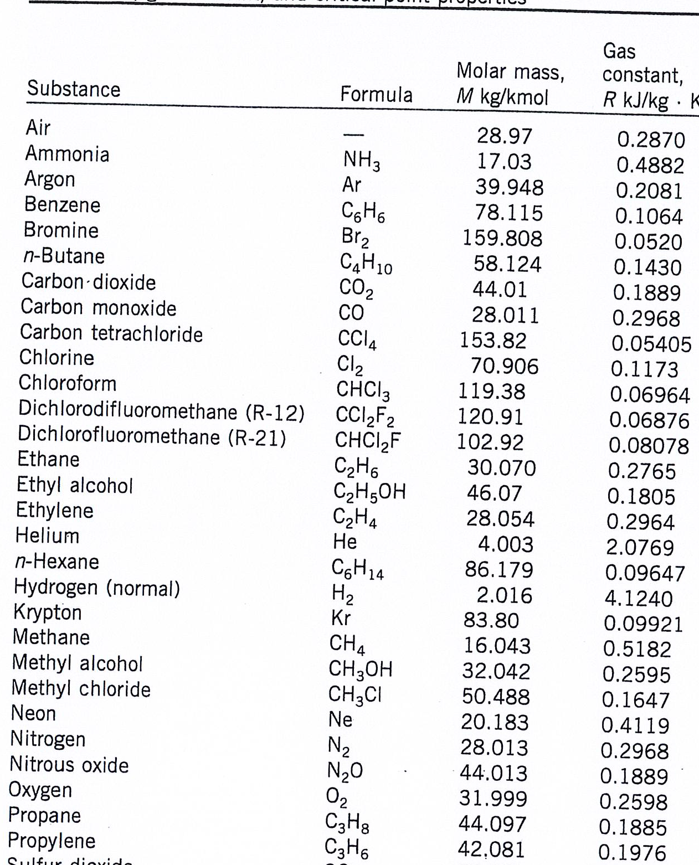

Slide 18
Equation of state (EOS)
EOS relates the quantity (mass or moles) and volume of gas with temperature and pressure
The simplest and mostly used is ideal gas law
  P = absolute pressure of the gas
  V = volume or volumetric flow rate of gas
  n = number of moles or molar flow rate of the gas
  R = the gas constant
  T = absolute temperature of gas
Generally applicable at low pressure (< 1 atm) and temperature > 0ºC.

Slide 19
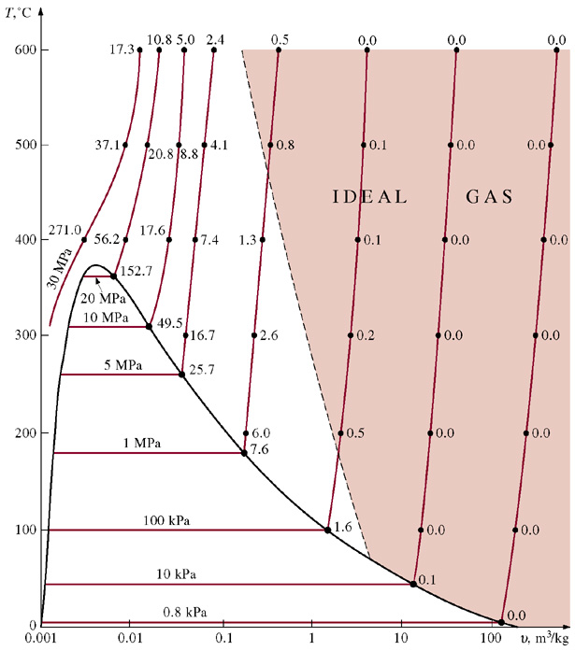
Copyright © The McGraw-Hill Companies, Inc. Permission required for reproduction or display.
FIGURE 2-49
Percentage of error
involved in assuming steam to be an ideal gas, and the region where steam can be
treated as an ideal gas with less than 1 percent error.
2-12

Slide 20


Standard Conditions for gases
Using PVT equation is easy, provided you have a set of R constant value with different units.
A way to avoid this is by dividing the gas law from process condition with given chosen reference condition
Standard Conditions (STP) for gases
System T_{s} P_{s} V_{s} n_{s}
SI 273 K 1 atm 0.022415 m³ 1 mol
SI 273 K 1 atm 22.415 m³ 1 kmol
CSS 273 K 1 atm 22.415 L 1 mol
American 492ºR 1 atm 359.05 ft³ 1 lb-mole

Slide 21
Compressibility Factor Equation of State
An equation of state that retains the simplicity of the ideal gas law but describe the PVT behavior of real gas
The coefficient z is called the compressibility factor, and the equation is known as the compressibility factor equation of state
A value of z = 1 correspond to ideal gas behavior
The compressibility factor of a gas depends on the gas temperature and pressure

Slide 22
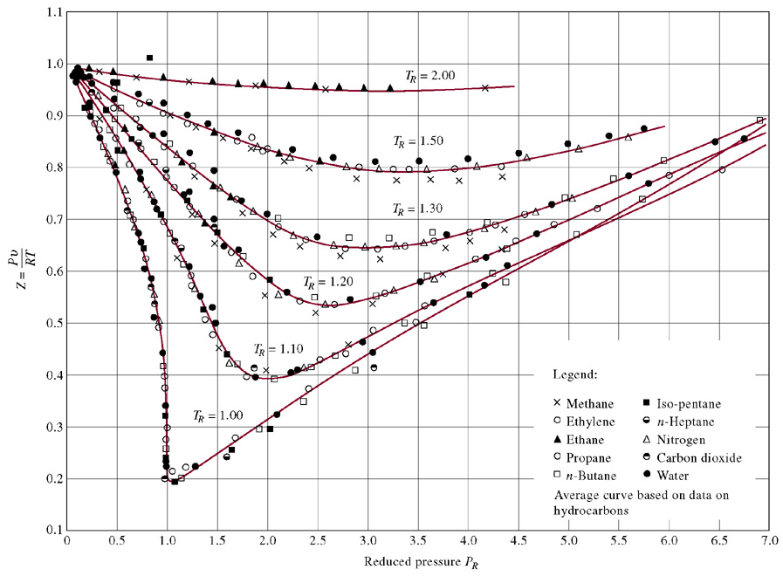
Copyright © The McGraw-Hill Companies, Inc. Permission required for reproduction or display.
FIGURE 2-51
Comparison of Z factors for various gases.
2-13

Slide 23
Combustion calculations
- Assumptions -
Avogadro’s hypothesis - the volume occupied by any gas in any mechanical mixture of gases is the same as the volume of the mixture.
Dalton’s law - the pressure exerted by the constituent gas is only a fraction of the total pressure exerted by the mixture.
The ideal gas law generally applies, since most combustion reactions involve high temperature and a total pressure close to one atmosphere, with exception of some combustion equipment such as gas turbine system and internal combustion engines.
Conservation of chemical elements : the total mass of reactants is same as that of products.
Conservation of energy : the total energy of reactants is same as that of products….the heat of combustion is referred to a datum temperature of 25ºC

Slide 24
Most combustion work is at constant pressure (in practice near one atmosphere), so constant pressure conditions may be assumed by convention unless stipulated
Atmospheric air requirement for combustion reaction is assumed to have the following composition
Theoretical air is defined as the quantity of air per unit mass of fuel which is sufficient on complete combustion to give CO₂, H₂O, SO₂ and N₂ as products…for the hypothetical reaction
Analyses of solid / liquid fuels are normally reported on a mass basis, while gaseous fuels are normally analysed on a volume basis.
Standard Temperature & Pressure (STP) → 0ºC and 1 atm unless stated
Air % | By volume | By weight
O₂ N₂ | 21 79 | 23 77

Slide 25
Fuel and flue gases composition analysis
Gravimetric or weight or mass analysis…….. Mass fraction → x_{i}
Volumetric analysis…….. Mole fraction → y_{i}
  Conversion of gravimetric analysis to volumetric analysis and vice-versa
Combustor
Combustion products
CO₂ , H₂O , O₂ , N₂ , CO
H₂ , C_{w}H_{v} , SO₂ etc
Fuel
Air
Analysis
Dry basis
Wet basis
Mass balance (Eq 3.3-7 & 8)

Slide 26
Flue Gas Measurement Techniques
Chemical Absorption Method
Electrochemical sensors
  Oxygen, O₂
  Carbon monoxide, CO
  Nitric oxide, NO
  Nitrogen dioxide, NO₂
  Sulphur dioxide, SO₂
IR sensor
  Unburned fuel (CH_{4,} )Carbon dioxide, CO₂
Catalytic devices
  Unburned fuel (e.g. H₂, CH₄)
Carbon dioxide, CO₂, can be estimated based on O₂ content in the flue gas

Slide 27
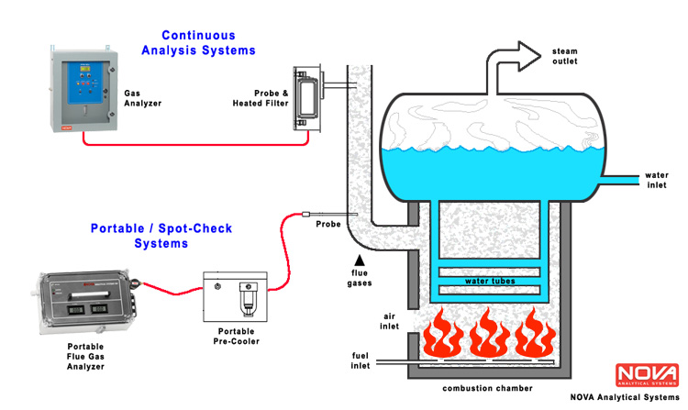
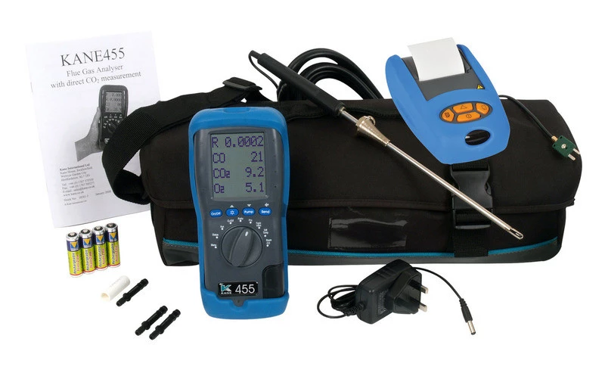
Flue Gas Analysis System
Electrochemical sensors – only measure dry gases

Slide 28
Heat Balance – Sankey diagram
Latent
Loss (H₂O)
Potential (CO) + Radiation
+ Convection Losses
Heat
Input
Useful
Heat
Gross CV Net CV
Sensible Loss
(N₂, O₂, CO₂)
Uncounted Losses e.g. opening, conveyor etc
Assuming the main source of energy/heat input comes only from the fuel and air only acts a source of oxidant unless it is preheated (usually from 25ºC) to a specific elevated temperature

Slide 29
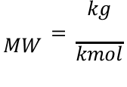
Example 1
Liquefied petroleum gas (LPG) composed of 30 wt % propane and 70 wt % butane. Determine the LPG composition by volume (vol %)
Amalgat’s law for ideal gas mixture ,
vol% ~ mol%
Mass balance (Eq 3.3-7 & 8)
$$MW=\frac{kg}{kmol}$$

Slide 30
Example 2
The molar compositions of wet combustion products are 5.06 % CO₂, 1.69% CO, 8.72% O₂ , 0.37 % CH₄, 10.12 % H₂O and the balance N₂ by volume (mol). Determine the composition of the combustion products on a dry basis.

Slide 31
Dew Point of Flue Gas
The dew point of a gaseous mixture is the temperature at which its water vapour starts condensing, i.e. the temperature at which the saturation pressure of water equals the partial pressure of water vapour in the gaseous mixture.
Controlling the flue gases temperature above the corresponding dew point temperature is very crucial
  especially when the flue gases containing sulphur element under high excess air combustion condition, i.e. SO₂ converted to SO₃ and becomes soluble in condensing water vapour and hence leads to low temperature corrosion.
  venting problem, i.e. backdraft or downdraft of flue gases
As sulphur content in the fuel increases, the acid dew point also increases which retards the heat recovery from the waste flue gas in order to protect the equipment from corrosion

Slide 32
As sulphur content in the fuel increases, the acid dew point also increases which retards the heat recovery from the waste flue gas in order to protect the equipment from corrosion
Higher sulfur content → higher acid dew point. So acids start condensing at higher temperatures.
If the flue gas is cooled below this dew point to recover more heat (improve efficiency), acid condensation occurs.
Acid condensation leads to severe corrosion of heat exchangers or equipment.
⚠️ So what do engineers do?
To protect equipment, they avoid cooling the flue gas below the acid dew point.
➡ But this limits how much heat you can recover from the waste gas.

Slide 33
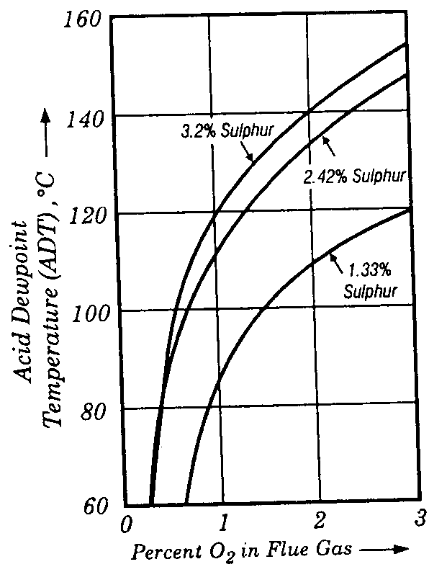
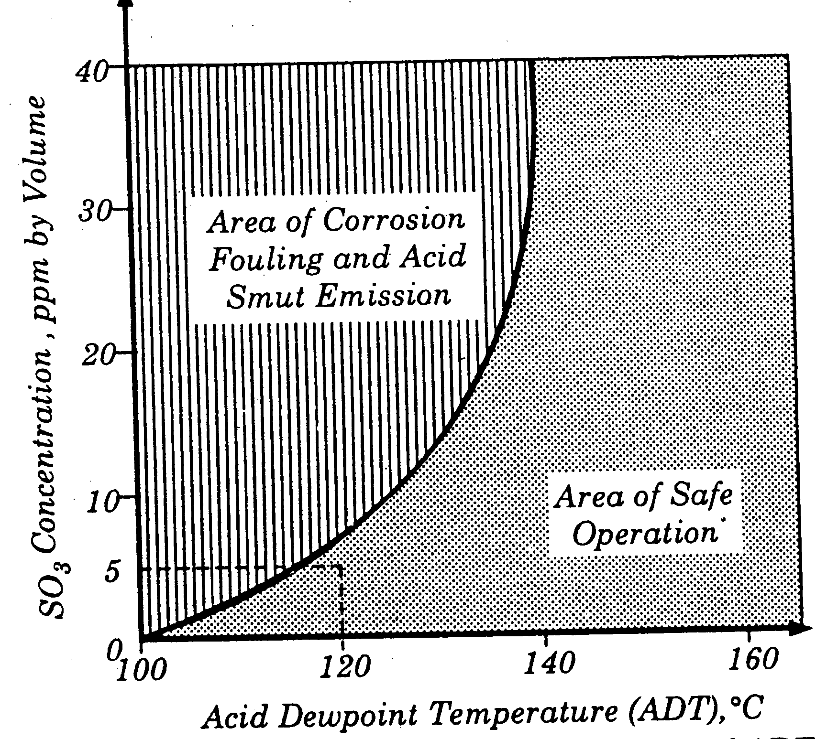
Sulphur wt. % in fuel | Acid Dew Point, ºC
1 2 3 4 5 | 130 133 138 143 150

Slide 34
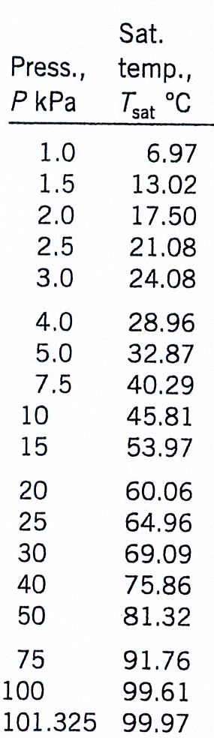
To determine the dew point temperature of the products, T_{dp}, the partial pressure of the water vapor is required.
  Dalton’s law
  If the total pressure (P) of the products is assumed to be atmospheric , i.e. 101.325 kPa , then…..from a steam table, T_{d.p} = f (P_{w})

Slide 35
Example 3a
The flue gas has the following molar composition;
5.06 % CO₂, 1.69% CO, 8.72% O₂ , 0.37 % CH₄, 10.12 % H₂O and the balance N₂
Estimate the dew point temperature (ºC) of the flue gas being exhausted out of chimney at atmospheric condition.

Slide 36
Example 3b
Estimate the wet and flue gas compositions and also the dew point temperature (ºC) of the flue gas for complete combustion of methane with
CH₄ + 2O₂ → CO₂ + 2H₂O
air at stoichiometric proportion.
50% excess air . (52.69ºC)

Slide 37
MASS BALANCE
The hypothetical stoichiometric combustion reaction on complete combustion can be expressed as to give CO₂, H₂O, SO₂ and N₂ as
Theoretical air (a) is defined as the stoichiometric quantity of air per unit mass of fuel which is sufficient on complete combustion to yield CO₂, H₂O, SO₂ and N₂ as combustion products.

Slide 38
The equivalence ratio can be expressed as
Percent excess air
Φ>1, fuel rich mixtures
Φ<1, fuel lean mixtures
Φ=1, stoichiometric mixture

Slide 39
Mass balance calculations of combustion reaction can be performed using
  Mole based method
    ‘Forward calculations’
    Known composition of gaseous fuels are normally reported on a volume basis, while solid and liquid fuels are normally reported on a mass basis
    There are two common approaches of solving combustion problem based on mole method
      atomic balance of each element
      molar balance of each element
      extent of reaction
  Flue gas analysis based method
    ‘Backward calculations’
    Known Composition of combustion or exhaust/flue gases reported from a gas analysis system are expressed based on a dry basis because water vapor is condensed and taken out prior to measurement

Slide 40
Example 4
Ethane is burned with 50% excess air. The percentage conversion of the ethane is 90%.; of the ethane burned, 25% reacts to form CO and the balance reacts to form CO₂. On the basis of 1 mol of the ethane, calculate
  the theoretical air fuel ratio (kmol air/kmol fuel)
  the actual air fuel ratio (kmol air/kmol fuel)
  the equivalence ratio
  the composition of combustion products on a dry and wet basis
  the dew point temperature of the products

Slide 41
Solution to Example 4
C₂H₆ + 3.5O₂ → 2CO₂ + 3H₂O
C₂H₆ + 2.5O₂ → 2CO + 3H₂O
1 mol/h C₂H₆
n_{o} mol/h Air
21 mole % O2
79 mole % N2
50 % excess
n1 mol/h CO2
n2 mol/h CO
n3 mol/h H2O
n4 mol/h O2
n5 mol/h N2
n6 mol/h C2H6
Given ;
f_{C2H6} = 0.9, % burned fuel to CO2 = 75, % burned fuel to CO = 25

Slide 42
Basis : 1 mol of ethane
MOLECULAR BALANCE METHOD :
(OUTPUT + CONSUMPTION = INPUT + GENERATION)
Theoretical Air
Percent excess air (50%)
C₂H₆ + 3.5O₂ → 2CO₂ + 3H₂O
  the theoretical air fuel ratio (kmol air/kmol fuel) ~ 16.67 /1 ~ 16.67 mol air/mol fuel
  the actual air fuel ratio (kmol air/kmol fuel) ~ 25/1 ~ 25 mol air/mol fuel
  the equivalence ratio ~ 16.67/25 ~ 0.67

Slide 43
N2 balance
CO2 balance
CO balance
H2O balance
O2 balance
C₂H₆ bal

Slide 44
the composition of combustion products on a dry and wet basis
the dew point temperature of the products

Slide 45
Example 5
A mixture of hydrocarbon gases containing , on a volume basis, 95% methane, 2% propane and 3% nitrogen is completely burned with 30% excess air. On the basis of 100 moles of the gas mixture, calculate
  the composition of combustion products on a dry and wet basis
  the dew point temperature of the products

Slide 46
Solution to Example 5
CH₄ + 2O₂ → CO₂ + 2H₂O
C₃H₈ + 5O₂ → 3CO₂ + 4H₂O
95 mole % CH4
2 mole % C3H8
3 mole % N2
no mol Air
21 mole % O2
79 mole % N2
30% excess
n1 mol CO2
n2 mol H2O
n3 mol O2
n4 mol N2

Slide 47
Basis : 100 mol of fuel mixture
Atomic balance method ( INPUT = OUTPUT)
Strategy : Solve the unknowns from the given information.
n_{o} mol Air (30% Excess)
Nitrogen balance (output = Input )
Excess oxygen or air = 1 + fractional excess oxygen or air

Slide 48
Atomic Carbon balance (Output = Input)
Atomic Hydrogen balance (Output = Input)

Slide 49
Atomic Oxygen balance (Output = Input)

Slide 50
54

Slide 51
Basis : 100 mol of fuel mixture
Molecular balance method
Strategy : Solve the unknowns from the given information.
n_{o} mol Air (30% Excess)
Nitrogen balance (output + consumption = Input + generation )
Excess oxygen or air = 1 + fractional excess oxygen or air

Slide 52
CO₂ balance (Output + consumption = Input + generation)
H₂O balance (Output + consumption = Input + generation)

Slide 53
O₂ balance (Output + consumption = Input + generation)

Slide 55
Example 6
Methane is burned with atmospheric air. The analysis of the products on a dry basis is as follows:
CO₂ 10.00 vol %
O₂ 2.37 vol %
CO 0.53 vol %
N₂ 87.10 vol %
Calculate the
  composition of combustion products on a wet basis
  percentage of excess air
  dew point temperature of the products

Slide 56
Process flowchart
Basis : 100 mol of dry flue gases
CH₄ + 2O₂ → CO₂ + 2H₂O
CH₄ + 1.5O₂ → CO + 2H₂O
nf mol CH4
no mol Air
0.21 mol O2 / mol
0.79 mol N2 / mol
X % excess
10.0 mol CO2
0.53 mol CO
2.37 mol O2
87.1 mol N2
nw mol H2O

Slide 57
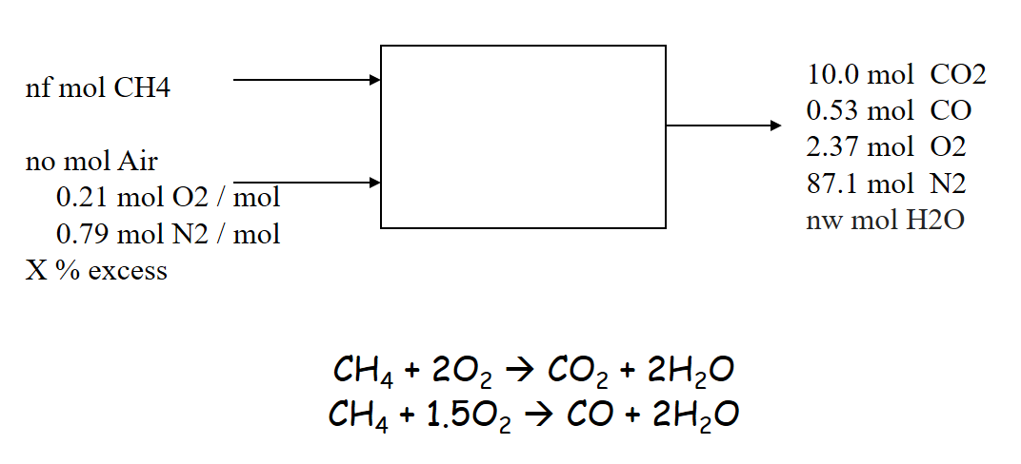
Basis : 100 mol/h of methane
Strategy : Solve the unknowns from the given information.
METHOD : ATOMIC BALANCE
Nitrogen balance (Input = output)
Atomic Carbon balance (Input = Output)

Slide 58
Theoretical Air
Atomic Hydrogen balance (Output = Input)

Slide 60

FLUE GAS ANALYSIS
 | %VOL (DRY) | %VOL (WET)
CO2 | 10.00 | 8.260
CO | 0.53 | 0.438
N2 | 87.10 | 71.948
O2 | 2.37 | 1.958
H20 |  | 17.396
TOTAL | 100 | 100
AMW | 29.7 | 27.7

Slide 61
Self Practice
Liquefied petroleum gases (LPG) containing 30 mol % propane and 70 mol% butane is complete burned with 10% excess air. 90 % LPG burns to form CO₂ and the remaining 25% to form CO. On the basis of 100 moles of the LPG, calculate
  the composition of combustion products (mol%) on a dry and wet basis
  the dew point temperature of the products
Liquefied petroleum gases (LPG) containing 30 mol % propane and 70 mol% butane is burned with atmospheric air. The analysis of the combustion products on a dry basis is as follows:
CO₂ 11.28 mol %
O₂ 2.68 mol %
CO 1.25 mol %
N₂ 84.79 mol %
On the basis of 100 moles of dry combustion products, calculate the
  composition of combustion products on a wet basis
  percentage of excess air
  dew point temperature of the products

Slide 62
Self Practice
Liquefied petroleum gases (LPG) containing 30 mol % propane and 70 mol% butane is completely burned with 10% excess air. 90 % LPG burns to form CO₂ and the remaining 10% to form CO. On the basis of 100 moles of the LPG, calculate
  the composition of combustion products (mol%) on a dry and wet basis
  the dew point temperature of the products

Slide 63
Liquefied petroleum gases (LPG) containing 30 mol % propane and 70 mol% butane is burned with atmospheric air. The analysis of the combustion products on a dry basis is as follows:
CO₂ 11.28 mol %
O₂ 2.68 mol %
CO 1.25 mol %
N₂ 84.79 mol %
On the basis of 100 moles of dry combustion products, calculate the
  composition of combustion products on a wet basis
  percentage of excess air
  dew point temperature of the products

