Slide 1
LECTURE 03
Combustion-Related Fuel Properties
Course Outcome ;
Calculate and analyse the various physical and chemical properties of fossil fuels and combustion-related properties.

Slide 2
Combustion-related Fuel Property Calculations
Fuel composition
Density, Specific gravity, Viscosity
Ideal & Real gases (compressibility factor)
Heat of Combustion
Calorific / Heating value
Flammability limit
Flame speed
Ignition temperature
Flame temperature

Slide 3
Fuel Composition
Fuel composition significantly influences other physical characteristics such as
relative density
calorific value
flammability limit
oxygen requirement
ignition temperature
emission properties

Slide 4
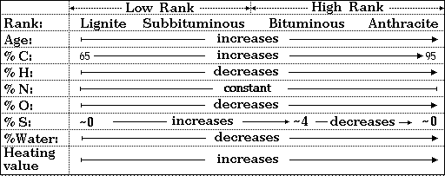
Typical Composition of Coal
Composition of some typical solid fuels (% by mass)
Fuel | Carbon | Volatile matter | Moisture | Ash
Peat Lignite Bituminous Anthracite | 44 57 82 90 | 65 50 25 4 | 20 15 2 1 | 4 4 5 3

Slide 5
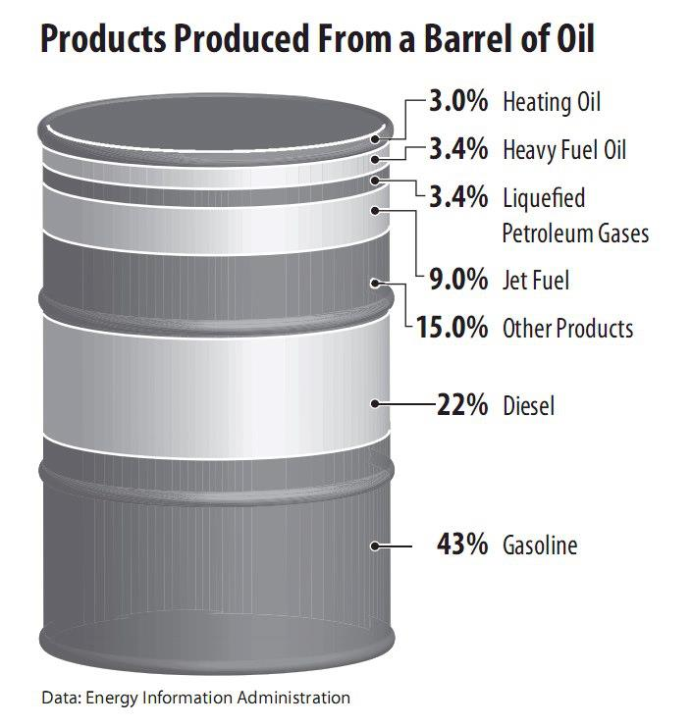
Typical Crude Oil Composition
  Gasoline C₄ to C₁₀ 27 w t%
  Kerosene C₁₁ to C₁₃ 13 wt %
  Diesel C₁₄ to C₁₈ 12 wt %
  Heavy gas oil C₁₉ to C₂₅ 10 wt%
  Lubricating oil C₂₆-C₄₀ 20 wt %
  Residue >C₄₀ 18 wt %

Slide 6
Typical Natural Gas Composition
Component | Range (vol %)
Methane | 87.0 - 97.0
Ethane | 1.5 - 7.0
Propane | 0.1 - 1.5
iso - Butane | 0.01 - 0.3
normal - Butane | 0.01 - 0.3
iso - Pentane | trace - 0.04
normal - Pentane | trace - 0.04
Hexanes plus | trace - 0.06
Nitrogen | 0.2 - 5.5
Carbon Dioxide | 0.1 - 1.0
Oxygen | 0.01 - 0.1
Hydrogen | trace - 0.02

Slide 7
Typical Malaysian hydrocarbon gas compositions
NG
LPG

Slide 8
Specific Gravity (SG)
SG of a fuel is the ratio between the gas fuel density and the dry air density of at the same condition (P and T )
In the gas industry, standard conditions of P & T are 101.3 kPa and 15ºC
SG depends very much on its gas mixture composition
  SG of a gas determines whether gas will rise or fall when released in the air
SG has two practical importance
  Effect on the flow of gases through orifices (d_{o}) or pipe :
  Rating of burners – burner conversion (Wobbe Index):

Slide 9
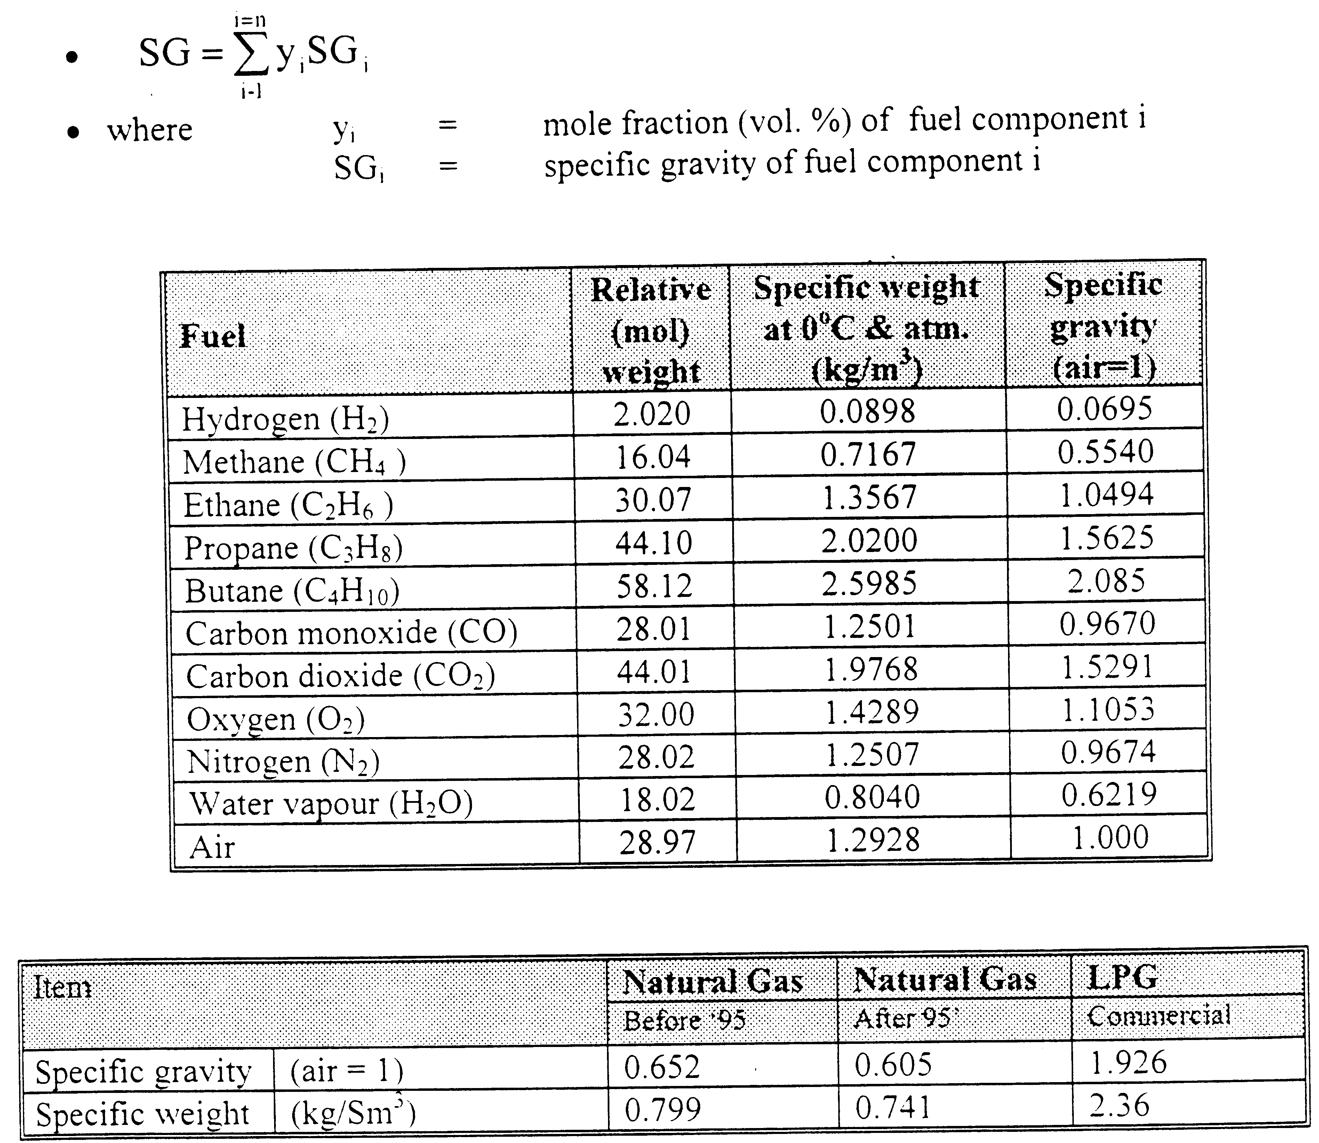
SG of multi-components fuel can be calculated as follows

Slide 10
Example 1
Calculate the specific gravity of NG and LPG compositions as shown above. What conclusion can you deduce?
Component | Range (vol %)
 | NG | LPG
Methane | 92.74
Ethane | 4.07
Propane | 0.77 | 30
Butane | 0.14 | 70
Nitrogen | 0.45
Carbon Dioxide | 1.83

Slide 12
Calorific Value (CV) / Heating Value (HV)
Also known as heating value (HV) - Quantity of heat release from combustion of unit weight or volume of fuel (MJ/kg or kcal/kg or kcal/ m³ or MJ/m³)
  Higher or gross CV (HCV or HHV) – when liquid water as a combustion product – taking account the presence of water vapor in flue gases
  Lower or net CV (LCV or LHV) – when vapour water as a combustion product - the difference between higher CV and the heat absorbed (latent heat) by water in having its phase changing to vapour
Negative of standard heat of combustion, …...hence CV is always positive
The more carbon and hydrogen atoms in each molecule of a fuel, the higher will be its CV or heating value
The larger the amount of inert matters, such as nitrogen and carbon dioxide, or water content, present in a fuel, the lower the CV will be

Slide 13
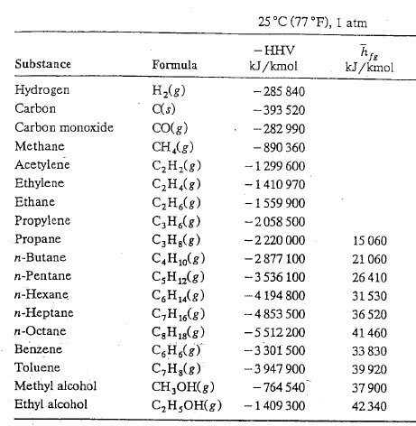
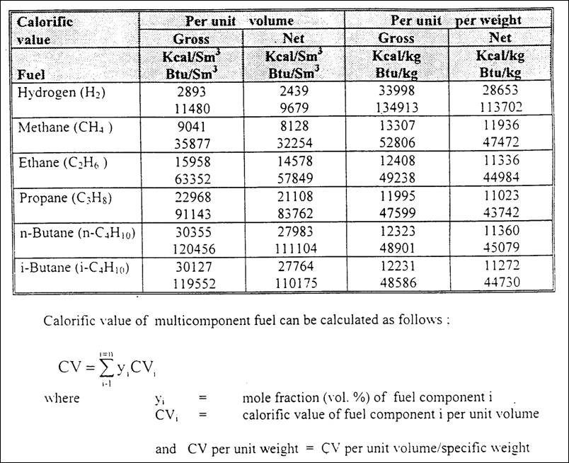
HCV

Slide 15
If latent heat corresponding to 25ºC saturation temp. = 44010 kJ/kmol, is assumed
    Net CV = gross CV – latent heat of water
    LCV = (HCV - n_{H2O}.44010) kJ/kmol, where n_{H2O} = mol of water produced per mol fuel burned
Example : CH₄(g) + 2O₂(g) → CO₂(g) + 2H₂O (g or l)
HCV_{methane} = 890, 360 kJ/kmol (25ºC & 1 atm)
LCV_{methane} = HCV_{methane} - n_{H2O} ΔH_{vap}
LCV_{methane} = 890, 330 – 2(44010) kJ/kmol
= 802,310 kJ/kmol

Slide 16
Example 2
Calculate the higher and lower calorific values (kJ/mol) of NG and LPG compositions as shown above.
Component | Range (vol %)
 | NG | LPG
Methane | 92.74
Ethane | 4.07
Propane | 0.77 | 30
Butane | 0.14 | 70
Nitrogen | 0.45
Carbon Dioxide | 1.83

Slide 18
Wobbe Number or Index (WI)
The rate at which heat may be generated in a gas burner is proportional to
  Volumetric rate of fuel
  Specific enthalpy of fuel
For a given pressure of fuel gas at the burner, the volumetric flow rate (V) is inversely proportional to the square root of the density of the gas, ρ, hence specific gravity (SG)…thus the heat released can be expressed as
Wobbe Index is also known as FUEL INTERCHANGEABILITY PARAMETER.
For the same pressure at the burner, gases of equal Wobbe Number (WI) will generate heat at equal rate per unit burner port area
  Hence, gaseous fuels having the same WI can be interchanged with no significant physical changes to the burner. (CHAP 6 : BURNER CONVERSION)

Slide 19
    Wobbe Index of gas mixture
  .

Slide 20
Example 3
Calculate the higher and lower Wobbe indices of NG and LPG compositions as shown above.
Component | Range (vol %)
 | NG | LPG
Methane | 92.74
Ethane | 4.07
Propane | 0.77 | 30
Butane | 0.14 | 70
Nitrogen | 0.45
Carbon Dioxide | 1.83

Slide 22
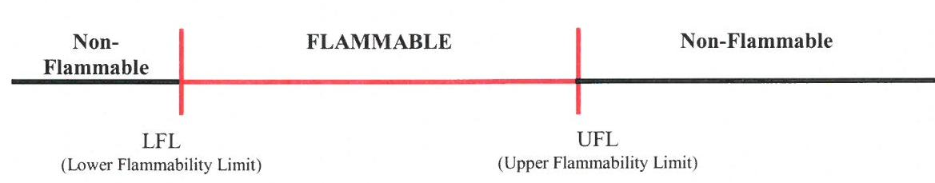
Flammability Properties
Vapor-air mixtures will ignite and burn only over a well-specified range of compositions, known as flammability limits.
  The mixture will not burn when the composition is lower than the lower flammable limit (LFL); the mixture is too lean for combustion.
  The mixture is also not combustible when the composition is too rich; that is, when it is above the upper flammable limit (UFL).
A mixture is flammable only when the composition is between the LFL and the UFL. Commonly used units are volume percent fuel (percentage of fuel plus air).
Lower explosion limit (LEL) and upper explosion limit (UEL) are used interchangeably with LFL and UFL

Slide 23
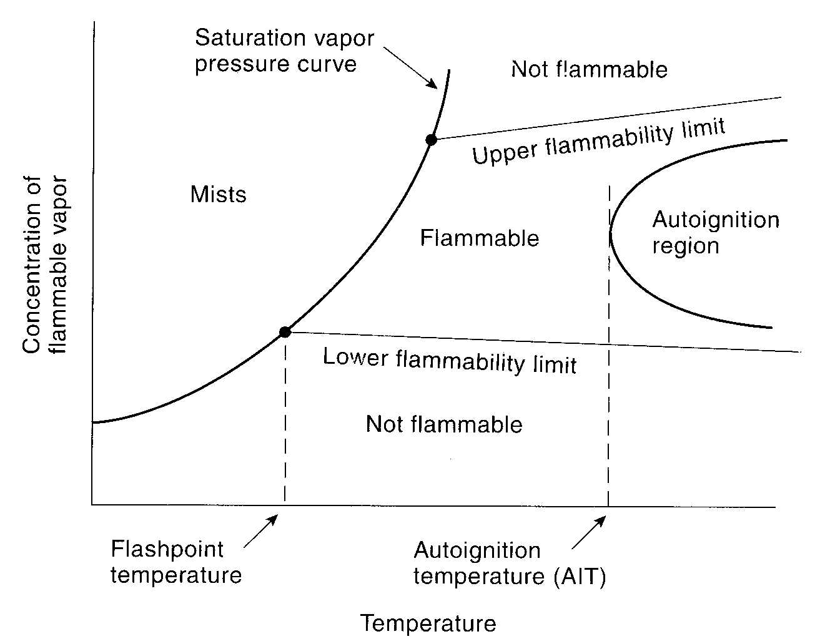

Slide 24
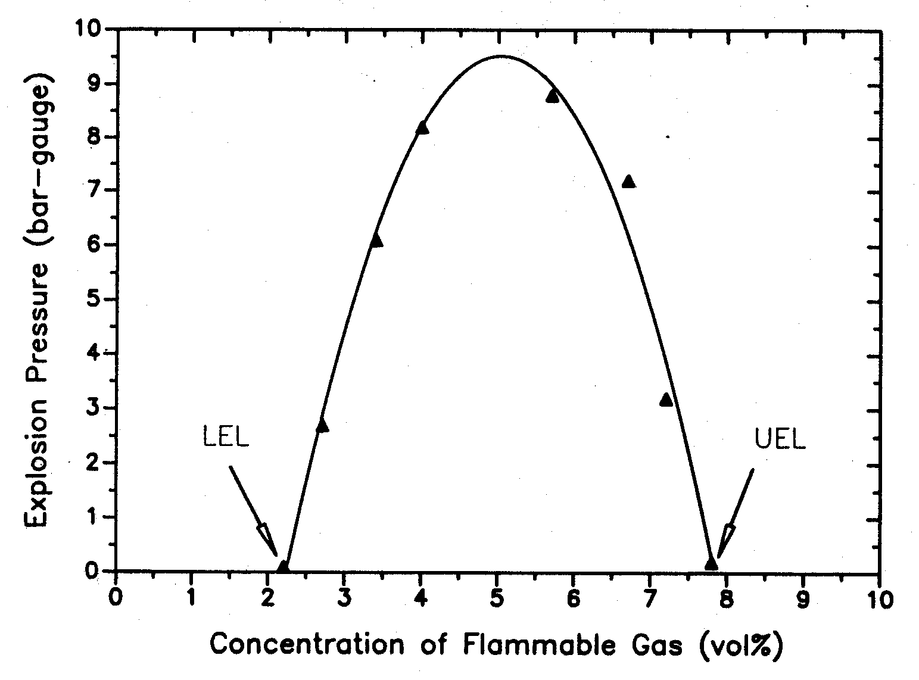
Stoichiometric limit

Slide 25
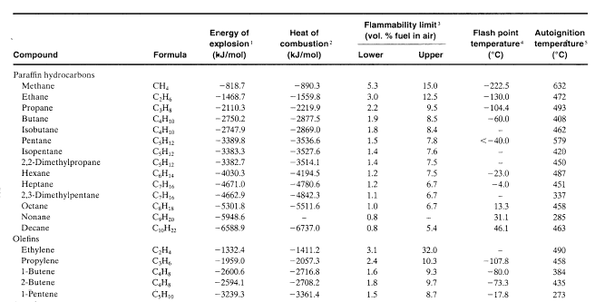
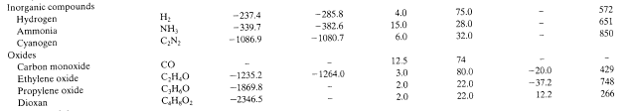
Flammable range for fuel-air & fuel-oxygen mixtures at 1 atm. and 25°C
Chemical Process Safety – Appendix B, Table AB-1

Slide 26
Mixture Flammability Limits
Lower flammability limits (or upper) for fuel mixtures may be calculated by Le Chatelier's law
where
FL_{mix} = vol. % flammability limit (lower or upper) of the mixture in air
y₁, y₂…y_{i} = vol.% of combustibles in the fuel mixture
l₁, l₂…l_{i} = vol. % flammability limit (lower or upper) of pure combustible in air

Slide 28
  Example 4
  Calculate the limits of lower, stoichiometric and upper flammability limits in air of a gas mixture containing (by vol.) 30% CO, 45% H₂ and 25% CH₄

Slide 29
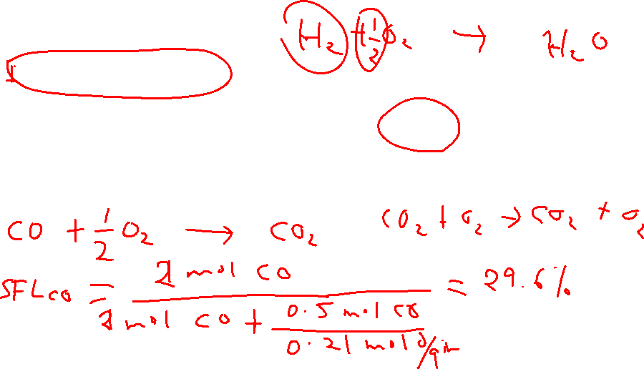

Slide 30
  Self Practice
  Calculate the limits of lower, stoichiometric and upper flammability limits in air of a gas mixture

Slide 31
LFL of flammable liquid can be estimated from Flash Point:
(SETG 1413 – Mass Balance)

Slide 32
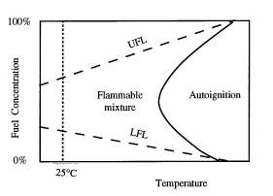
Flammability Limits – Temperature and Pressure Effects
The flammable range will widen when the initial temperature is increasing.
Changes in initial pressure for hydrocarbons in air, not change the LFL significantly, but the UFL will increase.

Slide 33
The flammable range will widen when the initial temperature is increasing.
Where,
ΔH_{c} is the net heating or calorific (kcal/mole), and T is temperature in ºC

Slide 34
For hydrocarbons in air, changes in initial pressure will not change the LFL significantly, but the UFL will dramatically increase
where P is absolute pressure in Mega Pascal (MPa)

Slide 35
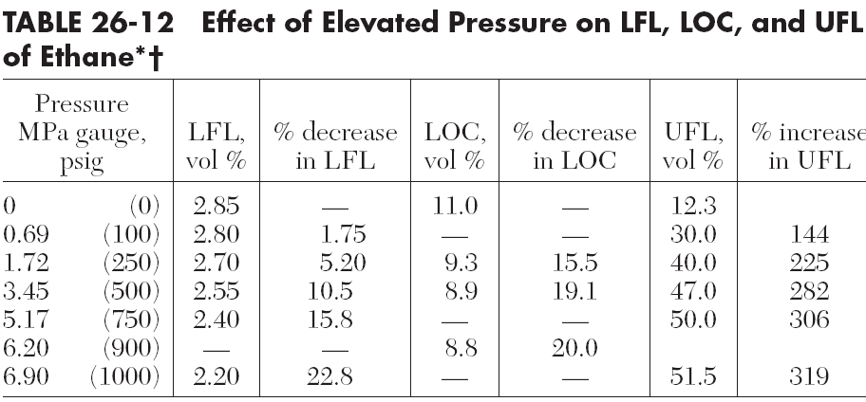

Slide 36
LOC (Limiting Oxygen Concentration)
Also called Minimum Oxygen Concentration (MOC).
The minimum oxygen level (% by volume) required to support combustion when mixed with a fuel and an inert gas (like N₂ or CO₂).
Below LOC: The mixture cannot burn, even if the fuel concentration is within LFL-UFL.

Slide 37
Example 5
What are the LFL and UFL of a fuel-air mixture composed of 1% methane, 2% ethane and 3% propane by volume at 25°C at 1 atmosphere (abs). Is this gas mixture flammable?
Repeat (i) at 200ºC and 1 atm (abs). Is this gas mixture flammable?
What is the UFL of a fuel-air mixture composed of 1% methane, 2% ethane and 3% propane by volume at 25ºC and 200 atmospheres (abs)
Data:
Component MW Heat of Combustion
(kcal/mol)
Methane 16.04 191.8
Ethane 30.07 341.3
Propane 44.09 488.5

Slide 38
What are the LFL and UFL of a fuel-air mixture composed of 1% methane, 2% ethane and 3% propane by volume at 25°C at 1 atmosphere (abs). Is this gas mixture flammable?
y₁, y₂…y_{i} = vol.% of combustibles in the fuel mixture
l₁, l₂…l_{i} = vol. % flammability limit (lower or upper) of pure combustible in air

Slide 39
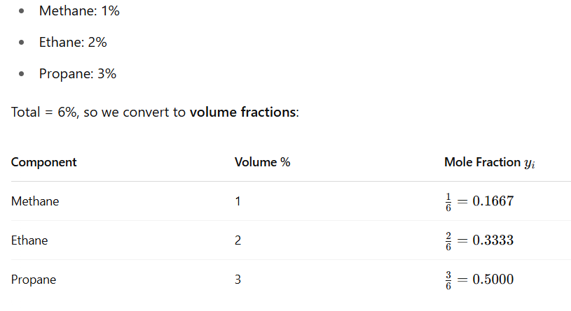
Given gas mixture

Slide 40
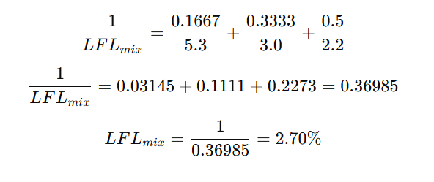
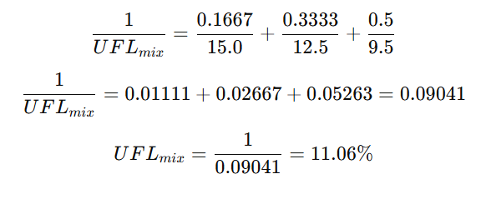
LFL of mixture
UFL of mixture

Slide 41
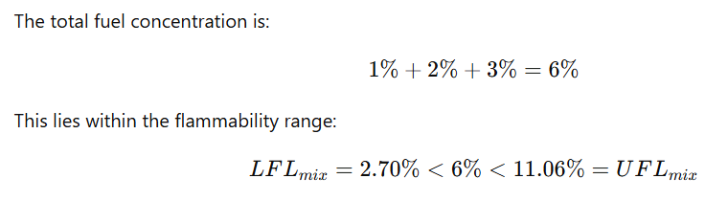
Comparison
The gas mixture is flammable at 25 °C and 1 atm, because the total fuel concentration of 6% falls between the LFL and UFL of the mixture.

Slide 42
Repeat (i) at 200ºC and 1 atm (abs). Is this gas mixture flammable?

Slide 43
What is the UFL of a fuel-air mixture composed of 1% methane, 2% ethane and 3% propane by volume at 25ºC and 200 atmospheres (abs) ?

Slide 44
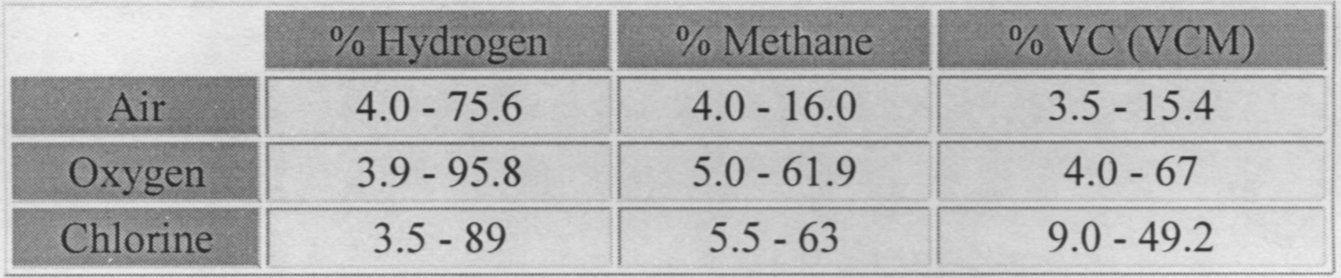
Mixture Flammability Limits – Oxidant Effects
Presence of oxidants significantly expands the flammable range by increasing the upper flammability limit

Slide 45
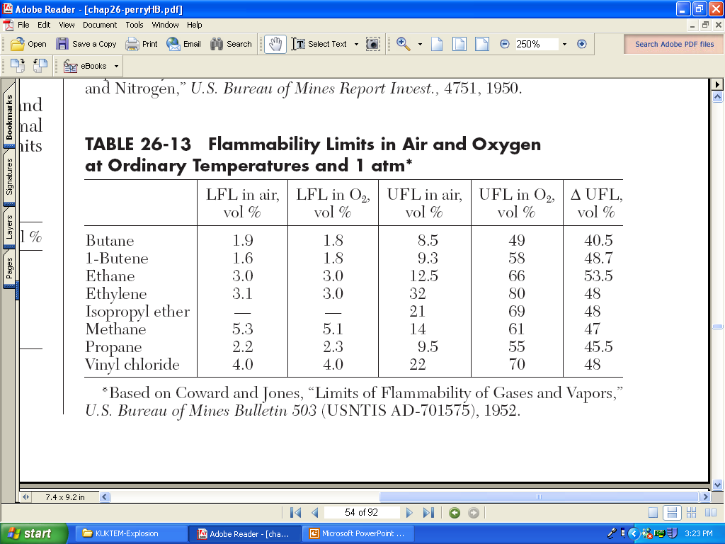

Slide 46
Minimum Oxygen Concentration (MOC)
LFL is based on “air” but actually it is O₂ that is important. Often in industry they “inert” to dilute the O₂ concentration.
Minimum Oxygen Concentration (MOC): Oxygen concentration below which combustion is not possible. Expressed as volume % oxygen.
  Below the MOC the reaction cannot generate enough energy to heat the entire mixture to the extent required for self propagation.
Also called: Limiting Oxygen Concentration (LOC)
Max. Safe Oxygen Conc. (MSOC)

Slide 48
Example 6
Estimate the LOC for methane,
ethane and butane

Slide 49
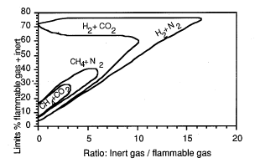
Flammability Limits – Diluent Effect
Presence of diluent such as CO₂, N₂ in a mixture of gases narrows down the flammability limits by increasing the lower limit

Slide 50
Flammability limit of combustibles containing diluent
FL_{mix,dil} = vol. % flammability limit (lower or upper) of the combustibles containing diluent in air
FL_{mix} = vol. % flammability limit (lower or upper) of the pure combustibles in air
y_{dil} = vol.% of diluent in the fuel mixture

Slide 51
Example 7
Calculate the limits of lower and upper flammability limits of a gas mixture containing (by vol.)
10 % CO
55 % H₂
25 % CH₄
5 % CO₂
5 % N₂

Slide 52
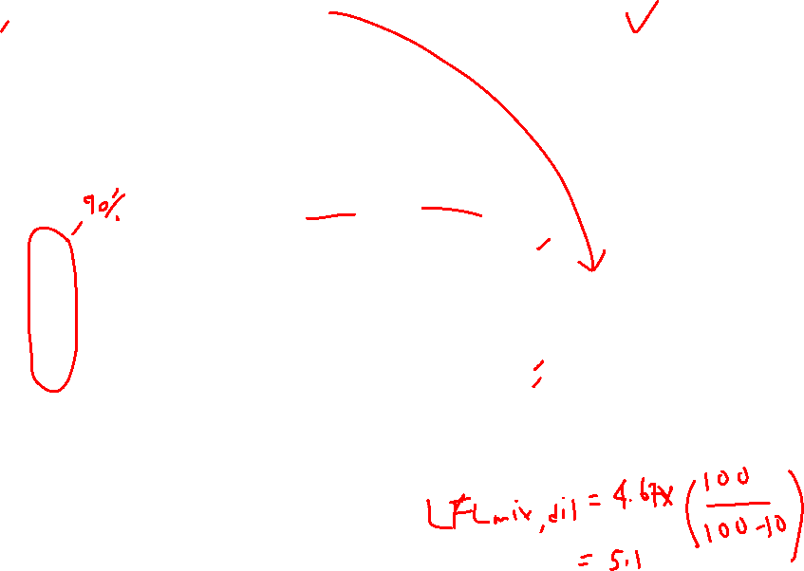
y₁, y₂…y_{i} = vol.% of combustibles in the diluent free fuel mixture
l₁, l₂…l_{i} = vol. % flammability limit (lower or upper) of pure combustible in air

Slide 53
Self practice
Estimate the stoichiometric, lower (lean) and upper (rich) flammability limits of NG and LPG compositions as shown above.
Component | Range (vol %)
 | NG | LPG
Methane | 92.74
Ethane | 4.07
Propane | 0.77 | 30
Butane | 0.14 | 70
Nitrogen | 0.45
Carbon Dioxide | 1.83

Slide 55
Minimum Ignition Temperature (MIT)
The temperature corresponding to energy externally supplied to initiate combustion is known as ignition temperature
The lowest temperature of ignition at which combustion can be initiated is known as minimum ignition temperature

Slide 56
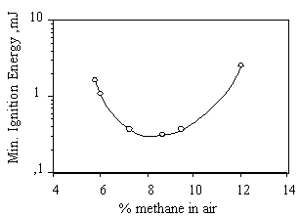
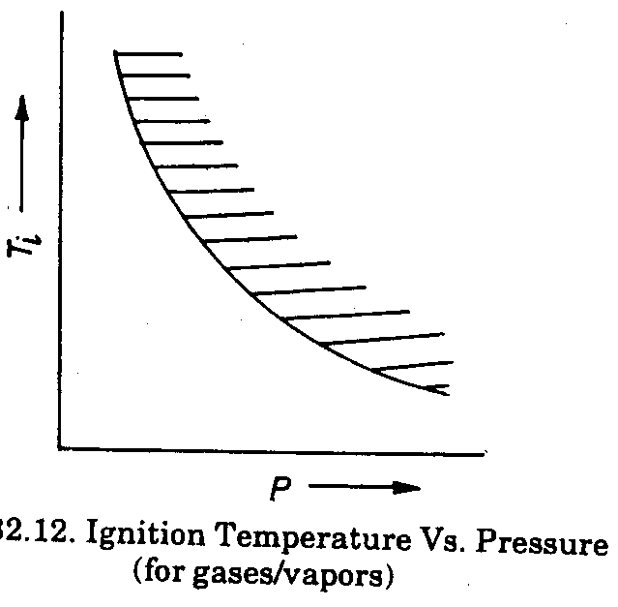
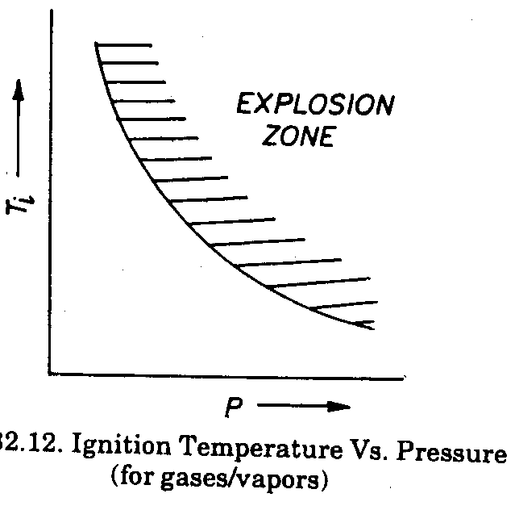
The ignition energy depends on the fuel concentration
  For most combustible fuels, the minimum ignition energy is between 0.1 and 0.3 mJ in normal ambient air.
Minimum ignition temperature also decreases with increasing pressure
Flammability
zone

Slide 57
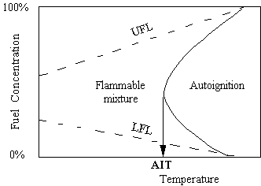
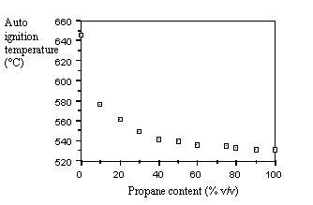

When a flammable mixture is heated up to a certain temperature, the chemical reaction will start spontaneously - this critical temperature for fuel-oxidiser is called the auto-ignition temperature, AIT.
For most pure hydrocarbon derivatives in air, the AIT lies between 540°C (methane) and 210°C (n-decane)

Slide 58
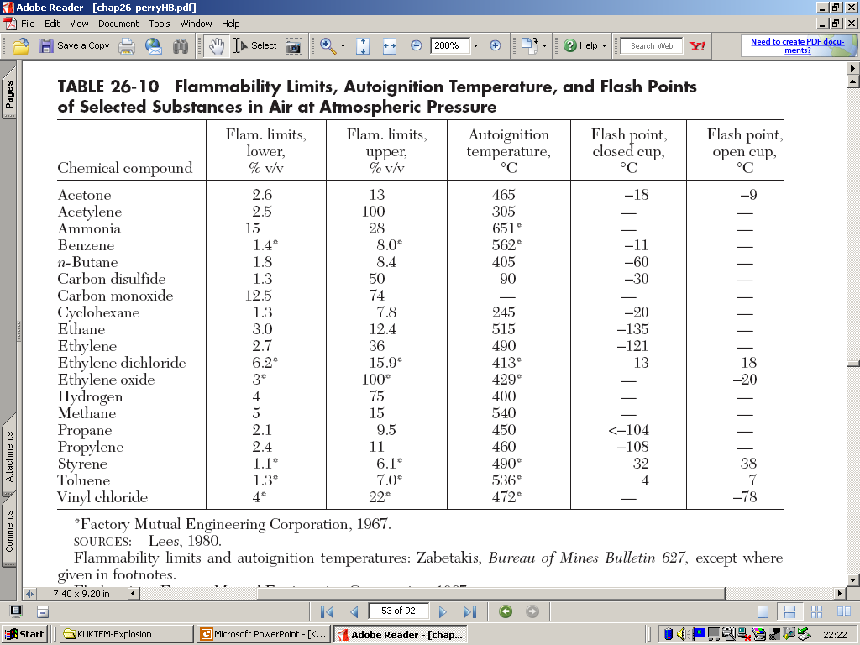

Relationships Between Various Flammability Properties

Slide 59
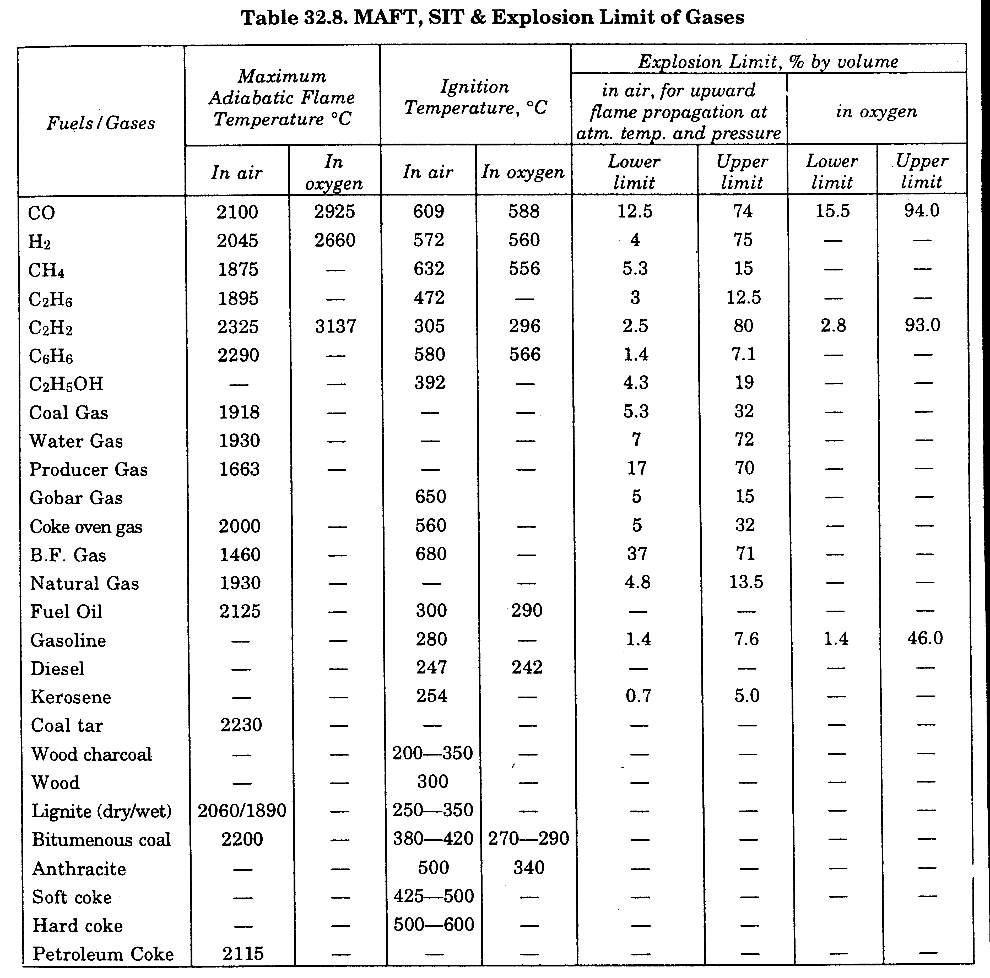

Slide 60
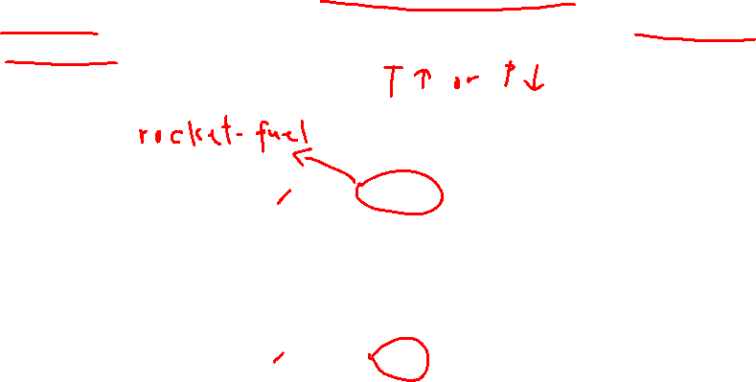
Flame Velocity
The rate of flame surface propagation into the un-burnt combustible mixture to ensure continuous and successful flame propagation - Also known as burning velocity or combustion velocity
Flame velocity depends on the fuel-air mixture composition and attains maximum for mixture slightly richer in fuel content than the stoichiometric composition….. and rises if the initial temperature is increased or the pressure of the system is decreased

Slide 61
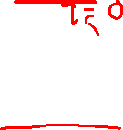
Flame Temperature
The temperature of the flame corresponds to heat generated during combustion process
Flame temperature of fuel depends on
  Calorific value
  Volume and specific heat of total gaseous products
  Losses by radiation
  Latent heat in water vapour in the combustion products
The adiabatic flame temperature is the (maximum) temperature obtained when a fuel oxidiser is burning at a constant pressure with no heat loss (to walls, equipment, etc.)

Slide 62
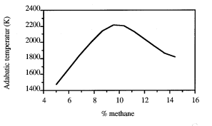
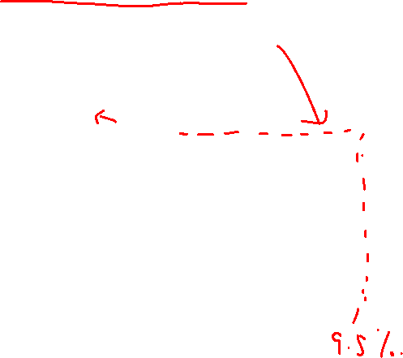
The flame temperature is strongly a function of fuel concentration
The maximum adiabatic flame temperature occurs close to the stoichiometric composition (i.e. 9.5% methane in air)
Adiabatic flame temperature of methane combustion for initial conditions 1 atm. and 25°C.

Slide 63
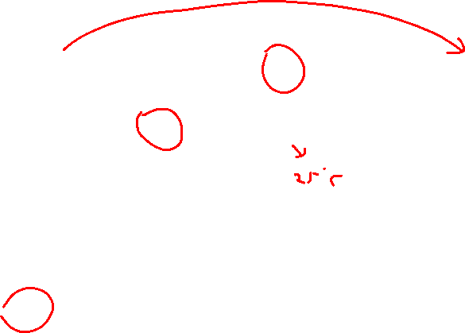
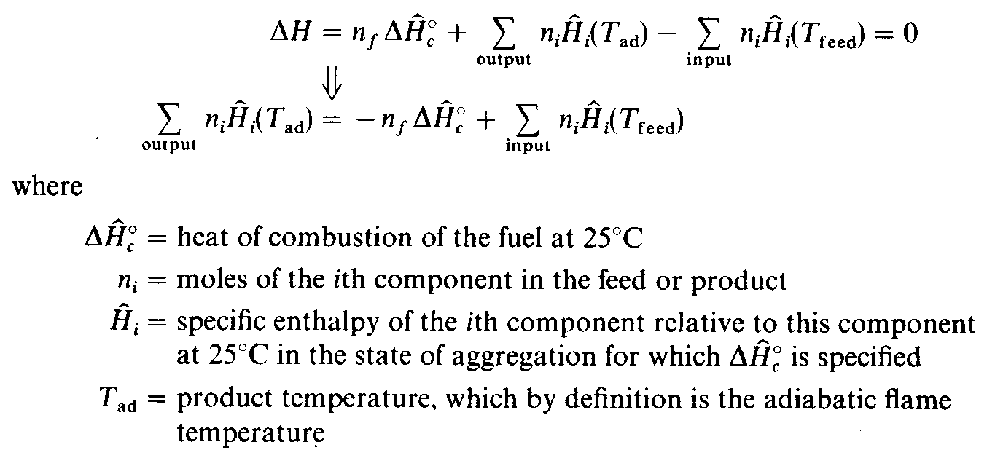
Theoretical adiabatic flame temperature can be estimated using the following energy balance

Slide 64
Adiabatic Flame Temperature
The temperature of product mixture obtained when the combustion is done in an adiabatic system
Highest temperature obtained
2 types
Constant pressure adiabatic flame temperature
Constant volume adiabatic flame temperature

Slide 65
Const. Press. Adiab. Flame Temp.
●
From 1st Law
H _{react} (T _{i} , P )= H _{prods} (T _{ad} , P )
Const. Vol. Adiab. Flame Temp.
From 1st Law
●
^{U} react ^{(T} i ^{, P}i ^{)=U} prods ^{(T} ad ^{, P} f ⁾

Slide 66
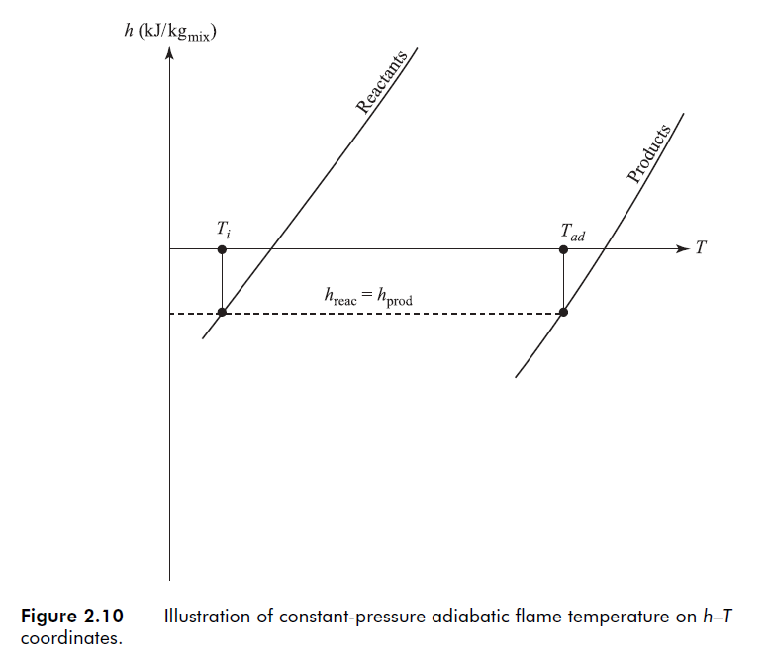

Slide 67

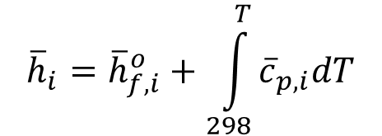
Specific Heats
C_{p} varies with temperature
Non trivial to determine T_{adiab} since temp is
●
●
implicit in c_{p} We may
Integrate c_{p}
Use an average c value
$${\overline{h}}_{i}={\overline{h}}_{f,i}^{o}+\int_{298}^{T}{{\overline{c}}_{p,i}dT}$$
●
$${\overline{h}}_{i}={\overline{h}}_{f,i}^{o}+{\overline{c}}_{p,i,avg}(T_{ad}−298)$$
p
– Both methods need an initial guess of T_{adiab}
T _{adiab}≈2100 K

Slide 68
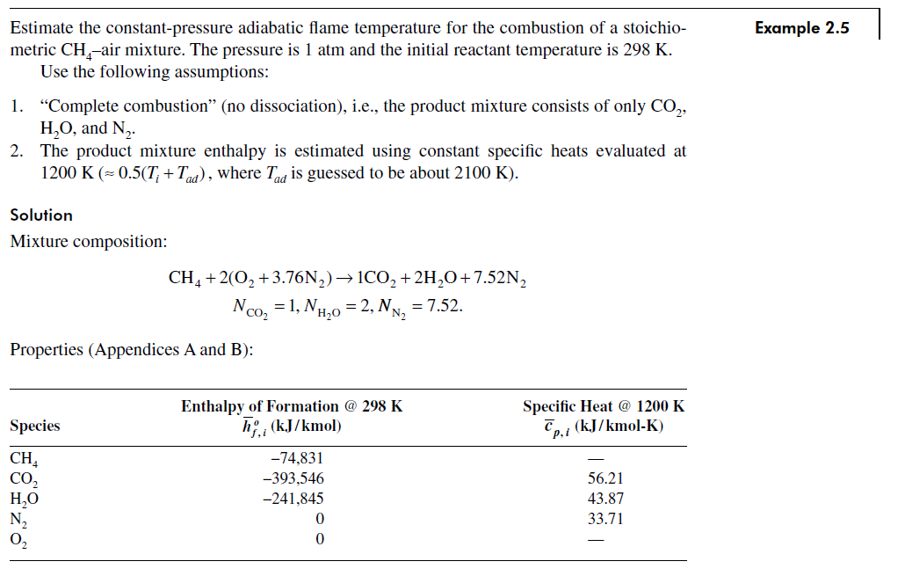

Slide 69
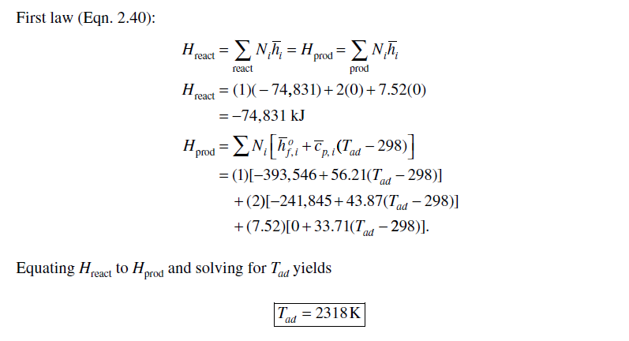

Slide 70
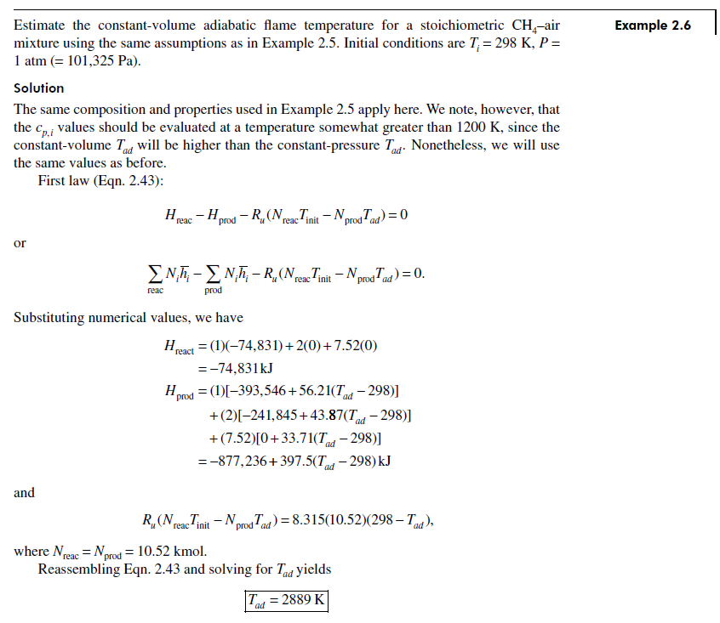

Slide 71
Absolute Enthalpy & Enthalpy of Formation
●
Absolute enthalpy = sum of enthalpy
= (energy of chemical bonds) + (sensible enthalpy change)
$${\overline{h}}_{i}\left(T\right)={\overline{h}}_{f,i}^{o}\left(T_{ref}\right)+∆{\overline{h}}_{s,i}(T_{ref})$$
Absolute enthalpy at temp T
Enthalpy of formation at std. Ref. state
Sensible enthalpy change going from
T_{ref} to T
(T , Pº)
ref

Slide 72

$$∆{\overline{h}}_{s,i}\left(T_{ref}\right)={\overline{h}}_{i}\left(T\right)−{\overline{h}}_{f,i}^{o}\left(T_{ref}\right)$$
Ref. state:
T_{ref} = 25 C (298.15 K)
o
P_{ref} = P = 1 atm
o
Enthalpy of formation,
$${\overline{h}}_{f}^{o}\text{≡}\text{0}$$
for elements in
naturally occurring state at ref. state
Oxygen | O₂ | gas
Nitrogen | N₂ | gas
Carbon | C | solid (graphite)

Slide 73
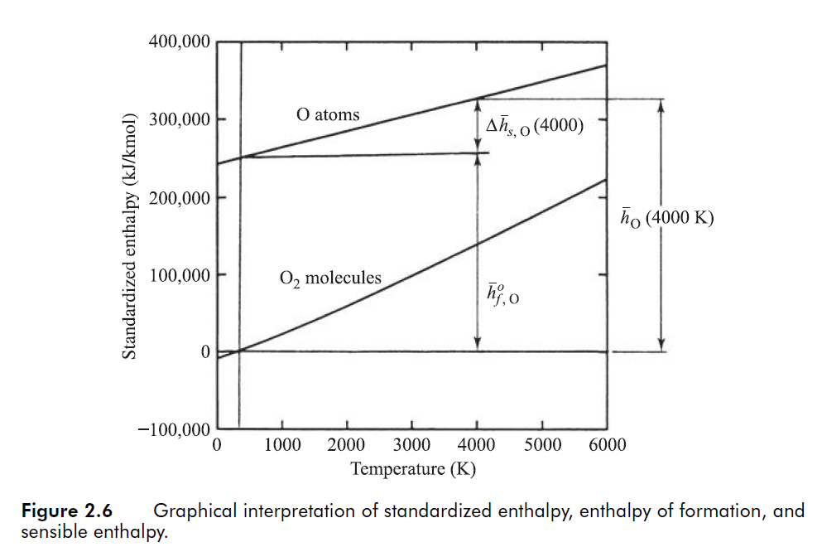

Slide 74
Enthalpy of Combustion
Enthalpy of Combustion = enthalpy of reaction, Δ h_{R}
Heat of combustion= heating value Δ h_{c}
Δ h_{c}=−Δ h_{R}

Slide 75
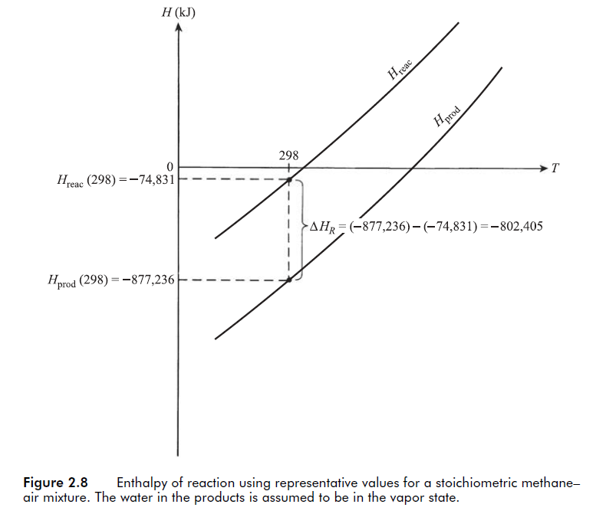

Slide 76
(assuming H₂O in products condensed into liquid)
HHV = higher heating value
LHV = lower heating value
(assuming no condensation)

Slide 77
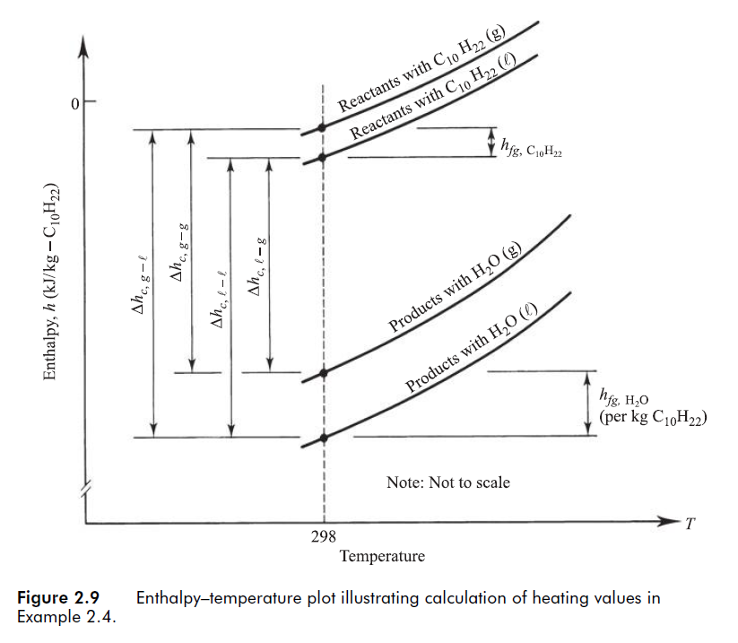

Slide 78
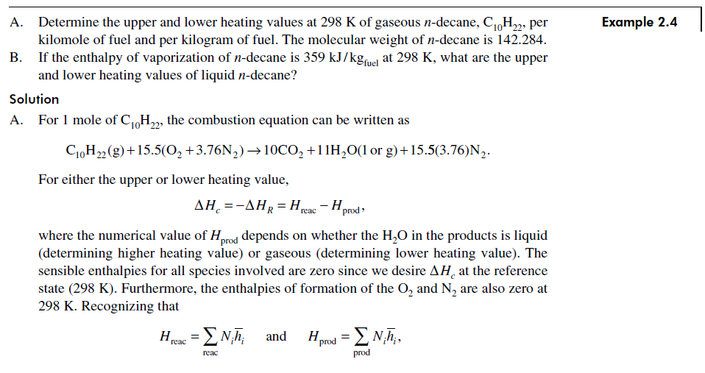
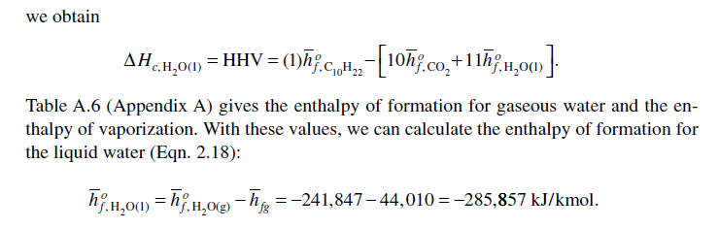

Slide 79
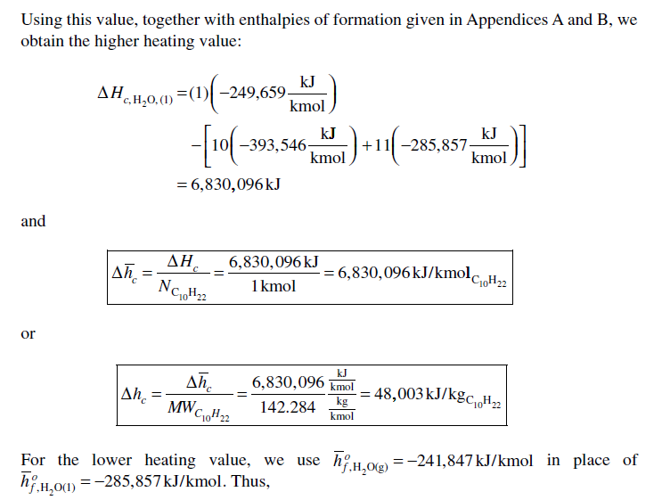
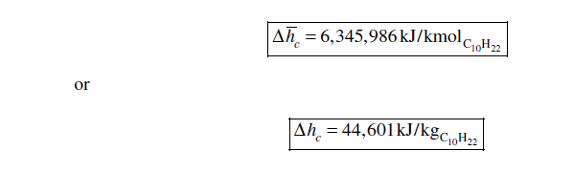

Slide 80
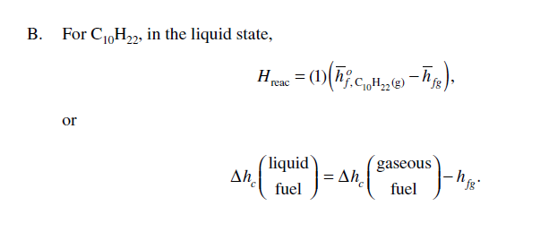
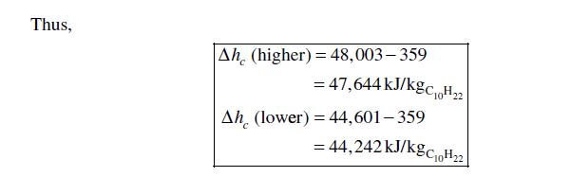

Slide 81
Properties of Liquefied Petroleum Gas (LPG)
Average composition in the Peninsular Malaysia
Typical LPG Characteristics in the Peninsular Malaysia

Slide 82

Properties of Natural Gas (NG)
Average composition Supplied by Gas Malaysia Sdn Bhd
Typical Natural Gas Characteristics

Slide 83
Average composition Supplied by Sabah Energy Corporation Sdn Bhd
Typical Natural Gas Characteristics

